Slide 1
Mediastinum and mediastinal mass
حزم العضايله
سيف الحاج مصطفى
ينال القيسي

Slide 2
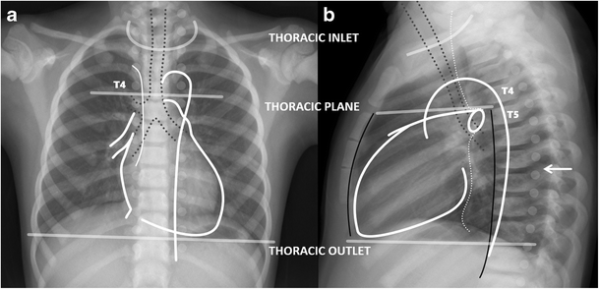
Mediastinum
It’s the central compartment of thoracic cavity ,covered on each side by mediastinal pleura , contain all thoracic viscera and structure except the lungs.
Division of the mediastinum into four compartments:
superior mediastinum
Inferior mediastinum:
anterior mediastinum (prevascular zone),
middle mediastinum (peritracheoesophageal zone),
posterior mediastinum (paravertebral zone).

Slide 3
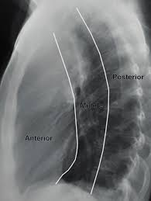
Normal Lateral view of Mediastinum on chest X-ray

Slide 4
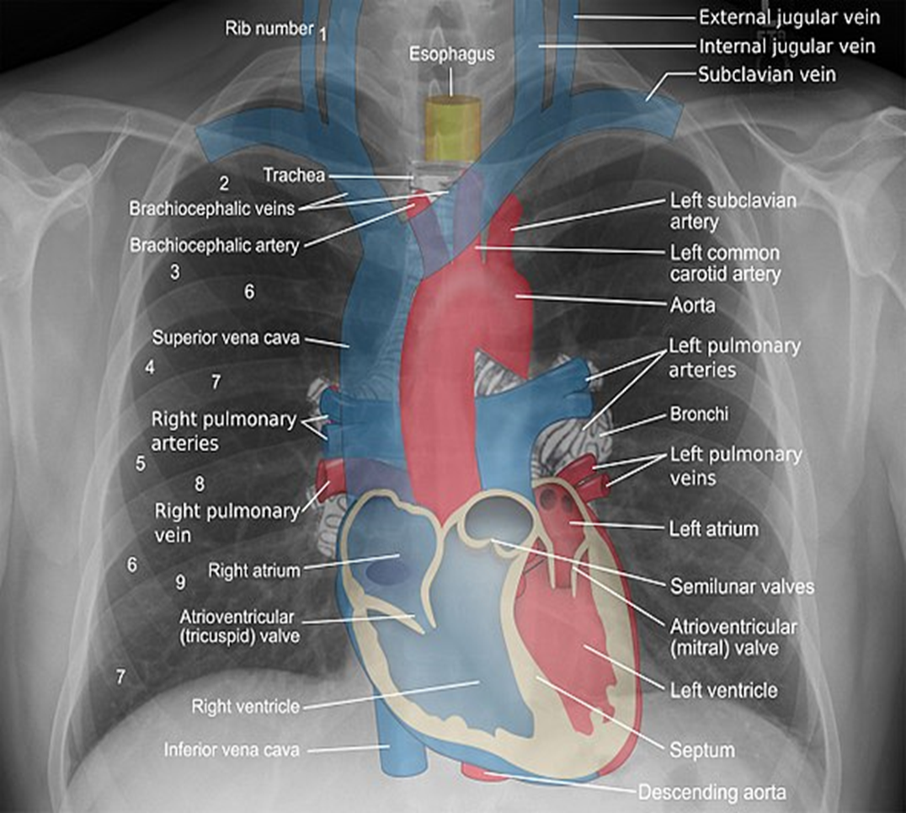
superior mediastinum
Arteries
Aortic arch
Brachiocephalic artery
Thoracic portions of the left common carotid and the left subclavian.
Veins
Brachiocephalic veins
Upper half of the superior vena cava
Left highest intercostal vein
Nerves
Vagus nerve
Cardiac nerve
Superficial and deep cardiac plexuses
Phrenic nerve
Left recurrent laryngeal nerve
Trachea with paratracheal and tracheobronchial lymph nodes
Esophagus
Thoracic duct
Remains of the thymus
Some lymph glands
Anterior longitudinal ligament

Slide 5
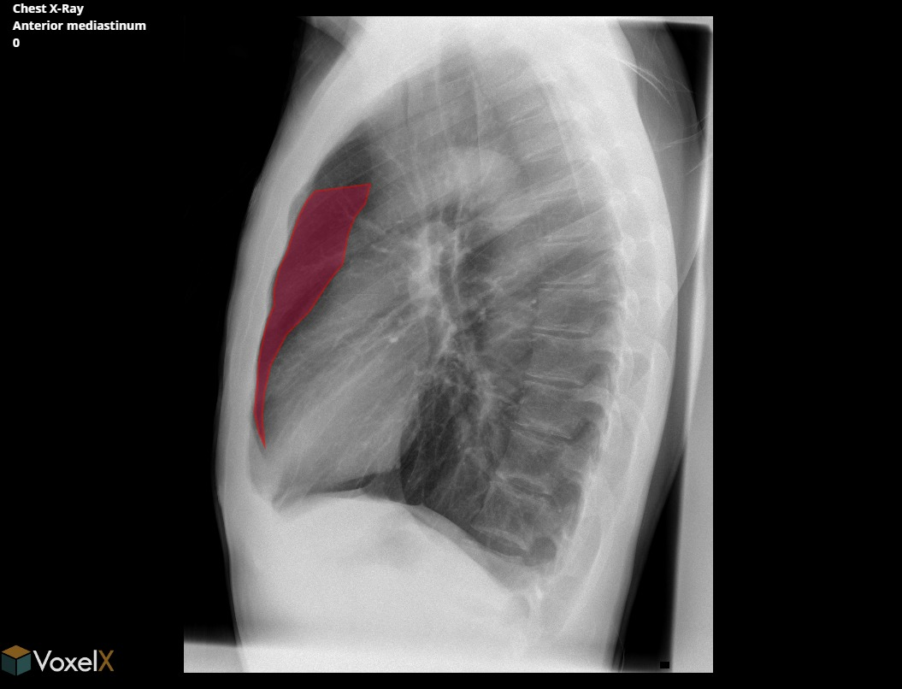
Anterior Mediastinum contains
major contents of this compartment include the thymus, lymph nodes, mediastinal fat, and left brachiocephalic vein.²,¹³,¹⁵

Slide 6
Mediastinal masses
your goal is to determine the following:
Is it a mediastinal mass?
Is it in the anterior, middle or posterior mediastinum?
Are you able to characterize the lesion by determining whether it has any fatty, fluid or vascular components?

Slide 7
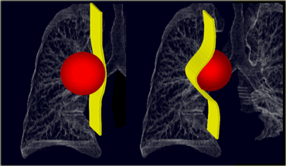
Unlike lung lesions, a mediastinal mass will not contain air bronchograms.
The margins with the lung will be obtuse.
Mediastinal lines (azygoesophageal recess, anterior and posterior junction lines) will be disrupted.
There can be associated spinal, costal or sternal abnormalities.
LEFT: A lung mass abutts the mediastinal surface and creates acute angles with the lung .RIGHT: A mediastinal mass will sit under the surface of the mediastinum, creating obtuse angles with the lung

Slide 9
Anterior mediastinal masses
5 T’s
Lymphoma (Terrible lymphoma).
Thyroid (Retrosternal goiter).
Teratoma.
Thymic tumor.
Pericardial cyst.
Diaphragmatic hernia (morgagni hernia).
The diagnosis of anterior mediastinal mass may be an incidental finding in the asymptomatic patient. However, 60% of patients are symptomatic at presentation
The most common localizing symptom is cough, which is present 60% of the time
Other common obstructive symptoms include chest pain, dyspnea, voice hoarseness, hemoptysis, and dysphagia.
On conventional radiographs look for the signs :
Obliterated retrosternal clear space
Hilum Overlay Sign
Obliterated cardiophrenic angle

Slide 10
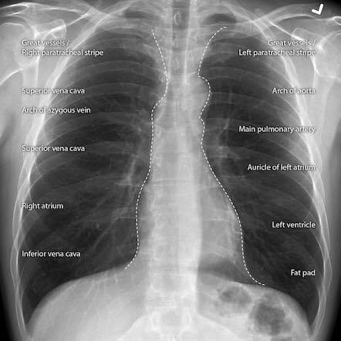
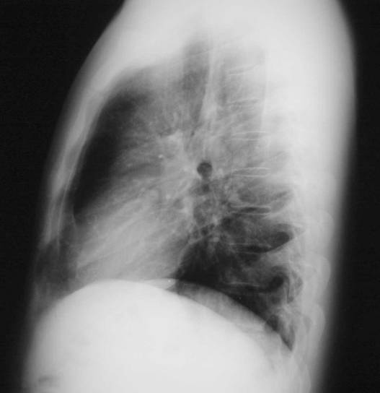
Normal chest x-rays

Slide 11
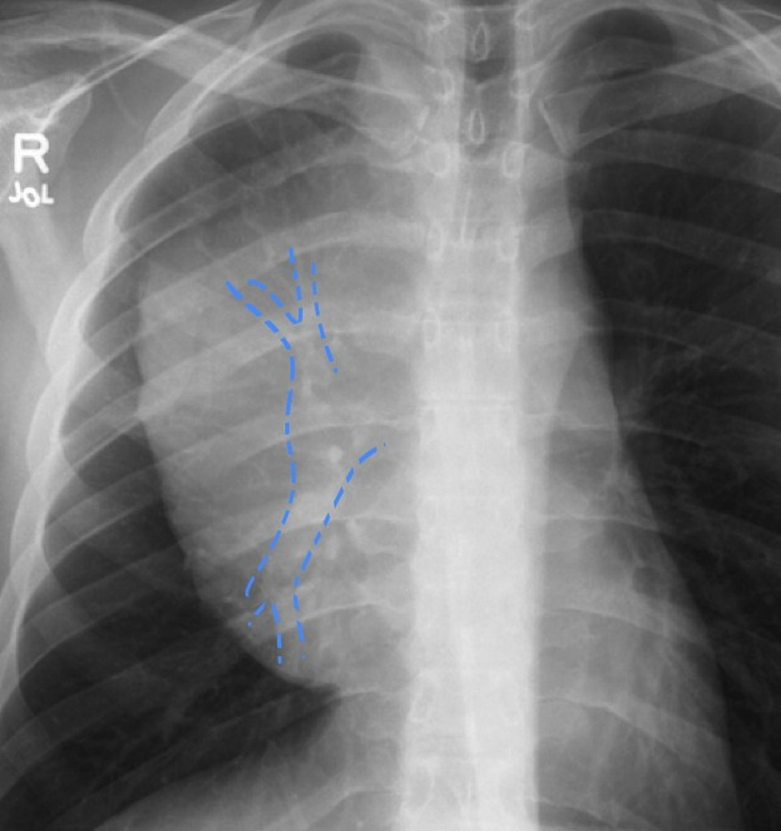
Obliterated retrosternal clear space in Lymphoma
Hilum Overlay Sign in lymphoma in a HIV-positive patient.

Slide 12
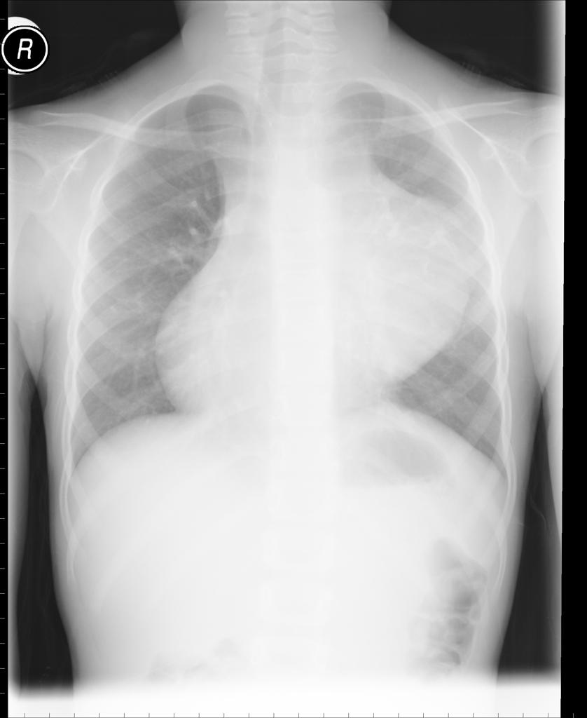
Substernal Thyroid Goiter. Frontal chest radiograph shows a large superior/anterior mediastinal mass (white arrows) displacing the trachea (black arrow) to the right of midline
Mediastinal Teratoma There is a large anterior mediastinal mass measuring 9 cm in size with calcification within it. shift of the mediastinum towards right side

Slide 13
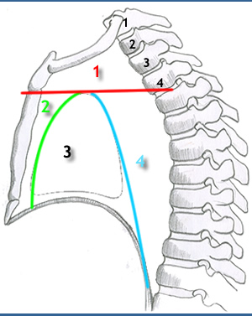
MIDDLE MEDIASTINAL MASSES
BOUNDERIES

Slide 14
:Contents
- pericardium
- heart
- great vessels joining the heart
ascending aorta
pulmonary trunk
right & left pulmonary arteries
the lower half of the superior vena cava
- tracheal bifurcation and both main bronchi
- phrenic nerves
- cardiac plexus
- tracheobronchial lymph nodes

Slide 15
MIDDLE MEDIASTINAL MASSES
Lymph node enlargement:
- lymphoma (most common)
- primary tuberculosis
- sarcoidosis )
Bronchogenic cyst.
Aneurysm of aortic arch.

Slide 16
lymphoma
- common
- responsible for 15% of all primary mediastinal masses
- the majority are Hodgkin lymphomas
- arise from either the thymus or lymph nodes
- majority of patients have anterior mediastinal and paratracheal involvement.

Slide 18
- bilateral widening /unilateral
- well-defined margin
- lobulated

Slide 20
Clinical presentation
patients are often asymptomatic from the mediastinal component but present with systemic manifestations of lymphoma, most commonly constitutional symptoms

Slide 21
TB
Lymph node enlargement Hilar lymphadenopathy (unilateral mainly in RT)

Slide 22
TB

Slide 23
Sarcoidosis
Is multisystemic disease of unknown etiology.
It is characterized by the development of non-caseating granulomas,which either resolve or become fibrotic.
Sarcoidosis commonly causes thoracic lymphadenopathy, predominantly affecting the bronchopulmonary nodes (Hilar nodes).
The hilar Lymph nodes enlargement is almost always bilateral and symmetrical.

Slide 25
Aortic arch aneurysm

Slide 26
Bronchogenic cyst
+Rare condition
+Most common site
+Filled with fluid (water)
+soft-tissue density rounded structures on the x ray
+Rarely multiple
Middle mediastinum

Slide 27
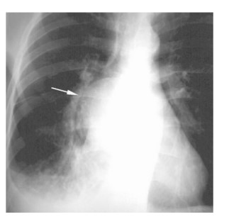
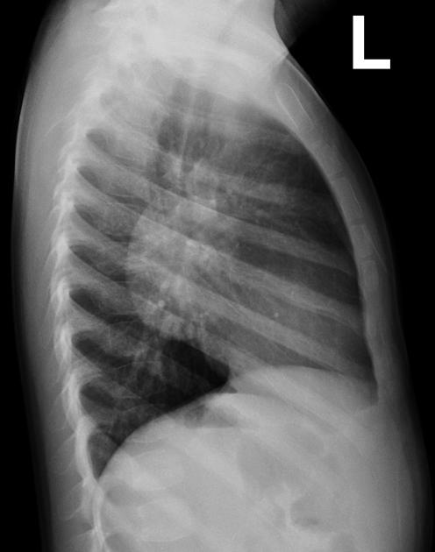
Bronchogenic cyst

Slide 28
Complications
ulceration of the cyst wall
secondary bronchial atresia
superimposed infection
hemorrhage
malignant transformation is very rare
Clinical presentation
asymptomatic . When large may result in bronchial obstruction leading to air trapping and respiratory distress..

Slide 29
Posterior mediastinum

Slide 30
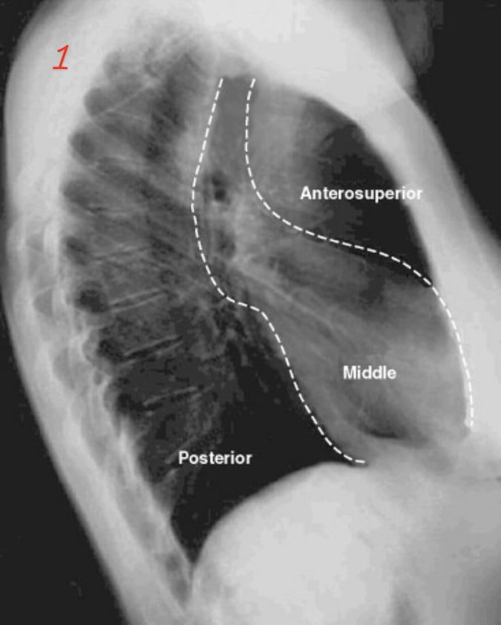
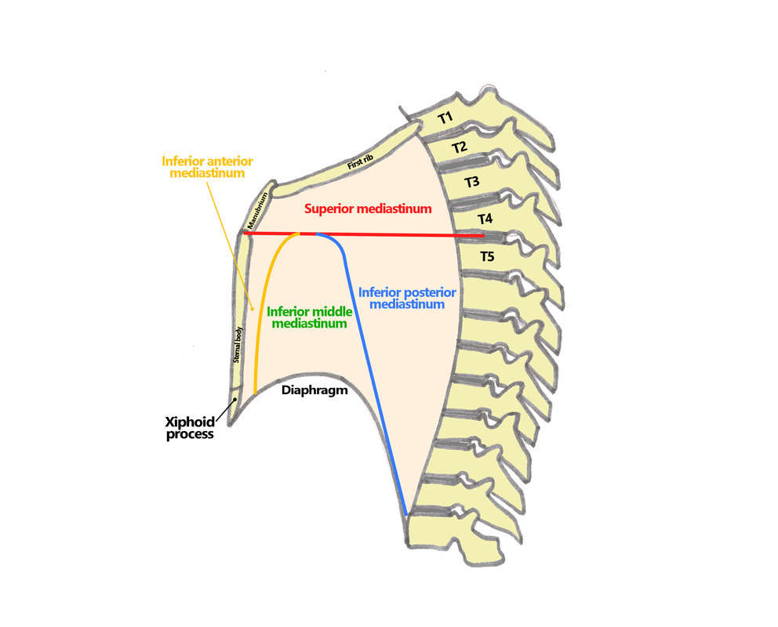
Posterior mediastinal borders
Sup : thoracic plane
Inf : diaphragm
Ant : pericardium
Post : ant border of spine

Slide 31
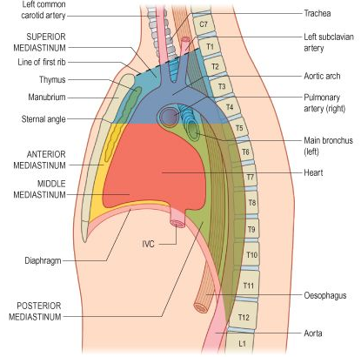
Posterior mediastinum component
Thoracic part of descending aorta
Azygos vein, hemiazygos and accessory hemiazygos veins
Autonomic nerves (Vagus nerve, splanchnic nerves, sympathetic chain)
Esophagus
Thoracic duct
Fat and lymph nodes

Slide 32
Posterior mediastinum mass
Neurogenic tumors (ganglioneuroma , schwannoma , neuroblastoma).
Aneurysm of descending aorta.
Hiatus hernia.
Paravertebral mass /abscess
Meningocele
Extramedullary hematopoiesis

Slide 34
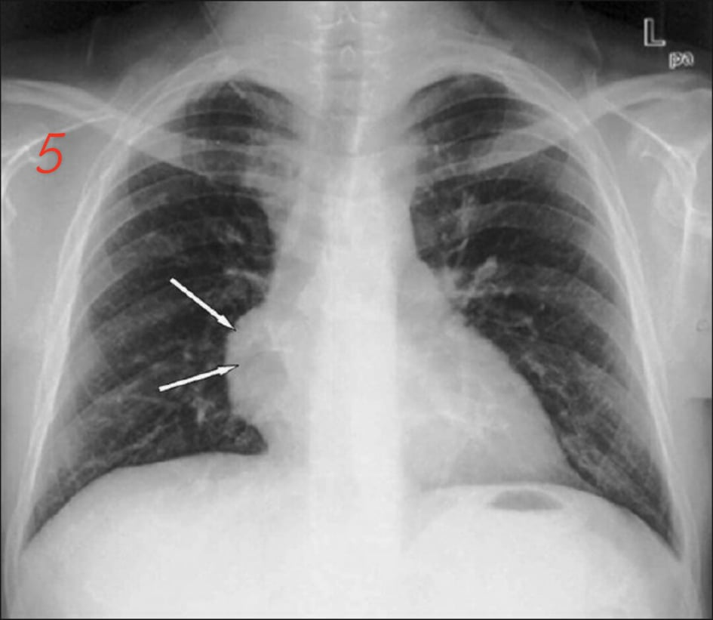
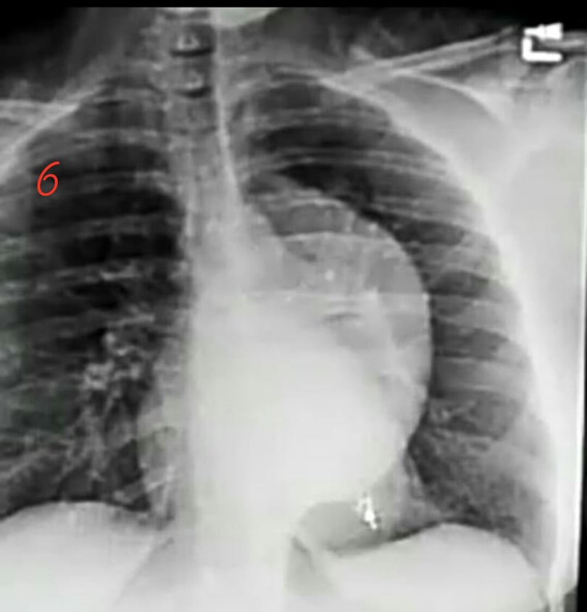
Ant . Med x-ray post . Med x-ray

Slide 35
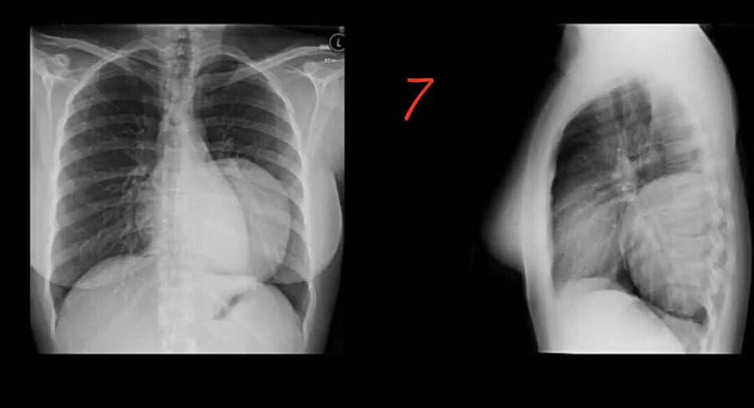
Frontal lateral

Slide 37
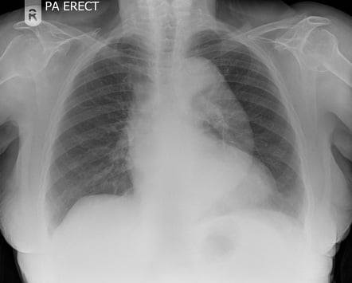
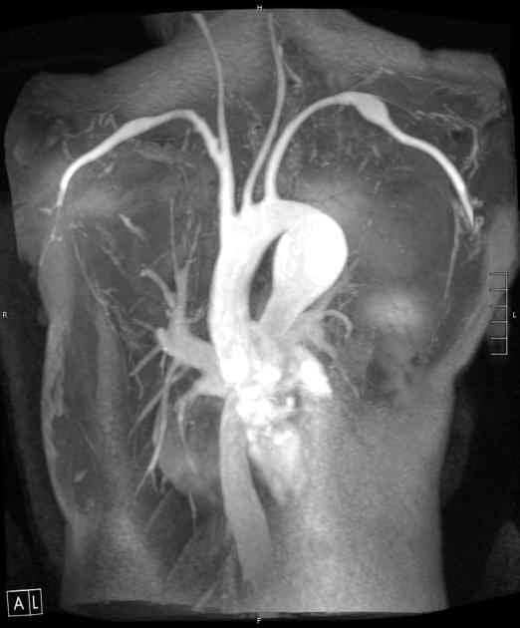
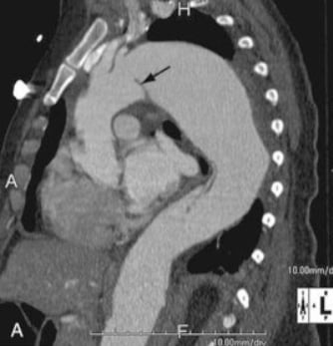

Slide 38
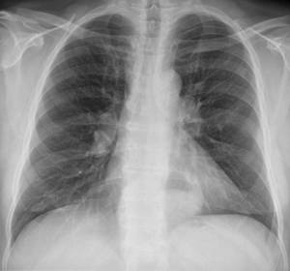

Slide 39
Ant. M. masses post. M. masses
Silhouetting cardiac border not silhouetting cadriac border
Not extend above the clavicle extend above the clavicle
** Cervicothoracic sign :
The anterior mediastinum stops at level of the superior clavicle . Therefore , when a mass extends above the superior clavicle , its located either in the neck or in the posterior mediastinum .
When lung tissue comes between the mass and the neck , the mass is probably in the posterior mediastinum .

Slide 40
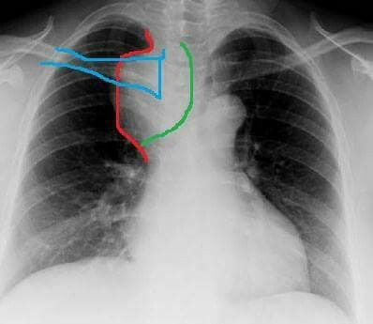
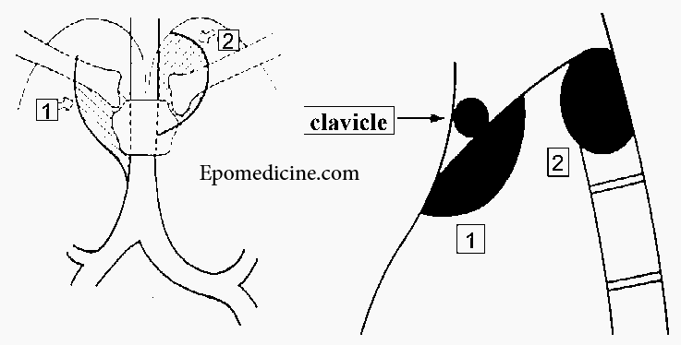
Cervicothoracic sign
ANTERIOR MEDIASTINAL MASS

Slide 41
NEGATIVE Cervicothoracic sign POSTERIOR mediastinal mass (schwannoma)

