Slide 1
Small and Large Intestinal pathology, part 3
Dr. Omar Hamdan MD
Anatomical pathology Mutah University School of Medicine- Department of Laboratory medicine & Pathology GIT lectures 2020

Slide 2
Diseases of the intestines
Intestinal obstruction
Vascular disorders
Malabsorptive diseases and infections
Inflammatory bowel disease.
Polyps and neoplastic diseases

Slide 3
Intestinal obstruction
Mechanical obstruction:
Intussusception
Hernias.
Adhesions.
Volvulus
Tumors.
Diverticulitis
Infarction
Non-mechanical obstruction
Hurschsprung disease
Neurological disorders.
Drugs….etc

Slide 4
Clinical picture of intestinal obstruction.
Abdominal pain
Distention
Vomiting
Constipation.
Acute or chronic.

Slide 5
80% of mechanical obstructions
Robbins Basic Pathology 10th edition

Slide 6
Intussusception
Segment of the intestine constricted by a wave of peristalsis, telescopes into
the immediately distal segment.
Once trapped, invaginated segment is propelled by peristalsis, and pulls mesentery with it.
Most common cause of intestinal obstruction in children younger than
2years of age.
Untreated progresses to infarction.

Slide 7
Causes of intussusception
< 2years : Idiopathic in most cases.
Peyer patches hyperplasia (rotavirus vaccine, viral infections)
Meckles diverticulum (ileum)
Old children & adults: Intraluminal mass or tumors

Slide 10
Clinical features:
Abdominal swelling
Vomiting
Passing stools mixed with blood and mucus (currant jelly stool)
Pain.

Slide 11
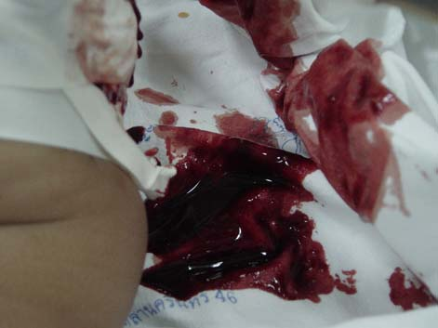

Slide 12
Management
Contrast enemas in uncomplicated idiopathic cases.
Surgery if complicated or if masses are the leading point.

Slide 13
Hirschsprung Disease
Congenital defect in colonic innervations
Congenital aganglionic megacolon
More common in males
More severe in females
Risk increase in siblings.
Typical presentation:
Neonatal failure to pass meconium
Obstructive constipation.

Slide 14
Pathogenesis
During embryogenesis
Disrupted migration of neural crest cells from cecum to rectum.
Lack of Meissner submucosal plexus and the Auerbach
myenteric plexus.
Failure of coordinated peristaltic contractions.
Mutations in RET: in familial cases and 15% of sporadic
Other genes and environmental factors play role.

Slide 15
Morphology
Rectum always involved.
Extent is variable.
Most cases in rectosigmoid.
Macroscopic
Aganglionic region normal or contracted
Proximal normal segment progressively dilated.
Diagnosis: BIOPSY, microscopic.

Slide 16
Robbins Basic Pathology 10th edition

Slide 17
ganglion cells
http://www.pathologyoutlines.com

Slide 18
Complications
Enterocolitis
Fluid and electrolyte disturbances
Perforation
Peritonitis
Treatment:
Surgical resection of aganglionic segment and anastomosis of normal segments.

Slide 19
VASCULAR DISORDERS OF BOWEL
Ischemic Bowel Disease
Hemorrhoids

Slide 20
Hemorrhoids
Dilated anal and perianal collateral vessels that connect the portal and caval
venous systems.
Predisposing factors:
Constipation and straining
Venous stasis of pregnancy,
Portal hypertension.
External and internal hemorrhoids

Slide 21
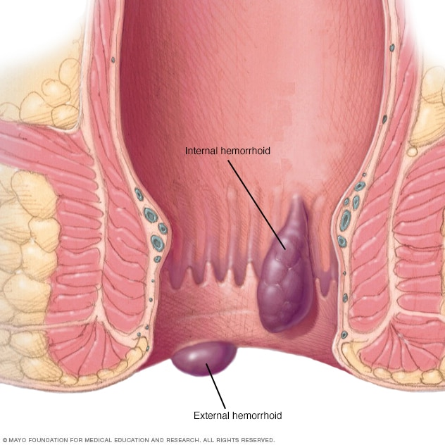
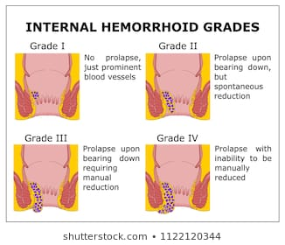

Slide 22
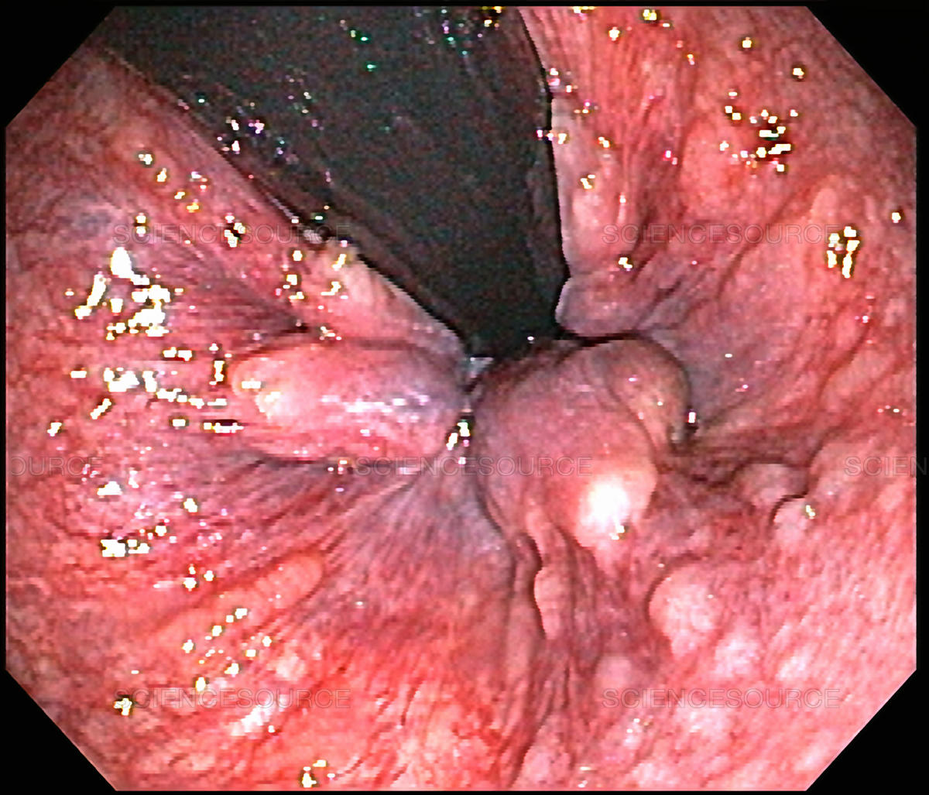
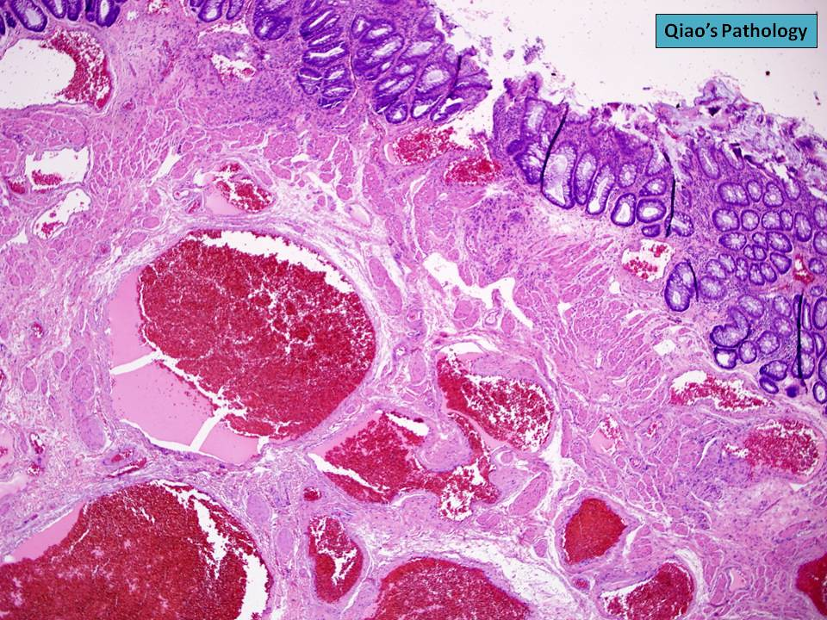

Slide 23
Thin -walled, dilated, submucosal vessels beneath anal or rectal mucosa.
Symptoms:
Bleeding, pain, thrombosis and inflammation

Slide 24
DIARRHEAL DISEASE
Diarrhea: increase in stool mass, frequency or fluidity (more than 200 grams per day).
Dysentery: painful , bloody, small volume diarrhea.
Malabsorptive Diarrhea
Pancreatic insuffciency.
Celiac disease
Crohn disease
Cystic Fibrosis
Lactase (Disaccharidase) Deficiency
Abetalipoproteinemia
Infectious Enterocolitis
Inflammatory bowel diseases…..

Slide 25
Malabsorptive Diarrhea
Chronic.
Defective absorption of fats, fat- and water-soluble vitamins, proteins, carbohydrates, electrolytes, minerals and water
Hallmark is : steatorrhea.

Slide 26
Malabsorptive diarrhea
Defect in one of the following:
Intraluminal digestion : Emulsification and initial enzymatic break-down.
Terminal digestion : Hydrolysis within the enterocyte brush border.
Transepithelial transport: transport through enterocytes.
Lymphatic transport: transport of absorbed lipids.

Slide 28
Manifestations:
Weight loss, anorexia,
Flatus, abdominal distention,
Borborygmi, Muscle wasting
Anemia and mucositis (iron, pyridoxine (VB6), folate, or vitamin B12
deficiency)
Bleeding (vitamin K deficiency)
Osteopenia and tetany (calcium, magnesium, or vitamin D deficiency)
Neuropathy (vitamin A or B12 deficiency)
Skin and endocrine disorders.

Slide 29
Cystic Fibrosis
Mutations in cystic fibrosis transmembrane conductance regulator (CFTR)
Defects in ion transport across intestinal and pancreatic epithelium.
Thick viscous secretions.
Mucus plugs in pancreatic ducts >>> pancreatic insufficiency (80% of patients).
Defect in intraluminal digestion.

Slide 30
Celiac Disease
Gluten sensitive enteropathy
Immune mediated enteropathy
Wheat, rye or barley.
Genetically predisposition, HLA-DQ2 or HLA-DQ8.
Treatment: gluten free diet.
Association with: type 1 diabetes, thyroiditis, and Sjogren syndrome

Slide 32
Pathogenesis
Gluten >>> gliadin >>> react with HLA-DQ2 or HLA-DQ8 on antigen-presenting
cells >>> CD4+ T cells activation >>> cytokines >>> tissue damage.
Serology:
Anti- tissue transglutaminase antibodies
Anti-gliadin antibodies.
Anti -endomysial antibodies

Slide 35
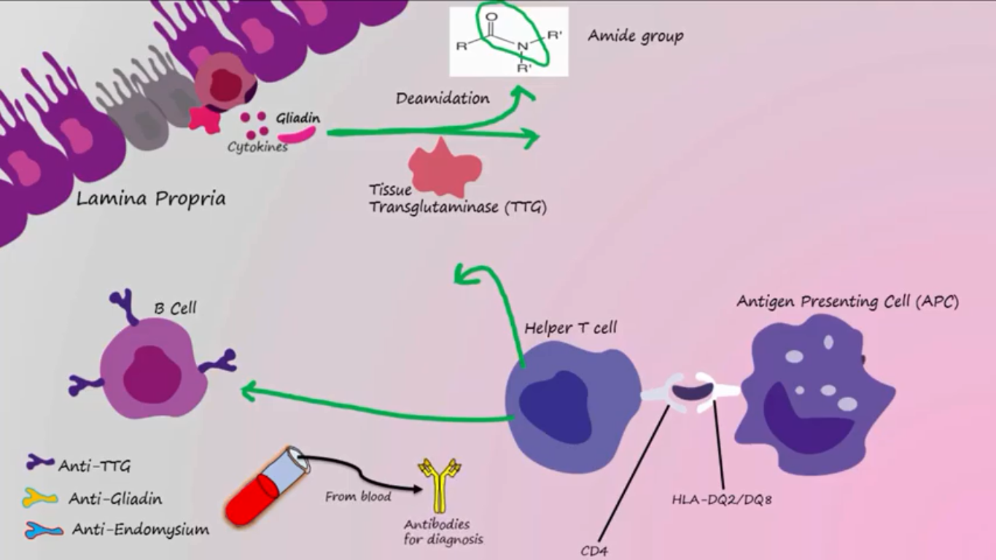

Slide 37
Robbins Basic Pathology 10th edition

Slide 38
MORPHOLOGY
Second portion of the duodenum or proximal jejunum.
Triad: intraepithelial lymphocytosis (CD8+ T cells), crypt hyperplasia, and villous atrophy.
Lamina propria: lymphocytes, plasma cells, eosinophils…….
IEL & villous atrophy are not pathognomonic, seen in viral enteritis.
Diagnosis: Clinical, histologic and serologic correlation.

Slide 39
webpathology

Slide 41
Clinical Features
Children 6-24 months : classical or non classical symptoms
Classical: Irritability, abdominal distention, anorexia, diarrhea, failure to thrive, weight loss, or muscle wasting
Non-classical: abdominal pain, nausea, vomiting, bloating, or constipation.
Blistering skin lesion, dermatitis herpetiformis, in 10% of Pnts.

Slide 42
Dermatitis herpetiformis.

Slide 43
Adults (30-60 years)
Anemia: iron deficiency
B12 and folate deficiency: less common.
Diarrhea , bloating, and fatigue.
Missed diagnosis: Silent celiac or latent celiac.
Increased risk of enteropathy associated T cell lymphoma & Small intestinal adenocarcinoma

Slide 45
Diagnosis:
Non invasive serologic tests:
Most sensitive:
Anti tissue transglutaminase antibody, IgA
Anti deamidated gliadin antibodies, IgA & IgG
Most specific, but less sensitive
Antiendomysial antibody.
Invasive tests: small bowel biopsy.

Slide 46
Lactase (Disaccharidase) Deficiency
Osmotic diarrhea
Lactose remains in the gut lumen.
Lactase found at apical brush border membrane
Normal biopsy findings.
Two types:
Congenital : AR, genetic mutation, rare, explosive diarrhea, watery, frothy stools & abdominal distention, after milk ingestion
Acquired : follow viral or bacterial enteritis, downregulation of gene, after
childhood.

Slide 47
Abetalipoproteinemia
Autosomal recessive, rare.
The underlying defect is a mutation in the microsomal triglyceride transfer protein (MTP) responsible for lipoprotein and fatty acid export from mucosal cells.
Infants w/ failure to thrive, diarrhea, and steatorrhea
Lack of absorption of fat and fat soluble vitamins
Inability to secrete triglyceride-rich lipoproteins.
Transepithelial transport defect of TG and FAs.
Monoglycerides and triglycerides accumulate in epithelial cells.

