Slide 1
Neoplasia 4
Dr. Sura Al Rawabdeh, M.D.
5-12-2022

Slide 2
HALLMARKS OF CANCER
All cancers display eight fundamental changes in cell physiology, which are considered the hallmarks of cancer.
• Self-sufficiency in growth signals
• Insensitivity to growth-inhibitory signals
• Altered cellular metabolism
• Evasion of apoptosis
• Limitless replicative potential (immortality)
• Sustained angiogenesis
• Invasion and metastasis
• Evasion of immune surveillance

Slide 3
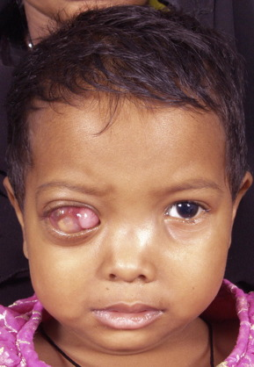
I. RB: Governor of the Cell Cycle:
RB, a key negative regulator of the cell cycle, is directly or indirectly inactivated in most human cancers.
Approximately 60% of retinoblastomas are sporadic, while the remaining ones are familial.
loss of normal RB genes predispose to:
Retinoblastomas
breast cancer.
small cell cancer of the lung.
bladder cancer.

Slide 4
2.TP53: Guardian of the Genome
The p53 protein is a transcription factor that thwarts neoplastic transformation by three interlocking mechanisms:
Activation of temporary cell cycle arrest (termed quiescence).
Induction of permanent cell cycle arrest (termed senescence).
Triggering of programmed cell death (termed apoptosis)
p53 plays a central role in maintaining the integrity of the genome.
Notes:
• p53-induced senescence is a form of permanent cell cycle arrest characterized by specific changes in morphology and gene expression that differentiate it from quiescence or reversible cell cycle arres

Slide 5
In nonstressed, healthy cells, p53 has a short half-life
(20 minutes) because of its association with MDM2, a protein that targets p53 for destruction

Slide 6
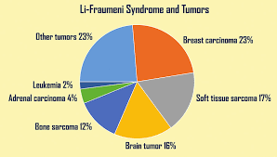
Li-Fraumeni syndrome (LFS) is an inherited condition caused by mutation in TP53
Patients with the Li-Fraumeni syndrome have a 25-fold greater chance of developing a malignant tumor by 50 years of age compared with the general population

Slide 7
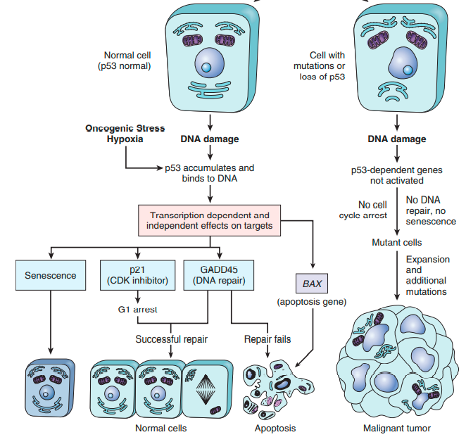
p53 can be viewed as a central monitor of internal stress, directing the stressed cells toward one of the previous pathways.
stress
stress
Ionizing radiation
Carcinogens
Mutagens

Slide 8
3. Transforming Growth Factor-β Pathway
TGF-β is a potent inhibitor of proliferation.
Seen in most normal epithelial, endothelial, and hematopoietic cells.
In many forms of cancer, the growth-inhibiting effects of the TGF-β pathways are impaired by mutations affecting TGF-β signaling.
Mutations affecting the TGF-β receptor are seen in cancers of the colon, pancreas, stomach, and endometrium

Slide 9
4. Contact Inhibition.
Normally, nontransformed cells stop proliferating once they form confluent monolayers.
But
When cancer cells are grown in the laboratory, their proliferation fails to be inhibited when they come in contact with each other

Slide 10
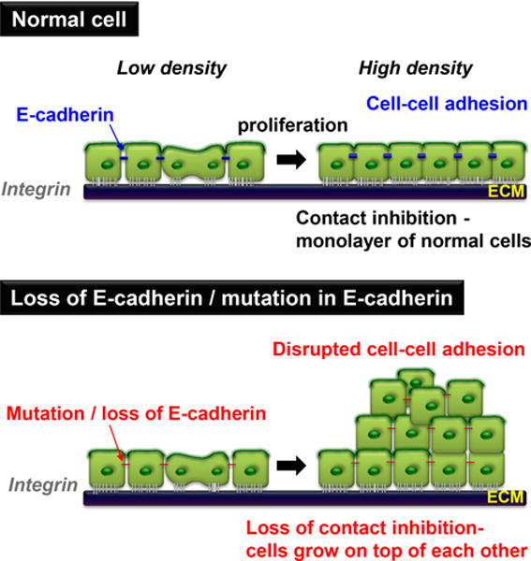
E-cadherin binding between cells is important in mediating contact inhibition of proliferation when cells reach confluence.
Loss of E-cadherin expression results in loss of contact inhibition and is associated with increased cell motility and advanced stages of cancer

Slide 11
HALLMARKS OF CANCER
All cancers display eight fundamental changes in cell physiology, which are considered the hallmarks of cancer.
• Self-sufficiency in growth signals
• Insensitivity to growth-inhibitory signals
• Altered cellular metabolism
• Evasion of apoptosis
• Limitless replicative potential (immortality)
• Sustained angiogenesis
• Invasion and metastasis
• Evasion of immune surveillance

Slide 12
III Altered Cellular Metabolism
Even in the presence of ample oxygen, cancer cells demonstrate a distinctive form of cellular metabolism characterized by high levels of glucose uptake and increased conversion of glucose to lactose (fermentation) via the glycolytic pathway
This phenomenon, called the Warburg effect and also known as aerobic glycolysis

Slide 13
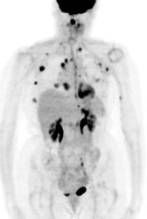
Clinically, the “glucose-hunger” of tumors is used to visualize tumors via positron emission tomography (PET) scanning, in which patients are injected with a glucose derivative that is preferentially taken up into tumor cells

Slide 14
Aerobic glycolysis generates two molecules of ATP per molecule of glucose.
While
Oxidative phosphorylation generates up to 36 molecules of ATP per molecule of glucose.
So why cancer cell rely on seemingly inefficient glycolysis ?
The answer to this question: Aerobic glycolysis provides rapidly dividing tumor cells with metabolic intermediates that are needed for the synthesis of cellular components

Slide 15
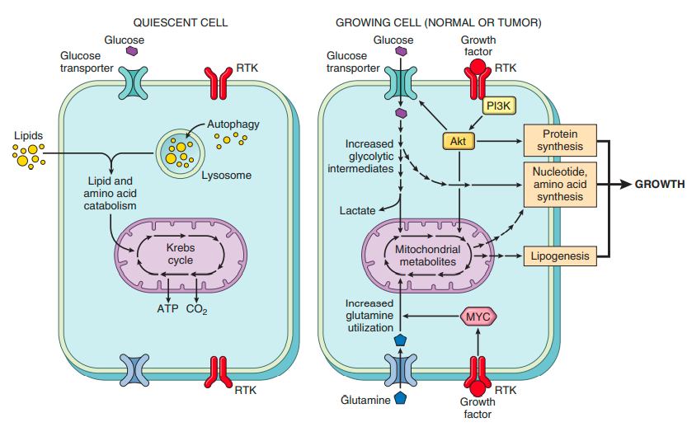

Slide 16
Beyond the Warburg effect, there are two other links between metabolism and cancer
1. Autophagy
2. oncometabolism.

Slide 17
1. Autophagy
Autophagy is a state of severe nutrient deficiency in which cells not only arrest their growth, but also cannibalize their own organelles, proteins, and membranes as carbon sources for energy production.
Tumor cells often seem to be able to grow under marginal environmental conditions without triggering autophagy, suggesting that the pathways that induce autophagy are deranged .
under conditions of severe nutrient deprivation, tumor cells may use autophagy to become “dormant,” a state of metabolic hibernation that allows cells to survive hard times for long periods

Slide 18
2. Oncometabolism
They are mutations in enzymes that participate in the Krebs cycle.
Of these, mutations in isocitrate dehydrogenase (IDH) have garnered the most interest, as they have revealed a new mechanism of oncogenesis termed oncometabolism.
Oncogenic IDH mutations have been described in :
Cholangiocarcinomas.
gliomas.
acute myeloid leukemias.
sarcomas.

Slide 19
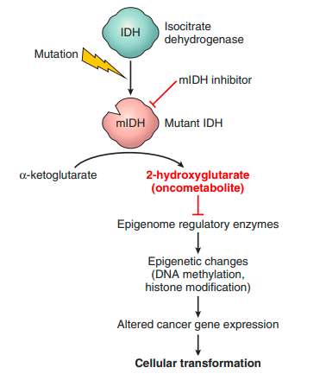
mutated IDH acts as an oncoprotein by producing 2-HG, which is considered a prototypical oncometabolite.

Slide 20
IV Evasion of Cell Death
Tumor cells frequently contain mutations in genes that regulate apoptosis, making the cells resistant to cell death.
evasion of apoptosis by cancer cells occurs mainly by way of acquired mutations and changes in gene expression that disable key components of the intrinsic pathway.

Slide 21
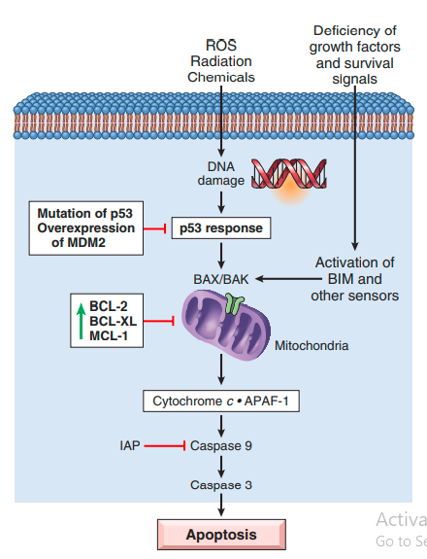

Slide 22
Major mechanisms by which apoptosis is evaded by cancer cells
1. Loss of TP53 function:
prevents the upregulation of PUMA, a pro-apoptotic BH3-only that is a direct target of p53.
As a result, cells survive levels of DNA damage and cell stress that otherwise would result in their death
2. Overexpression of anti-apoptotic members of the BCL2 family:
Overexpression of BCL2 is a common event leading to the protection of tumor cells from apoptosis, e.g follicular lymphoma

Slide 23
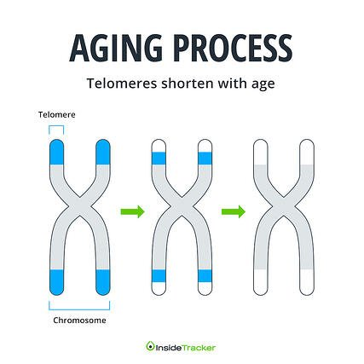
V. Limitless Replicative Potential (Immortality)
Tumor cells, unlike normal cells, are capable of limitless replication.
most normal human cells have a capacity of at most 70 doublings. Thereafter, the cells lose the ability to divide and enter replicative senescence.
This phenomenon occure due to progressive shortening of telomeres at the ends of chromosomes

Slide 24
Limitless Replicative Potential (Immortality) of the tumor cells is due to:
telomere maintenance
By: lengthening of telomeres
upregulation of the enzyme telomerase

Slide 25
Markedly eroded telomeres are recognized by the DNA repair machinery as double-stranded DNA breaks, leading to cell cycle arrest and senescence, mediated by TP53 and RB.
In cells in which TP53 or RB mutations are disabled by mutations, the nonhomologous end-joining pathway is activated as last effort to save the cell, joining the shortened ends of two chromosomes.

Slide 26
VI. Sustained Angiogenesis
Even if a solid tumor possesses all of the genetic aberrations that are required for malignant transformation, it cannot enlarge beyond 1 to 2 mm in diameter unless it has the capacity to induce angiogenesis.
Neovascularization has a dual effect on tumor growth:
perfusion supplies needed nutrients and oxygen.
angiogenesis contributes to metastasis

Slide 27
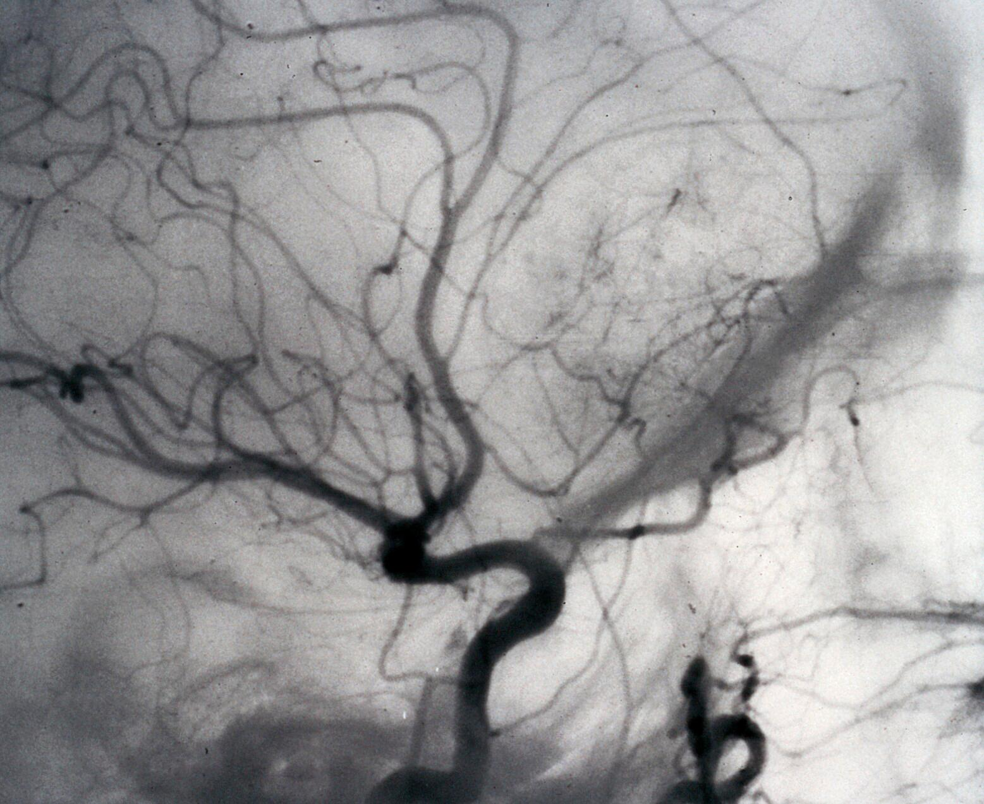
Neovascularization not entirely normal; the vessels are leaky and dilated, and have a haphazard pattern of connection, features that can be appreciated on angiograms
Angiogram of meningioma

Slide 28
How do growing tumors develop a blood supply?
angiogenesis is controlled by a balance between angiogenesis promoters and inhibitors; in angiogenic tumors this balance is directed toward promoters.
molecular basis of the angiogenesis involves:
increased production of angiogenic factors.
E.g proangiogenic basic fibroblast growth factors (bFGF)
loss of angiogenic inhibitors;
E.g angiostatin and endostatin

Slide 29
The local balance of angiogenic and anti-angiogenic factors is influenced by several factors:
1. Relative lack of oxygen due to hypoxia stabilizes HIF1α, an oxygen-sensitive transcription factor, which then activates the transcription of proangiogenic cytokines such as VEGF.
2. Mutations involving tumor suppressors and oncogenes in cancers also tilt the balance in favor of angiogenesis.
E.g , p53 stimulates
expression of antiangiogenic molecules, such as thrombospondin-1
represses expression of proangiogenic molecules, such as VEGF. Thus, loss of p53 in tumor cells provides a more permissive environment for angiogenesis.

Slide 30
Thank you.

