Slide 10
Note
Σ Sinus rhythm, rate 62/min
Σ Normal axis (there is a dominant S wave in lead III, but a dominant R wave in lead II)
Σ Normal QRS complexes and ST segments
Σ T wave inversion in all the chest leads, especially V2–V5
Σ In a white man this might suggest a non-ST segment elevation myocardial infarction, but in a black man
it is perfectly normal
Notes:
T wave inversion

Slide 12
Note
Σ Sinus rhythm, rate 80/min
Σ PR interval prolonged at 336 ms
Σ Constant PR interval in all beats
Σ Loss of the R wave in lead V3 could indicate an old anterior infarction, otherwise QRS complexes,
ST segments and T waves are norlma

Slide 21
Sinus rhythm, rate 60/min
Σ QRS complexes predominantly downward (S wave greater than R wave) in lead I
Σ Upright QRS complexes (R wave greater than S wave) in leads II–III
Σ QRS complexes and T waves are normal

Slide 24
: Note
Σ P waves at just over 300/min (most easily seen in leads II and VR)
Σ Regular QRS complexes, rate 160/min
Σ Narrow QRS complexes of normal shape
Σ Normal T waves (best seen in the V leads; in the limb leads it is difficult to distinguish between T and
P waves)

Slide 25
Note :
No P waves
Regular QRS complexes, rate 200/min
Broad QRS complexes, duration 280 ms, with a very abnormal shape
No identifiable T waves

Slide 26
Σ Regular broad complex tachycardia, rate 200/min
Σ No P waves visible
Σ Left axis deviation
Σ QRS complex duration 180 ms (if >160 ms, the rhythm is more likely to be ventricular in origin than
to be supraventricular with bundle branch block)
Σ QRS complexes all point the same way (upwards) in the chest leads (again, makes a ventricular
origin likely)

Slide 28
Atrial fibrillation
Note
Σ No P waves
Σ Irregular baseline
Σ Irregular QRS complexes, rate varying between 75/min and 190/min
Σ Narrow QRS complexes of normal shape
Σ Depressed ST segments in leads V5–V6 (digoxin effect – see p. 101)
Σ Normal T waves

Slide 29
no QRS complex can be identified

Slide 30
Sinus rhythm, rate 125/min
Right axis deviation
Short PR interval
Slurred upstroke of the QRS complex, best seen in leads V3 and V4. Wide QRS complex due to this ‘delta’ wave
Dominant R wave in lead V1

Slide 31
Sinus rhythm, rate 80/min
Normal axis
Small Q waves in leads II, III and VF – associated with flat ST segments and inverted T waves – indicate old
inferior infarction
Small Q waves in leads V3–V4 – associated with raised ST segments – indicate acute anterior infarction

Slide 32
Sinus rhythm, rate 70/min
Σ Normal axis
Σ Q waves in leads III and VF
Σ Normal QRS complexes
Σ Raised ST segments in leads II, III and VF
Σ Inverted T waves in lead VL (abnormal) and in lead V1 (normal)

Slide 33
Sinus rhythm, rate 70/min
Σ Normal axis
Σ Dominant R waves in lead V1
Σ Flattened T waves in leads I and VL

Slide 34
Atrial fibrillation
Σ Ventricular rate about 85/min
Σ Normal QRS complexes and T waves
Σ There is no ST segment depression, suggesting that the individual is not taking digoxin

Slide 35
Σ Sinus rhythm, rate 47/min
Σ Normal QRS complexes, ST segments and T waves

Slide 36
Sinus rhythm; rate as judged from adjacent sinus beats is about 35/min
Σ The overall heart rate, calculated including the extrasystoles, is about 45/min
Σ Extrasystoles are identified by early P waves that are differently shaped compared with those associated
with the sinus beats
Σ The QRS complexes and T waves are the same in the sinus and atrial beats

Slide 37
Note
Σ Sinus rhythm, rate 50/min
Σ Frequent ventricular extrasystoles, identified by their early occurrence without preceding P waves, and
by their wide and abnormal QRS complex and differently shaped T wave compared with the sinus beats
Σ In the sinus beats the QRS complexes and T waves are normal

Slide 38
Σ Sinus rhythm, rate 60/min
Σ Normal axis
Σ Normal QRS complexes
Σ ST segments depressed horizontally in leads V3–V5
Σ Normal T waves

Slide 39
Σ Sinus rhythm, rate 75/min
Σ Normal axis
Σ Normal QRS complexes
Σ ST segments elevated in leads V1–V5
Σ Normal T waves
Σ The ST segment elevation could be confused with high take-off ST segments, but the trace has to be
interpreted in the context of a patient with acute chest pain

Slide 40
Note
Σ Sinus rhythm, rate 80/min
Σ Normal axis
Σ Q waves in leads VL and V2–V4
Σ Isoelectric (i.e. at baseline) ST segments (except in lead V4)
Σ Inverted T waves in leads I, VL and V4–V6

Slide 41
Σ Sinus rhythm, rate 70/min
Σ Normal axis
Σ Small Q wave in lead III: other QRS complexes are normal
Σ ST segment elevation of 3 mm in leads II, III and VF
Σ T waves inverted in lead VL

Slide 42
Σ Sinus rhythm, rate 60/min
Σ Normal axis
Σ Q waves in leads III and VF
Σ ST segments in leads II, III and VF have nearly returned to the baseline
Σ T waves inverted in leads II, III and VF
Σ QRS complexes and T waves are normal in the anterior leads

Slide 43
Note
Σ Sinus rhythm, rate 95/min
Σ Right axis deviation (QRS complexes predominantly downward in lead I)
Σ Peaked P waves in lead II, suggesting right atrial hypertrophy
Σ Persistent S wave in lead V6
Σ T waves inverted in leads V1, V5, II, III and VF
Σ Right bundle branch block pattern

Slide 47
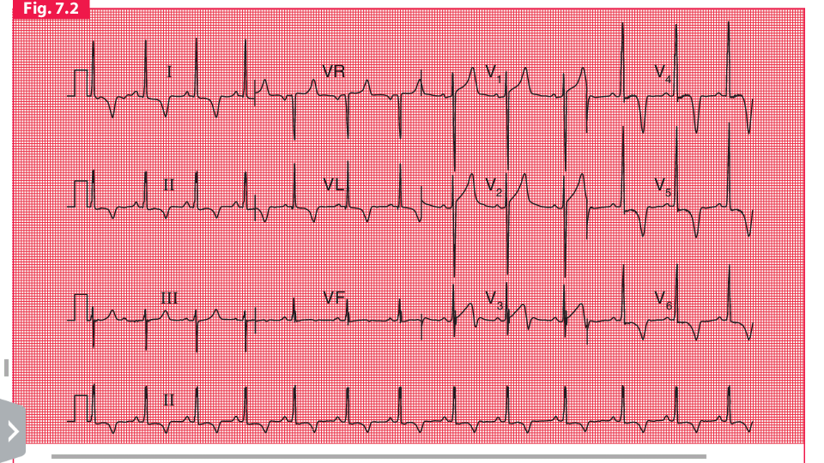
Hypertrophic cardiomyopathy
Note
Σ Sinus rhythm, rate 70/min
Σ Normal axis
Σ Left ventricular hypertrophy on voltage criteria (S wave in lead V1 = 28 mm, R wave in lead V5 = 30 mm)
Σ Deep T wave inversion in leads I, II, VL and V3–V6, maximal in lead V4
Σ This ECG could be due to left ventricular hypertrophy rather than hypertrophic cardiomyopathy, but the
T wave inversion is dramatic and is maximal in lead V4 rather than in V6. Anterolateral ischaemia is also
unlikely, because of the marked nature of the T wave inversion

Slide 48
Pericarditis

Slide 49
idiopathic dilated cardiomyopathy
ECG of a patient with idiopathic dilated cardiomyopathy with very low ejection fraction and LBBB .

Slide 50
Congestive heart failure

Slide 51
Hyperkalemia

Slide 52
A) Digitalis effect B) Hypokalemia C) Mitral prolapse

