Slide 1
Abdominal trauma
Done by: supervised by: dr saad al-azzawi
Amer hammoudeh
Qutaiba habahbeh
Mohamad-alhmouz
Amro-hammad

Slide 2
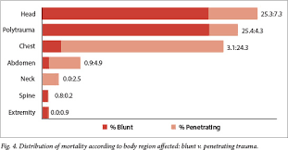
Introduction
1.Road traffic accidents is the main cause of abdominal trauma in the civilian population
2. Abdominal injuries rank third as a cause of traumatic death after head and chest injuries
3. The primary cause of death in abdominal trauma is hemorrhage and sepsis after 48 hours

Slide 3
Types:-:-
There are two types of abdominal trauma:-
1- Blunt abdominal trauma which is the most common cause usually due to RTA, direct blow to the abdomen or falling down.
2- penetrating abdominal trauma may be due to missile injuries or stab wounds.

Slide 4
Blunt abdominal trauma:-
Mechanism of injury:-
1- sudden deceleration can lead to differential movement among adjacent structures especially at fixed points of attachment such as (ligament of Treitz, ileocecal valve, phrenocolic ligament and ligamentum teres)
2- Compression with crush:- intraabdominal contents are crushed between anterior abdominal wall and the vertebral column.
3- compression with rupture:- it affects hollow viscus organs due to sudden rise in intraabdominal pressure.

Slide 5
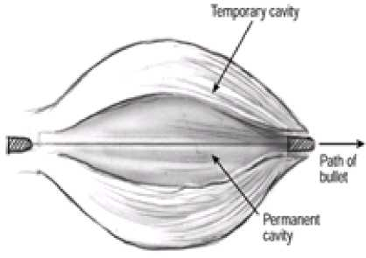
Mechanism of injury in penetrating abdominal trauma:-
The mechanism of penetrating injuries is mechanical disruption of the tissues along the pathway of the bullet or the stab.
Cavitation injuries occurs when velocities exceed 500-600 m/s which is a temporary space torn in tissues at right angles to the direction of travel. It depends on the tissue involved and its elasticity. Usually it occur in a hollow viscus organ as if it occurs in solid organs it will cause shattering of the organ.( cavitation injury require high speed and more elastic tissue)
Combined Penetrating & Blunt traumas can occur in explosive devices due to penetrating fragments wounds in addition to the patient being thrown or struck.

Slide 6
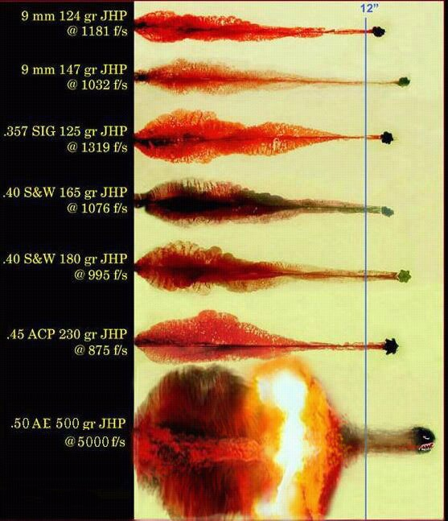

Slide 7
Approach to Patient
Resuscitation of all injuries to the abdomen should follow traditional Advanced Trauma Life Support (ATLS) principles:
Primary Survey (ABCDE)
Resuscitation
Secondary Survey:
History (AMPLE) & head to toe physical examination
Continuous monitoring and re-evaluation
Definitive care and transfer

Slide 8
Approach to Patient
After initial resuscitation:
Abdominal trauma patients can generally be classified into the following categories based on their physiological condition into:
Haemodynamically ‘normal’: Full Assessment & investigation can be completed before treatment is planned.
Haemodynamically ‘stable’: Assessment & investigation is more limited aiming at establishing whether the patient can be managed non-operatively, whether angioembolisation can be used, or whether surgery is required.
Haemodynamically ‘unstable’: investigations need to be suspended as immediate surgical correction of the bleeding is required.

Slide 10
Assessment of blunt abdominal trauma:-
History:-
In RTA:-
1- The type of collision.
2- The extent of vehicle damage.
3- The patient position in the vehicle.
4- The extraction time.
5- The status of other passengers.
In Falling Down patients the most important question is to ask about the height of FD and in direct blow patients you have to ask about the site of blow.
We have to ask about the BP of the patient to know if there is intraabdominal injury even if the patient arrives at hospital normotensive.
Examination:-
There are some signs that indicate an intra abdominal injury such as abdominal distention, seat belt mark, abrasions and ecchymosis.
The most reliable signs and symptoms in alert patients are pain, tenderness, gastrointestinal hemorrhage, hypovolemia, and evidence of peritoneal irritation.

Slide 11
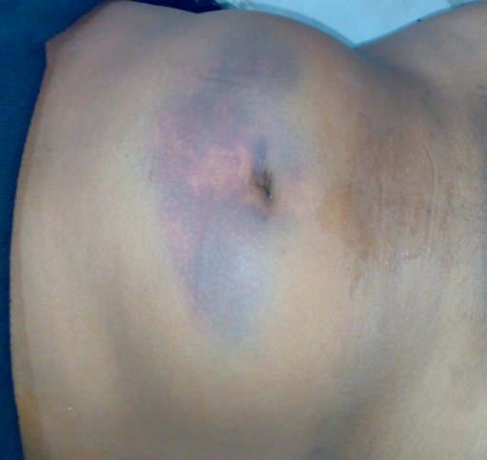
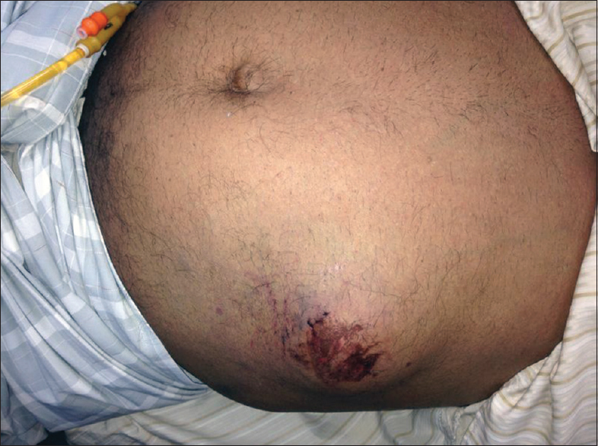
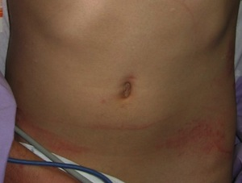

Slide 12
Assessment of penetrating injuries:-
History:- generally we have to ask about the time between injury and reaching hospital and the type of weapon and the site of injury.
If it is knife we have to ask about how many times and its length.
If it is gunshot we have to ask about the type and how many bullets.
Examination:-
Assessment should be done when the patient is stable.

Slide 13
cont
Site:-
Any wound in the boundaries of the abdomen is a potential abdominal injury.
If the wound in the retroperitoneum we consider it in the ascending or descending colon.

Slide 14
Physical Examination: Inspection
The patient must be fully undressed.
The anterior and posterior abdomen, as well as the lower chest and perineum, should be inspected for:
Abrasions, contusions from restraint devices, lacerations, Penetrating wounds.
Abdominal distension
Impaled foreign bodies.
Log roll the patient for complete examination.

Slide 15
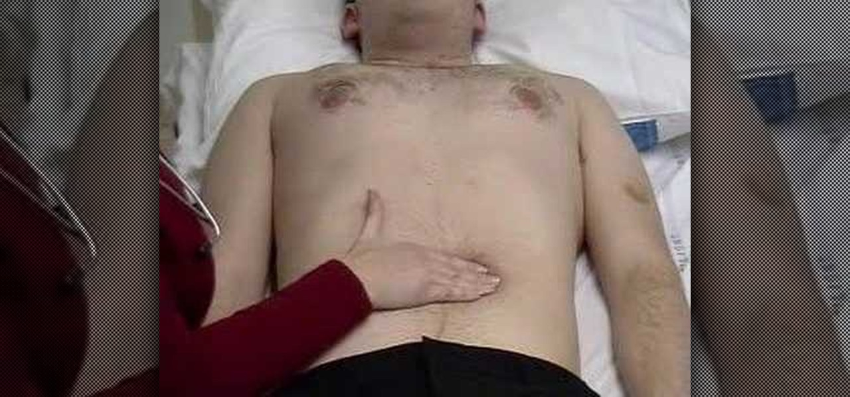
Physical Examination: Palpation
Distinguish superficial (abdominal wall) and deep tenderness.
Signs of peritoneal irritation: gaurdining, rigidity and rebound tenderness.
Crepitus at lower thoracic cage.
The presence of a pregnant uterus.

Slide 16
Physical Examination: Auscultation
Used to confirm the presence or absence of bowel sounds.

Slide 17
Urethral, Perineal and Rectal examination
Look for evidence of urethral injury:
Blood at the urethral meatus
Scrotal ecchymosis or hematoma
Rectal examination, look for:
Assess sphincter tone and rectal mucosal integrity.
Determine the position of the prostate.
Identify any fractures of the pelvic bones.
Gross blood from bowel perforation.

Slide 18
Physical examination
Lastly, Vaginal examination is done if severe perineal injuries, pelvic fracture or trans-pelvic gunshot are present.
Gluteal examination: Penetrating injuries to this area are associated with up to a 50% incidence of significant intra-abdominal injuries.
At the conclusion of the rapid physical exam, the patient should be covered with warmed blankets to help prevent hypothermia.
Repeated Physical examinations are encouraged to detect signs of bleeding or peritonitis developing over time.

Slide 19
Diagnosis
1- Local wound exploration:-it is done for penetrating injuries if it is stab wound we dilate the wound and we put a probe to explore the wound when the probe stops it indicates the depth of the wound. If the probe passes the peritoneum then we have to do laparotomy.
If the cause is gunshot then radiological studies are used to determine the depth of injury.
2- Focused abdominal sonar for trauma:- it is used to indicate the presence of blood in the abdominal cavity mainly (morison (hepatorenal recess) pouch, paracolic gutter, splenorenal recess and pouch of douglas). If it is present it is an indication of laparotomy. It can be done in unstable patients.
Accurate in detecting more than 100 ml of fluid in the abdomen.
Should be repeated in 30 minutes for detection of progressive hemoperitoneum.

Slide 20
cont
3- CT scan:- it is used in stable patients to identify injured organs(solid and retroperitoneal)
We can determine bowel perforation, diaphragmatic rupture, retroperitoneal blood and pelvic and spinal fractures.
4- DPL:- it is used to asses the presence of blood in the abdomen.
Indications of DPL:-
1- ambiguous clinical examination.
2- difficulty in assessing the patient.
3- persistence of hypotension despite resuscitation.
4- presence of multiple injuries.

Slide 21
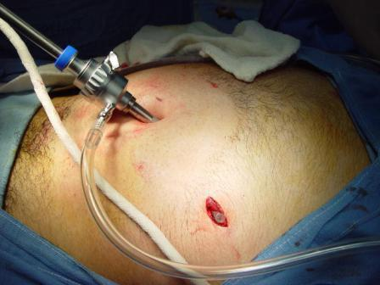
We put a cannula below the umbilicus caudally and posteriorly then we aspirate blood then we put ringer lactate then it is re-aspirated.

Slide 22
Positive results of DPL:-
Before putting RL:-
- more than 10 ml of blood is aspirated from the abdomen at first.
After putting RL
- the presence of more than 100,000 red cells/µL or more than 500white cells/µL.
Amylase > 175 units.
The presence of enteric contents or bile.

Slide 23
Comparison

Slide 24
Observe Vs. Laparotomy
Non-operative Management
Non-operative management is universally preferred for the management of solid organ injury in hemodynamically stable children. However, it is also gaining acceptance in the management of adults as well.
A stable patient and accurate CT imaging are prerequisites for this approach.

Slide 25
Observe Vs. Laparotomy
Indications for Laparotomy
Blunt abdominal trauma with hypotension with a positive FAST or clinical evidence of intraperitoneal bleeding
Blunt or penetrating abdominal trauma with a positive DPL
Hypotension with a penetrating abdominal wound
Gunshot wounds traversing the peritoneal cavity or visceral/vascular retroperitoneum
Evisceration

Slide 26
Observe Vs. Laparotomy
Indications for Laparotomy
Bleeding from the stomach, rectum, or genitourinary tract from penetrating trauma
Peritonitis
Free air, retroperitoneal air, or rupture of the hemidiaphragm
Contrast-enhanced CT that demonstrates ruptured gastrointestinal tract, intraperitoneal bladder injury, renal pedicle injury, or severe visceral parenchymal injury after blunt or penetrating trauma

Slide 27
Liver injury

Slide 28
Symptoms of a liver injury
right upper quadrant pain, increase with deep breathing.
nausea or vomiting, tachycardia and fainting,
Physical examination :
tenderness to palpation in the right upper quadrant of the abdomen. Abnormalities of blood pressure and pulse will be noted (low blood pressure and pulse over 100).

Slide 29
Liver injury scale
Grade I :Sub capsular hematoma < 10%of surface area,non expanding.
Laceration < 1cm parenchymal depth,non bleeding.
Grade II :Sub capsular hematoma 10-50%
parenchymal Laceration 1-3 in depth ,<10 cm in length.
Grade III :Sub capsular hematoma >50 %
3 cm parenchymal depth.
Grade IV : Ruptured intra parechymal hematoma with active bleeding.
Parechymal distruption involving 25-50%of hepatic lobe.
Grade V : Parenchymal distruption >50%of hepatic lobe
Vascular injuries :hepatic veins,inf. Vena cava.

Slide 30
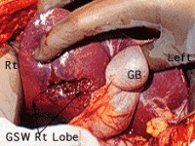
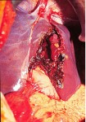
Liver injury
Grade II
Grade IV

Slide 31
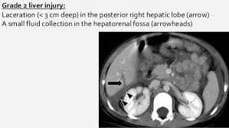
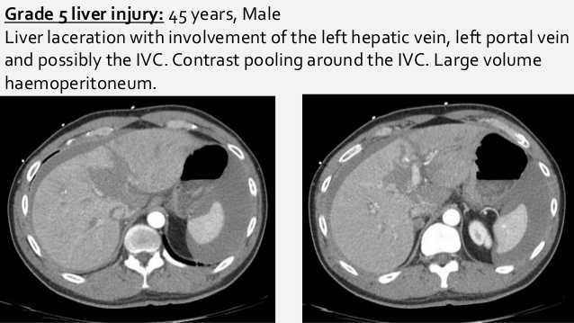

Slide 32
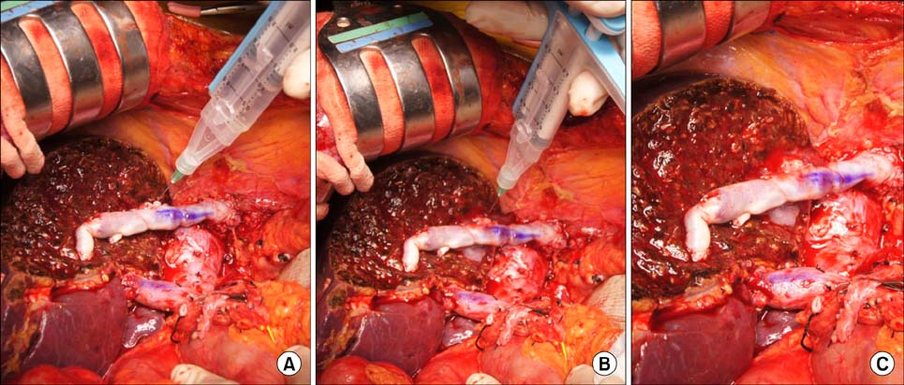
Treatment of liver injury
Nonoperative management: is safe, effective, and clearly
the treatment modality of choice in hemodynamically stable patients.
The weakness in this treatment is the possibility of missing an associated intra abdominal injury
Operative management :
- simple suture techniques
- resectional debridement to control hemorrhage.
- Anatomic resection,
-hepatic artery ligation
- Mesh wrapping or perihepatic packing,
- fibrin glue application

Slide 33
Pancreatic Injury

Slide 34
Etiology
The pancreas, sitting in a relatively protected position high in the retroperitoneum, is infrequently injured in typical blunt injuries.
Penetrating trauma
- 70% of all pancreatic injuries
- Stab / firearm wounds
Blunt abdominal trauma
- 30% cases

Slide 35
Clinical Presentation
Pancreatic injury can be symptom free early in the post injury time frame and even silent in many cases.

Slide 36
Pancreatic Injury Grading
Grade | Injury | Description
I | Hematoma | Minor contusion without duct injury
 | Laceration | Superficial laceration without duct injury
II | Hematoma | Major contusion without duct injury or tissue loss
 | Laceration | Major laceration without duct injury or tissue loss
III | Laceration | Distal transection or parenchymal injury with duct injury
IV | Laceration | Proximal transection or parenchymal injury involving ampulla
V | Laceration | Massive disruption of pancreatic head

Slide 38
Investigations
Serum amylase
Plain abdominal x-ray
CT Abdomen: mainstay of accurate diagnosis
ERCP
Exploratory laparotomy

Slide 39
CT scan
In patients experiencing blunt trauma, CT scans provide the best overall method for diagnosis and recognition of a pancreatic injury.
Findings:
A hematoma surrounding the pancreas
Fluid in the lesser sac
Parenchymal lacerations
Transections
Contraindicated if the patient is hemodynamically unstable

Slide 41
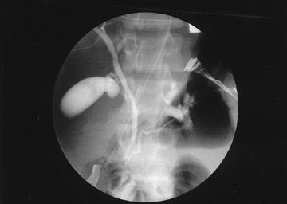
ERCP
(ERCP) can be used in cases where clinically there is high suspicion of pancreatic ductal injury .
Preoperative ERCP may be done in a stable patient to know any pancreatic ductal disruption which helps to plan a definitive procedure and reduces morbidity .

Slide 42
Non-operative management
If there is no evidence of a ductal injury on CT, non-operative management is acceptable, although it may be wise to perform ERCP to establish normal ductal anatomy definitively.
Notes:
In non-operative management, serial physical and laboratory examinations (ie, hemoglobin, amylase, lipase) are required.
A continued increase in serum amylase levels or change on physical examination mandates an abdominal operation or repeat imaging with CT or ERCP.

Slide 43
Operative Management
Indications:
Peritonitis on physical examination
Hypotension
Evidence of disruption of the pancreatic duct

Slide 45
Complications of Pancreatic injury
Fistula formation is the most frequently reported complication,
Treatment : wide local drainage and good nutrition and supportive care, usually resolve spontaneously within 2 weeks of injury
Chronic pancreatitis, traumatic pseudocysts.

Slide 46
Duodenal injury
The duodenum lies retroperitoneally and so injuries are hidden and only discovered late or at laparotomy performed for other reasons.

Slide 47
Clinical presentation
The diagnostic accuracy of duodenum injury is low because it has no specifical clinical symptoms and signs. the injury may not present with any peritoneal irritation sign, especially when the second and third parts of duodenum are injured.
Abdominal pain especially when the right upper quadrant is injured.
Retching or vomiting with blood in the vomitus.
Abdominal distension especially in the upper quadrant
Detection of fluid like bile or intestinal juice by diagnostic abdominocentesis.

Slide 48
Diagnosis
Water-soluble radiopaque contrast medium can be injected through a nasogastric tube just before the abdominal film is taken. If leakage happens, rupture of duodenum can be confirmed.
The only sign may be gas in the periduodenal tissue seen at CT.

Slide 49
Duodenal Injury Grading

Slide 51
Management
Duodenal Hematoma Management:
Non operative: NGT , TPN
Surgical: Evacuation after 2 weeks
Duodenal perforation management:
Primary repair ( most perforations of the duodenum can be treated by primary repair)

Slide 52
Management
Management of Duodenal injury depends on which portion is affected:
1st portion → debridement & end-to-end anastomosis (because of the mobility and rich blood supply of the gastric pylorus )
2nd portion → For lesions between the accessory papilla and the papilla of Vater, avascularized jejunal graft, either a patch or tubular interposition graft, may be required.

Slide 53
Management
3rd & 4th portion → resect the third and fourth portions and perform a duodenojejunostomy on the left side of the superior mesenteric vessels
High-risk or complex duodenal repairs → Whipple procedure (Pancreaticoduodenectomy)

Slide 56
Done by : Qutaiba habahbeh

Slide 57
Damage control surgery
DONE BY MOHAMAD-ALHMOUZ

Slide 58
Damage Control Surgery
Multiple trauma patients are more likely to die from their intra-operative metabolic failure than from a failure to complete operative repairs.
Those at high risk of death has the death triad of:
Coagulopathy,
Hypothermia and
Metabolic acidosis

Slide 59
Damage Control Surgery
Definition :It is the minimum surgery needed to stabilize the patient’s condition until the physiological condition can be corrected.
Damage control surgery is restricted to the following goals:
Stopping any active surgical bleeding.
Controlling any contamination.
Protection from further injury.
Notes:
The operation is then suspended and the abdomen temporarily closed. The patient’s resuscitation continues in the intensive care unit. Once the physiology has been corrected, the patient warmed and the coagulopathy corrected, the patient is returned to the operating theatre for any definitive surgery

Slide 61
THE DAMGE CONTROL APPROCH
The term damage control describe a systematic Five-stages approach designed to disrupt the lethal cascade of event leading to death

Slide 62
Stages of Damage Control Surgery
Stage I: initial resuscitation and Patient selection based on indications.
Most of the resuscitation is carried out in the operating room or before hospital arrival.
Commonly, the initial resuscitation is provided by large bore intravenous catheters using crystalloids.
fluids have been given to restore normal vital parameters, goal systolic pressure of approximately 90 mm Hg .

Slide 63
Stage II: abbreviated laparotomy
Control of haemorrhage and control of contamination through various techniques:
Simple ligation of bleeding vessels,
multiple holes in bowel closed by stapling or ligation to prevent further spillage of content
Therapeutic packing
Manual occlusion of the Aorta .
Splenic , Renal , and Pancreatic tail injuries make them candidates for total or partial resection.
Liver : Packing or Pringle manouver if the bleeding is not controlled

Slide 64
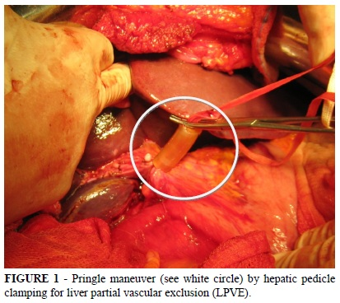
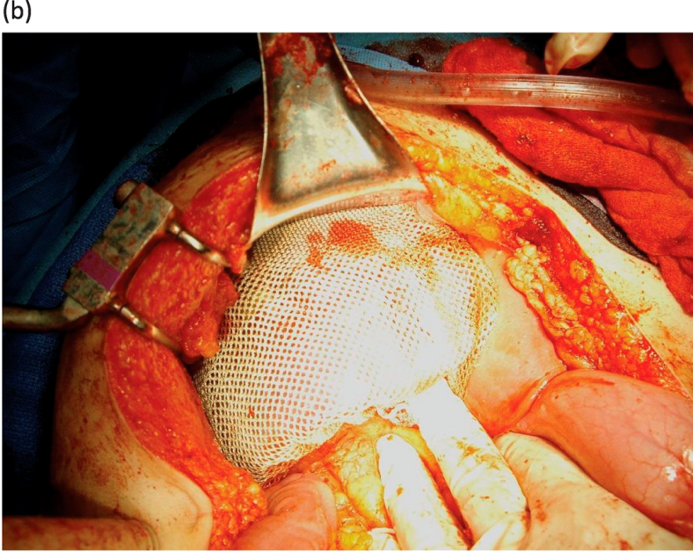

Slide 65
Stage 2 (Cont.)
Temporary closure using:
Numerous methods of temporary closure exist Regardless of which method one decides to use it is important that the abdominal fascia is not reapproximated
-Towel-clipping of skin edges
-Bogota Bag
Bogota Bag is transparent allow inspection of intestine , hemorrhage , leak and gangrene

Slide 66
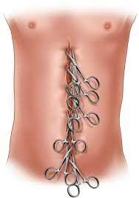

Slide 68
Stage III: ICU Resuscitation
Resuscitation continued in the intensive care unit the aim of this is the correction of hypothermia, acidosis and coagulopathy. Following this, further physiological investigation or radiological intervention can be carried out.
Monitoring for abdominal compartment syndrome development needs to be performed. Failure to recognize this clinical entity is often lethal.

Slide 69
Stage IV: Subsequent Laparotomy and Definitive surgery
After resuscitation in the ICU has allowed the patient to regain physiologic reserve, generally in 24 to 48 hours, definitive repair can be undertaken.
Premature return to theatre will convert a definitive second operation into a second damage control procedure and result in further physiological insult for the patient; however, undue delay may increase the risk of intra-abdominal sepsis and the progression of previously unrecognized injuries.
Stage V: Abdominal closure

Slide 70
intra abdominal hypertension and Abdominal compartment syndrome

Slide 71
Definitions
Intra-abdominal Hypertension (IAH): An IAP > 12 mm Hg (often causing occult ischemia) without obvious organ failure
Abdominal Compartment Syndrome (ACS): IAH >20mmHG + with at least one overt organ failure

Slide 72
Grading of IAH:

Slide 73
ETIOLIGY
ACS can be classified primary or secondary.
Primary ACS is due to injury or disease in the abdominopelvic region (eg , abdominal trauma , hemopertinum ,pancreatitis ) intervention ( surgical, radiologic) .
Secondary ACS refers to condition that do not originate in the abdomen or pelvis (eg , fluid resuscitation , sepsis, burn)

Slide 74
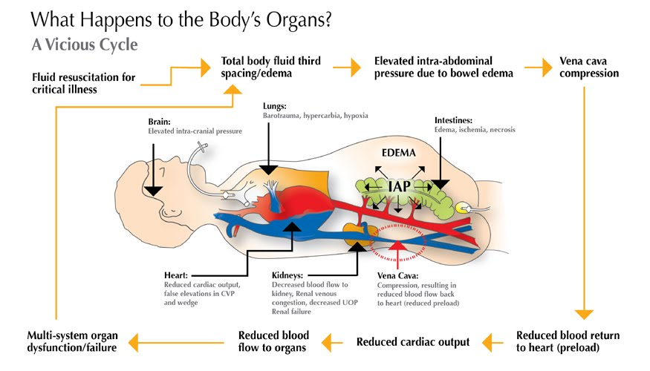

Slide 75
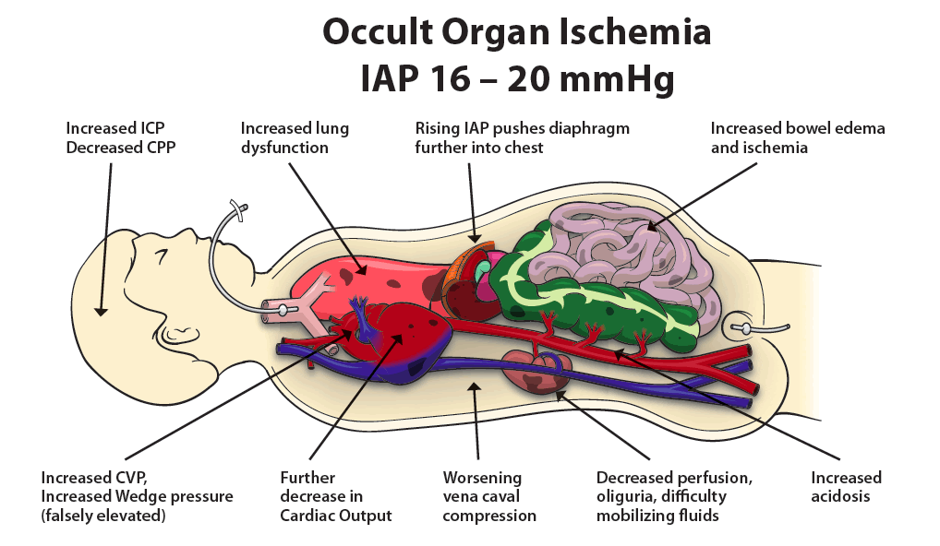

Slide 76
Clinical presentation
The history varies depending on the cause of abdominal compartment syndrome, but abdominal pain is commonly present. Abdominal pain may precede the development of abdominal compartment syndrome and may be directly related to a precipitating event, such as blunt abdominal trauma or pancreatitis.
patients who develop abdominal compartment syndrome may be unable to communicate, because they are often intubated and critically ill.
Signs and symptoms can include the following:
-Tense distended abdomen
-Difficulty breathing
-oliguria

Slide 77
Diagnostic evaluation
Definitive diagnosis of ACS requires measurement of IAP.
Can be done indirectly using intragastric , intracolonic ,intravesical (bladder), IVC Catheter.
Intravesical It is simple ,minimally invasive ,accurate and material available in all ICU.

Slide 78
Iap measurement

Slide 79
mangment
Icu admission with close monitring.
IAP monitring.
Oxygen mask.
Iv fluid with restriction.
NG tube
Antibiotic .
Correct hypovolemia , hypothermia, coagulation state
Blood transfusion
Decompressive laparotomy

Slide 81
Colorectal trauma
Done by :Amro Hamad

Slide 82
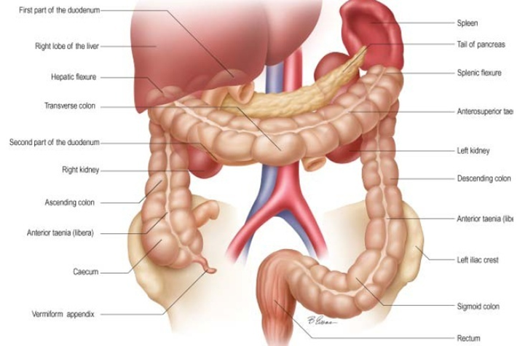
Anatomy

Slide 83
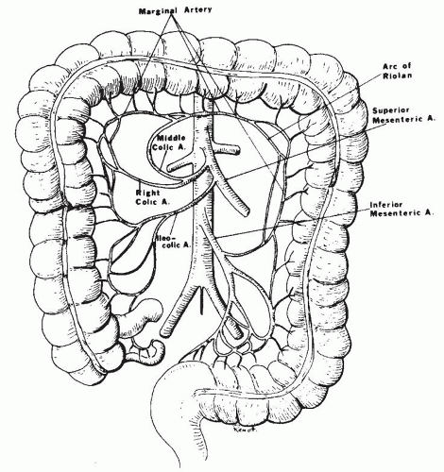

Slide 85
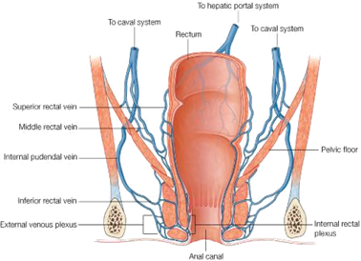
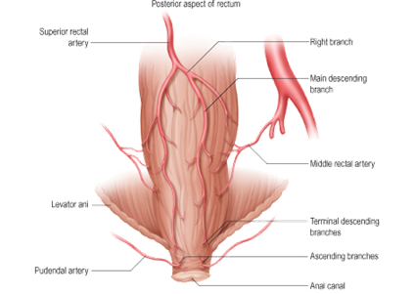

Slide 87
Incidence:
Penetrating 16%
Relatively infrequent after blunt trauma (2-5%)
Morbidity – 20-35%
Mortality – 3-15%
Etiology
Penetrating trauma
Blunt trauma
epidemiology

Slide 88
Colorectal Injury
Penetrating trauma
This is the most common type of trauma seen, and is usually due to:
High velocity missiles.
Rectal impalement injuries result when a patient falls on a penetrating object.
Iatrogenic injuries due to uterine perforation during curettage of the uterus, use of endoscopies or with rectal instrumentations.
During surgical operations for urologic or gynecologic operations.

Slide 89
Colorectal Injury
Blunt trauma
This is rare due to the protected situation of the anus and rectum and it is usually associated with fracture pelvis. The commonest cause is motor vehicle accidents followed by falls and crush injuries.

Slide 90
Intra-abdominal injuries are diagnosed as any abdominal trauma by the presence of manifestations of peritoneal irritation, free intraperitoneal fluid or air, and/or by assuring the presence of penetration into the peritoneal cavity.
How to suspect large bowel injuries

Slide 91
Rectal, anal canal and perineal trauma are diagnosed by proper inspection and per rectal examination of the patient.
The presence of bleeding per rectum is a very important sign.
The presence of different types of uretheral injuries as well as different types of fracture pelvis should stimulate the surgeon to properly examine and even sigmoidoscope the rectum and the pelvic colon.
How to suspect large bowel injuries

Slide 92
Investigation
CBC
Clotting Profile
ABG
Urinalysis
DPL : 95 % Accurate
CT & Ultrasound are replacing DPL
Sigmoidoscope (the preferred method of investigation) the rectum and the pelvic colon.
Notes:
If an enema is to be used, water soluble contrast (gastrographin) is a must and barium should never be used.

Slide 96
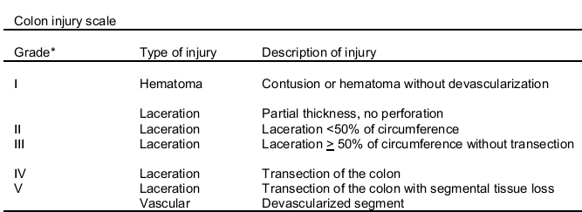
Colon Injury Grading

Slide 97
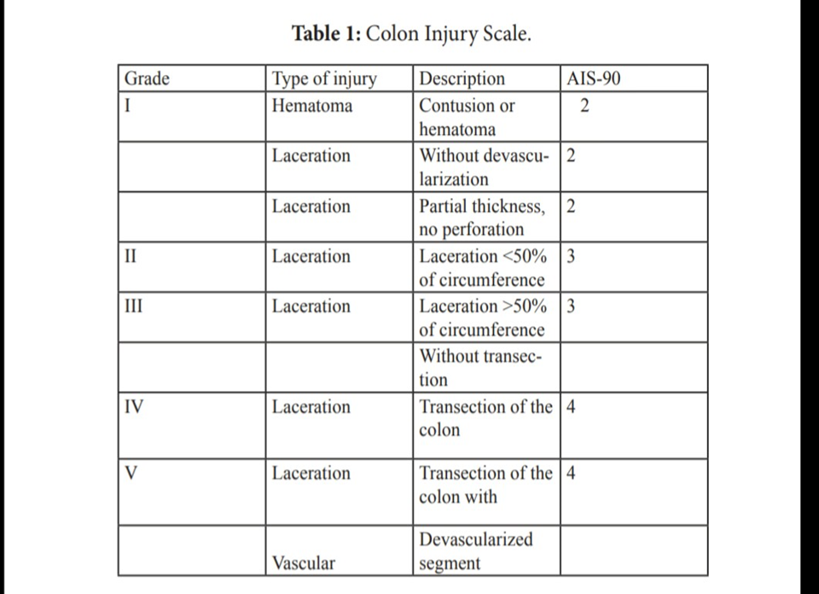

Slide 98
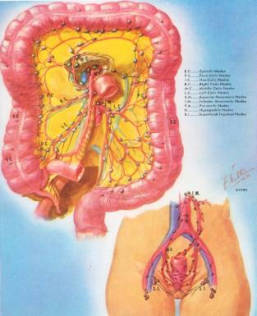
Treatment
There are three different methods for treating colonic injuries:
Primary repair
Colostomy
Exteriorized repair

Slide 99
Primary Repair
Include lateral suture of perforations and resection of the damaged colon with reconstruction by ileocolostomy or colocolostomy.
Advantage of primary repairs is that definitive treatment is carried out at the initial operation.
Disadvantage is that suture lines are created in suboptimal conditions, and leakage may occur.

Slide 100
Primary Repair
Necessitates the presence of the following conditions
Small tear less than 2 cm
Little contamination and minimal fecal spillage
Interference in a time less than 8 hours from wound inflection
No other large bowel injuries
No other organ injuries
No hemodynamic shock

Slide 101
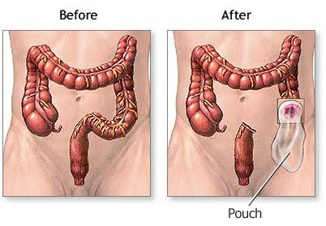
Colostomy
Several different styles of colostomies are used to manage colonic injuries.
Advantage of colostomy is that it avoids an unprotected suture line in the abdomen.
Disadvantage is that a second operation is required to close the colostomy.

Slide 102
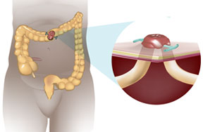
Types of colostomies
Ther three possibilities: (1) If the wound involves part of the circumference of the gut, you can make a loop colostomy without dividing the gut, as in E. Loop colostomies are easier in the transverse or sigmoid colon.
But if you mobilise the colon properly you can use them anywhere at or beyond the hepatic flexure. The loop must lie easily on the abdominal wall without tension. If it is tight, it will gradually retract and cause great problems with abdominal wall abscesses

Slide 103
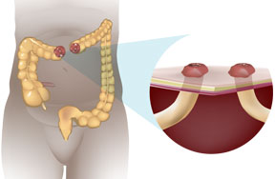
Double-barrel Colostomy
If you have to resect a short (5cm) length of gut you can bring the cut ends out through same incision (F).

Slide 104
If you have to resect a longer length of gut (more than about 5 cm), you cannot bring the two cut ends out of the same incision. So you will have to bring them out through separate incisions as faecal and mucous colostomies (G)

Slide 105
If the lower end of the gut is too short to bring out to the surface, you will have to use Hartmann’s procedure (H).

Slide 106
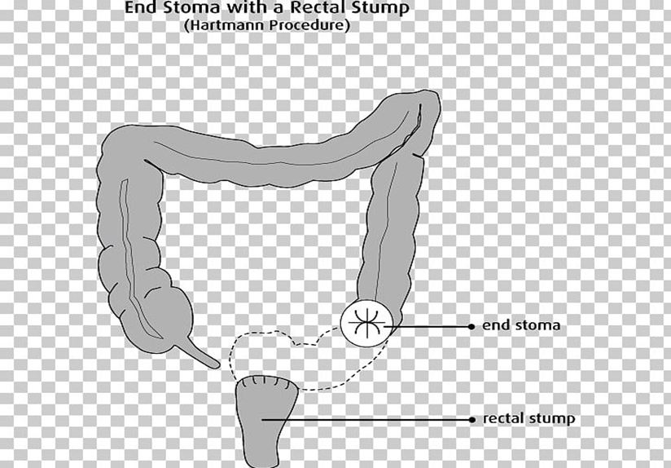

Slide 107
Exteriorized repairs
Exteriorized repairs are created by the suspending of a repaired perforation or anastomosis on the abdominal wall with an appliance after the fashion of a loop colostomy.
If after 10 days the suture line does not leak, it can be returned to the abdominal cavity under local anesthesia without subsequent risk of leakage.
If the repair breaks down before 10 days, it is treated as a loop colostomy. Healing is successful in 50 to 60 percent of cases.

Slide 108
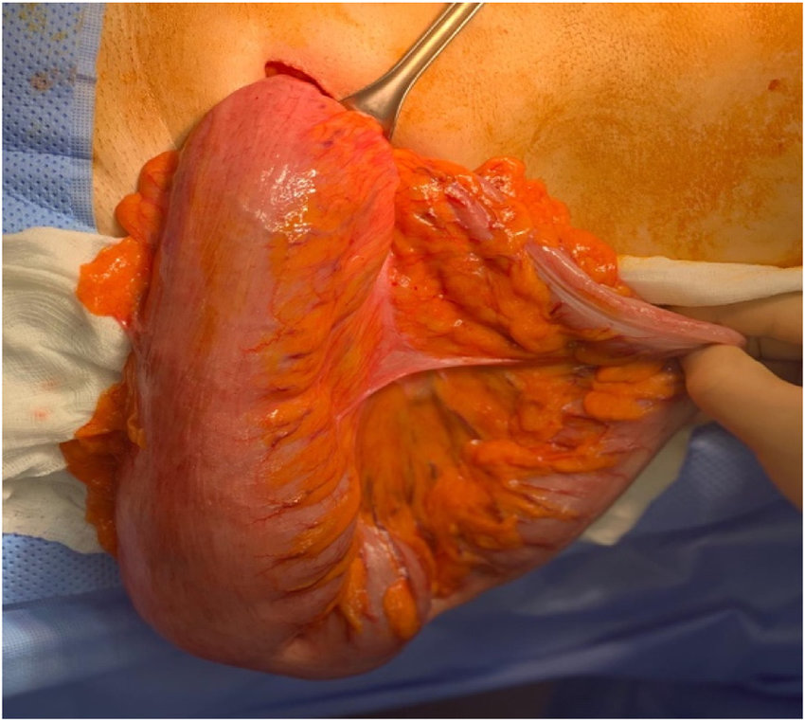
exteriorization of the sigmoid colon showing the mini-incision in left iliac fossa

Slide 109
Exteriorized repairs
advantage is avoidance of an intraperitoneal suture line when it is at risk of leakage.
disadvantage is that 40-50% of patients require colostomy closure.

Slide 110
Complications
Complications related to the colonic injury and its treatment may include :
Intraabdominal abscess
Fecal fistula
Wound infection
Stomal complications

Slide 111
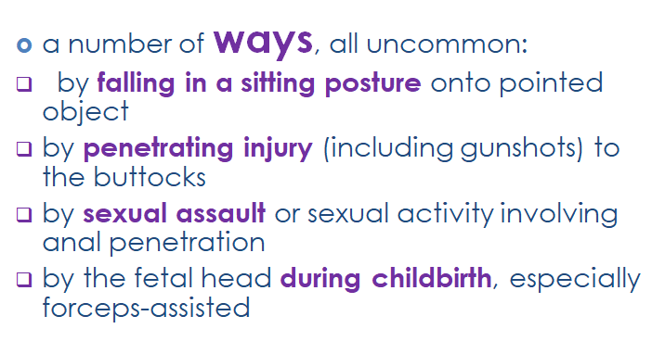

Slide 121
THANKS FOR LISTENING
DONE BY :-Amro Hamad

