Slide 1
1- SCFE
2-Irritable Hip
3-Perthis
Dr M.Abu Hilal
Ass. Prof Mutah University

Slide 2
Blood Supply Of Femoral Head

Slide 3
SCFE – Slipped Capital Femoral Epiphysis
Definition:
Displacement of proximal femur epiphysis (epiphysolysis) from the neck ???
Etiology:
Increased force applied across the physis
Decrease in the resistance (week physis) within the physis to shearing
Endocrinal factors ( HORMONAL IMBALANCE )
Chronic kidney disease and low calcium level in the body
Repeated minor Trauma, Obesity, and Physical over stress).

Slide 4
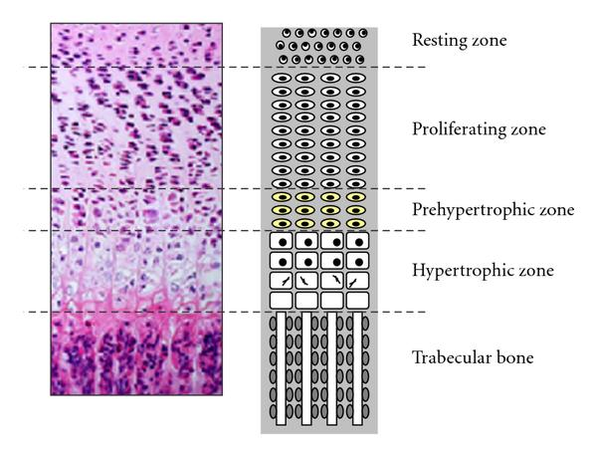
Physis layers :insufficiency fracture through the hypertrophic zone
Notes:
Insufficiency fractures are a type of stress fracture, which are the result of normal stresses on abnormal bone.

Slide 5
SCFE
Uncommon, boys more common than girls
Children going through the pubertal growth spurt (13-14 in boys) and earlier in girls
unusually tall or obese → Mechanical stress applied to physis
delayed gonadal development→ (Endocrinal) in these children there is an imbalance between growth hormone (which stimulates bone growth) and gonadal hormone (which promotes stable physeal fusion).
Growth H more than Gonadal H :the relatively immature physis can not tolerate the increased stress of body weight
Kidney disease: physis not calcified as low level of calcium
Trigger ( Trauma, Obesity.) → Slippage

Slide 6
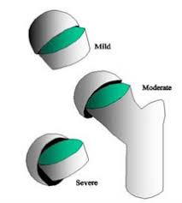
SCFE – Pathology
The head (epiphysis) remains seated in the acetabulum with no movement
Neck moves laterally and forward →the head is retroverted relative to the neck
Like any proximal femur fracture: lower limb goes in external rotation and shortening

Slide 7
Pathology
If the slip is severe, the anterior retinacular vessels are torn.
However, at the back of the femoral neck the periosteum with intact vessels is there; this may be the only source of blood supply to the femoral head, and damage to these vessels by aggressive manipulation or operation may result in avascular necrosis.
In early stages, synovial membrane edematous & hyperemic → High pressure and decrease perfusion of blood and AVN
If you don’t stop slippage, it will continue
Disruption of physis leads to premature fusion of the epiphysis – usually within 2 years of the onset of symptoms.

Slide 8
SCFE - Signs & Symptoms
The patient is usually an obese boy ,13-14 years and no secondery sexual characters that presents with :
pain in the groin or the anterior part of the thigh
Only Knee pain (referred pain) 25%
Limping
External rotation of the limb with or without shortening
Inability to bear weight
Decreased range of motion especially internal rotation, abduction and flexion
Sometimes, all these symptoms
Notes:
Abduction primarily occurs via the gluteus medius as well as the gluteus minimus. Medial rotation is performed by the gluteus medius and gluteus minimus, as well as the tensor fasciae latae and assisted by the adductors brevis and longus and the superior portion of the adductor magnus.

Slide 10
Investigation
1- Blood test :TFT, PTH, Growth Hermon, KFT, Ca level, Gonadal Hermons
2-XR pelvis AP and frog
Klein's line: on AP view, a line drawn along the superior surface of the femoral neck does not pass through the head(Trethowan’s sign).
The frog position XR is used to evaluate the severity of displacement

Slide 15
Calcifications
Stable or unstable
Stable : patient can bear weight with or without crutches
unstable: patient cant bear weight
Mild , moderate and sever According to degree of displacement
Acute , chronic and acute on top of chronic
Acute : symptoms less than 3 weeks Chronic: more than 3 weeks
Acute on top of chronic: symptoms more than 3 weeks but exacerbation happened

Slide 16
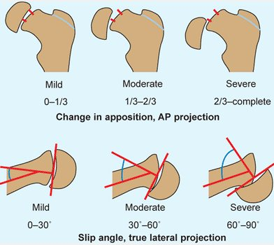

Slide 17
SCFE - Treatment
All cases regardless needs surgery for fixation
Minor displacement:(less then 30 degrees) fixation with pin without reduction
Moderate displacement :(30-60 degrees) gentle reduction and pin fixation
Sever displacement (60-90 degrees) may need osteotomy and fixation

Slide 19
SCFE - Complications
Slipping at the opposite hip → 30% risk
Avascular necrosis is the most serious complication → if aggressive reduction of slip induced damage of remaining vessels.
Coxa vara deformity may result if the displacement is not reduced and the epiphysis fuses in its deformed position
Secondary osteoarthritis
Shortening and lower limb discrepancy , usually painless and less than 2-3cm
Limited ROM

Slide 20
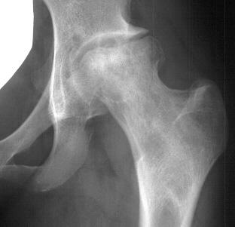

Slide 21
Irritable Hip – Transient Synovitis
It is a self-limiting condition in which there is an inflammation of the inner lining (the synovium) of the capsule of the hip joint
Etiology: unknown, but usually caused by upper respiratory viral infection
Incidence: The most common cause of an acute limping and hip pain in children.
Age: 3–8 years but can be any age
Boys affected twice as often as girls.

Slide 22
Irritable Hip Vs septic arthritis
Irritable hip | Septic
Pt looks well | Pt looks ill
Normal temperature or low grade fever | High grade temperature
Feeding Okay | Loss of appetite
Decrease ROM of hip | Decrease ROM of hip
Pain and refuse to bear weight Pseudo-paralysis | Pain and refuse to bear weight Pseudo-paralysis
ESR, CRP, and WBC are normal or mild elevated | ESR, CRP and WBC are sky high With shift to left (neutro 70% or more)
Imaging not needed (clinical diagnosis), if done , it shows minimal collection | US or MRI shows significant collection inside joint

Slide 23
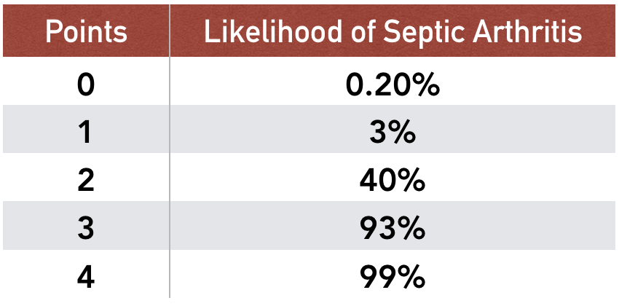

Slide 24
Irritable Hip - Differential Diagnosis
Septic arthritis; patient looks ill
Perthes’ disease: painful or painless recurrent limping for weeks or months
Juvenile chronic arthritis → raised ESR and CRP, and systematic symptoms
Slipped epiphysis : usually older patient 13-14 yrs
Trauma: hx of trauma

Slide 25
Irritable Hip - Treatment
Bed rest, reduced activity and observation
NSAIDS: makes dramatic improvement within 24-48 hours, if not consider your diagnosis
No need for antibiotic, it is not infection

Slide 26
Perthes’ Disease
Disorder of childhood characterized by ischemia and varying degrees of necrosis of the femoral head with no identified cause (not like AVN secondary to previous hip pathology)
Incidence: 1 in 10,000 child
Patients are usually 4-8 years old
Small in size and shows delayed skeletal maturity(related to IUGR)??
Boys are affected four times as often as girls.
Passive smokers??parents
Over active(ADHD)???

Slide 27
Femoral Head Blood Supply
(1) metaphyseal vessels which penetrate the growth plate: decreases by age of 4 years
(2) lateral epiphyseal vessels running in the retinacula: present all the time
(3) ligamentum teres: becomes active at age of 7-8 years

Slide 28
Perthes - Etiology
The metaphyseal supply gradually declines, by the age of 4 years, it has virtually disappeared; by the age of 7, however, the vessels in the ligamentum teres has developed.
Between 4 and 7 years of age the femoral head depend for its blood supply almost entirely on the lateral epiphyseal vessels
Trauma or synovitis at this age affects the retinacular vessels and leads to more decrease in blood supply.

Slide 29
Perthes’ Disease – Signs & Symptoms
The patient – usually a boy of 4–8 years
Hip(groin) or knee pain exacerbated by movement.
Reduced range of motion, particularly in abduction , internal rotation and flexion.
Limping Child: recurrent and sometimes painless
Atrophy of thigh muscles may occur from disuse and an inequality of leg length

Slide 30
X-RAY
Can be normal at early stages, MRI may be helpful
XR early change is widening of joint space (the head is smaller)
Sclerosis :increased radiographic density in the bony
Flattening of the head due to ischemia
'fragmentation' and lateral displacement of the epiphysis follow
rarefaction and broadening of the metaphysis.

Slide 31
Perthes’ Disease - Pathology
The pathological process takes 2–4 years to complete, passing through three stages.
Stage 1: ischaemia
part of femoral head dies; it still looks normal on plain x-ray or Subtle Widening of joint space
As ischemia continues the head becomes sclerotic (dead trabeculae ) then flattened

Slide 32
Small sclerotic head

Slide 33
Stage 2: revascularization (fragmentation and re-ossification)
Some of the necrotic parts are resorbed and replaced by fibrous tissue, producing the x-ray appearance of epiphyseal ‘fragmentation’
new blood vessels enter the necrotic area and new bone is laid down on the dead trabeculae, producing the appearance of increased density on the x-ray.

Slide 34
Fragmentation

Slide 35
Perthes’ Disease – Pathological Stages
Stage 3: distortion and re-modelling
if large part of the bony epiphysis is damaged, or repair process is slow, the epiphysis will collapse. Epiphysis becomes more flattened (‘coxa plana’) and enlarged (‘coxa magna’) and uncovered by the acetabulum(lateral displaced) with rarefaction and broadening of the metaphysis
If small part is involved or repair is fast: remodeling

Slide 36
flattened ,enlarged and uncovered

Slide 37
Remodeling of the head

Slide 38
Perthes’ Disease - Prognosis
Herring’s Classification; it depends on the severity of affection of lateral pillar (lateral part of head), if lateral pillar is severely affected the prognosis is worse
Group A: normal height of the lateral pillar compared to medial part of head
Group B: partial collapse but still more than 50% height ,
Group C: less than 50% of normal height, usually end up with significant distortion of the femoral head.

Slide 40
Perthes’ Disease – General Management
1-Symptomatic treatment
Bed rest and limit movement
period of skin traction for sever pain???
ROM exercise and physiotherapy
Avoid aggressive activities
2-containment; keep head covered under acetabulum to enhance remodeling So that it may retain sphericity

Slide 41
Prognostic factors
Age:
1-Less than 6 years : they do well regardless of the treatment
2- 6-8 years: they need containment is head get lateralized to do well
3-more than 8 years: they do bad regardless of treatment
Gender: females have bad prognosis
Severity of the collapse
Containment: to enhance remodeling
Decreased ROM and high weight are bad
Caterral Signs of hip at risk: see the next slide , bad signs

Slide 43
Thank you

