Slide 1
Pulmonary hypertension
DONE BY : Batool Kasasbeh , shahed Qatawneh , Hala Qatawneh

Slide 2
Definition :
Sever condition of multiple etiologies .
defined as “ an increase in mean pulmonary arterial blood pressure > 25 mmHg at rest , > 30 mmHg on exercise “.
Normal MABP 14-18 mmHg at rest.
20-25 mmHg on exercise.
It is a type of blood pressure that affects both the lung vessels and the right side of the heart .
Can be measured by Right-Heart cathetrization.

Slide 3
Classification of pulmonary hypertension is based on the revised WHO classification system
Group 1 : Pulmonary arterial hypertension (PAH)
-Idiopathic , familial , veno-occlusive disease , and PAH with associated conditions ( connective tissue disorders , congenital shunting , HIV )
-An abnormal increase in pulmonary arteriolar resistance leads to thickening of pulmonary arteriolar walls .
This worsens the pulmonary HTN , which in turn causes further wall thickening , thus leading to a vicious cycle .
-The cause is unknown ; it usually affects young or middle-aged women.
-The prognosis is poor . Mean survival is 2 to 3 years from the time of diagnosis .

Slide 4
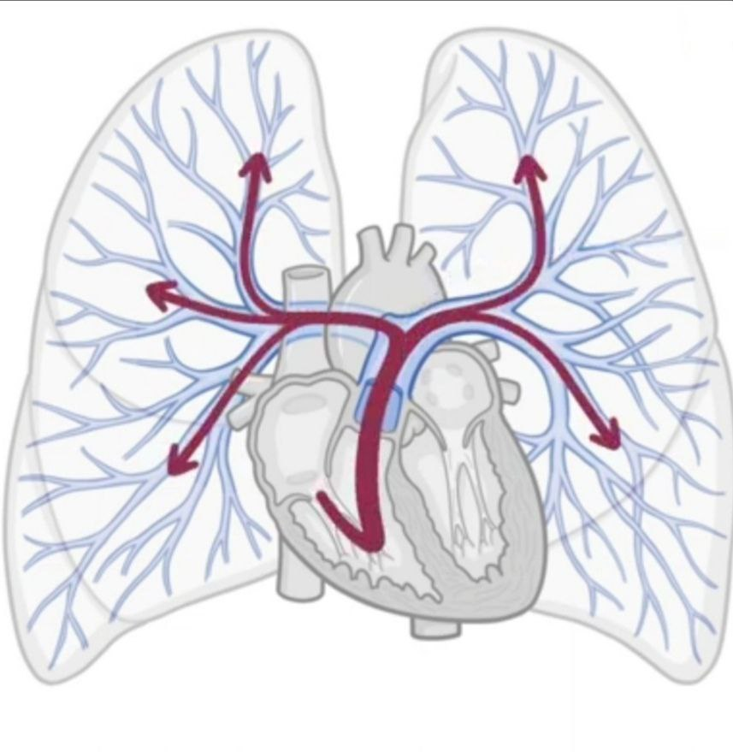
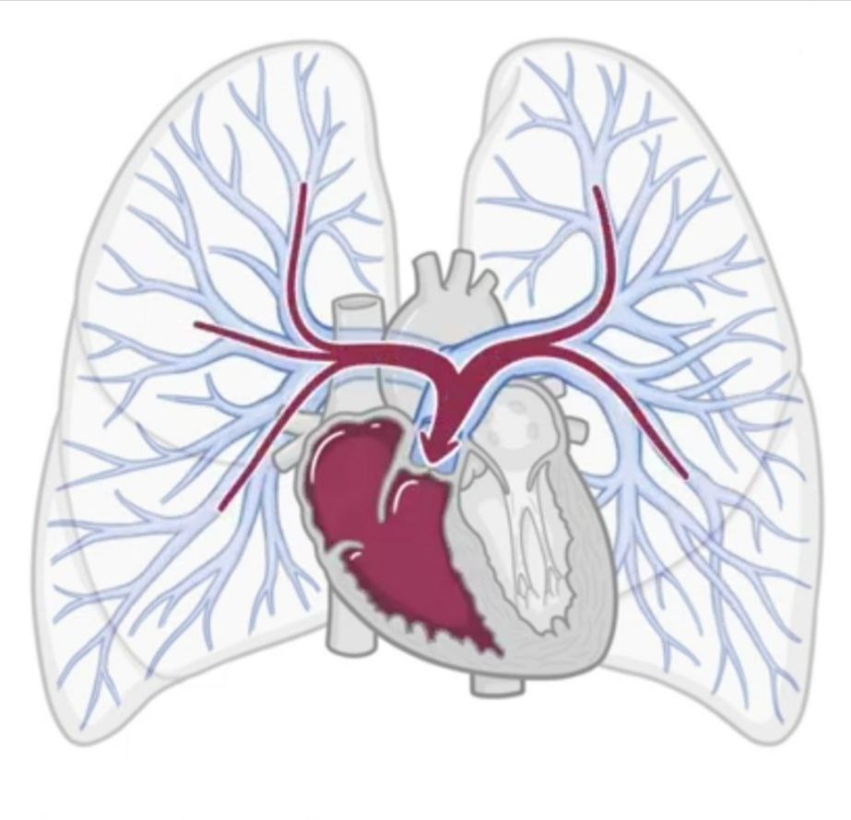

Slide 5
B. Group 2 : left heart disease
-Secondary to any cause of left heart failure , including mitral stenosis and mitral regurgitation .
increased left atrial pressure is transmitted retrograde into the pulmonary veins and pulmonary capillaries and ultimately into the pulmonary arteries
C. Group 3 : Lung disease and/or chronic hypoxemia
Causes ; COPD, OSA ) Obstructive sleep apnea( , interstitial lung disease
D. Group 4: Chronic thromboembolic disease
-Recurrent PE , including non-thrombotic etiologies ( e.g. tumor emboli )

Slide 6
Other causes
E. Group 5 : Miscellaneous :
Autoimmune diseases, such as scleroderma or systemic lupus erythematosus (SLE) ,
Certain medications and drugs
Heart defects from birth (also known as congenital heart disease)
Genetics Liver disease
HIV

Slide 7
Complications:
Right-sided heart enlargement and heart failure (cor pulmonale). In cor pulmonale, the heart's right ventricle becomes enlarged and has to pump harder than usual to move blood through narrowed or blocked pulmonary arteries.
At first, the heart tries to compensate by thickening its walls and expanding the chamber of the right ventricle to increase the amount of blood it can hold. But these changes create more strain on the heart, and eventually the right ventricle fails.
Blood clots. Having pulmonary hypertension makes it likely to develop clots in the small arteries in lungs, which is dangerous if there are already narrowed or blocked blood vessels.
Arrhythmia. (arrhythmias), which can lead to a pounding heartbeat (palpitations), dizziness or fainting. Certain arrhythmias can be life-threatening.
Bleeding in the lungs. Pulmonary hypertension can lead to life-threatening bleeding into the lungs and coughing up blood (hemoptysis).
Pregnancy complications. Pulmonary hypertension can be life-threatening for a woman and her developing baby.

Slide 8
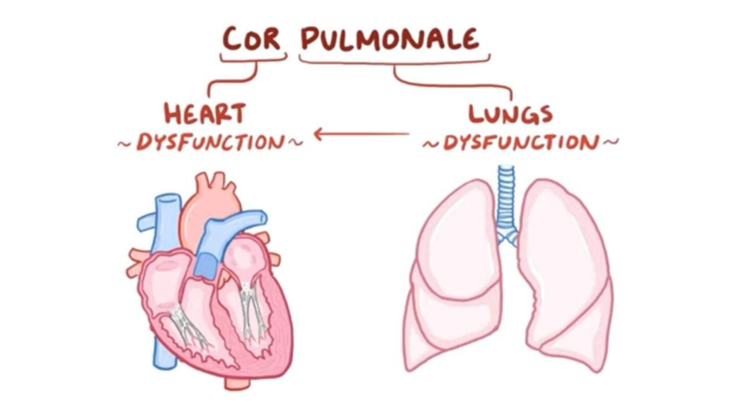

Slide 9
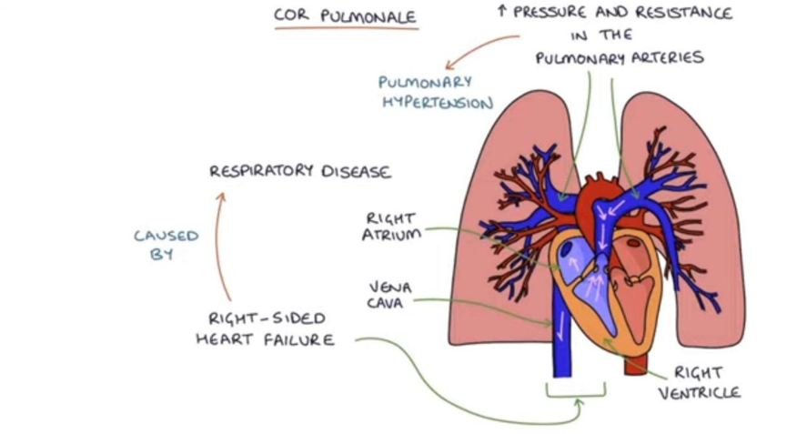

Slide 10
Clinical features
Symptoms:
The signs and symptoms of pulmonary hypertension develop slowly. You may not notice them for months or even years. Symptoms get worse as the disease progresses.
A. Dyspnea on exertion
B. Fatigue
C. Chest pain—exertional
D. Syncope—exertional (with severe disease)
E. a racing heartbeat (palpitation)
F. swelling (oedema) in the legs, ankles, feet or tummy (abdomen)
The symptoms often get worse during exercise, which can limit your ability to take part in physical activities.
If you have a type of pulmonary hypertension known as pulmonary arterial hypertension (PAH), you may not have any symptoms until the condition is quite advanced.

Slide 11
Signs:
A. Loud pulmonic component of the second heart sound (P2) and subtle lift of sternum (sign of RV dilatation)—These may be the only findings, and yet the patient may still have a devastating disease! B. When right ventricular failure occurs, the corresponding signs and symptoms appear (JVD, hepatomegaly, ascites, peripheral edema)

Slide 12
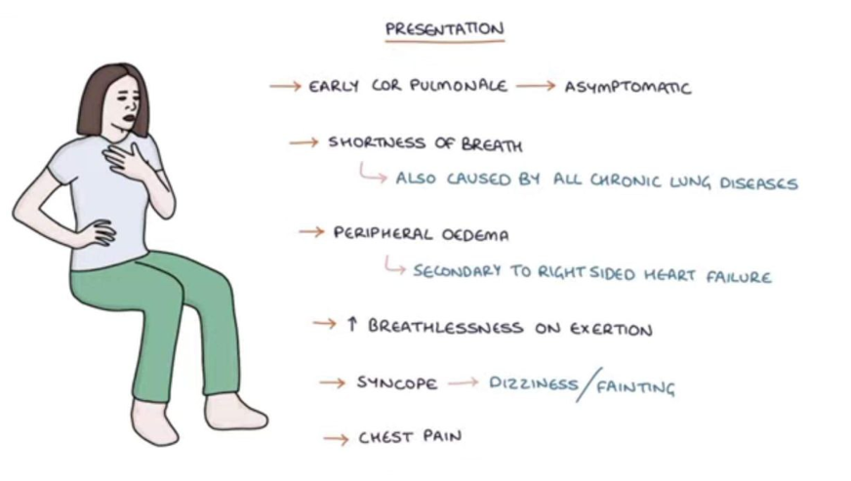

Slide 14
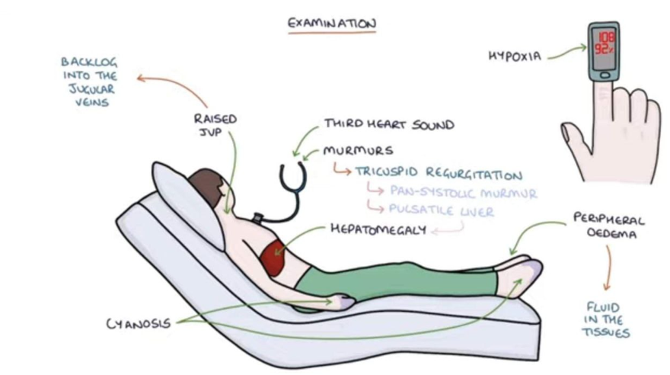

Slide 16
MANAGEMENT
INVESTIGATION+TREATMENT

Slide 17
INVESTIGATION:
1. ECG:
right atrial abnormality frequently peaked p wave (p pulmonale))present
Right axis deviation
Rt ventricular hypertrophy
r/s ratio MORE THAN 1mm in v1
R wave more than 7 mm in v1
Right ventricular strain pattern (st segment and T wave invertion
Right bundle branch block V1/ V2 incresed QRS duration more than 120 ms/ (rSR) bunny ear.

Slide 19
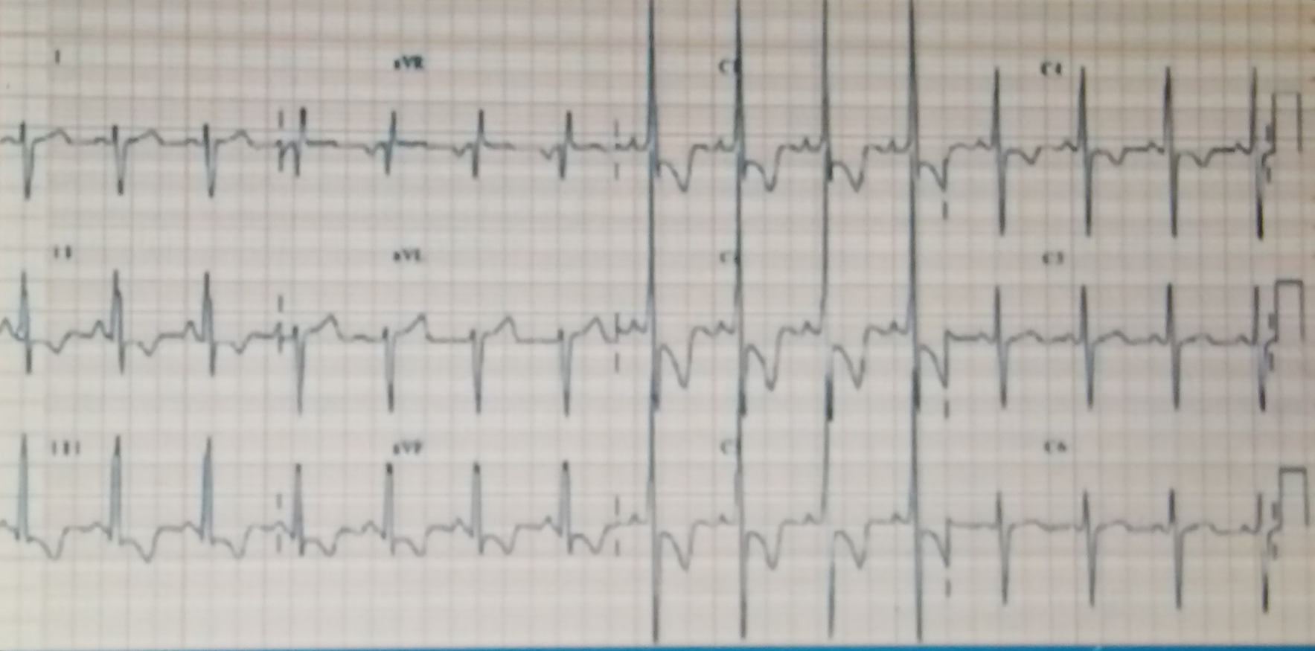

Slide 20
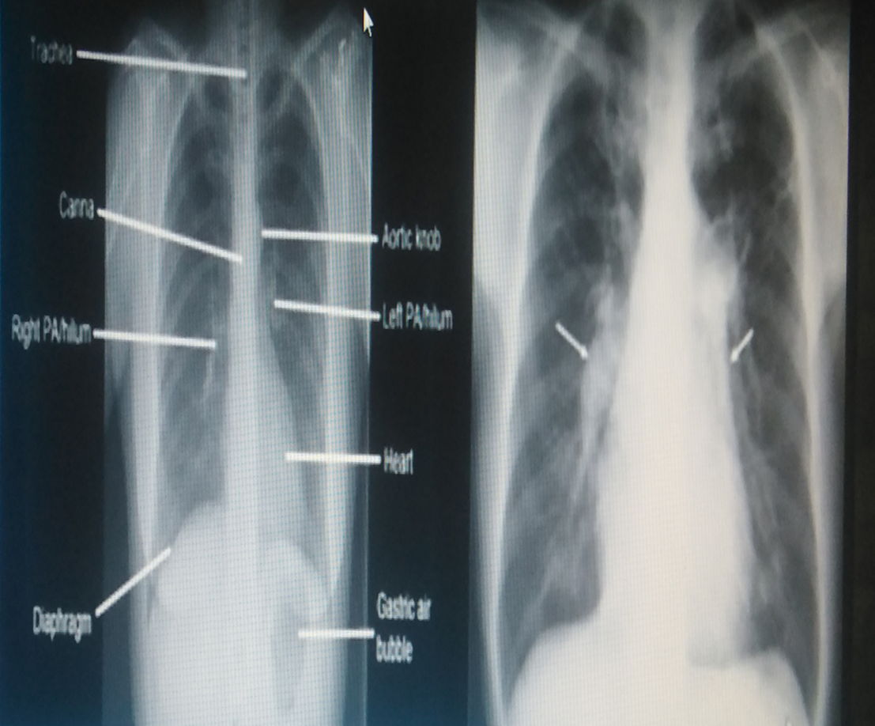
2. CXR:
Enlarged pulmonary arteries with or without clear lung fields based on the cause of pulmonary hypertension

Slide 21
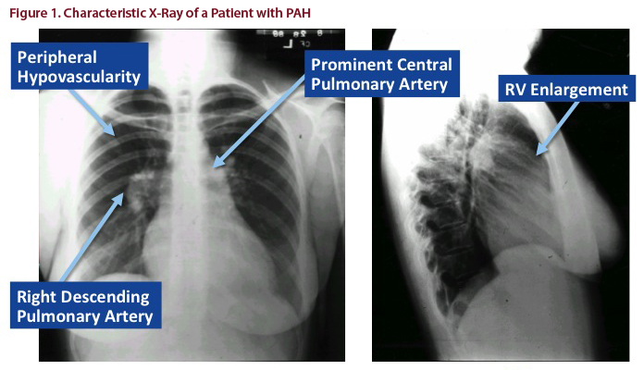

Slide 22
3. Echocardiogram:
a. Dilated pulmonary artery
b. Dilatation/hypertrophy of RA and RV
c. Abnormal movement of IV septum (due to increased right ventricular volume)
4. Right heart catheterization:
required for confirmatory diagnosis of pulmonary HTN. Reveals increased mean pulmonary artery pressure >25 mm Hg

Slide 23
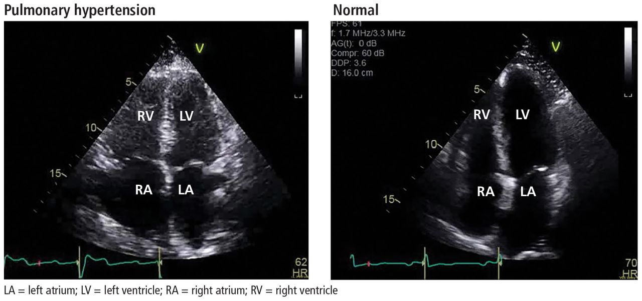

Slide 24
Treatment
Treatments include:
-Treatment cause
-Treatment RSHF
Supportive
1. anticoagulant medicines – such as warfarin to help prevent blood clots(in chronic thromboembolic pulmonary hypertention life long and referral endarterectomy))
2.diuretics (water tablets) – to remove excess fluid from the body caused by heart failure
3.oxygen treatment – this involves inhaling air that contains a higher concentration of oxygen than normal
4.digoxin – this can improve your symptoms by strengthening your heart muscle contractions and slowing down your heart rate
5. lung transplant early and if late lung and heart transplant

Slide 25
Specfic treatment (dilated blood vesseles)
-There are also a number of specialist treatments for PAH that help relax the arteries in the lungs and reduce the blood pressure in the lungs. These medicines slow the progression of PAH, and may even reverse some of the damage to the heart and lungs.
Other treatments that are sometimes used are: 1.endothelin receptor antagonists – such as bosentan, ambrisentan , macitentan 2.phosphodiesterase 5 inhibitors – sildenafil and tadalafil 3.prostaglandins – epoprostenol, iloprost and treprostinil 4.soluble guanylate cyclase stimulators the first targeted therapy to be shown to be effective in Chronic Thromboembolic Pulmonary Hypertension (CTEPH)– such as riociguat 5.calcium channel blockers – nifedipine, diltiazem, nicardipine and amlodipine
Notes:
inhibit the binding of endothelin, a vasoconstrictive peptide, to its receptors on smooth muscle cells which results in vasodilation
-Soluble guanylyl cyclase (GC-1) is the primary receptor of nitric oxide (NO) in smooth muscle cells and maintains vascular function by inducing vasorelaxation in nearby blood vessels

Slide 26
THANK YOU ☺

