Slide 1
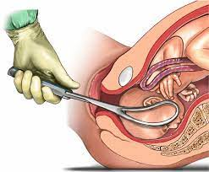
ASSISTED VAGINAL DELIVERY
DONE BY :
Esraa Hawawreh
Batool Kasasbeh
Lujain Bashar
Yaqout Mriyan
Halla Qatawneh
Dania AL- Hameed
supervised by :
Dr. Suad Jaafreh

Slide 2
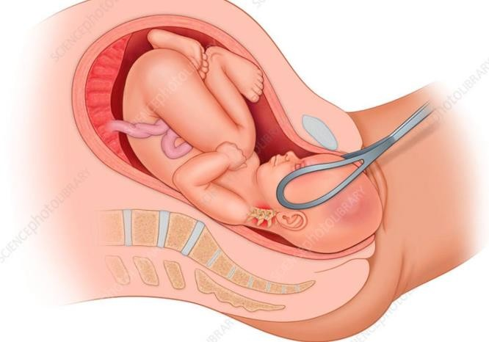
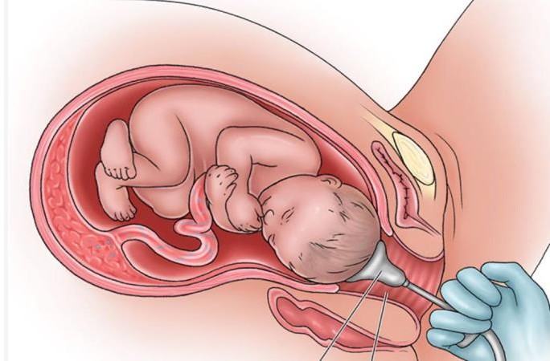
ASSISTED VAGINAL DELIVERY
Definition:
vaginal birth with the use of any type of forceps or vacuum extractor.
forceps vacuum

Slide 3
Safety criteria for assisted vaginal delivery
After full abdominal and vaginal examination
Head engagement is 1/5 or 0/5 in role of fife (stations 0/+1/+2/+3)
Fully dilated cervix
Membrane ruptured
Exact position of the head must be determined to place the instrument correctly
Caput or molding are no than moderate
Pelvis is deemed adequate
Adequate analgesia and empty bladder ensured

Slide 4
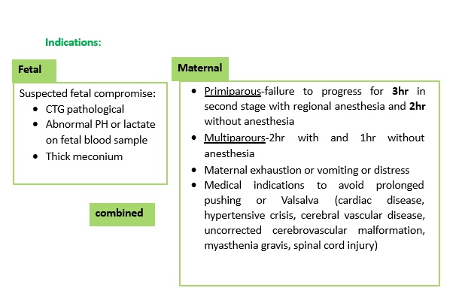

Slide 5
Choice of the instrument:
The choice of instrument should be based on a combination of
indication, experience and training. The aim should be to complete the delivery successfully with the lowest possible morbidity and, where appropriate, the preferences of the mother should be taken into account.

Slide 6
Forceps
Definition:
Forceps are instruments designed to aid in the delivery of the fetus by applying traction to the fetal head which consist of 2 mirror image metal instruments that are maneuvered to cradle the fetal head and are articulated, after which traction is applied to effect delivery.
Many different types of forceps have been described and developed.

Slide 7
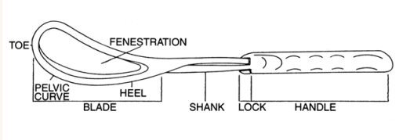
Parts:
Forceps have 4 major components, as follows:
Blades: The blades grasp the fetus. Each blade has a curve to fit around the fetal head. The blades are oval or elliptical and can be fenestrated (with a hole in the middle) or solid. Many blades are also curved in a plane 90° from the cephalic curve to fit the maternal pelvis (pelvic curve).
Shanks: The shanks connect the blades to the handles and provide the length of the device.
Lock: The lock is the articulation between the shanks. Many different types have been designed.
Handles: The handles are where the operator holds the device and applies traction to the fetal head.

Slide 8
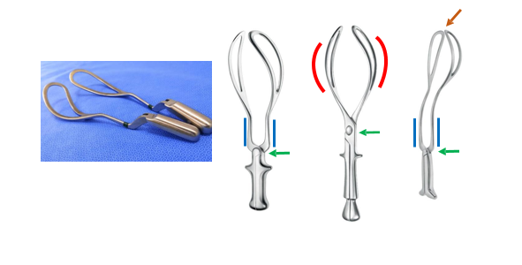

Slide 9
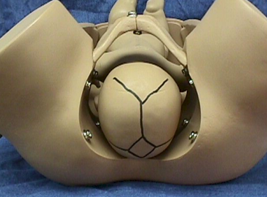
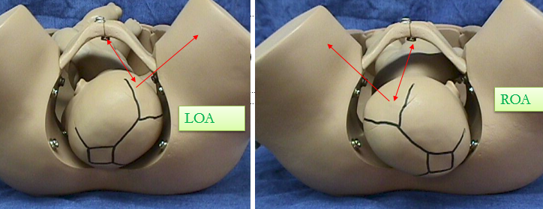
Classification of forceps
Non-rotational forceps: are used when the head is OA with no more than 45º deviation to the left or right (LOA, ROA).
Ex: Simpson forceps, Elliot forceps, Wrigley's Forceps
Rotational forceps: when the head is positioned more than 45º from the vertical, rotation must be accomplished before traction.
Ex: Kielland forceps, piper forceps.

Slide 10
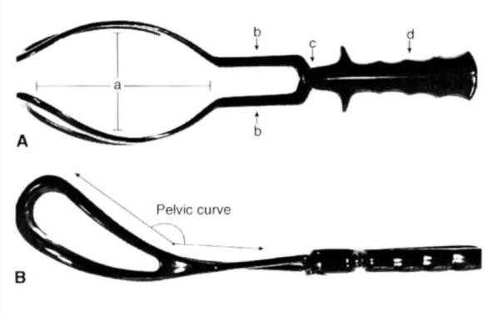
Simpson forceps:
Which have a pelvic curvature, a cephalic curvature, and locking handles
Was commonly used.
Used for aid in delivery a baby in an
ideal occiput anterior position.

Slide 11
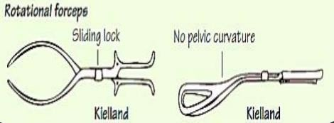
Kielland's forceps:
Sliding lock, minimal pelvic curvature.
Used for rotation and extraction of the head which is arrested in the deep transverse or occipito- posterior position.
Not used nowadays.

Slide 12
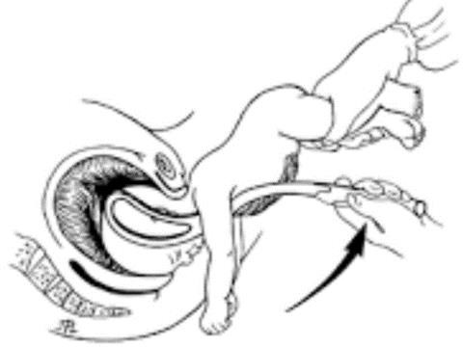
Piper forceps:
Allows for application to the after coming head in breech deliveries.
No pelvic curve Long shanks to contain the body

Slide 13
function
Traction: the most important function.
Rotation of head: (Kielland's forceps) never done now.
Protective cage: When applied on a premature baby it protects from the pressure of the birth canal, and when applied on the after- coming head it reduces the sudden decompression effect
Technique of forceps vaginal delivery:
The first thing to do is adequate verbal consent
Application technique for occiput anterior position.
The presence of the sagittal suture in the anteroposterior diameter of the pelvic outlet is confirmed.

Slide 14
Safety criteria for forceps vaginal delivery (assisted)
After full abdominal and vaginal examination
sufficiently experienced operator
Head engagement is 1/5 or 0/5 in role of fife (stations 0/+1/=2+3)
Fully dilated cervix
Membrane ruptured
Exact position of the head must be determined to place the instrument correctly
Caput or molding are no than moderate
Pelvis is deemed adequate
empty bladder ensured
Unsuccessful trial of vacuum extraction (relative contraindication)
Absence of adequate anesthesia or analgesia (relative contraindication)

Slide 15
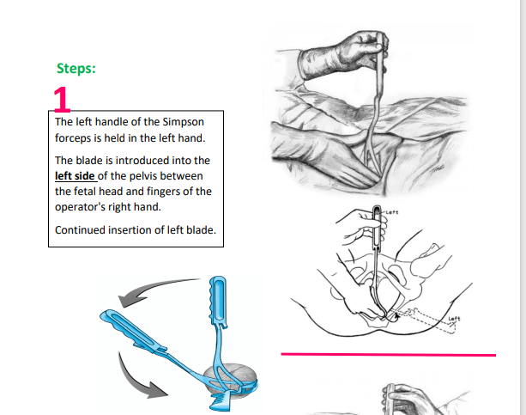

Slide 18
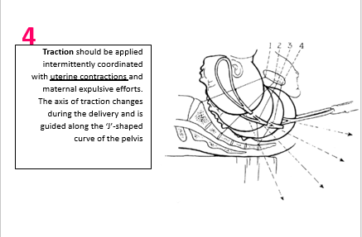

Slide 19
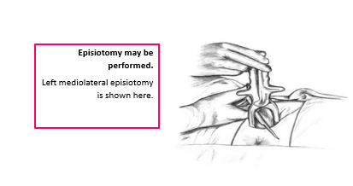

Slide 20
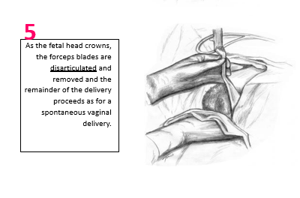

Slide 21
Complications
Mostly due to faulty technique rather than the instrument, and its more than in vacuum delivery.
Maternal:
Injury:
Extension of the episiotomy involving anus & rectum or vaginal vault.
Vaginal lacerations and cervical tear if cervix was not fully dilated.
Postpartum hemorrhage: Due to trauma or Atonic uterus.
Shock due to blood loss, dehydration or prolonged labor.
Increase the Use of maternal regional anesthesia.
general index of pelvic floor disorders (incontinence of urine and feces and pelvic organ prolapse) due to decrease in pelvic muscle strength.
Urinary incontinence has been reported in up to 24% of women within 6 months of a forceps delivery.

Slide 22
Fetal complications:
Asphyxia→Cerebral palsy, mental retardation, and behavioral problems
Trauma:
Intracranial haemorrhage.
Cephalic haematoma.
Facial / Brachial palsy.
Injury to the soft tissues of face & forehead.
Skull fractures.
The risk for serious morbidity is 1.5% and the risk of fetal or neonatal death is 0.05%.

Slide 23
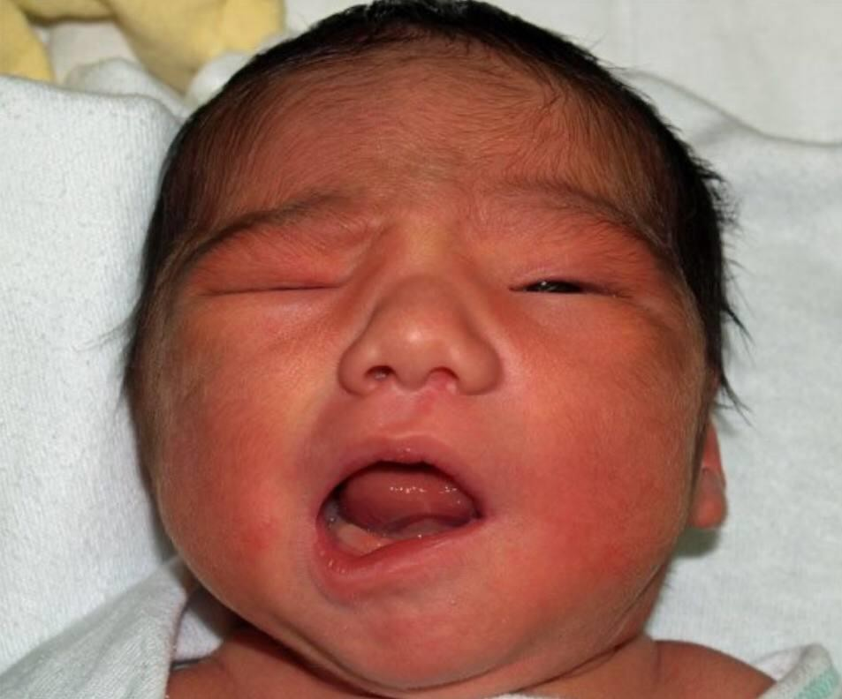

Slide 24
Contraindications:
Any contraindication to vaginal delivery
Inability to obtain adequate verbal consent
A cervix that is not fully dilated or retracted
Inability to determine the presentation and fetal head position
Inadequate pelvic size
Confirmed cephalopelvic disproportion
relative contraindication
Unsuccessful trial of vacuum extraction
Absence of adequate anesthesia or analgesia
Inadequate facilities and support staff
An insufficiently experienced operator

Slide 25
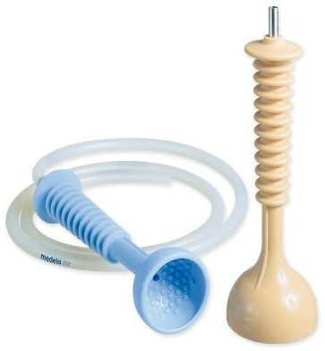
Vacuum
Definition:
Traction of fetal head by creating negative pressure through a suction cup applied to the head.
Types:
Soft Cups (polyethylene or silastic): are associated with less scalp injuries and appropriate for occipitoanterior position.
There is higher rate of failure with soft cups.

Slide 26
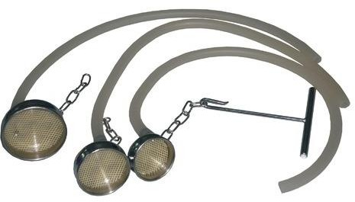
Rigid cups (Metal or Plastic) are more suitable for occipitoposterior, transverse, and difficult occipitoanterior position where the infant is larger.

Slide 27
Safety criteria for vacuum vaginal delivery (assisted)
After full abdominal and vaginal examination
Head engagement is 1/5 or 0/5 in role of fife (stations 0/+1/=2+3)
Fully dilated cervix
Membrane ruptured
Exact position of the head must be determined to place the instrument correctly
Cannot use in breech and preterm babies.
Caput or molding are no than moderate
Pelvis is deemed adequate

Slide 28
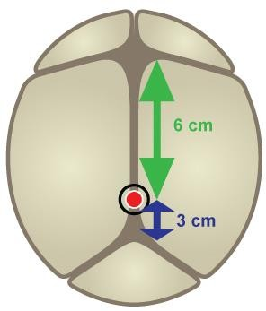
The FLEXION POINT is a point over the sagittal suture of the fetal skull, located approximately 6 cm posterior to the center of the anterior fontanel or 3 cm anterior to the posterior fontanel
Vacuum Extraction Technique
Insertion: the labia are gently spread, and the device is slipped into the vagina and then positioned against the fetal head.
Correct application: the vector of traction is directed through the cranial FLEXION point.
Flexion of fetal head must be maintained to provide the smallest diameter to the maternal pelvis by the correct application.

Slide 29
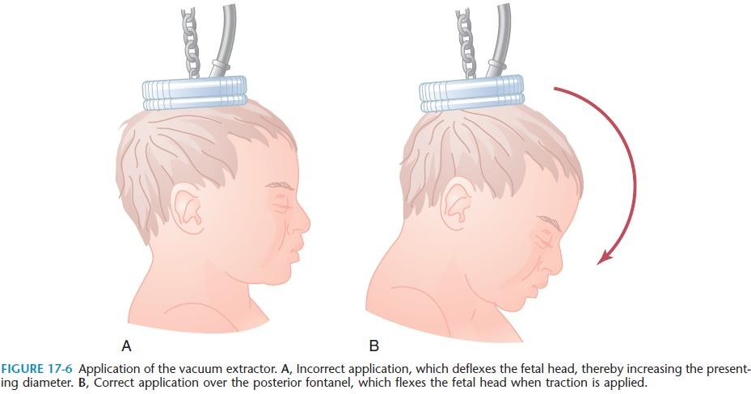
360° check should be performed to ensure that the pelvic tissue of the mother ( cervix or vagina) or umbilical cord .
is not trapped in the vacuum cup.

Slide 30
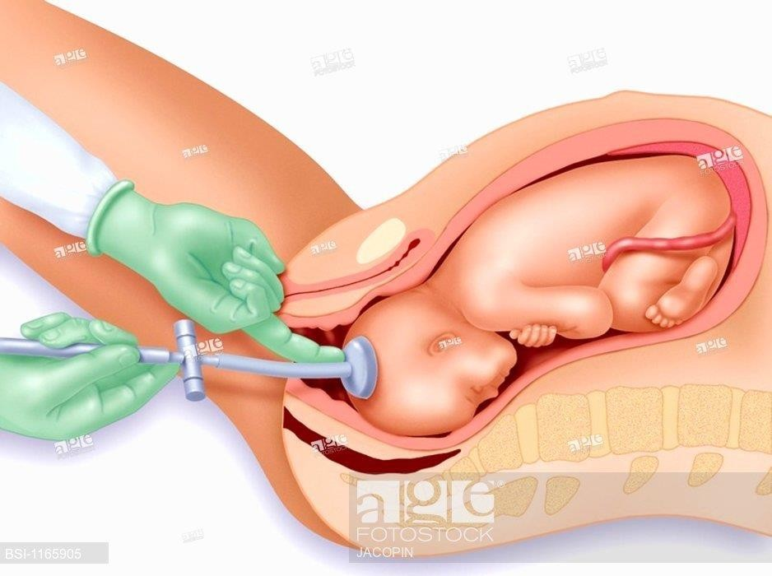
Traction
Once the doctor has verified cup placement, full vacuum is applied (450-600 mm Hg) with onset of contraction and the traction pulls along the axis of the pelvis, handle perpendicular to the cup, paralleling the uterine contractions with the aid of maternal pushing effort.

Slide 31
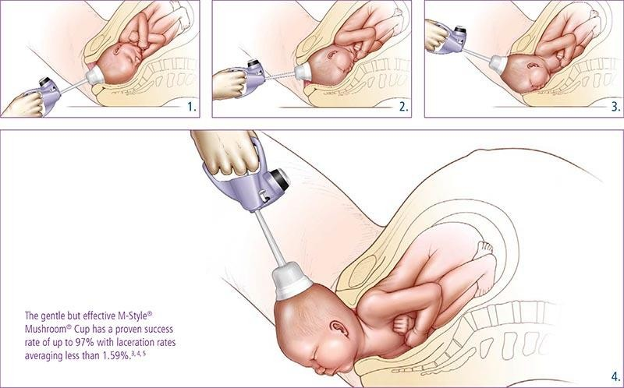
Maximum time from application to delivery should ideally be less than 15-20 minutes.

Slide 32
Applying rotational force to rotate the head of the fetus is contraindicated because it can lead to detachment of the cup, cephalohematoma of the fetus, and scalp laceration
“Pop-off “
Detachment of the suction cup from the fetal head during traction
IF two “pop-offs” occur, the procedure should be discontinued in favor of CS.

Slide 33
Complication
Fetal injury:
fetal death or severe fetal injury from vacuum extraction (VE)
is low, ranging from 0.1-3 cases per 1,000 extraction procedures.
The most common injuries are to the fetal scalp.
Cephalo-hematomas: collection of blood between fetal scalp and skull
Caput succedaneum
Subgaleal hemorrhages: bleeding in the potential space
scalp galea
between the skull periosteum and the aponeurosis.
Intracranial hemorrhage, Scalp Lacerations
Radiographic or ultrasonic studies of the CNS performed on newborns who were delivered by instrumental assistance, help to discover injuries more frequently than clinical examination

Slide 34
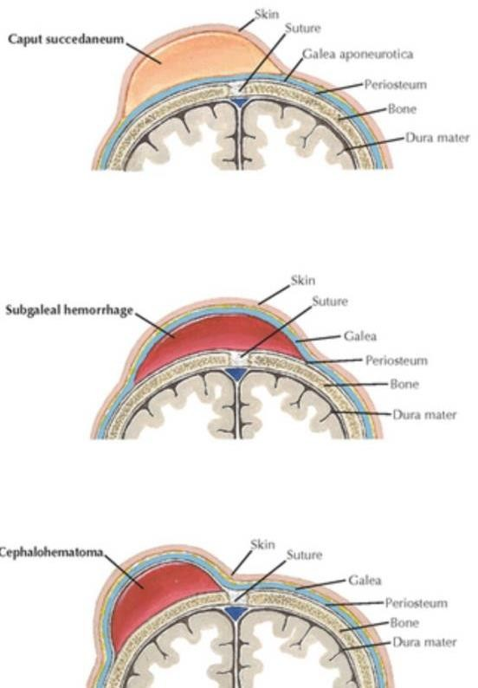
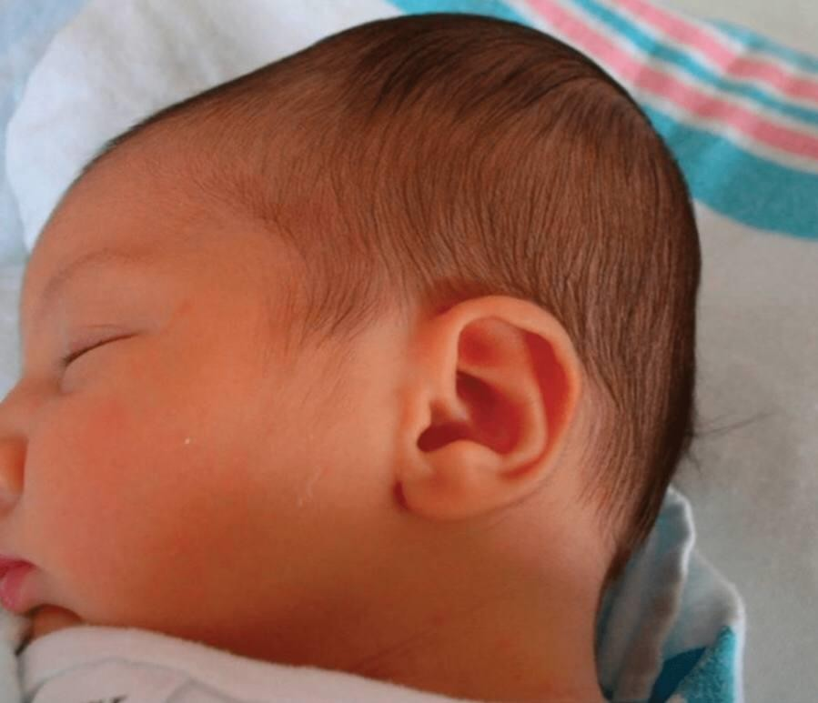
Maternal injury
Vacuum extraction has a low rate of maternal injury in comparison with forceps operations or cesarean delivery such as urinary incontinence, fecal incontinence, pelvic organ prolapse, and occasionally fistula formation

Slide 36
THANK YOU
THANK YOU
FREE PALESTINE

