Slide 1
MSS Module 2019-2020 Trichinella &Onchocercus volvolus
Dr. Mohammad Odibat

Slide 2
Nematodes of medical importance
Intestinal
Tissue & Blood
With tissue stage:
Ascaris lumbricoides
Ancylostoma duodenale
Necator americanus
Strongyloides stercoralis
Trichinella spiralis
Without tissue stage:
Enterobius vermiculars
Trichuris trichiura
Wuchereria bancrofti
Brugia malayi
Loa loa
Onchocerca volvulus
Dracunculus medinensis
Trichinella spiralis
Larva migrans:
Ancylostoma spp.
Toxocara spp.
Small intestine
Large int.

Slide 3
What is Trichinellosis?
Trichinellosis is a serious zoonotic disease (an animal disease that can infect humans) caused by parasitic nematodes (roundworms) of the genus Trichinella.
Trichinellosis develops after the ingestion of meat containing cysts of Trichinella (e.g., pork or other meat from a carnivore).
Although most infections are mild and asymptomatic, heavy infections can cause severe enteritis, periorbital edema, myositis, and (infrequently) death.

Slide 4
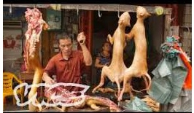
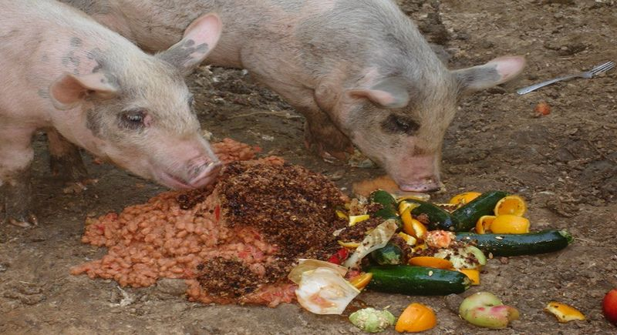
How dose the disease transmitted and spread?
Among animals:
By predation and scavenging.
To pigs:
by feeding uncooked meat scraps or meat products or by eating rats.
To humans:
by eating uncooked contaminated meat.
including dogs (in parts of Asia and Africa), horses (in Italy and France), and bears (in northern regions).
cattle (herbivores) are not natural hosts of Trichinella , beef has been implicated in outbreaks when contaminated or adulterated with trichinous pork.

Slide 5
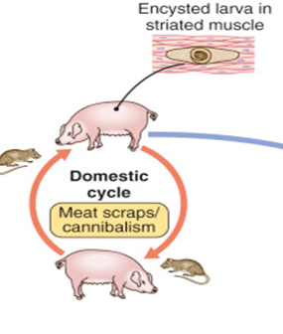
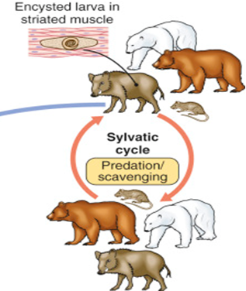
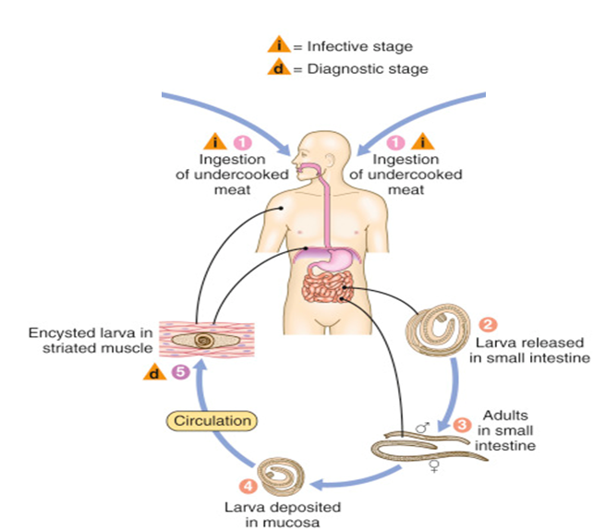
Life cycle of Trichinella
Notes:
Trichinellosis is acquired by (1) ingesting meat that contains cysts (encysted larvae) of Trichinella. After exposure to gastric acid and pepsin, (2) the larvae are released from the cysts and (3) invade the small bowel mucosa where they develop into adult worms (female 2.2 mm in length, males 1.2 mm; life span in the small bowel: 4 weeks). After 1 week, (4) the females release larvae that migrate to the striated muscles where (5) they encyst. (T. pseudospiralis, however, does not encyst.) Encystment is completed in 4–5 weeks and the encysted larvae may remain viable for several years. Ingestion of the encysted larvae perpetuates the cycle. Rats and rodents are primarily responsible for maintaining the endemicity of this infection. Carnivorous / omnivorous animals, such as pigs or bears, feed on infected rodents or meat from other animals. Different animal hosts are implicated in the life cycle of the different species of Trichinella. Humans are accidentally infected when eating improperly processed meat of these carnivorous animals (or eating food contaminated with such meat)..
Trichinella is very prolific and an infected animal might have up to several hundred larvae per gram of muscle. The life cycle in animals can continue as larvae are able to survive in decaying carcasses for a long time, facilitating transmission by scavenging.

Slide 6
Pathogenesis and clinical features
Clinical symptoms of trichinellosis arise from the successive phases of:
Parasite enteric invasion.
Larval migration.
Muscle encystment .
Notes:
Pathogenesis and clinical features
Clinical symptoms of trichinellosis arise from the successive
phases of parasite enteric invasion, larval migration,
and muscle encystment ( Fig. 126-1 ). Most light
infections (those with <10 larvae per gram of muscle)
are asymptomatic, whereas heavy infections (which can
involve >50 larvae per gram of muscle) can be lifethreatening.
Invasion of the gut by large numbers of parasites
occasionally provokes diarrhea during the fi rst week
after infection. Abdominal pain, constipation, nausea, or
vomiting also may be prominent.
Symptoms due to larval migration and muscle invasion
begin to appear in the second week after infection. The migrating Trichinella larvae provoke a marked local
and systemic hypersensitivity reaction, with fever and
hypereosinophilia. Periorbital and facial edema is common,
as are hemorrhages in the subconjunctivae, retina,
and nail beds (“splinter” hemorrhages). A maculopapular
rash, headache, cough, dyspnea, or dysphagia
sometimes develops. Myocarditis with tachyarrhythmias
or heart failure—and, less commonly, encephalitis
or pneumonitis—may develop and accounts for most
deaths of patients with trichinellosis.
Upon onset of larval encystment in muscle 2–3 weeks
after infection, symptoms of myositis with myalgias,
muscle edema, and weakness develop, usually overlapping
with the inflammatory reactions to migrating larvae.
The most commonly involved muscle groups include the
extraocular muscles; the biceps; and the muscles of the jaw,
neck, lower back, and diaphragm. Peaking ∼3 weeks
after infection, symptoms subside only gradually during
a prolonged convalescence. Uncommon infections
with T. pseudospiralis, whose larvae do not
encapsulate in muscles, elicit prolonged polymyositislike
illness.

Slide 7
Pathogenesis and clinical features
Parasite enteric invasion:
Light infection usually asymptomatic.
Heavy infection produces symptoms such as nausea, vomiting, dyspepsia, abdominal pain and diarrhea (like food poisoning).
This phase occurs in the 1st week after infection.
Eosinophilia detected early and increased.
Larvae can be detected in the stool.
Notes:
Pathogenesis and clinical features
Clinical symptoms of trichinellosis arise from the successive
phases of parasite enteric invasion, larval migration,
and muscle encystment ( Fig. 126-1 ). Most light
infections (those with <10 larvae per gram of muscle)
are asymptomatic, whereas heavy infections (which can
involve >50 larvae per gram of muscle) can be lifethreatening.
Invasion of the gut by large numbers of parasites
occasionally provokes diarrhea during the fi rst week
after infection. Abdominal pain, constipation, nausea, or
vomiting also may be prominent.
Symptoms due to larval migration and muscle invasion
begin to appear in the second week after infection. The migrating Trichinella larvae provoke a marked local
and systemic hypersensitivity reaction, with fever and
hypereosinophilia. Periorbital and facial edema is common,
as are hemorrhages in the subconjunctivae, retina,
and nail beds (“splinter” hemorrhages). A maculopapular
rash, headache, cough, dyspnea, or dysphagia
sometimes develops. Myocarditis with tachyarrhythmias
or heart failure—and, less commonly, encephalitis
or pneumonitis—may develop and accounts for most
deaths of patients with trichinellosis.
Upon onset of larval encystment in muscle 2–3 weeks
after infection, symptoms of myositis with myalgias,
muscle edema, and weakness develop, usually overlapping
with the inflammatory reactions to migrating larvae.
The most commonly involved muscle groups include the
extraocular muscles; the biceps; and the muscles of the jaw,
neck, lower back, and diaphragm. Peaking ∼3 weeks
after infection, symptoms subside only gradually during
a prolonged convalescence. Uncommon infections
with T. pseudospiralis, whose larvae do not
encapsulate in muscles, elicit prolonged polymyositislike
illness.

Slide 8
Pathogenesis and clinical features
Larval migration:
Larvae migrate in the blood invade different tissue  initiate inflammatory reaction and presented by:-
Fever and urticarial rash due to toxaemia.
Eye lids  periorbital oedema (a classic sign), subconjuctival haemorrhage and difficulty in eye movement.
Tongue difficulty in speaking and dysphagia.
Diaphragm and intercostals muscles  difficulty in breathing.
Muscles of mastication difficulty in mastication.
Splinter haemorrhage under the nails (a common symptom)
Larynx: Hoarseness of voice.
Heart: Myocarditis may lead to heart failure.
Lung: Pneumonia.
Brain: Encephalitis and meningitis.
In severe cases, death can occur 4-6 weeks after the infection and is usually caused by myocarditis, encephalitis or pneumonia.
Eosinophilia: 20-50%.
Notes:
Pathogenesis and clinical features
Clinical symptoms of trichinellosis arise from the successive
phases of parasite enteric invasion, larval migration,
and muscle encystment ( Fig. 126-1 ). Most light
infections (those with <10 larvae per gram of muscle)
are asymptomatic, whereas heavy infections (which can
involve >50 larvae per gram of muscle) can be lifethreatening.
Invasion of the gut by large numbers of parasites
occasionally provokes diarrhea during the fi rst week
after infection. Abdominal pain, constipation, nausea, or
vomiting also may be prominent.
Symptoms due to larval migration and muscle invasion
begin to appear in the second week after infection. The migrating Trichinella larvae provoke a marked local
and systemic hypersensitivity reaction, with fever and
hypereosinophilia. Periorbital and facial edema is common,
as are hemorrhages in the subconjunctivae, retina,
and nail beds (“splinter” hemorrhages). A maculopapular
rash, headache, cough, dyspnea, or dysphagia
sometimes develops. Myocarditis with tachyarrhythmias
or heart failure—and, less commonly, encephalitis
or pneumonitis—may develop and accounts for most
deaths of patients with trichinellosis.
Upon onset of larval encystment in muscle 2–3 weeks
after infection, symptoms of myositis with myalgias,
muscle edema, and weakness develop, usually overlapping
with the inflammatory reactions to migrating larvae.
The most commonly involved muscle groups include the
extraocular muscles; the biceps; and the muscles of the jaw,
neck, lower back, and diaphragm. Peaking ∼3 weeks
after infection, symptoms subside only gradually during
a prolonged convalescence. Uncommon infections
with T. pseudospiralis, whose larvae do not
encapsulate in muscles, elicit prolonged polymyositislike
illness.

Slide 9
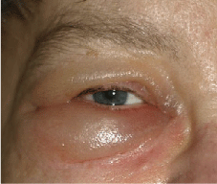
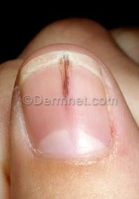
Splinter haemorrhage under the nail
Periorbital oedema

Slide 10
Pathogenesis and clinical features
larval encystment in muscle :
larval encystment in muscle: 2–3 weeks after infection.
Asymptomatic infection:<10 larvae per gram of muscle), whereas heavy infections (which can involve >50 larvae per gram of muscle) can be life threatening.
Symptoms:
myositis with myalgias,
muscle edema, and weakness develop, usually overlapping with the inflammatory reactions to migrating larvae.
The most commonly involved muscle groups include the:
extraocular muscles;
the biceps;
the muscles of the jaw, neck, lower back, and diaphragm.
Peaking ∼3 weeks after infection, symptoms subside only gradually during a prolonged convalescence.
Notes:
larval encystment in muscle 2–3 weeks
after infection, symptoms of myositis with myalgias,
muscle edema, and weakness develop, usually overlapping
with the inflammatory reactions to migrating larvae.
The most commonly involved muscle groups include the
extraocular muscles; the biceps; and the muscles of the jaw,
neck, lower back, and diaphragm. Peaking ∼3 weeks
after infection, symptoms subside only gradually during
a prolonged convalescence. Uncommon infections
with T. pseudospiralis, whose larvae do not
encapsulate in muscles, elicit prolonged polymyositislike
illness.

Slide 11
Laboratory findings and diagnosis
Patients should be questioned thoroughly about their consumption of pork or wild animal meat and about illness in other individuals who ate the same meat.
A presumptive clinical diagnosis can be based on fevers, eosinophilia, periorbital edema, and myalgias after a suspect meal
Notes:
Blood eosinophilia develops in >90% of patients with symptomatic trichinellosis and may peak at a level of >50% 2–4 weeks after infection. Serum levels of muscle enzymes, including creatine phosphokinase, are elevated
in most symptomatic patients. Patients should be questioned
thoroughly about their consumption of pork or
wild animal meat and about illness in other individuals
who ate the same meat. A presumptive clinical diagnosis
can be based on fevers, eosinophilia, periorbital edema,
and myalgias after a suspect meal. A rise in the titer of
parasite-specific antibody, which usually does not occur
until after the third week of infection, confirms the
diagnosis. Alternatively, a definitive diagnosis requires
surgical biopsy of at least 1 g of involved muscle; the
yields are highest near tendon insertions. The fresh
muscle tissue should be compressed between glass slides
and examined microscopically (Fig. 126-2), because
larvae may be missed by examination of routine histopathologic
sections alone.

Slide 12
Laboratory findings and diagnosis
Direct
Indirect
Stool examination: For larvae or adult.
Blood examination: For larvae.
Muscle biopsy: Taken from the swollen tender part & compressed between two slides after digestion in acid pepsin to see larvae .
Trichinoscopy: To see larvae in muscle.
X ray for calcified cyst.
CT for brain lesions.
Intradermal test (Bachman test).
Serological tests: CFT, IHA, IFAT, ELISA.
Eosinophlia (20-50%).
Bachman test
A skin test for trichinosis in which an
extract of Trichinella larvae is suspended
in saline and injected intradermally.
An immediate wheal-and- flare reaction or a delayed response indicates infection
Notes:
Blood eosinophilia develops in >90% of patients with symptomatic trichinellosis and may peak at a level of >50% 2–4 weeks after infection. Serum levels of muscle enzymes, including creatine phosphokinase, are elevated
in most symptomatic patients. Patients should be questioned
thoroughly about their consumption of pork or
wild animal meat and about illness in other individuals
who ate the same meat. A presumptive clinical diagnosis
can be based on fevers, eosinophilia, periorbital edema,
and myalgias after a suspect meal. A rise in the titer of
parasite-specific antibody, which usually does not occur
until after the third week of infection, confirms the
diagnosis. Alternatively, a definitive diagnosis requires
surgical biopsy of at least 1 g of involved muscle; the
yields are highest near tendon insertions. The fresh
muscle tissue should be compressed between glass slides
and examined microscopically (Fig. 126-2), because
larvae may be missed by examination of routine histopathologic
sections alone.

Slide 13
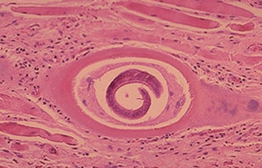
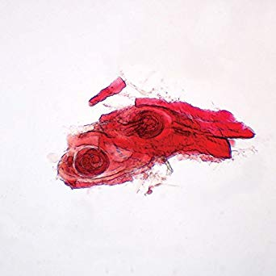
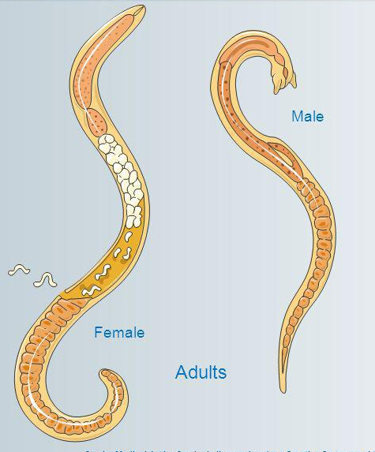
Pathogenesis and clinical features
larval encystment in muscle :
Trichinella spiralis Encysted Larvae (Microscope Slide)
Male: up to 1.5mm
Female: up to 4 mm, viviparous
Notes:
larval encystment in muscle 2–3 weeks
after infection, symptoms of myositis with myalgias,
muscle edema, and weakness develop, usually overlapping
with the inflammatory reactions to migrating larvae.
The most commonly involved muscle groups include the
extraocular muscles; the biceps; and the muscles of the jaw,
neck, lower back, and diaphragm. Peaking ∼3 weeks
after infection, symptoms subside only gradually during
a prolonged convalescence. Uncommon infections
with T. pseudospiralis, whose larvae do not
encapsulate in muscles, elicit prolonged polymyositislike
illness.

Slide 14
Treatment
General treatment
Specific therapy
Thiabendazole.
Mebendazole.
Bed rest and fluid therapy
Sedatives for headache and muscle pain.
Corticosteroids to reduce inflammatory reaction.
Cardiac and respiratory monitoring.

Slide 15
Prevention and Control
Application of meat inspection methods for detecting Thrichinella.
Freezing is not recommended as a control measure; as some species are freeze tolerant.
Rat control is a necessary part of any eradication effort.
Public education to make sure that meat is well cooked has also helped control the spread of the disease.
Notes:
What is being done to prevent or control the disease? Once widespread in domestic pigs, the disease was controlled in many countries by banning the feeding of raw swill to pigs and the application of meat inspection methods for detecting Thrichinella. Rats are known to play a role in transmitting Thrichinella, so rat control is a necessary part of any eradication effort. To systematically prevent trichinellosis from entering the food chain when there is a demonstrated risk, pork meat should be treated to a specifi c time temperature regimen for example to 60°C for 1 minute. Freezing is not recommended as a control measure; as some species are freeze tolerant. Public education to make sure that meat is well cooked has also helped control the spread of the disease. The OIE Terrestrial Animal Health Code lists the standards for certifying a country or zone to be free of trichinellosis

Slide 16
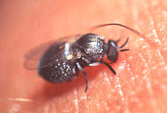
Onchocercus volvolus (River Blindness worm)
Geographical distribution: Sudan, Saudi Arabia, Yemen and Central America.
Habitat:
Adult inhabits subcutaneous tissues.
Microfilariae does not reach the circulation, they are present in the dermis, subcutaneous nodules, subcutaneous tissues, all chambers of the eye and they are non periodic.
D.H: Man.
I.H (vector): Female Black flies (Simulium).

Slide 17
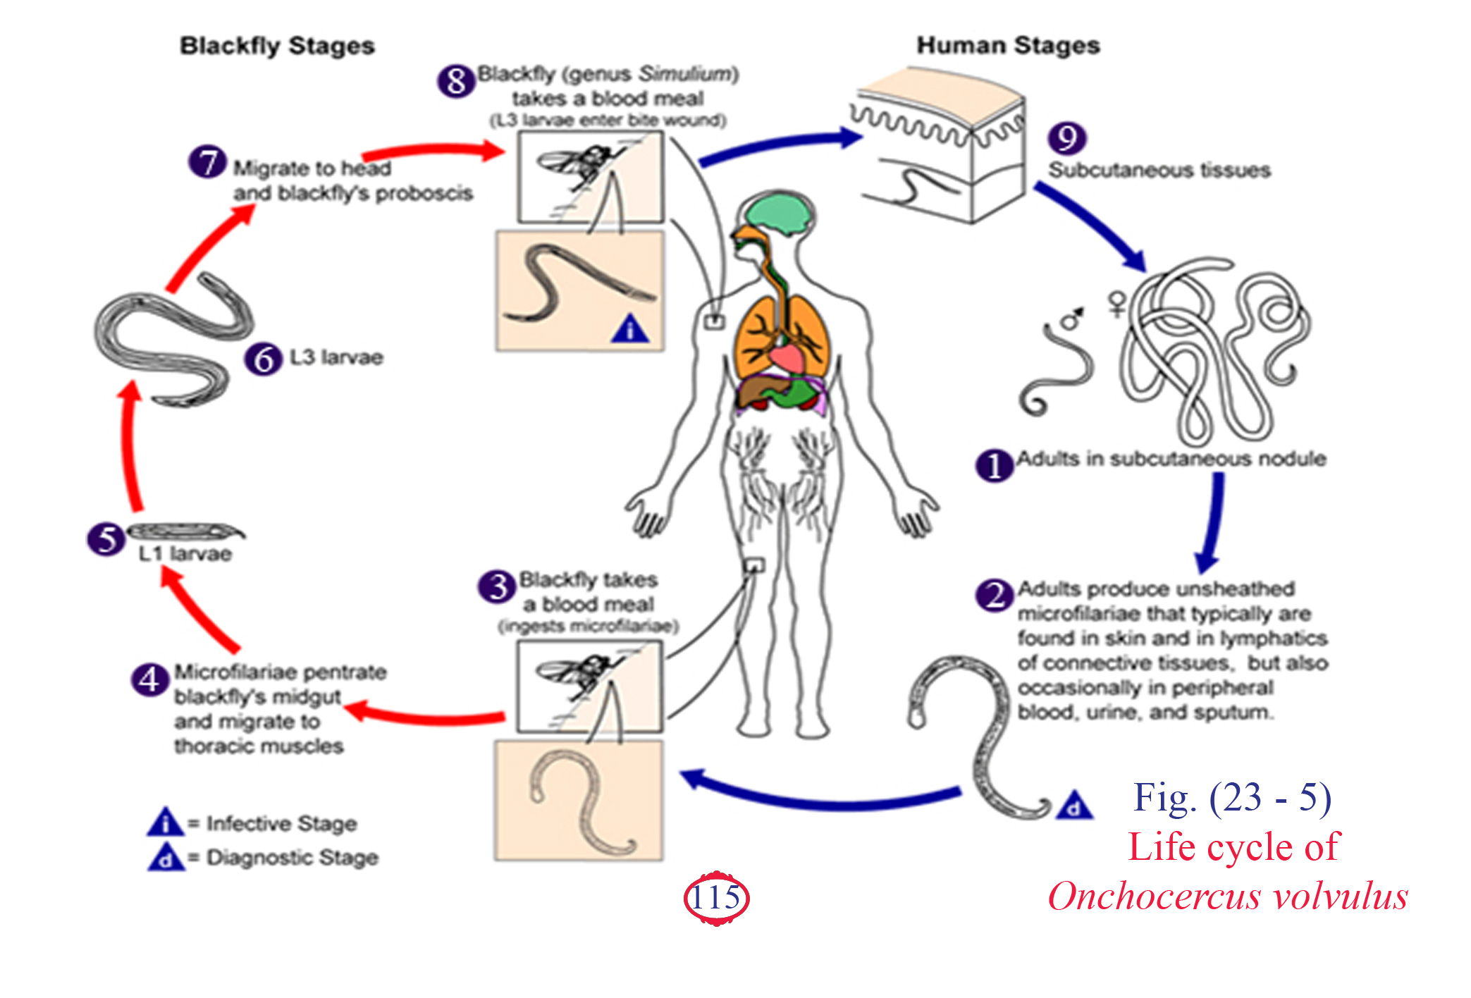

Slide 18
Pathogenesis and symptomatology
Disease: Onchocercosis or river blindness.
1- Cutaneous lesions
Onchocerca nodule (onchocerchoma ):
Fibrous subcutaneous nodules over bony prominences as scalp, elbow, knee, ribs, iliac crest & scapula.
Firm rounded or oval.
Containing adults and microfilariae
The skin over and near nodules shows sever dermatitis, an intense itching and may lead to 2ry infection.
Skin may be depigmented (Leopard) or hyper pigmented (Sowda) with oedema.
The lymph nodes in femoral triangle are enlarged (in males and females)  (hanging groin) with loss of skin elasticity.

Slide 19
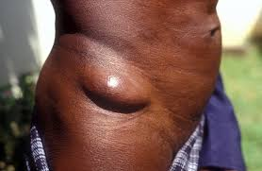
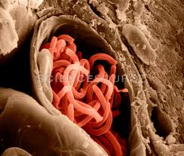
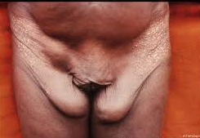
Onchocerca nodule
Onchocerca nodule
hanging groin

Slide 20
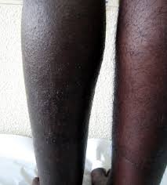
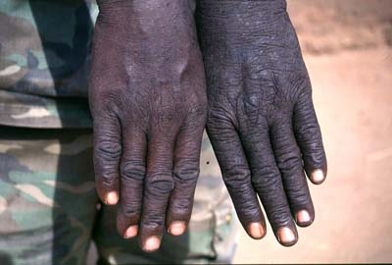
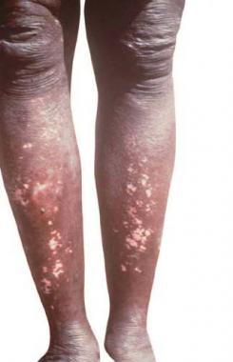
Man demonstrating the difference in color and appearance of his hands and legs due to sowda
Leopard (Hypopigmentation)

Slide 21
2- Eye lesions
River blindness or Sudanese blindness
Due to immunologic response to microfilaria that invade the eye.
Microfilaria invades many parts of the eye  keratitis with corneal opacity  chorioretinitis with degenerative changes and optic neuritis  blindness.

Slide 22
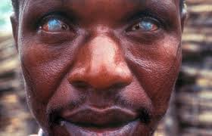
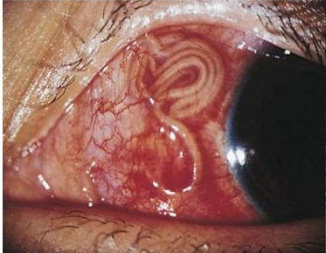
River blindness or Sudanese blindness

Slide 23
Laboratory diagnosis
Direct
Indirect
Eosinophilia (20%).
Intradermal test (using Dirofilaria antigen).
Serological tests and PCR.
Mazzotti test: 50 mg - 100 mg of hetrazan is given orally  appearance of skin rash, itching within 24 hours (due to death of microfilaria in subcutaneous tissue and liberation of high amount of antigen and toxins).
Demonstration of microfilaria in aspirate of nodules or skin snips.
Determination of adult in excised nodule.
Eye examination: presence of microfilariae in cornea and eye chambers.

Slide 24
Treatment
Surgical removal of the nodule.
Hetrazan.
Ivermectin (Drug of choice).

