Slide 1
Pleural effusion
Mohammad AL sarayreh
Hamzah AL adaile
Mohammad AL thnebat

Slide 2
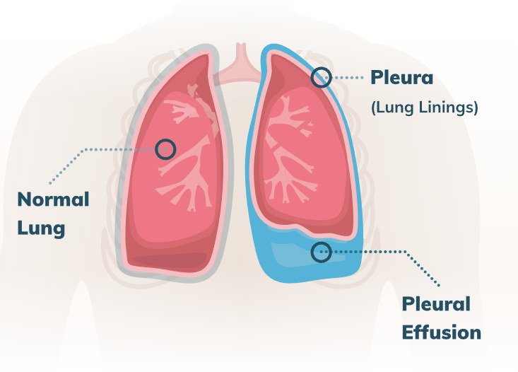
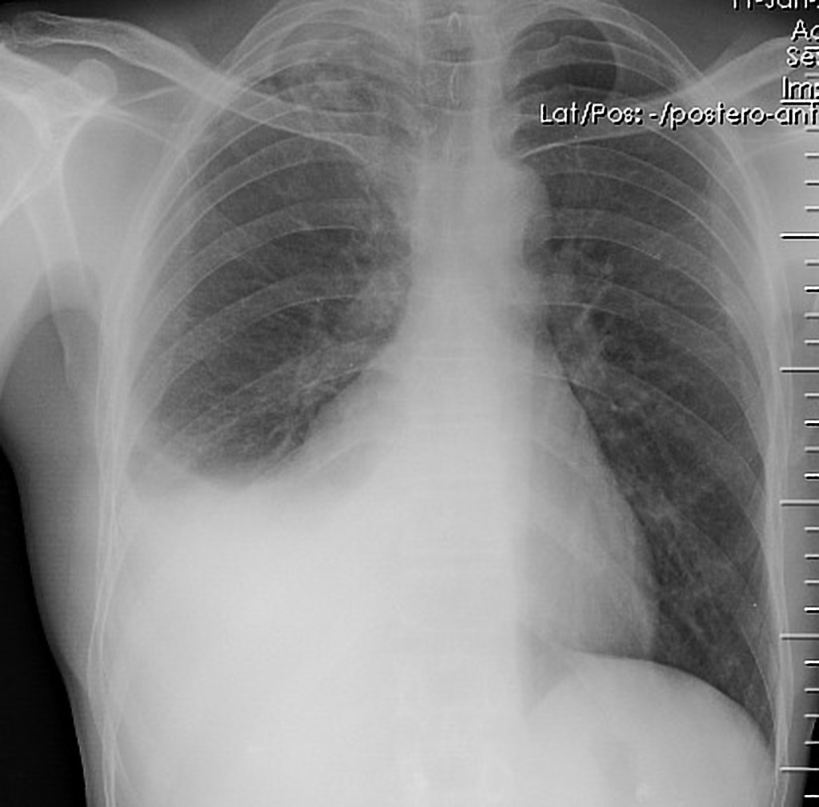
Pleural effusion
Presence of fluid inside pleural cavity not inside the alveoli.
Symptom: SOB!
Physical examination: 1. Palpation: decrease tactile fremitus 2. Percussion: dull 3. Auscultation: absence breath sound
Chest x-ray findings: 1. Obliteration of costophrenic angle 2. Meniscus sign “concave line obscuring the costophrenic angle”.

Slide 3
More Definitions ?
Loculated Effusion : Fluid anatomically confined and not freely flowing in the pleural space when there are adhesions between the visceral and the parietal pleura .
Sub-Pulmonic Effusion: accumulation of fluid between the lung & the diaphragm which gives the false impression of an elevated hemi-diaphragm

Slide 4
Pleural Effusion
Parapneumonic effusion
Subpulmonic Effusion
Loculated Effusion

Slide 5
Diagnosis of pleural effusion
1. CXR (PA and lateral):look for the following: about 250 mL of pleural fluid must accumulate before an effusion can be detected.
Lateral decubitus films: more reliable than PA and lateral CXRs for detecting (15 ml can be detected)
2. CT chest—more reliable than CXR for detecting effusions
3. Echocardiography: to exclude HF as a cause.
4. Urinalysis: to exclude nephrotic syndrome

Slide 6
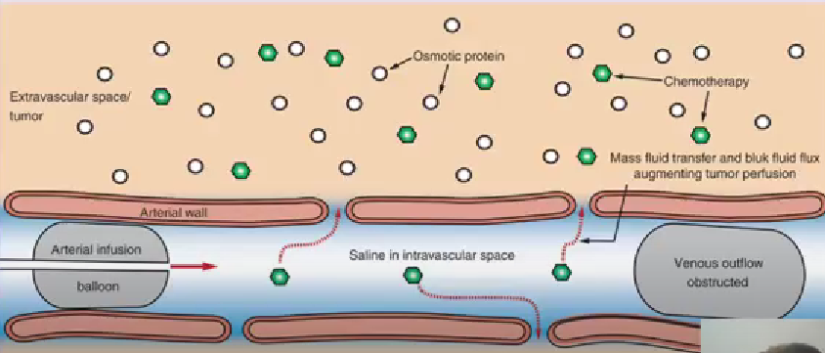
Starling law
Hydrostatic pressure gradient: difference between hydrostatic pressure intravascularly and interstitial.
More pressure intravascular > fluid out to interstitial.
Oncotic pressure gradient?
More oncotic pressure intravascular > fluid tends
Net gradient: net of oncotic and hydrostatic

Slide 7
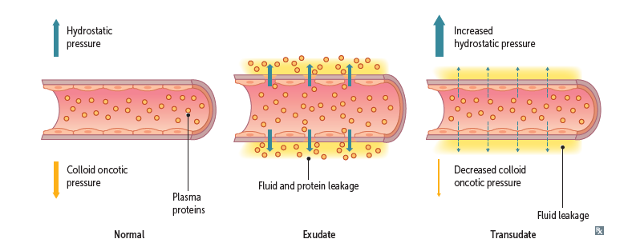
Pathophysiology
Transudate: leakage of fluid due to increase capillary pressure (Example: Heart failure) or decrease oncotic pressure (due to decrease synthesis of albumin “Example: liver cirrhosis” or loss of albumin in urine “Example: nephrotic syndrome”). Content of leaked fluid: Low protein
Exudate: leakage of fluid due to increase oncotic pressure in the interstitial fluid. (leakage of fluid and protein due to increase permeability of endothelium) Content of leaked fluid: High protein

Slide 8
Exudate formation
Rupture of the structure containing high protein content: rupture of the esophagus, thoracic duct rupture and pancreatitis.
Debris of necrotic cell from the inflammatory reaction: pneumonia, autoimmune diseases (SLE, RA, vasculitis) , pericarditis, Pulmonary embolism and TB.
Malignancy: secrete protein in the interstitial fluid. Lung cancer, lymphoma and leukemias.
Drugs: Bromocriptine, amiodarone, nitofurantoin, dantrolene, INH, PAS

Slide 9
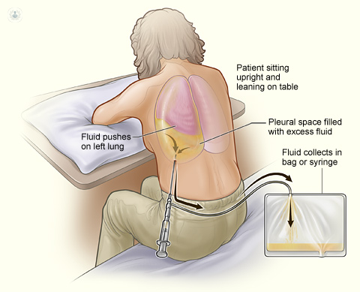
Thoracentesis
Use of ultrasound guidance decreases complication rate, permits sampling of small and/or loculated effusions, and is rapidly becoming the standard of care for thoracentesis

Slide 10
Composition of pleural fluid
Volume
Cells/ mm3
Mesothelial cells Monocytes
Lymphocytes
PMN’s
Protein
LDH
Glucose
pH
0.3 mL/kg
1000 – 5000 60% 30% 5% 5%
1-2 g/dL
<50% plasma level(105-333IU/L)
≅ plasma level(90-120)
≥ plasma level(7.6-7.64)

Slide 11
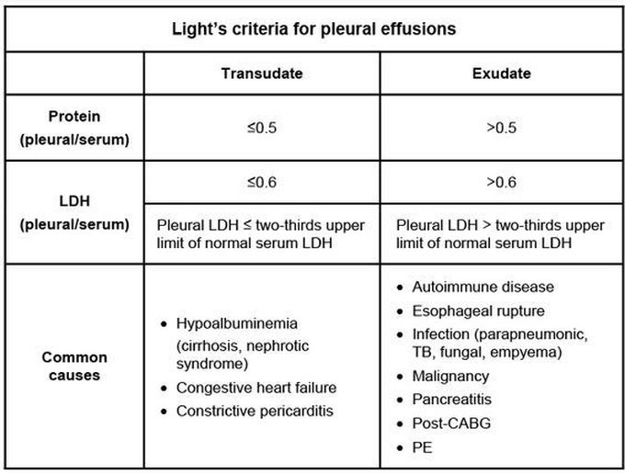
Analysis 1. Transudate vs Exudate

Slide 12
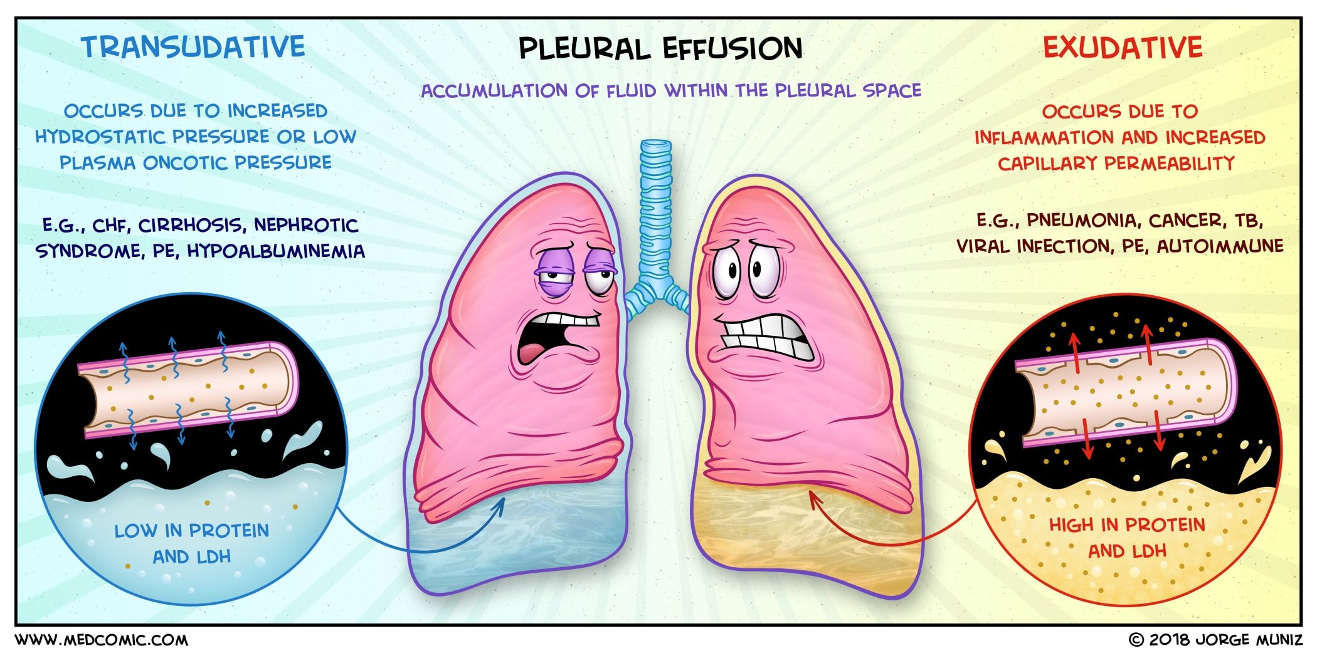

Slide 13
Analysis 2. Cell counts
A. RBC count >100,000/μL suggests:
1. Trauma 2. Malignancy 3. Pulmonary embolism with infarction
B. WBC count
1. <1000/μL suggests transudate 2. >1000/μL suggests exudate
C. WBC differential
1. >10,000 neutrophils/μL suggests parapneumonic effusion or empyema.
2. >50% lymphocytes suggests tuberculosis or malignancy.

Slide 14
Analysis 3. Glucose
Glucose <60 mg/dL suggests: used by the cells 1. Parapneumonic effusion 2. Empyema 3. Rheumatoid pleurisy 4. Malignant effusion 5. Tuberculous pleuritis

Slide 15
Analysis 4. pH
pH <7.2 suggests:
1. Complicated parapneumonic effusion
2. Empyema
3. Esophageal rupture
4. Rheumatoid pleurisy
5. Malignant effusion
pH >7.8 suggests Proteus infection

Slide 16
Analysis 5. Specific tests
Amylase: Pancreatic disease and esophageal rupture
Triglycerides: Thoracic duct rupture
ANA: SLE
Adenosine deaminase: TB
Interferon gamma: TB

Slide 17
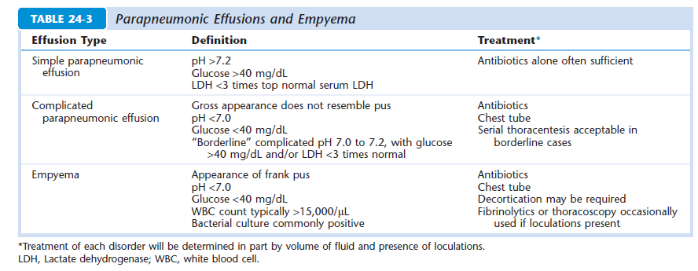

Slide 18
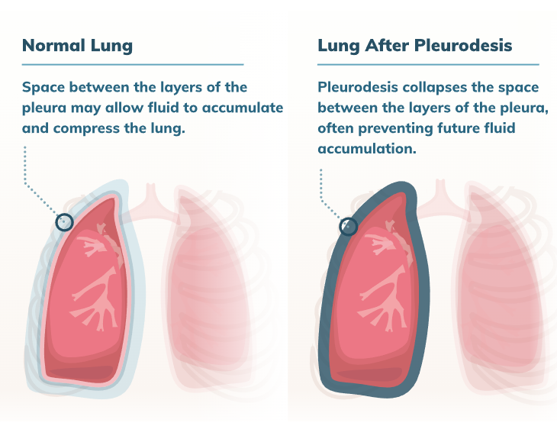
Treatment
Treat the cause (HF> diuretics, pneumonia> antibiotics, hypoalbuminemia> albumin, TB> antituberculosis)
If it is severe and huge pleural effusion> chest tube and connected with one-way valve bag or under water seal.
Failure to drain with a single small-bore tube should also lead to thoracic surgery consultation to avoid delays in case video assisted thoracoscopy (VATS).
Recurrent pleural effusion: Chemical pleurodesis

Slide 19
Thanks for listening

