Slide 1
Arousal mechanism and reticular activating system
Dr. Arwa Rawashdeh

Slide 2
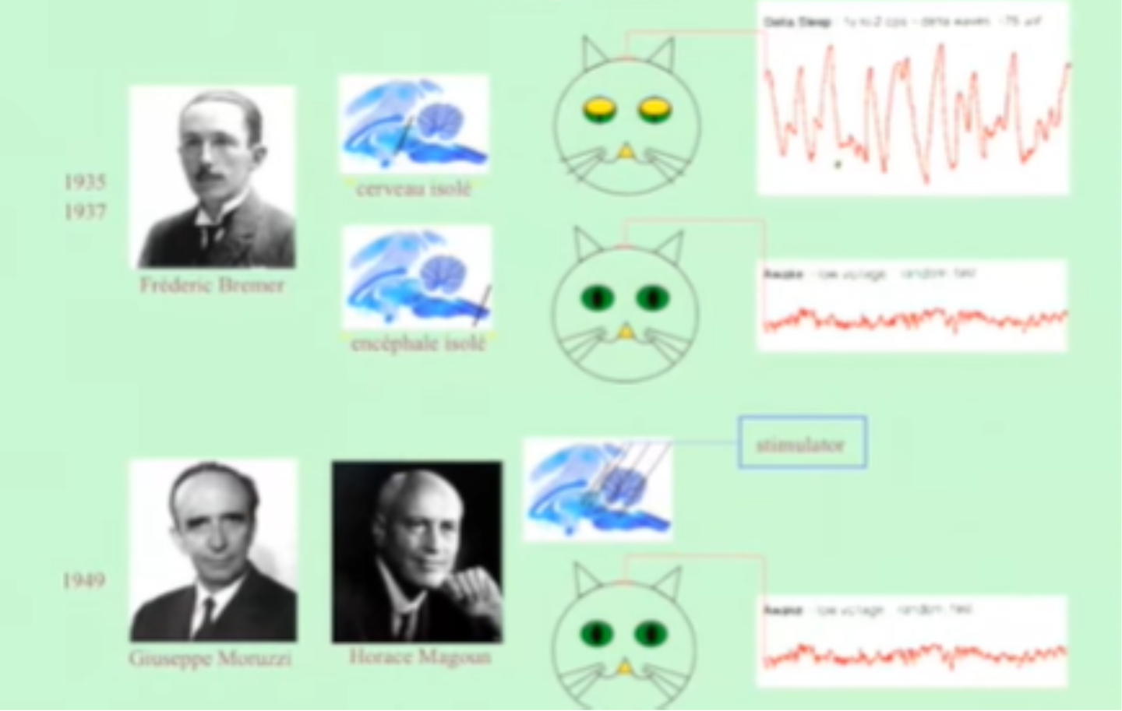
Physiological basic of this phenomenon
In 1930 in Belgium ; he was working essentially on cats
He made a transection in the rostral portion of the midbrain he found that the EEG rhythms is Delta rhythm that means that there is something is really important to maintain alertness
He cut between the medulla and the spinal cord at the C1 level , the EEG for the cat like normal animal
In the 1940s in Italy, they stimulating electrodes at different points of brain stem
they noticed no matter where you put the electrodes at different region of brain stem especially rostrally these resulted in alertness .
At the level of the brain stem there is a reticular activating system

Slide 3
Old definition
Diffuse mass of neurons & nerve fibers that make the core of the brain stem;
They run through the medulla oblongata, pons & midbrain;

Slide 4
Reticular activating system (RAS)
We know that discrete nuclear masses that releases neurotransmitter that are ascending and project to the thalamus and cerebral cortex; a very beautiful example of diffuse masses in order of 10 to 15
In the middle of the brain stem synthesis NE; they provide noradrenergic innervation to wide areas of the nervous system
rostral than this at the midbrain and pones junction raphe nuclei that joins both side provide serotonin
More rostral to the midbrain ; inferior colliculi and massive decussation here of the superior cerebellar peduncle . In the dorsal lateral of the pones there is nuclei parochial nuclei that surrounds superior cerebellar peduncle and provide cholinergic innervation
More rostral in the midline and medially to the substantial nigra there's is ventral tegmentum area release dopamine

Slide 5
AFFERENT & EFFERENT CONNECTIONS OF RETICULAR FORMATION
Cerebellum
Sensory Pathways
Substancia Nigra ( reward and movement)
Thalamus
Cortex
Reticular Formation
Red Nucleus coordination of sensorimotor information
Reticular Formation
Cerebellum
Cortex
Superior colliculus
Tectum
Superior colliculus
Thalamus, Hypothalamus
Corpus Striatum
EFFERENT CONNECTION TO THE RETICULAR FORMATION
AFFERENT CONNECTION TO THE RETICULAR FORMATION

Slide 6
RETICULAR ACTIVATION SYSTEM (RAS)
RETICULAR FORMATION & ITS CONNECTIONS
ASCENDING RETICULAR ACTIVATION SYSTEM
DESCENDING RETICULAR ACTIVATION SYSTEM via reticulospinal tracts

Slide 7
Function of reticular activating system
Somatic motor control – Some motor neurons send their axons to the reticular formation nuclei, giving rise to the reticulospinal tracts of the spinal cord, during body movements.
The reticular formation also relays eye and ear signals to the cerebellum so that the cerebellum can integrate visual, auditory, and vestibular stimuli in motor coordination.
Other motor nuclei include gaze centers, which enable the eyes to track and fixate objects, and central pattern generators, which produce rhythmic signals of breathing and swallowing.
Cardiovascular control – The reticular formation includes the cardiac and vasomotor centers of the medulla oblongata.
Pain modulation
Sleep and consciousness –It plays a central role in states of consciousness like alertness and sleep. Injury to the reticular formation can result in irreversible coma.
Mediate autonomic function

Slide 8
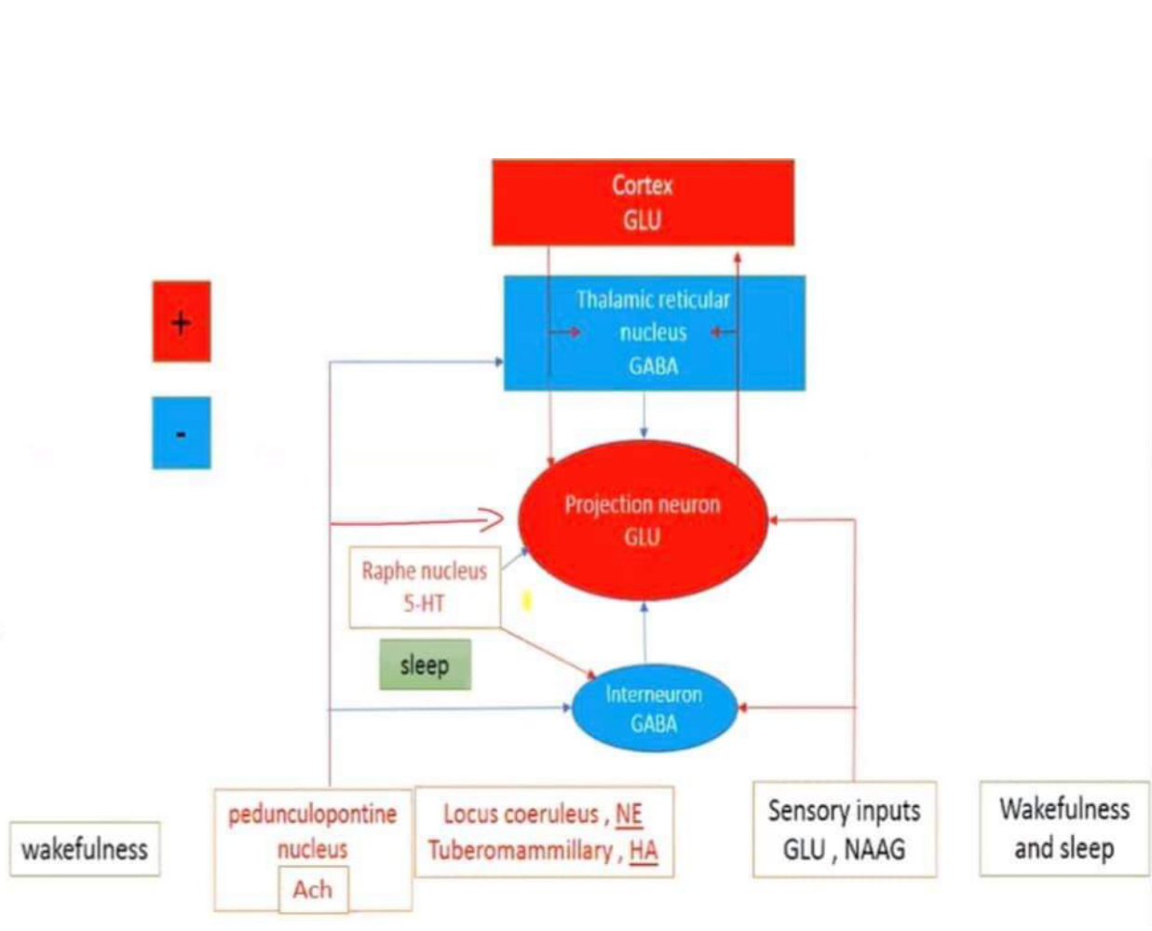
Influence of ascending system on thalamocortical interactions according to behavioral state (ARAS)

Slide 9
The stimulus is still going on, but you are sleep
When you are watching a television and you fall asleep and your eyelid is drop, you have the information going to the eyelid you don’t see form or patterns but you have different level of illumination that go through eyelid perfect well which means that the stimuli is still going on but you are sleep
The function of the thalamus not only processing the information before it send to the cortical network but also gates the information so that during drowsiness or sleep it shut off this input still go to the thalamus but not to the cortex , so you are sleep despite the noises and the siren

Slide 10
The double process of excitation in nicotinic receptors and inhibition in muscarinic receptors you have the maximum activity of the projection of the neuron that sending information to the cortex that is a characteristics of the wakefulness
Tuberomammillary nuclei in the hypothalamus that is the only nucleus in the system that fabricate histamine ; you realize that when you take antihistamine you would eliminate inhibition sending and therefore you depress the activity of the thalamus and become drowsy
Serotonin multi various function substances in alertness increasing and tuning attention process, it does so by mostly influencing the cortical area in the thalamus; it excites the interneuron which in turn inhibit the projection neuron and end up with the decreasing the excitability of projection neuron

