Slide 1
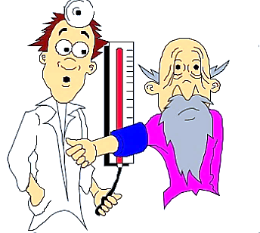
Arterial blood pressure measurement
Prepared by:
Assist. Prof. Nourelhuda A. Mohammed

Slide 2
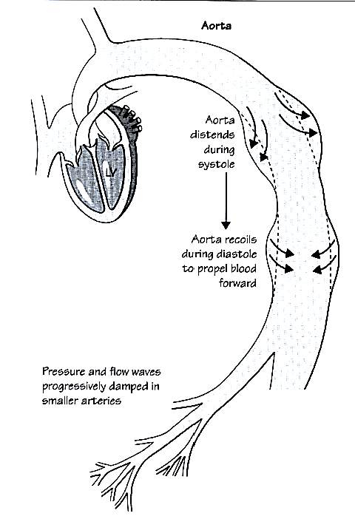
Arterial Blood Pressure (ABP)
- It is the Pressure of Blood on Arterial wall.
- BP value is expressed as a fraction: The upper value is the systolic pressure, and the lower value is the diastolic pressure.

Slide 3
Definitions:
Systolic blood pressure | Diastolic blood pressure
Maximum pressure. During ventricular systole. 90 - 140 mmHg (average 120 mmHg). Due to Ejection of blood into aorta during systole Expansion of aorta prevents excessive ↑↑. | Minimal pressure. During diastole. 60 - 90 mmHg (average 80 mmHg). Due to Escape of blood to peripheral circulation during diastole. Elastic recoil of aorta prevents excessive ↓↓.

Slide 4
Pulse pressure: It is the e difference between the SBP and the DBP.
= systolic BP - diastolic BP
↑ In hyperdynamic circulation as thyrotoxicosis, atherosclerosis, anemia & pregnancy.
↓ in aortic stenosis, cardiogenic shock, advanced HF.
Mean systemic blood pressure (Mean arterial pressure):
It is the average pressure in systemic arteries throughout cardiac cycle.
MAP (at resting HR)= 2/3 DBP+1/3 SBP
= diastolic blood pressure +1/3 Pulse pressure
= 93 mmHg

Slide 5
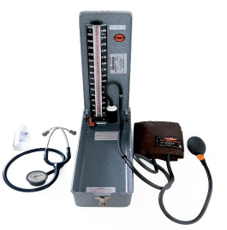
Measurement of ABP
1. Direct Method
By cardiac catheter cannulated through a large artery, transmits the blood pressure to manometer.
2. Indirect Method: By sphygmomanometer + stethoscope.
-Principle: The pressure of blood in the artery (brachial artery) is balanced against the pressure of air in a rubber cuff surrounding the artery. The pressure of air in the cuff is then measured by means of a mercury manometer.
- Methods:
Palpatory step.
Auscultatory step.

Slide 6
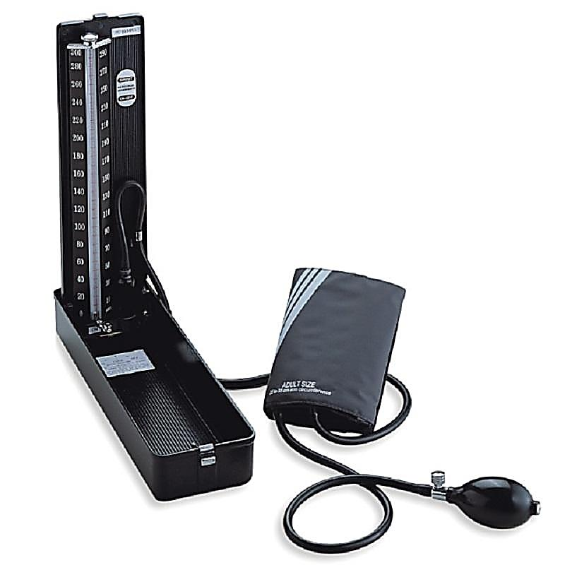
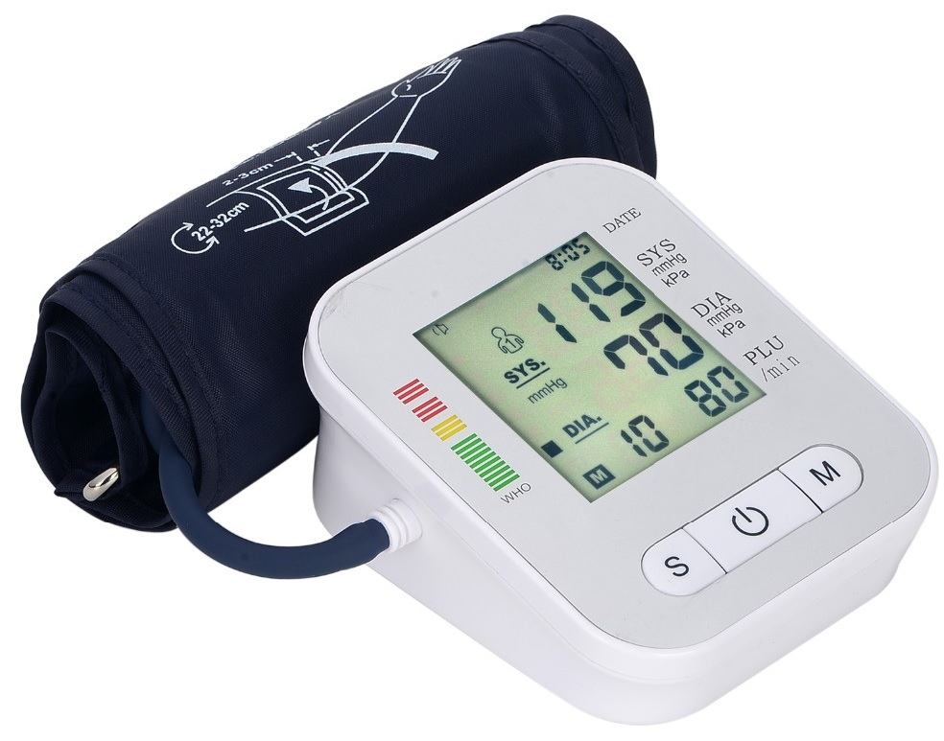
Mercurial
(the most accurate) Digital
(the least accurate)

Slide 7
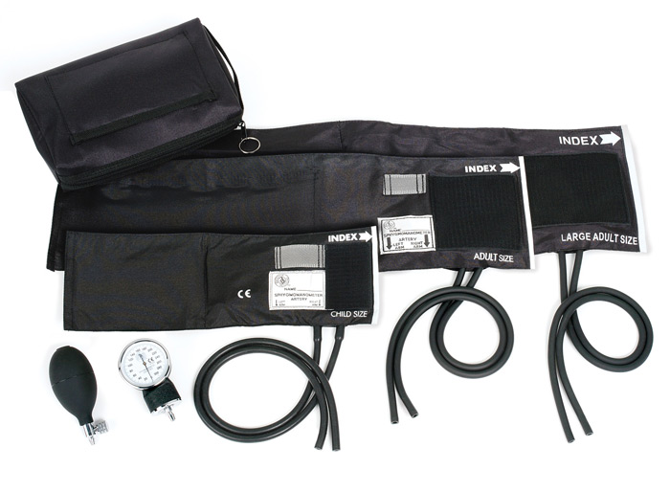
Cuffs of different sizes

Slide 8
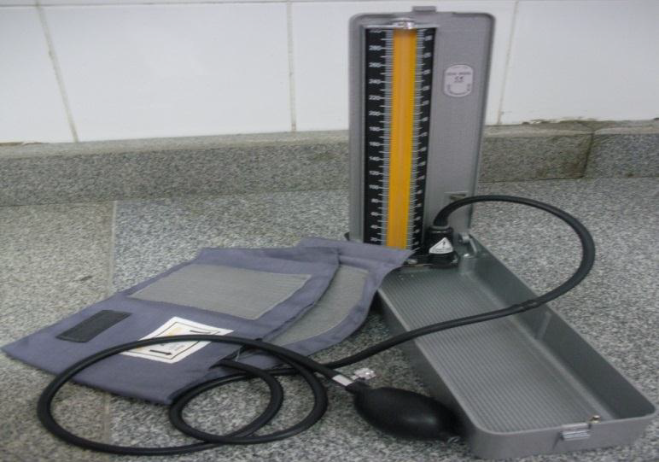
Apparatus
Sphygmomanometer . Which is composed of
Mercury Manometer,
Mercury Reservoir,
Rubber Tubes,
Rubber Cuff
Air Pump.

Slide 9
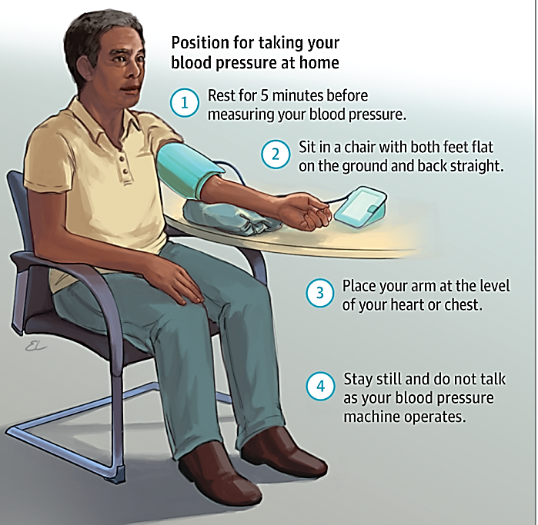
General Rules

Slide 10
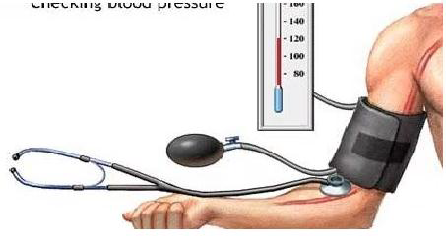
How to measure?
1. Palpatory method | 2. Auscultatory method
Less accurate | More accurate
Only Systolic pressure | Systolic and Diastolic pressure

Slide 11
1. palpatory method
• A rubber inflatable cuff is placed over the brachial artery.
• Feel the subject’s radial artery with the tip of 3 middle fingers, the pressure in the cuff is raised until the cuff pressure exceeds that of the pressure in the artery and at this point, the artery collapses and the radial pulse can no longer be felt .
• Then the pressure in the cuff is slowly released and the radial pulse reappears. The pressure at which the pulse reappears corresponds to the systolic pressure as it is the point at which the systolic pressure peaks in the brachial artery exceeding the occluding pressure in the cuff.

Slide 12
2. Auscultatory method.
The cuff is inflated manually until the artery is completely occluded.
Listening with the stethoscope over the brachial artery at the elbow, the examiner should then slowly release the pressure in the cuff.
When blood just starts to flow in the artery,
Korotkoff sound are heard which are:
Sudden appearance of faint clear sounds corresponds to SBP., heard as tapping sounds.
As the cuff pressure is lowered, the sounds become murmur-like.
With further lowering of the cuff pressure, the sounds become louder.
When the cuff pressure approaches the diastolic pressure, turbulent flow becomes continuous and sounds become dull and muffled
At the diastolic pressure, the sounds disappear.

Slide 13
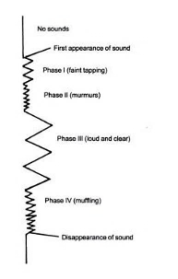
Korotkoff sounds

Slide 14
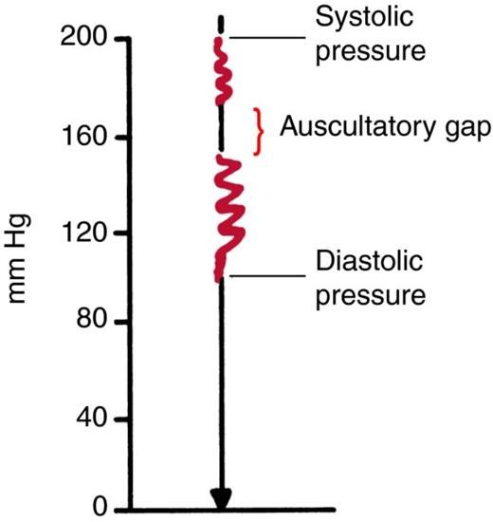
Auscultatory gap:
During auscultation, sound disappears for short time (gap) between systolic and diastolic BP.
in hypertensive atherosclerotic patients.

Slide 15
Physiological variations:
A. Age:
- In newly born infants the ABP = 80/40 mmHg.
- At 4 years old ABP = 100/60 mmHg.
- At 20 years old ABP = 120/80 mmHg.
- It increases gradually a er the age of 20 years to reach 150/90 mmHg at the age of 60 years due to decrease the elasticity of arteries.
B. Body weight:
- ABP is usually higher in obese persons.
C. Sex:
- The ABP in adult male is higher than in adult female.
- After menopause, it is higher in female due to hormonal changes.
D. Diurnal variation: During sleep ABP is decreased due to decreased sympathetic activity.
(highest value in afternoon & lowest value in early morning )

Slide 16
E.
Exercise:
-In the isometric (static) exercise:
Both the DBP & SBP rise sharply.
Then, return immediately to normal after stoppage of exercise.
-Due to reflex action by impulses originate in the contracting muscles proprioceptors to stimulate vasomotor center (VMC).
-In the isotonic (dynamic) exercise:
The SBP increases, while the DBP decreases.
Then, this effect remains for a time after stoppage of exercise.
Due to vasodilator effect of accumulated metabolites in the skeletal muscle.
Emotions:
e.g. anger, ABP increases(especially systolic ) due to increased sympathetic activity.

Slide 17
Eating (meals):
After meals the ABP increases(especially systolic ) due to:
Vasodilatation (VD) in the splanchnic area due to increased venous return (VR) & cardiac output (COP).
GIT wall contraction with blood vessels compression that leads to increased VR & COP.
F. Familial & Race:
ABP in orientals is less than in europeans & americans due to:
Genetic & Environment & Less cholesterol in diet & Less stressful life.

Slide 18
G. Gravity:
During standing, the blood pressure increases in all vessels below the heart and decreases in vessels above the heart level. The rise or decrease in ABP is equal to 0.77 mmHg per 1 cm.
R. Respiration:
The ABP shows rhythmic fluctuations during the respiratory cycle called Traube-Herring waves.

Slide 19
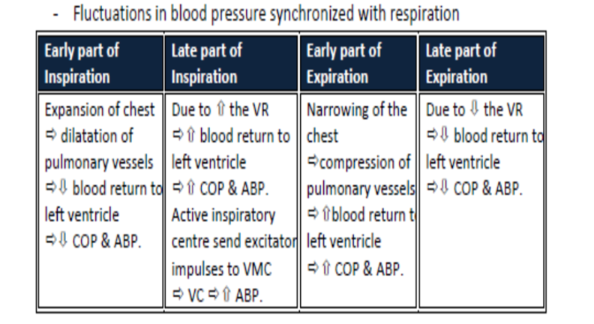

Slide 20
Factors affecting ABP: 1) Blood volume
↑ Blood volume → ↑ blood pressure.
Blood is incompressible—the molecules cannot be forced to come closer together by external force. However, the impact of changes in blood volume are partially damped out by the fact that arteries are compliant—the walls are able to stretch to accommodate more fluid without a proportional increase in pressure.

Slide 21
With age, our arteries stiffen (become less compliant)
Arteriosclerosis is a factor that contributes to the gradual increase in blood pressure that we experience with age.
The kidney controls the blood volume by modulating the amount of salt and, consequently, water that is reabsorbed in the distal tubule.

Slide 22
2) COP
COP= SV x HR
The relationship between cardiac output and blood pressure is a proportional: if all other parameters remain unchanged, doubling cardiac output would double blood pressure.

Slide 23
3) Total peripheral resistance (TPR)
It is the resistance that opposes the blood flow, it is present mainly in the arterioles(contain more smooth muscles ).
It is mainly controlled by the diameter of arterioles(As blood vessel length & blood viscosity kept constant ).
↓ Arteriolar diameter (VC)
↑ Peripheral resistance
↑ Blood pressure
↑ Arteriolar diameter (VD)
↓ Peripheral resistance
↓ Blood pressure

Slide 24
Comment on pulse
Pulse:
The impulse transmitted to the arteries by contraction of the left ventricle of the heart.
Provides information concerning the number of cardiac contractions per minute (rate) and the overall regularity of the contractions (rhythm).
A full comment on (Patient’s pulse) should include a comment on:
▪ Rate
▪ Rhythm
▪ Volume
▪ Equality on both sides

Slide 25
Thank you!

