Slide 1
Liver & pancreatic injury
Done by: supervised by: dr. saad al- azzawi
OTHMAN ALI
ANAS SHAWAREH
MAHDI ALOUSH

Slide 2
Liver injury
Liver injury
Introduction :
Liver is the second most common organ injured in abdominal trauma
Liver trauma can be divided into : Blunt (more common , higher mortality )& Penetrating injury .

Slide 3
Symptoms of a liver injury
right upper quadrant pain, increase with deep breathing.
nausea or vomiting, tachycardia and fainting,
Physical examination :
tenderness to palpation in the right upper quadrant of the abdomen. Abnormalities of blood pressure and pulse will be noted (low blood pressure and pulse over 100).

Slide 4
Liver injury scale
Grade I :Sub capsular hematoma < 10%of surface area,non expanding.
Laceration < 1cm parenchymal depth,non bleeding.
Grade II :Sub capsular hematoma 10-50%
parenchymal Laceration 1-3 in depth ,<10 cm in length.
Grade III :Sub capsular hematoma >50 %
3 cm parenchymal depth.
Grade IV : Ruptured intra parechymal hematoma with active bleeding.
Parechymal distruption involving 25-50%of hepatic lobe.
Grade V : Parenchymal distruption >50%of hepatic lobe
Vascular injuries :hepatic veins,inf. Vena cava.

Slide 6
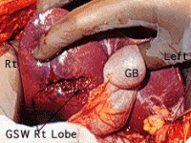
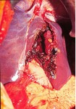
Liver injury
Grade II
Grade IV

Slide 7
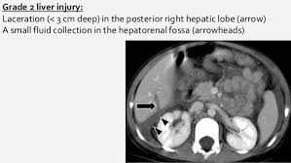
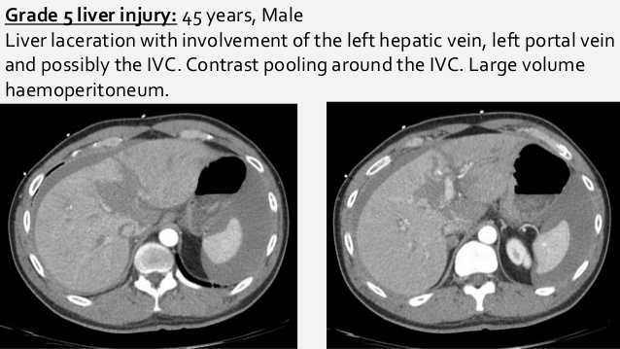

Slide 8
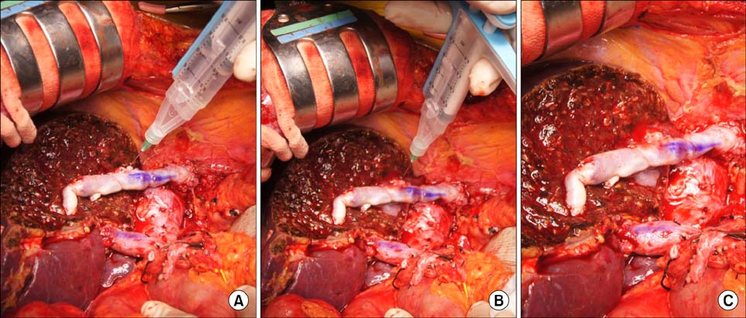
Management of liver injury :
Nonoperative management: is safe, effective, and clearly
the treatment modality of choice in hemodynamically stable patients.
The weakness in this treatment is the possibility of missing an associated intra abdominal injury
Operative management :
- simple suture techniques
- resectional debridement to control hemorrhage.
- Anatomic resection,
-hepatic artery ligation
- Mesh wrapping or perihepatic packing,
- fibrin glue application

Slide 9
Pancreatic Injury

Slide 10
Etiology
The pancreas, sitting in a relatively protected position high in the retroperitoneum, is infrequently injured in typical blunt injuries.
Penetrating trauma
- 70% of all pancreatic injuries
- Stab / firearm wounds
Blunt abdominal trauma
- 30% cases

Slide 11
Clinical Presentation
Pancreatic injury can be symptom free early in the post injury time frame and even silent in many cases.

Slide 12
Pancreatic Injury Grading
Grade | Injury | Description
I | Hematoma | Minor contusion without duct injury
 | Laceration | Superficial laceration without duct injury
II | Hematoma | Major contusion without duct injury or tissue loss
 | Laceration | Major laceration without duct injury or tissue loss
III | Laceration | Distal transection or parenchymal injury with duct injury
IV | Laceration | Proximal transection or parenchymal injury involving ampulla
V | Laceration | Massive disruption of pancreatic head

Slide 14
Investigations
Serum amylase
Plain abdominal x-ray
CT Abdomen: mainstay of accurate diagnosis
ERCP
Exploratory laparotomy

Slide 15
CT scan
In patients experiencing blunt trauma, CT scans provide the best overall method for diagnosis and recognition of a pancreatic injury.
Findings:
A hematoma surrounding the pancreas
Fluid in the lesser sac
Parenchymal lacerations
Transections
Contraindicated if the patient is hemodynamically unstable

Slide 17
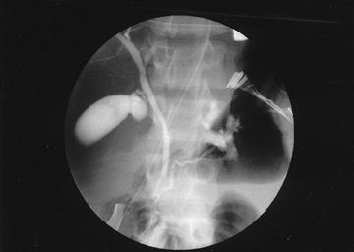
ERCP
(ERCP) can be used in cases where clinically there is high suspicion of pancreatic ductal injury .
Preoperative ERCP may be done in a stable patient to know any pancreatic ductal disruption which helps to plan a definitive procedure and reduces morbidity .

Slide 18
Non-operative management
If there is no evidence of a ductal injury on CT, non-operative management is acceptable, although it may be wise to perform ERCP to establish normal ductal anatomy definitively.
Notes:
In non-operative management, serial physical and laboratory examinations (ie, hemoglobin, amylase, lipase) are required.
A continued increase in serum amylase levels or change on physical examination mandates an abdominal operation or repeat imaging with CT or ERCP.

Slide 19
Operative Management
Indications:
Peritonitis on physical examination
Hypotension
Evidence of disruption of the pancreatic duct

Slide 21
Complications of Pancreatic injury
Fistula formation is the most frequently reported complication,
Treatment : wide local drainage and good nutrition and supportive care, usually resolve spontaneously within 2 weeks of injury
Chronic pancreatitis, traumatic pseudocysts.

Slide 22
Duodenal injury
The duodenum lies retroperitoneally and so injuries are hidden and only discovered late or at laparotomy performed for other reasons.

Slide 23
Clinical presentation
The diagnostic accuracy of duodenum injury is low because it has no specifical clinical symptoms and signs. the injury may not present with any peritoneal irritation sign, especially when the second and third parts of duodenum are injured.
Abdominal pain especially when the right upper quadrant is injured.
Retching or vomiting with blood in the vomitus.
Abdominal distension especially in the upper quadrant
Detection of fluid like bile or intestinal juice by diagnostic abdominocentesis.

Slide 24
Diagnosis
Water-soluble radiopaque contrast medium can be injected through a nasogastric tube just before the abdominal film is taken. If leakage happens, rupture of duodenum can be confirmed.
The only sign may be gas in the periduodenal tissue seen at CT.

Slide 25
Duodenal Injury Grading

Slide 27
Management
Duodenal Hematoma Management:
Non operative: NGT , TPN
Surgical: Evacuation after 2 weeks
Duodenal perforation management:
Primary repair ( most perforations of the duodenum can be treated by primary repair)

Slide 28
Management
Management of Duodenal injury depends on which portion is affected:
1st portion → debridement & end-to-end anastomosis (because of the mobility and rich blood supply of the gastric pylorus )
2nd portion → For lesions between the accessory papilla and the papilla of Vater, avascularized jejunal graft, either a patch or tubular interposition graft, may be required.

Slide 29
Management
3rd & 4th portion → resect the third and fourth portions and perform a duodenojejunostomy on the left side of the superior mesenteric vessels
High-risk or complex duodenal repairs → Whipple procedure (Pancreaticoduodenectomy)

Slide 31
Damage control surgery

Slide 32
Damage Control Surgery
Multiple trauma patients are more likely to die from their intra-operative metabolic failure than from a failure to complete operative repairs.
Those at high risk of death has the death triad of:
Coagulopathy,
Hypothermia and
Metabolic acidosis

Slide 33
THE DAMGE CONTROL APPROCH
The term damage control describe a systematic Five-stages approach designed to disrupt the lethal cascade of event leading to death

Slide 35
Stages of Damage Control Surgery
Stage I: initial resuscitation and Patient selection based on indications.
Most of the resuscitation is carried out in the operating room or before hospital arrival.
Commonly, the initial resuscitation is provided by large bore intravenous catheters using crystalloids.
fluids have been given to restore normal vital parameters, goal systolic pressure of approximately 90 mm Hg .

Slide 36
Stage II: abbreviated laparotomy
Control of haemorrhage and control of contamination through various techniques:
Simple ligation of bleeding vessels,
multiple holes in bowel closed by stapling or ligation to prevent further spillage of content
Therapeutic packing
Manual occlusion of the Aorta .
Splenic , Renal , and Pancreatic tail injuries make them candidates for total or partial resection.
Liver : Packing or Pringle manouver if the bleeding is not controlled

Slide 37
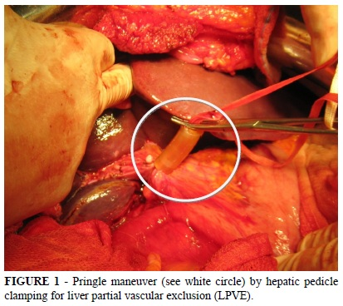
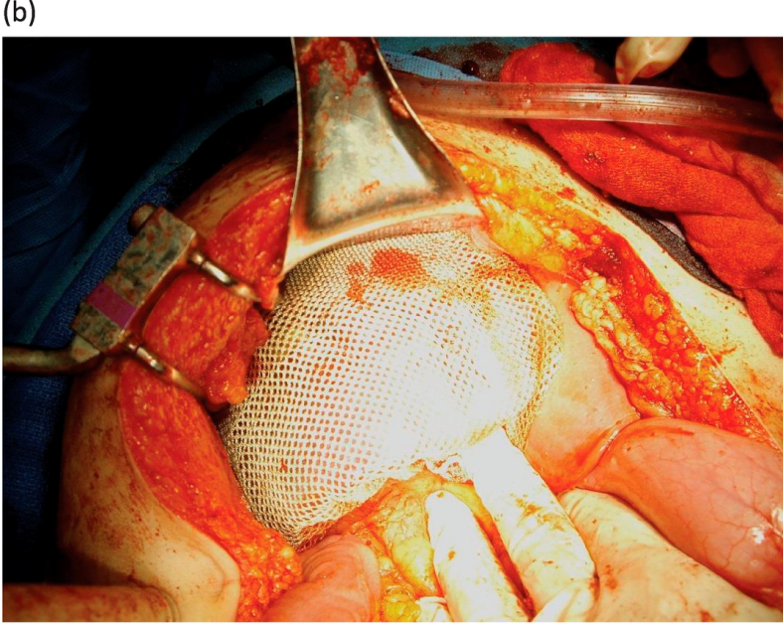

Slide 38
Stage 2 (Cont.)
Temporary closure using:
Numerous methods of temporary closure exist Regardless of which method one decides to use it is important that the abdominal fascia is not reapproximated
-Towel-clipping of skin edges
-Bogota Bag
Bogota Bag is transparent allow inspection of intestine , hemorrhage , leak and gangrene

Slide 39
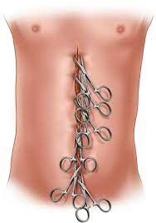

Slide 41
Stage III: ICU Resuscitation
Resuscitation continued in the intensive care unit the aim of this is the correction of hypothermia, acidosis and coagulopathy. Following this, further physiological investigation or radiological intervention can be carried out.
Monitoring for abdominal compartment syndrome development needs to be performed. Failure to recognize this clinical entity is often lethal.

Slide 42
Stage IV: Subsequent Laparotomy and Definitive surgery
After resuscitation in the ICU has allowed the patient to regain physiologic reserve, generally in 24 to 48 hours, definitive repair can be undertaken.
Premature return to theatre will convert a definitive second operation into a second damage control procedure and result in further physiological insult for the patient; however, undue delay may increase the risk of intra-abdominal sepsis and the progression of previously unrecognized injuries.
Stage V: Include RCU again with abdominal closure if it is need

Slide 43
intra abdominal hypertension and Abdominal compartment syndrome

Slide 44
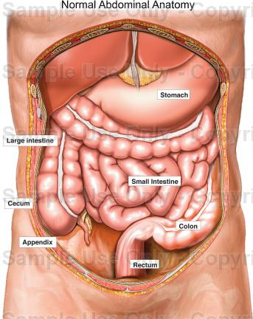
Intra-abdominal pressure;
The abdomen can be considered a closed box with walls both rigid (costal arch, spine, and pelvis) and flexible (abdominal wall and diaphragm).
Since the abdomen and its contents can be considered as relatively non-compressive and primarily fluid in character. Therefore, the IAP measured at one point may be assumed to represent the IAP throughout the abdomen (with the rare exception of upper ACS).
IAP increases with inspiration (diaphragmatic contraction) and decreases with expiration (diaphragmatic relaxation).
It is also directly affected by the volume of the solid organs or hollow viscera (which may be either empty or filled with air, liquid or fecal matter), the presence of ascites, blood or other space-occupying lesions (such as tumors or gravid uterus), and the presence of conditions that limit expansion of the abdominal wall (such as burn or third-space edema)

Slide 45
Definitions
Intra-abdominal Hypertension (IAH): An IAP > 12 mm Hg (often causing occult ischemia) without obvious organ failure
Abdominal Compartment Syndrome (ACS): IAH >20mmHG + with at least one overt organ failure

Slide 46
Grading of IAH:

Slide 47
ETIOLIGY
ACS can be classified primary or secondary.
Primary ACS is due to injury or disease in the abdominopelvic region (eg , abdominal trauma , hemopertinum ,pancreatitis ) intervention ( surgical, radiologic) .
Secondary ACS refers to condition that do not originate in the abdomen or pelvis (eg , fluid resuscitation , sepsis, burn)

Slide 48
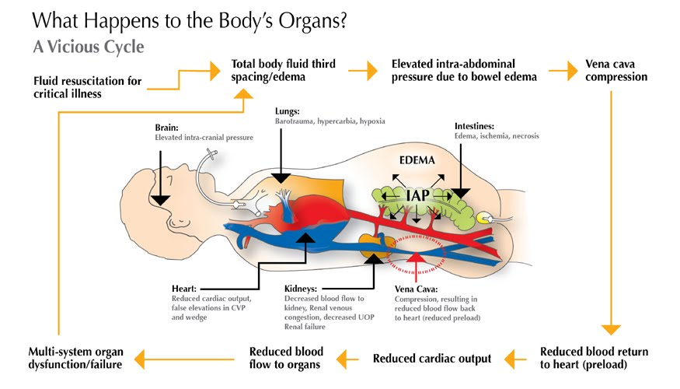

Slide 49
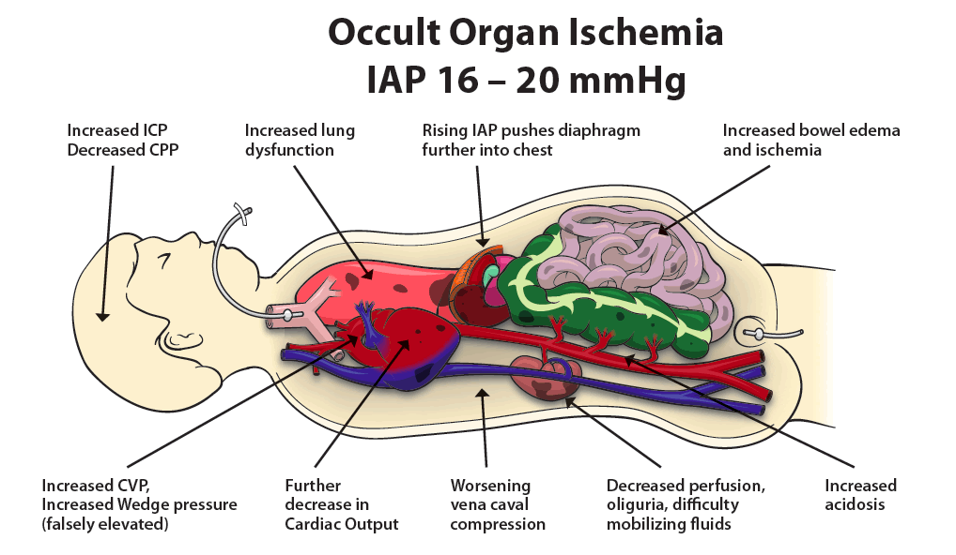

Slide 50
Clinical presentation
The history varies depending on the cause of abdominal compartment syndrome, but abdominal pain is commonly present. Abdominal pain may precede the development of abdominal compartment syndrome and may be directly related to a precipitating event, such as blunt abdominal trauma or pancreatitis.
patients who develop abdominal compartment syndrome may be unable to communicate, because they are often intubated and critically ill.
Signs and symptoms can include the following:
-Tense distended abdomen
-Difficulty breathing
-oliguria

Slide 51
Diagnostic evaluation
Definitive diagnosis of ACS requires measurement of IAP.
Can be done indirectly using intragastric , intracolonic ,intravesical (bladder), IVC Catheter.
Intravesical It is simple ,minimally invasive ,accurate and material available in all ICU.

Slide 52
Iap measurement

Slide 53
mangment
Icu admission with close monitring.
IAP monitring.
Oxygen mask.
Iv fluid with restriction.
NG tube
Antibiotic .
Correct hypovolemia , hypothermia, coagulation state
Blood transfusion
Decompressive laparotomy

