Slide 1
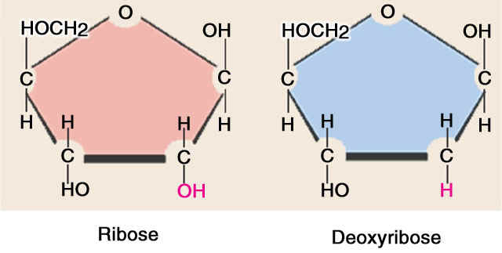
Pentose Phosphate Pathway
Dr. Nesrin Mwafi
Biochemistry & Molecular Biology Department
Faculty of Medicine, Mutah University

Slide 2
Pentose Phosphate Pathway
The predominant pathway for glucose catabolism is glycolysis which yield pyruvate followed by oxidation to CO₂ in the Krebs cycle
Pentose phosphate pathway (PPP) is an anabolic rather than catabolic pathway. PPP is an alternative pathway for glucose metabolism which draws G6P from the glycolysis cycle
PPP occurs in the cytosol of the cell. It has two main purposes:
To generate NADPH molecules (universal reductant) required for biosynthetic pathways and detoxification reactions
To generate the pentose sugar “ribose-5-phosphate” required for nucleotides and nucleic acids biosynthesis

Slide 3
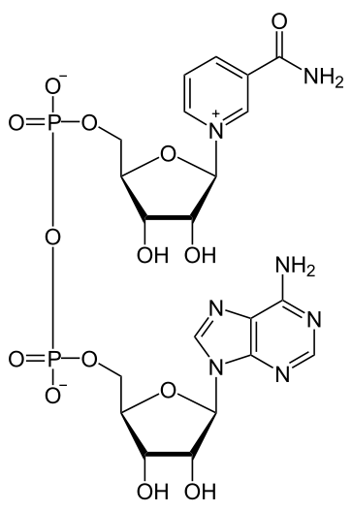
Nicotinamide Adenine Dinucleotide
Nicotinamide adenine dinucleotide, abbreviated as NAD⁺, is a coenzyme found in all living cells
It is composed of two nucleotides linked through their phosphate groups
The coenzyme is found in two forms in cells:
The oxidized form “NAD^{+”} is an oxidizing agent which can accept electrons from other molecules and becomes reduced
The reduced form “NADH” which can be used as a reducing agent (electrons donor)
NAD⁺

Slide 4
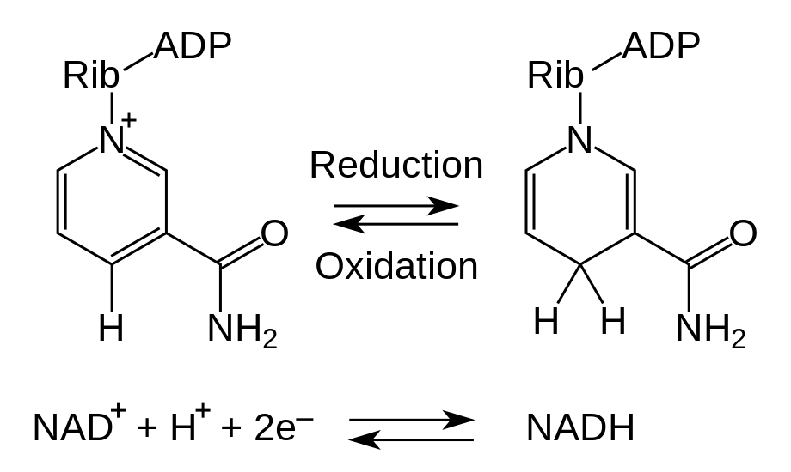
Nicotinamide Adenine Dinucleotide
Therefore, Nicotinamide adenine dinucleotide is used in redox reactions during metabolism carrying electrons from one reaction to another (RH₂ + NAD⁺ → NADH + H⁺ + R)
H⁺
H
H⁻

Slide 5
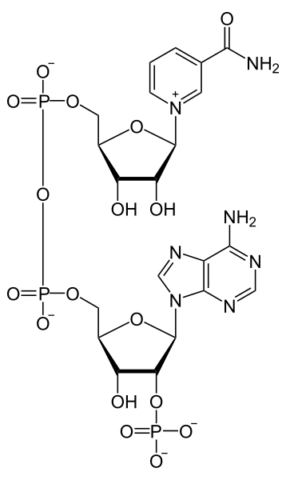
Nicotinamide Adenine Dinucleotide Phosphate
Nicotinamide adenine dinucleotide phosphate (abbreviated as NADP⁺) differs from NAD⁺ in the presence of additional phosphate group on the C2’ of the adenosine ribose ring
NAD⁺
NADP⁺

Slide 6
Nicotinamide Adenine Dinucleotide Phosphate
Nicotinamide adenine dinucleotide phosphate exists in two forms: NADP⁺ the oxidized form and NADPH the reduced form
This coenzyme is used in anabolic rather than catabolic reactions such as lipid and nucleic acid synthesis which require NADPH as reducing agent. Additionally, it has a role in detoxification reactions
Pentose phosphate pathway is the major source of NADPH in animals (continuously regenerated from NADP⁺)
Tissues such as liver, adipose tissue, mammary gland and adrenal gland are rich in PPP enzymes because NADPH is used for fatty acids and steroids biosynthesis
High level of PPP enzymes also seen in rapidly proliferating cells but PPP is nearly absent in other tissues like skeletal muscles

Slide 7
Nicotinamide Adenine Dinucleotide
Nicotinamide adenine dinucleotide is synthesized by two different metabolic pathways:
A de novo pathway: most organisms synthesize NAD⁺ from simple components like tryptophan in animals and aspartic acid in plants.
Some NAD⁺ is converted to NADP⁺ via NAD⁺ kinase which phosphorylate NAD⁺ in an ATP-dependent step
A salvage pathways: by recycling preformed components back to NAD⁺ such as nicotinic acid and nicotinamide obtained from food (i.e. niacin or vitamin B3)

Slide 8
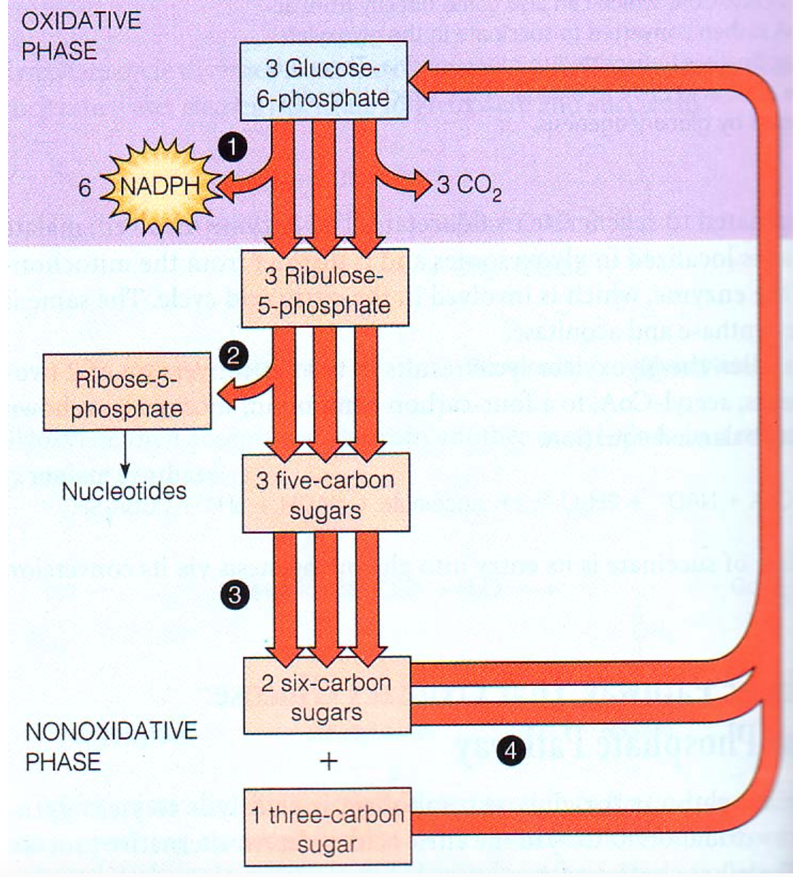
From Glycolysis to PPP
ate

Slide 9
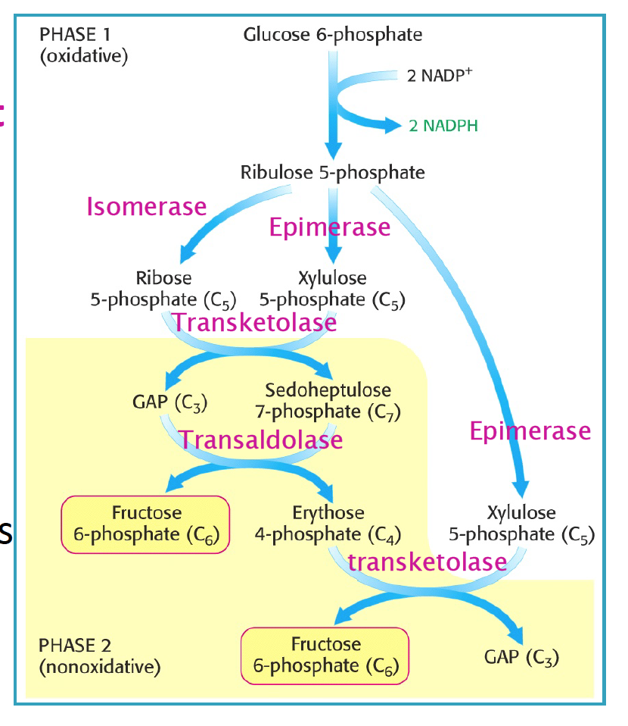
Pentose Phosphate Pathway
The PPP pathway consists of two phases: the oxidative phase (irreversible reactions) during which NADPH molecules are generated and the non-oxidative phase (reversible reactions) during which different sugars phosphates are synthesized according to cellular need

Slide 10
The Oxidative Pathway
Step 1: Glucose-6-phosphate (G6P) is oxidized by G6P dehydrogenase generating 6-phosphogluconolactone. One NADP⁺ is reduced to NADPH
Step 2: 6-phosphogluconolactone is hydrolyzed in presence of H₂O by glucolactonase to 6-phosphogluconate
Glucose-6-P
6-Phosphogluconolactone

Slide 11
The Oxidative Pathway
Step 3: 6-phosphogluconate undergoes oxidative decarboxylation to yield ribulose-5-phosphate, CO₂ and another NADPH. Initially, OH at C3 is oxidized to carbonyl group and subsequently carboxyl group at C1 is eliminated as CO₂
COO⁻
Glucolactonase
6-Phosphogluconolactone
6-Phosphogluconate
COO⁻
6-Phosphogluconate
Ribulose-5-phosphate

Slide 12
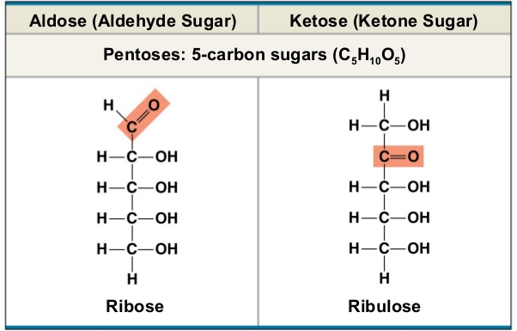
The Oxidative Pathway
The net result of this process is:
G6P + 2NADP⁺ + H₂O → ribulose-5-phosphate + 2NADPH + 2H⁺ + CO₂

Slide 13
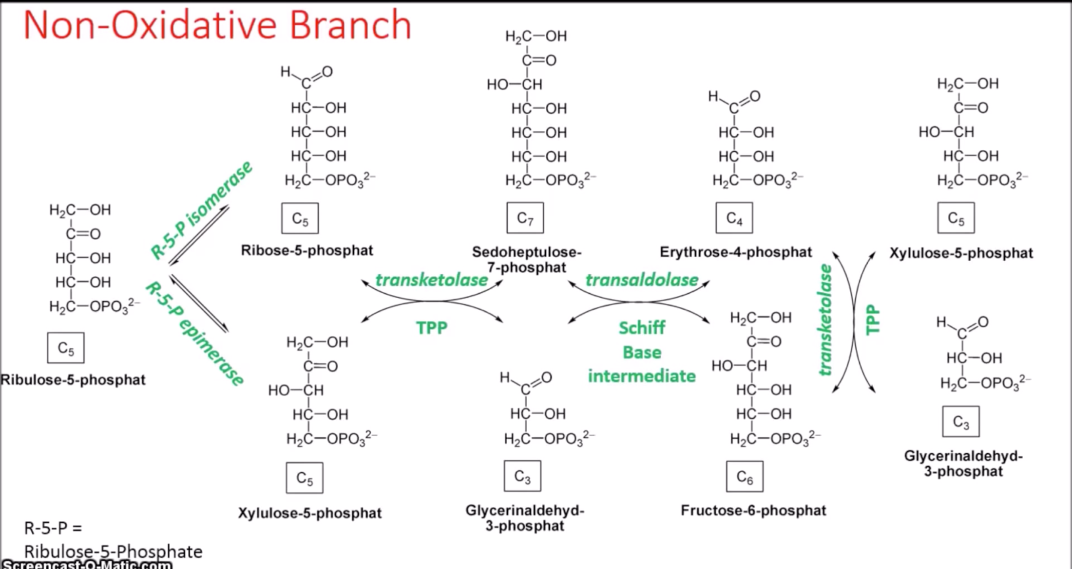
The Non-oxidative Pathway
The non-oxidative pathway is the alternative fates of pentose phosphates

Slide 14
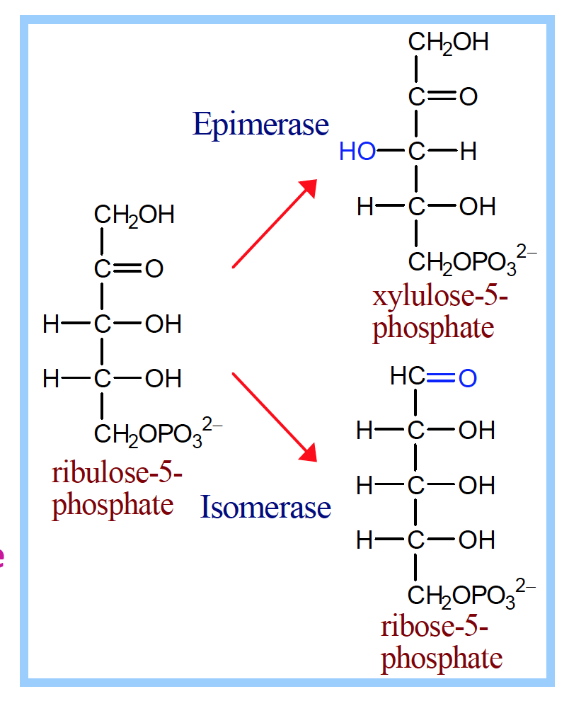
The Non-oxidative Pathway
Step 1: is the beginning of the non-oxidative phase. Some of the ribulose molecules are converted to ribose-5-phosphate by phosphopentose isomerase and some are converted to xylulose-5-phosphate by phosphopentose 3-epimerase

Slide 15
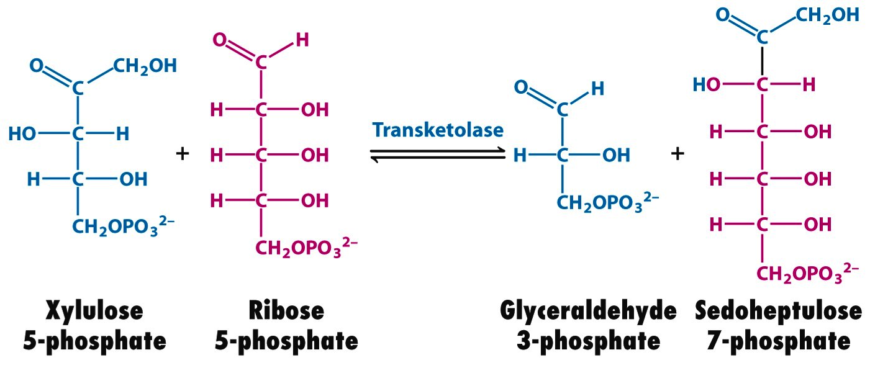
The Non-oxidative Pathway
Step 2: the produced two pentoses: ribose-5-phosphate and xylulose-5-phosphate can react together in a reaction catalyzed by transketolase which transfers a two carbon fragment from xylulose-5-phosphate to ribose-5-phosphate to generate sedoheptulose-7-phosphate (7C) and glyceraldehyde-3-phosphate (3C)
An activated glycolaldehyde fragment is transferred using thiamine pyrophosphate (TPP) as coenzyme
TPP

Slide 16
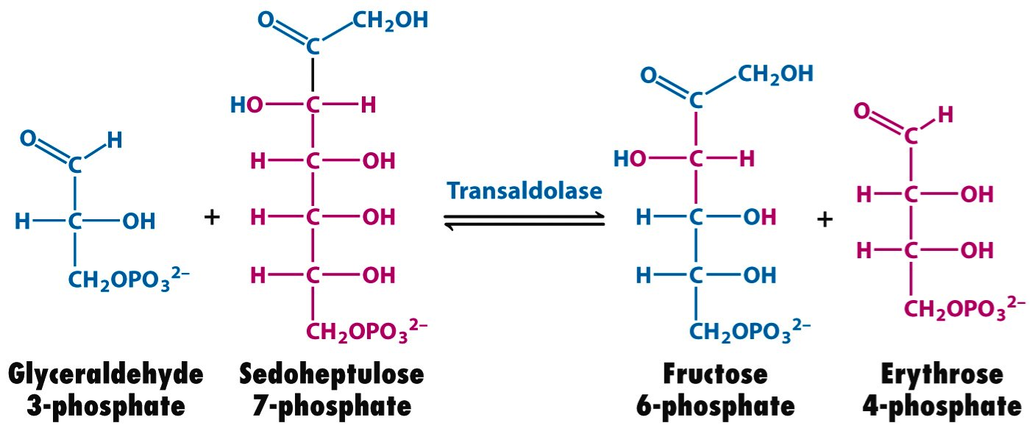
The Non-oxidative Pathway
Step 3: transaldolase acts on the transketolase two products with the transfer of dihydroxyacetone fragment (3C) from 7C substrate to 3C substrate. This reaction generates erythrose-4-phospahte and fructose-6-phoshate

Slide 17
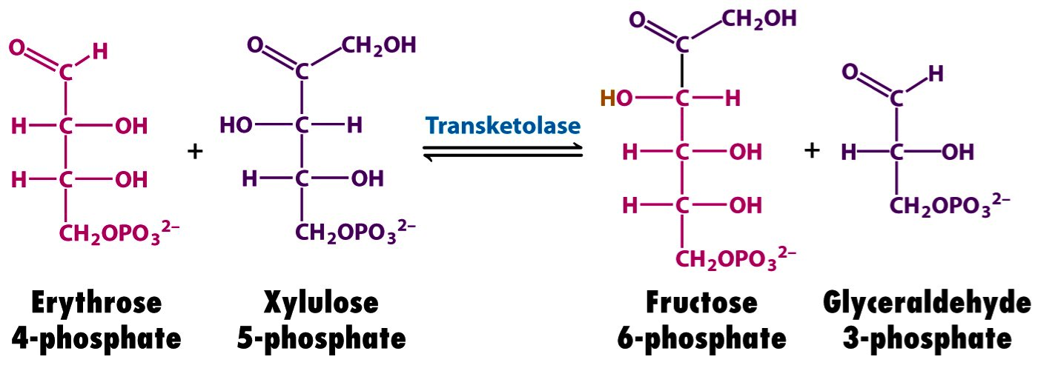
The Non-oxidative Pathway
Step 4: transketolase acts on another molecule of xylulose-5-phosphate by transferring glycolaldehyde fragment (2C) to erythrose-4-phospahte (4C). This produces glyceraldehyde-3-phosphate and fructose-6-phosphate

Slide 18
Pentose Phosphate Pathway
Oxidative phase:
3 G6P + 6 NADP⁺ + 3 H₂O 3 pentose-5-phosphate +
6 H⁺ + 6 NADPH + 3 CO₂
Non-oxidative phase:
2 xylulose-5-phosphate + 1 ribose-5-phosphate
2 fructose-6-phosphate + 1 glyceraldehyde-3-phosphate

Slide 19
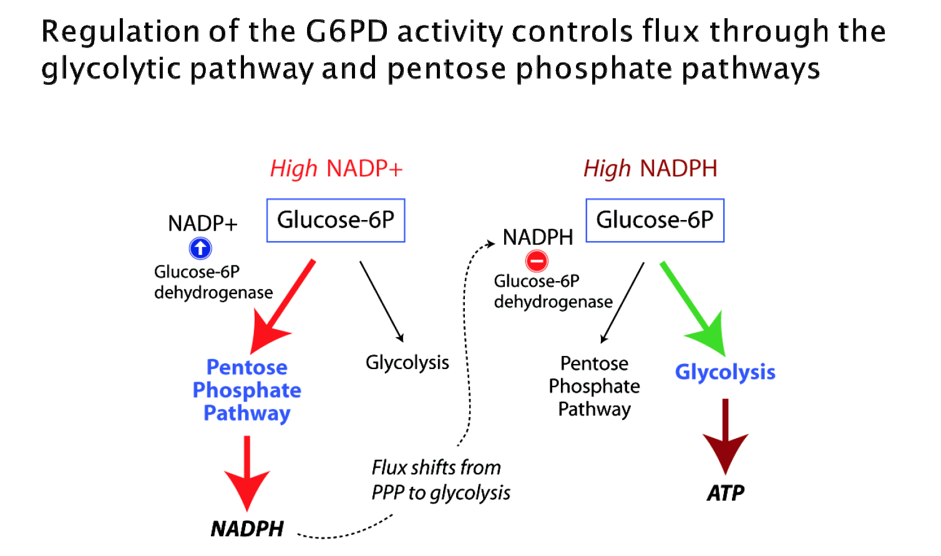
Pentose Phosphate Pathway Regulation
The activity of glucose-6-phosphate dehydrogenase (catalyzing the rate limiting reaction) is controlled by the ratio of NADPH/NADP⁺
It is allosterically stimulated by NADP⁺ and strongly inhibited by NADPH

Slide 20
Metabolic Needs of the Cell Direct the Fates of PPP products
Although PPP is not primarily an energy-generating pathway but in certain modes it can operate to oxidize glucose completely to CO₂ and H₂O
The actual fates of PPP sugar phosphates depend on the metabolic needs of the cell in which the pathway is functioning
Therefore, PPP can operate in various modes/scenarios to maximize the level of its different products (i.e. NADPH, ribose-5-phosphate and ATP)
Because of the multiple metabolic needs of a particular cell, more than one model operates in that cell in temporal fashion (time based)

Slide 21
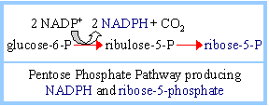
Metabolic Needs of the Cell Direct the Fates of PPP products
First Metabolic Mode “nucleic acids biosynthesis”
If the primary need is for nucleotide and nucleic acid synthesis (as in rapidly proliferating cells), the major product is ribose-5-phosphate and most of the non-oxidative phase does not take place. Some NADPH are also produced

Slide 22
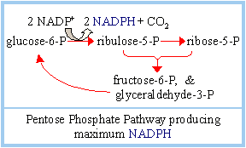
Metabolic Needs of the Cell Direct the Fates of PPP products
Second Metabolic Mode “NADPH Synthesis”
If the primary need is for NADPH (i.e. for fatty acids or steroids synthesis), the non-oxidative phase generates compounds that can be easily reconverted to G6P for subsequent passage through the oxidative phase maximizing the NADPH production

Slide 23
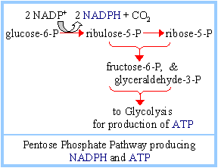
Metabolic Needs of the Cell Direct the Fates of PPP products
Third Metabolic Mode “Energy Generation”
If the cell in moderate need for both NADPH and ribose-5-phosphate, the end products of non-oxidative phase F6P and G3P can be further catabolized by glycolysis and TCA cycle to produce ATP. This pathway also produce some NADPH

Slide 24
G6P Dehydrogenase Deficiency
One of well known disorder is the deficiency in G6P dehydrogenase also known as “favism” consequently, reduced intracellular NADPH level. It is an X-linked recessive genetic condition
Favism

Slide 25
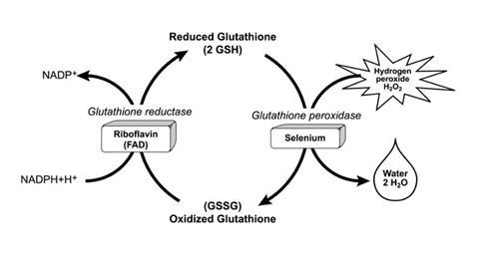
G6P Dehydrogenase Deficiency
Defects in PPP results in reduced intracellular NADPH level which participates in the glutathione cycle to protect cells against hydrogen peroxide
G6PD enzyme prevents oxidative damage
G6PD deficiency is characterized by hemolytic anemia
Glutathione
reductase
Glutathione
peroxidase
PPP

Slide 26
G6P Dehydrogenase Deficiency
PPP is active pathway in RBCs for generation of reducing power. Actually, NADPH in RBCs is important to keep a high ratio of the reduced glutathione which is vital to protect cells from damaging effect of ROS (detoxification process)
People with this deficiency are asymptomatic until stressed
People with G6PD deficiency are at risk of hemolytic anemia (destruction of RBCs) in state of oxidative stress such as exposure to infection, some medications and certain foods (e.g. broad or fava beans)
Oxidative stress is due to imbalance between the generation of ROS or free radicals (e.g. H₂O₂, .OH,…) and the removal by specific cellular enzymes (antioxidants) like glutathione peroxidase (enzyme abundant in cells)

Slide 27
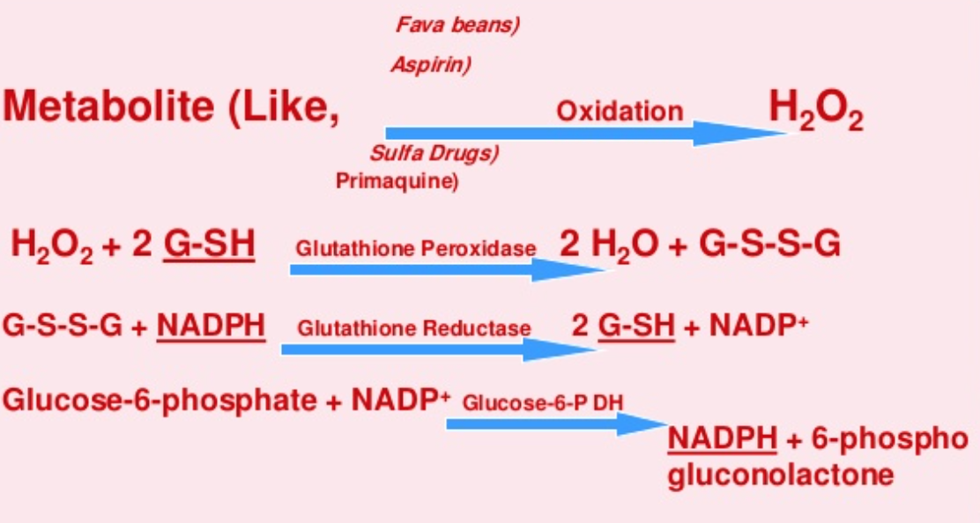
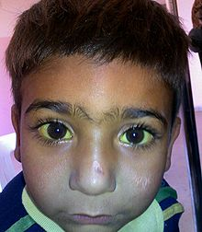
G6P Dehydrogenase Deficiency
Oxidative stress depletes the reduced form of glutathione (GSH) and G6P dehydrogenase deficiency disorder can not supply enough NADPH to regenerate GSH from the oxidized one (GSSG)
Damaged RBCs are recycled to the spleen. The hemoglobin is metabolized to bilirubin causing jaundice in high concentration
Fava beans

