Slide 1
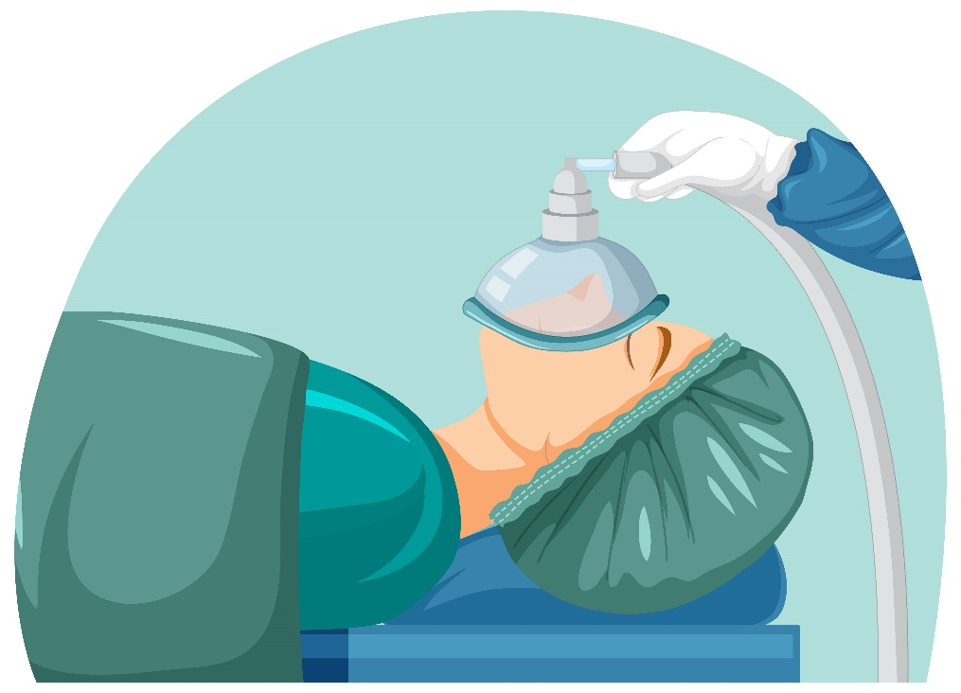
DAY
DATE
THURSDAY
18/09/2024
Intro To Anesthesia
PRESENTED BY
Abdullah Abu Khalaf Emran Younis Obada Alayed Khaled Emad
MUTAH UNIVERSITY
FACULTY OF MEDICINE

Slide 2
TABLE OF CONTENTS
01
HISTORY OF ANAESTHESIA
03
STAGES AND PHASES
02
TERMS AND CONCEPTS
04
HISTORY TAKING
05
PHYSICAL EXAM AND ASA CLASSIFICATION

Slide 3
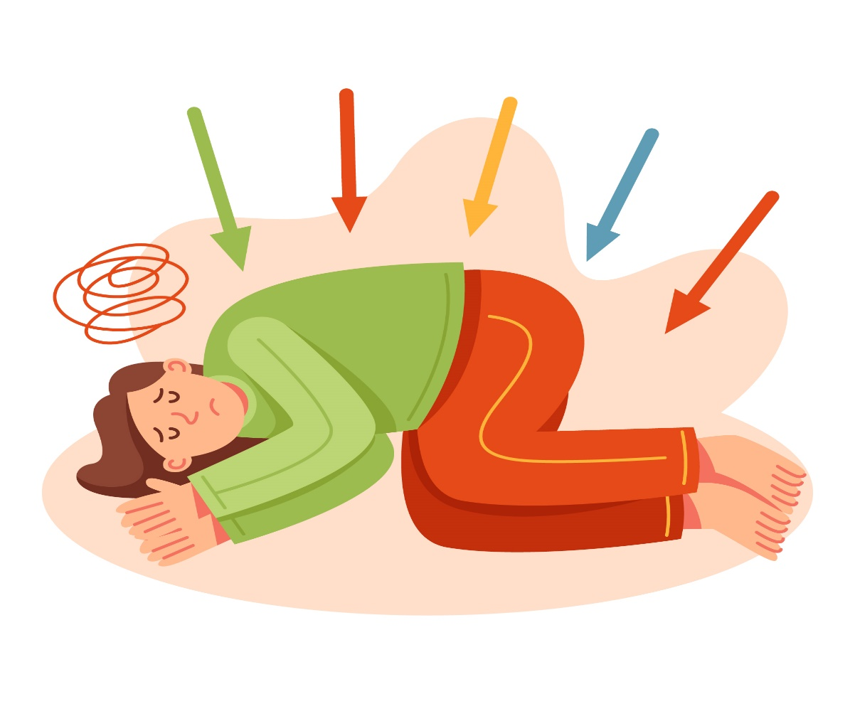
BEFORE 1846
Few drugs/plants product used to remove pain:
- Alcohol - Opium - Cocaine
Other method /nondrugs method used to remove pain:
- Cold - Concussion - Carotid compression - Hypnosis
جاء في وفيات الأعيان: "لما دُعي الجزار ليقطعها، قال له: نسقيك الخمر؛ حتى لا تَجِد لها ألمًا، فقال: لا أستعين بحرام الله على ما أرجو من عافية، قالوا: فنسقيك المُرْقِد، قال: ما أحب أن أسلب عضوًا من أعضائي وأنا لا أجد ألم ذلك فأحتسبه"
HISTORY!

Slide 4
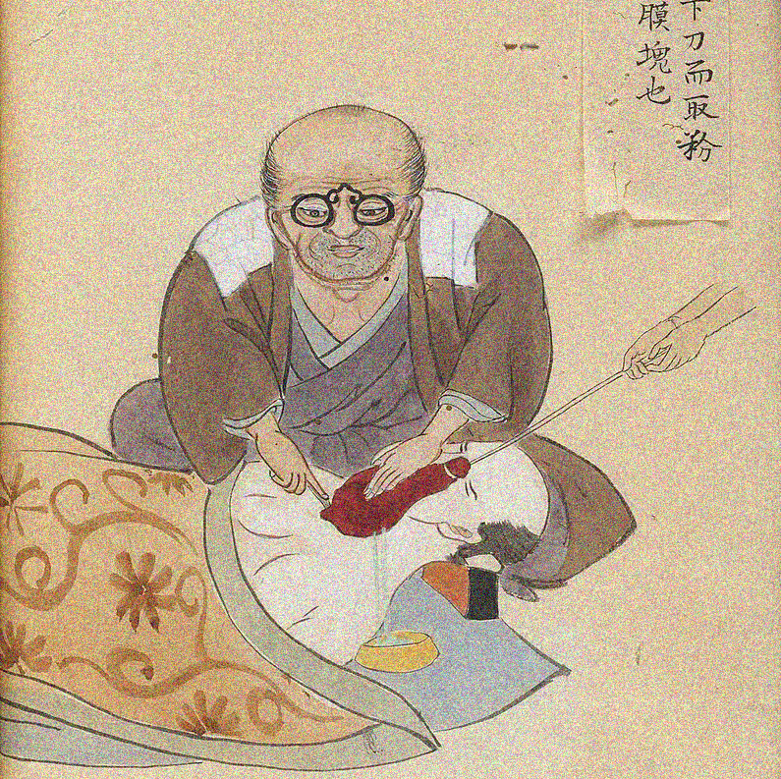
1804
The first reliable documentation of an operation to be performed under general anesthesia was
conducted by the Japanese surgeon, Hanaoka Seishu, in 1804 who performed a partial mastectomy for breast cancer on a 60-year-old woman.
He used an oral solution composed of blend of some herbal extracts to perform the anesthesia.

Slide 5
Terminology
Anesthesia: is a state of controlled, temporary loss of sensation or awareness that is induced for medical purposes.
Anesthesiology: is the medical specialty concerned with the total perioperative care of patients before, during and after surgery.
Anesthesiologist: A physician specialized in anesthesiology.

Slide 6
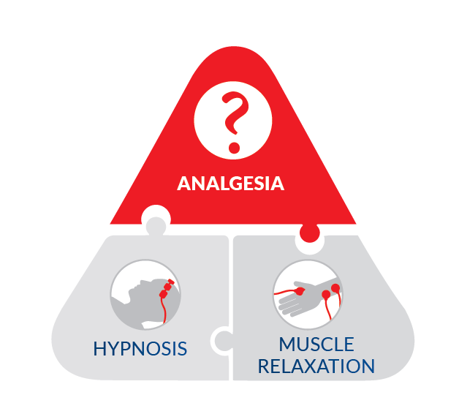
Triangle Of Anesthesia
Analgesia: the loss of physical sensation with or without loss of consciousness.
Muscle Relaxation: aided by drugs which affect skeletal muscle function and decrease the muscle tone by which immobility and relaxation of the skeletal muscle produced.
Hypnosis (Amnesia): refers to the loss of memories, such as facts, information and experiences and is usually anterograde amnesia.

Slide 7
Types of Anesthesia
General
Spinal
Epidural
Nerve Block
Local

Slide 8
General Anesthesia
Is altered physiological state characterized by Reversible :
loss of consciousness
Analgesia of the entire body
Amnesia
± muscle relaxation

Slide 9
Local Anesthesia
Technique depends on a group of drugs that produces transient loss of autonomic, sensory and motor function when the drugs are injected or applied to neural tissue. It is used when nerves can be easily reached by drops, sprays, ointments or injections. You stay conscious, but free from pain. Common examples of surgery using local anesthetic are having teeth removed and some common operations on the eye.

Slide 10
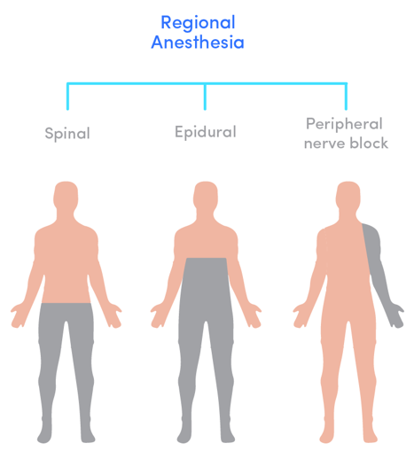
Regional Anesthesia
This is when a local anesthetic drug is injected near to the nerves
that supply a larger or deeper area of the body. The area of the body affected becomes numb.
(Spinal and epidural, nerve block).

Slide 11
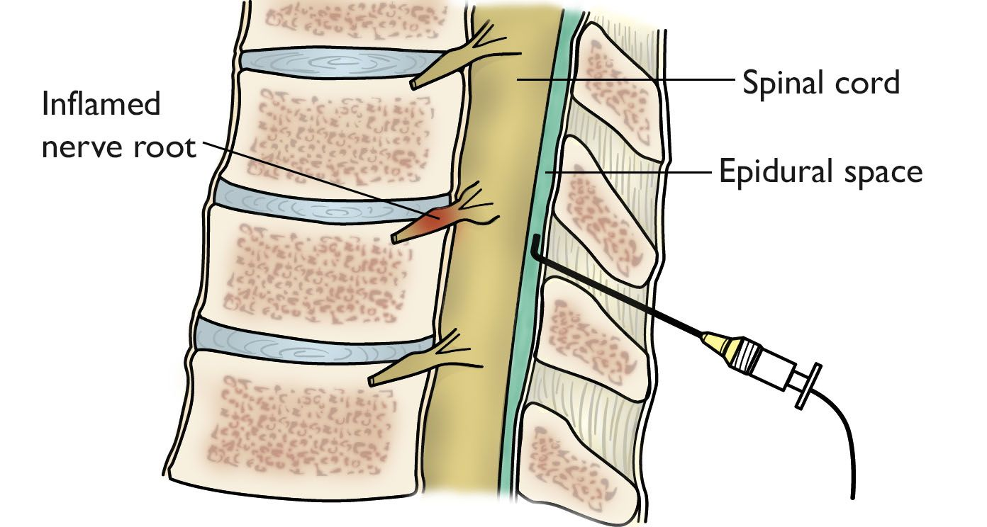
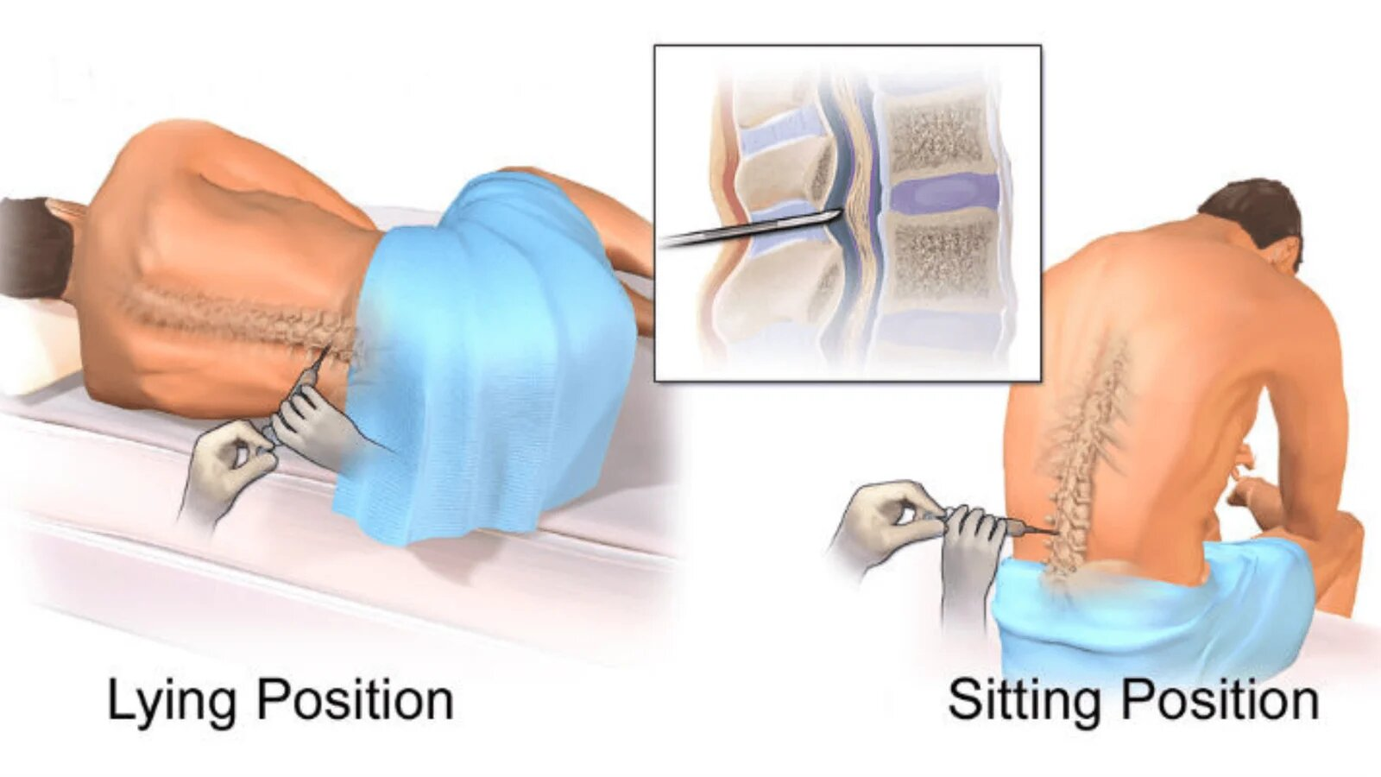
Spinal & epidural
Spinals and epidurals are the most common types of regional anesthetics. These injections can be used for operations on the lower body, such as caesarean section, bladder operations or replacing a hip. You stay conscious, but free from pain.
Nerve Block
injection placed near to a nerve or group of nerves, for example in the arm or leg , Nerve blocks are also useful for pain relief after the operation, as the area will stay numb for a number of hours (brachial plexus block)

Slide 12
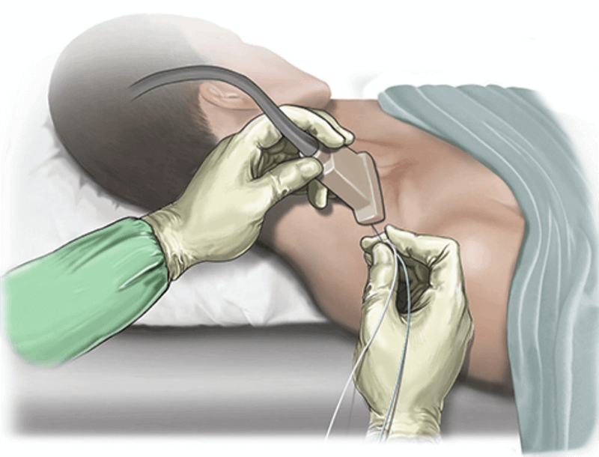
Nerve Block

Slide 13
Balanced Anesthesia
No one anesthetic agent can produce analgesia, muscle relaxation, loss of body sensations and amnesia, so we employ Balanced Anesthesia in which a “cocktail” of different drugs is used to achieve the goals on general anesthesia.
Balanced Anesthesia uses a combination of agents to limit the doses and toxicity of each drug.
The objectives of Balanced Anesthesia are to calm the patient, minimize the pain, and reduce the potential for adverse effects associated with analgesic and anesthetic agents.
Analgesia
Anesthesia
sedation
Muscle Relaxtion

Slide 14
Balanced Anesthesia
Analgesic or painkiller :is any member of the group of drugs used to achieve analgesia, relief from pain ( They are distinct from anesthetics Analgesia is pain relief without loss of consciousness and without total loss of feeling or movement Ex(Opioids, NSAIDs, Ketamine ….)
Amnesia: refers to the loss of memories, such as facts, information and experiences. Ex(Propofol, Benzodiazepines…)
Muscle relaxation: is a type of drug that causes muscle contraction to cease and decrease its tone. By block the nerve impulses to the muscles. They sometimes are also referred to as neuromuscular blocking agentsEx(Succinylcholine, Atracurium …)
Anxiolytics, or anti-anxiety drugs: are a category of drugs used to prevent anxiety and treat anxiety related to several anxiety disorders. Ex(Benzodiazepines, Alpha-2 Agonists ..)

Slide 15
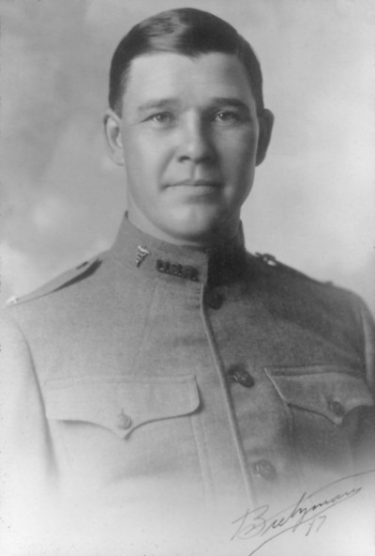
Stages of Anesthesia
Four main stages are recognized based upon:
Patient's body movements
Respiratory rhythm,
Oculomotor reflexes,
Muscle tone
Arthur Ernest Guedel

Slide 16
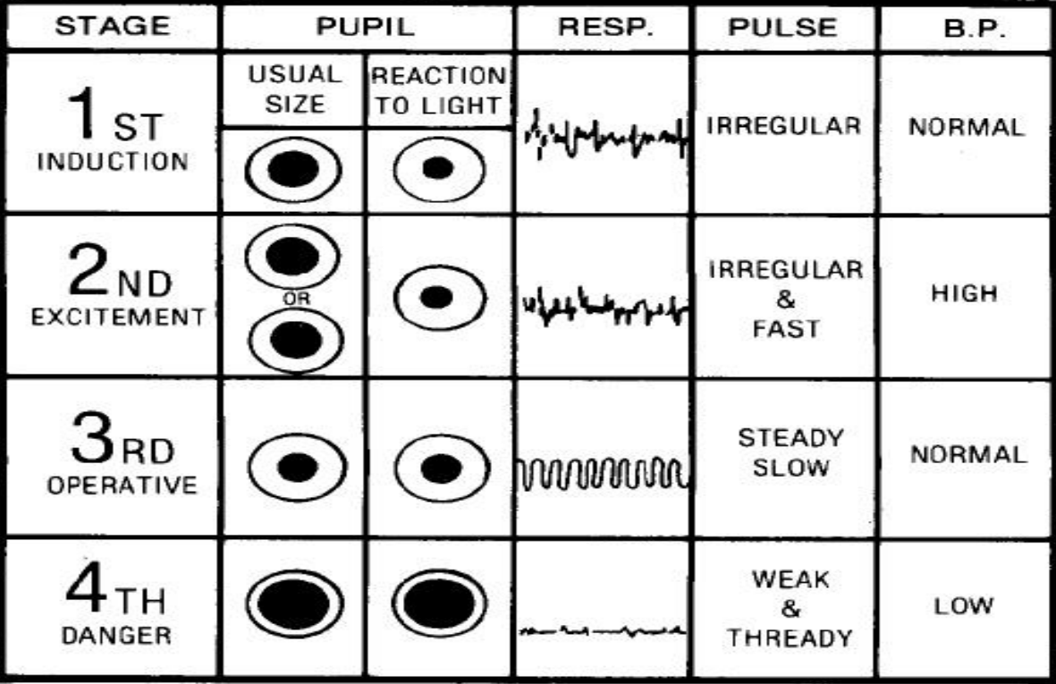
Arthur Experiment

Slide 17
Stage 1
(Amnesia and analgesia)
(Amnesia and analgesia) stage from beginning of the anesthetic to the loss of consciousness. During this stage, the patient progresses from analgesia without amnesia to analgesia with amnesia. Patients can carry on a conversation at this time.

Slide 18
Stage 2
(Excitement)
Because the combination of spastic movements, vomiting, and irregular respiration may compromise the patient's airway, rapidly acting drugs are used to minimize time in this stage and reach Stage 3 as fast as possible.
from loss of consciousness to onset of automatic breathing. Eyelash reflexes disappear but other reflexes remain intact. During this stage, the patient’s respiration and heart rate may become irregular in addition, there may be uncontrolled movements, vomiting, suspension of breathing, and pupillary dilation.

Slide 19
Stage 3
(Surgical Anesthesia)
From onset of automatic respiration to respiratory paralysis.
This is the targeted anesthetic level for procedures requiring general anesthesia. Airway manipulation is safe at this level.
Ceased eye movement and respiratory depression are hallmarks of this stage. Reaction to
skin incision disappear.

Slide 20
Planes of Stage 3
Plane I
Plane II
from onset of automatic respiration to cessation of eyeball movements.
Eyelid reflex is lost, swallowing reflex disappears, marked eyeball movement may occur but
conjunctival reflex is lost at the bottom of the plane
from cessation of eyeball movements to beginning of paralysis of intercostal muscles. Laryngeal reflex and corneal reflex disappear, secretion of tears increases (a useful
sign of light anesthesia), respiration is automatic and regular, movement and deep breathing as a response to skin stimulation disappears.

Slide 21
Planes of Stage 3
Plane III
Plane IV
from beginning to completion of intercostal muscle paralysis. Diaphragmatic
respiration persists but there is progressive intercostal paralysis, pupils dilated and light
reflex is abolished.
from complete intercostal paralysis to diaphragmatic paralysis (apnea)
Plane I
Plane II
Plane III
Plane IV

Slide 22
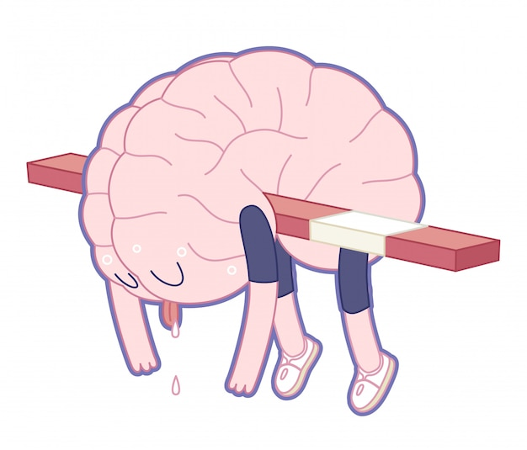
Stage 4
(Medullary Depression)
Also known as overdose, occurs when too much anesthetic medication is given relative to the amount of surgical stimulation and the patient has severe brainstem or medullary depression, resulting in a cessation of respiration and potential cardiovascular collapse. This stage is lethal without cardiovascular and respiratory support.

Slide 23
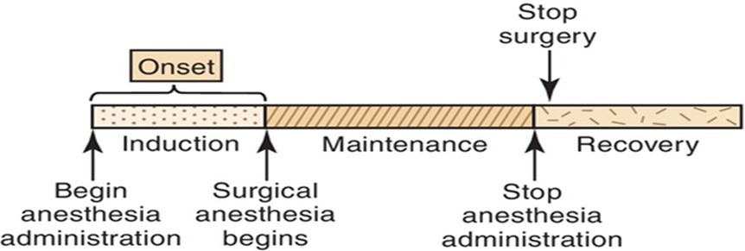
Phases of Anesthesia

Slide 24
Phases of Anesthesia
Induction: putting the patient to sleep (initial entry to surgical anesthesia).
Maintenance: keeping the patient asleep without awareness (Maintain depth of anesthesia, ventilation, fluid balance, hemodynamic control, homeostasis).
Emergence (recovery): waking the patient up(resumption of normal CNS function.
Extubation , resumption of normal respiration).

Slide 25
Preoperative evaluation of patient
Preoperative evaluation is important to provide better anesthesia service & prevent anesthesia complication.
This evaluation is taking history and physical examination of patient as well as doing any indicated laboratory tests & imaging.
the preoperative evaluation is an opportunity for the anesthesiologist to describe the proposed anesthetic plan in the context of the overall surgical and postoperative plan, provide the patient with psychological support, and obtain informed consent for the proposed anesthetic plan from the surgical patient. (morgan p297)

Slide 26
Preoperative evaluation of patient
History Review:
1- Current problem and operation.
2- Past medical history ( other known medical problems ).
3- Drug history: drug allergy, intolerance, present medical therapy (DM & HTN), alcohol and tobacco intake.
4- Previous anesthetic history (Obstetric history & pain history & any complication).
5- Family history.
6- Social history.
7- last oral intake.
8- Review of systems

Slide 27
History Review
Social history
(smoking history is very important)
4-6 hrs decrease CarboxyHb 12-24 hrs decrease nicotine (nicotine is a sympathomimetic and a coronary vasoconstrictor) 6-8 weeks normalize mucociliary function 2-3 months normalize pulmonary function 6-12 months returns to non-smoker lung

Slide 28
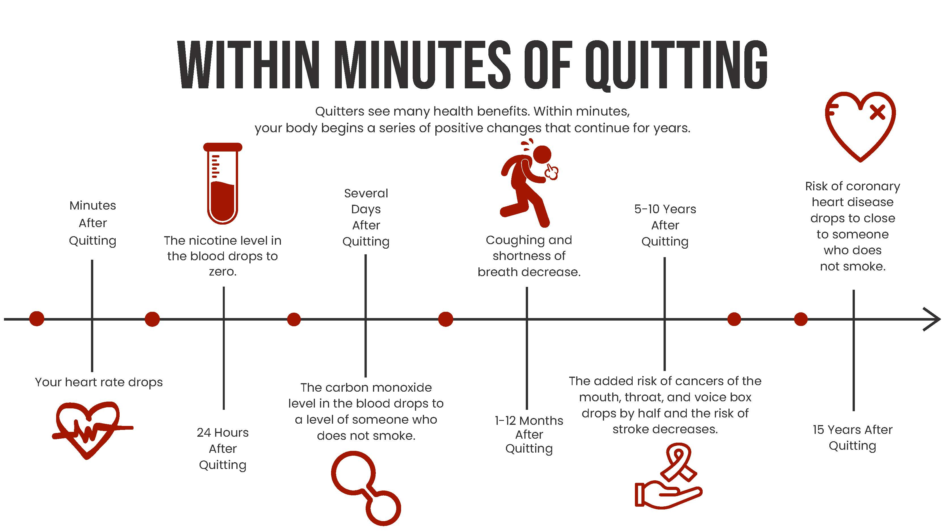

Slide 29
History Review
Last oral intake
F
A
S
T
I
N
G
Clear fluids |  | 2 Hours | Water , fruit juice without pulp , carbonated beverages , clear tea , black coffee
Milk | Breast milk | 4 Hours
 | formula | 6 Hours
Light food |  | 6 Hours | Fruits , juice with pulp , vegetables
Heavy food |  | 8 Hours | Fatty meals , meat
N E E D

Slide 30
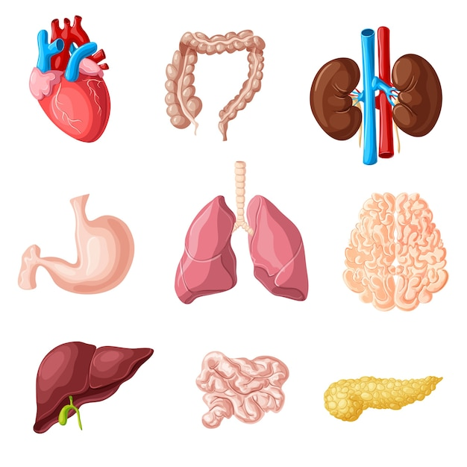
History Review
Review of Systems
RS & CVS
Renal & electrolyte imbalance
Hematology
GI
Neurological
Endocrine
Psychiatric
Musculoskeletal & dermatological

Slide 31
Physical Examination
1- vital signs and general examination
2- airway assessment (LEMON )
✓ L look externally
✓ E evaluate
✓ M mallampati
✓ O obstruction
✓ N neck mobility
3- heart ( HR , B.P , S1 & S2 , PULSE )
4- lung ( crackles , wheezing , Resp. rate ,dyspnea )
5- neurological examination
6- extremities , edema , deformity

Slide 32
Laboratory Investigations
age | sex | investigation
<40 | M | Nill
<40 | F | Hb
Infant |  | Hb
40-60 | M | ECG & Blood sugar & Kidney Function Test
40-60 | F | Hb & ECG & Blood sugar & Kidney Function Test
>60 | M&F | All
 | M>40, F>50 | ECG

Slide 33
Laboratory Investigations
If a patient is known to have certain diseases, do investigations according to disease ex.
Thyroid pt -> T3 ,T4 ,TSH
D.M -> Glucose level
Renal disease and hypertension -> electrolytes & creatinine
Liver disease or anticoagulant therapy -> INR, aPTT

Slide 34
ASA Classification
The ASA physical status classification system is a system for assessing the fitness of patients before a surgical procedure that requires anesthesia.
The purpose of ASA classification is to:
Keep a record of your health before surgery.
Provide a uniform system for all anesthesiologists to use.
Help predict your risk of surgical complications, along with other factors like the type of surgery, your age, the extent of the procedure, surgery timeframe and more.
In 1963 the American Society of Anesthesiologists (ASA) adopted a five category physical status classification system; a sixth category was later added.

Slide 35
ASA Classification
ASA 1 | A normal healthy patient. | Example: Fit, nonobese (BMI under 30), a nonsmoking patient with good exercise tolerance.
ASA 2 | A patient with mild systemic disease. | Examples: Patient with no functional limitations and a well-controlled disease (e.g., treated hypertension, obesity with BMI under 35, frequent social drinker, or cigarette smoker).
ASA 3 | A patient with a severe systemic disease that is not life-threatening. | Examples: Patient with some functional limitation due to disease (e.g., poorly treated hypertension or diabetes, morbid obesity, chronic renal failure, a bronchospastic disease with intermittent exacerbation, stable angina, implanted pacemaker).
ASA 4 | A patient with a severe systemic disease that is a constant threat to life. | Examples: Patient with functional limitation from severe, life-threatening disease (e.g., unstable angina, poorly controlled COPD, symptomatic CHF, recent (less than three months ago) myocardial infarction or stroke.
ASA 5 | A moribund patient who is not expected to survive without the operation. The patient is not expected to survive beyond the next 24 hours without surgery | Examples: ruptured abdominal aortic aneurysm, massive trauma, and extensive intracranial hemorrhage with mass effect.
ASA 6 | A brain-dead patient whose organs are being removed with the intention of transplanting them into another patient. | The patient is deceased
Note: The addition of “E” to the ASAPS (e.g., ASA 2E) denotes an emergency surgical procedure. The ASA defines an emergency as existing “when the delay in treatment of the patient would lead to a significant increase in the
threat to life or body part.”

Slide 36
Increase risk of morbidity & mortality in anesthesia
• Age > 70
• Smoking
• MI < 6 months OR unstable angina within 3 m
• Pulmonary edema < 1 week
•Hb < 10 g/dl
•Urea > 20 mmol/L & dehydration
•Wt. loss > 10% in 1 month
• Severe medical illness, sepsis, emergency, major operation.

Slide 37
Patients who are at increased risk of aspiration during surgery
o Abdominal pathology, especially obstruction.
o Delayed gastric emptying (e.g. pain, opioids).
o Incompetent lower esophageal sphincter
o Altered conscious level resulting in impaired laryngeal reflexes
o Pregnancy

Slide 38
Rapid Sequence Induction (RSI)
Rapid sequence induction (RSI) is an established method of inducing anesthesia inpatients who are at risk of aspiration of gastric contents into the lungs. It involves loss of consciousness during cricoid pressure followed by intubation without face mask ventilation. The aim is to intubate the trachea as quickly and as safely as possible.
Need rapid induction and intubation
Full stomach
Emergency Bleeding Obstetric delays stomach emptying

Slide 39
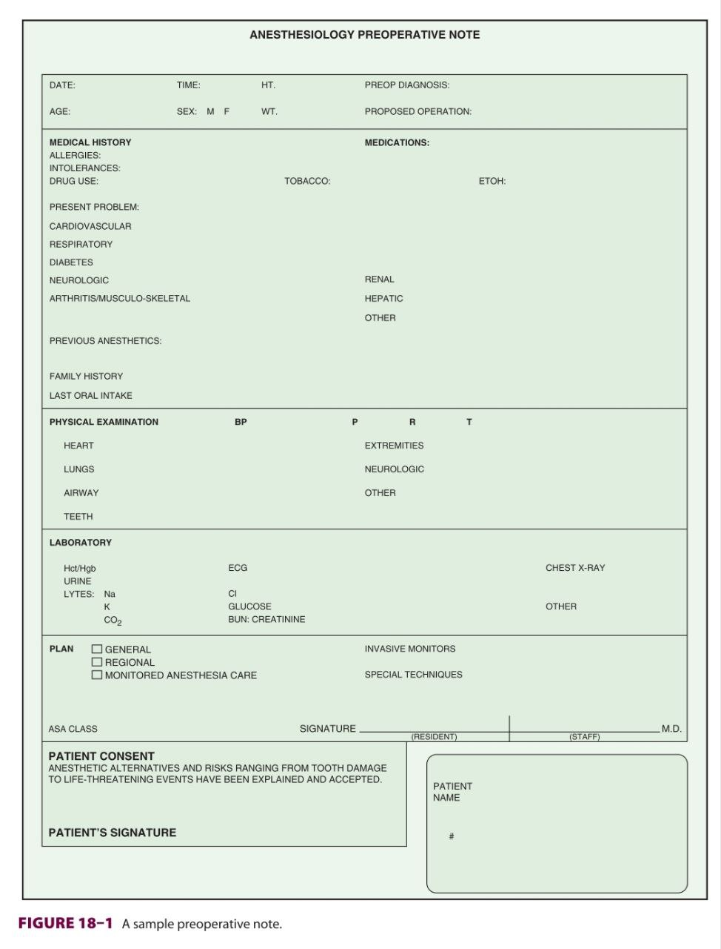
Morgan & Mikhail's Clinical Anesthesiology

