Slide 1
Rape
By
DR mElad gad

Slide 2
Virginity

Slide 3
When?????????
Medicolegal conditions in which a female is examined for signs of virginity are:
Female alleged rape.
Female alleged impotence of the husband.
Male alleged non virginity of the wife (the husband asks for compensation; sometimes it is due to elastic hymen).

Slide 4
What is HYMEN?
It is a thin moderately elastic mucous membrane about 1mm thick with connective tissue core and stratified squamous epithelium on both surfaces, partially suspended across the vaginal entrance

Slide 5
Is it one type or more than one?
There are several types according to it SHAPE.

Slide 6
Posterior
opening
Anterior opening
annular
fimbriate
semilunar
cripriform
septate
Imperforate
dentate

Slide 7
Causes Of Rupture Of Hymen:
1- Sexual intercourse.
2- Car accidents.
3- Diseases: ulceration of vulva & polyps.

Slide 8
Types of Hymen That May Cause Medico-Legal Problems:
Elastic annular hymen
does not rupture in widening night.

Slide 9
fimbriate
dentate
simulate ruptured hymen

Slide 10
Dentate or Fimbriate hymen | Torn hymen
Never reach vaginal wall | 1.Serrations usually reach vaginal wall.
Symmetrical on both sides | 2.Dentations are irregular and asymmetrical
Admits the tip of the little finger | 3.Width of the opening admits 2 fingers to pass through easily.
Translucent tissue without scar | 4.Transillumination shows opaque scar tissue after healing of tear.

Slide 11
Imperforate
causes hematocolpos which simulates pregnancy.

Slide 12
Recent rupture | Old
Hyperaemic edges. | Pale not hyperaemic.
Tender, swollen bleeding edges with blood clots | No tenderness or bleeding
Edges after a weak are covered with a membrane but never unite. | Covered with a scar which is opaque on transillumination

Slide 13
Signs of virginity:
1- Intact hymen with normal edge.
2- Labia majora are firm, rounded and completely closing vaginal opening in lithotomy position.
3. Narrow vagina with rugose mucosa.
4. Intact posterior commissure normal condition of fourchette
5- Breasts are firm hemispherical with small nipples and rosy areolae.

Slide 14
What is the meaning of rape?
Unlawful (outside the bond of marriage)
sexual intercourse with a female
against her well, without her consent and by force (Physical or moral).

Slide 15
Conditions in which a consent is true: She must be
Above 18 y.
Sane
Conscious.
Without threatening.
Without fraud.

Slide 16
Medical examination for rape:
Victim
Accused
History.
General appearance.
General examination.
Local examination.

Slide 17
Examination of victim
Written consent obtained from the victim (if less than 21 y, obtained from parents).

Slide 18
The History:
Is the key.
Fresh story.
Complete without interruption.
Ask for details.
Compare with the police story.

Slide 19
General Appearance
Gait.
General behaviour conduct of the victim.
Apparent age.
Physical body built character.
Mental condition.
Psychic condition.
Signs of distress and the general appearance.
Signs of narcosis.
.Clothing: examined for tears, lost button, stain (blood, seminal, grease,….)

Slide 20
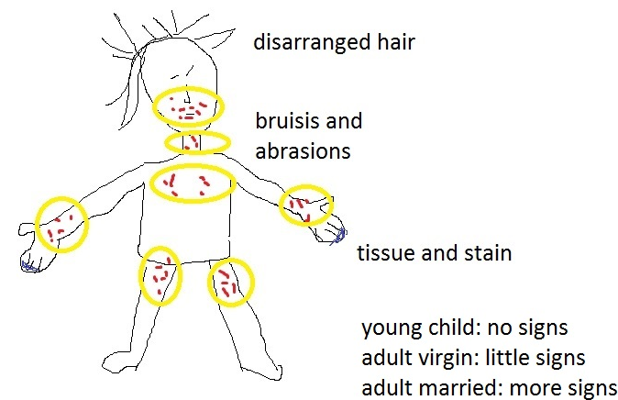
General Examination
Hair
Abrasions and bruises
Tissue and stains

Slide 21
Signs Of Local Violence
Pubic hair: look for semen, fibres or foreign hairs. It should be sent for analysis.
Vulva: Careful inspection for swelling, reddening, abrasions, bruises and.
Hymen:
Signs Of Tear Of The Hymen Vary According To The Age
Child ˂ 6 years → no penetration, no rupture.
Child > 6 years adult virgins → penetrations and rupture.
Married: no signs of rupture.

Slide 22
(d) Vagina:
Bruising abrasions or lacerations of the vaginal walls.
(e) Presence of Semen:
It is not necessary to be present.
Spermatozoa - motile sperm found in endocervix up to seven days after intercourse
Anal intercourse - semen may be found up to 3 days later.
If present sample must be taken for analysis
(f) Vaginal Discharge:
Bacteriological examination may reveal venereal disease.
(g) Pregnancy:
Pregnancy test is done.
H: Examination of the semen

Slide 23
Examination of the accused:
His consent for examination is essential.
His story.
His age is estimated ⇨ below 14 years incapable of rape.
His mental condition is noticed.
His physical condition is noticed for the possibility of overpowering her.

Slide 24
Signs of general violence.
Abrasions and bruises (bites) ⇨ age = date of the crime.
Clothes: tear or lost buttons.
Signs of local violence:
Abrasions and bruises on the genitalia.
Victim's pubic hairs & blood stains.
Venereal diseases: gonorrhea & syphilis
Impotence: Lack of erection may be alleged by the accused as a defense for the crime.

Slide 25
After effects of Sexual Assault /Rape
Physical, mental, reproductive and sexual health consequences including:
Physical injuries
Depression
Post-traumatic stress disorder
Suicide attempts
Substance abuse
Unwanted pregnancy
Gynaecological disorders
Sexually transmitted infections
Increased HIV/AIDS risk.
Relationship difficulties.

Slide 26
Impotence
-Impotence is the inability to do the act of sexual intercourse.
impotence can stand as a reason for divorce when it is permanent and irremediable.

Slide 27
Evidence of impotence is demanded in:
1- Claims for divorce.
2- Disputed paternity & legitimacy.
3- Rape where the accused may allege it.
4- Claims of compensation, where impotence is claimed to result from an assault or accident.

Slide 28
Causes of Impotence:
1- Physiological: before puberty:
2- Psychological: Is the commonest
3. Pathological: various causes can cause it as local congenital anomalies or general diseases as diabetes.

Slide 29
Types of sexual perversion:
Sodomy: between two males.
Lesbianism: sexual stimulation between 2 female.
Bestiality: between human and animals.
Sadism: inducing painful stimuli to the other partner.
Masochism: sexual stimulation by receiving pain from the other partner.
Buggary: anal intercourse with female.

