Slide 1
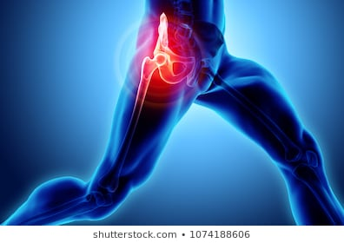
osteoarthritis
Moh’d Said dawod m.d.
Orthopedics and reconstructive surgery consultant
Faculty of Medicine , mutah University
Mar. 2020

Slide 2
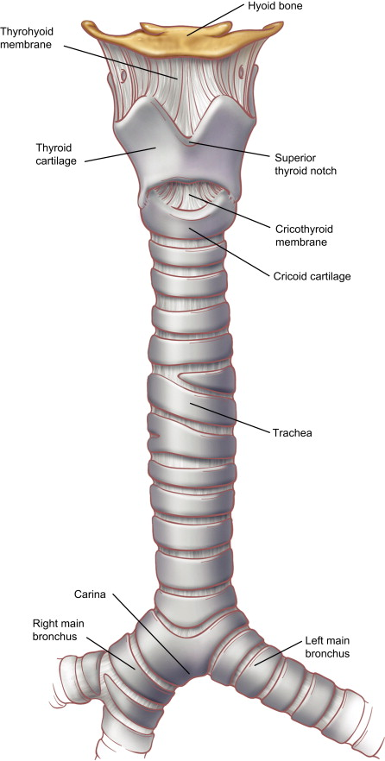
cartilage
hyaline or articular cartilage
fibroelastic cartilage (meniscus)
fibrocartilage (at tendon and ligament insertion into bone)
elastic cartilage (trachea)
physeal cartilage (growth plate)

Slide 3
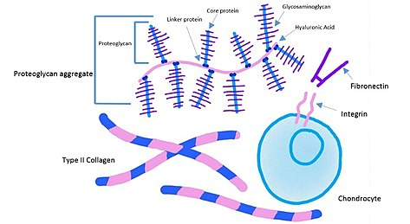
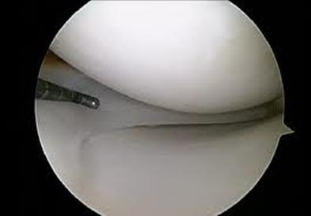
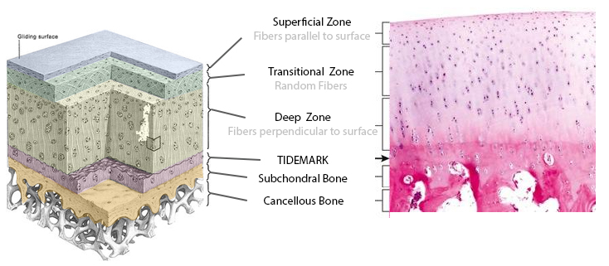
hyaline or articular cartilage
Function
decreases friction and distributes loads
Composition.
extracellular matrix.
Cells.
Water.

Slide 4
Definition
a chronic disorder of synovial joints in which there is
1-progressive softening and disintegration of articular cartilage
2- accompanied by new growth of cartilage and bone at the joint margins (osteophytes)
3- cyst formation
4- sclerosis in the sub-chondral bone, mild synovitis and
5- capsular fibrosis.

Slide 5
osteoarthritis
Primary
Secondery
Risk factors:
-trauma
-occupation
-obesity
-family history

Slide 6
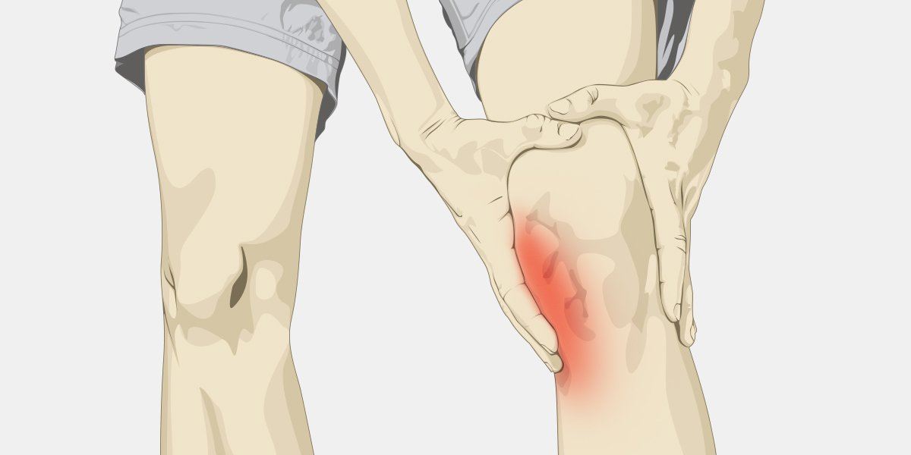
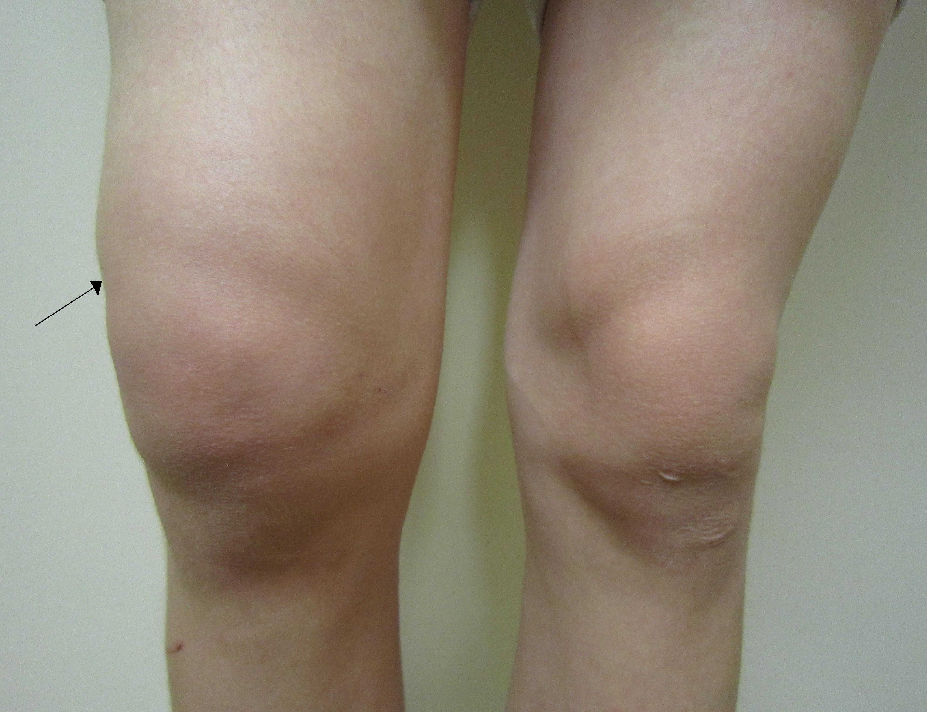
osteoarthritis
Symptoms:
Pain
Deformity
Stifness
swelling

Slide 7
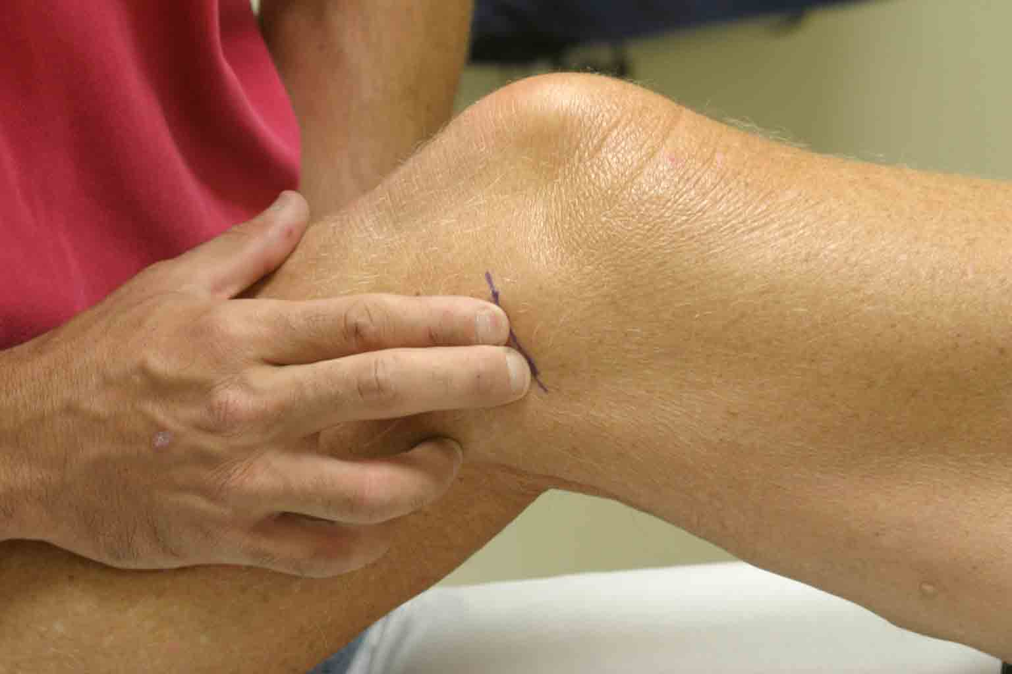
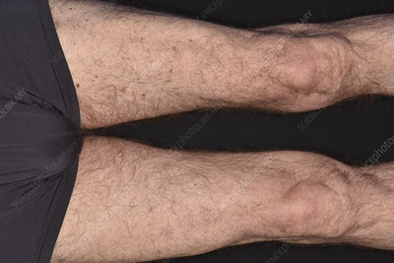
osteoarthritis
Signs:
Tenderness
Swelling
Muscle wasting
Deformity
crepetus

Slide 8
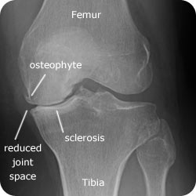
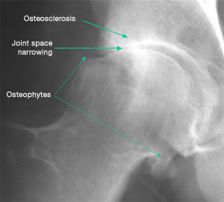
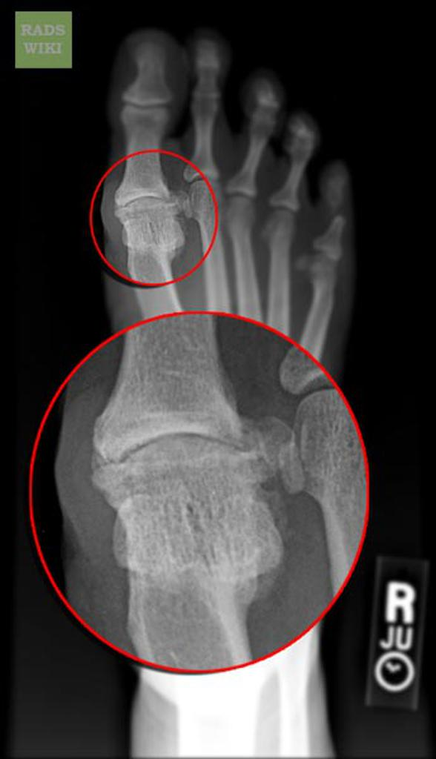
osteoarthritis
x-ray

Slide 9
osteoarthritis
Treatment
Conservative Treatments.
- Life style modification.
- Pharmacological.
- Intraarticular.
Operative treatment.

Slide 10
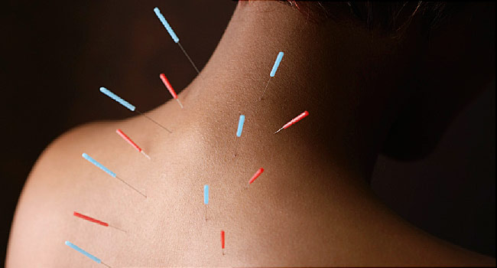
osteoarthritis
Life style modification
- Weight Reduction
(We suggest weight loss for patients with symptomatic osteoarthritis of the knee and a BMI ≥ 25)
exercise:
(We recommend that patients with symptomatic osteoarthritis of the knee participate in self-management programs, strengthening, low-impact aerobic exercises, and neuromuscular education; and engage in physical activity)
- acupuncture
(We cannot recommend using acupuncture in patients with symptomatic osteoarthritis of the knee)

Slide 11
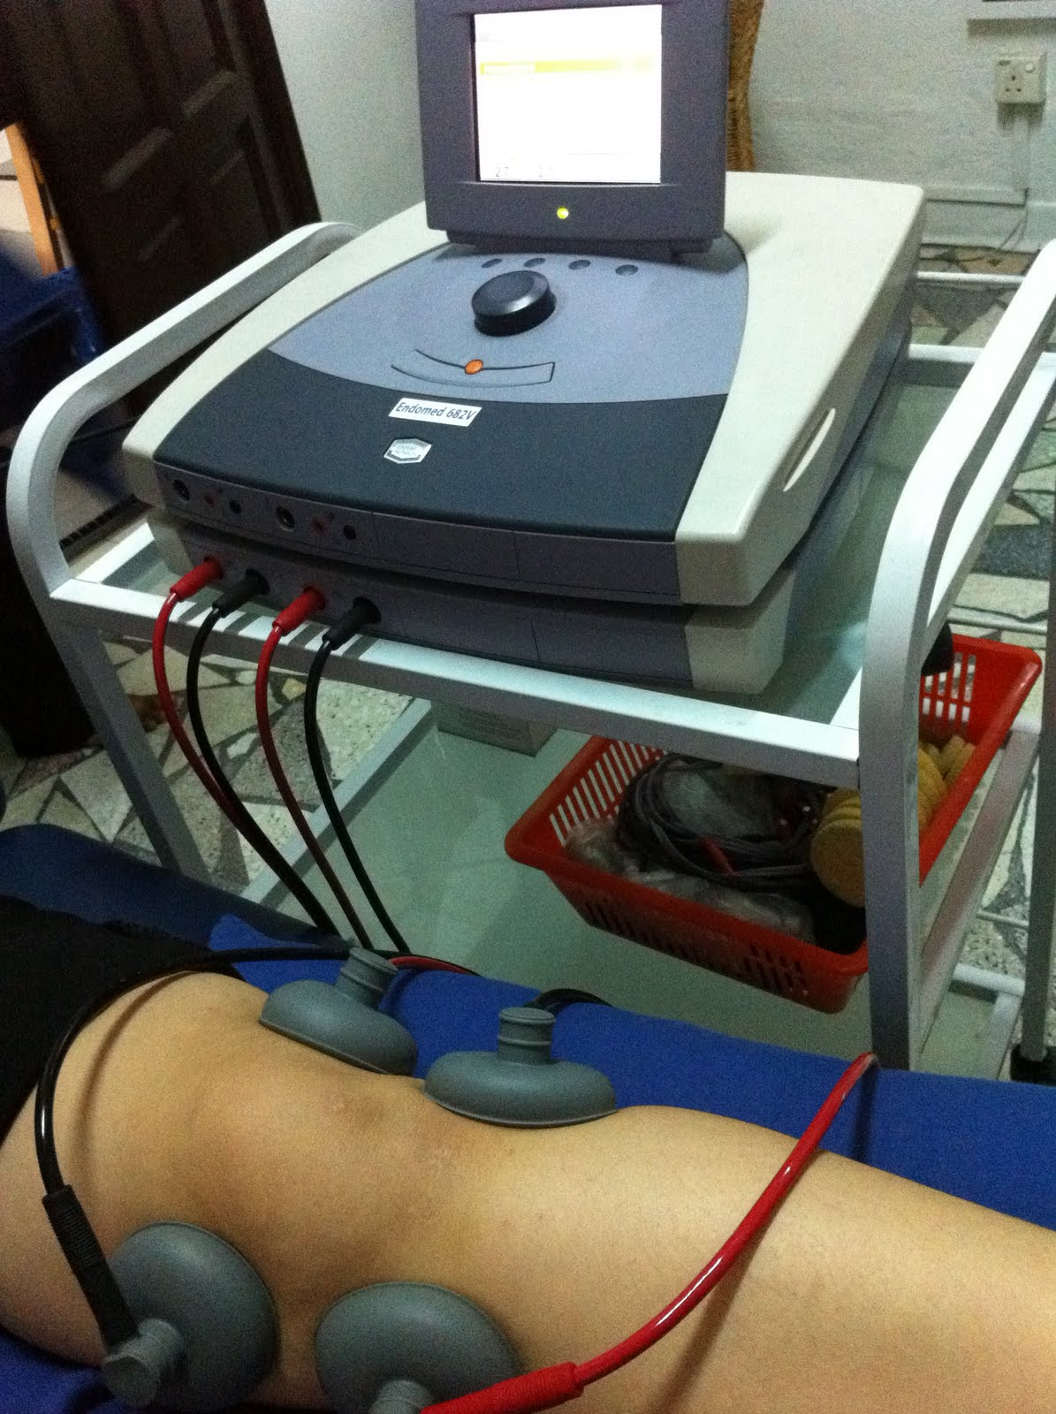
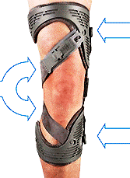
osteoarthritis
physical agents
We are unable to recommend for or against the use of physical agents (including electrotherapeutic modalities) in patients with symptomatic osteoarthritis of the knee
brace
We are unable to recommend for or against the use of a valgus directing force brace (medial compartment unloader) for patients with symptomatic osteoarthritis of the knee
insoles
We cannot suggest that lateral wedge insoles be used for patients with symptomatic medial compartment osteoarthritis of the knee.

Slide 12
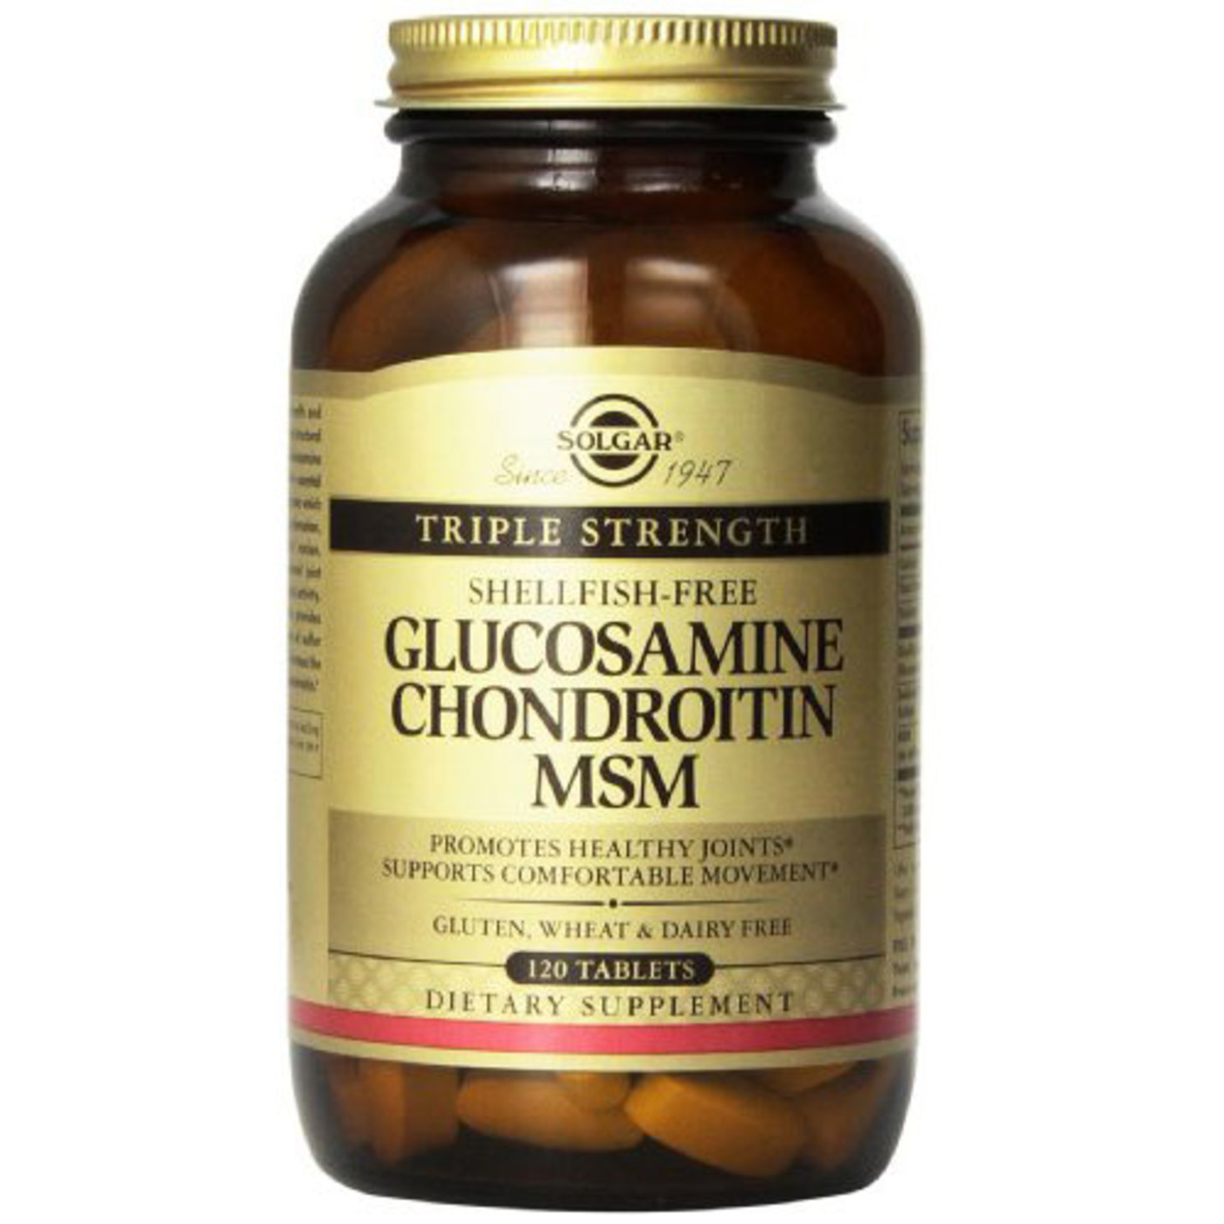
osteoarthritis
Pharmacological
- NSAIDs
We recommend nonsteroidal anti-inflammatory drugs (NSAIDs; oral or topical) or Tramadol for patients with symptomatic osteoarthritis of the knee.
-acetaminophen
We are unable to recommend for or against the use of acetaminophen, opioids, or pain patches for patients with symptomatic osteoarthritis of the knee.
- glucosamine and chondroitin
We cannot recommend using glucosamine and chondroitin for patients with symptomatic osteoarthritis of the knee.

Slide 13
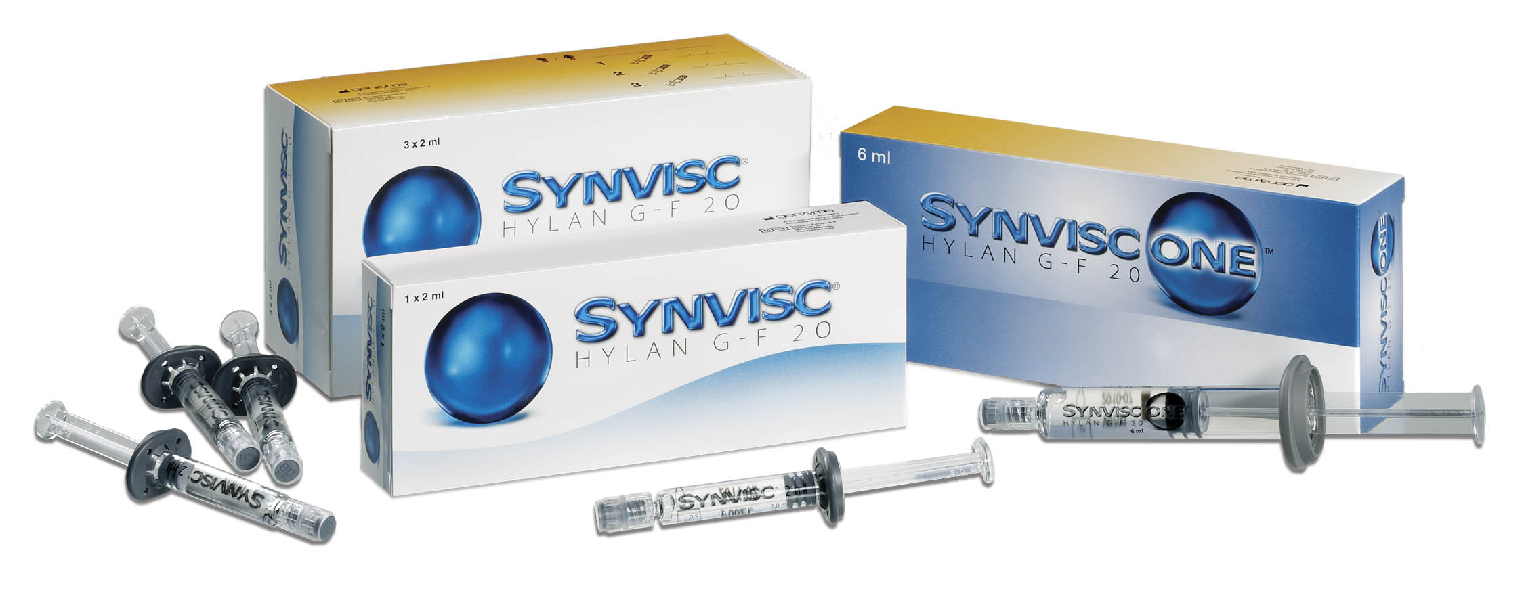
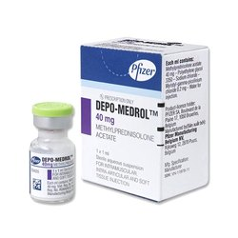
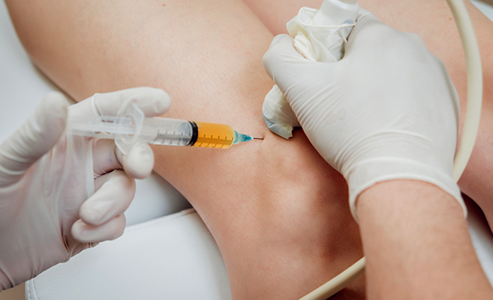
osteoarthritis
intraarticular (IA)
IA corticosteroids
(We are unable to recommend for or against the use of intraarticular (IA) corticosteroids for patients with symptomatic osteoarthritis of the knee)
Ia hyaluronic acid
We cannot recommend using hyaluronic acid for patients with symptomatic osteoarthritis of the knee
PRP (Platelet-rich plasma)
We are unable to recommend for or against growth factor injections and/or platelet rich plasma for patients with symptomatic osteoarthritis of the knee.

Slide 14
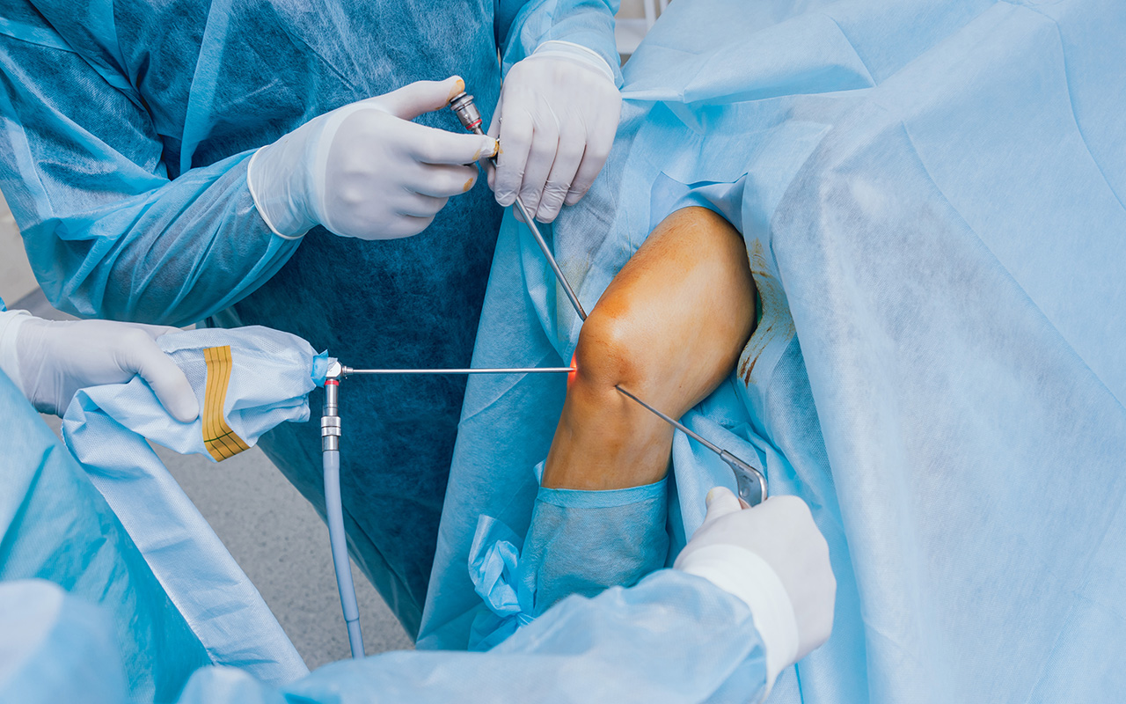
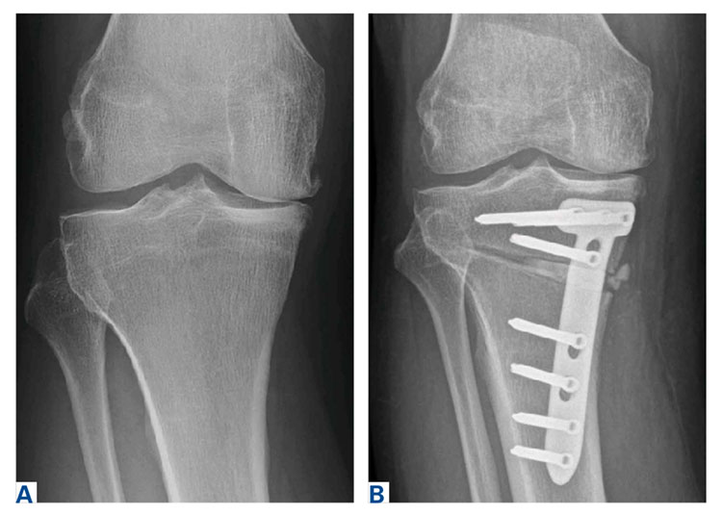
osteoarthritis
Operative treatment:
arthroscopy with lavage
(We cannot recommend performing arthroscopy with lavage and/or debridement in patients with a primary diagnosis of symptomatic osteoarthritis of the knee.)
Osteotomy
(The practitioner might perform a valgus producing proximal tibial osteotomy in patients with symptomatic medial compartment osteoarthritis of the knee. Strength of Recommendation: Limited)

Slide 15
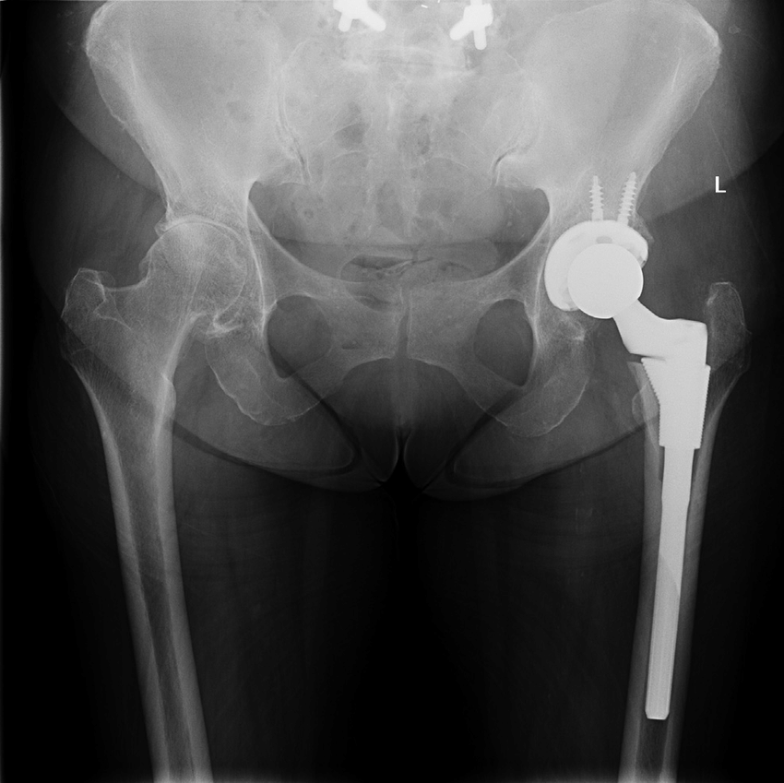
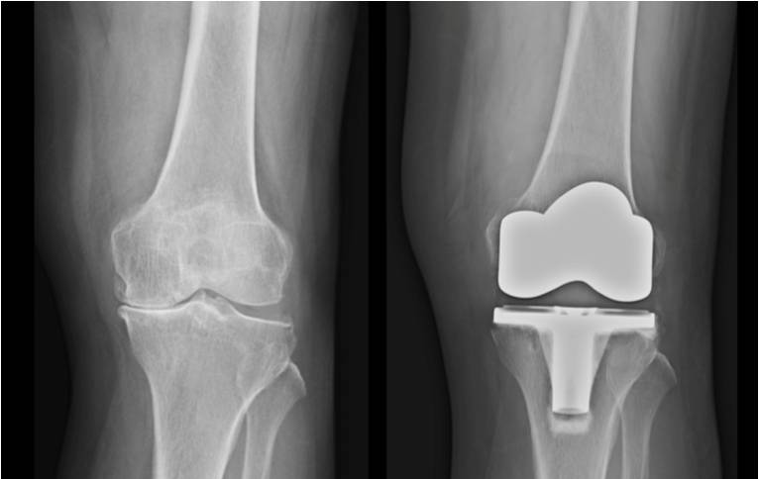
osteoarthritis
Replacement surgery

Slide 16
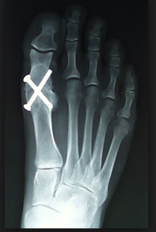
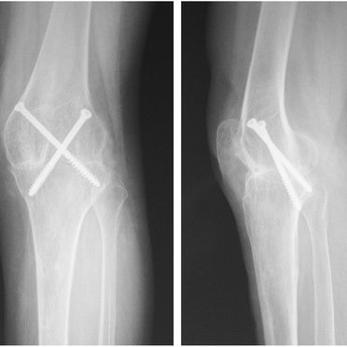
osteoarthritis
Arthrodesis

Slide 17
Thank you
be safe # stay_home

