Slide 1
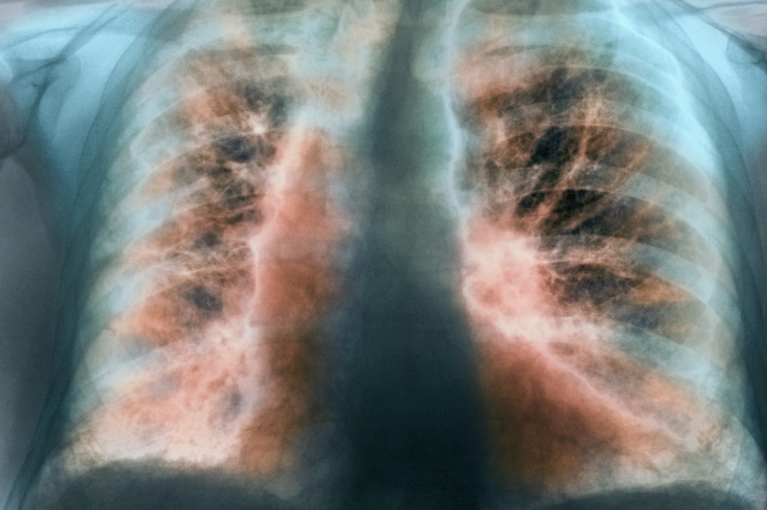
Idiopathic Pulmonary Fibrosis
Abdallah Alaween Sanad Ibrahim Mohammad Mustafa

Slide 2
Definition
Rare specific form of chronic, progressive and restrictive interstitial lung disease of an unknown cause.
Characterised by patchy bilateral accumulation of fibrotic tissue in the lungs parenchyma.
More common in male older age (typically occurring in the 6th and 7th decades ) patient with IPF aged less than 50 years are rare.

Slide 3
Epidemiology
Incidence of IPF 10.7 cases per 100,000 per year for men 7.4 cases per 100,000 per year for women
Estimated to affect 5 millions people worldwide
The most common (and deadly )interstitial lung disease
Most cases are sporadic but rare cases of familial IPF have been described

Slide 4
Risk Factors
1- Cigarette Smoking 2- Environmental exposure increase risk has been observed after exposure to (metal dusts, wood dusts, farming, vegetable dusts, animal dusts and raising birds) 3-Microbial agents Epstien-Barr Virus (Protein and DNA have been identified in the lung tissue of IPF patients ) 4-GERD microaspiration increases the risk of IPF 5- Genetic Factors mutations in the surfactant protein C gene

Slide 5
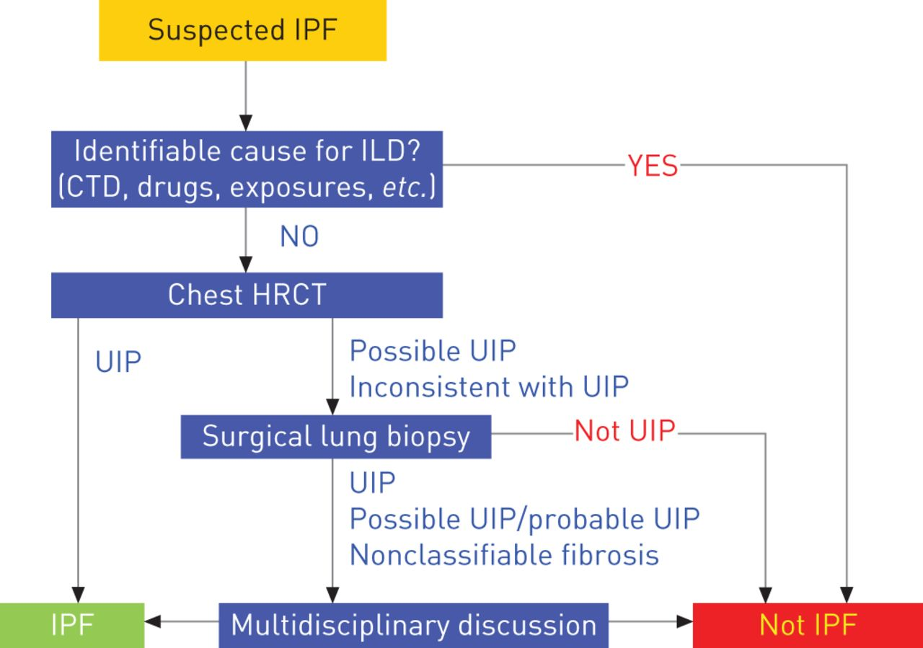
Criteria for Diagnosis
The diagnosis of IPF requires: - the exclusion of other known causes of ILD (e.g., domestic and occupational environmental exposures, connective tissue disease, and drug toxicity)
- The role of CT is expanded to permit diagnosis of IPF without surgical lung biopsy in select cases when CT shows a probable UIP pattern. -Additional investigations, including surgical lung biopsy, should be considered in patients with either clinical or CT findings that are indeterminate for IPF.

Slide 6
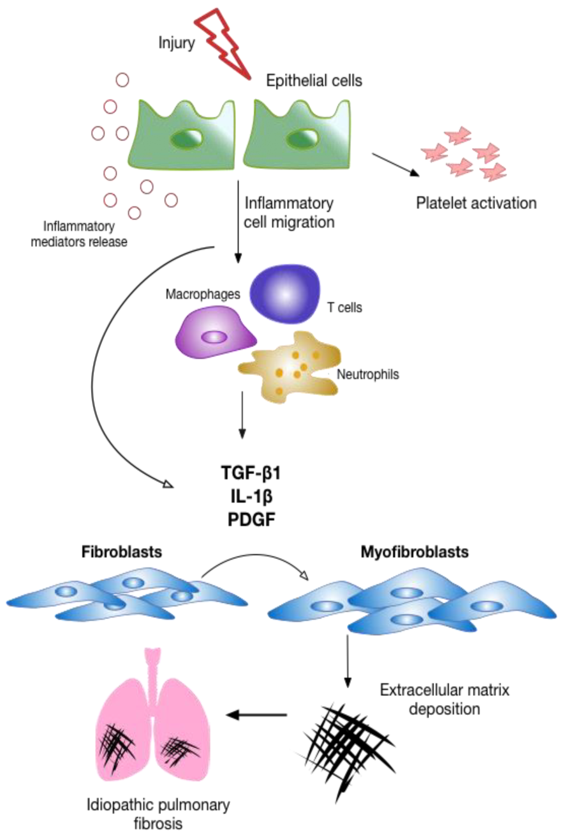
Pathogenesis
-Repeated injury to the epithelium -abnormal response -release of pro fibro genic factor ex: transforming growth factor beta -activation of fibroblast -leads to production of excess collagen and scar formation -forming irreversible fibrosis and distortion of lung architecture -impairment of lung’s function Prognosis : poor

Slide 7
CLINICAL PICTURE OF IPF :
Symptoms :
1- dry cough 2- shortness of breath ( dyspnea )
(rare constitutional symptoms ex:Weight loss fatigue arthritis fever myalgia arthralgia )
Most have symptoms for 12-18 months prior to definitive evaluation
Signs :
1- Dry, Velcro-like crackles “Velcro-type” crackles are brief, discontinuous pathological lung sounds in late expiration, explosive and transient in character, named after their similarity to the sound generated by Velcro strips
2- Clubbing 3- Signs of elevated right-sided pressure on cardiac examination late in disease (e.g., elevated jugular venous pressure , edema , and right ventricular heave )

Slide 8
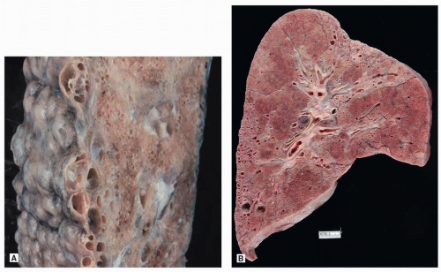
Grossly
Grossly, the pleural surfaces of the lung are cobblestoned due to retraction of scars along the interlobular septa.
The cut surface shows firm, rubbery white areas of fibrosis, which occurs preferentially within the lower lobe, the subpleural regions, and along the interlobular septa

Slide 9
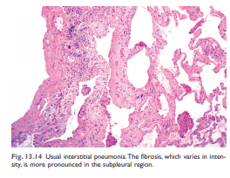
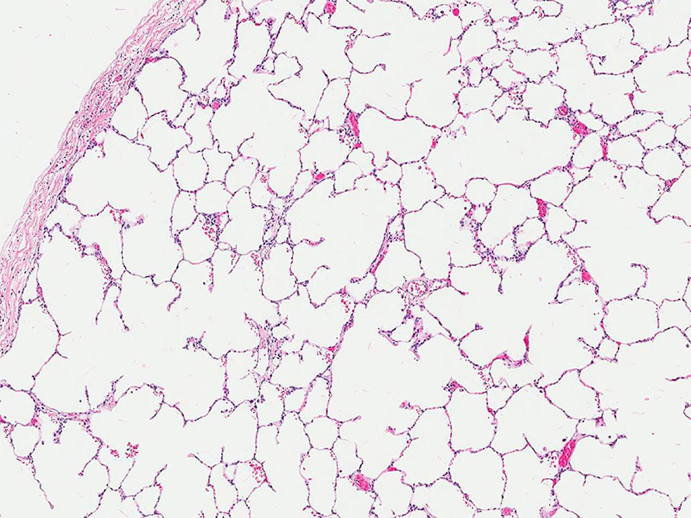
Histology
the hallmark is patchy interstitial fibrosis, which varies in intensity and worsens with time .

Slide 10
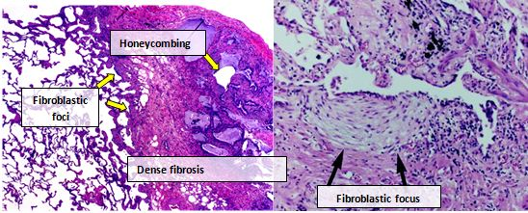
The earliest lesions demonstrate excessive fibroblastic proliferation (fibroblastic foci).
Overtime these areas become more collagenous and less cellular.
Quite typical is the existence of both early and late lesions.
The dense fibrosis causes collapse of alveolar walls and formation of cystic spaces lined by hyperplastic type II pneumocytes or bronchiolar epithelium (honeycomb fibrosis).

Slide 11
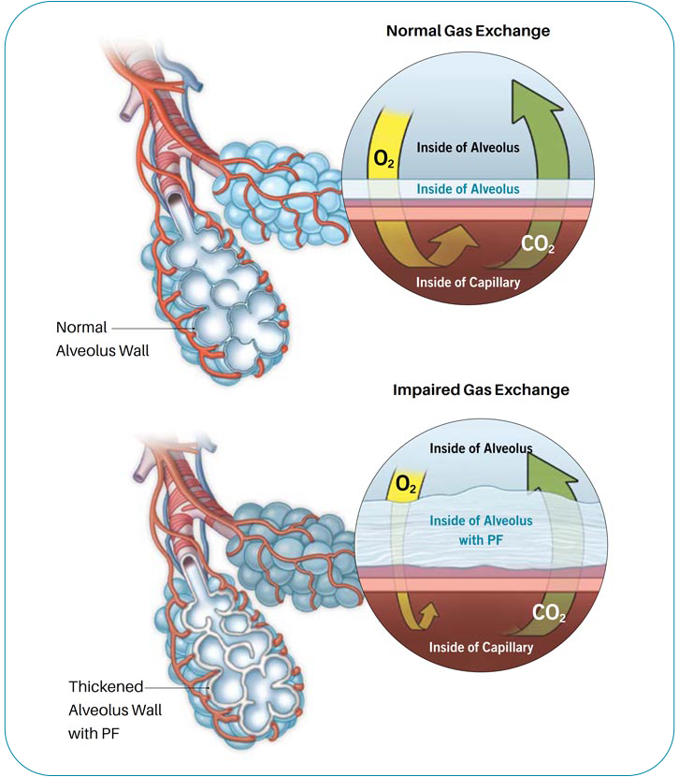
The radiologic and histologic pattern of fibrosis is referred to as usual interstitial pneumonia (UIP), which is required for the diagnosis of IPF.
Radiology
Interstitial wall is thick due to fibrosis lead to impair in the o2 co2 exchange

Slide 12
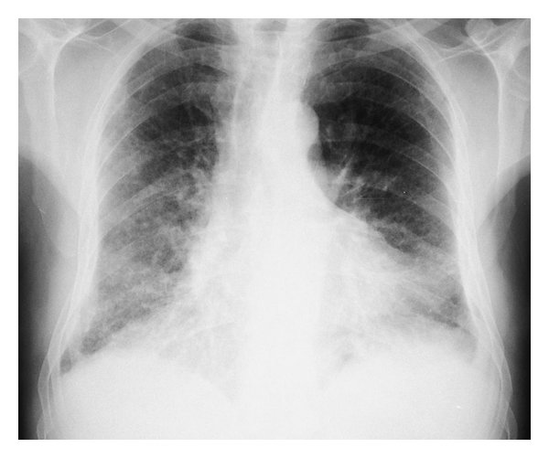
Chest X-ray
-Early Disease normal in most patients
-Advanced disease Decrease Lung volumes basilar, peripheral, bilateral, asymmetric, reticular opacities

Slide 13
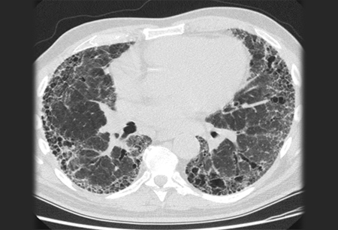
High resolution CT
-Apicobasal gradient -Subpleural reticular opacities -Macrocystic Honeycombing -Traction Bronchiactasis (bronchial tree as it becomes dilated with irregular wall) -Ground glass opacity

Slide 14
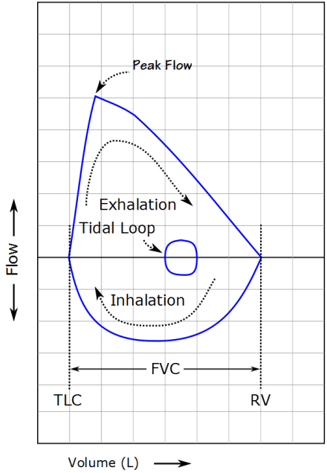
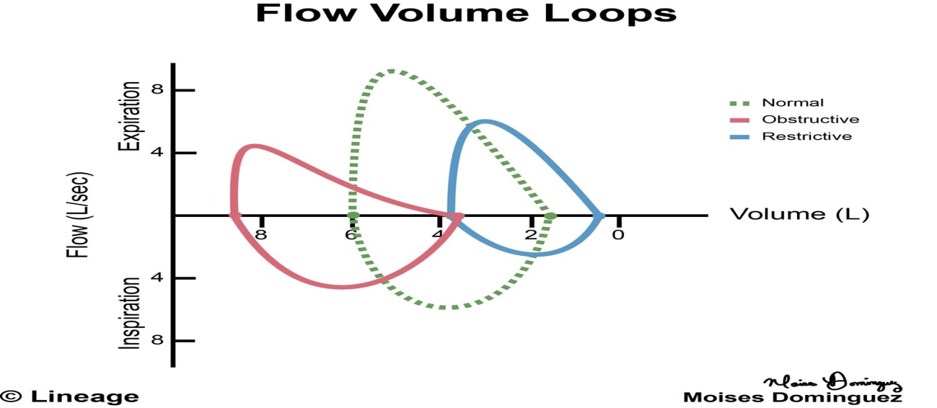
Pulmonary function tests (PFTs)
Restrictive disease with decreased forced vital capacity (FVC), total lung capacity (TLC), and diffusing capacity for carbon monoxide (DLCO) the 6-minute-walk test
Assess Oxygen requirement during Exercise Flow Volume Loop :
Shift to right

Slide 15
6 : ABG
Hypoxemia, Respiratory alkalosis
7 : Lung biopsy
Although all patients with IPF should have changes typical of usual interstitial pneumonia (UIP) on biopsy, not all patients with UIP on biopsy have IPF So In the absence of a typical UIP pattern on HRCT, a surgical lung biopsy is required for confident diagnosis. (Definitive diagnosis)

Slide 16
Management
First line of treatment :
1- pirfenidone : (Antifibrotic ) inhibit TGF-B
2-Nintedanib : tyrosine kinase inhibitor with antifibrotic properties that has also been shown to significantly reduce the progression of the disease.
Severe dyspnea may be managed with oral or parenteral opioid medications .
Proton pump inhibitor (PPI ) : Associated with longer survival life,slowing the decline in measures of lung function, reducing episodes of acute exacerbations and prolonging transplant-free survival.
Smoking cessation .
Pulmonary rehabilitation : improve functional statue and quality of life .

Slide 17
Second Line Treatment Lung transplantation :
For patients who experience progressive physiologic deterioration despite optimal medical management, or have contraindications to pharmacologic treatment, severe functional impairment, oxygen dependency.
Vaccination influenza and pneumococcal Vaccines As infections are poorly tolerated by IPF patients

Slide 18
Case History
A 58-year-old white male presented with shortness of breath, dry cough, fatigue and weight loss for two months. He was a former smoker and had regular exposure to a parakeet and poultry. Physical examination revealed bilateral basal crackles and chest imaging showed subpleural cystic lesions. Auto-antibodies and IgG immunoglobulins to parakeet and fungal proteins were negativehe has no lower-extremity edema, elevations in jugular venous pressure, or any other findings to suggest volume overload. He has clubbing of his fingers. Lung function tests displayed moderate restriction, low diffusion capacity and resting hypoxaemia.

