Slide 1
Blood vessels of the head& neck
BY DR./DALIA M. BIRAM
ASSISTANT PROFESSOR OF ANATOMY&EMBRYOLOGY

Slide 2
Main Arteries of
the neck
Subclavian
system
Subclavian artery
Carotid system
Common carotid
artery
Internal carotid
artery
External carotid
artery

Slide 3
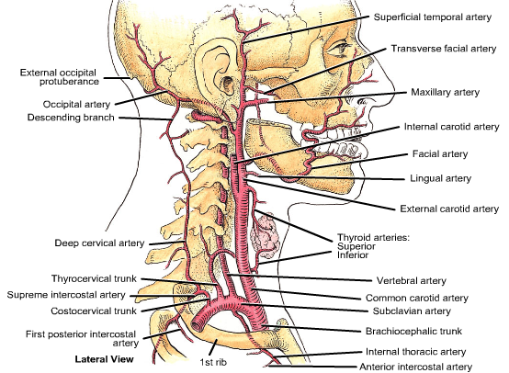

Slide 5
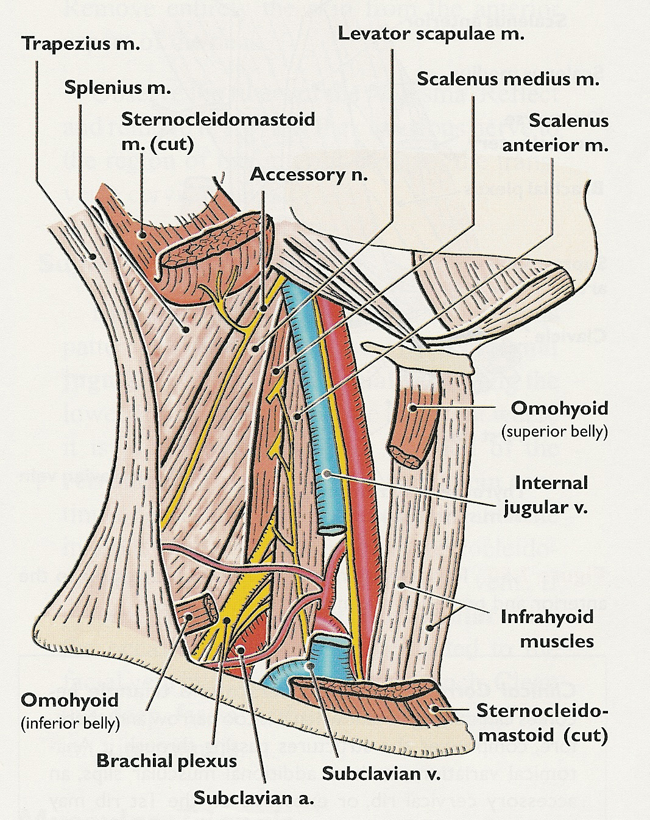

Slide 6
1st part
Vertebral
artery
Internal
mammary
artery
Thyro-
cervical
trunk
Inferior
thyroid
artery
Suprascapular
artery
Superficial
cervical
artery
2nd part
Costo-
cervical
trunk
Deep
cervical
artery
Superior
intercostal
artery
3rd part
Dorsal
scapular
artery
Branches of subclavian artery

Slide 7
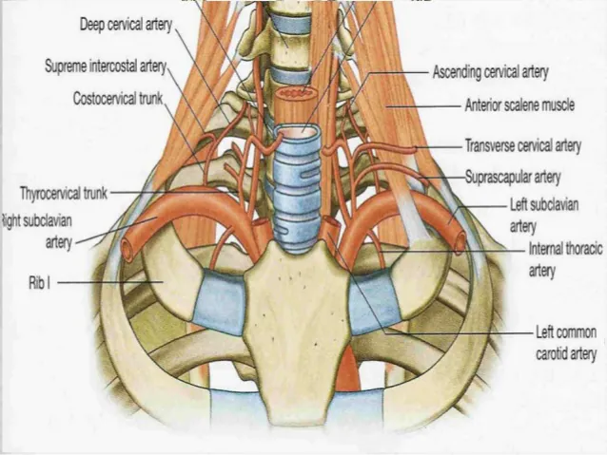

Slide 9
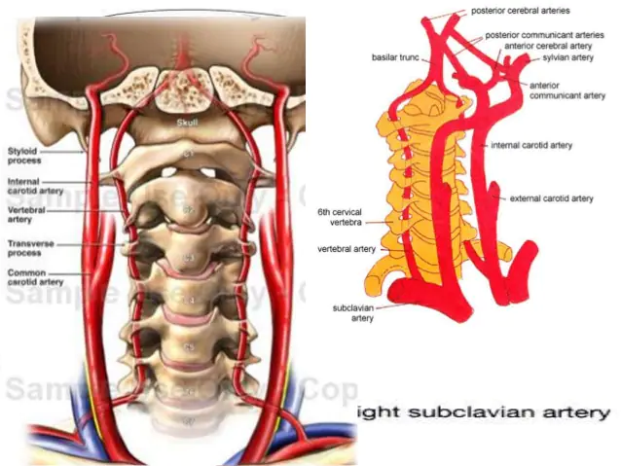

Slide 14
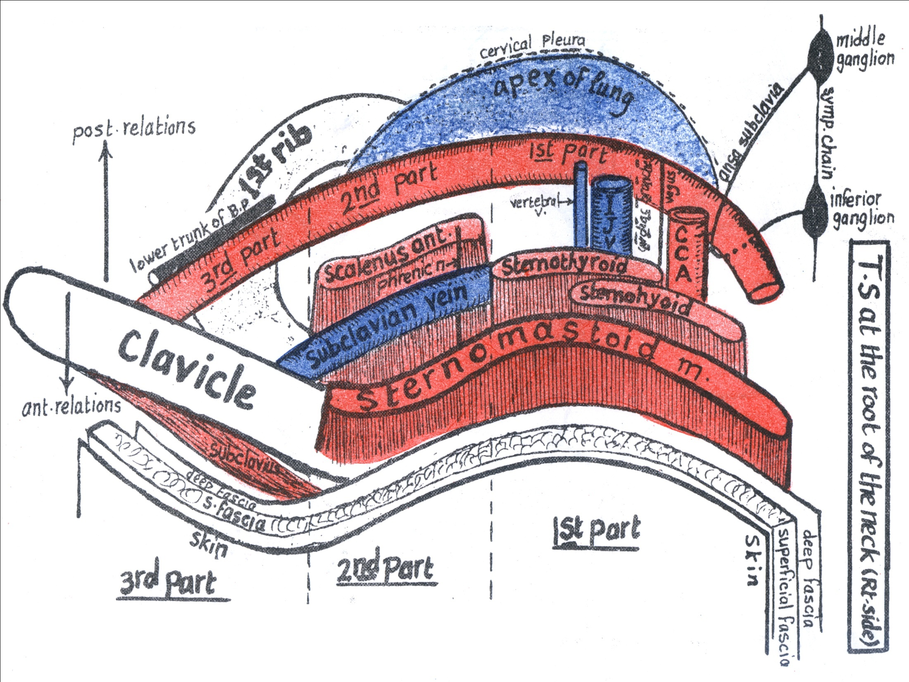
RELATIONS OF SUBCLAVIAN ARTERY

Slide 15
Relations: First part of Subclavian artery
Anterior: common carotid artery, vagus nerve and internal jugular vein.
Posterior: Dome of pleura, apex of the lung and on right the right recurrent laryngeal n.
Second part of Subclavian artery
Anterior: scalenus anterior muscle.
Posterior: Dome of pleura, apex of the lung.

Slide 16
Third Part of Subclavian Artery
Course:
enters the antero-inferior angle of posterior triangle and disappears behind the middle of the clavicle. Together with the brachial plexus, it is surrounded by extension from prevertebral fascia called axillary sheath.

Slide 17
Relations: Third Part of Subclavian Artery
Anteriorly: Skin, superficial fascia, external jugular vein and investing deep cervical fascia. At its beginning it is partially covered by sternomastoid, and at its end it is covered by clavicle.
Posteriorly: Lower trunk of brachial plexus and scalenus medius.
Superiorly: Upper and middle trunks of brachial plexus.
Inferiorly: Upper surface of the first rib.

Slide 18
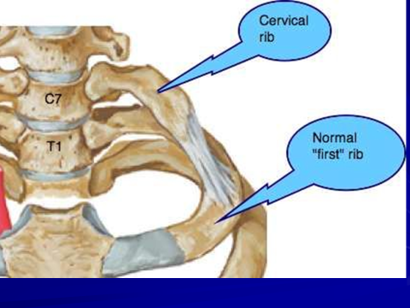
Thoracic outlet syndrome

Slide 19
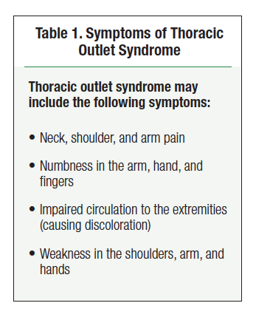

Slide 20
Common Carotid Artery
Beginning: the right from the brachiocephalic trunk behind the sternoclavicular joint. The left arises directly from the arch of aorta in the superior mediastinum of thorax.
End: at the level of the upper border of thyroid cartilage (disk between c3&c4) by dividing into internal and external carotid arteries.
At its end (or beginning of internal carotid) there is a dilatation called carotid sinus which is sensitive to blood pressure changes. It has pressure receptors which are innervated by glossopharyngeal nerve.

Slide 21
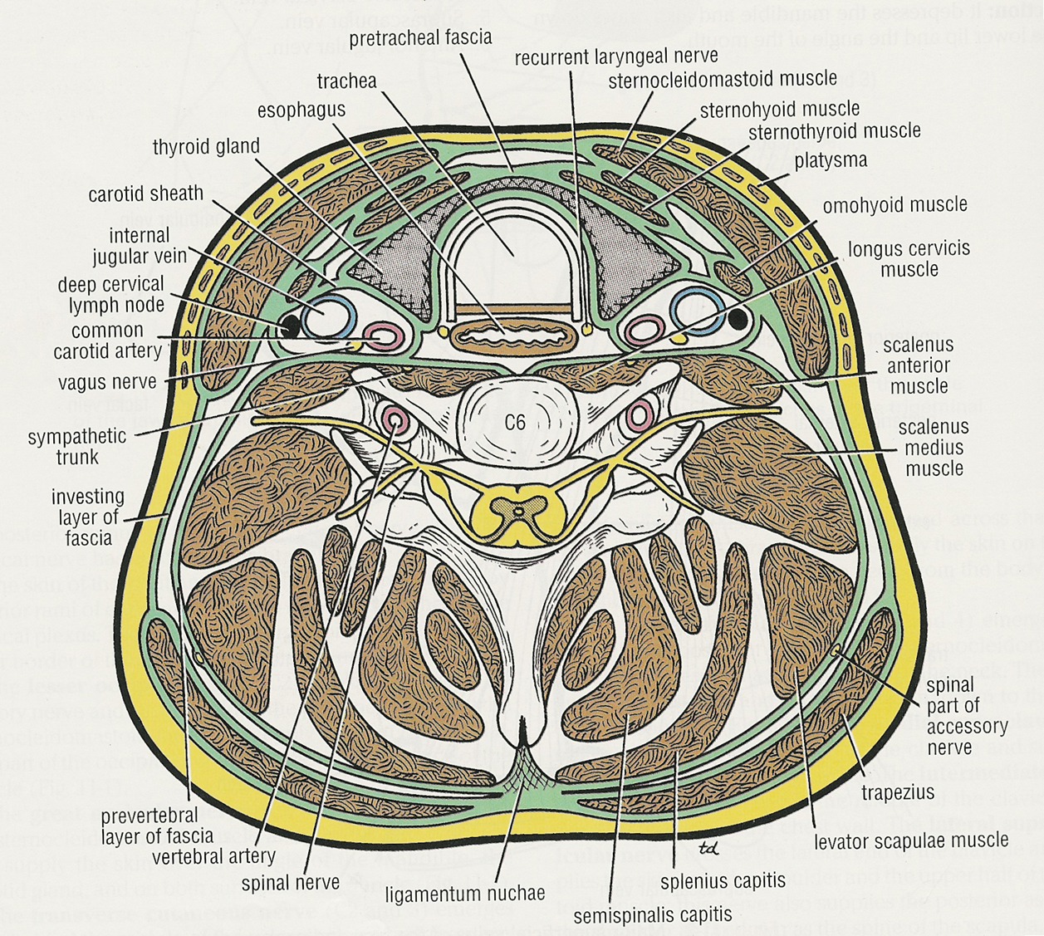
Common Carotid Artery

Slide 22
Common Carotid Artery Course and Relations
It ascends in the neck, enclosed in the carotid sheath with internal jugular vein and vagus nerve.
Anterolateral relations: Skin, superficial fascia, investing fascia, sternocleidomastoid, sternohyoid, sternothyroid and superior belly of omohyoid.
Posterior relation: Transverse processes of lower 4 cervical vertebra, prevertebral muscles and sympathetic trunk.
Medial relations: larynx, pharynx, thyroid gland, trachea and esophagus.
Lateral relation: Internal jugular vein and (posterolaterally) vagus nerve

Slide 23
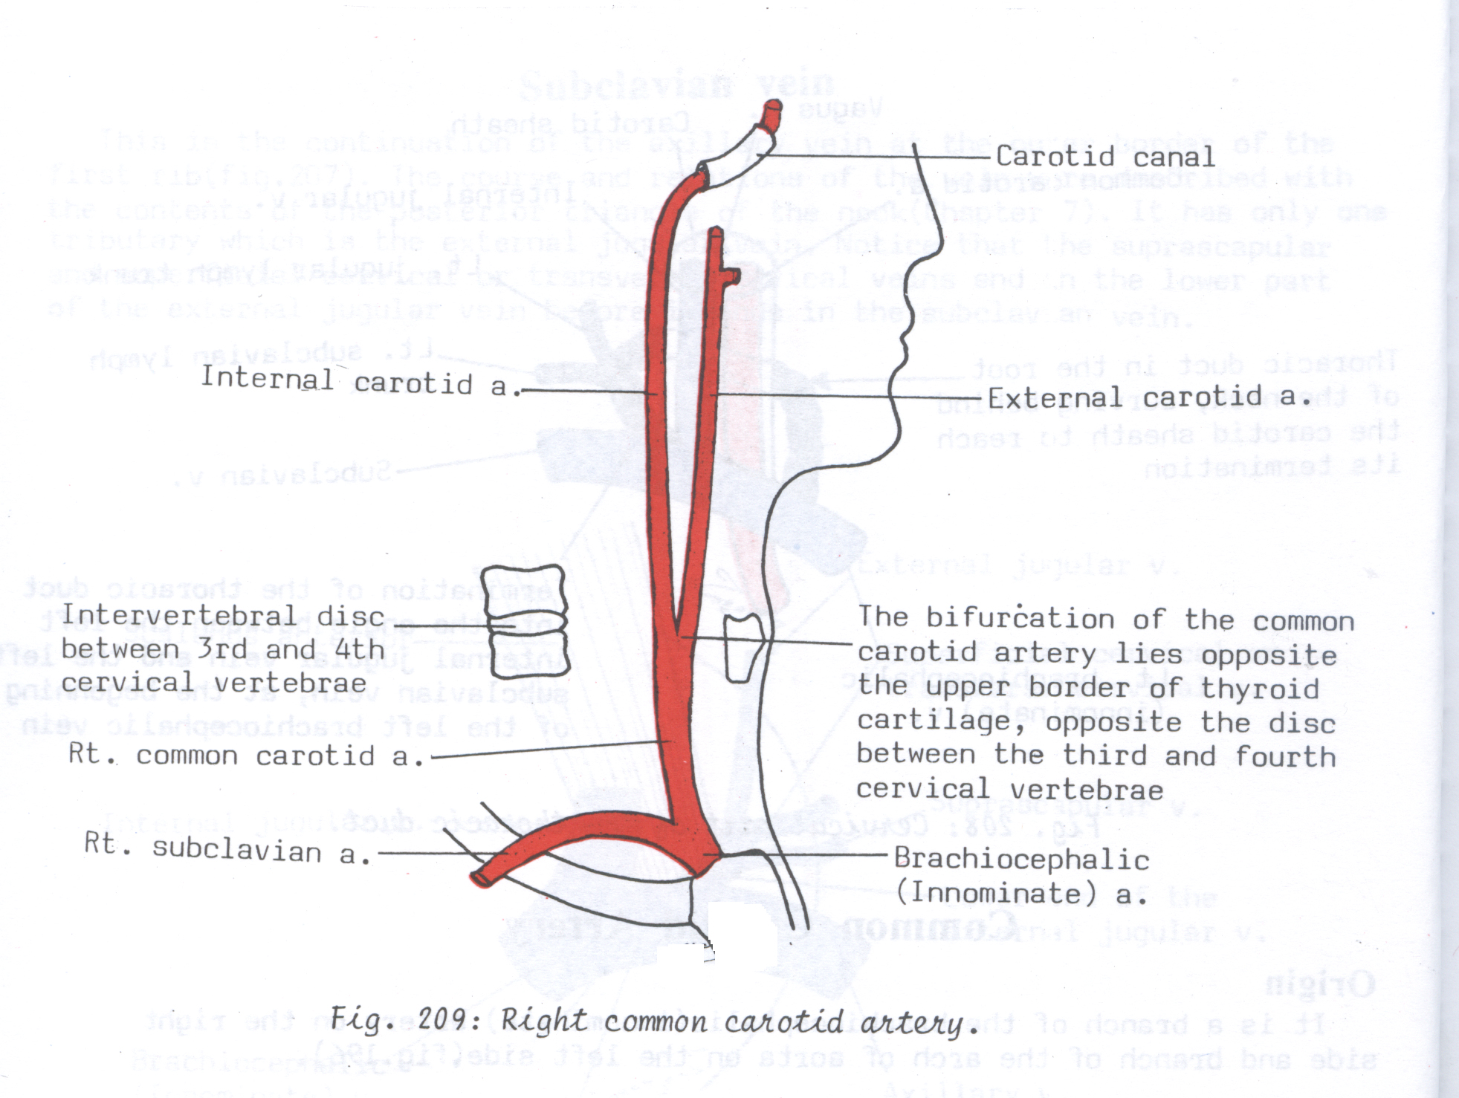
Right common
carotid artery

Slide 24
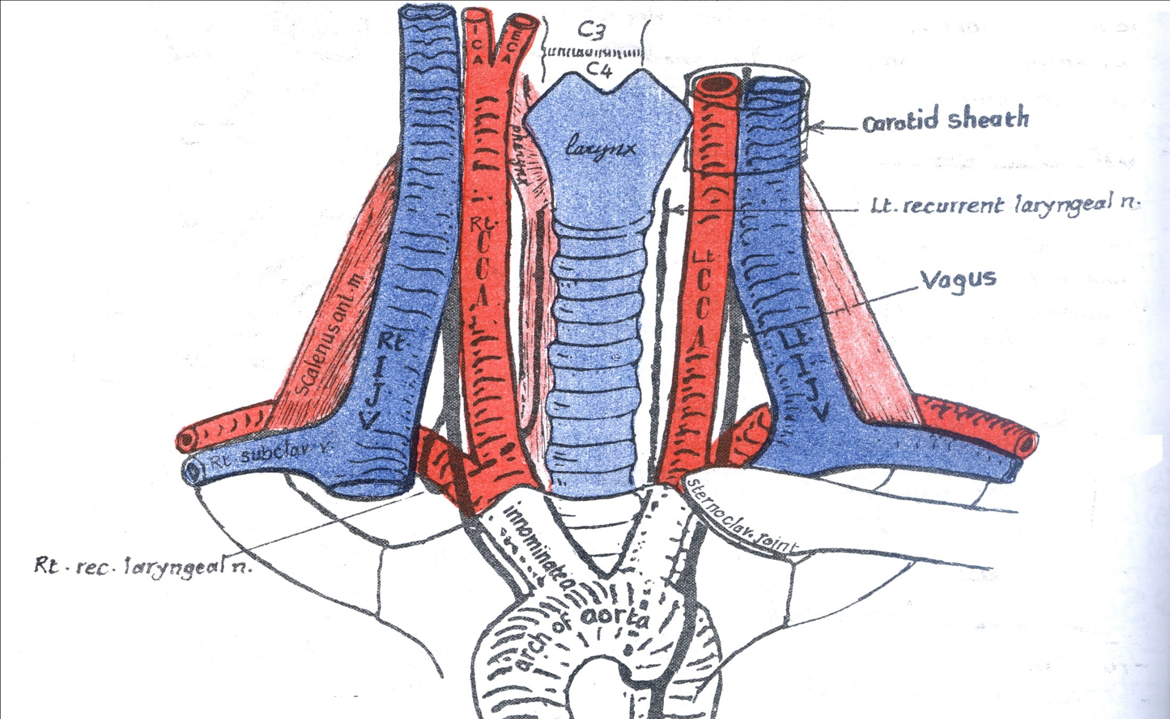
Common Carotid Artery

Slide 25
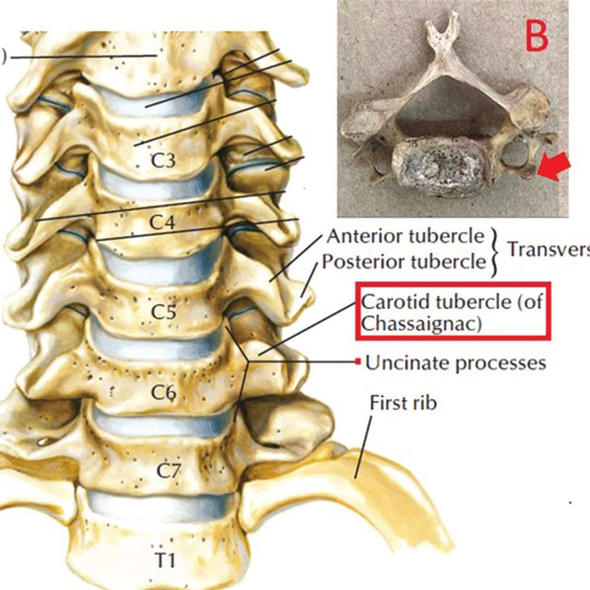
Where to feel the pulse of common carotid artery CCA

Slide 26
External Carotid Artery
Beginning: One of the two terminal branches of the common carotid artery. It begins at the level of the upper border of thyroid cartilage.
End: behind the neck of the mandible, within the substance of parotid gland by dividing into maxillary and superficial temporal arteries.
At is beginning, the artery lies medial to the internal carotid artery but as it ascends in the neck passes backward and laterally.
It is crossed by the posterior belly of digastric and stylohyoid muscles.

Slide 27
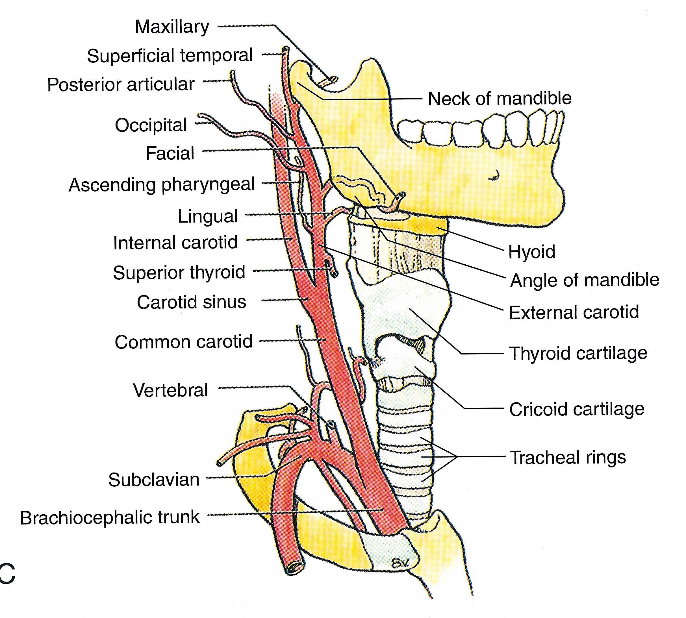
External Carotid Artery

Slide 28
External Carotid Artery Relations
Anterolateral relations: At its beginning, it is overlapped by sternocleidomastoid. Above, it is covered by skin, superficial fascia, investing deep fascia. It is crossed by hypoglossal nerve, posterior belly of digastric and stylohyoid. Within parotid gland, it is crossed by facial nerve.
Internal jugular vein first lies lateral then posterior to the artery.
Medial relations: pharynx, internal carotid artery.
Structures passing between external and internal carotid arteries: Styloid process, stylopharyngeus muscle, glossopharyngeal nerve, pharyngeal branch of vagus and parotid gland.

Slide 29
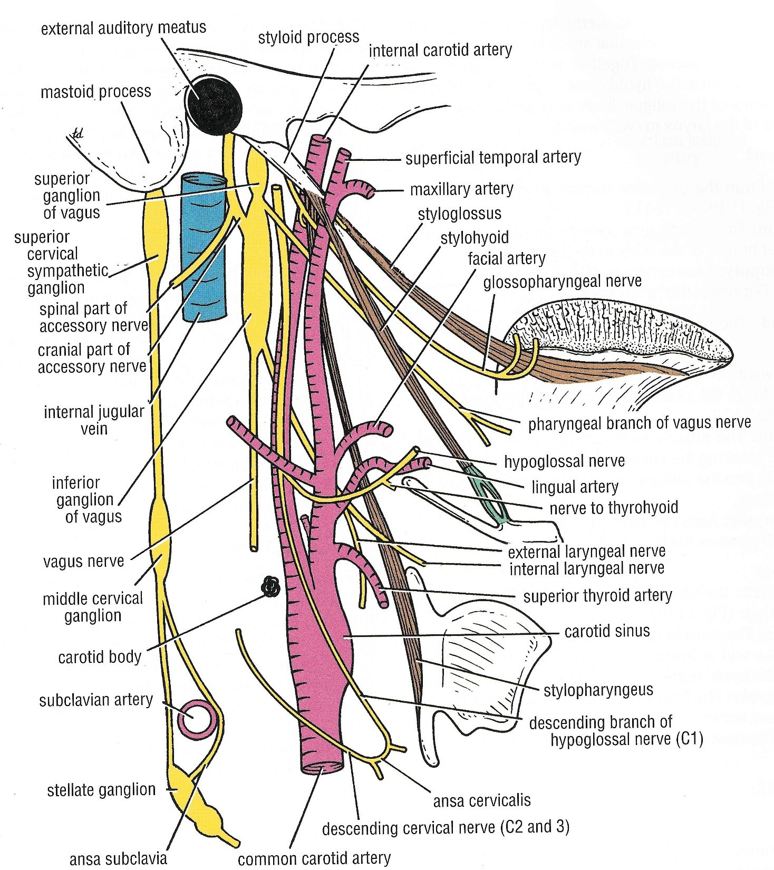

Slide 30
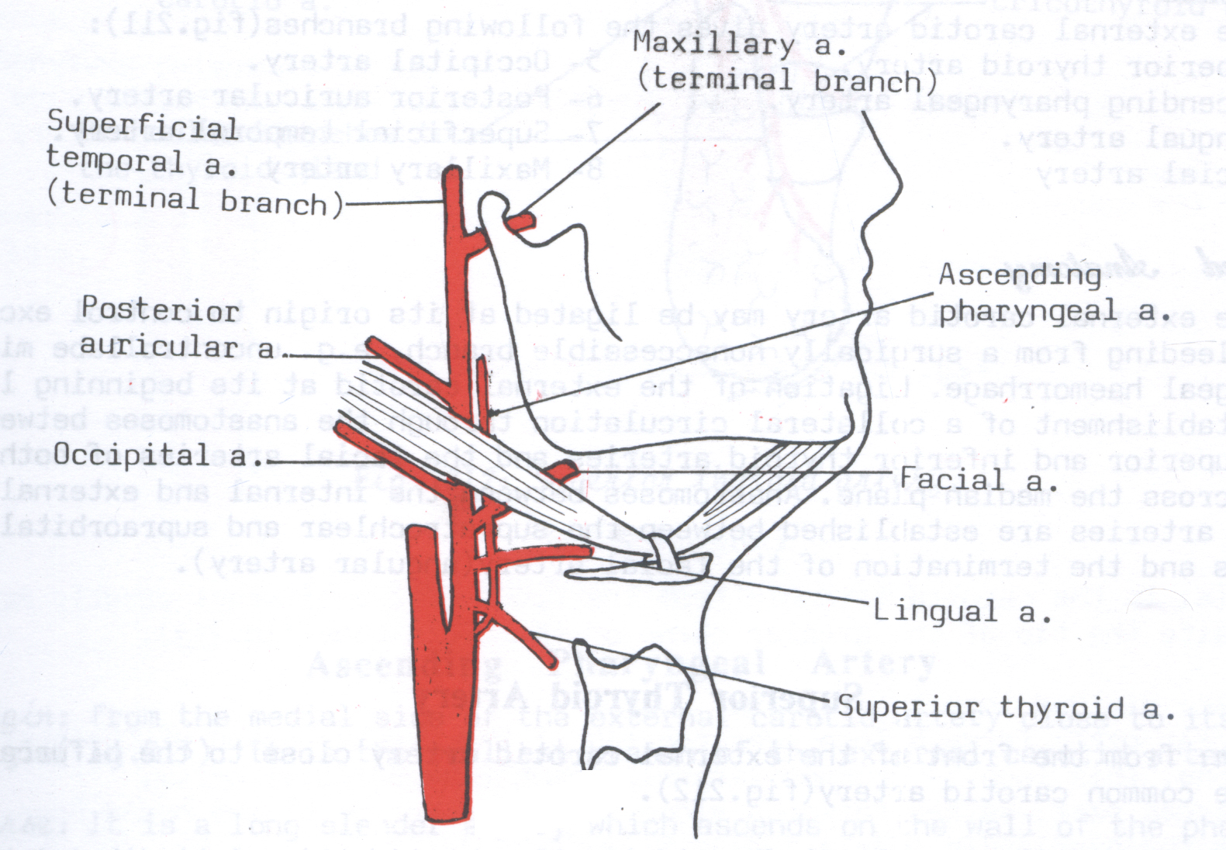
Branches of external carotid artery

Slide 31
Branches: ECA gives the following branches:
1 branch from its medial side:
Ascending pharyngeal artery.
3 branches from its front:
Superior thyroid artery.
Lingual artery.
Facial artery.
2 branches from its posterior side:
Occipital artery.
Posterior auricular.
2 terminal branches:
Superficial temporal artery.
Maxillary artery.

Slide 32
Internal Carotid Artery ICA
Origin:
It is one of the two terminal branches of the common carotid artery.
It takes origin at the level of upper border of thyroid cartilage, opposite the disc between 3rd & 4th cervical vertebrae.
Termination:
It ascends vertically upwards inside the carotid sheath to the base of the skull where it passes into the carotid canal to reach the cranial cavity.
It ends (lateral to optic chiasma) by dividing into: anterior & middle cerebral arteries.

Slide 33
Cervical part:
This part ascends vertically upwards (in line with CCA) inside the carotid sheath to the base of the skull where it passes into the carotid canal to reach the cranial cavity.
Relations:
The ICA is enclosed with the IJV & vagus N. inside the carotid sheath. The IJV is lateral to the ICA while the vagus lies behind and between the 2 vessels.

Slide 34
Anterolaterally:
Skin, superficial fascia, platysma, deep fascia. .
As the artery ascends, it is crossed by the posterior belly of digastric muscle.
Above the digastric muscle, it is related superficially to the ECA, but it is separated from it by the following:
styloid process.
Stylohyoid.
Stylopharyngeus.
Glossopharyngeal nerve.
Pharyngeal branch of vagus nerve.
A part of the parotid gland.

Slide 35
Posterior relations: Sympathetic trunk, longus capitis and transverse processes of the upper 3 cervical vertebrae.
Medial relations: pharynx and superior laryngeal nerve.

Slide 36
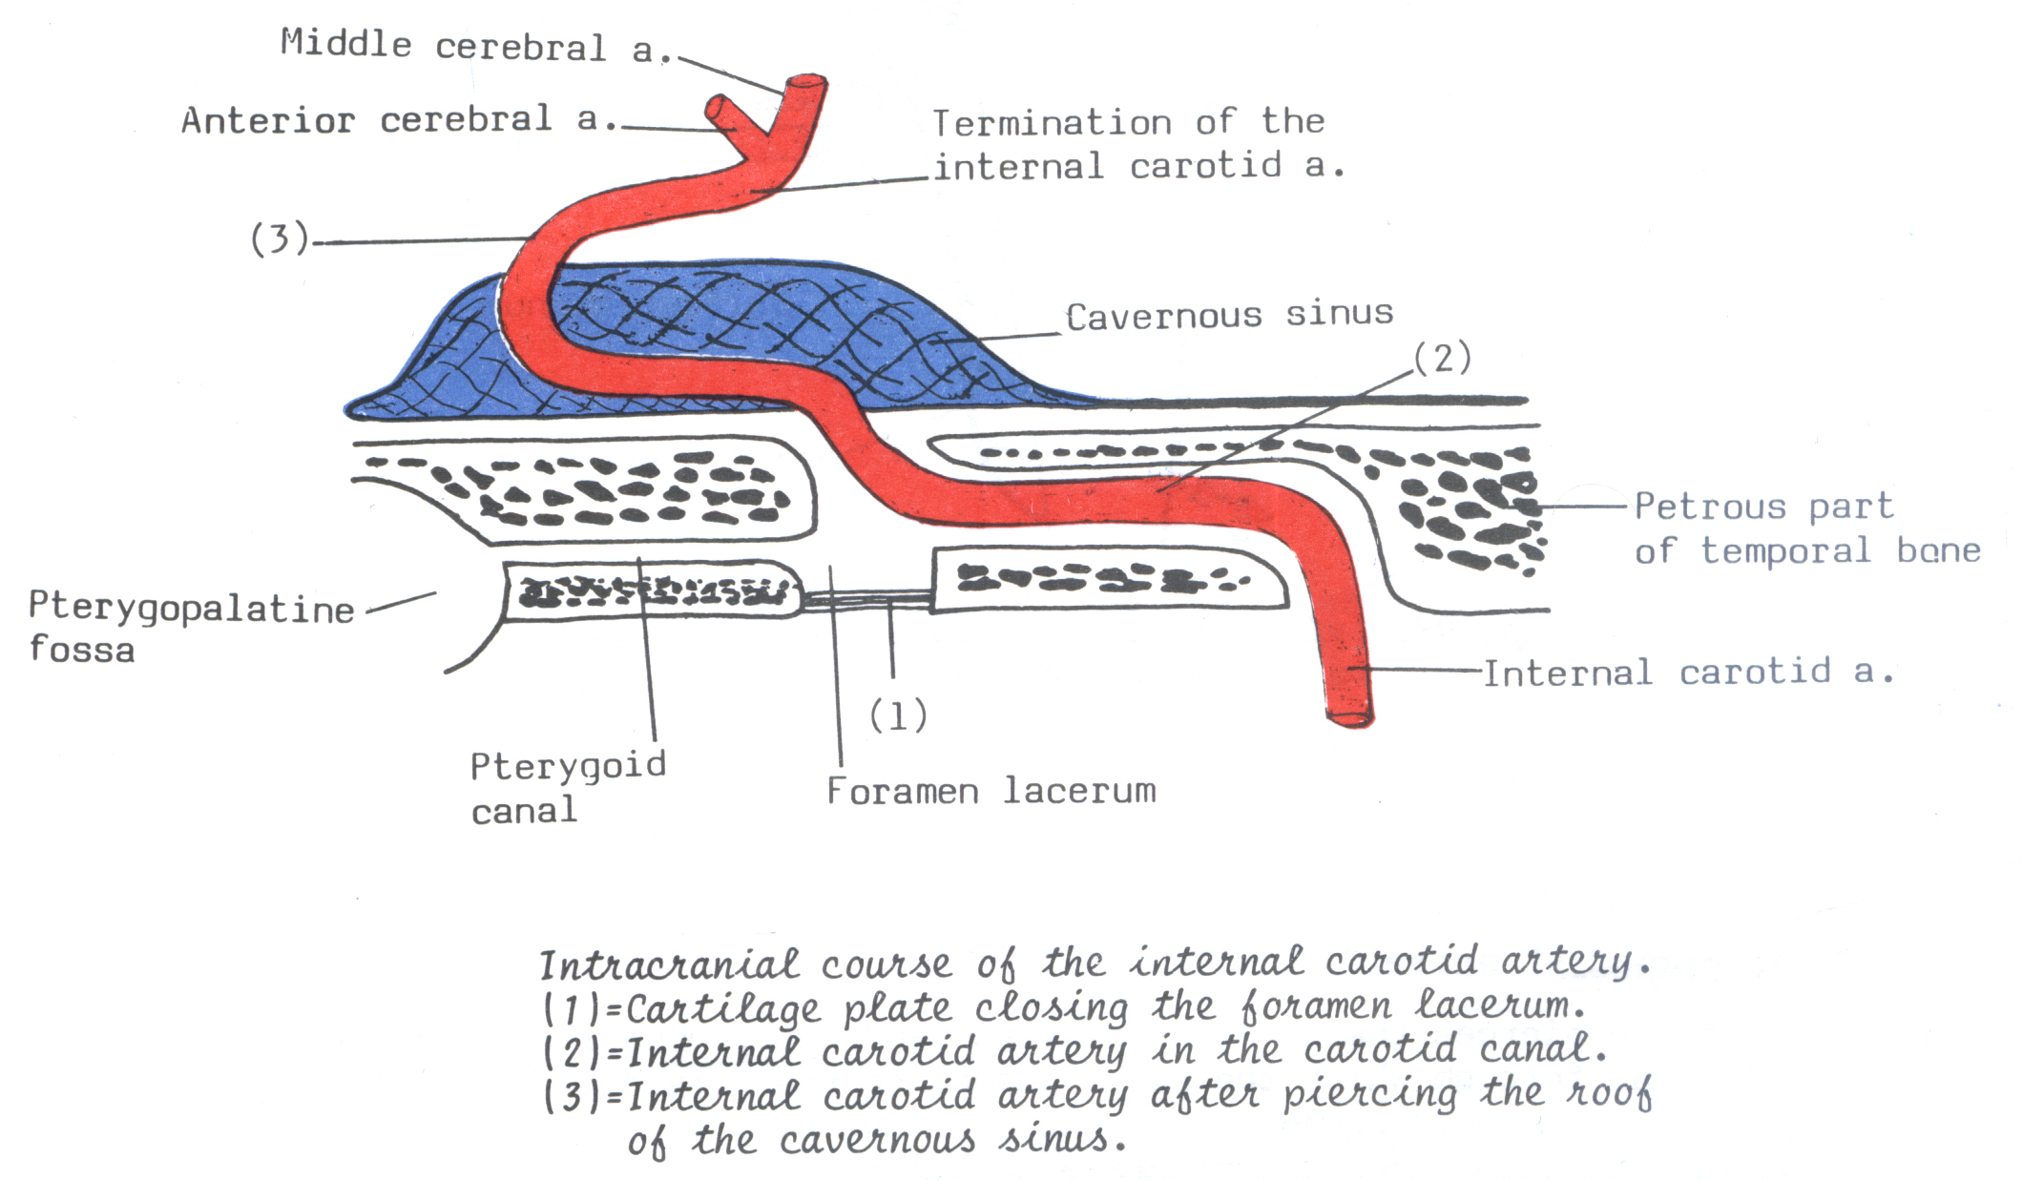
Course,parts of ICA:
1- Cervical part. 3- Cavernous part.
2- Petrous part. 4 - Cranial part.

Slide 37
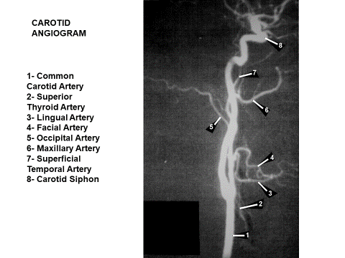

Slide 38
Veins of neck
Superficial veins
Deep veins
Anterior jugular
vein
Subclavian
vein
External jugular
vein
Internal jugular
vein

Slide 39
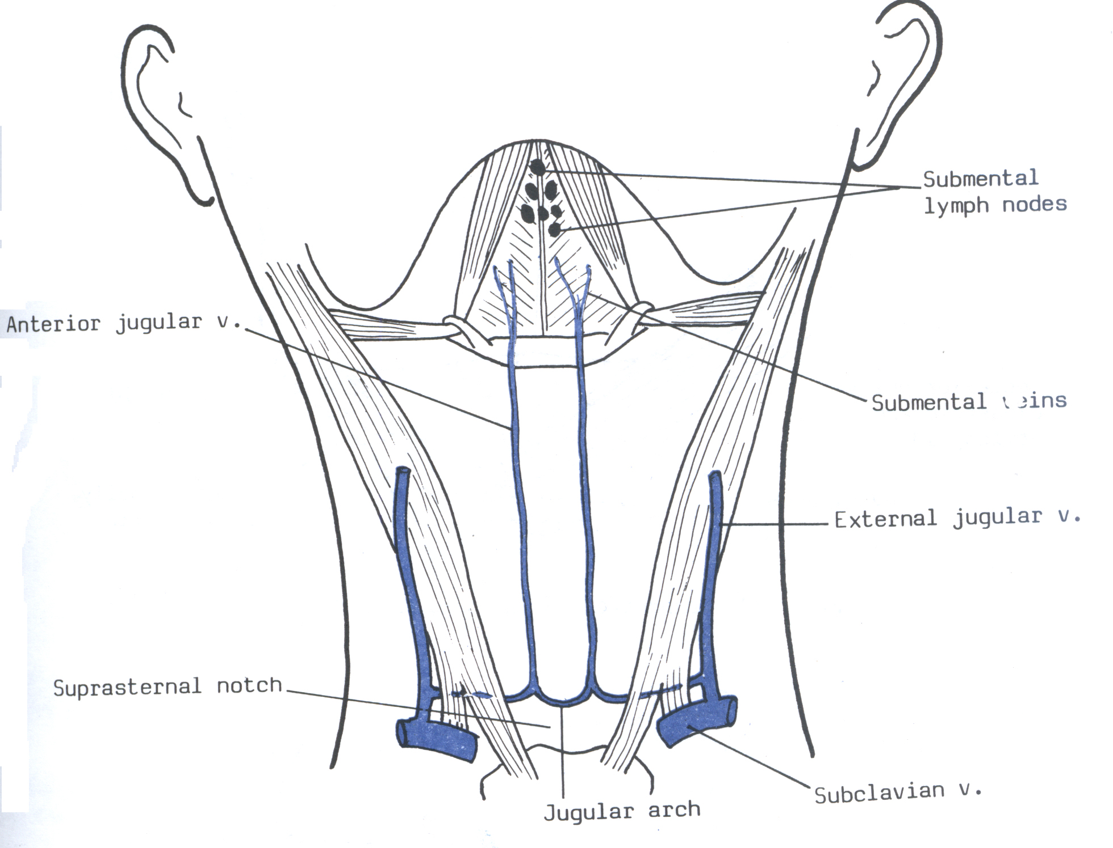
Anterior jugular vein

Slide 40
Anterior jugular vein
It is formed by union of small submental veins.
It descends in the superficial fascia close to the midline of neck.
It pierces the deep fascia just above sternum and turns laterally deep to sternocleidomastoid muscle to reach the posterior triangle of neck where it opens into the external jugular vein.
At the point of turning, the 2 anterior jugular veins are connected together by “jugular arch” which is present in the suprasternal fossa.

Slide 41
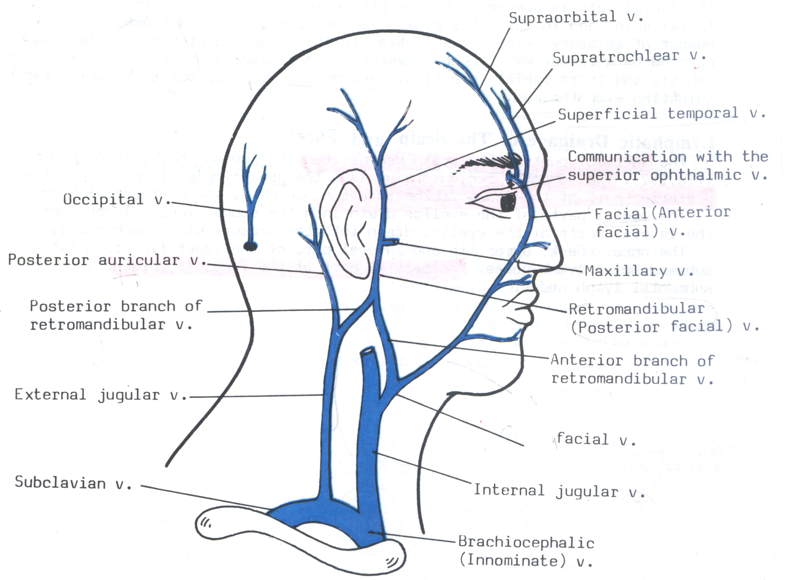
External jugular vein

Slide 42
External jugular vein
It is formed by union of posterior branch of the retromandibular vein and the posterior auricular vein.
It descends obliquely downwards and backwards lateral to the sternocleidomastoid where it is covered by the skin, superficial fascia and platysma.
Then, it descends in the roof of the posterior triangle and pierces its deep fascia to end in the subclavian vein.
It has the following tributaries:
Anterior jugular vein
Suprascapular vein.
Superficial (or transverse) cervical vein.
Posterior external jugular vein: drains skin and superficial muscles of upper part of the back of the neck.

Slide 43
Subclavian vein
It is continuation of axillary vein at the outer border of first rib.
It runs on the upper surface of first rib in front of insertion of scalenus anterior, which intervenes between it and the subclavian artery.
It corresponds only to the third and second parts of the artery.
It ends behind the medial end of clavicle by joining the IJV vein to form the innominate vein.
It has only one tributary, which is the external jugular vein.

Slide 44
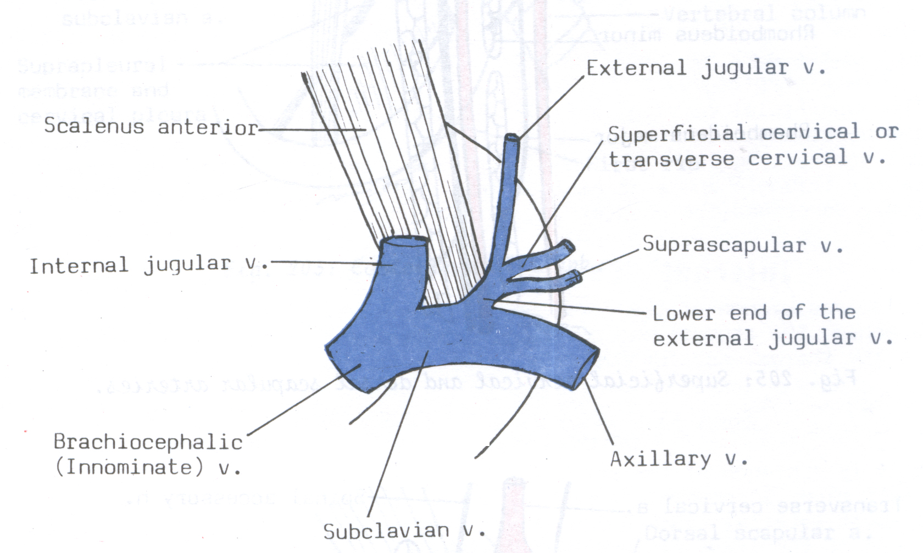
Subclavian vein

Slide 45
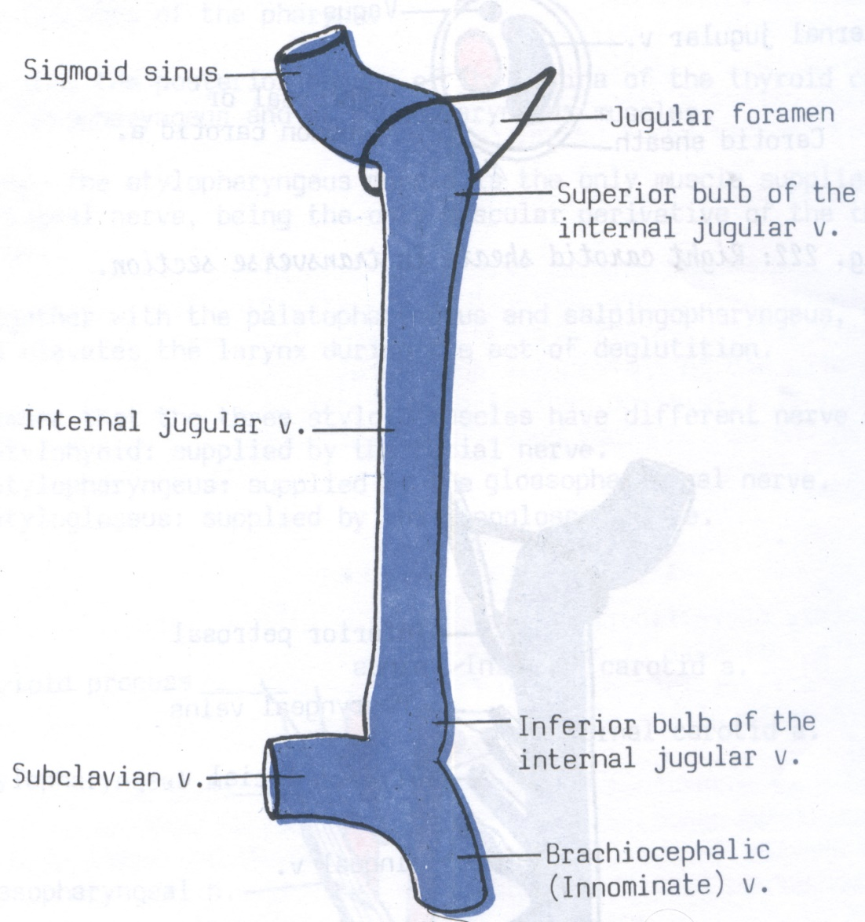
Internal jugular vein
It is the continuation of the sigmoid sinus just outside the jugular foramen.
Course & Relations:
At its upper end, it forms a dilatation called the superior bulb. At its lower end, it forms a smaller dilatation called the inferior bulb.
The vein descends vertically in the carotid sheath lateral to ICA & CCA.
The vagus nerve descends behind and between the V & A.

Slide 46
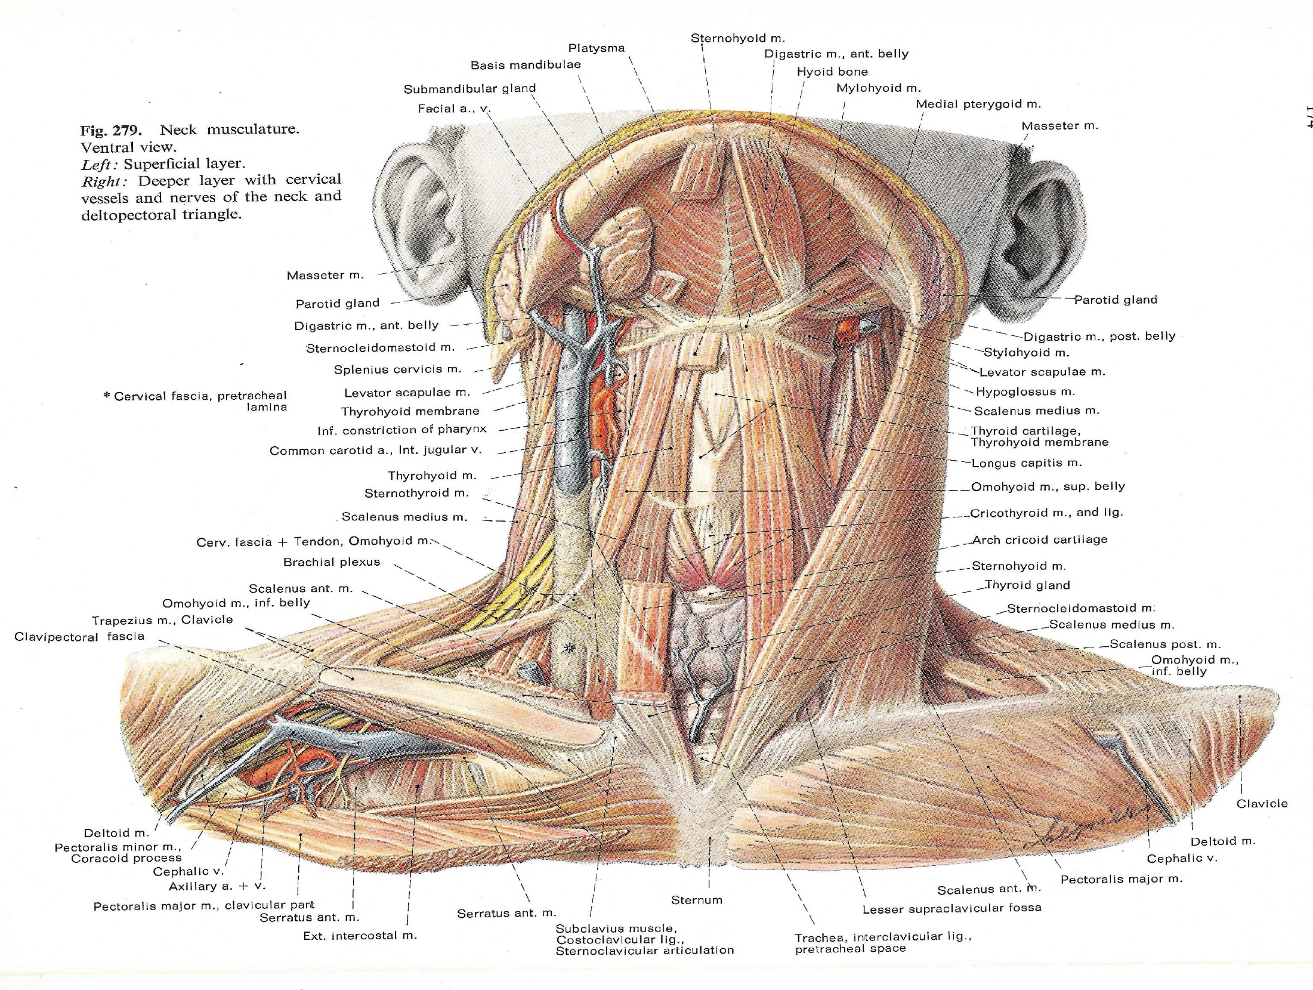

Slide 47
Anterolateral | Medial | Posterior
Its upper part is deeply covered by: styloid process and structures attached to it. parotid gland. It is crossed by the spinal accessory nerve, posterior auricular, occipital arteries and the posterior belly of digastric. Its lower part is covered by: skin, superficial fascia, platysma, deep fascia. sternomastoid. It is separated from the sternomastoid by the deep cervical L.Ns, intermediate tendon of omohyoid, terminal part of anterior jugular vein, sternothyroid and sternohyoid. | ICA & CCA inside the carotid sheath. However, the ICA is anterior to the vein at the skull base, with the lower 4 cranial nerves between the artery and the vein. | From above downwards: Cervical transverse processes & muscles attached to them. Cervical plexus. Phrenic nerve. Scalenus anterior. Thyrocervical trunk & its branches. Subclavian artery. Cervical pleura Thoracic duct on the left side.

Slide 48
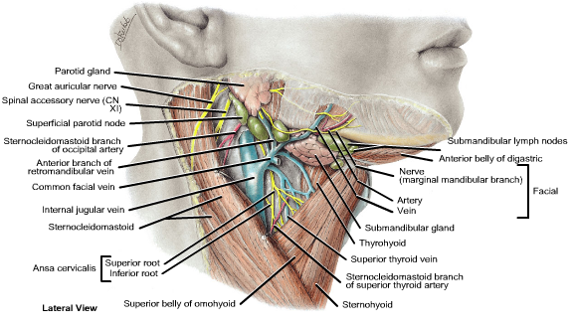

Slide 49
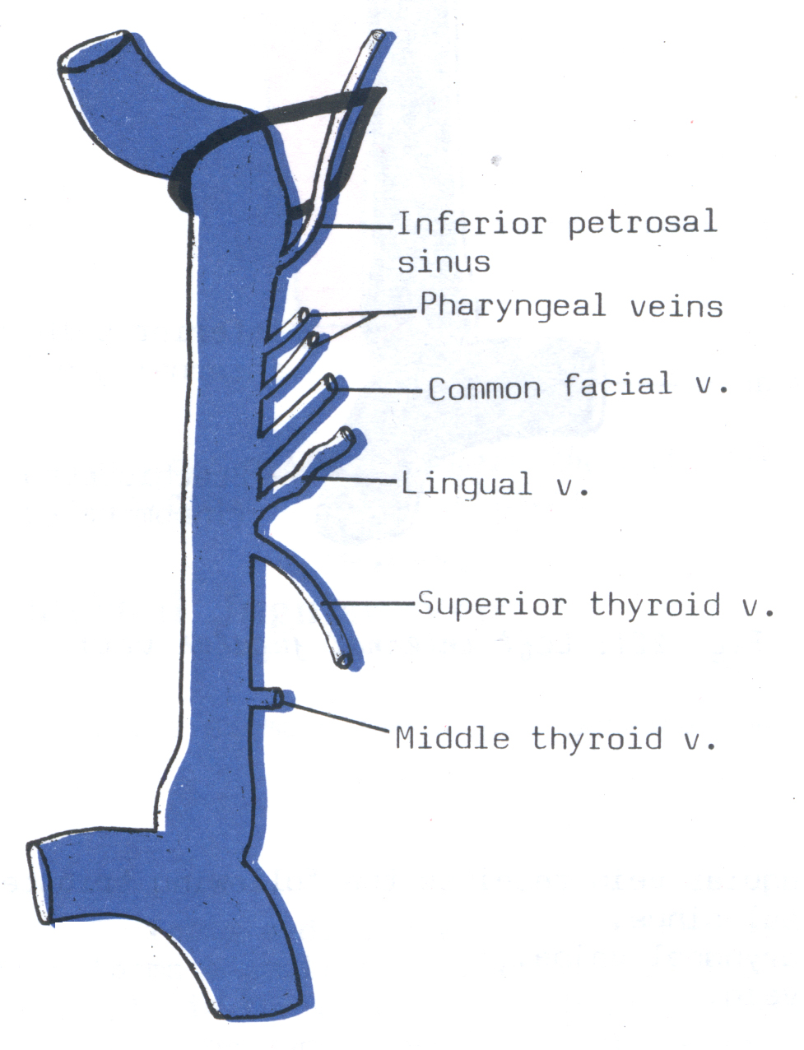
Tributaries: the internal jugular vein receives the following tributaries:
Inferior petrosal sinus.
Two or more pharyngeal veins.
Common facial vein.
Lingual vein.
Superior thyroid vein.
Middle thyroid vein.

Slide 50
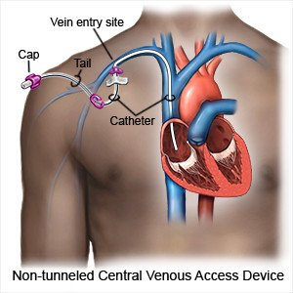

Slide 51
THANK YOU

