Slide 1
Development of: RHOMBENCEPHALON

Slide 2
A deep furrow( the rhombencephalic isthmus) separates the mesencephalon from the rhombencephalon.
The rhombencephalon also consists of two parts:
The metencephalon: (from pontine flexure to rhombencephalic isthmus) which later forms the pons and cerebellum.
The myelencephalon(the most caudal of the brain vesicles) which later forms the medulla oblongata.
*The boundary between these two portions is marked by the pontine flexure.
*The lumen of the spinal cord(the central canal) is continuous with that of the brain vesicles.

Slide 4
1-Myelencephalon
Forms medulla oblongata.
Difference of open medulla from spinal cord:
1.lateral walls: everted.
2.Roof plate: single layer of ependymal cells covered by vascular mesenchyme called pia mater.
Together these constitute tela choroidea

Slide 5
Basal plates
3 motor nuclei from medial to lateral:
Somatic efferent.
Special visceral efferent.
General Visceral efferent

Slide 6
1-Somatic efferent:
Extent: up to mesencephalon…called somatic efferent motor column
Hypoglossal nerve (Cr.N. XII) nucleus supplying muscles of the tongue except palatoglossus

Slide 7
2-Special visceral efferent:
Nucleus ambiguous
Extent: up to Metencephalon
Cr.N.:
-Glossopharyngeal (IX)
-Vagus (X)
-Accessory (XI)
supplies striated muscles derived from pharyngeal arches (larynx, pharynx and palate)

Slide 8
3-General visceral efferent(involuntary muscles):
Dorsal motor nucleus of vagus X
Inferior salivary nucleus of glossopharyngeal IX
Parasympathetic supply for involuntary muscles of :
GIT
Respiratory tract
Heart

Slide 9
Alar plates
From medial to lateral:
1-General and Special visceral afferent
2-Special somatic afferent
3-General somatic afferent

Slide 10
1-A.General visceral afferent:
Impulses from (GIT and Heart)
-B.Special visceral afferent:
Oral cavity (tongue,palate,oropharynx,epiglottis)

Slide 11
*Solitary nucleus
Its medial part:
Represents the General visceral afferents
Receives general interoceptive information from G.I.T and the heart.
Carried by IX & X Cr.N.
Its lateral part:
Represents the Special visceral afferents.
Recieves impulses from the taste buds of the tongue, palate, oropharunx, and epiglottis.
Taste sensation is carried by VII, IX, & X Cr.N.

Slide 12
2-Special somatic afferent:
Vestibulo-cochlear nuclei (Cr.N. VIII)
Receives impulses from ear
3-General somatic afferent:
3 trigeminal nuclei (V)
Receives impulses from the surface of the head

Slide 13
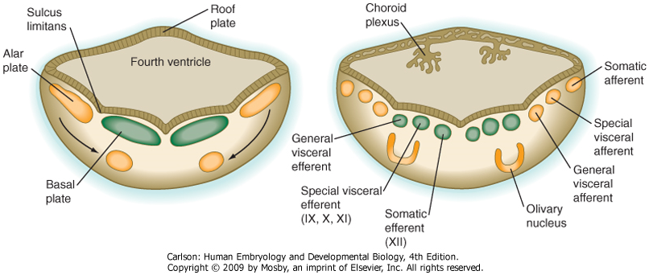

Slide 14
FORMATION OF CHOROID PLEXUS
Tela choroidea in the roof of myelencephalon invaginates into the underlying cavity in the form of tufts forming choroid plexus

Slide 15
2-Metencephalon: A-Pons: Basal plate develops into :
1-General somatic efferent (innervation of lateral rectus muscle of the eye C.Nucleus VI)
2-Special visceral efferent (innervation of muscles of the faceC.Nucleus VII and of mastication C.Nucleus V)
3-General visceral efferent (autonomic output to salivary and lacrimal glands C.Nucleus VII)

Slide 16
Alar plate develops into:
1-General and special visceral afferent (autonomic input from soft palate & pharynx –taste from ant.2/3 of the tongue CN VII)
2-Special somatic afferent (vestibulo-cochlear nuclei VIII)
3-General somatic afferent (general sensation from the face, tongue, and extraocular muscles(C.Nuclei V)

Slide 17
Solitary nucleus
Its medial part:
Represents the General visceral afferents.
Its lateral part:
Represents the Special visceral afferents.

Slide 18
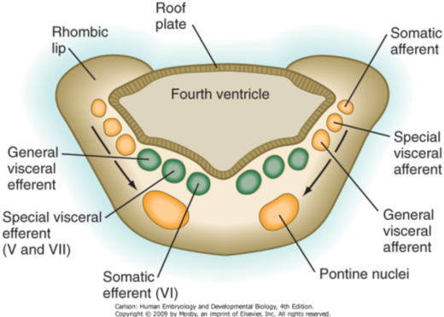

Slide 19
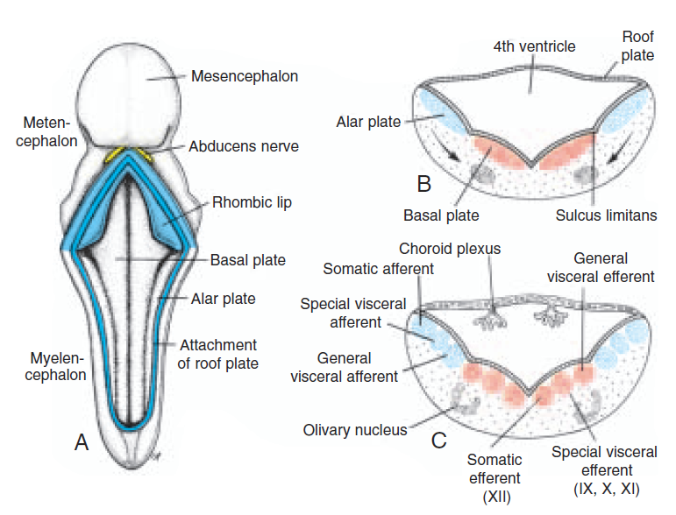

Slide 20
B-Cerebellum:
The dorsolateral parts of the alar plates of metencephalon bend medially and form the rhombic lips.
The rhombic lips have two parts:
Intra-ventricular part:
projecting into 4th ventricle.
Extra-ventricular part:
Above the attachment of roof plate
In the caudal portion of the metencephalon, the rhombic lips are widely separated, but immediately below the mesencephalon they approach each other in the midline.
As a result of a further deepening of the pontine flexure, the rhombic lips compress cephalocaudally and form the cerebellar plate.
In a 12-week embryo, this plate shows a small midline portion, the vermis, and two lateral portions, the hemispheres.
A transverse fissure soon separates the nodule from the vermis and the lateral flocculus from the hemispheres.

Slide 22
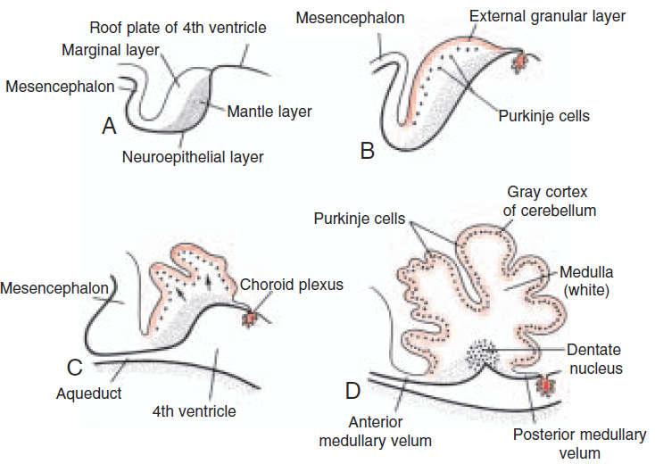

Slide 23
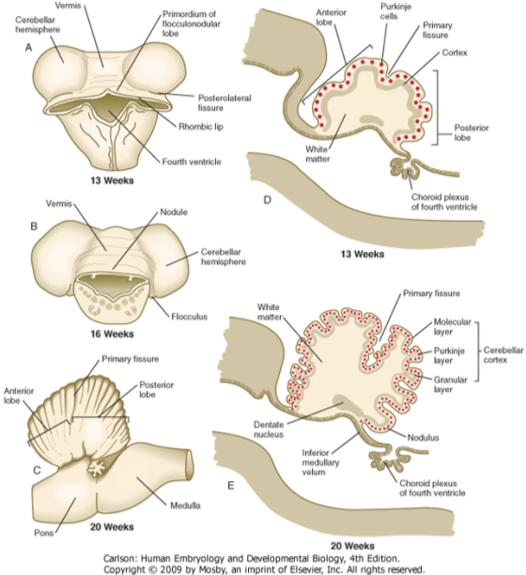
Anatomy of the developing cerebellum

Slide 24
Developmentally the cerebellum is divided into:
Flocculonodular lobe (Archicerebellum):
The most primitive part of the cerebellum.
Connected with the vestibular system.
Anterior lobe (Paleocerebellum):
The next to develop.
Receives spinal connections.
Middle lobe(Neocerebellum):
The last to appear.
Receives cerebral connections.

Slide 25
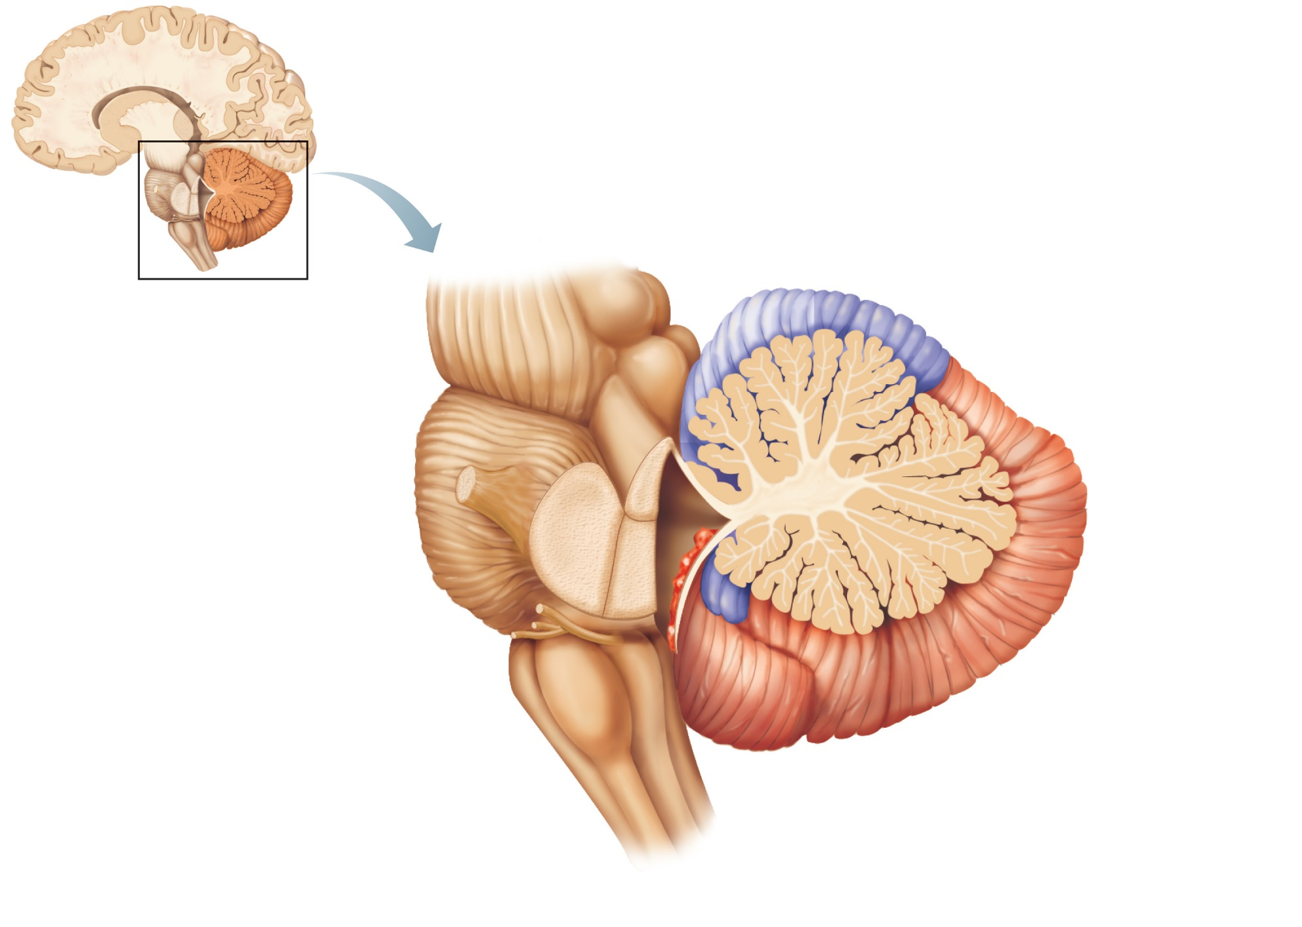
Anterior lobe
Cerebellar cortex
Arbor
vitae
Cerebellar
peduncles
Posterior
lobe
• Superior
• Middle
Choroid
plexus of
fourth
ventricle
• Inferior
Medulla
oblongata
Flocculonodular
lobe
(b)
Figure 12.17b

Slide 26
MESENCEPHALON: (MIDBRAIN)
Basal plate
contains two groups of motor nuclei:
Somatic efferent group:
oculomotor
trochlear nerves
innervate the eye musculature.
General visceral efferent group:
the nucleus of Edinger- Westphal
innervates the sphincter pupillary muscle.
The marginal layer of each basal plate enlarges and forms the crus cerebri.

Slide 27
Alar plates
appear as two longitudinal elevations separated by a shallow midline depression.
With further development, a transverse groove divides each elevation into :
Anterior (superior) colliculus : visual relay
Posterior (inferior) colliculus : auditory relay

Slide 28
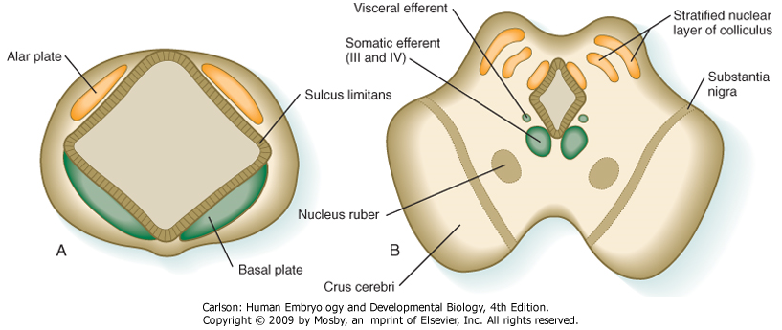

Slide 29
PROSENCEPHALON: FOREBRAIN
The prosencephalon consists of the
Telencephalon, which forms the cerebral hemispheres.
Diencephalon, which forms the optic cup and stalk, pituitary, thalamus and hypothalamus.

Slide 30
Diencephalon
The diencephalon develops from the median portion of the prosencephalon
consist of a roof plate and two alar plates only
floor and basal plates are absent.
The lumen forms the 3rd ventricle.
The roof plate of the diencephalon consists of a single layer of ependymal cells covered by vascular mesenchyme. Together these layers give rise to the choroid plexus of the third ventricle.
The most caudal part of the roof plate develops into the pineal body, or epiphysis as evagination in the 7th week of foetal life.

Slide 31
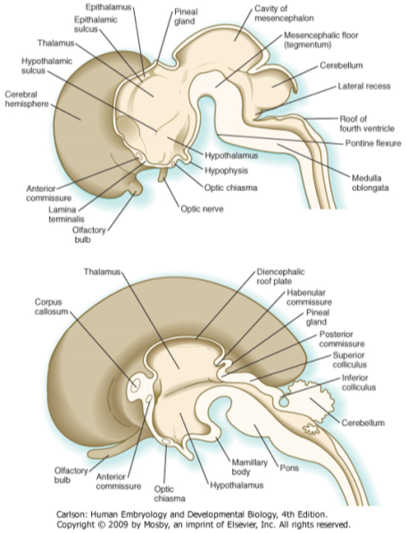
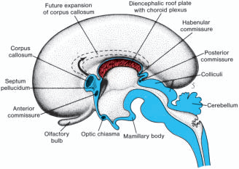

Slide 32
Diencephalon
The alar plates form the lateral walls of the diencephalon.
A groove, the hypothalamic sulcus, divides the plate into two region:
Thalamus (above).
Hypothalamus (below).
The thalamus gradually projects into the lumen of the diencephalon which become narrow and forms the 3rd ventricle.
The hypothalamus, forms the lower portion of the alar plate,
and differentiates into a number of nuclear areas
One of these groups, the mamillary body.

Slide 33
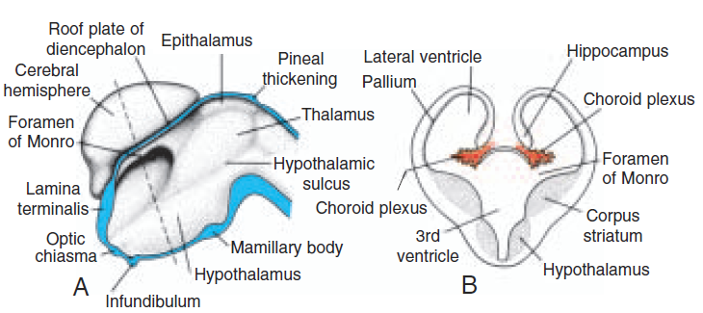
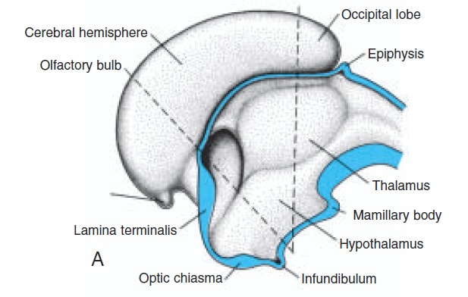
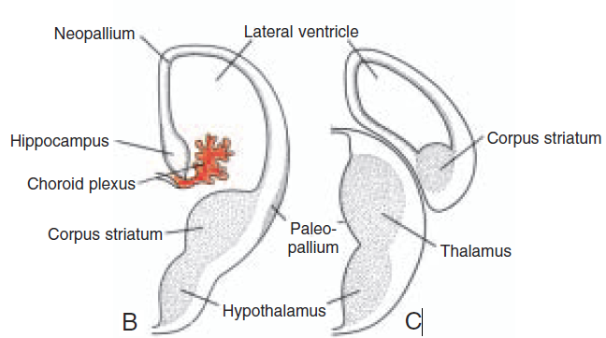

Slide 34
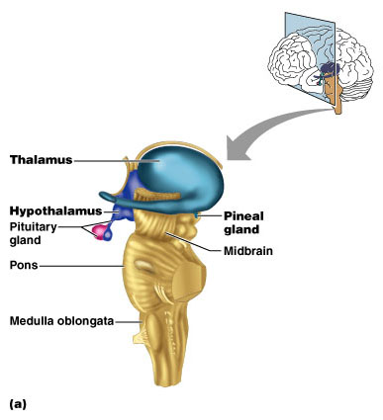
The Diencephalon
Figure 13.16a

Slide 35
Telencephalon
The telencephalon, the most rostral of the brain vesicles, consists of:
2 lateral pouches, the cerebral hemispheres.
1 Median portion, the lamina terminalis.
The lumen of each telencephalon is called the lateral ventricle.
it communicates with the lumen of the diencephalon (3rd ventricle) on each side through the interventricular foramen

Slide 36
Cerebral Hemispheres
The cerebral hemispheres arise at the beginning of the 5th week of development as bilateral evaginations of the lateral wall of the prosencephalon.
During the 7th week, the lower part of telencephalic vesicle is thickened due to marked cellular proliferation and in transverse sections, has a striated appearance >> therefore known as the corpus striatum .

Slide 37
The wall of the hemisphere at the attachment to the roof of diencephalon remain very thin to form The choroid plexus, but as a result of the disproportionate growth of the various parts of the hemisphere, it protrudes into the lateral ventricle along the choroidal fissure.
Immediately above the choroidal fissure, the wall of the hemisphere thickens, forming the hippocampus which bulges into the lateral ventricle.
Axons passing to and from the cortex of the hemisphere and breaking through the nuclear mass of the corpus striatum forming band of fibres known as the internal capsule.

Slide 39
INTERNAL CAPSULE:
Split the nuclear mass of corpus striatum into:
Caudate nucleus medially
Lentiform nucleus laterally
At the same time, the medial wall of the hemisphere and the lateral wall of the diencephalon fuse, and the caudate nucleus and thalamus come into close contact.
Cerebral cortex develops from the pallium which has two regions:
1 paleopallium or archipallium immediately lateral to corpus striatum
It includes the hippocampal formation (hippocampus, dentate gyrus, fimbria and fornix)
2 neopallium between the hippocampus and palleopallium
It incudes olfactory (bulb, tract and stria), uncus and parahippocampal gyrus.
The archipallium and neopallium together constitute the rhinencephalon

Slide 40
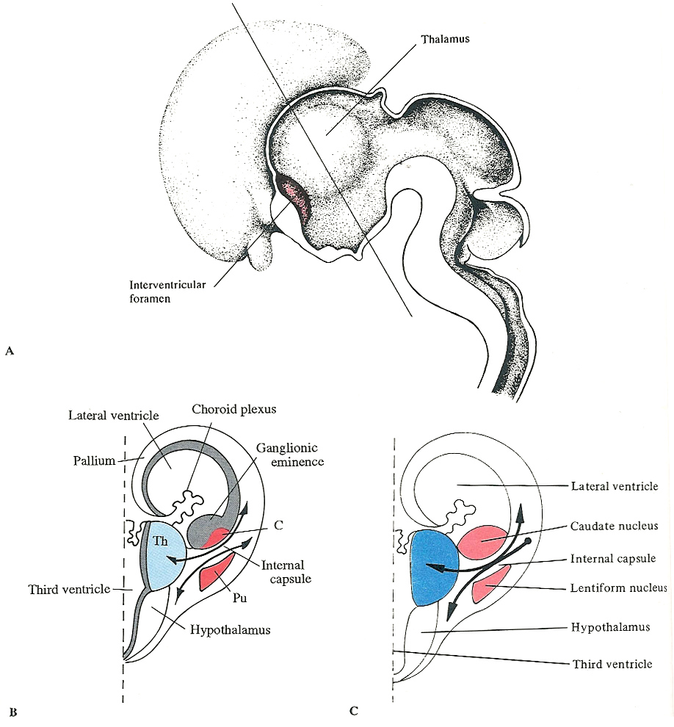

Slide 41
The hemisphere expands ventrally, dorsally, and caudally to form frontal, occipital and temporal lobes.
The lateral ventricle extends to form its anterior, posterior and inferior horns.
Cerebral cortex Initially the surface is smooth
During the final part of foetal life the surface grows so rapidly that many convolutions [ gyri ] appear on the surface separated by fissures and sulci
Sulci and gyri increase the surface area of the cortex without requiring an extensive increase in cranial size

Slide 42
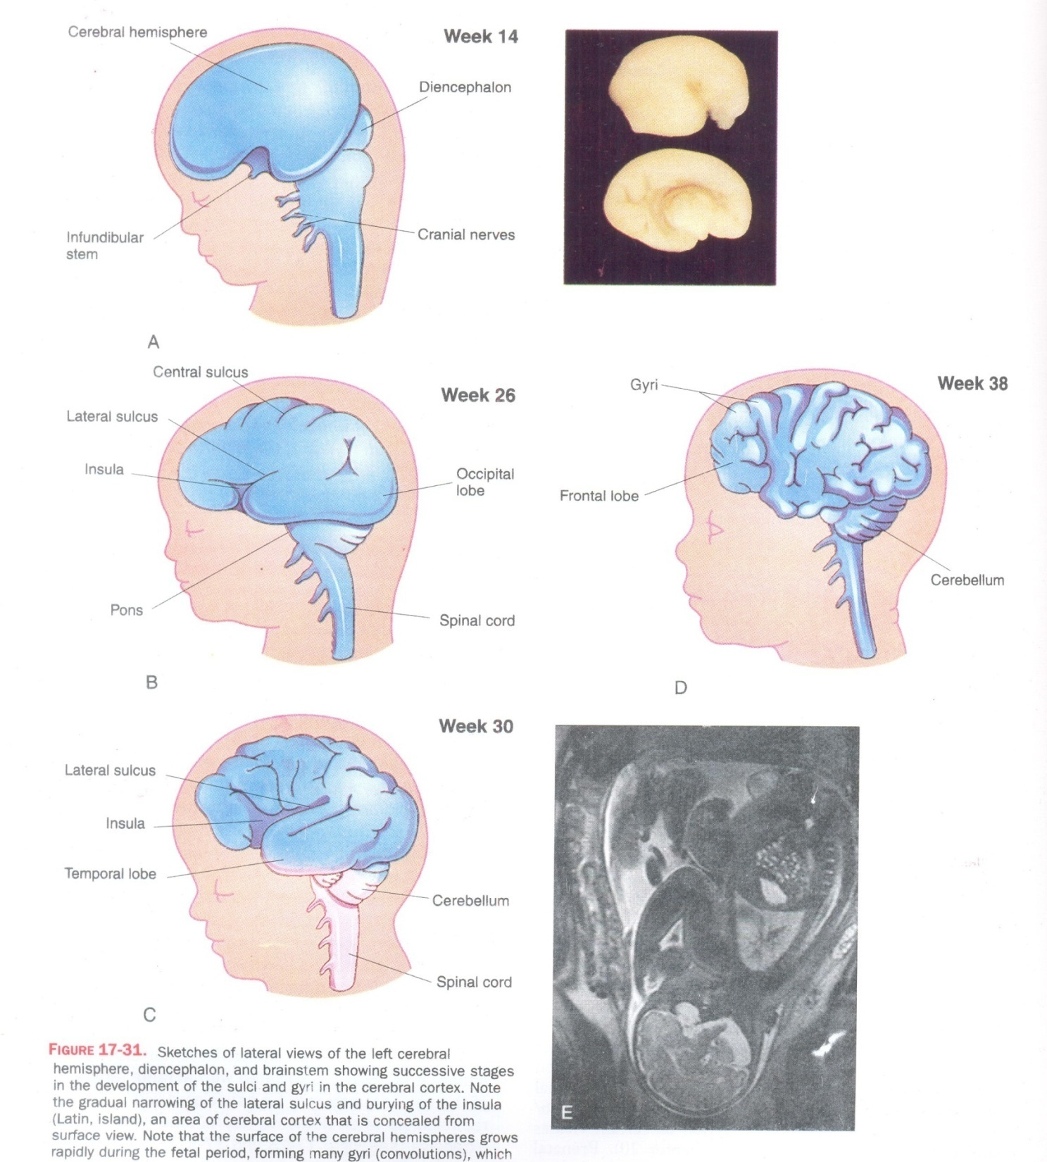

Slide 43
COMMISSURES
Fibre bundles cross the midline and connect the corresponding areas of the two hemispheres.
Anterior commissure
First commissure to develop
Runs in lamina terminalis
Connects the olfactory temporal lobes of the two sides
Hippocampal commissure/fornix commissure
Connect the two hippocampi across the fornix.
Corpus callosum
extends anteriorly and then posteriorly arching over the roof of 3rd vevtricle

Slide 44
Posterior commissure
Lies below the stalk of the pineal body
Habenular commissure
Lies above the stalk of the pineal body
Optic chiasma
Lies in the anterior part of the floor of the 3rd ventricle.

Slide 45
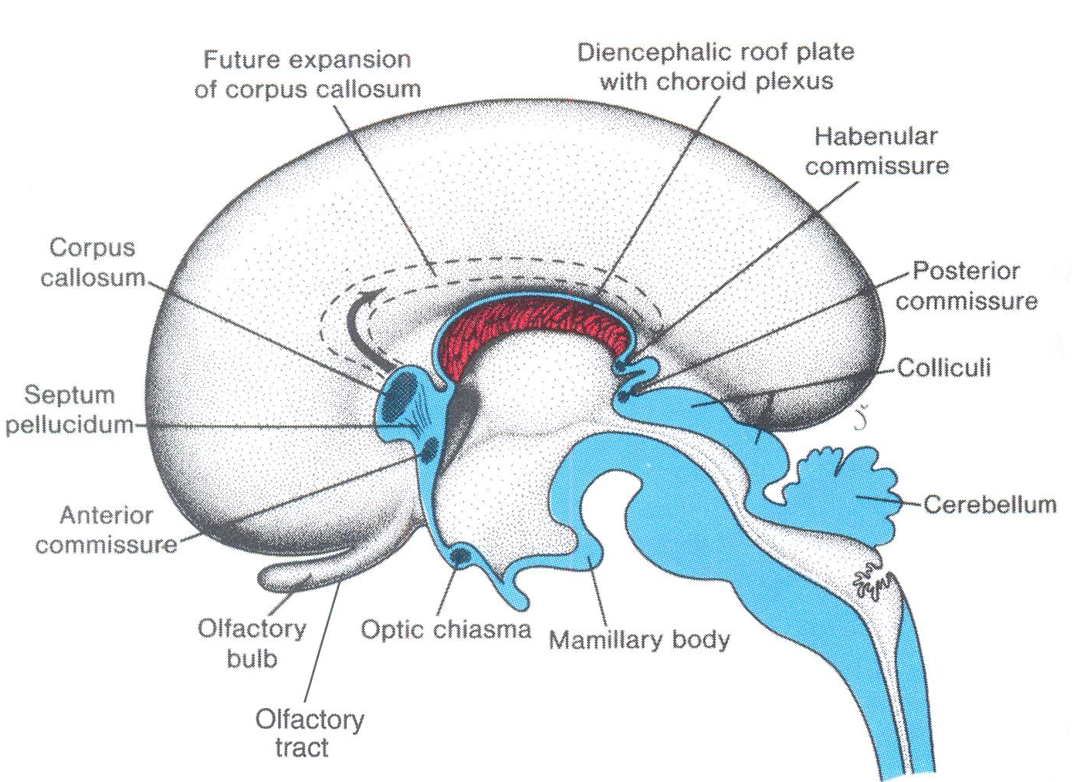

Slide 46
CONGENITAL ANOMALIES
Anencephaly is a lethal anomaly due to the absence of
The membrane-ossifying bones of the cranial vault and consequently the skull and scalp.
The cerebral hemispheres, underlying the above structures
It is more common in girls.
Hydrocephalus is an excess of cerebrospinal fluid within the ventricles, and the subarachnoid space.
Congenital cerebral malformations: e.g. Arnold-Chiari malformation.
Congenital fetal infections e.g. toxoplasmosis, cytomegalovirus.
Intrauterine intracranial hemorrhage.
Certain forms are multifactorial origin.
Obstruction of the aqueduct of Sylvius which may be due to genetic disorders as trisomy 21, infection as toxoplasmosis and cytomegalovirus, intracranial tumors, and intracerebral hemorrhage.
Chromosomal abnormalities: triploidy, trisomy 18, and X-linked trait.

Slide 47
Ossification defects in the bones of the skull:
Meningocele
Only meninges bulge through the defect
Meningoencephalocele
Meninges and part of the brain bulge through the defect
meningohydroencephalocele
Meninges, part of the brain and part of the ventricle bulge through the defect

Slide 48
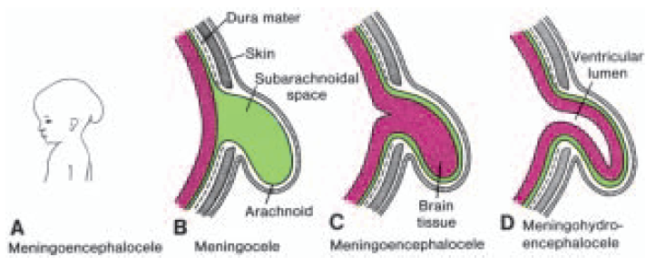
Figure 19.36 A–D. Various types of brain herniation due to abnormal ossification of the skull.

Slide 49
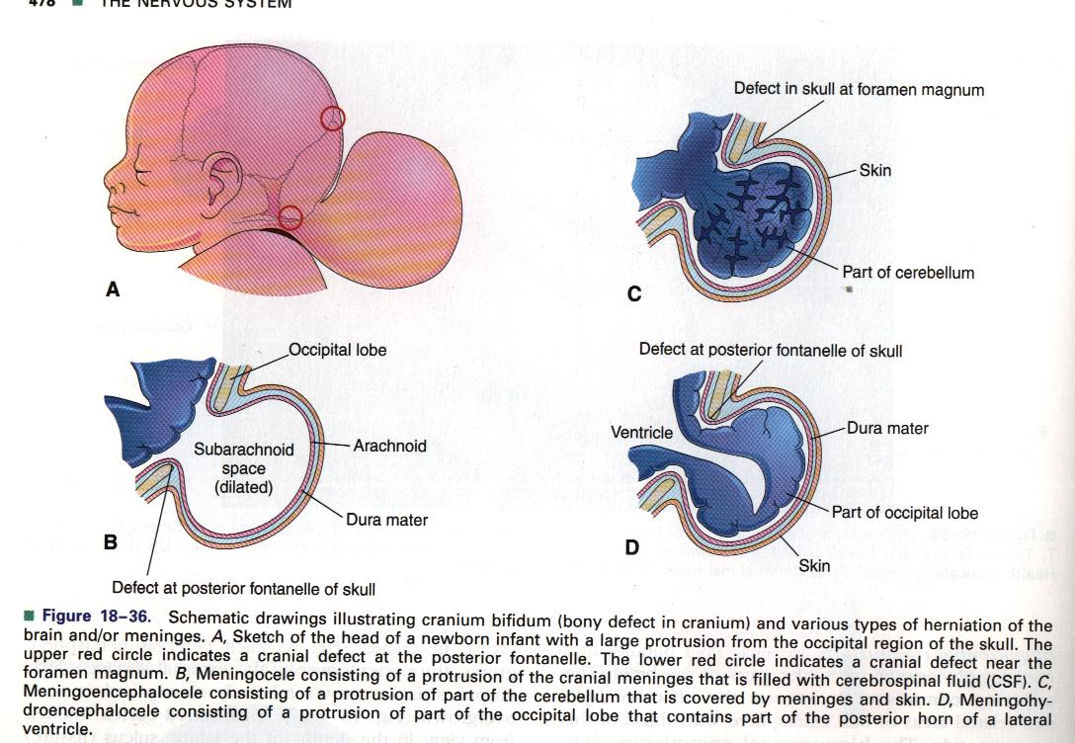
Cranial Bifida
Meningoencephalocele
Cranial Meningocele
Meningohydroencephalocele

Slide 50
NEURAL CREST
They are separated cells from the apices of the neural folds.
They are dorsolateral to the neural tube.
They give rise to :
Autonomic ganglia.
Sensory ganglia of spinal and cranial nerves.
Melanocytes.
Cells of supra renal medulla.

Slide 51
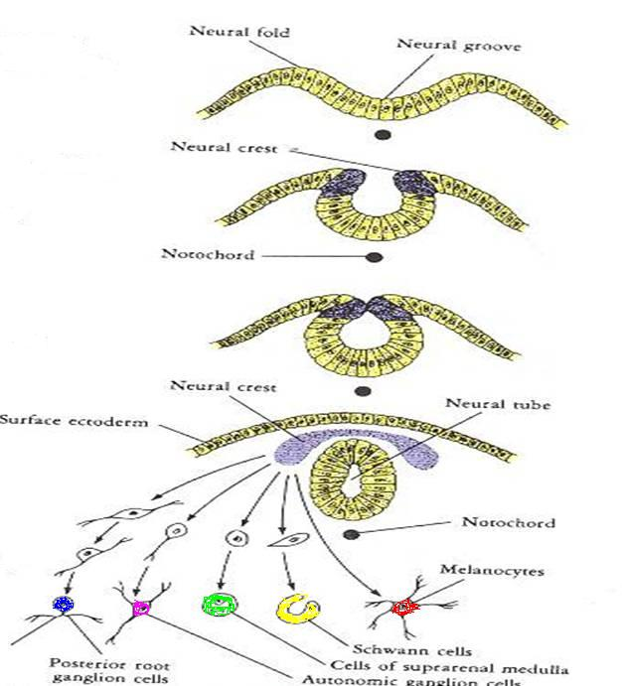

Slide 52
