Slide 1
Endocrine module Regulation of metabolism Lecture Bio.8 (36 slides) I. Hormonal regulation of metabolism II. Regulation of different metabolic pathways III. Integration of metabolism (Role of tissues)
DR. Eman Shaat
Professor of Biochemistry and Molecular Biology

Slide 2
Glucose homeostasis
Normal fasting blood glucose level is 60 - 110 mg/dl.
Maintenance of normal level is a function of different tissues as well as many hormones.
Glucose is the molecule ultimately used by body cells to make ATP.
Blood glucose levels of 40 mg/dl and below constitute severe hypoglycemia

Slide 3
Blood glucose level
The minute-by-minute adjustments that keep the blood glucose level involve the integrated actions of:
Several hormones:
Insulin - signals that blood glucose concentration is higher than necessary.
Glucagon - signals that blood glucose is too low.
Epinephrine - released into the blood to prepare the muscles, lungs, and heart for a burst of activity.
Many tissues, primarily liver, muscle, and adipose tissue.

Slide 4
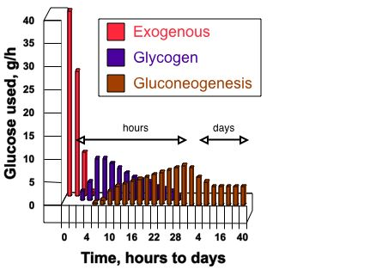
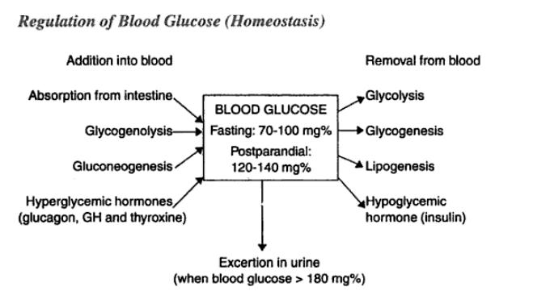
Glucose Homeostasis

Slide 5
Some Facts
The most important metabolic fuels are glucose and fatty acids.
In normal circumstances, glucose is the only fuel by the brain.
Glucose is also preferentially used by muscle during the initial stages of exercise.
Liver glycogen can supply glucose for no longer than 18h.
Gluconeogenesis provides glucose over longer periods.
The caloric value of fats (9 Kcal/g) is higher than that of either carbohydrate or protein (4 Kcal/g).
The body has a virtually unlimited capacity for the accumulation of fats as adipose tissue triglycerides.
Fatty acids can support the body’s energy needs over prolonged periods of time. In extreme circumstances, humans can fast for as long as 60-90 days and obese persons longer.

Slide 6
Hormonal regulation
Hormonal regulation of blood glucose
Hypoglycemic Hormone
Insulin
Hyperglycemic hormones
Glucagon
Epinephrine
Glucocorticoids
Growth hormone

Slide 7
Hormones regulation of glucose: Epinephrine
Secreted by the adrenal medulla in response to stressful stimuli
(fear, excitement, hemorrhage, hypoxia, hypoglycemia, etc).
Both liver and muscle cells have receptors to epinephrine.
Stimulates glucagon secretion .
inhibits insulin secretion.
Metabolic effects:
1. Carbohydrate metabolism:
hhh glycogen breakdown in the liver and muscle.
>>> glycogenesis. [epinephrine →cAMP →phosphorylates/activates phosphorylase; phosphorylates/inactivates glycogen synthase].
Stimulates the breakdown of glycogen to G1P (which is converted to G6P). Increased G6P levels hhh the rate of glycolysis in muscle.
>>> uptake of glucose by the tissues.
hhh gluconeogenesis.
2. lipid metabolism:
hhh fat mobilization in adipose tissue, activating (via PKA) triacylglycerol lipase (tissue lipase; hormone-sensitive lipase; HSL).
hhh F.A. release and oxidation.
Increased secretion of adrenaline can produce D.M. (emotional or stress D.M.)

Slide 8
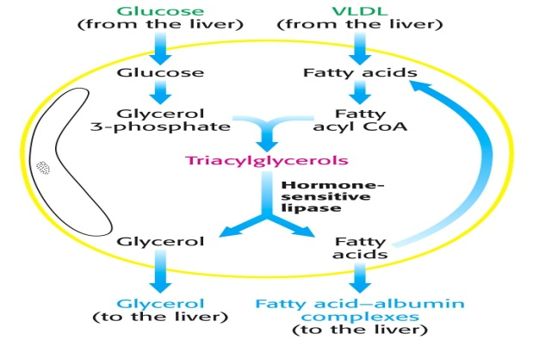
Triglyceride metabolism

Slide 9
Hormones that affect blood glucose: Glucagon:
Physical activity or stress, several hours after carbohydrate intake
↓
Blood glucose levels fall because of utilization by brain and other tissues. (elevated glucagon is associated with the fasted state).
↓
Glucagon, is produced by the α cells of islets of Langerhans.
↓
Only liver cells are rich in glucagon receptors.
↓
Acts through formation of cAMP.
1. carbohydrate metabolism:
Glucagon increases blood glucose in several ways:
- hhh breakdown of liver glycogen.
- inhibition of glycogenesis.
- inhibits glucose breakdown in liver (glycolysis).
- hhh gluconeogenesis. hhh phosphoenolpyruvate carboxykinase and fructose 1,6-bisphosphatase.
2. lipid metabolism
Glucagon stimulates fatty acid mobilization in adipose tissue. (stimulates HSL)
[ Insulin/ glucagon ratio is the main regulator of blood glucose ].

Slide 10
**Anti-insulin hormones (glucagon, epinephrine and cortisol): hyperglycemic
Cortisol :
Secreted by the adrenal cortex.
- It stimulates protein catabolism, and gluconeogenesis from amino acids (induce 4 key enzymes of gluconeogenesis).
- In extra hepatic tissues, it decreases glucose utilization.
- stimulate HSL.
(+) protein catabolism → hhh amino acids (as an important substrates for hepatic gluconeogenesis).
Activate liver transaminases.
Growth hormone:
Secreted by the anterior pituitary gland in response to abnormal low blood glucose level.
Induce liver transaminases.
Hyper secretion of GH can produce DM (pituitary DM)

Slide 11
Hormones that affect blood glucose. Insulin:
high levels are associated with the fed state
It is secreted by the β-cells of pancreatic islets in response to hyperglycemia.
Metabolic Action:
1. Carbohydrate metabolism:
hhh glucose uptake in muscle & adipose tissue via GluT₄ transporter.
hhh glucose uptake in liver (inducing glucokinase).
hhh glycogen synthesis in the liver via the second messenger (PIP₃) , so that glucose is channeled into storage.
As a consequence of accelerated uptake of blood glucose, the concentration falls to the normal range, slowing insulin release.
2. Lipid metabolism:
hhh storage of excess fuel as fat - it promotes glycolysis and thereby acetyl-CoA production used for fatty acid synthesis.
Overall insulin has a fat sparing action. It works to store excess energy

Slide 12
Hormones that affect blood glucose: Insulin
It produces its effects through the following mechanisms:-
I. It increases the uptake of glucose in muscles and adipose tissue.
II. It increases utilization of glucose (oxidation, glycogenesis and lipogenesis) in different tissues.
III. It decreases output of glucose by liver (decreases glycogenolysis and gluconeogenesis).
Effect of insulin on lipogenesis:
1. Stimulate entry of glucose to adipose tissue (GluT4).
2. stimulate glycolysis : hhh Glucose → G-6-P →glycerl-3-P.
3. hhh PDH → hhh acetyl CoA → hhh FA synthesis.
4. hhh HMS → hhh NADPH used for FA synthesis.
hhh FA + glycerol-3-P →TAG
Effect of insulin on lipolysis:
,,, lipolysis (inhibits HSL).

Slide 13
Insulin: Metabolic Action:
3. Protein metabolism: (anabolic)
Insulin stimulates protein synthesis.
Insulin inhibits protein catabolism: Insulin downregulates enzymes responsible for protein degradation (ATP-ubiquitin-dependent proteases, and ATP-independent lysosomal proteases).

Slide 14
Thyroid hormone: thyroxine increases all aspects of metabolism.
Thyroxine
(+) insulin secretion. (+)insulin catabolism
(+) GLC absorption by intestine.
(+) GLC uptake & utilization.
(+) glycogenolysis
(+) gluconeogenesis.
hhh fat mobilization
hhh FA oxidation
Effect on the protein metabolism:
In physiological concentration hhh the synthesis of proteins and nucleic acids.
In the increased concentration hhh protein catabolism.
Effect on energetic metabolism
In excess thyroxin uncouples respiration and phosphorilation, decreases the ATP formation and increases the heat formation
Excess thyroxine causes hyperglycemia.

Slide 15
II. Regulation of different metabolic pathways: 1. glycolysis 2. gluconeogenesis 3. glycogen metabolism

Slide 16
Regulation of different metabolic pathways:
Regulation of enzymes
They are regulated by:
reversible binding of allosteric effectors (milliseconds).
covalent modification (seconds)
regulation of transcription (change of the enzymes amounts).(hours)
Generally:
Insulin: dephosphorylate enz.
Epinephrine & glucagon: phosphorylate enz.
Notes:
16

Slide 17
Regulation of hexose transporters
Glucose transporters (GluT):
GLUT1 and GLUT3, present in erythrocytes, endothelial, neuronal responsible for basal glucose uptake.
GLUT2, present in liver and pancreatic β-cells has a very high K_{m} value for glucose (15-20 mM). Glucose enters these tissues at a biologically significant rate only when there is much glucose in the blood.
GLUT4, which has a K_{m} value of 5 mM, transports glucose into muscle and fat cells. The presence of insulin leads to a rapid increase in the number of GLUT4 transporters in the plasma membrane.
GLUT5, present in the small intestine.
Sodium-dependent transporter (SGLT1): small intestine & kidney.

Slide 18
Regulation of gluconeogenesis
Glycolysis & gluconeogenesis are strictly and reciprocally regulated (one reaction is inhibited as the other is stimulated )
Generally
In fed state,’’ hhhCHO ’’hyperglycemia’
hhh insulin (+) glycolysis
(-) gluconeogenesis.
In fasting, stress,exer’’ hhh C.R. Hormones,
,, insulin (-)glycolysis
(+) gluconeogenesis.

Slide 19
**Anti-insulin hormones (glucagon, epinephrine and cortisol): hyperglycemic 2-(+)lipolysis (in adipose tissue)
hh glycerol (as substrate for gluconeogenesis)
hh FFA mobilization
hh FFA oxidation
hh ATP production
hh acetyl CoA
hh citrate
hh citrate
(-)PDH
(+)PC
(-) PFK1 & PK
(+) F1,6 bisphosphatase
(+)F1,6 bisphosphatase
(-)PFK1
(-) further G oxi.
(-) glcolysis
(-) glycolysis
(-) glycolysis
(+) gluconeogenesis
(+) gluconeogenesis
(+)gluconeogenesis
(+)gluconeogenesis
(-) glycolysis

Slide 20
Cascade regulation of glycogen synthase activity
Epinephrine (in liver & muscle)+ glucagon (liver only)
AC AC**
ATP cAMP 5 AMP
Ptn. Kinase A Ptn.kinase A**
glycogen synthase** glycogen synthase
insulin
+
PDE
ATP ADP
insulin
Ptn phosphatase-1
+

Slide 21
Regulation of glycogensis & glycogenolysis
Hormonal
Insulin: - induces glycogen synthase.
- activates glycogen synthase (by dephosphorylation).
- inactivates glycogen phosphorylase (by dephosphorylation).
Epinephrine & glucagon:
- inactivate glycogen synthase (by phosphorylation).
- activate glycogen phosphorylase (by phosphorylation).
Allosteric
G-6-P & ATP activate glycogen synthase.
Glycogen inhibits glycogen synthase.

Slide 22
 | Insulin | Glucagon | Epi-nephrine | Cortisol | G.H.
Stimulus for release | Hyper-glycemia. | Hypo-glycemia. | Hypo-glycemia. Stress. Exercise. |  | Hypo-glycemia.
I-GLC consumption i-GLC entry | (+) in adipose T., muscle.liver | # | ,,, uptake | ,,, uptake | ,,, uptake (in mus.)
ii-GLC utilization: Glycolysis PDH HMS | hhh Induces & activates (glucokinase, PFK1, PK ) Activates PDH Induces G6PDH | ,,, Represses & inactivates (PFK1, PK ). | # | ,,, utilization by extra-hepatic tissues. | ,,, utilization

Slide 23
 | Insulin | Glucagon | Epi-nephrine | Cortisol | G.H.
iii-storage: glycogenesis | Induces & Activates Glycogen synthase. | Inactivates glycogen synthase. | Inactivates glycogen synthase. | # | #
II-GLC production i-Glycogenolysis | (-) Inactivates glycogen phosphorylase (dephosphorylation) | (+) Activates liver glycogen phosphorylase (not mus.) | (+) Activates liver & muscle glycogen phosphorylase. | (+) | (+)
ii-Gluconeo-genesis | Represses 4 key enz (PC, PEPCK, F1,6 diphosphatase, G-6 -phosphatase) | Induces 4 key enzymes | Induces 4 key enzymes | induces 4 key enzymes | Induces4 key enzymes

Slide 24
 | Insulin | Glucagon | Epineph. | Cortisol | G.H.
Lipid metabolism: I- lipogenesis | (+) | # | # | # | #
II-lipolysis | (-) HSL no glycerol no excess FA | (+)HSL | (+)HSL | (+)HSL | (+)
Protein metabolism: I-synthesis | (+) | # | # | # | #
II-catabolism | (-) (-) enzymes responsible for protein degradation (,,proteases) | # | # | (+) Releases a.a. Activates trans-aminases. | (+) Induces liver trans-aminases

Slide 25
 | Insulin | Glucagon | Epi-nephrine | Cortisol | G.H.
I-GLC consumption: GLC entry & GLC utilization & storage: | (+) | (-) | (-) | (-) | (-)
II-GLC output: Glycogenolysis & gluconeogenesis. | (-) | (+) | (+) | (+) | (+)
Net effect | Hypo-glycemic hormone | Hyper-glycemic Hormone | Hyper-glycemic Hormone | Hyper-glycemic Hormone | Hyper-glycemic Hormone
Diabetes mellitus if: | ,,, | hhh | hhh | hhh | hhh

Slide 26
III. Integration of metabolism (Role of tissues)

Slide 27
Metabolism in tissues
Liver is primarily responsible for glucose maintenance.
Skeletal muscle contributes alanine to liver for gluconeogenesis, lactate during replenishment.
Adipose tissue donates fatty acids to liver for ketogenesis.
Red blood cells, retina, and kidney donate lactate to liver for gluconeogenesis (Cori cycle).
Kidneys and intestines do gluconeogenesis from lactate and glutamine.
Nutrient requirements of each tissue vary with types and quantities of enzymes present in cell

Slide 28
Metabolic Interactions
Relationships among 5 components change over 24-hour period.
Body has 2 patterns of daily metabolic activity:
1. Absorptive state is the period following a meal when nutrient absorption is under way.
2. Postabsorptive state is the period when nutrient absorption is not under way and the body relies on internal energy reserves.

Slide 29
Metabolic Interactions 1. Metabolism during absorptive state
Soon after a meal nutrients enter blood
Glucose, amino acids, and triglycerides in chylomicrons
2 metabolic hallmarks
Oxidation of glucose for ATP production in all body cells
Storage of excess fuel molecules in hepatocytes, adipocytes, and skeletal muscle cells.
Pancreatic beta cells release insulin
Promotes entry of glucose and amino acids into cells

Slide 30
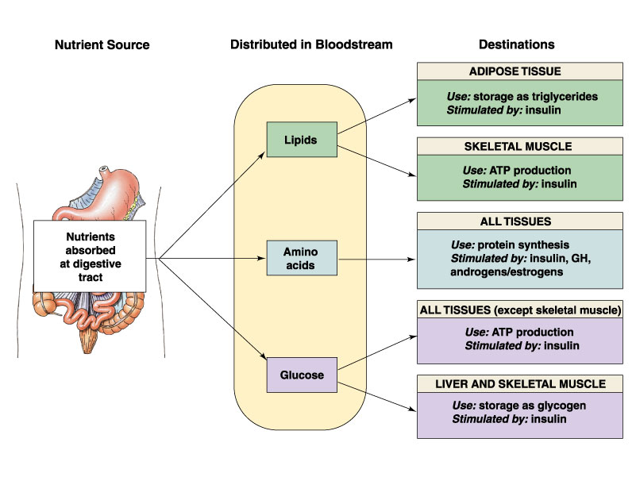
1. Metabolism during absorptive state

Slide 31
Metabolic Interactions 2. Postabsorptive state
About 4 hours after the last meal absorption in small intestine nearly complete
Blood glucose levels start to fall.
Insulin secretion falls.
Glucagon, epinephrine, and glucocorticoids dominate.
Main metabolic challenge to maintain normal blood glucose levels
Glucose production
Breakdown of liver glycogen, lipolysis, gluconeogenesis using lactic acid and/or amino acids.
Glucose conservation
Oxidation of fatty acids, lactic acid, amino acids, ketone bodies and breakdown of muscle glycogen.
[cells conserve energy by shifting to lipid based metabolism]

Slide 32
Ketone Bodies
Acetoacetic acis, β-hydroxybutyrate & acetone.
Liver cells synthesizes ketone bodies but do not catabolize ketone bodies.
compounds diffuse into general circulation to peripheral cells.
Cells reconvert ketone bodies to acetyl-CoA for TCA cycle.
[Metabolic shift reserves circulating glucose for use by neurons]
Fasting produces ketosis.
Ketoacidosis : Is a dangerous drop in blood pH
Brain uses ketone bodies.

Slide 33
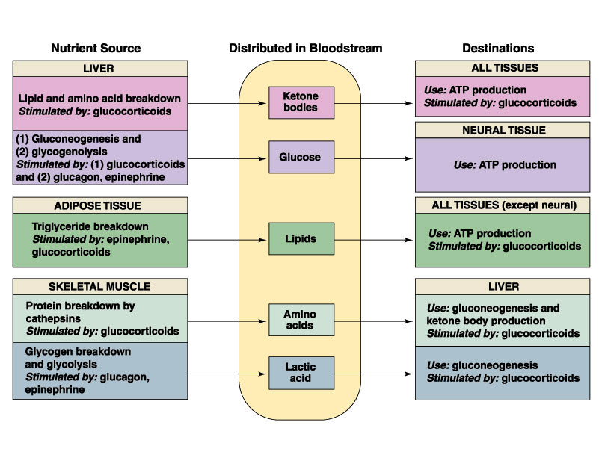
2. Metabolism during postabsorptive state

Slide 34
Summary
Ingestion of excess kilocalories
Anabolic metabolism
Excess energy from carbohydrates, proteins and fats are converted to fat and stored
Fasting or starvation
Catabolic metabolism
Fat is broken down to fatty acids.
Glycerol and amino acids maintain blood glucose.
Lack of glucose leads to formation of ketone bodies for energy.
Ketogenesis peaks three days into fasting or limited carbohydrate intake

Slide 35
Fasting: glucose production
Glycogenolysis: about 2-3 hr after a meal. The liver begins to break down its glycogen stores.
Gluconeogenesis: after about 4-6 hr of fasting, the liver begins gluconeogenesis.
Within 30 hr, liver glycogen stores are depleted, leaving gluconeogenesis as the major process maintaing blood glucose levels.
ketone bodies production by liver.
Muscles during fasting:
Degradation of muscle proteins (Ala., Gln.) go to liver for glucose or ketone bodies synthesis.
Muscle oxidizes FA released from adipose T. and ketones produced by liver.
During exercise, muscle can use its own glycogen as well as glucose, FA and ketones from blood.

Slide 36
Prolonged fasting (starvation)
A. Metabolic changes: After 3-5 days of fasting
Muscle decreases its use of ketone bodies and oxidizes FA as its primary energy source.
Brain decreases its use of glucose, although glucose is still the major fuel for brain.
Liver gluconeogenesis decreases.
Muscle protein is spared.
Less urea is produced from amino acids nitrogen in starvation than after an overnight fast.
B. Fat is the primary fuel: The body uses its fat stores as its primary source of energy during starvation, conserving functional protein.
Fats are quantitatively the most important fuel in the body. The length of time that a person can survive without food depends mainly on the amount of fat stored in adipose T.
Best wishes
Dr.Eman Shaat

