Slide 1
Introduction to Medical Terminology

Slide 2
Medical Term: fundamentals
Most medical terms are derived from Greek and Latin
language, which means that two different roots may have
the same meaning, e.g. dermatos (Greek word) and the
cutane (Latin word) both refer to the skin.
- A medical word consists of some or all of the following elements:
- Medical roots
- Combining Form
- Prefix
- Suffix
.

Slide 3
1-Term Root
It is the main part of the medical term and which carries its primary meaning (Greek roots are used for building up the words that describe a disease, condition, treatment, or diagnosis, while, Latin roots are used to build up words that describe anatomical structures.
It can appear at the beginning of a word, after a prefix, before a suffix, or between a prefix and a suffix.
- All terms have at least one word root.
A word root may be used alone or combined with other elements to form a complete word.
Examples of Medical roots
“stomat” means mouth (Greek) “or” means mouth (Latin)
“dermat” means skin (Greek) “cutane” means skin (Latin)
“nephr” means kidney (Greek) “ren” means kidney (Latin)

Slide 4
2-Combining Form
A combining form is the combination of the word root and the combining vowel which could be an o, but sometimes it is an i to make the word roots pronunciation easier.
The combining vowel has no meaning of its own, but enables two word elements to be connected.
A combining form is presented as word root/vowel (such as gastr/o).
i.e. gastr / o pronounced GASTRO.
Word root
Combining vowel

Slide 5
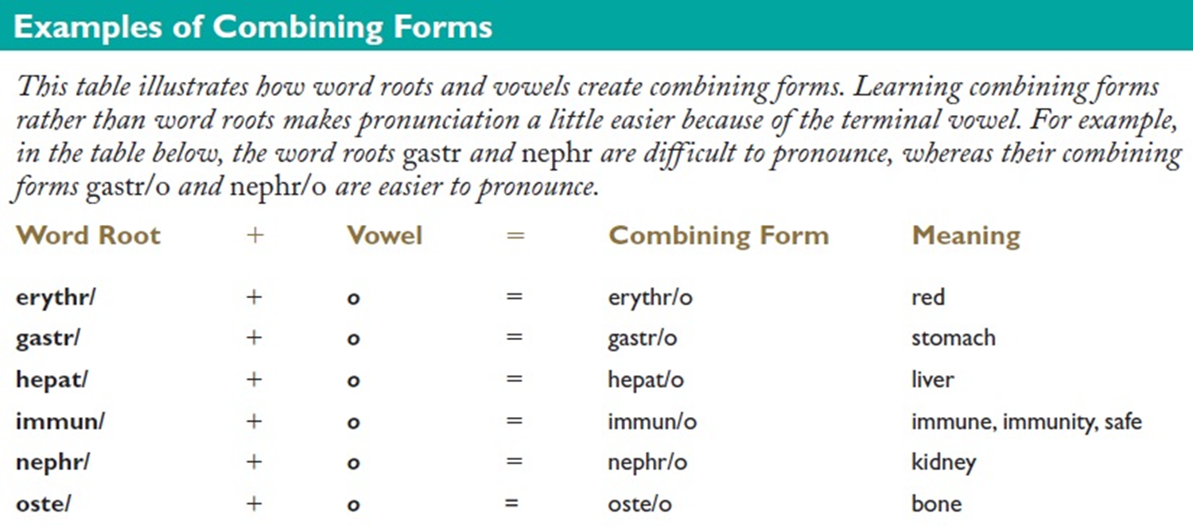
When a word has more than one root, a combining vowel is used to link the root to each other.
i.e. osteoarthritis
oste/ o / arthr/ itis
Word root
Combining vowel
Word root
suffix

Slide 6
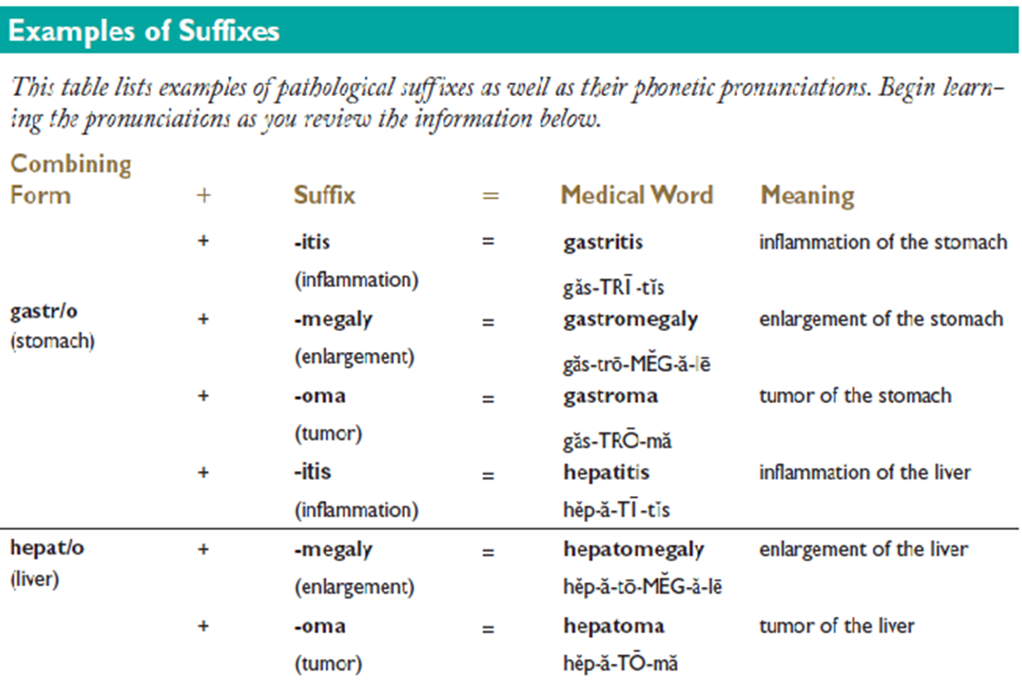
3-Suffix
A suffix (derived from Greek or Latin words) is composed of one or more letters added to the END of a word root or combining form to modify its meaning, it describes a pathology (disease or abnormality), symptom, surgical or diagnostic procedure, or part of speech.

Slide 7
Building Medical Words
There are three basic rules for building medical words.
Rule I
A word root links a suffix that begins with a vowel.
Rule II
A combining form (root o) links a suffix that begins with a consonant.
Rule III
A combining form links a root to another root to form a compound word. This rule holds true even if the next root begins with a vowel, as in osteoarthritis.
Keep in mind that the rules for linking multiple roots
to each other are slightly different from the rules for
linking roots and combining forms to suffixes.

Slide 8
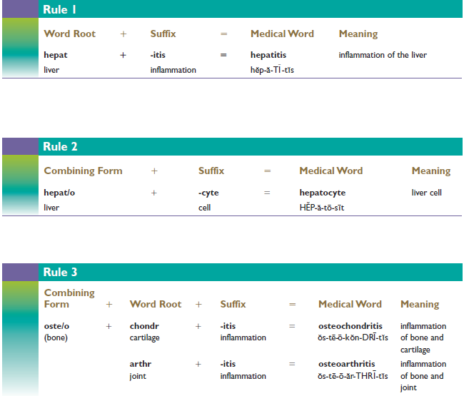

Slide 9
Meanings of certain suffixes
-scope (instrument to view) -rrhexis (rupture)
-rrhea (excessive flow or discharge) -toxic ( poison)
-stenosis ( narrowing, stricture) -pathy (disease)
(All begin with a consonant, therefore a combining vowel must be used between the word root and the suffix).
-algia (pain) -edema (swelling)
-uria (urine, urination) -osis (abnormal condition)
-ectomy (excision)
(These suffixes begin with a vowel, therefore a combining vowel is NOT used between the word root and the suffix).

Slide 10
4-Prefix
A prefix is a syllable or syllables attached to the beginning of a word or word root to alter its meaning or create a new word.
Not all medical terms have a prefix.
The prefix usually indicates a number, time, position, direction, or negation (absence). Many of the same prefixes used in medical terminology are also used in the English language.
Anti- (against)
Hyper- (excessive)
Pre- (before)
Post- (after)
Homo- (same)
Hypo- (under)
Hetero- (different)
Eu- ( normal)
Dys- (painful)
Brady- (slow)
Epi- (above)
hemi- (half)
bi- (two)
tri- (three)
mono- (one)
Hypo- (under)
para- (beside)
Intra – ( within)
Endo- ( within)
Ecto – (outside)
Epi- (above))
inter- (between)
retro- (behind)
macro- (large)
micro- (small)
multi- (much)
ab- (away from)
ad – ( within)
Endo- (toward)
circum– (around)

Slide 11
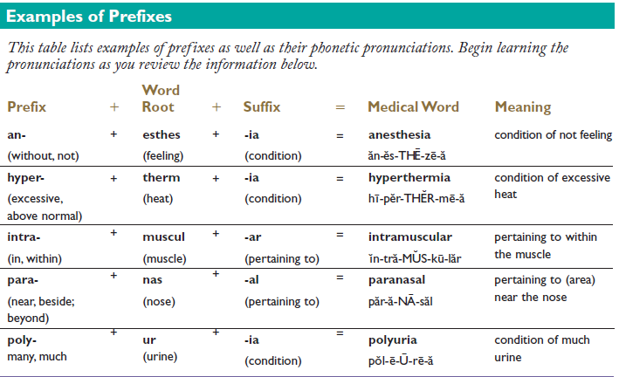

Slide 12
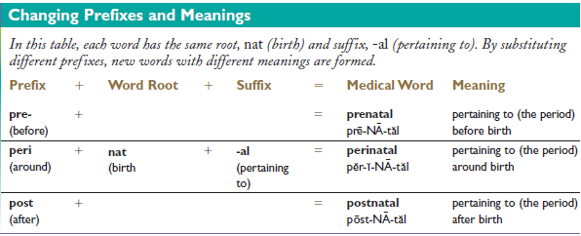

Slide 13
Medical term Interpretation
It can be done by defining the term components (1- suffix, or last part of the word, 2- the first part of the word (which may be a word root, combining form, or prefix), 3- the middle parts of the word).
Examples:
Acrocyanosis
Acr (word root = extremities)
cyan (word root = blue)
/ o / = combining vowel
- osis (suffix = condition)
So, Acrocyanosis = a condition characterized by blue extremities

Slide 14
Hypoinsulinemia
Hypo / insulin / emia
Prefix
Word root
suffix
Low
Insulin
Blood
In this example, there is no combining vowel in this word because the prefix ends with a vowel and the suffix begins with a vowel.

Slide 15
Plural words
Are formed by adding or substituting another vowel or syllable at the end of a word (i.e. suffix).
Examples
macula – the plural is maculae
adenoma – the plural is adenomata
glomerulus – the plural is glomeruli
ovum – the plural is ova
spermatozoon – the plural is spermatozoa

Slide 16
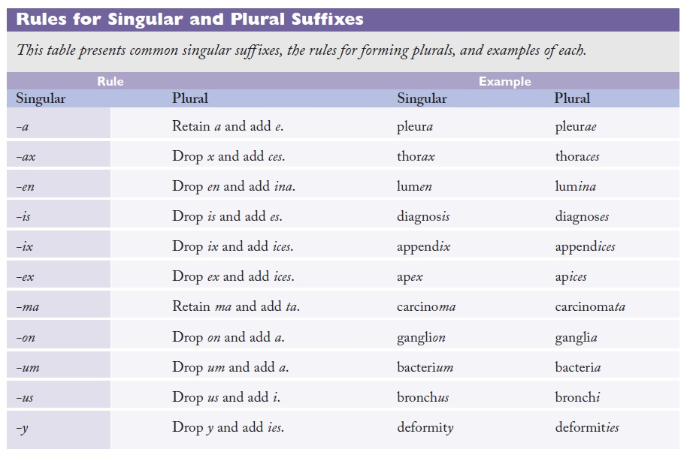

Slide 17
Eponyms
Eponyms are medical terms derived from the name of a person. Many procedures and tests are also named after the person who invented or perfected them.
Examples of diseases;
- Addison’s disease - Alzheimer’s disease
- Cushing’s disease - Parkinson’s disease
- Stokes-Adam’s syndrome
Examples of body parts;
- Bowman capsules - Cowper’s glands
- Wernicke’s center or area
Examples of tools;
- Foleys catheter - Hegar dilators

Slide 18
Acronyms
Acronyms are medical abbreviations. They are used very frequently in medicine. They boost efficiency as long as they are used intelligently.
Examples;
- ACE (angiotensin converting enzyme)
- ACTH (adrenocorticotropic hormone)
- AIDS (acquired immune deficiency syndrome)
- HDL (high density lipoprotein)
- Hx (history)
- MI (myocardial infarction)
- RBC (red blood cells)
- RBBB (right bundle branch block)
- TB (tuberculosis)
- ADH (anti-diuretic hormone)

