Slide 1
MULTIPLE MYELOMA
Done by :
لينا محمود
رقية الخنازرة
دانيا الطراونة

Slide 2
Definition
Multiple myeloma is malignant proliferation of plasma cells in the bone marrow, it is one of the most common lymphoid malignancies.
The etiology is unclear
The median age at diagnosis is 70 years
it is more common in males and in people of African origin

Slide 3
It involves the bone marrow and usually is associated with lytic lesions throughout the skeletal system, it also affects the immune system and the kidneys, all of which contribute to morbidity and mortality of the disease.
The most frequent M protein produced by myeloma cells is IgG (60%), followed by IgA (20%–25%); rarely IgM, IgD, or IgE M proteins observed. In the remaining cases, the plasma cells produce only κ or λ light chains.
Patients with MM rarely (<0.5%) produce monoclonal IgM.

Slide 4
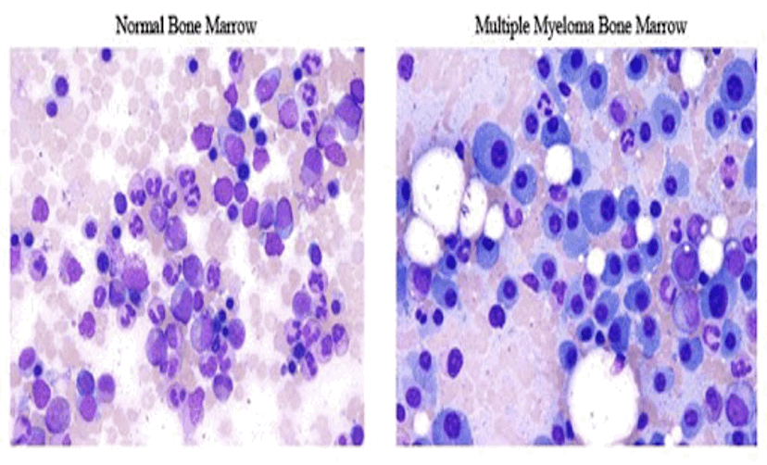
Morphology
Microscopically,
1- The marrow shows increased numbers of plasma cells, usually > 10% of the cellularity.
Bone marrow biopsy

Slide 5
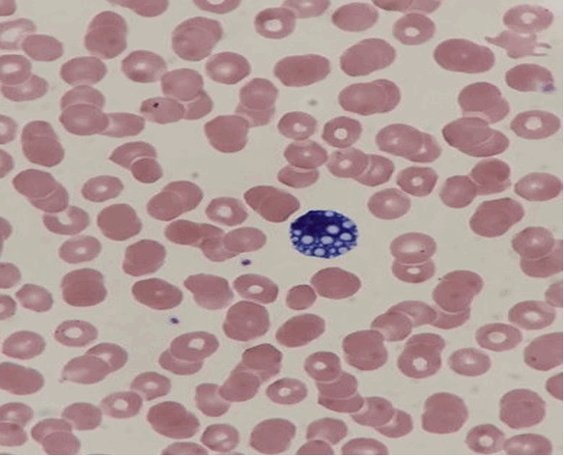
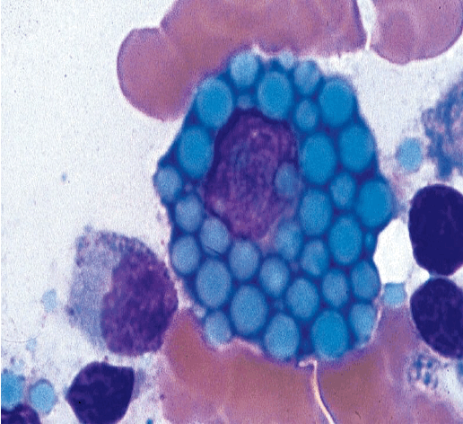
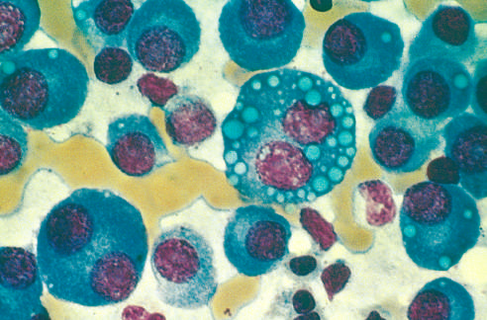
2- Mott cells are plasma cells that have spherical inclusions packed with Ig in their cytoplasm, Inclusions: Russell bodies

Slide 6
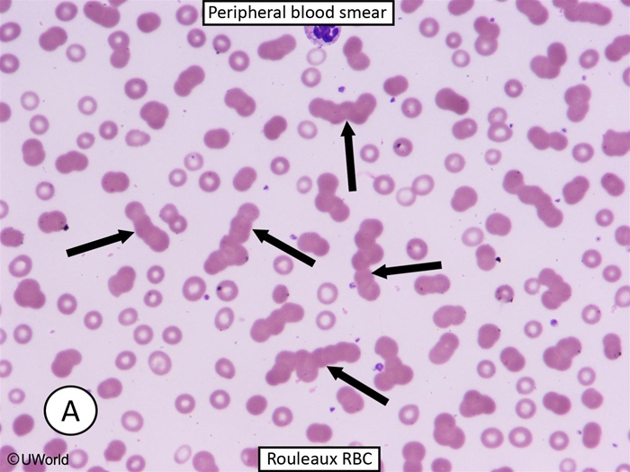
Peripheral blood smear

Slide 7
Bone involvement
Bone destruction is the major pathologic feature of multiple myeloma.
Factors produced by neoplastic plasma cells mediate bone destruction, through:
A- upregulating the expression of the receptor activator of NF-κB ligand (RANKL) by bone marrow stromal cells, which in turn activates osteoclasts.
B- other factors released from tumor cells are potent inhibitors of osteoblast function.
The net effect is increased bone resorption, leading to hypercalcemia and pathologic fractures.

Slide 8
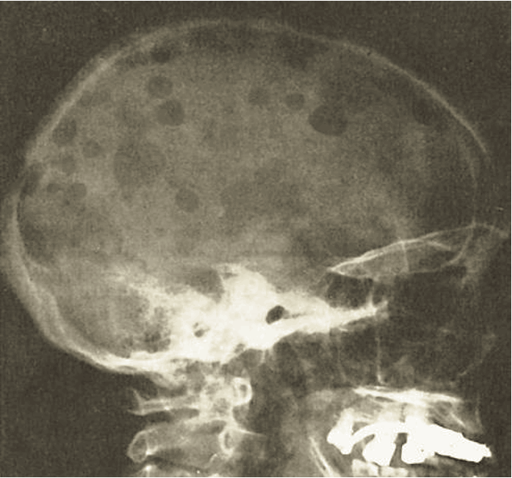
Punched-out bone lesions
(caused by bone destruction in MM and are most obvious in the skull particularly in the parietal and occipital parts of the skull)

Slide 10
Humoral immunity
Because multiple myeloma compromises the function of normal B cells there is depression of the production of functional antibodies, so infections are the most common cause of death in these patients.
Neoplastic infiltration of the bone marrow alters and impairs the normal lymphocyte population, resulting in ineffective antibody production and hypogammaglobulinemia.

Slide 11
Renal dysfunction
Due to :
1) M-protein and Bence Jones proteins deposition
2) Hypercalcemia
3) Infection
4) NSAIDs-use for bone pain.
5) Amyloidosis.

Slide 12
Hypercalcemia
At the time of diagnosis, approximately 25% of patients with MM have hypercalcemia.
Typically, this is a result of osteolytic bone destruction by the neoplastic plasma cells.
Although hypercalcemia may be asymptomatic with a calcium level <12 mg/dL, anorexia, nausea, polyuria, constipation, weakness, and confusion are common.

Slide 13
Hyperviscosity Syndrome
Although more common in Waldenström's macroglobulinemia (due to elevated IgM), hyperviscosity syndrome can also occur in patients with multiple myeloma (MM).
The hyperviscosity in myeloma is typically due to increased serum protein content with large molecular size, abnormal polymerization, and abnormal immunoglobulin shape.
The impaired microcirculation in the brain can cause headache, dizziness, vertigo, nystagmus, hearing loss, and visual impairment.
Severe cases can present with somnolence, coma, seizures, and heart failure. Mucosal hemorrhage (eg, nasal or oral bleeding) is usually due to impaired platelet function.
Treatment involves prompt plasmapheresis for symptom relief

Slide 14
Clinical features and findings
Significant bone pain (esp. in the low back, chest and jaw), pathologic fractures, loss of height
Renal failure and proteinuria
Hypercalcemia and neurological manifestations; confusion, lethargy and weakness
Anemia
Recurrent infections (esp. of the lung or urinary tract)
Cord compression may occur secondary to plasmacytoma or fractured bone fragment.
Solitary plasmacytoma: an infrequent variant of multiple myeloma that presents as a single mass in bone or soft tissue.

Slide 15
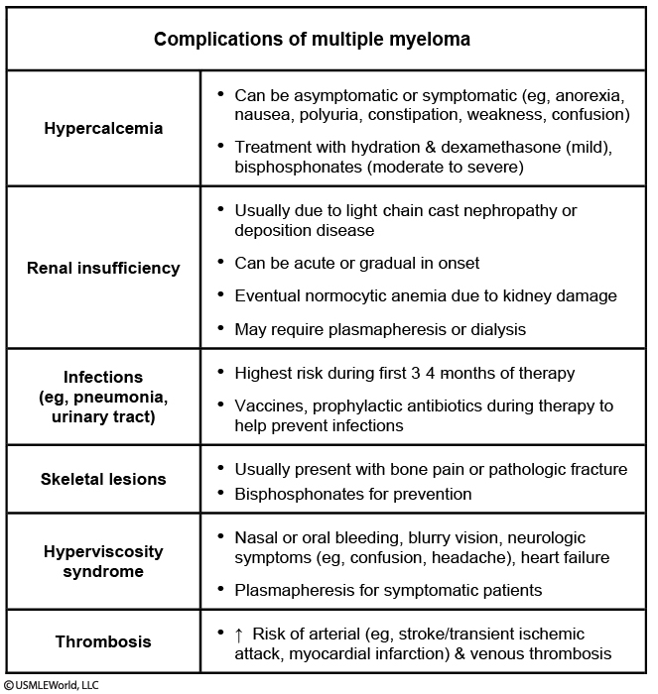

Slide 16
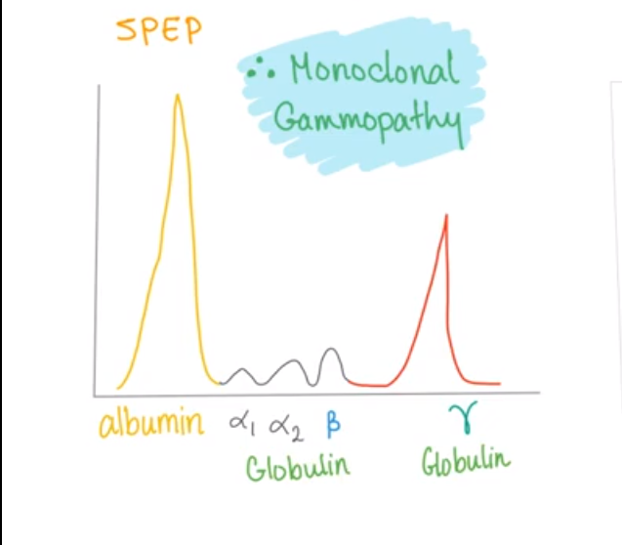
Diagnosis
1- Serum and urine protein electrophoresis (SPEP/UPEP)-reveals monoclonal protein spike (M-spike)

Slide 17
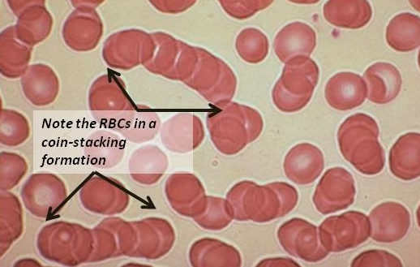
2- Low-dose CT, PET/CT, or MRI - reveal lytic bone lesion
3- Bone marrow biopsy
4- Hypercalcemia
5- Elevated creatinine or urea
6- Elevated serum total protein
7- Anemia, leukopenia, thrombocytopenia
8- Urinalysis- reveals large amounts of free light chains called Bence Jones proteins
9- Peripheral blood smear- reveals normocytic anemia with RBCs in rouleaux formation
Notes:
A protein gap (difference between total protein and albumin >4 g/dL) indicates elevated nonalbumin protein in the serum; it may be seen with polyclonal gammopathies (infection, connective tissue disease) or excessive monoclonal protein (MM, Waldenström macroglobulinemia). Serum protein electrophoresis (SPEP) can determine if a protein gap is caused by a monoclonal or polyclonal source. In MM, SPEP typically shows a monoclonal spike (M-spike). Bone marrow biopsy, a more invasive procedure, can then confirm diagnosis (>10% clonal plasma cells).

Slide 18
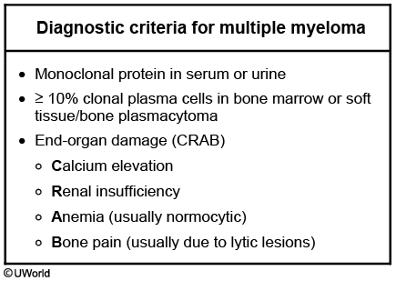

Slide 19
Treatment
Autologous hematopoietic cell transplantation ( HCT )
Systemic chemotherapy for patients who are not transplant candidates such as elderly.
Radiation therapy
if no response to chemotherapy & if disabling pain is present
Palliative care for elderly

Slide 20
Con…
Multiple Myeloma has a poor prognosis with a median survival of 2 to 4 years with treatment and only a few months without treatment
The 5-year survival rate is about 10%

