Slide 1
Conjunctival disorders
Loulou Mahmoud
Mohmad Alzoubi
1

Slide 2
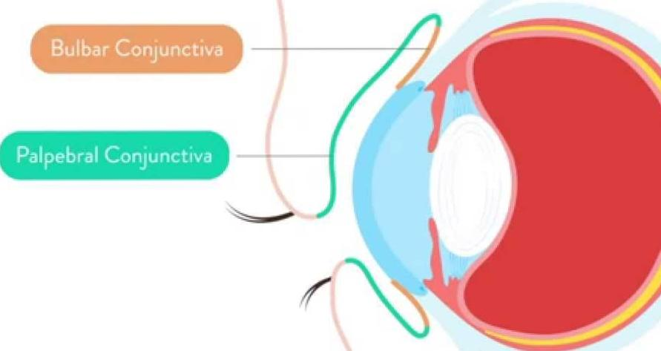
The conjunctiva
Very thin transparent mucus membrane
Covers the anterior part of the eye except the cornea & lines internal surface of the eye lids
The conjunctival epithelium includes goblet cells that produce the mucous layer of the tear film.
2

Slide 3
Parts of conjunctiva:
Bulbar conjunctiva: attached to anterior part of sclera. Formed of st. columnar epith e goblet-like cells supported by a thin lamina propria of loose vascular C.T.
tarsal conjunctiva:it is richly vascular , extremely thin and strongly bounded to tarsal palate
Fornix: is the junction between the bulbar & palpebral parts . Has same lining
3

Slide 4
Symptoms
Pain .(usually mild in the form of discomfort ).
Redness : usually diffuse in conuctivitis while if circumciliary we should suspect keratitis ,uveitis and angle closure glaucoma
Discharge : purulent (bacterial ),watery (viral) and mucoid (allergic )
4
Notes:
Pain and irritation. Conjunctivitis alone is seldom associated with anything more than mild discomfort. Pain signifies something more serious such as corneal injury or infection. This symptom helps differentiate conjunctivitis from corneal disease.
Visual loss which is not cleared by blinking. This occurs only when the central cornea is affected.
4

Slide 5
Signs
Papillae :These are raised lesions on the upper tarsal conjunctiva, about 1 mm or more in diameter with a central vascular core. They are a non - specific sign of chronic inflammation. They result from inflammatory infiltrates within the conjunctiva, constrained by the presence of multiple, tiny fibrous septa.
Giant papillae seen in allergic conditions
5
Notes:
Papillae: inflammatory exudates accumulate in the fibrous layer, heaping the conjunctiva into mounds. There is a central tuft of vessels. When small, papillae produce a smooth velvety appearance. ‘Giant papillae’ have a cobblestone appearance. At the limbus, giant papillae appear as gelatinous mounds, usually in the palpebral aperture.
5

Slide 6
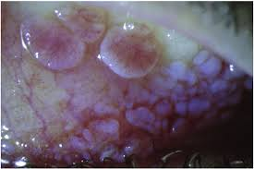
6

Slide 7
Follicles : oval ,pale lesions about 1 mm in diameter, found usually in the lower tarsal conjunctiva and upper tarsal border, and occasionally at the limbus. they represent lymphoid tissue ( it is more specific to viral and chlamydial infections )
Conjuctival injection ( dilated vessels )
Subconjuctival hemorrhage ( usually bright (because it is fully oxygenated by the ambient air, through the conjunctiva).
7
Notes:
Follicles: focal lymphoid hyperplasia over the tarsus produces rounded, avascular, whitish-grey centres with small vessels encircling the base. Differentiate from papillae.
7

Slide 8
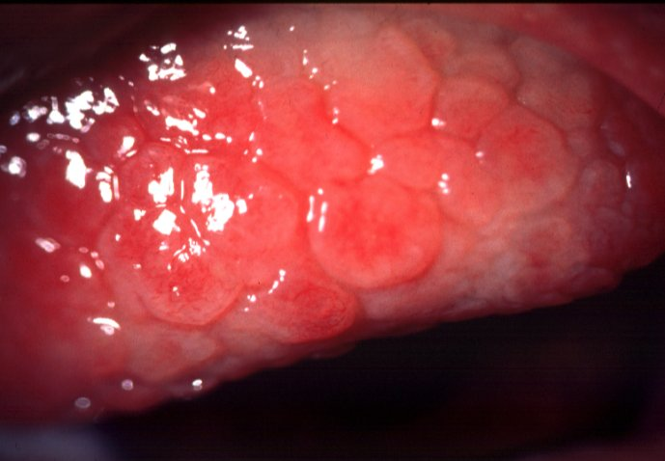
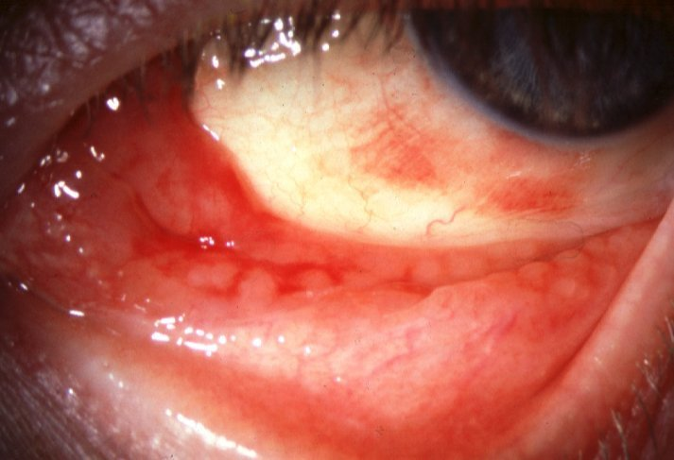
Follicles
8

Slide 9
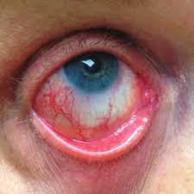
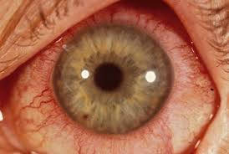
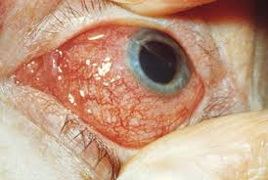
Conjuctival injection

Slide 10
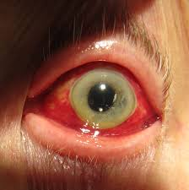
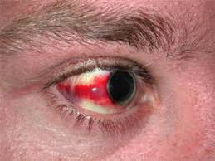
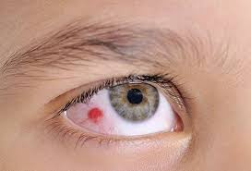
Conjictival hemorrhage

Slide 11
Inflammatory diseases of the conjuctiva
Bacterial
Simple bacterial conjunctivitis
Gonococcal keratoconjunctivitis
Viral
Adenoviral keratoconjunctivitis
11
Notes:
Molluscum contagiosum conjunctivitis
Herpes simplex conjunctivitis
11

Slide 12
Chlamydial
Adult chlamydial keratoconjunctivitis
Neonatal chlamydial conjunctivitis
Trachoma
Allergic conjuctivitis
12

Slide 13
Bacterial conjuctivitis
Presentation with :
Redness of the eye
Discharge
Ocular Irritation
Commonest microorganism :
Staphylococcus ,Streptococcus and Hemophilus
Usually self limited
Antibiotics may be needed : topical or systemic.
Culture & sensitivity may be needed in sever disease or if the condition is fails to resolve
13
Notes:
13

Slide 14
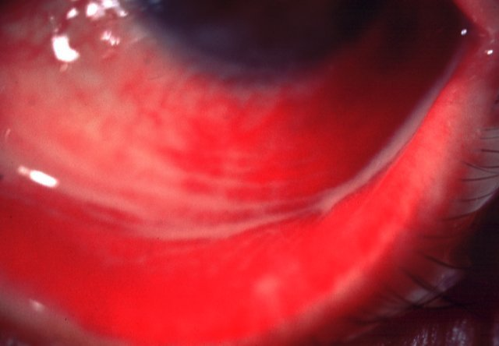
Simple bacterial conjunctivitis
Crusted eyelids and conjunctival injection
Subacute onset of mucopurulent discharge
-treatment- broad spectrum topical antibiotics
14
Notes:
14

Slide 15
Gonococcal keratoconjunctivitis
sign
complication
Acute, profuse,purulent
discharge,Hyperaemia
and chemosis
Corneal ulceration,
perforation and
endophthalmitis if severe
Topical gentamicin and bacitracin
Intravenous cefoxitin or cefotaxime
15
Notes:
Chemosis: oedematous conjunctiva appears milky and may swell beyond the lid margins. ‏Endophthalmitis is an inflammatory condition of the intraocular cavities (ie, the aqueous and/or vitreous humor) usually caused by infection
15

Slide 16
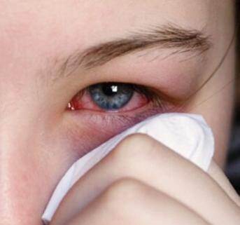
Viral conjuctivitis
Differs from the bacterial conjuctivitis in the following :
Watery discharge
Conjuctival follicles
Lid edema
Lacrimation
16

Slide 17
Viral conjuctivitis
Highly contagious
Self limited
Can cause membranous conjuctivitis
Causative viruses :
Adenoviral ( the commonest)
Coxsackie
Picornaviruses
17

Slide 18
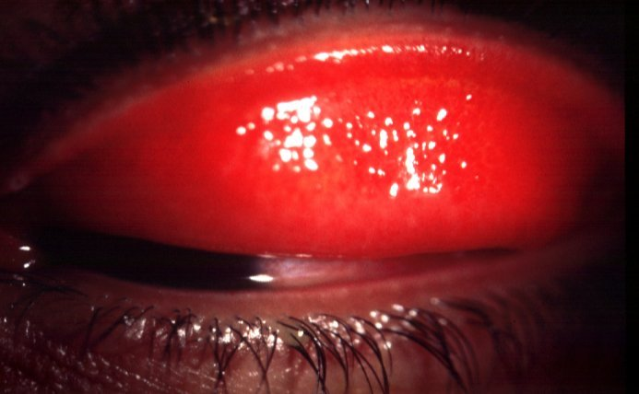
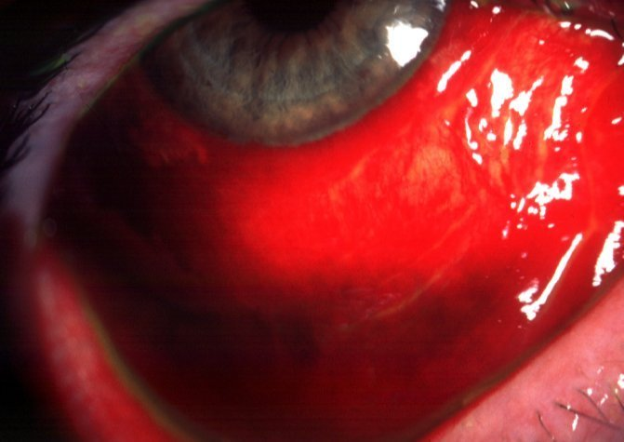
Usually bilateral, acute watery
discharge and follicles
Subconjunctival haemorrhages and
pseudomembranes if severe
18

Slide 19
Viral conjuctivitis Treatment
Good hygiene ( separate towels )
Symptomatic treatment for irritation
AB if bacterial conjuctivitis is over
Topical steroid may used if cornea involvement .
19

Slide 20
Ophthalmia neonatorum
Any conjuctivitis with in the first 4weeks of life
It is a notifiable disease
Swaps are mandatory
First 2 days = chemical cause ,3-5 days =gonorrhea, more than 5 days=chlamydia
20

Slide 21
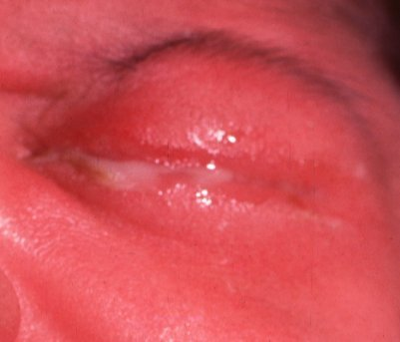
Ophthalmia neonatorum
21

Slide 22
Ophthalmia neonatorum causative microorganisms
Bacterial conjuctivitis ( usually gram +ve )
Niesseria Gonorrhea
Herpes simplex virus
Chlamydia : causing chronic conjuctivitis and forming a sight threatening complication in the form of corneal scaring
22

Slide 23
Ophthalmia neonatorum Treatment
Neisseria : topical and systemic penicillin
HSV : topical antiviral
Chlamydia : topical tetracycline and systemic Erythromycin
23

Slide 24
Chlamydial infections
It is an obligate intracellular organism
Two form of ocular infections :
Adult Inclusion Keratoconjuctivitis
Trachoma
24

Slide 25
Adult Inclusion Keratoconjuctivitis
Is a STD (sexually transmitted disease )
Chronic course unless treated
Present with hyperemia and mucopurulent follicular conjuctivitis
Pannus formation
Corneal vascularization and sub- epithelial scarring
25

Slide 26
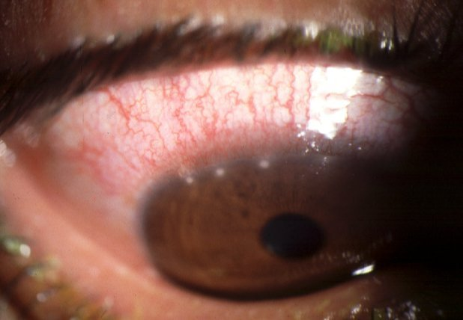
Adult chlamydial keratoconjunctivitis
Subacute, mucopurulent follicular
conjunctivitis
Variable peripheral keratitis
26

Slide 27
Inclusion Keratoconjuctivitis Diagnosis &Treatment
Immunoflourescence to detect chlamydial antigens
Inclusion body identification by Giemsa stain
Treatment with topical & systemic Tetracycline
27

Slide 28
Neonatal chlamydial conjunctivitis
Presents between 5 and 19 days after birth
May be associated with otitis, rhinitis and pneumonitis
Treatment-- topical tetracycline and oral erythromycin
Mucopurulent papillary conjunctivitis
28

Slide 29
Trachoma
The commonest infective cause of blindness
Transmitted by the housefly
Poor hygiene, crowding in a dry, hot climate.
Recurrent subconjuctival fibrosis ( due to re-infection)
Corneal scaring( blindness)
Keratitis and Trichiasis are complications
Treatment with topical and systemic Tetracycline or Erythromycin . Azithromycin is an alternative
Surgery correction for trichiasis and entropion .
29

Slide 30
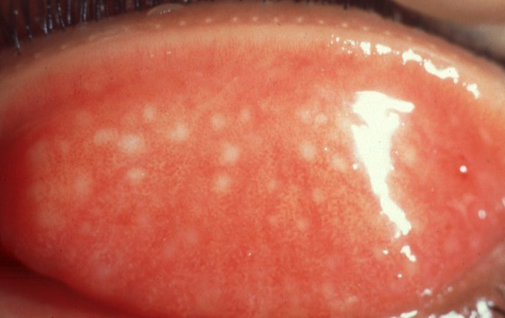
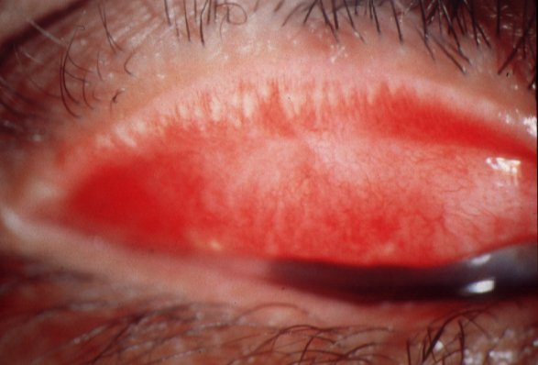
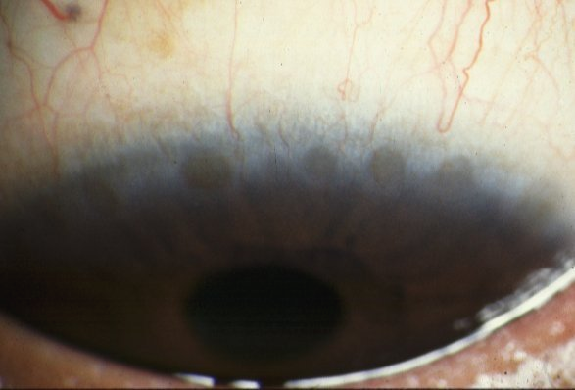
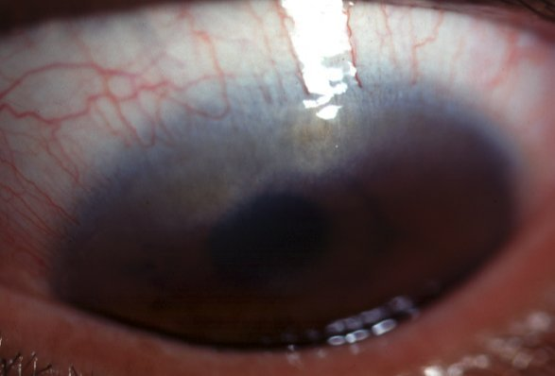
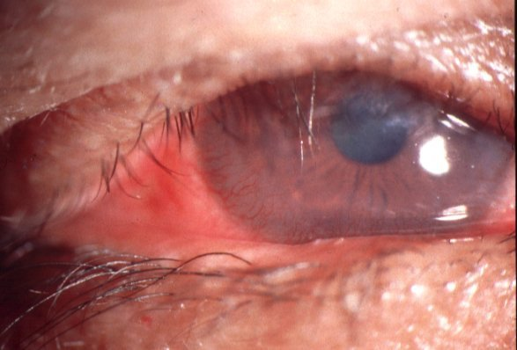
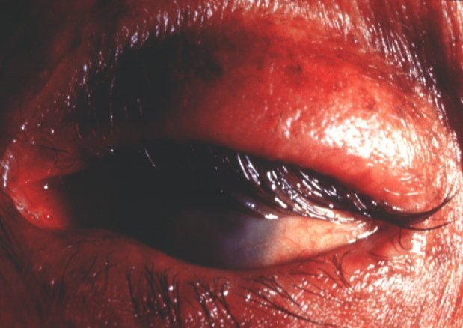
Trachoma
Progression
Acute follicular
conjunctivis
Conjunctival
scarring (Arlt line)
Herbert pits
Trichiasis
Pannus formation
Cicatricial entropion
30

Slide 31
Allergic Conjuctivitis
Acute ( hay fever or seasonal ) : acute IgE mediated reaction to mostly airborne allergens .
Presentation with :
Itching
Conjuctival injection and swelling
Lacrimation
rhinitis
31

Slide 32
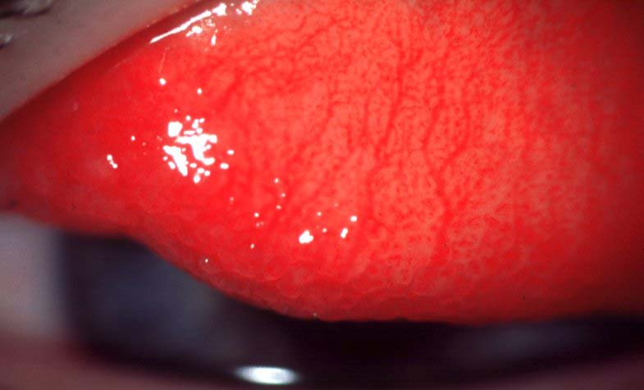
32

Slide 33
Allergic Conjuctivitis
Vernal (Spring catarrh )
It is seasonal but may be present all year long and become a chronic and intractable disease.
Also an IgE mediated allergic reaction .
Associated with history of atopy as Eczema and bronchial asthma .
33

Slide 34
Symptoms : Itching
Photophobia
Lacrimation
34

Slide 35
Allergic conjuctivitis Vernal
Signs :
Papillary conjuctivitis
Giant papillary reaction
Limbal follicles hypertrophy
Punctate corneal lesions
Opaque arcus of the upper cornea
35

Slide 36
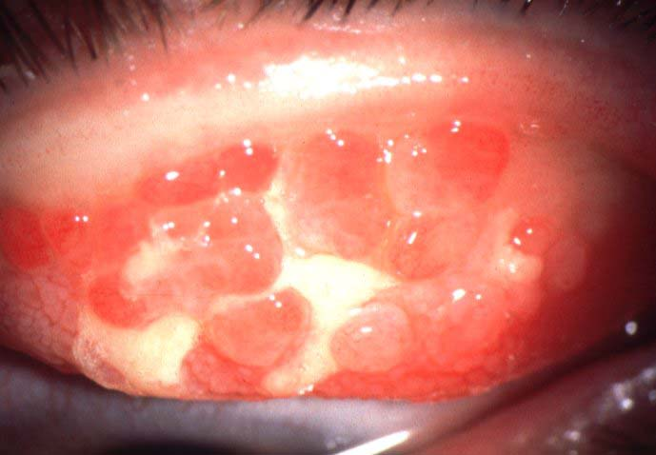
36

Slide 37
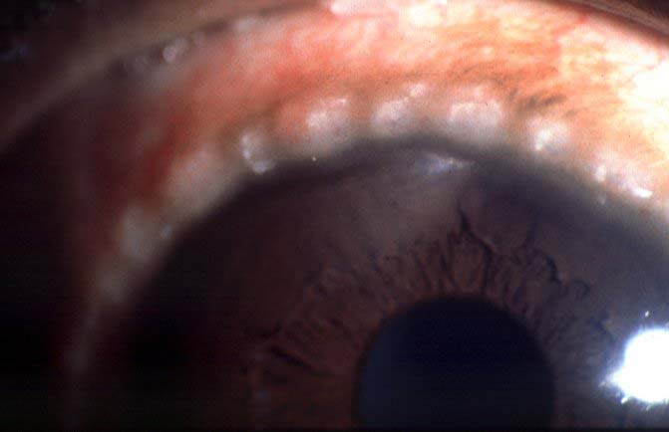
37

Slide 38
Allergic Conjuctivitis treatment
Antihistamines
Mast cell stabilizers : Na Chromolin
nedochromil
Lodoxamide
olopatidine
mucolytics to disolve the corneal plaque , surgery may required.
Topical steroids may be needed
38

Slide 39
Contact lens wearers may develop an allergic reaction to their lenses or to
lens cleaning materials, leading to a giant papillary conjunctivitis ( GPC ) with a
mucoid discharge. Whilst this may respond to topical treatment with mast cell
stabilizers, it is often necessary to stop lens wear for a period, or even permanently
if symptoms recur.
39

Slide 40
Conjuctival degenerations Pterigium
Solar elastosis of the conjuctival collagen due to UV light exposure .
Usually a triangular elevation fibro vascular band located nasally and encroaching over the cornea
Their apices are directed toward the cornea and may cause redness and discomfort
May need to be removed if reaching visual axis or unacceptable cosmetically
40

Slide 41
41

Slide 42
Conjuctival degeneration Pingecula
Small yellowish lesions
Paralimbal
Never impinge over the cornea
Needs no treatment
42

Slide 43
43

Slide 44
Conjuctival tumors
These are rare. They include:
• Squamous cell carcinoma: An irregular raised area of conjunctiva which may invade the deeper tissues.
• Malignant melanoma: The differential diagnosis from benign pigmented lesions (for example a naevus or melanosis) may be difficult. Review is necessary to assess whether the lesion is increasing in size. Biopsy, to achieve a definitive diagnosis, may be required.
44

Slide 45
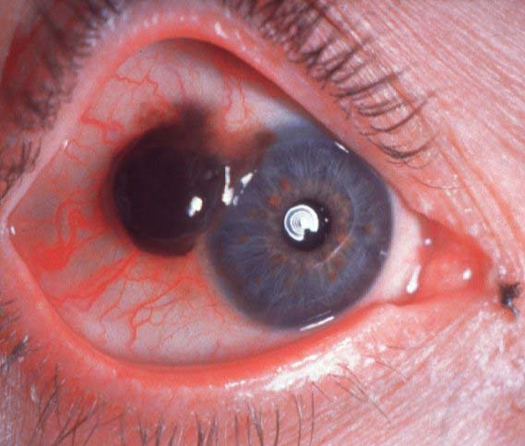
45

Slide 46
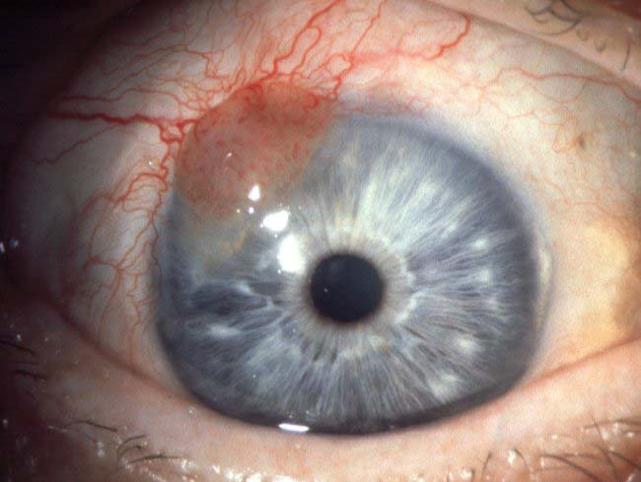
46

