Slide 1
RBCs Metabolism
*All component inside the RBCs (protein / carbohydrate / lipids …etc) are for its life span (120 days) once it ends, there is no generation.
*RBCs are not considered cells, because they lack of cell organelles especially those which participate in energy production.
*RBCs are susceptible to form free radicals, because its very active in metabolic reactions (just like lung and liver cells).
*RBCs have super oxide dismutase(SOD) to deal with free radicals.
*SOD is 2 types:-
*Copper manganese= mitochondria
*Copper zinc= cytoplasm ---- because of this RBCs have higher levels of Zn

Slide 2
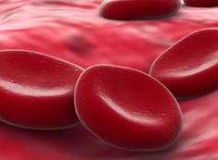
Biochemical composition of the RBCs
They contain 35 % solids, hemoglobin, the chief protein.
Other proteins are present in combination with lipids and
oligosaccharide chains, forming the stroma and cell membrane.
K⁺, Mg⁺⁺ and Zn⁺⁺ concentrations in RBCs are more than in plasma.
The primary physiological objective of the red blood cell is gas
exchange and transport beside several metabolic function.
The major metabolic function of RBC is to produce the necessary
ATP, NADPH, and NADH for maintaining its osmotic balance,
electroneutrality and fighting oxidative stresses.
Also, they are necessary for the biconcave
shape of the cell as well as for the specific
intracellular cation concentrations.
Maintenance of the shape of the erythrocytes
Cofactors for kinases in anaerobic conditions for energy production
Zinc contributes in: 1) SOD 2) carbonic anhydrase 3) lactate dehydrogenase

Slide 3
Erythrocyte exceptions
The RBC is, both structurally and metabolically, the simplest cell
in the body, during its maturation, the RBC loses all its subcellular
organelles, so,
- No ATP production in oxidative phosphorylation
No ability to replace damaged lipids and proteins (low
metabolic activities, with no ability to synthesize new
proteins or lipids)
- No synthesis of DNA and RNA because of lacking nuclei
Free radicals exposure
- Haemoglobin autoxidation (O₂^{•-} release)
A cell membrane rich in polyunsaturated fatty acids
(susceptible to lipid peroxidation)
Deformation in tiny capillaries; catalytic ions leakage (cause
of lipid peroxidation)
It is always subjected to oxidative stress
* The peroxide increase the rigidity of the cell membrane so it will not be modified to adapt it self inside the small capillaries

Slide 4
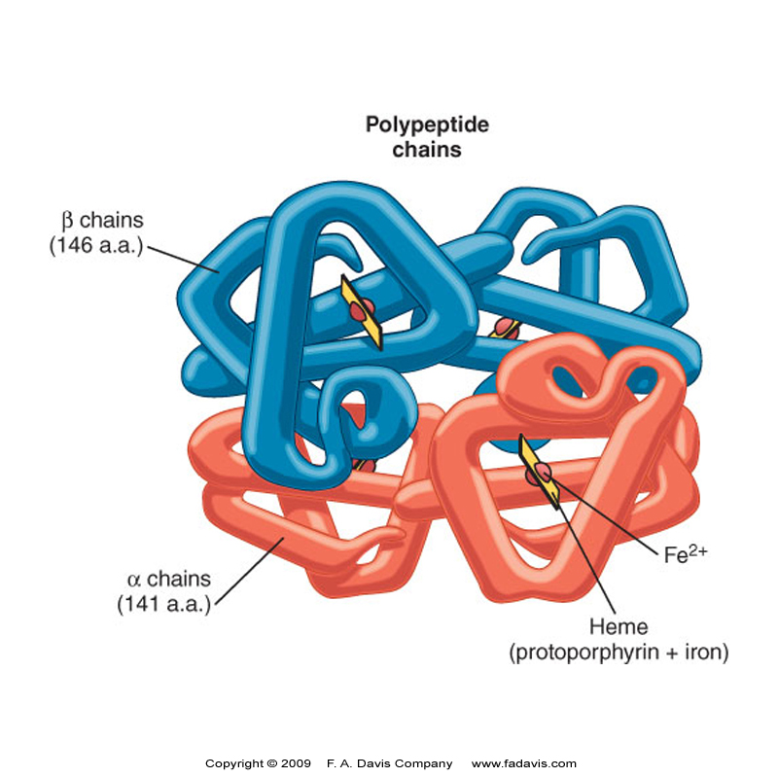
Metabolism of the human RBCs
-The main red cell energy source is
glucose because of lacking
mitochondria, it is metabolized
through the glycolytic pathway
(anaerobically) for producing 2 moles
of ATP and 2 lactate molecules as end
products/glucose mol. No ability to
oxidize fats.
-The glycolytic pathway is modified
by the Rapoport-Luebering shunt
by diphosphoglycerate mutase
generating 2, 3-
bisphosphglycerate.
-The pentose phosphate shunt
contributes to the redox status of
the cell by producing 2 moles of
NADPH/ 1 mole of glucose.
Hemoglobin

Slide 5
The red cell energy requirement is necessary for:
1- Replenishing its adenine nucleotide pool using salvage pathways
2- Protecting the cell against oxidative stress
3- Controlling its volume by membrane Na/K ATPase (cation
pump), which maintains high K+, low Na+ and Ca++ in the cell
4- Maintaining the plasticity of its membrane and the biconcave
shape (If energy is decreased, RBCs will be logged with Ca++
and Na+, while K+ is depleted causing a change of biconcave
into spherical form).
5- Preventing the accumulation of methemoglobin
6- Modulating oxyhemoglobin
7- Keeping the sulfhydryl groups of RBCs enzymes, Hb and
membranes in the active reduced form.
By converting it into hemoglobin
The body blood (5L) contain 2L of RBCs 2Kg
The 2 Kg utilize 20g of glucose/ day = every 1Kg consume 10g of glucose/ day
On the other hand, the skim utilize 2.5g of glucose /day
4:1 by skim
By RBCs

Slide 6
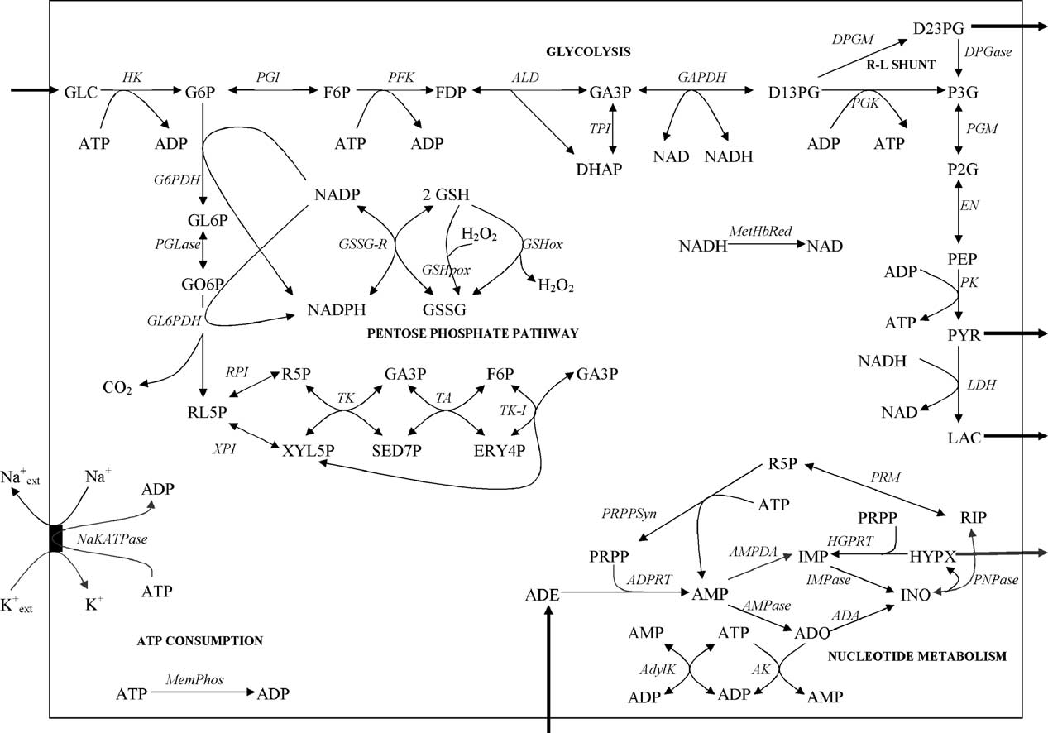
The human RBCs metabolism
So that the amount of NADH is less than the pyruvate
Fighting the ROS
Function 3 & 4 in the previous slide
Replinshing of the catabolite
Adenine nucleotide pool

Slide 7
*deficiency of DPGM which is responsible of converting 10-20% of D13PG into D23PG
=there will be NO O2 supply to the cell = because the affinity will not be decreased.
*D23PG= allosteric effector of the affinity of hemoglobin to O2.
*LDH concentration in RBCs is 10-100 times that in the muscle cells.
*PYR cant be utilized, so accumulate inside the RBCs then transported to the liver to be converted into glucose.
*Glycolysis= energy + lactic acid returned to the liver for glucose synthesis.

Slide 8
In RBCs, which lack mitochondria and pyruvate dehydrogenase
multienzyme complex, pyruvate is reduced to lactic acid (anaerobic
glycolysis), consistent with the primary role of the RBC in oxygen
transport and delivery, rather than its utilization.
- Each mole of glucose yields 2 moles of lactate to maintain
electrochemical and ion gradients across its plasma membrane, then
lactate is excreted into blood.
In RBCs, 10-20% of the glycolytic intermediate, 1,3- DPG, is
converted into 2,3- BPG, an allosteric regulator of the O₂ affinity of Hb.
The pentose phosphate pathway, accounts for about 10% of glucose
metabolism in the red cell, this pathway in RBCs has a special role in
protection against oxidative stress, while, in nucleated cells, it also
serves as a source of NADPH for biosynthetic reactions and pentoses
for nucleic acid synthesis.

Slide 9
Glucose utilization in the red cell
Glucose is transported through RBC membrane by a facilitated
diffusion by glucose transporters [(GLUT-1) insulin-
independent i.e. insulin does not promote glucose transport to
RBCs)].
In a 70-kg person, there are about 5 L of blood and a little over 2 kg (2
L) of RBCs.
These cells constitute consume about 20 g of glucose/day, representing
about 10% of total body glucose metabolism.
The RBC has the highest specific rate of glucose utilization of any cell
in the body, approximately 10 g of glucose/kg of tissue/day, compared
with ~2.5 g of glucose/kg of tissue/day for the whole body.
In the RBC, about 90% of glucose (~18 g/day) is metabolized via
glycolysis, yielding ~0.2 mole of lactate.
Despite its high rate of glucose consumption, the RBC has one of the
lowest rates of ATP synthesis of any cell in the body, ~0.2 mole of
ATP/day.

Slide 10
Synthesis of 2, 3-bisphosphoglycerate
2,3-BPG is an important product of glycolysis in the RBC, sometimes
reaching 5 mmol /L concentration, comparable with the molar
concentration of Hb in the RBC.
It is the major phosphorylated intermediate in the RBCs, present at
even higher concentrations than ATP (1-2 mmol/L) or inorganic
phosphate (1 mmol/L).
2,3-BPG is a negative allosteric effector of O₂ affinity to Hb.
It decreases the O₂ affinity of deoxy Hb, promoting the release of O₂ in
peripheral tissue.
The presence of 2,3-BPG in the RBC explains the observation that the
O₂ affinity of purified HbA is greater than that of whole RBCs.
2,3-BPG concentration ↑in the RBC during adaptation to high altitude
and in anemia, promoting the release of O₂to tissues when the PO₂ and
saturation of Hb is ↓ in the lung.
HbF is less sensitive than HbA to the effects of 2,3-BPG, promoting
efficient transfer of O₂ across the placenta from HbA to HbF.

Slide 11
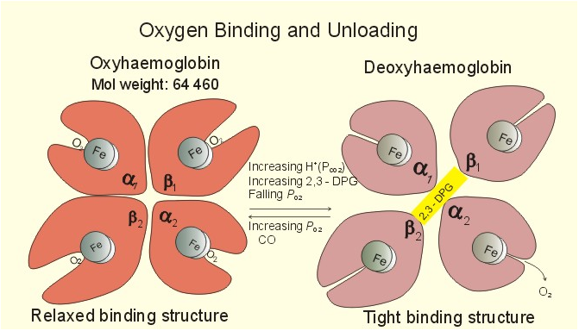
Glutathione is synthesized from glycine, cysteine, and glutamic acid in
a two-step process that requires ATP as a source of energy.
Catalase and glutathione peroxidase serve to protect the red cell from
oxidative damage.
The maturation of reticulocytes into erythrocytes is associated with a
rapid decrease in the activity of several enzymes and it occurs much
more slowly or not at all with ageing.

Slide 12
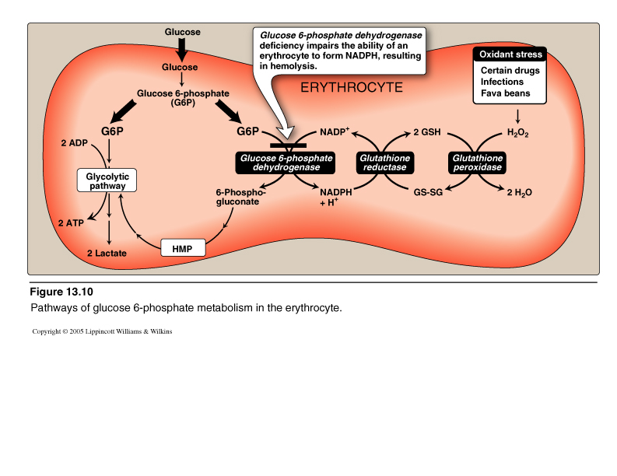
*Folism = deficiency of G6PD

Slide 13
RBCs membrane structure
RBCs must be able to squeeze through capillaries, so, RBCs must be
easily & reversibly deformable.
Its membrane must be both fluid & flexible.
About 50% of membrane is protein, 40% is fat & up to 10% is
carbohydrate.
RBCs membrane comprises a lipid bilayer (which determine the
membrane fluidity), proteins (which is responsible for flexibility) that
are either peripheral or integral penetrating the lipid bilayer &
carbohydrates that occur only on the external surface.
The membrane skeleton is four structural proteins that include α & β
spectrin, ankyrin, protein 4.1 and actin.
*If there is NO association between these proteins, there is NO biconcave shape or flexibility

Slide 14
Spectrin is major protein of the cytoskeleton & its two chains (α & β)
are aligned in an antiparallel manner.
α & β chains are loosely interconnected forming a dimer, one dimer
interact with another, forming a head to head tetramer.
Ankyrin binds spectrin & in turn binds tightly to band 3 securing
attachment of spectrin to membrane.
- Band 3 is anion exchange protein permits exchanges of Cl⁻ for HCO₃⁻.
Actin binds to spectrin & to protein 4.1 which in turn binds to integral
proteins, glycophorins A, B & C.
Glycophorins A,B,C are transmembrane glycoproteins.
Defects of proteins may explain some of the abnormalities of shape of
RBCs membrane as (hereditary spherocytosis & elliptocytosis).

Slide 15
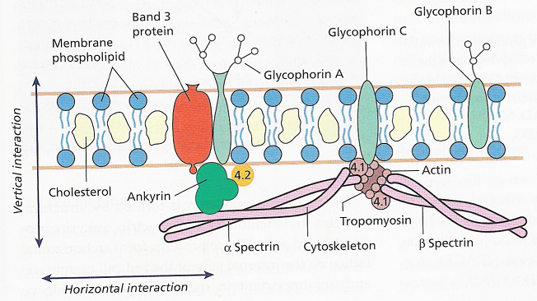

Slide 16
Glycosylated haemoglobin (HbA_{1c})
Formed by hemoglobin's exposure to high plasma levels of
glucose
Non-enzymatic glycolysation (glycation)- sugar bonding to a
protein
Normal level HbA₁- 5%; a buildup of HbA₁- increased
glucose concentration
The HbA₁ level is proportional to average blood glucose
concentration over previous weeks; in individuals with
poorly controlled diabetes, increases in the quantities of these
glycated hemoglobins are noted (patients monitoring)
Sugar CHO + NH₂ CH₂ Protein
Sugar CH N CH₂ Protein
Schiff base
Amadori reaction
Sugar CH₂ NH CH₂ Protein
Glycosylated protein

Slide 17
Glucose-6-phosphate dehydrogenase deficiency (Folism)
It is an X-linked recessive hereditary disease, considered the most
common human enzyme defect.
Individuals with the disease may exhibit non- immune hemolytic
anemia in response to a number of causes, most commonly infection or
exposure to certain medications or chemicals.
G6PD deficiency is closely linked to favism, a disorder characterized
by a hemolytic reaction to consumption of bean (fava).
The name favism is sometimes used to refer to the enzyme deficiency as
a whole, although this is misleading as not all people with G6PD
deficiency will manifest a physically observable reaction to
consumption of broad beans.
Classification
The WHO classifies G6PD genetic variants into five classes, the first
three of which are deficiency states.
1- Severe deficiency (<10% activity) with chronic (non- spherocytic)
hemolytic anemia (which is non-immune mediated)
2- Severe deficiency (<10% activity), with intermittent hemolysis

Slide 18
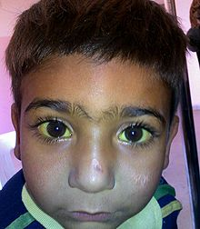
3- Mild deficiency (10-60% activity), hemolysis with stressors only
4- Non-deficient variant, no clinical sequelae
5- Increased enzyme activity, no clinical sequelae
This is a 4-year old boy diagnosed with glucose-6-phosphate dehydrogenase deficiency showing jaundice in the sclera
*Hemolysis of the erythrocytes+ yellow discoloration of sclera as a result of bilirubin accumulation
*unfavorable Iyonization: random inactivation of some X-chromosomes in some immature erythrocytes
NO mutation
It‘s inactivated
The amount & concentration & the activity of G6PD affect the maturation will be little & it will show manifestation

Slide 19
- Most individuals with G6PD deficiency are asymptomatic.
Symptomatic patients are almost exclusively male, due to the X-
linked pattern of inheritance, but female carriars can be clinically
affected due to unfavorable lyonization, where random inactivation of
an X-chromosome in certain cells creates a population of G6PD-
deficient red blood cells coexisting with normal red cells.
A typical female with one affected X chromosome will show the
deficiency in approximately half of her red blood cells.
However, in rare cases, including double X deficiency, the ratio can be
much more than half, making the female almost as sensitive as a male.
Abnormal red blood cell show hemolysis in G6PD deficiency can
manifest in a number of ways, including the following:
1- Prolonged neonatal jaundice, possibly leading to kernicterus
2- Hemolytic crises in response to:
a- Illness (especially infections) b- Diabetic ketoacidosis
c- Sulpha drugs, antimalarial drugs and aspirin.
d- Certain foods, most notably broad beans e- Certain chemicals
3- Very severe crises can cause acute renal failure. HOW??
*mental retradation results from the effect of the unconjugated bilirubin by interfering the metabolic pathways
*hemolyzed erythrocytes will release hemoglobin which will go to the kidney & precipitate renal tubules (low molecular weight) & cause renal failure

Slide 20
Its dissociation may produce ]O-[free radical which will target the poly double bond in the polyunsaturated F.A = peroxides
H₂O₂ accumulated will cause:
1- Convert F.A.s on cell membrane to peroxide which will cause
hemolysis of RBCs.
2- Convert Hb to methemoglobin that leads to increase cell membrane
fragility.
Diagnosis
It is suspected when patients from certain ethnic groups develop anemia
, jaundice and symptoms of hemolysis after challenges from any of the
causes, especially when there is a (+) family history.
- Generally, tests will include:
1- Complete blood count and reticulocytes count; in active G6PD
deficiency , Heinz bodies can be seen in RBCs on a blood film.
2- Liver enzymes (to exclude other causes of jaundice).
3- Lactate dehydrogenase (elevated in hemolysis and a marker of
hemolytic severity)
4- Haptoglobin (decreased in hemolysis);
5- A "direct antiglobulin test" (coombs' test) - this should be negative,
as hemolysis in G6PD is not immune-mediated.
Increase the rigidity of the cell membrane
*definite diagnosis=DNA sequencing to the gene responsible of producing G6PD*

Slide 21
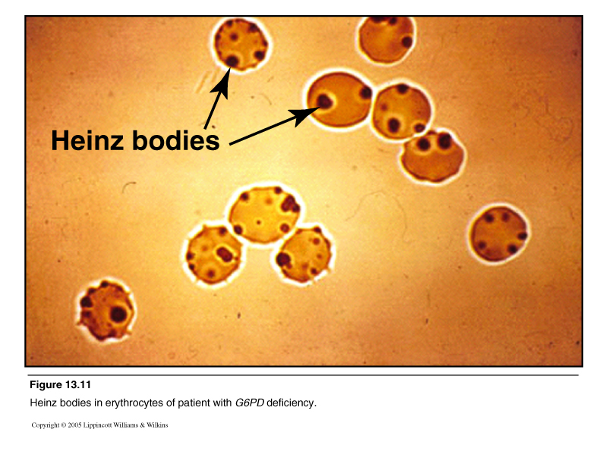
Treatment ابعد عن الشر وغنيله
Avoid the drugs and foods that cause
hemolysis (inevitable).
Vaccination against some common
pathogens (e.g. Hepatitis A and Hepatitis
B) may prevent infection-induced attacks.
In the acute phase of hemolysis, blood
transfusions might be necessary, or
even dialysis in acute renal failure.
Blood transfusion is an important
symptomatic measure, as the transfused
red cells are generally not G6PD deficient
and will live a normal lifespan in the
recipient's circulation.
Some patients may benefit from
splenectomy as this is an important site of
red cell destruction.
Folic acid should be used in any disorder
featuring a high red cell turnover.
Antioxidants as vitamin E and selenium.

Slide 22
Pyruvate kinase deficiency:
It is one of the most common enzymopathy associated with chronic
hemolytic anemia, which usually occurs in compound heterozygotes for
two different mutant alleles and in homozygotes.
- The increased 2, 3-BPG levels eases the anemia by lowering the
oxygen-affinity of hemoglobin.
- Phenotypically, the clinical picture varies from severe hemolysis
causing neonatal death, to a well-compensated hemolytic anemia and
only very rare cases can present with hydrops fetalis.
More than 180 gene mutations in had been reported to be associated
with PK deficiency.
- Most of these mutations (70%) are the missense mutants c.1456C→T
(Arg486Trp), c.1529G→A (Arg510Gln), c.994G→A (Gly332Ser), and
the nonsense mutant c.721G→T (Glu241stop).
They affect conserved residues in structurally and functionally
important domains of PK.
*nonsense mutation: substitution of a single base pair that leads to appearance of stop codon
*its more dangerous than the missense mutation

Slide 23
Triose phosphate isomerase deficiency
TPI catalyzes the interconversion of dihydroxyacetone phosphate and
glyceraldehyde-3-phosphate and plays an important role in several
crucial metabolic pathways.
The metabolic pattern of TPI deficient erythrocytes is characterized by
high levels of dihydroxyacetone phosphate and a relatively minute
decrease of ATP.
Dihydroxyacetone phosphate accumulation has been reported to be
toxic for cellular functions and responsible for the severity of TPI
enzymopathies but its mechanism of toxicity is not well understood.
The defect leads to hemolytic anemia coupled with neurological
dysfunction.

Slide 24
Phosphoglucose isomerase deficiency
Phosphoglucose isomerase catalyzes the reversible isomerization from
G6P to F6P, an equilibrium reaction of glycolysis.
Glucose turnover reacts, therefore, only on deficiency below a very low
critical residual activity of PGI but then with a decline of lactate
formation, i.e., decrease in glycolytic flux.
-The consequence of a limitation by the PGI reaction is an increase of the
G6P level which causes a feedback inhibition of hexokinase resulting
both in a lower rate of glycolysis and increased PPP activity associated,
in turn, with the recombination of F6P formed in PPP with glycolytic
pathway.
- With the effect of hexokinase inhibition, ATP, D23PG and GSH
regeneration decreases.
- This is the third most common enzymopathy in the world.

Slide 25
Diphosphoglycerate mutase deficiency
Disphosphoglyceromutase is a multifunctional enzyme which
catalyzes both the synthesis and dephosphorylation of D23PG in
human red blood cells.
With lowering of disphosphoglyceromutase, the turnover via D23PG
declines in favor of substrate phosphorylation catalyzed by
phosphoglycerate kinase and pyruvate kinase leading to changes
of the metabolic pattern. ATP, FDP, triose phosphates, P3G, P2G,
PEP are enhanced, ADP, D23PG, F6P, G6P are diminished.
Phosphoglycerate kinase deficiency
PGK is a key enzyme for ATP generation in the glycolytic pathway,
catalyzing the conversion of 1,3-diphosphoglycerate to
3-phosphoglycerate bypassing the Rapoport-Luebering shunt.
A significant accumulation of D23PG, and a decreased concentration
of ATP were observed in patients with PGK deficiency.
- Also, diminished glucose consumption was reported.

