Slide 1
Complications of DM
Done by :
Khalil abu awwad
Moath alharasees
Yousef abu halawah
Ahmad alsarayreh

Slide 2
Complication of DM
Acute complication:
Diabetic ketoacidosis
Hyperglycemic hyperosmolar nonketotic syndrome
Hypoglycemia
Chronic complications:
Macrovascular complications
(Atherosclerosis)
2. Microvascular complications
a.Neuropathy
B,Nephropathy
c.Retinopathy
d.Diabetic foot ulcer

Slide 3
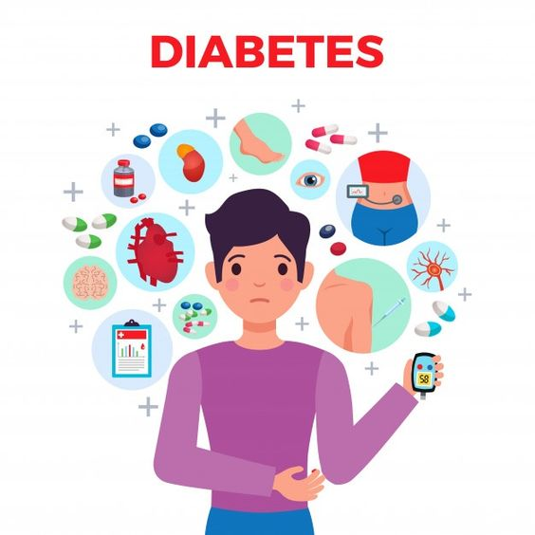
CHRONIC COMPLICATIONS OF
MACROVASCULAR or MICROVASCULAR
-Can be found in both type 1 and type 2 DM
In type 1 DM it may develop 5-10 years after diagnosis while in type 2 DM it may present at time of diagnosis because there is a latent period of disease .
-Mainly it caused by chronic hyperglycaemia which lead to vascular changes.

Slide 4
Macrovascular complications
mainly in type 2 DM at elderly.
-They have other metabolic risk factors:
obesity ,HTN , dyslipidemia.
The best management of type 2 DM patient :
is controlling metabolic risk factors to prevent macrovascular disease.

Slide 5
ATHEROSCLEROTIC
VASCULAR CHANGES

Slide 6
Manifestations
Coronary heart disease :
Myocardial infarction, CHF
Cerebrovascular diseases :
Haemorrhage , cerebral infract , memory problem
Peripheral vascular disease
Atherosclerosis, gangrene, ulcers “required foot check” .

Slide 7
Management
Early glycemic control will reduce the risk of cardiovascular disease .
Reduction of risk factor :
BP reduction by ACE inhibitors ,ARBs .
lipid lowering agent like statin
Exercise + smoking cessation .

Slide 8
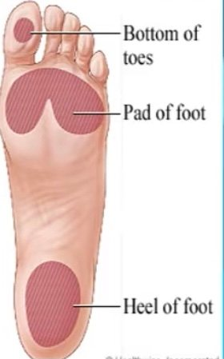
DIABETIC FOOT
Diabetic Foot Ulcer (DFU): is as a foot affected by ulceration The classical triad of DFU is neuropathy, ischemia, and infection
25% of diabetic patient will develop foot ulcer.
common site of foot ulcers are on the sole of the foot commonly around where most of pressure is exerted .
There will be decreased blood supply to the foot with loss of feeling of
pain

Slide 9
Pathogenesis of Immunopathy
High blood glucose is a good medium for the growth of bacteria
hyperglycaemic state causes an elevation of pro-inflammatory cytokines and impairment of neutrophile functions which lead to lowered leukocyte activity, inappropriate inflammatory response and the disruption of cellular immunity
Pathogenesis of ischemia
1. Small BV : Diffuse thickening of the basement membrane
2. Large BV : Atherosclerosis
Pathogenesis of neuropathy
Osmotic damage : Glucose is converted by some tissues into sorbitol by aldose reductase enzyme then sorbitol is converted to fructose → Accumulation of sorbitol and fructose lead to osmotic destruction of these tissue ex. Lens, peripheral nerves and kidney
All of these lead to increase the risk of infection and poor wound healing

Slide 10
Treatment
The best treatment is prevention and regular foot care
Mangment
The gold standard is:
A)debridement of the wound
B)off-loading of the ulcer
C)revascularization –when indicated-
D) management of infection

Slide 11
NOW ….
MICROVASCULAR
COMPLICATIONS

Slide 12
PATHOPHYSIOLOGY
Chronic hyperglycemia
is the primary factor in the development of microvascular complications , results in :
Glycation of proteins and lipids with subsequent impaired protein and cell membrane function and tissue damage

Slide 14
DIABETIC NEUROPATHY
A- AUTONOMIC NEUROPATHY :
1- impotence in men
2- neurogenic bladder (retention , incontinence )
3- postural hypotension
4- cardiac denervation
5- gastroparesis ( chronic nausea and vomiting )

Slide 15
B- PERIPHRAL NEUROPATHY (distal symmetric neuropathy )
Usually affect sensory nerve in a stocking/glove pattern
typically begins in feet and later in hands
Numbness and paraesthesia are common
LOSS OF SENSATION lead to ulcer formation
Painfull diabetic neuropathy –hypersensitivity to light touch ,sever burning pain ,especialy at night that can be difficult to tolerate
Treatment is with GABAPENTIN
C- CRANIAL NERVE COMPLICATION :
- secondary to cranial nerve infarction
Diabetic Third nerve palsy :diplopia , ptosis, eye pain , ….
Inability to adduct the eye but the pupils are sparing

Slide 16
D- mononeuropathies : secondary to nerve infarction
1- ulnar neuropathy
2- common peroneal neuropathy
3- median nerve neuropathy (carpal tunnel syndrome )
4- diabetic lumbosacral plexopathy :

Slide 17
DIABETIC RETINOPATHY
Prevalence is 75% after 20 years of DM , so annual screening of all diabetic patients is recommended .The risk of the development and progression of diabetic retinopathy can be reduced by tight control of both glucose and blood pressure.
Nonproliferative retinopathy :
-hemorrhage , hard exudates , micro aneurysms and venous dilatation .
- These patients are usually asymptomatic unless retina eodema or ischemia involve the central macula
Proliferative retinopathy :
-New abnormal blood vessels formation and scarring
-2 serious complication : vitreous hemorrhage and retinal detachment
- Can lead to blindness

Slide 19
Management of retinopathy
Refer to ophthalmologist
The lipid-lowering drug , fenofibrate, has been shown to slow the progression of retinopathy.
Smoking cessation is recommended.
Laser photocoagulation
Vitreoretinal surgery

Slide 20
WHAT WE SEE ?

Slide 21
DIABETIC NEPHROPATHY

Slide 22
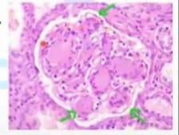
Pathologic type : .nodular glomerular sclerosis (Kimmelstiel-Wilson syndrome)hyaline deposition in one area of glomerulus pathognomonic for DM . Diffuce glomerular sclerosis –hyaline deposition is global .this also occur HTN . . Isolated glomerular basement membrane thickening.

Slide 23
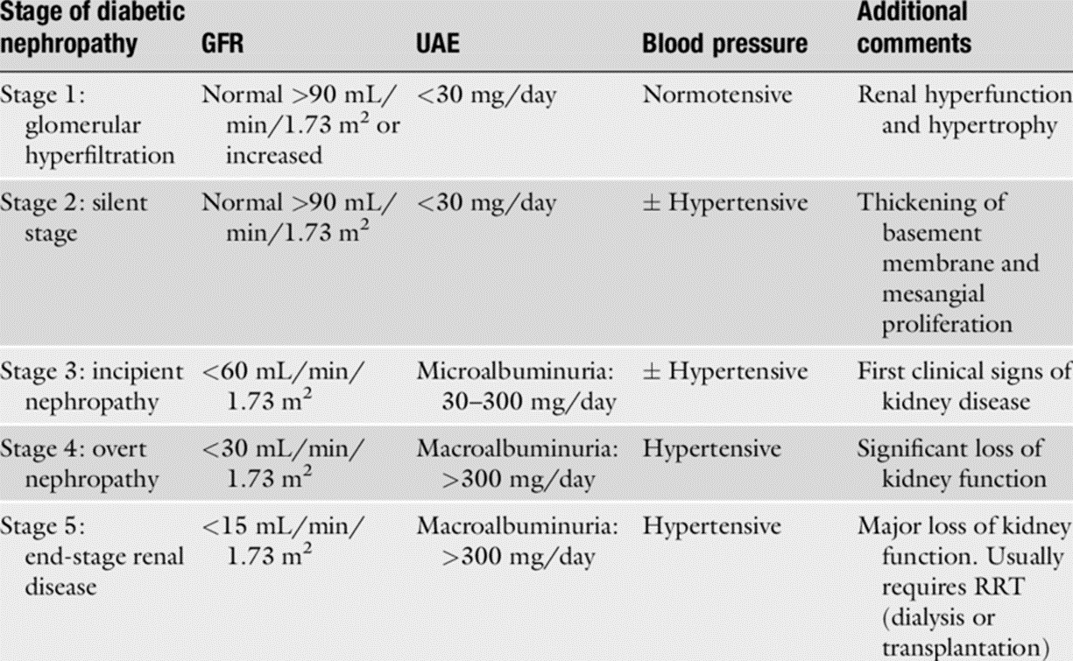
Diabetic nephropathy is a major cause of
end stage renal disease (ESRD).

Slide 24
Microalbuminuria / proteinuria
- If microalbuminuria is present , strict glycemic control is critical .
Tight blood glucose has been shown to limit progression from microalbuminuria to clinical proteinuria .
Without effective treatment , the albuminuria gradually worsens .
HTN usually develops during the transition between microalbuminuria and progressive proteinuria .
Persistent HTN + proteinuria
cause a decrease in ( GFR) , leading to renal insufficiency and eventually
ESRD
Treatment : ACE inhibitor and ARB

Slide 25
Management of Diabetic nephropathy
HTN increase the risk of progression of diabetic nephropathy to ESRD
SO , CONTROL BP AGGRESSIVELY
particularly with ACE inhibitors and angiotensin receptor blockers.
The target blood pressure should be <130/80 mmHg
Renin–angiotensin system blockers should also be used in people with normal blood pressure and persistent microalbuminuria

Slide 26
Acute complication of dm

Slide 27
Diabetic Ketoacidosis :
DKA is an acute, life-threatening medical emergency that can occur in both type I and type II diabetic patients (more common in type I).
It is characterized by insulin deficiency with increasing counterregulatory hormones.
Precipitants factor :
Stress, infection, trauma.
2.Inadequate administration of aspirin

Slide 28
Mechanism of DKA
Lake of insulin >High Glucagon > Adipose Tissue breaks down Fat into Free fatty acids > Liver converts free fatty acids into Free ketone bodies> free ketone bodies are converted into Acetoacetic acid and B-hydroxybutyric acid.
After the conversion of FFA into ketones bodies , Cells now can get energy but at the same time Acidity of the blood increases(Metabolic Acidosis Blood pH <7.3).
Kussmual Respiration: Deep labored breathing that reduces CO2 from the blood to decrease acidity.
Fruity breath odor : Generation of ketone bodies break down into Acetone and escape from the lungs giving us a SWEET SMELL.

Slide 29
Clinical Features Of DKA
Polyphagia: Although Glucose is inside our blood, it can’t get into the cells leaving them starving for energy. So, Adipose tissue starts breaking down fat and Muscle cells break down proteins causing WEIGHT LOSS and INCREASE APETITE.
Glycosuria: With high glucose levels, blood gets filtered through the kidneys and some glucose spill over into the urine.
Polyuria: Since glucose is osmotically active , water tends to follow it and leads to increase in urination.
Polydipsia: Because there is frequent urination, px with DM will become DEHYDRATED and THIRSTY.
“Fruity” (acetone) breath odor.
Kussmaul respiration—rapid, deep breathing.
Gi symptoms: Abdominal pain, nausea, and vomiting because of Ketoacidosis.

Slide 30
Complications of DKA:
Cerebral edema : common cause of death in children with DKA.
Mucormycosis: A fungal infection that starts in sinuses and spread to adjacent structures.
Complications of electrolyte disturbances:
Hyperkalemia: arrythmias
Risk of Hypophosphatemia: Loss of ATP
Muscle weakness(Respiratory failure)
Heart Failure (↓ contractility)

Slide 31
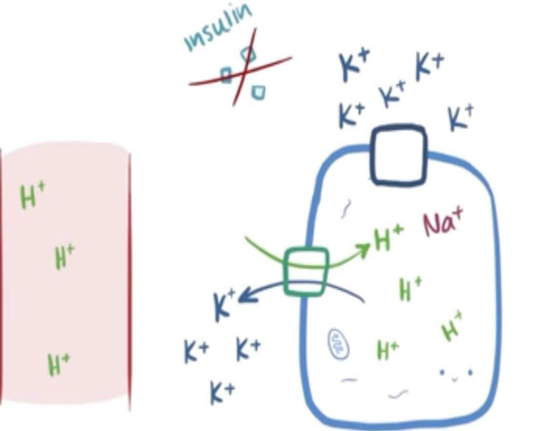
Electrolyte disturbances :
Hyponatremia : serum sodium decrease because of the osmotic shift of fluid from the ICF to ECF space ,total sodium level is normal .this generally does not require treatment
Hyperkalemia : may be present initially ,although total body potassium is low
As insulin is given it causes shift of potassium into cell ,resulting in hypokalemia .this can happen very rapidly
Phosphate and magnesium level may also be low

Slide 32
Diagnosis of DKA
Hyperglycemia: serum glucose typically >450 mg/dL and <850 mg/dL
Metabolic acidosis
Blood pH <7.3
Increased anion gap—due to production of ketones (acetoacetate and β-hydroxybutyrate)
Ketonemia (serum positive for ketones) and ketonuria
Serum levels of acetoacetate, acetone, and β-hydroxybutyrate are greatly increased.

Slide 33
Treatment of DKA
IV fluids (isotonic saline solution 0.9% sodium chloride)
-Treats dehydration.
-When serum glucose falls to < 200–250 mg/dL, add 5% dextrose to infusion.
Insulin (IV) 0.1 unit of insulin per kilogram of body weight continue the insulin until the anion gap close and metabolic acidosis corrected :
Potassium Replacement :
-Potassium levels must be ≥ 3.3 mEq/L before insulin therapy is initiated
-If potassium level is < 3.3 mEq/L, potassium should be repleted and rechecked prior to giving any insulin.
-If potassium level is < 5.3 mEq/L, the patient will likely require potassium repletion once insulin therapy is started.
-Maintain serum potassium between 4-5 mEq/L.

Slide 34
Hyperosmolar Hyperglycemic State(HHS)
A state of severe Hyperglycemia , Hyperosmolarity and Dehydration
-Primarily affects patients with type 2 diabetes.
-The pathophysiology of HHS is similar to that of DKA.
However, in HHS, there are still small amounts of insulin being secreted by the pancreas, and this is sufficient to prevent DKA by suppressing lipolysis and, in turn, ketogenesis.
-HHNS has a higher mortality rate(10–20%) than DKA (5–10%), but it is less common than DKA.

Slide 35
Clinical features:
-Polydipsia, polyuria, and dehydration.
-Signs of extreme dehydration and volume depletion— orthostatic hypotension, tachycardia
-CNS findings and focal neurologic signs(can affect the excitability of neurons) are common (e.g., seizures)—secondary to hyperosmolarity.
-Lethargy and confusion may develop, leading to convulsions and coma.
Diagnosis :
Hyperglycemia: serum glucose typically higher than DKA and frequently >900mg/dL
Hyperosmolarity: serum osmolarity >320 mOsm/L.
Usually no acidosis(Serum pH >7.3)
Few or no ketone bodies

Slide 36
Treatment OF HHS:
- Fluid replacement is most important (Normal saline 0.9%NACL): 1 L in the first hour, another liter in the next 2 hours. Most patients respond well. Switch to half normal saline once the patient stabilizes.
-Insulin: Check to ensure serum K >3.3 prior to initiating.
-Very rapid lowering of blood glucose can lead to cerebral edema in children , so When glucose levels reach 300 mg/dL, add 5% dextrose.
-Normalization of serum osmolality (i.e., < 320 mOsm/kg)

Slide 37
Hypoglycemia
Hypoglycemia is defined as a blood glucose of less than 3.9 mmol/L (70 mg/dL).
-As glucose levels decrease into the 50s and below, symptoms begin.
-It occurs most commonly in people treated with insulin injections, but prolonged hypoglycemia can less frequently be to the use of oral insulin secretagogues such as sulphonylurea drugs.
Many factors precipitate an insulin reaction in a person with type 1 diabetes, including:
-Wrong insulin dose
-Poor Appetite
-Increased exercise
-Medication changes and change in insulin site
- The primary organ at risk in hypoglycemia is the Brain—The brain uses glucose as its main energy source except when using ketone bodies during fasting.

Slide 38
Clinical features:
-Elevated epinephrine levels cause sweating, tremors, increased BP and pulse, anxiety, and palpitations.
Neuroglycopenic symptoms: decreased glucose for the brain (CNS dysfunction), resulting in irritability,, weakness, headache, confusion, convulsions, coma, and even death.
Diagnosis :
The following labs should be obtained during a hypoglycemic episode (or 72-hour fast if no spontaneous hypoglycemic episode is documented):
- Proinsulin C-peptide Glucose Insulin

Slide 39
Treatment of Hypoglycemia
-Treatment of acute hypoglycemia depends on severity and whether the patient is conscious or not.
If the patient is conscious:
-Oral glucose 15–20 g.
-Fast-acting carbohydrates (such as glucose tablets, candy, or juice) .
-If the patient is unconscious (or unable to ingest glucose): IV dextrose.
-IM glucagon: if neither oral or IV routes of administering glucose are feasible.

Slide 40
Thank you

