Slide 1
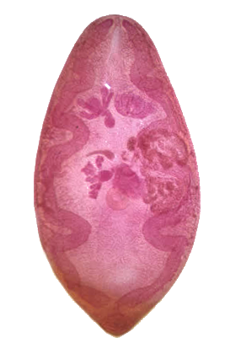
Respiratory Module (2023-2024) Paragonimus westermani (Lung Fluke) Class: Trematoda
By
Professor Dina Moustafa Abou Rayia
Medical Microbiology and Immunology Department

Slide 3
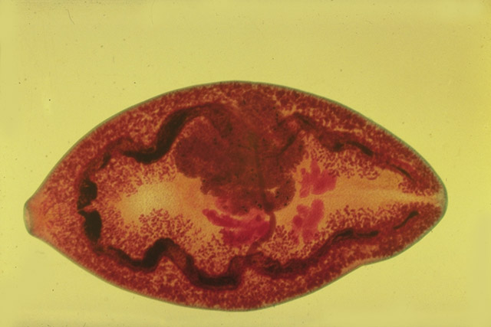
Paragonimus westermani
(Oriental lung fluke)
Geographical distribution :
Endemic in the far East of Asia (Japan, Korea, China, Philippines) and Central & South America.
Habitat : Lung in cyst like pockets.

Slide 4
Morphology
Egg (D.S)
Size : 90 x 50 µm.
Shape : Oval.
Shell : Thick shell with operculum .
Color : Golden brown.
Content : Immature ovum.
Size: 12 × 6 mm

Slide 5
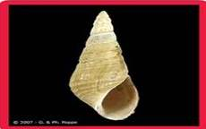
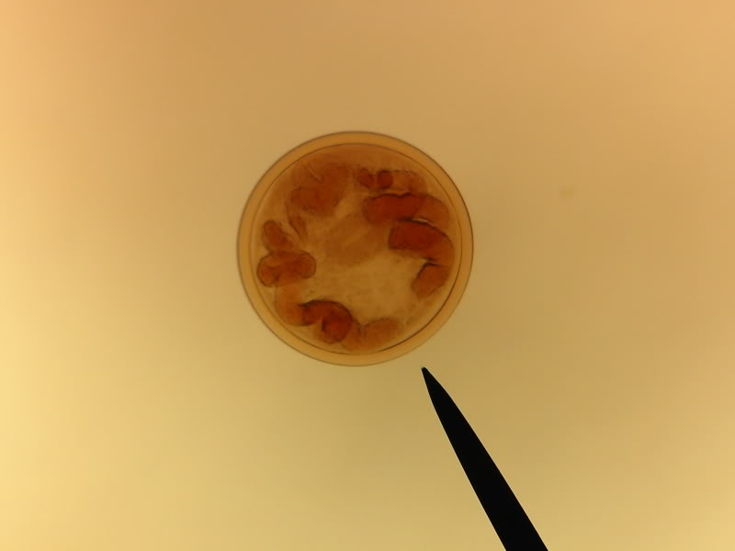
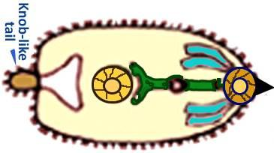
Semisulcospira libertina snail
Encysted metacercaria ( I.S)
Microcercous cercaria with knob-like tail

Slide 6
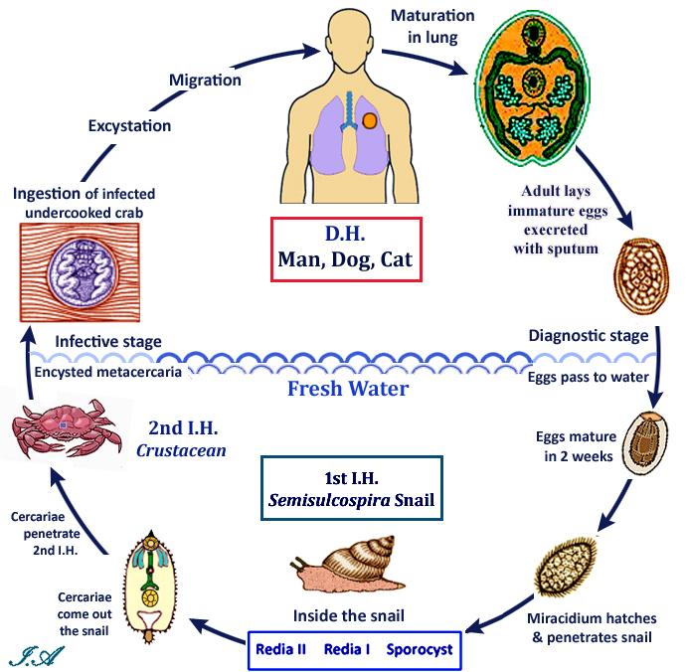

Slide 7
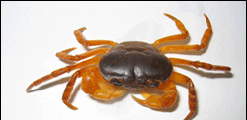
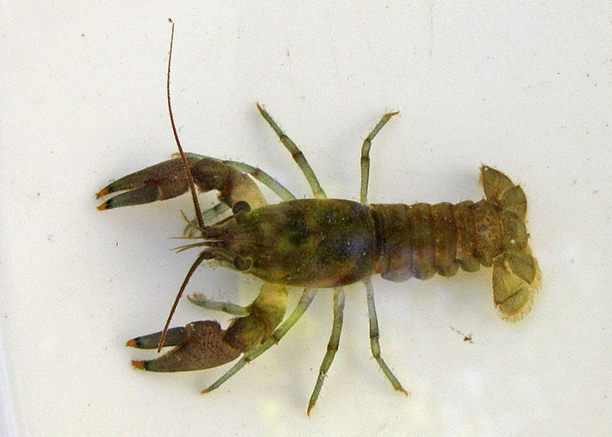
Life cycle
D.H : Man
R.H: fish eating animals & carnivorous.
I.H:• 1st: Fresh water snail (Semisulcospira libertina).
• 2nd: Fresh water cray fish or crabs.
Mode of infection: Infection occurs by eating raw or undercooked crabs or cray fish containing encysted metacercaria (I.S)

Slide 8
Pathogenesis & Symptomatology
Diseases : Paragonimiasis
Adult worms live in lung and stimulate granulomatous tissue fibrous capsule surrounding worms and eggs forming cyst containing blood tinged fluid.
Rupture of the cyst into bronchioles causes pulmonary symptoms such as fever, chest pain and cough with rusty sputum (blood tinged with eggs)  endemic haemoptysis.
Chronic cases resemble pulmonary tuberculosis.
Complications:
Pulmonary : pneumonia, bronchitis, lung abscess &pneumo-thorax and pleural effusion.
CNS : seizures, coma , paralysis.
GIT: abdominal pain & diarrhea.
Skin: migratory allergic skin lesions.
8

Slide 9
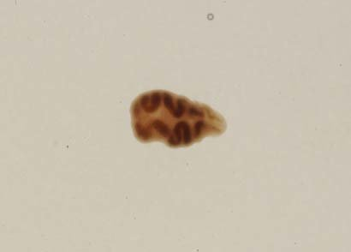
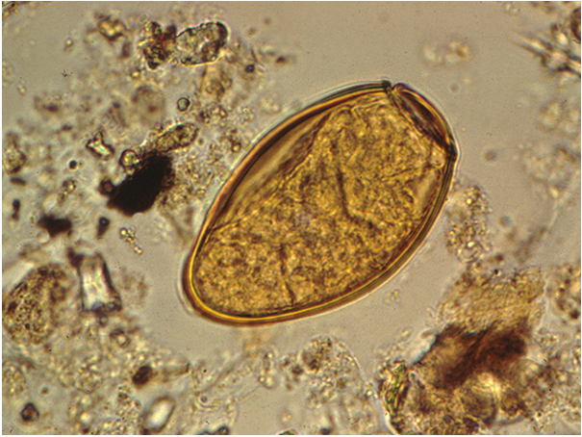
Laboratory Diagnosis
Direct
Indirect
Detection of eggs & sometimes adult in rusty sputum.
Detection of eggs in stool.
Serological tests: CFT and ELISA
High eosinophilia.
Chest X ray & CT : ring shadow opacity comprising several small contagious cavities resembling bunch of grapes.
9

Slide 10
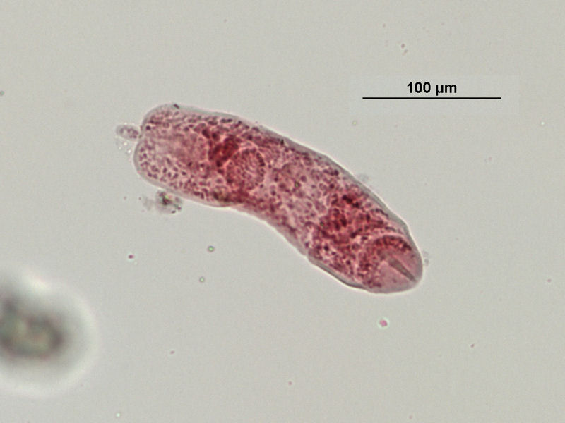
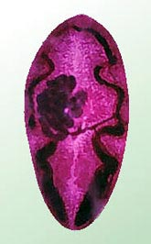
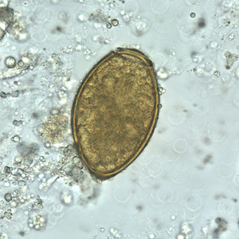
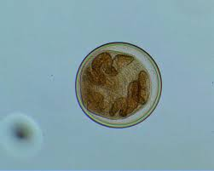
Treatment
1- Praziquantel is the drug of choice
Identify ??????

Slide 11
Echinococcus granulosus Class: Cestoda
(Hydatid worm)

Slide 12
Echinococcus granulosus
Geographical distribution : Cosmopolitan.
Habitat: Small intestine of the D.H.
D.H: Dogs, foxes and other canines.
I.H: Sheep, cattle, pigs and occasionally man.

Slide 13
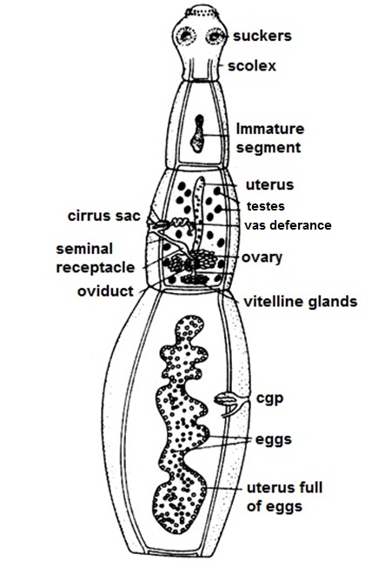
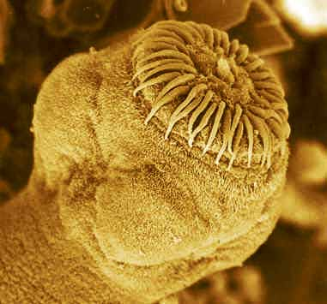
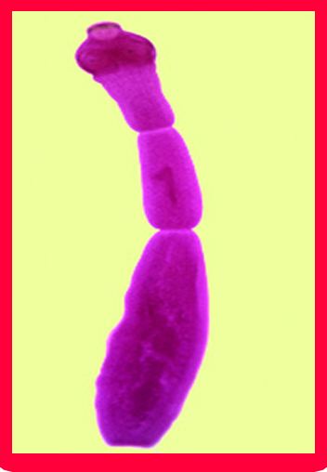
1- Adult worm of E. granulosus

Slide 14
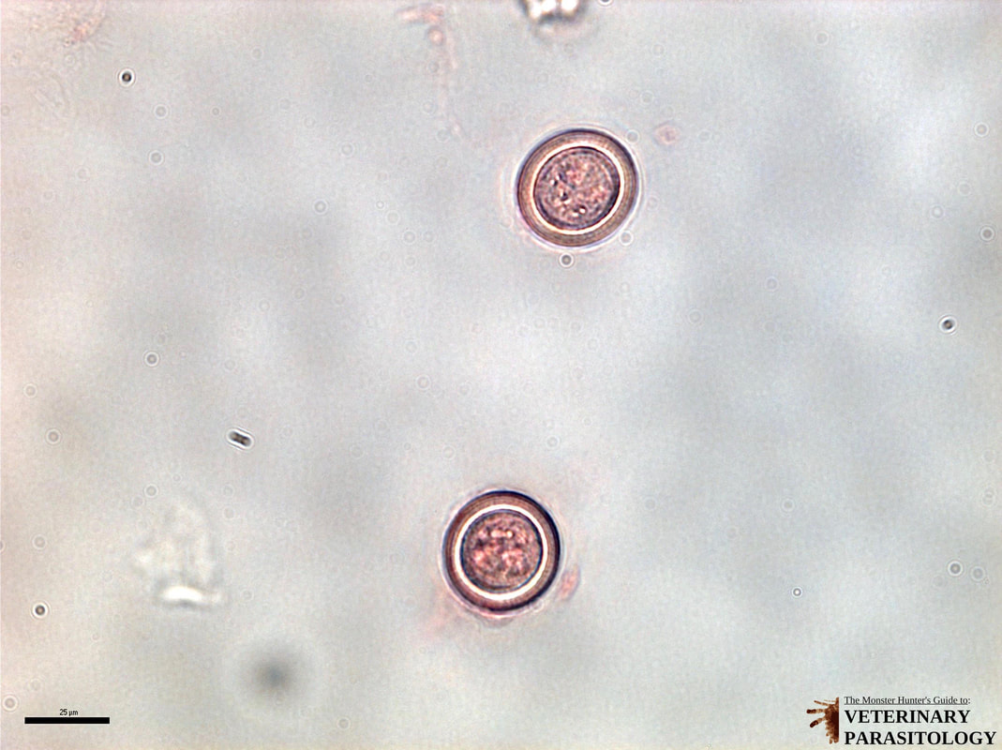
2-Egg of E. granulosus
(I.S to man & herbivorous).
Size: 30-40 um.
Shape: Spherical.
Shell: Thick, radially striated emberyophore.
Color: brownish.
Content: Mature hexacanth embryo (onchosphere)

Slide 15
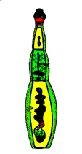
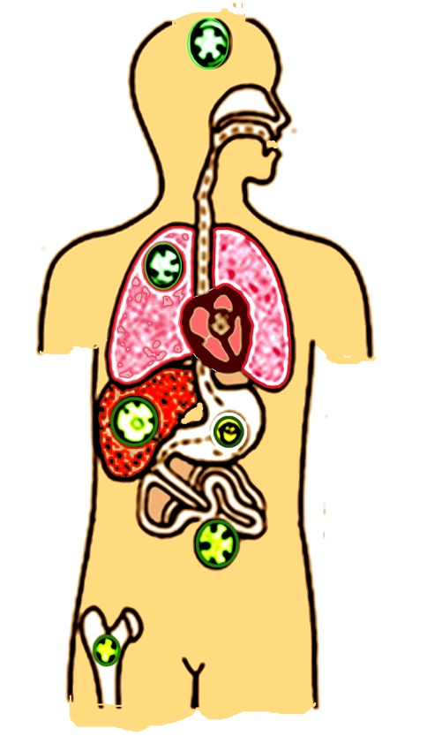
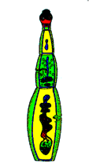
Life Cycle of Echinococcus granulosus
Protoscolices release
(D.H.)
Carnivores (dogs)
Adult maturation
Man accidentally ingests eggs
Adult in small intestine
Eggs Pass with stool
Dog (D.H) ingests infected viscera
Oncosphere migrates to various organs
& Cyst develops
Oncosphere hatches in intestine
Oncosphere hatches in intestine
(I.H.)
Herbivores
& Man
Oncosphere migrates to viscera
& Cyst develops
I H ingests Eggs or Gravid segment
Dr/ Ibrahim

Slide 16
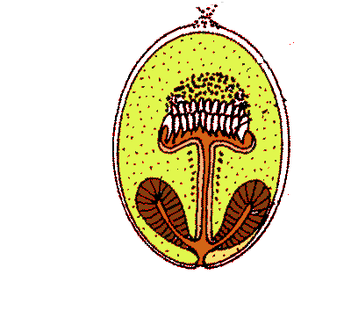
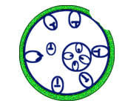
CESTODA
Unilocular hydatid cyst
Hooklets
Fibrous adventitial layer
sucker
Laminated layer
Germinal layer
Protoscolices
Daughter cysts
Brood capsules
& Protoscolices
Exogenous daughter cysts
Hydatid fluid
Hydatid sand
Dr/ Ibrahim

Slide 17
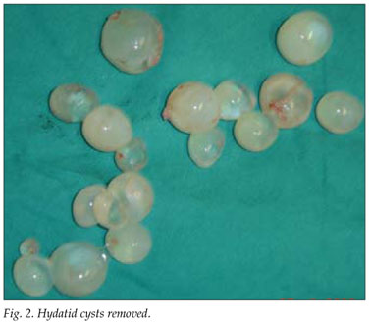
Hydatid cyst
(D.S in man and herbivorous & I.S to DH):
Simple unilocular hydatid cyst:-
The most common type.
Size : Variable from pin's head
to head of the foetus (1 mm - 20 cm).
Shape : More or less spherical.

Slide 18
Hydatid cyst disease
(Cystic Echinococcosis or Hydatidosis)
It is a parasitic infection of both humans and other mammals such as sheep, and cattle with hydatid cysts, the larval stage of Echinococcus granulosus.
Man is an intermediate and blind host for Echinococcus granulosus
Infection occurs by Ingestion of eggs with food or drinks contaminated with dogs' faeces or by handling dogs whose hair are usually contaminated with eggs.

Slide 19
Pathogenesis & Symptomatology
Local inflammatory reaction around the hydatid cyst, ending in formation of a fibrous capsule which may become calcified or even ossified.
The symptoms depend on the size & site of the cyst.
Large sized cysts pressure atrophy of affected organs:-
Liver (70%)  enlargement and dysfunction (fever, pain and jaundice).
Lung (20%)  pain, cough and dyspnea.
Brain  epilepsy.
Eye  protrusion of the eye ball.
Bones  Pain& spontaneous fracture.
Kidney  membranous nephropathy.
Spontaneous rupture of cyst into peritoneal cavity or pleura may lead to severe allergic reaction (anaphylactic shock) or secondary cysts.

Slide 20
Pulmonary Cystic Echinococcosis
Common in children than adult.
Clinical picture:
Mainly asymptomatic until the cyst enlarges to cause symptoms.
Complication occurs as a result of cyst enlargement & its rupture. It presented by:
Cough.
Chest pain.
Dyspnea.
Haemoptysis.
Pneumothorax, pleural effusion & pulmonary abscess.

Slide 21
Diagnosis
Clinical
Laboratory
History of contact with dogs.
Slowly growing cystic tumour.
Hydatid thrill.
Direct
Indirect
X-ray for calcified cyst.
Ultrasonography, CT scan and MRI.
Scolices in sputum or urine due to rupture of the cyst in bronchus or urinary tract.
Puncture or aspiration of hydatid fluid may lead to anaphylactic shock due to leakage of the fluid.
Eosinophilia.
Intradermal test(Casoni test).
Serological tests.
PCR

Slide 22
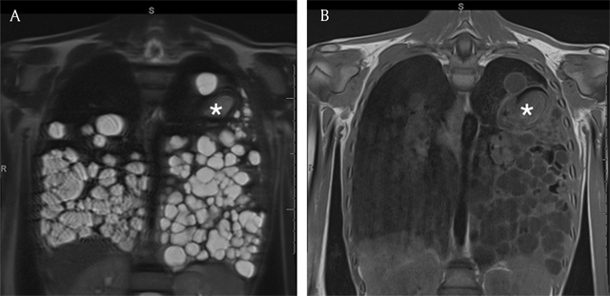
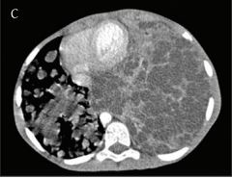

Slide 23
Treatment
Surgical removal of the cyst: The most efficient treatment but it may cause mortality (2%) and recurrence of the disease (2 - 25%).
Percutaneous treatment (PAIR): In three steps:
- Puncture (P) and needle aspiration (A) of the cyst.
- Injection (I) of a scolicidal solution usually hypertonic sodium chloride solution or ethanol and left for 5 - 30 minutes.
- Cyst-re-aspiration (R) and final washing.
This procedure is indicated in inoperable cases and who have drug resistance (no response to medical treatment).

Slide 24
Medical treatment:
Indications: In inoperable cases and before and after surgery.
Albendazole (Drug of choice).
Mebendazole.
The combination of ABZ and Praziquantel (PZQ) may provide synergistic effect and better efficacy.
Disadvantages:
It may lead to drug resistance.
It is used for long time in high dose.

Slide 26
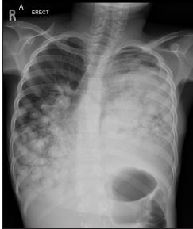
Case 1
10-year-old girl. A pediatric, female patient presented with acute respiratory distress, productive cough, and pleuritic chest pain. The first-line investigations included a biochemical work-up and a chest X-ray.
Lab investigations revealed high eosinophilia
Chest X ray revealed complete opacity of the left lung and multiple round opacities of the right lung

