Slide 1
OBS\GYN LABs Summary
Done By :
Taif haitham Al-Saraireh
this file is suffiecint to study all about lab material in OBS & Gyne course , its made with classes material m osce dossier and Dr.Seham Abu-frejieh notes and other doctor notes from all labs material in lectures .
for any edits please contact me as I will be always available to help and do the proper adjustments for this file material .
Best of luck to All of you

Slide 2
Table of contents
slide No | Subject
3 | Instruments
37 | Complications of obs & gyne examination by the instruments
43 | obs and gyne Examinations
44 | Bimannual Examination
48 | Obstetric Examination
63 | Pelvic examination : speculum and other procedures
74 | previous years stations+watan station

Slide 3
Instruments in OBS\GYN

Slide 4
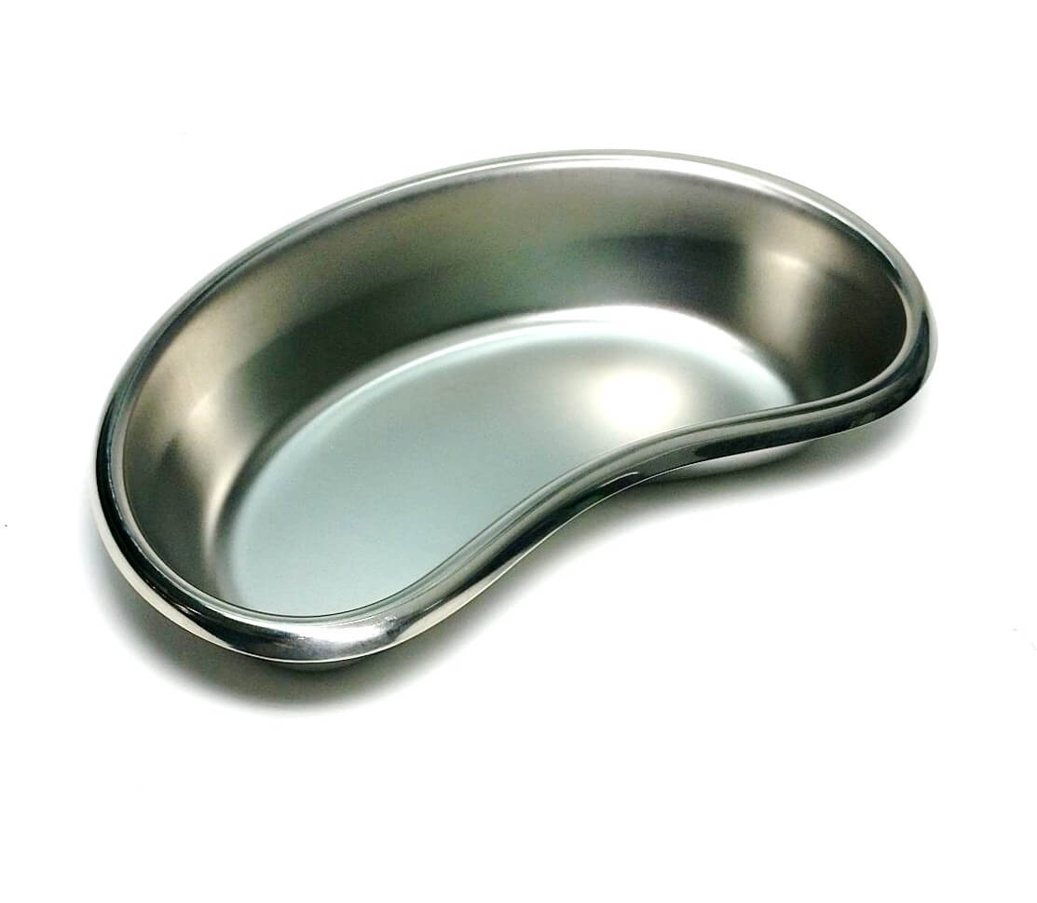
1- Kidney dish
To Receive and holding :
Dressing
Needles
Medical waste
Instruments
Biopsy
Drainage

Slide 5
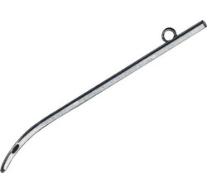
2- Female catheter
For intermittent catheterization of the urinary bladder , when you went to do a “vaginal examination” while the patient is under GA .
We can use instead the Folleys Catheter

Slide 6
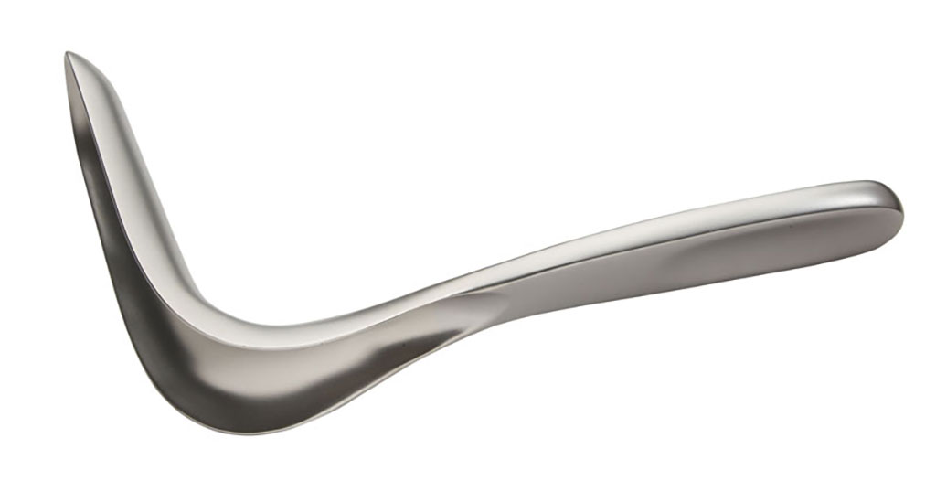
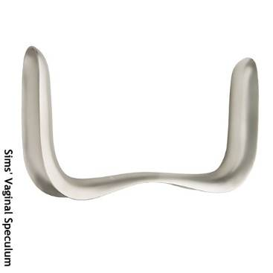
3- Univalve vaginal speculum “sim’s speculum”
Uses :
To examine Genital prolaps “vaginal wall prolaps”
In D & C
In Hysteroscopy
In Curettage under anesthesia
In Vaginal hysterectomy
Blade
Handle
It need assistant during examination (holding the handle ) of the vagina andThe patient should be in the “left lateral position” !
Got 2 shapes , the first with one blade and the other with 2 blades
Blade
Handle
Blade
Notes:
*It should be used in any vaginal procedure done under GA

Slide 7
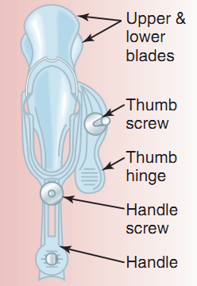
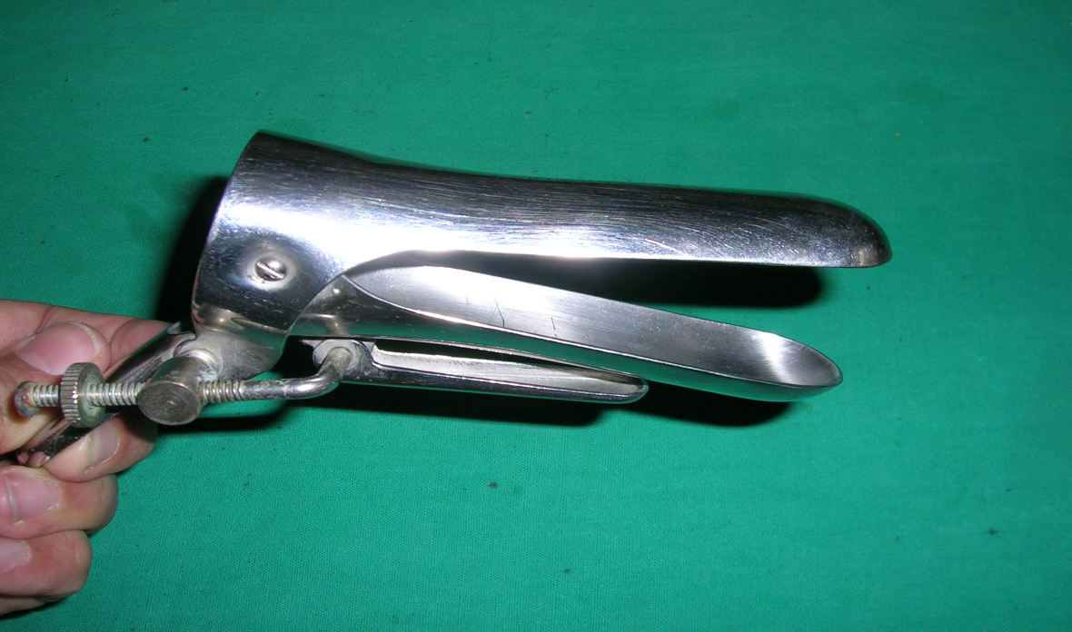
4- Bivalve vaginal wall self retaining speculum or
Cusco's Speculum

Slide 8
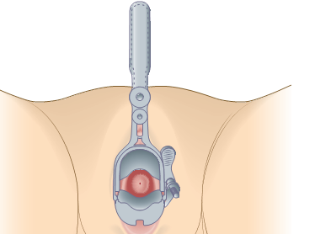
Proceed as follows:
Should be applied under full aseptic conditions.
➔Gently part the labia using your left hand.
➔ With your right hand gently insert
a lightly lubricated** bivalve speculum
with the blades vertical, fully into
the vagina.
➔Rotating the speculum 90o so that the
handles point anteriorly and the blades
are now horizontal ,Slowly open the
blades and see the cervix between them.
Note any discharge or vaginal or cervical
abnormalities
In this tool we can examine both the cervix
and the lateral vaginal walls
Notes:
**which should be warmed and lubricated with warm water only, so as not to interfere with the examination of cervical cytology or any vaginal exudate.

Slide 9
bivalve speculum examination Indications and uses :
To perform a cervical smear.
To inspect the cervix for any lacerations or polyps.
To examine for vaginal discharge.
To examine for vaginal bleeding .
Apical vaginal prolapse
To take a high vaginal swab or endocervical swab for culture
To insert, remove and follow up of IUD .
To conﬁrm potential rupture of membranes.
For doing hysterosalpingogram HSG
For embryo transfer in case of “IVF”
For Office hysteroscope
Notes:
Obstetric and gynecological indications

Slide 10
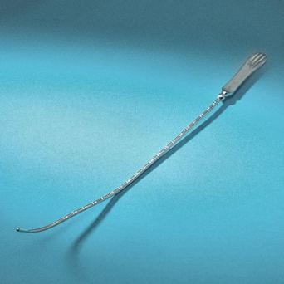
Complications with wrong use : perforation and bleeding (see the complaications slides )
5 - Uterine sound
To examine the uterine size “non pregnant uterus” before :
D&C
IUD insertion
Taking endometrial biopsy
The insertion ➔ Depends on the bimanual examination “direction of the uterus”

Slide 11
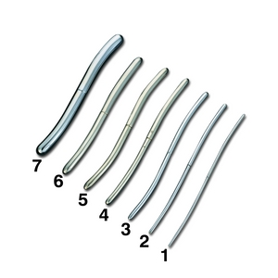
6 - Hegar’s dilator
Are dilators used to induce cervical dilation
in order to gain entry to the interior of the uterus.
With various sizes
The degree of dilatation will depend on the
next procedure .
Should be insert until it reaches the
internal os “resistance”
One enters by one till we reached
the desired dilatation .

Slide 12
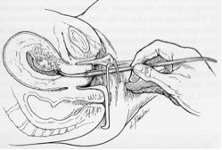
Hegar’s dilator
It precede :
Evacuation of product of conception after missed or incomplete miscarriage .
Endometrial biopsy.
Evacuation of molar
pregnancy .

Slide 13
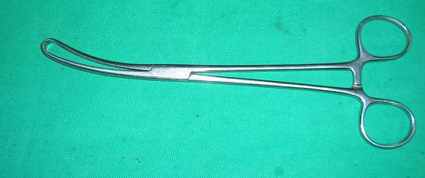
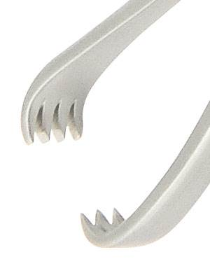
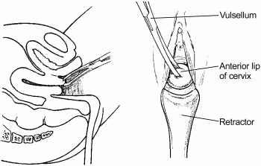
7 - Vulsellum
To catch the anterior lip’s of
the cervix “fixation” of the uterus as
its mobile in nature .

Slide 14
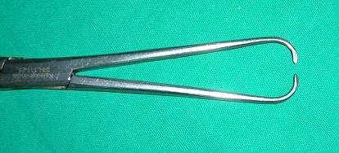
8 - Tenaculum
To grasp the cervix

Slide 15
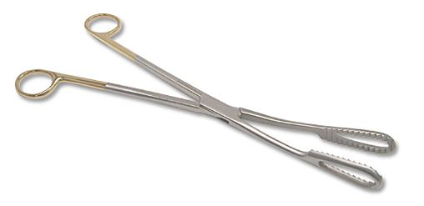
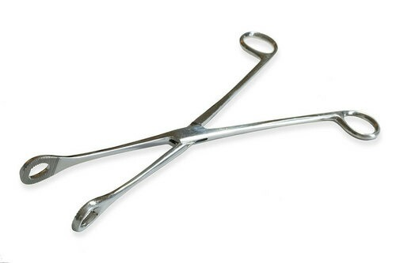
9- Ovum & spongy forceps
It will be inserted remains closed, then opened inside the endometrial cavity to evacuate the product of conception
and to remove the cervical polyps
Ovum
Used at cleaning phase “catch the gauze”
Used to explorate/clear field the cervix ,
To role out the cervical laceration “in case of PPH”
spongy

Slide 16
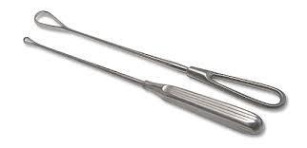
10 - Uterine Curette
2 types : sharp and blunt “according to the edge”
= blunt edge = in pregnant uterus .

Slide 17
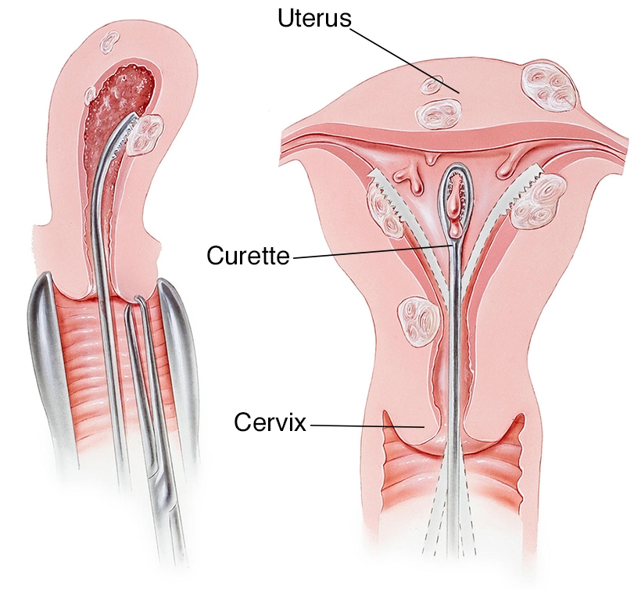
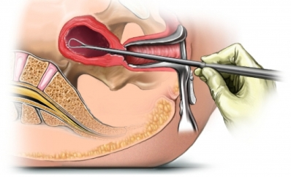
For :
Taking endometrial biopsy
Uterine curettage “anterior , lateral then posterior wall” There are distinctive sound when the uterus is empty .
Evacuation
Aggressive curettage can cause ➔ uterine adhesion ”Asherman syndrome” **
Notes:
** ASHERMAN syndrome :
A = Acquired anomaly
S = secondary to surgery
H = Hysterosalpingography confirms diagnosis
E = endometrial damage\ Eugonadotropic
R = repeated uterine trauma
M = missed menses “amenorrhea”
A = adhesions
N = normal estrogen and progesterone 😐

Slide 18
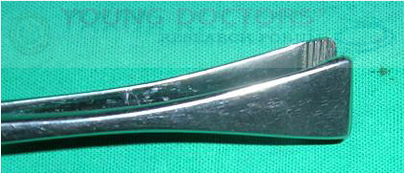
11 - Green armytage
In case of CS , to catch the angle of the uterus , to ensure homeostasis.

Slide 19
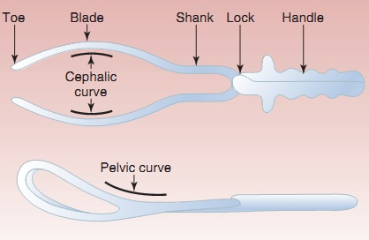
12- Forceps
Commonly used in case of preterm delivery .
3 types :
- Outlet
Low cavity
Mid cavity
All of info in seminar

Slide 20
classification of forceps operations
Outlet forceps:
Fetal head is at the perineum,,(The scalp is visible at the introitus, without separating the labia. )
Sagittal suture in anterior or posterior diameter (DOA-DOP).
Rotation is < 45º (ROA-LOA).
Low-cavity Forceps:
Fetal head is at station (+2, or more), but not on perineum, any degree of rotation maybe present
Rotation is > 45º
Mid-cavity forceps:
fetal head at station (0 to +1) head engaged
high forceps : ( head is not engaged not used anymore )…….

Slide 21
1-Outlet forceps. (Wrigley’s) | Fetal scalp is visible at the introitus, without separating the labia. Fetal skull has reached the pelvic floor Most forceps used here
2-Low forceps. (Simpson) | The leading point of the fetal skull is at a station >/= +2 cm below the ischial spine and is not on the pelvic floor.
3-Mid forceps. (Simpson) | The station is above +2 cm, but the head is engaged.
4-High forceps (killand) | Head is not engaged Not included and not recommended

Slide 22
tractional

Slide 23
Each blade consists of: - The Blade proper, that fits on the head. - The Shank, that connects the blade to the handle. - The Lock, where the two blades cross each other - The handle, by which traction is done. Each blade is fenestrated: - To minimize compression - To make its weight lighter - To prevent slipping as the parietal eminences protrudes through the fenestration

Slide 24
Structure
Lock
Shanks
Cephalic curve
Handles
Blades
Pelvic curve

Slide 25
function
Traction: the most important function.
Should be steady (not rocking) and in the line of the birth canal.
Should be exerted with each contraction and in conjunction with maternal expulsive efforts.
Forceps can be relaxed between contractions to reduce fetal cranial compression.
Rotation of head: (Kielland's forceps) never done now .
Protective cage: When applied on a premature baby it protects from the pressure of the birth canal, and when applied on the after-coming head it reduces the sudden decompression effect.

Slide 26
Wrigley's Forceps is designed for use when the head is on the perineum and local anaesthesia is being used. It is a short light instrument with pelvic and cephalic curves

Slide 27
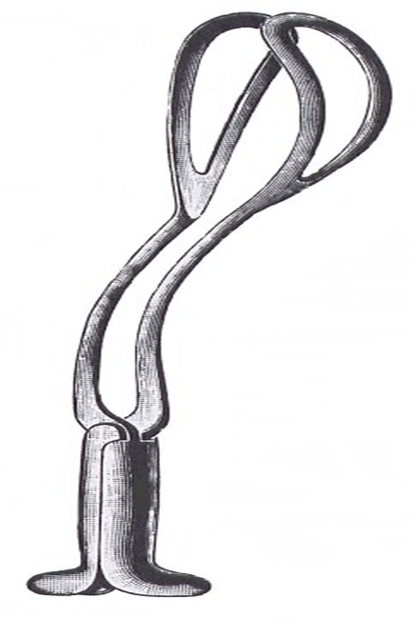
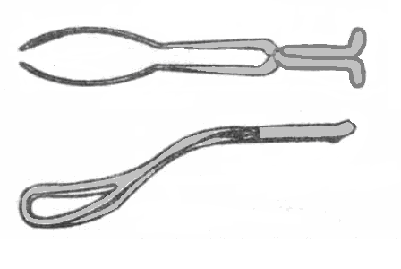
The Pippers Forceps
It is a long forceps designed to facilitate delivery of the after coming head in breech presentation

Slide 28
It is characterized by a long shank with the presence of a perineal curve.
It promotes flexion of the fetal head.
It prevents sudden compression and decompression on the fetal head.
It allows safer traction on the after coming head and not on the fetal neck.

Slide 29
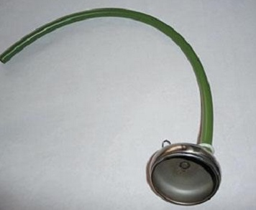
13 - Metal vacuum
For vacuum vaginal delivery.
2 types ➔ metal & plastic vacuum .
With different sizes .”according to the size of the fetal head and wither she is multi or primi”
Indications :
- Prolonged second-stage labor.
- fetal distress
Prerequisite :
Fully dilated cervix .
Membrane ruptured and engaged head .
Vertex presentation .
Adequate pelvis with empty bladder .
Verbal concept from the patient

Slide 30
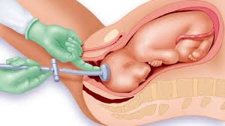
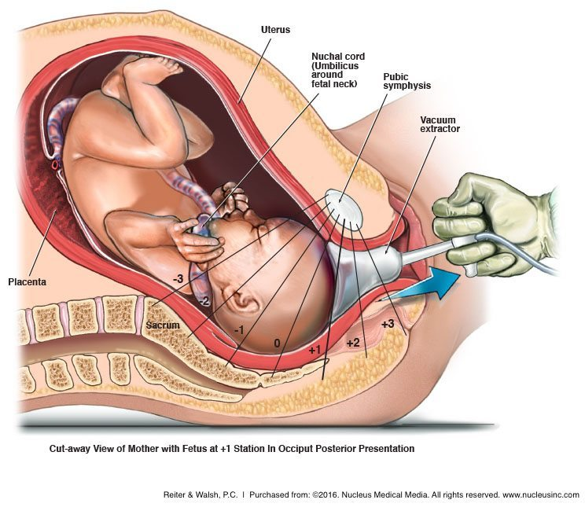
Cont.. Vaccum extraction (ventouse) Rigid VS. Soft cups
Soft Cups (polyethylene or silastic ) : are associated with less scalp injuries and appropriate for occipitoanterior position .
Rigid cups (Metal or Plastic ) are more suitable for occipitoposterior , transverse , and difficult occipitoanterior position where the infant is larger.
There is higher rate of failure with soft cups .
Notes:
Cups diameter average 40-60 mm
Shapes : mushroom , bell

Slide 31
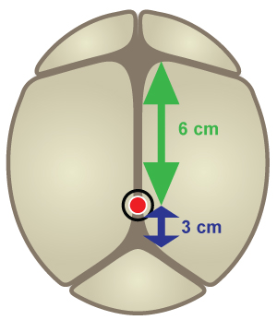
Technique :
1- The woman is placed in the lithotomy position and assists throughout the process by pushing.
2- suction cup is placed onto the head of the baby.
3- Correct placement of the cup directly over the flexion point (pivot point) , about 3 cm anterior from the (posterior) fontanelle, and 6 cm posterior from the Anterior fontanelle
For proper use :
the maternal cervix has to be fully dilated,
the head engaged in the birth canal
and the head position known.
The baby should not be preterm
Not previously exposed to scalp sampling or failed forceps delivery.^{[3]} If the ventouse attempt fails
Ant Fontanelle
Pivot Point
Post Fontanelle

Slide 32
Advantages of VE :
1- less training
2- no risk of excessive traction
3-clear cut roles
4-less injury to mother
Disdvantages :
1-cannot used for ➔ preterm , face or breech presentaion , and the mother is unable to assist the delivery with expulsive effort
2-need more complex equipments
3-more trauma for baby

Slide 33
The ventouse compared to forceps is more likely to be associated with :
Failure to achieve a vaginal delivery.
Cephalohaematoma (subperiosteal bleed).
Retinal haemorrhage.
Maternal worries about the baby.
The ventouse compared to forceps is significantly less likely to be associated With:
Use of maternal regional/general anaesthesia.
Significant maternal perineal and vaginal trauma.
Severe perineal pain at 24 hours.

Slide 34
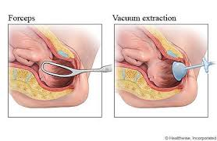
The ventouse compared to forceps is similar in terms of:
Delivery by caesarean section (where failed vacuum is completed by forceps).
Low 5 minute Apgar scores.

Slide 35
operative | vacuum |  | Forceps
1- delay in second stage of labor (eg. Uterine inertia) 2-Maternal indications (Pre-eclampsia , Intrapartum infection , bleeding , Cardiac or pulmonary diseases) 3-Fetal indications (Fetal distress or compromise “Abnormal heart rate pattern , Abnormal scalp blood pH “ ,Fetal malpositions including the after-coming head in breech vaginal delivery) |  |  |  |  | indications
1- Informed consent 2-Vertex , Engaged 3-Fully dilated cervix 4-Membranes ruptured 5-Adequate maternal pelvis 6-Adequate anesthesia 7-Maternal empty bladder 8-fetal and maternal assessment |  | 1- Informed consent 2-Prepared physician 3-Prepared patient 4-Acceptable analgesia/anesthesia (regional (eg, pudendal block) or a conduction anesthetic (eg, epidural, spinal, saddle block ) |  | 1- head must be engaged 2-cervix must be fully dilated and retracted 3-position of the head must be known 4-no CPD 5-membranes must be ruptured 6-patient must have adequate analgesia | Prerequisites
1-Non-verex presentation 2-non-engaged vertex 3-Incompletely dilated cervix 4-Clinical evidence of CPD 5-< 34 weeks gestation 6-Need for device rotation 7-Deflexed attitude of fetal head 8-Fetal conditions (e.g. thrombocytopenia) |  | 1-Inability to achieve a correct application 2-lack of a standard indication 3-Uncertaint fetal position or station 4-Suspicion of CPD 5-inappropriate presentation 6-known or suspected fetal bleeding diathesis or demineralizing bone disease |  | 1-Any contraindication to vaginal delivery 2-Inability to obtain adequate verbal consent 3-A cervix that is not fully dilated or retracted 4-Inability to determine the presentation and fetal head position 5-Inadequate pelvic size 6-Confirmed CPD 7-insufficiently experienced operator | contraindications

Slide 37
Complications of Gyne and obstetric Instrument in Examination

Slide 38
complications
1- Gyne exam complications ( currtets or sound ,…)
1- perforation and bleeding .
How to asses if perforation happened ?
1- change in vital signs of mother (hypoT and TachyC)
2- bleeding (large, new onset of bleeding , if happen : call the blood bank for Blood , go for laparotomy and laproscopy for defining the direct cause and managing it)
3- when using the uterine sound , you can asses if perforation happened if the tool gone further than expected .
يعني اذا حجم رحم متوقع يكون 18 سم مثلا، و شفت انه ال sound دخلت اكثر من 22 سم مثلا ، اعرف انه صار perforation ، هيك حكت الدكتورة باللاب .

Slide 39
2- Maternal forceps
Injury: (acute)
Extension of the episiotomy involving anus & rectum or vaginal vault.
Vaginal lacerations and cervical tear if cervix was not fully dilated.
Post partum haemorrhage: Due to trauma or Atonic uterus.
Shock, due to blood loss, dehydration or prolonged labour.
Urinary incontinence has been reported in up to 24% of women within 6 months of a forceps delivery.
Decrease in pelvic muscle strength, as a result increase in fecal incontinence and in a general index of pelvic floor disorders (incontinence of urine and feces and pelvic organ prolapse).
Fistula
Long term

Slide 40
Cont..
Fetal complications: more in vaccum
Asphyxia.
Trauma:
Intracranial haemorrhage.
Cephalic haematoma.
Facial / Brachial palsy.
Injury to the soft tissues of face & forehead.
Skull fractures.
Cerebral palsy, mental retardation, and behavioral problems.
The risk for serious morbidity is 1.5% and the risk of fetal or neonatal death is 0.05%.

Slide 41
Analgesia in VE and forceps
Analgesic requirements are greater for forceps than for ventouse delivery. rotational forceps or midpelvic direct traction forceps are needed regional analgesia is preferred
. For a rigid cup ventouse delivery, a pudendal block
Whith perineal infiltration may be all that is needed soft
if soft cup is used analgesic requirements may be limited to perineal infiltration with local anaesthetic
If one failed don’t try other
If 2 try vacuum without decent go cs
Max pressure vaccume is 400-600 mmhg
Max time vacum is 15- 20 minute .

Slide 43
Examinations in Obs and Gyne
What can you perform at the the out patient clinic ?
Resources :
- Dr. Seham Labs Records and Notes
- OSCE Dossier of obs and gyne :
http://www.msc-mu.com/uploaded/100820200%20%D9%87%D8%B3%D8%AA%D9%88%D8%B1%D9%8A%20%D9%88%D8%A7%D9%83%D8%B2%D8%A7%D9%85%D9%86%D9%8A%D8%B4%D9%86%20%D8%A7%D9%84%D9%86%D8%B3%D8%A7%D8%A6%D9%8A%D8%A9%20%20.pdf
Teach me obs and gyne (https://teachmeobgyn.com/)
oxford handbook for Obs & Gyne

Slide 44
1- Bimanual examination

Slide 45
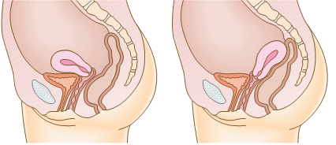
Bimanual examination
After emptying the urinary bladder , bimanual examination Should be done before doing any procedure introducing to the uterus .
➔ Sterile hands with gloves , then :-
■1- Apply lubricating gel to your right index and middle finger.
■2- Gently insert them into the vagina and feel for the firm cervix.
The uterus is usually anteverted and you feel its firmness anterior to the cervix.
If the uterus is retroverted and lying over the bowel, feel the firmness posterior to the cervix .

Slide 46
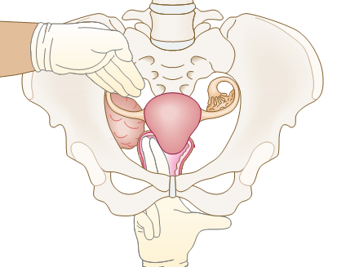
■3- Push your fingers into the posterior fornix
and lift the uterus while pushing on the abdomen
with your left hand.
■4- Place your left hand above the umbilicus
and bring it down, palpating the uterus between
both hands and note its size, regularity and
any discomfort.
■5- Move your fingers to the lateral fornix and,
with your left hand above and lateral to the
Umbilicus, bring it down to assess any adnexal
masses between your hands on each side.

Slide 47
So from the bimanual examination we can determine :
The consistency of the cervix .
The size of the cervix ,
if there is any tenderness to motion.
The size of the uterus .
SHAP-REGULARITY-masses in uterus .
Mobile or fixed. “as in endometriosis”
The direction of the uterus. “we should know it to avoid the uterine perforation”
If there is any adnexal masses .

Slide 48
2- Obstetric Examination

Slide 49
Introduction
Introduce yourself to the patient
Wash your hands
Explain to the patient what the examination involves and why it is necessary
Obtain verbal consent
Preparation
Measure the patient’s height and weight
In the UK, this is performed at the booking appointment, and is not routinely recommended at subsequent visits
Patient should have an empty bladder
Expose the abdomen from the xiphisternum to the pubic symphysis
Cover above and below where appropriate
Ask the patient to lie in the supine position with the head of the bed raised to 15 degrees
Prepare your equipment: measuring tape, pinnard stethoscope or doppler transducer, ultrasound gel

Slide 50
General Inspection
General wellbeing – at ease or distressed by physical pain.
Hands – palpate the radial pulse.
Head and neck – melasma, conjunctival pallor, jaundice, oedema.
Legs and feet – calf swelling, oedema and varicose veins.
Abdominal Inspection
In the obstetric examination, inspect the abdomen for:
Distension compatible with pregnancy
Fetal movement (>24 weeks)
Surgical scars – previous Caesarean section, laproscopic port scars
Skin changes indicative of pregnancy – linea nigra (dark vertical line from umbilicus to the pubis), striae gravidarum (‘stretch marks’), striae albicans (old, silvery-white striae)

Slide 51
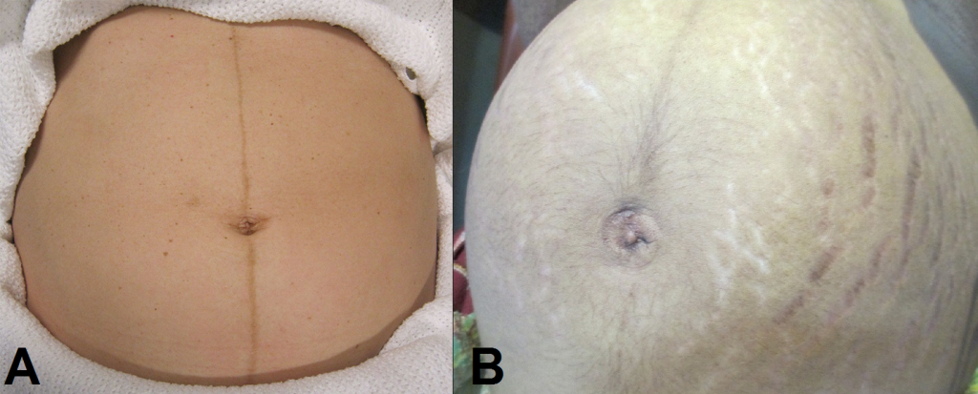
Skin changes in pregnancy. A) Linea nigra. B) Striae gravidarum and albicans

Slide 52
Palpation
Ask the patient to comment on any tenderness and observe her facial and verbal responses throughout. Note any guarding.
1- Fundal Height
Use the medial edge of the left hand to press down at the xiphisternum, working downwards to locate the fundus.
Measure from here to the pubic symphysis in both cm and inches. Turn the measuring tape so that the numbers face the abdomen (to avoid bias in your measurements).
Uterus should be palpable after 12 weeks, near the umbilicus at 20 weeks and near the xiphisternum at 36 weeks (these measurements are often slightly different if the woman is tall or short).
The distance in CM should be similar to gestational age in weeks (+/- 2 cm).
fundal height in cm = GA in weeks

Slide 53
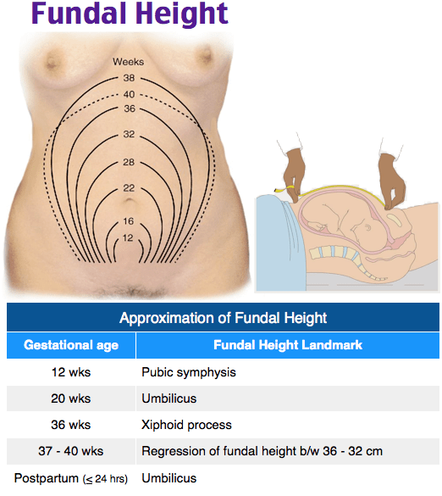
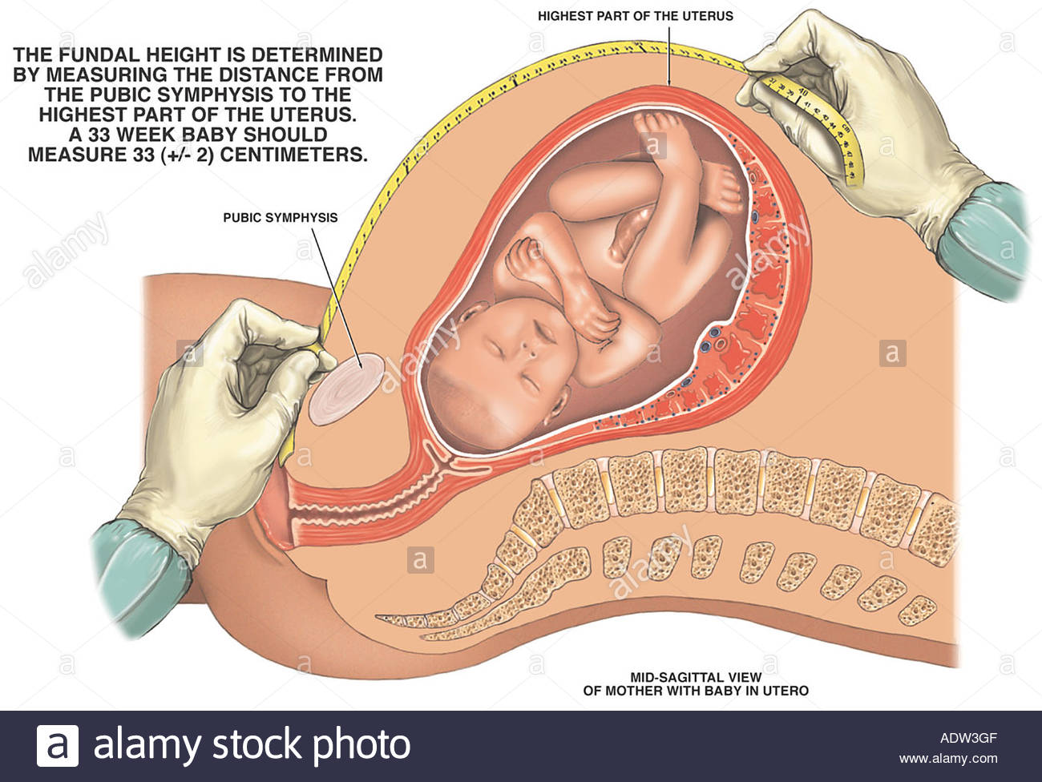
Fundal Height

Slide 54
2- Leopold's Maneuvers
Leopold's Maneuvers are a common and systematic way to determine the
position of a fetus inside the woman's uterus; they are named after the gynecologist Christian Gerhard Leopold.
The maneuvers consist of four distinct actions, each helping to determine the position of the fetus.
The maneuvers are important because they help determine the position and presentation of the fetus, which in conjunction with correct assessment of the shape of the maternal pelvis can indicate whether the delivery is going to be complicated, or whether a Cesarean section is necessary .
To aid in this, the health care provider should first ensure that the woman has recently emptied her bladder
Leopold's Maneuvers are difficult to perform on:
1) Obese women
2) Women who have polyhydramnios

Slide 55
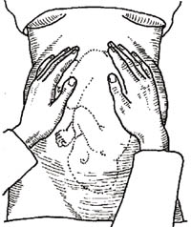
First maneuver:
Fundal Grip
While facing the woman, palpate the woman's upper abdomen with both hands.
starting from this grip , your face toward the face of the patient
Findings:
1) The level of uterine
fundus and GA
2) which part of fetus
occupying the fundus ?
- The fetal head is hard, firm,
independently of the trunk
- the buttocks feel softer
- shoulders and limbs have
small bony processes; unlike
the head, they move with
the trunk..

Slide 56
Second maneuver:
Lateral Grip
Attempts to determine the location of the fetal back. Still facing the woman.
Both hands are placed on the lateral surfaces of uterus at the level of umbilicus .First the right hand remains steady on one side of the abdomen while the left hand explores the right side of the woman's uterus. This is then repeated using the opposite side and hands.
Findings :
1) lie
2)position
3)uterine tone
4) quantity of
amniotic fluid
5) fetal movement
- The fetal back will feel
firm and smooth
- fetal extremities (arms,
legs, etc.) should feel
like small irregularities
and protrusions.

Slide 57
Third maneuver:
Pawlick's Grip(1st pelvic grip)
Your thumb is placed on one side of the pelvis while the remaining 4 other fingers are placed on the other side.
Deep but gentle palpation is required till the presenting part is felt. In the majority of cases we can palpate a round and hard object – the fetal head.
starting from this grip , your face toward the legs
Findings :
We do this :
1 - To identify the
presenting part.
2- To assess if the
presenting part has
engaged or not.

Slide 58
cont Third maneuver:
Pawlick's Grip(1st pelvic grip)
Hard rule :
the umbilicus level is 20-22 wks and every cm above this level =1week.
Easy rule :
read the whole measure and this is equal to the weeks of gestational age.
e.g 29cm=29 wks.
Notes :
-a primipara uterus fundus at term(40wks) is at the level of xiphysternum which is
the same level for multipara but at 36 wks which means that the uterus of
primipara is at a lowr level than multipara.
-primipara gets the head of the uterus down at 36-37wks. While for multipara the
head gets down on labour.

Slide 59
Fourth maneuver:
2nd Pelvic Grip
A doctor is standing towards patient’s feet. The fingers of both hands are located on the lateral surfaces of lower uterine segment and carefully try to insert the fingers between presented part and pelvic inlet..
Findings :
We can determine :
1)The presented
part
2) Station .
- If the head of the fetus is well-flexed, it should be
on the opposite side from
the fetal back.
- If the fetal
head is extended
though, the occiput is
instead felt and is
located on the same side
as the back.

Slide 60
3- Rule of 5:
If you can feel the whole of fetus head above the pelvic brim so it is (free) and
recorded as 5/5. But it is (engaged) if you feel only 2/5th or less(method for
diagnosis of engagement on abdominal exam).

Slide 61
to complete obstetric Examination you have to do-mention :
1-Measure blood pressure (It's very Important and has it's own mark on check list/OSCE )
2-Auscultating the baby’s heart:
This is best heard over the baby’s shoulder. If you have correctly identified the lie
you should roughly know where this is. Put either your Doppler ultrasound or Pinard stethoscope over this area and listen. The baby’s heart rate should be between 110-160bpm (ensure you are not incorrectly hearing the transmission of mum’s, remember her’s will be slower).
3- perform a vaginal examination ONLY IF INDICATED

Slide 63
3- Pelvic Examinations : Speculum Examination and other procedures

Slide 64
1- Speculum Examination
speculum is a device used to look inside in the vagina and observe the cervix. A speculum examination is often performed alongside a bimanual examination, as part of a complete gynaecological workup.
In these slides , we shall look at how to perform an speculum examination in an OSCE-style setting.
1- Introduction
Introduce yourself to the patient
Wash your hands
Explain to the patient what the examination involves and why it is necessary
For example: “I will be passing a speculum, which is a plastic/metal instrument, through the vagina to visualise the neck of the womb.”
Reassure them that this should not be painful, but you will stop immediately if it becomes too uncomfortable
Obtain verbal consent
Request a chaperone

Slide 65
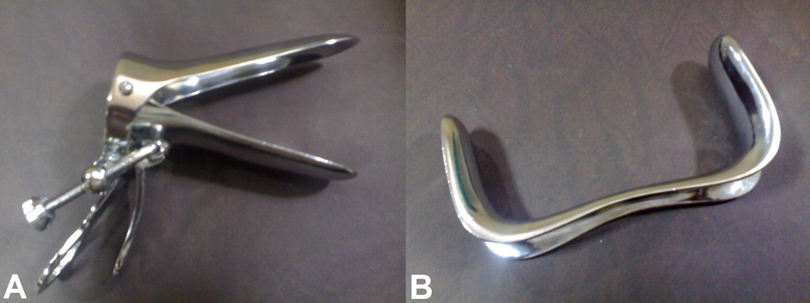
2- Preparation
The patient ought to have an empty bladder
Exposure : Ask the patient to remove all clothing from the waist down and any sanitary protection
Cover with sheet when appropriate
Prepare your equipment: gloves, lubricant, speculum (for example Cusco’s speculum) +/- smear, swabs, Pipelle biopsy.
Types of speculum. A – Cusco’s speculum. B – Sim’s speculum

Slide 66
3- External Examination
The patient should be laid on their back, with legs bent at the hip (feet towards their buttocks), and asked to flop their knees apart.
Put on a pair of gloves
Inspect the external genitalia for:
Deficiency associated with childbirth
Abnormal secondary sexual characteristics – hair distribution, cliteromegaly
Skin abnormalities – lesions, warts, erythema
Discharge – colour, consistency
Bleeding
Swellings of the vulva – tumours, cysts (sebaceous, Bartholin’s)
Ask the patient to cough or strain to observe any incontinence or prolapse
Palpate the labia majora with the index finger and thumb for any swellings

Slide 67
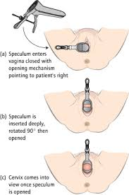
4- Speculum Examination
Lubricate the speculum and warn the patient
Part the labia using your left hand
Gently insert the speculum with your right hand:
Fully insert the speculum with the screw facing sideways and the blades vertical
Rotate 90 degrees during insertion so the screw faces upwards and the blades become horizontal
Slowly open the blades and use light to inspect the cervix
Tighten the screw to hold open the speculum so you can use your right hand for swabs or Pipelle biopsy if necessary

Slide 68
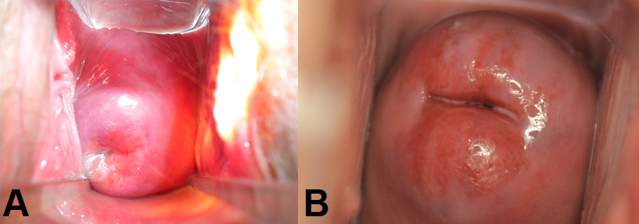
Look for:
Abnormal discharge
Erosions
Ulcerations
Growths
Inflammation
Bleeding
Polyps
Ectropion
At this point swabs/endometrial biopsy should be taken if required
To remove the speculum, undo the screw to allow the blades to close (leave open slightly to not pinch the vaginal walls), rotating back 90 degrees and gently remove
A – Normal cervix. B – Cervical ectropion.

Slide 69
Other Techniques : we do the same steps as before : introduction , sterilization , Bimanual examination and then step to one of these procedures in the circumstances may help to assess

Slide 70
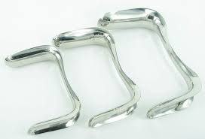
Sims Speculum
A Sim’s speculum can be used to assess prolapse:
Ask the patient to lie on her left side and bring her knees to her chest
Insert the blade of the speculum along the posterior wall of the vagina to hold it back
Ask the woman to cough whilst looking for uterine descent and cystocoele
Repeat whilst holding back the anterior wall, looking for rectocoele/enterocoele

Slide 71
Obtaining Swabs
Swabs often required in cases of suspected infection:
Pick up the sample tube with the right hand and place it in the left hand (with the speculum secured with the screw) and remove the lid if a separate one is present. Sometimes using the chaperone is useful.
Take out the swab with the right hand and perform swabs in this order
Hi-vaginal charcoal media swab – circle around the high vaginal wall once (BV, TV, Candida, group B strep)
Endocervical charcoal media swab – place in endocervical canal and do a 360-degree sweep (gonorrhoea)
Endocervical chlamydia swab – scrub endocervical region for 10-30 seconds
Place the used swab back into the tube in your left hand, close the lid and label the specimens

Slide 72
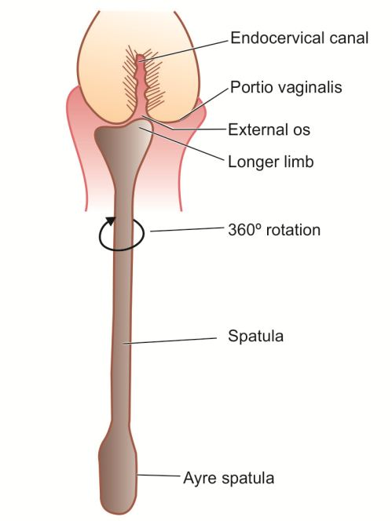
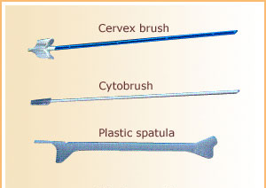
Endocervical Smear
The cervical smear is used to detect precancerous changes in the cervix:
Pass the cytobrush through the vagina (which is held open by the speculum), into the endocervical canal
Turn the brush 360 degrees 5 times
Introduce the brush to the specimen pot and move the brush against the bottom of the pot to dislodge cells into the liquid
Label the specimen and send it off for liquid based cytology

Slide 74
stations from previous years

Slide 75
Group 2 station ,29-10-2020
1- name these instruments ?
1- female catheter
2- double bladed sims speculum
3- hegar dilator
4- uterine sound
5- uterine currates
2- what is the purpose of instrument no 1 ?
female cather uses slide
3-
a- what instrument used to measure the fundal height ? the uterine sound
b- and what complication can happen during this procedure ? obstetric complications slide
c-how can you asses if these complication happened ? obstetric complications slide
4- what are the indications for using instrument no 3 ? why its used ?
-i dont remeber the question for but it was about the dilators and why we use it ....-
1
2
3
4
5

Slide 76
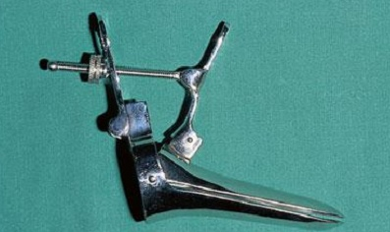
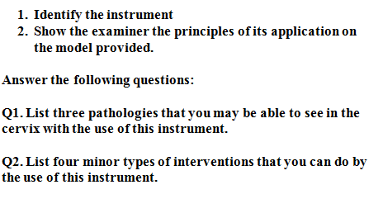
Station #2

Slide 77
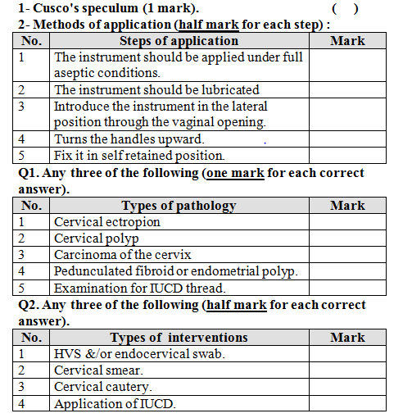

Slide 78
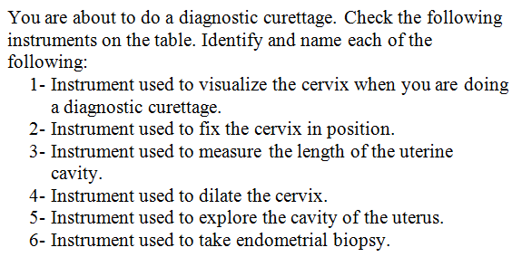
Station #3

Slide 79
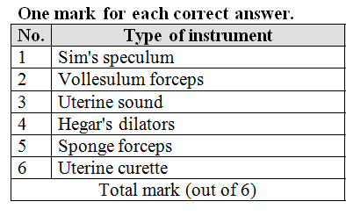

Slide 80
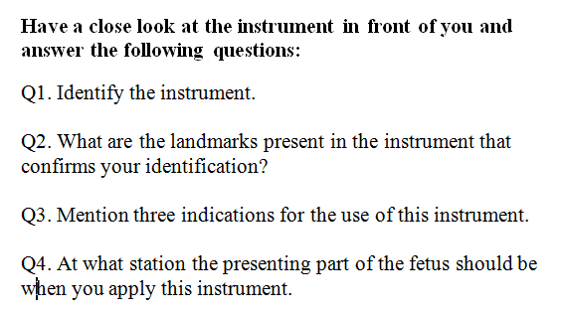
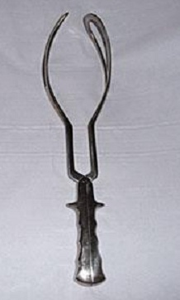
Station #4

Slide 81
