Slide 1
Neuroscience II Peripheral Neuropathy
Dr Omar Alrawashdeh
Associate Professor in Neurology
MRCP, PhD Clinical Neurology

Slide 2
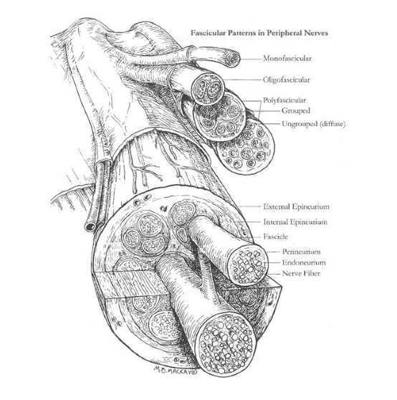
Anatomy of Peripheral nerves

Slide 3
Types of nerve injury
Class I: Neuropraxia
Class II: Axonotmesis
Class III: Neurotmesis

Slide 4
Neuropraxia
Functional deficit in a segment of the nerve where:
The continuity of the nerve is intact
The perineureum, endoneureum, and epineureum are intact
The distal and proximal segments are intact
There is usually full recovery
No degeneration of the nerve
There is usually motor and sensory symptoms

Slide 5
Axonotmesis
Injury to the axon and endoneureum
Degeneration of the segment distal to the injury (Wallerian degeneration several days after the injury)
No conduction distal to the segment
Recovery can occur by axonal regeneration but it takes longer duration
Functional deficit occurs as a result but recovery is possible

Slide 6
Neurotmesis
There is lesion of the axons, endoneureum, perineurem, and epineureum
Wallerian degeneration within several days
No spontaneous recovery is possible without surgical repair
Functional motor and sensory deficits result from this type of injury

Slide 7
Classification of neuropathy
Plexopathy: such as brachial plexus lesion
Mononeuropathy: such as median neuropathy, anterior interosseus syndrome, Ulnar nerve compression, Radial nerve compression, Posterior interosseus syndrome, Femoral nerve syndrome, Lateral cutaneus nerve syndrom (meralgia parasthetica), Common peroneal nerve syndrome.
Polyneuropathies: it is a systemic neuropathy that affects almost all nerves in a variable degree. It is usually length dependent where the longest axons are affected earlier. It can be classified into hereditary or acquired polyneuropathy

Slide 8
Hereditary Polyneuropathies
CMT: Charcot-Marie-tooth syndrome
Friedreich ataxia
Giant axonal neuropathy

Slide 9
Acquired polyneuropathies
Neuropathies associated with endocrine disorders: diabetes and thyroid diseases
Neuropathies associated with systemic disease Connective tissue disease (rheumatoid arthritis, lupus, Sjögren syndrome) (see pg. 315) Inflammatory bowel disease (ulcerative colitis, Crohn disease) Liver disease Renal failure (uremic neuropathy)
Neuropathy related to nutritional deficiency Vitamin deficiency (B12, B6, E), Copper

Slide 10
Acquired polyneuropathies
Toxic neuropathies: Medications (metronidazole, colchicine, disulfiram, cisplatin, vinca alkaloids, many others) Heavy metals (lead, mercury, arsenic)
Neuropathy associated with infections Viral (HIV, HTLV-1, VZV, hepatitis B and C), Bacterial (Lyme, leprosy)
Acute inflammatory: Guillain-Barré Syndrome (GBS)
Chronic Acquired Immune-Mediated Demyelinating Polyneuropathies

Slide 11
GBS Variants
Acute inflammatory demyelinating polyneuropathy (AIDP): 90% of cases
Acute motor axonal neuropathy
Acute motor-sensory axonal neuropathy (AMSAN)
Miller-Fisher syndrome:
Acute panautonomic neuropathy
.

Slide 12
Chronic Acquired Immune-Mediated Demyelinating Polyneuropathies
Chronic inflammatory demyelinating polyneuropathy (CIDP)
Multifocal acquired demyelinating sensory and motor neuropathy (MADSAM)/ Lewis-Sumner syndrome
Distal acquired demyelinating sensory neuropathy.
Multifocal motor neuropathy

Slide 13
Symptoms of polyneuropathy
Motor symptoms (somatic or autonomic)
Sensory neuropathy (somatic or special senses)

Slide 14
Motor somatic Symptoms
Weakness
flaccidity
Atrophy of muscles
Hyporeflexia or a reflexia
Fasciculations

Slide 15
Motor autonomic symptoms
Orthostatic hypotension in the form of dizziness
Tachycardia or bradycardia
Gastroparesis (feeling of fullness)
Urine incontinence
Fecal incontinence
Impotence
Blurred vision
Dryness of skin (anhydrosis with reduced sympathetic flow)
Excessive sweating (with increased sympathetic flow)

Slide 16
Somatic sensory symptoms
Focal sensory loss (mononeuropathies) and gloves and stocking distribution of sensory loss in case of polyneuropathy)
Parasthesia, dysesthesia, allodynia, hypersthesia, burning sensations, electric shooting pain
Ataxia due to decreased position sense

Slide 17
Special sense neuropathy
Loss of smell due to involvement of the olfactory nerve: anosmia
Blurring of vision (optic neuritis). This is central nervous system nerve
Loss of taste that is usually seen with facial nerve palsy
Vertigo with vestibular neuritis

Slide 18
Neuralgias
Irritation of the nerve results in ephabtic transmission and spontaneous firing
Usually idiopathic but can result from irritation of the nerve or toxic, metabolic causes.
Examples:
Trigeminal neuralgia
Occipital neuralgia
Glossopharyngeal neuralgia

