Slide 1
بسم الله الرحمن الرحيم
DR. Waqar Al – Kubaisy

Slide 2
L XVI
t-Tests
Part 4
Paired t-Test

Slide 3
Paired t-Test
In many medical studies, individuals are followed over time
to see if there is a change in the value of some continuous variable.
Typically, this occurs in a “before and after” experiment
such as one testing to see
if there was a decrease in average blood pressure after treatment or
to see if there was a reduction in weight after the use of a special diet.
In this type of comparison, an individual patient serves as his or her own control.
The appropriate statistical test for this type of data is the paired t-test.
The paired t-test is more robust

Slide 4
Cont. …Paired t-Test
The paired t-test is more robust than pooled Student’s t-test
because it considers the variation from only one group of people, whereas pooled Student’s t-test considers
variation from two groups.
Variation that is detected in the paired t-test is presumably
(probably) attributable to the intervention or to changes over time in the same person

Slide 5
CALCULATION OF THE VALUE OF T in Paired t-Test
To calculate a paired t-test, a new variable must be created. This variable, called d, is the difference between the values before and after the intervention for each individual studied.
The paired t-test is a test of the null hypothesis that, on the average, the difference is equal to 0,
which is what would be expected if there were no change over time.
Using the symbol d to indicate the mean observed difference between the before and after values,
the formula for the paired t-test is as follows:

Slide 6
d

Slide 7
Cont. ..Calculation of t in Paired t-Test
r.
The formulas for pooled Student’s t-test and the paired t-test
are similar the ratio of a difference to the variation around that difference (the standard error).
In pooled Student’s t-test, each of the two distributions to be compared contributes to the variation of the difference, and the two variances must be added.
In the paired t-test, there is only one frequency distribution, that of the before-after difference in each person.
In the paired t-test, because only one mean is calculated (d), only 1 degree of freedom is lost; the formula for the degrees of freedom is N − 1.

Slide 8
III- Difference between two means of dependent sample
We have one sample (group) under two different condition, or two different events or two different occasions
Therefore each individual in the sample having two observations or two values .
Each value related to certain occasion or event .
Each individual having two values .
Each individual having paired of value or observation
Evening Before
B. Sugar Hb
Morning After

Slide 9
We would like to know if there is a significance difference in the variable (B. sugar, Hb level) between two occasions or conditions .
Whether changing of the condition have an effect on the variable value that we are interest about .
We are measuring and testing the significance difference between two means of two different occasions .
We use what we call it Paired t test .
We have one sample (N) under two different conditions
Measuring the difference between two values of each individuals

Slide 10
d

Slide 11
Example
Five Geriatric patients put under Zinc Sulphate, their body weight was measured before treatment, then 10 WS after treatment by 200 mg Zinc Sulphate T d s .
At α level of 0.05, could we conclude that Zinc Sulphate affect body Wt. of geriatric patients
B. Wt lb
Pt Before After 2
1 140 143 +3 9
2 138 136 -2 4
3 142 138 -4 16
4 130 125 -5 25
5 152 150 -2 4

Slide 12
Data
-Quantitative data .Representing mean B. Wt (lb) of five geriatric patients before treatment and after treatment .
Assumption
We assume that dependent sample has been chosen randomly from normal distribution population under two different conditions .
Formulation of hypothesis
Ho
There is no significance difference in the mean body Wt. of the Geriatric patients before treatment and after treatment , .
There is no effect of zinc sulphate treatment on B. Wt. of geriatric patients between two conditions

Slide 13
The difference in mean B. Wt. ( before and after ) is due to Sampling Error, Sampling Variability and Chance Factor.
HA
There is a significance difference in mean B. Wt. between two conditions .
This difference is due to the effect of Zinc Sulphate on the
B. Wt.
Level of significance

Slide 14
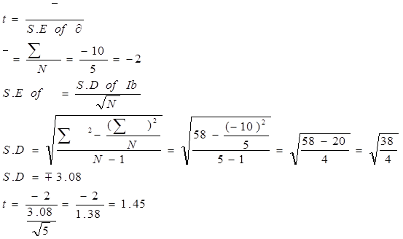
Apply Proper test
t test
paired t test

Slide 15
Decision
Calculated t fall in area of acceptance
↓
accept Ho
There is no significance difference in the mean B. Wt. between two condition (before and after treatment ) .
Calculated t < tabulated t .
Calculated t falls in front of critical region .
Area or % of influencing factor decreased (less than 95%)
While the chance factor increased (more than 5%) .
P > 0.05 .
Conclusion
There is no significance effect of Zinc Sulphate on the B. Wt. of the Geriatric patients .

Slide 16
Example
In order to determine the effect of certain oral contraceptive on weight gain, 9 healthy females were weighed prior to the start of medication and again at the end of the three month period .
SUBJECT INITIAL 3 MONTH
WT.(POUND) WT.(POUND)
1 120 123
2 141 143
3 130 140
4 150 145
5 135 140
6 140 143
7 120 118
8 140 141
9 130 132
Is there a sufficient evidence to conclude that female experience a weight gain following three months of oral contraception .Alpha=0.05

Slide 17
Example
Serum digoxin level in 9 healthy males following intravenous injection of the drug was measured after 4 hours and again after 8 hours . the following data was obtained
Person After 4 hours After 8 hours
. 1 1 1
2 1.3 1.3
3 0.9 0.7
4 1 1
5 1 0.9
6 0.9 0.8
7 1.3 1
8 1.1 1
9 1 1
A-Is there a statistical significant difference in the serum digoxin level concentration at the end of 4 hours and at the end of 8 hours,
Alpha = 0.05 .
B--- Present the above data properly

Slide 18
