Slide 1
THORACIC INJURY
Presented by
IZZAT ABABNEH
MO’TASIM AL-KHATTAB

Slide 2
epidemiology
Represents 20% of trauma associated mortality
It is the commonest cause of death in cases of RTA
Up to 75% of patients have also other associated injuries

Slide 3
classification
According to the chest wall status; thoracic injuries can be classified into two main categories :
Open
Closed

Slide 4
Complications and sequalae of chest trauma
Parietal injuries
Soft tissue
Bone
Visceral injuries
Thoracic injuries
Pleura and lung
Heart
Tracheo-bronchial tree
Major vessels
Esophagus and diaphragm
Associated abdominal injuries

Slide 5
Clinical picture of thoracic injuries in general
Symptoms
History of chest trauma followed:
Chest pain
Dyspnea
Cyanosis
Cough or haemoptasis
+/- abdominal pain
Signs
Internal hemorrhage and hypovolemic shock
Associated injuries

Slide 6
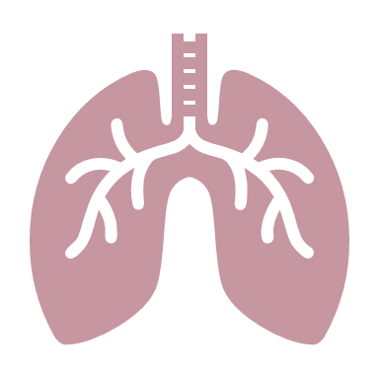
Rib fractures

Slide 7
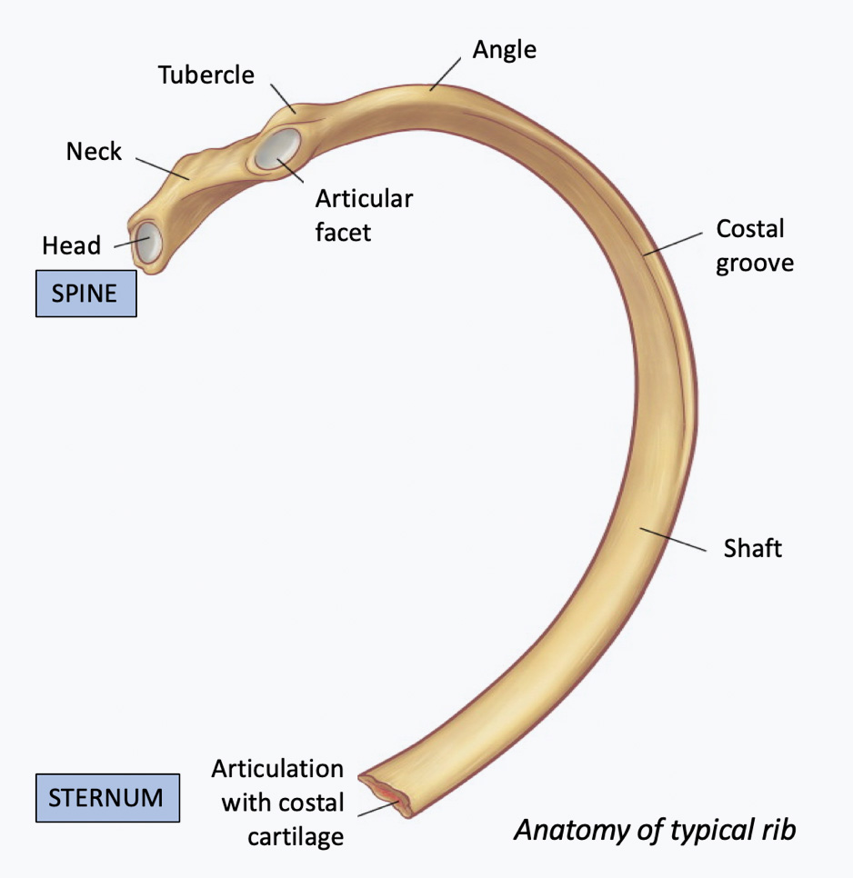
The commonest thoracic injury
Etiology :
Direct trauma
Fracture occurs at the site of trauma
Indirect trauma
Fracture at the angle of the ribs
Muscular violence
Pathological fracture

Slide 8
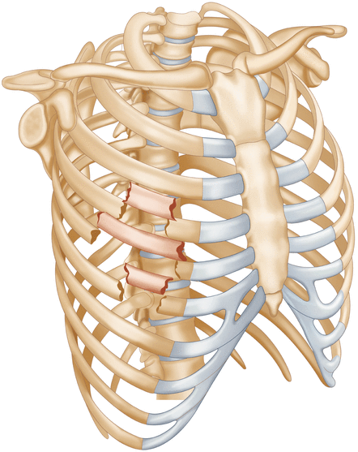
Pathologically, rib fractures can be divided into:
Isolated simple rib fracture
One or more ribs are fractured in a single site
Double rib fractures
Flail chest
Three or more successive ribs are fractured at two points
Stove-in chest
Rare type of flail chest where the flail part collapses into the chest

Slide 9
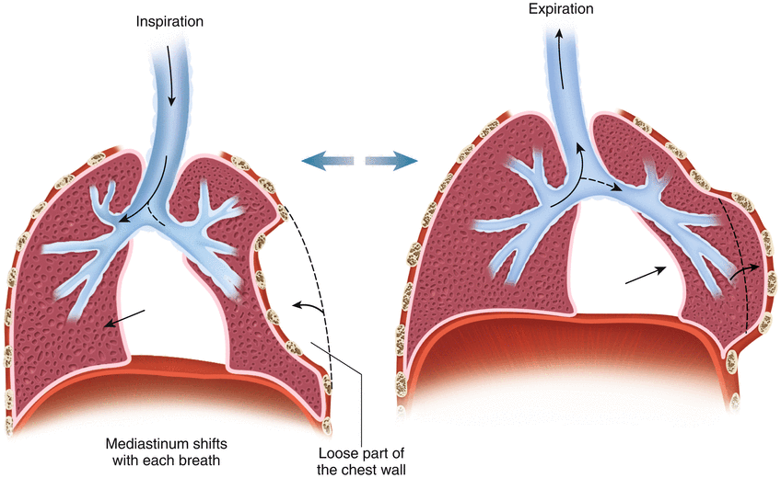
Effects of flail chest:
Paradoxical chest wall movement with respiration
Impaired respiratory movement of the affected lung
Pendulum breathing
Mediastinal flutter
Circulatory failure
Lung contusion and laceration

Slide 10
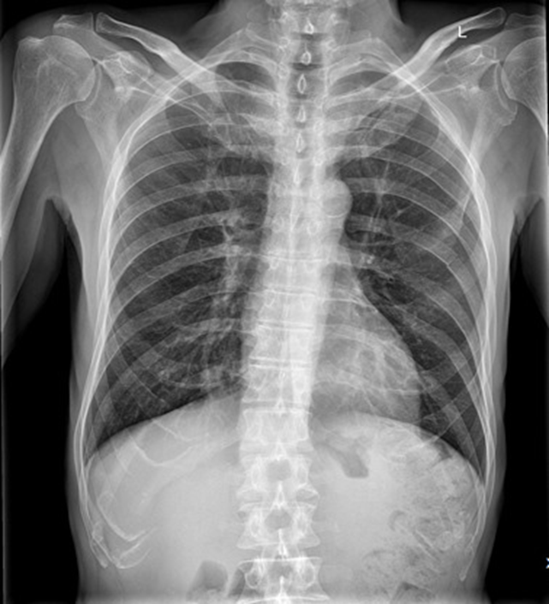
Clinical picture
Sever pain and tenderness over the fracture site
Shallow rapid breathing
Crepitus
Evidence of other associated chest or abdominal injuries
Plain chest X-ray

Slide 11
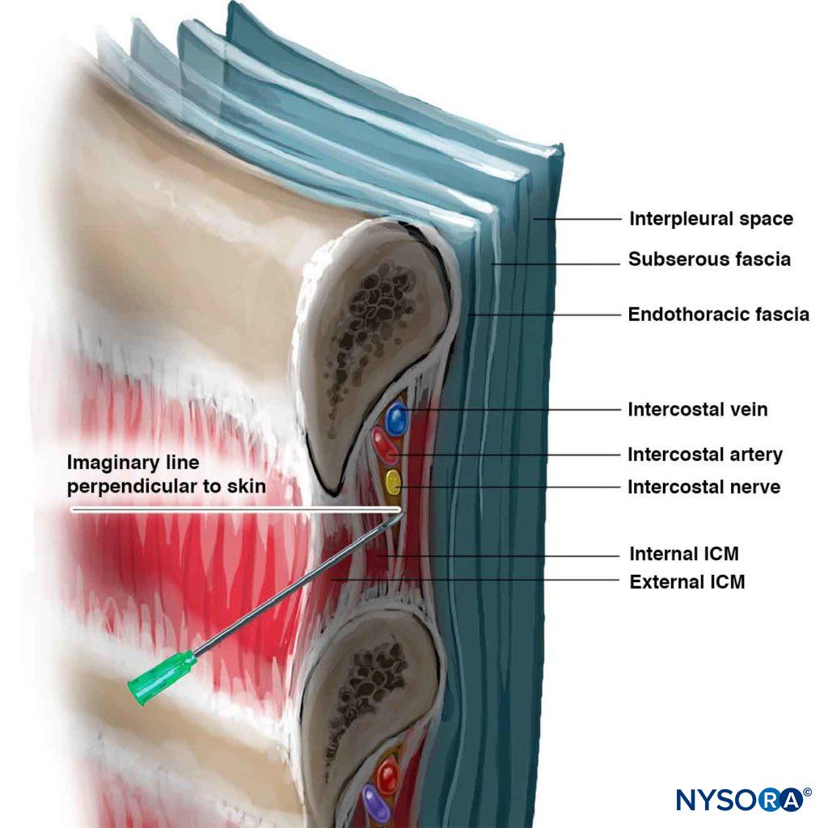
Treatment:
Simple fracture
Pain relief by strong analgesics, intercostal or thoracic epidural nerve block
Mucolytics and expectorants
Chest physiotherapy
Indications for admission:
Age 65 years or older
Underlying pulmonary disease
Inability to cough
First and/or second rib fracture
Associated injuries

Slide 12
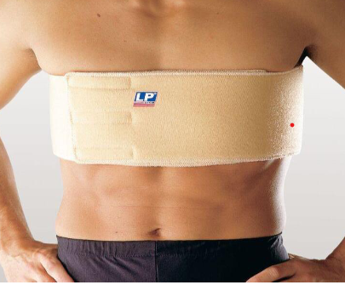
Flail chest
Small flail segment
Same as simple fracture + external fixation (by cotton pad and adhesive plaster)
Sever cases
Internal fixation of the flail segment
By endotracheal intubation with intermittent positive pressure ventilation
Indications:
Disturbed level of consciousness
RR > 35/min
PaO2 < 60 mmHg
PaCO2 > 50 mmHg
Age > 50 year
Open reduction and internal fixation
Only if thoracotomy is indicated for another cause

Slide 13
pneumothorax

Slide 14
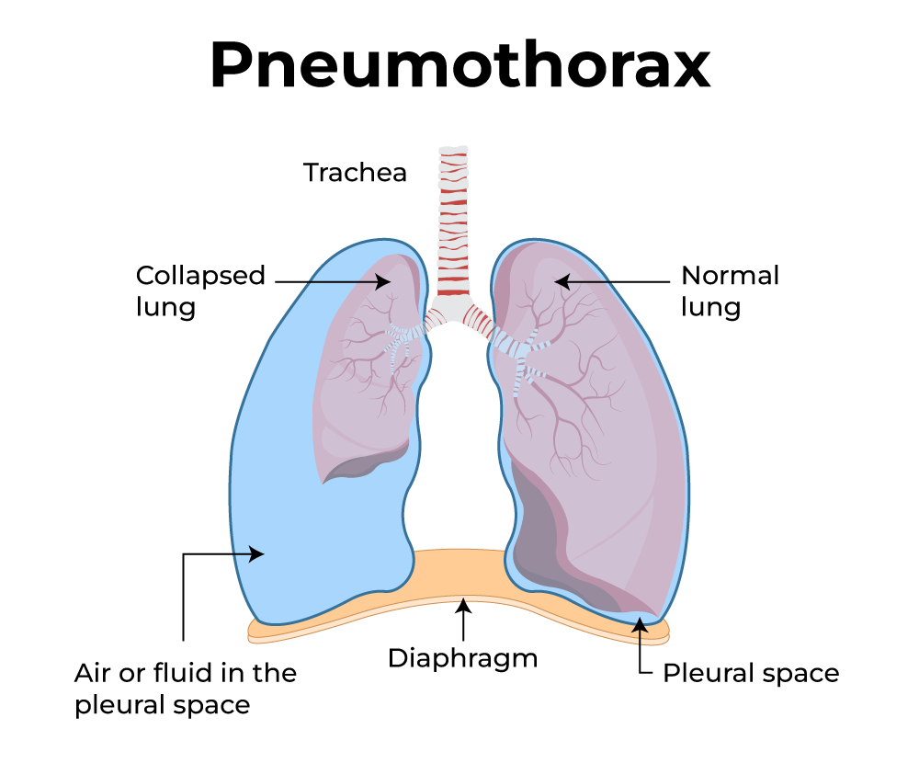
Air collection in the plural cavity
Etiology:
Traumatic
Spontaneous
Iatrogenic

Slide 15
Types of traumatic pneumothorax:

Slide 16
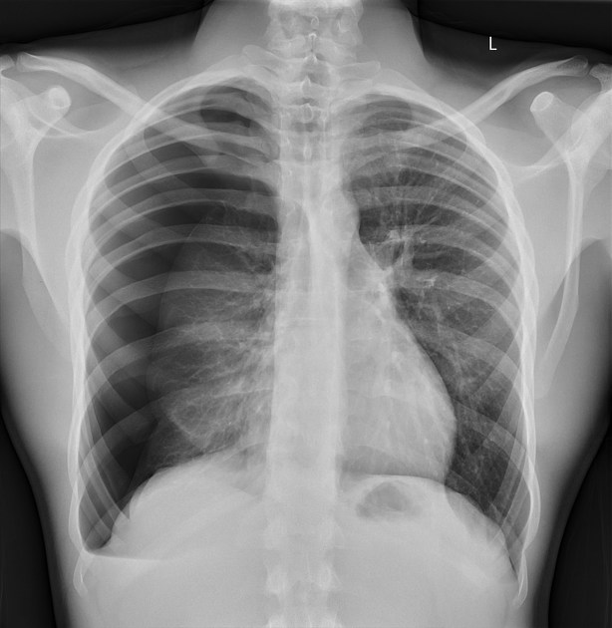
Closed pneumothorax
Also known as simple pneumothorax
The patient may be asymptomatic or presents with a mild chest pain and dyspnea
On physical examination:
Diminished air entry and resonance on percussion
No tracheal or mediastinal shifting
Chest X-ray:
Translucency
Loss of lung marking
Visible collapsed lung edges
Treatment:
Minimal amount of air without dyspnea may resolve spontaneously
Chest tube connected to underwater seal

Slide 17
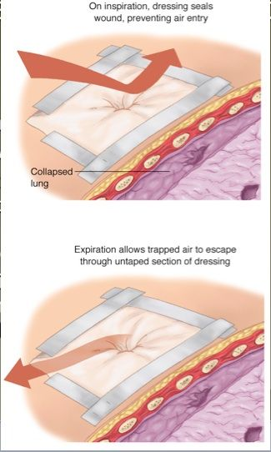
Open pneumothorax
Characterized by the presence of a sucking wound
Effects on respiration and circulation:
Paradoxical respiration
Pendulum respiration
Mediastinal flutter
Circulatory failure
The patient presents with moderate dyspnea, chest pain and cyanosis
On physical examination:
Same as closed type
Sound of air passing the wound (both sucking and wheezing sounds)
Chest X-ray findings (same as closed type)
Treatment:
3-way dressing
Chest tube connected to underwater seal

Slide 18
Tension pneumothorax
The most serious type, characterized by the presence of valvular wound
Effects on respiration and circulation:
Lung collapse
Mediastinal shifting
Circulatory failure
Acute right ventricular failure
The patient presents with sever sharp stabbing chest pain with sever progressive dyspnea and cyanosis
On physical examination:
Sound of air passing the wound (sucking sound only)
Diminished chest movement and air entry with hyper-resonance percussion tone
Tracheal and mediastinal shifting
Congested neck veins

Slide 19
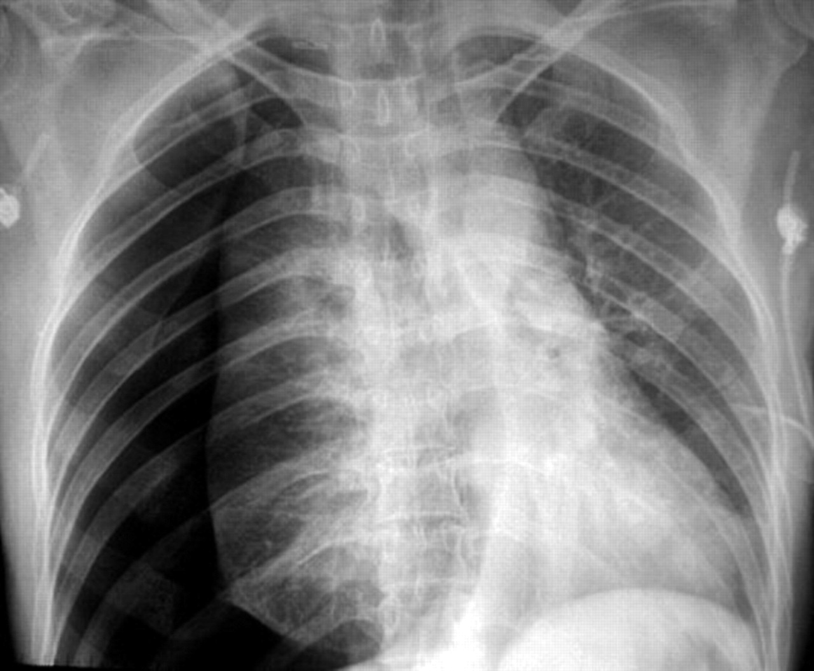
Chest X-ray findings (after needle decompression):
Translucency
Loss of lung marking
Visible collapsed lung edges
Mediastinal shifting
Depression of diaphragm
Treatment:
Needle decompression
Chest tube connected to underwater seal
thoracotomy

Slide 20
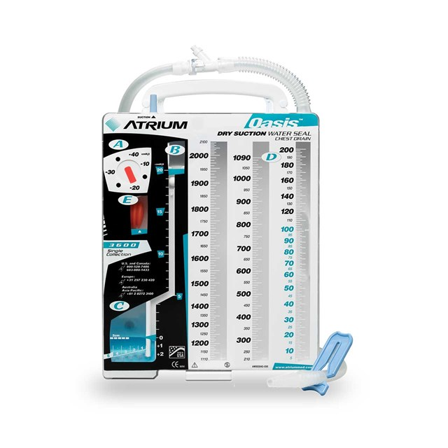

Slide 21
hemothorax

Slide 22
Collection of blood in the plural cavity
Etiology:
Traumatic
Iatrogenic
Spontaneous
May be associated with pneumothorax

Slide 23
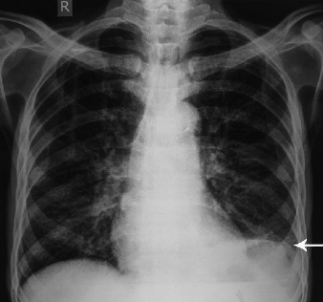
Complications and sequelae:
Blood remain liquid for many days due to defibrination
Clot formation
Fibrosis of parietal and visceral plura
Empyema
Clinical picture:
Hx of chest trauma
Manifestations of hypovolemic shock
Diminished chest wall movement with dull percussion tone
Tracheal and mediastinal shifting
Investigations:
Chest X-ray findings
Obliteration of costovertebral angle

Slide 24
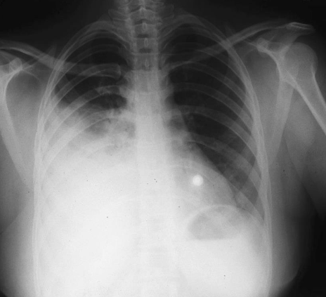
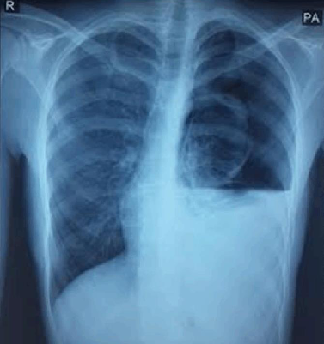
Opacity raised to the axilla
Air-fluid level
Lung collapse
Mediastinal shifting
Treatment:
IVF, prophylactic antibiotic and analgesia
Chest tube connected to underwater seal
Video assisted thoracoscopy
Interventional radiologic arterial embolization

Slide 25
Thoracotomy:
Early indications:
Complete opacification of hemithorax
Output > 200ml/hour for 3 successive hours
Output > 1500 ml in 24 hours
Associated injury requiring surgery
Late indications:
Clotted hemothorax
Fibrothorax

Slide 26
Lung injuries

Slide 27
Types:
Hematoma
Contusion
Laceration
Blast injury
Clinical picture:
Lung injuries are suspected in high energy trauma, sternal or multiple rib fractures and flail chest
Manifestations of associated hemo-pneumothorax

Slide 28
Tracheobronchial injuries

Slide 29
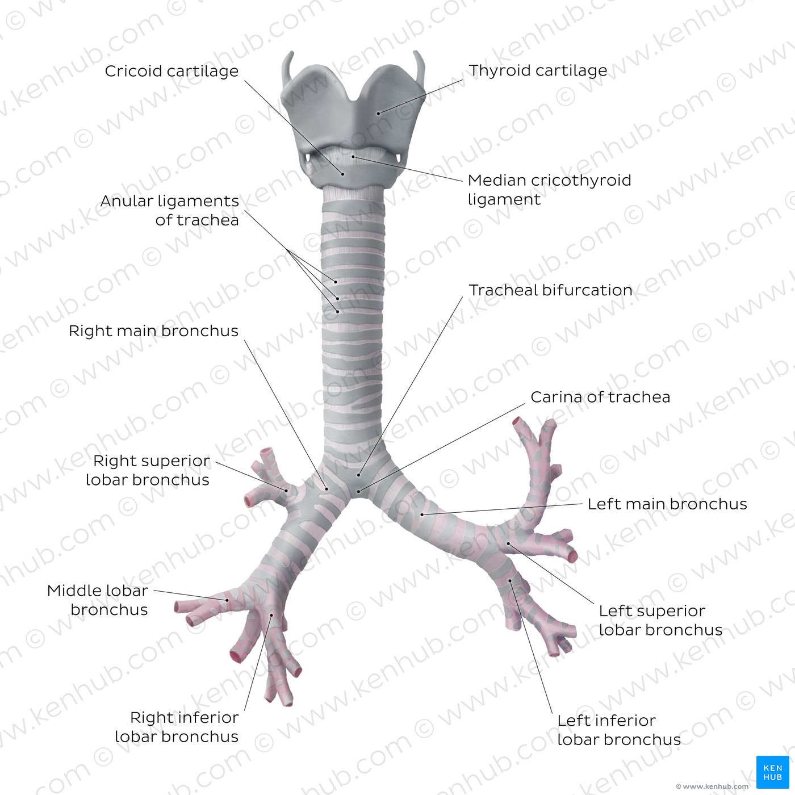
Etiology:
Linear rupture
Disruption at sites of fixation
Laceration or transection
Clinical picture:
Dyspnea
Dysphonia
Hemoptysis
Subcutaneous emphysema

Slide 30
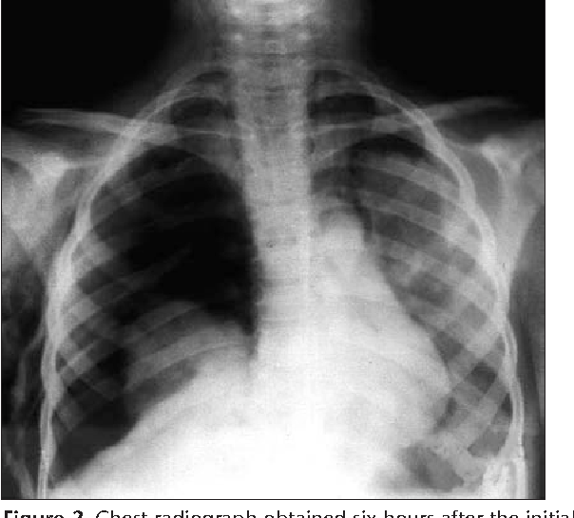
Diagnosis:
Chest X-ray shows fallen lung sign
Complications:
Empyema
Clotted Hemothorax
Bronchopleural fistula
Bronchial stenosis
Chylothorax

Slide 31
Cardiac injuries

Slide 32
Etiology:
Penetrating injury
Blunt injury to sternum
Complications and sequels:
Mural thrombosis
Myocardial fibrosis and aneurysm
Hemopericardium and cardiac tamponade
Cardiac arrest
Cardiac rupture

Slide 33
Cardiac tamponade

Slide 34
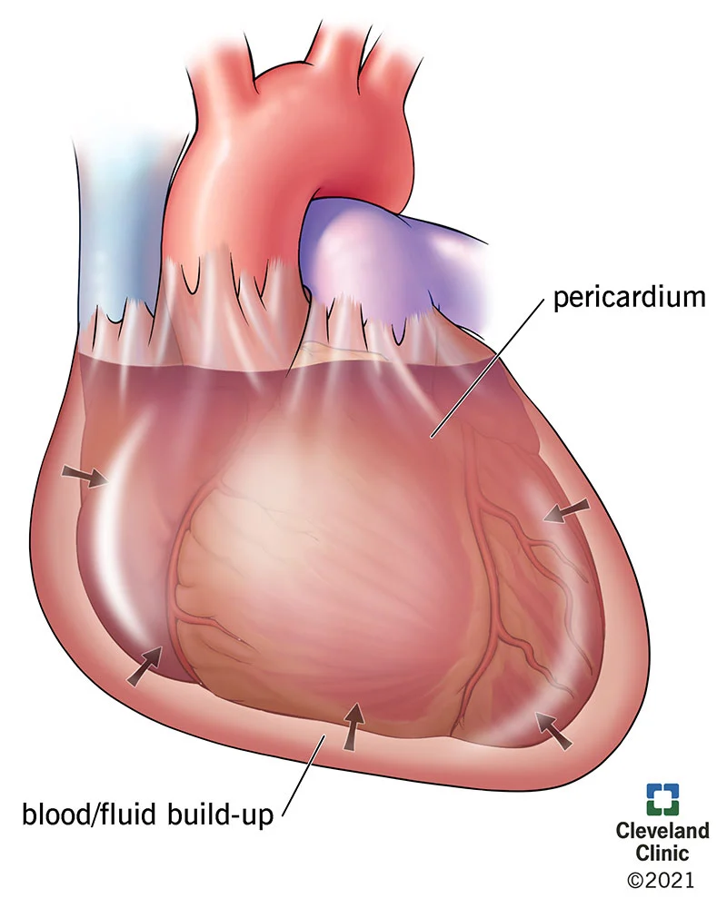
Cardiac compression by hemopericardium which decreases the cardiac output due to impaired cardiac filling
Rate of accumulation is more important than the amount itself

Slide 35
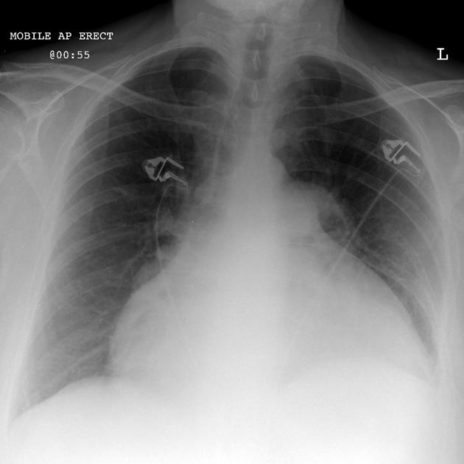
Clinical picture:
Massive rapid hemopericardium
Lead to sudden death
Survivors will show:
Dyspnea and cyanosis
Beck’s triad ( persistent hypotension, congested neck veins and weak heart sounds)
Manifestations of hypovolemic shock
High venous pressure
Weak apex beat
Investigations:
ECG
Chest X-ray
Echocardiography
EFAST

Slide 36
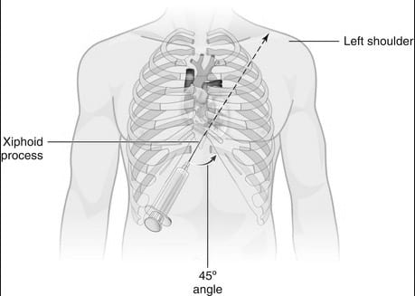
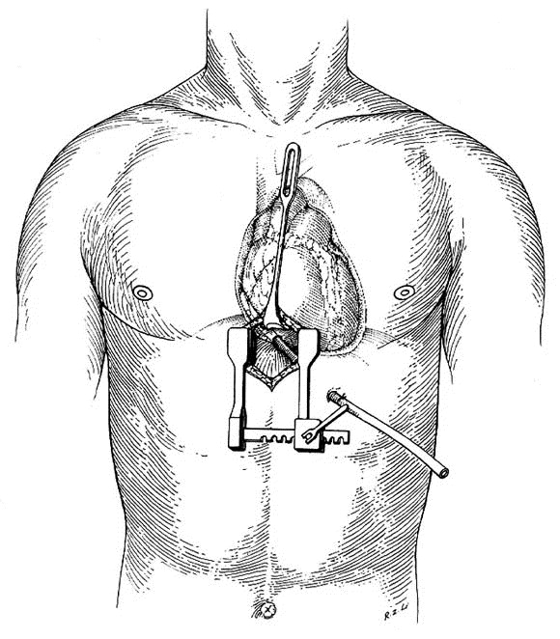
Treatment:
Temporary relief of cardiac compression:
Pericardiocentesis
Subxiphoid pericardiotomy
Thoracotomy and pericardiotomy

Slide 37
Esophageal injuries

Slide 38
Etiology:
Iatrogenic
Swallowing of corrosive agent or foreign body
Penetrating or blunt chest or neck trauma
Complications:
Mediastinitis
Septic shock
Clinical picture:
Sudden onset of pain at the site of trauma followed by fever, tachycardia and hypotension
Mediastinal emphysema
Manifestations pneumothorax and plural effusion

Slide 39
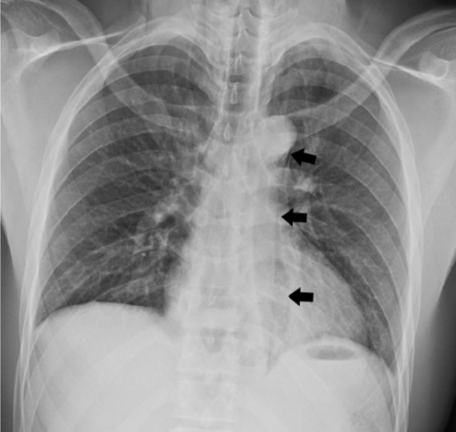
Investigations:
Plain chest X-ray
Contrast media study
Treatment:
NPO,IVF, IVA and never try to pass a NG tube
Depends on site of perforation and time of detection:
Early detected cervical and thoracic perforation
Surgical closure and drainage
Late detected cervical perforation
External drainage with parenteral feeding
Late detected thoracic perforation
Drainage with feeding jejunostomy
Abdominal perforation
Surgical repair

Slide 40
Diaphragmatic injury

Slide 41
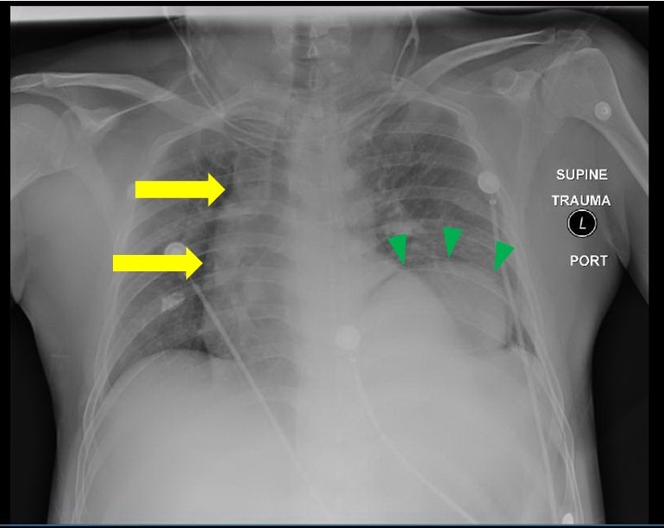
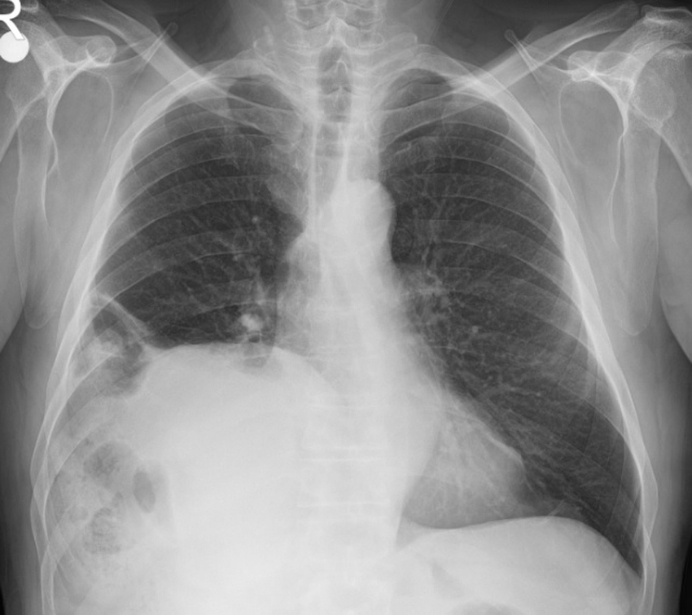
A common injury especially in the left side
We must have a high index of suspicion based on the injury mechanism
All diaphragmatic injuries must be surgically corrected to avoid bowel herniation
Diagnosis:
Chest X-ray
Hemi-diaphragmatic elevation
Bowel in chest cavity
Collar’s sign

Slide 42
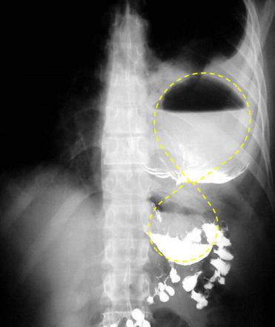
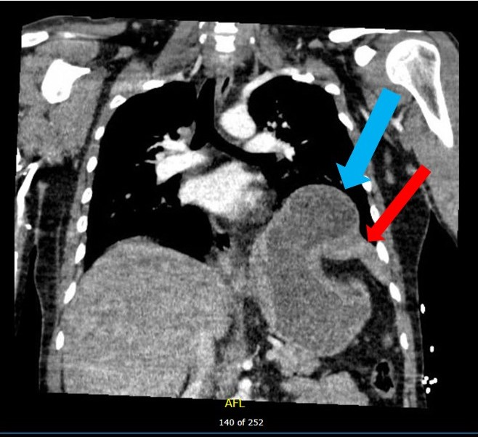
CT-scan
Bowel herniation
Diaphragmatic tear
Collar’s sign
Direct visualization
By laparotomy, laparoscopy or thoracoscopy

Slide 43
Other chest wall injuries

Slide 44
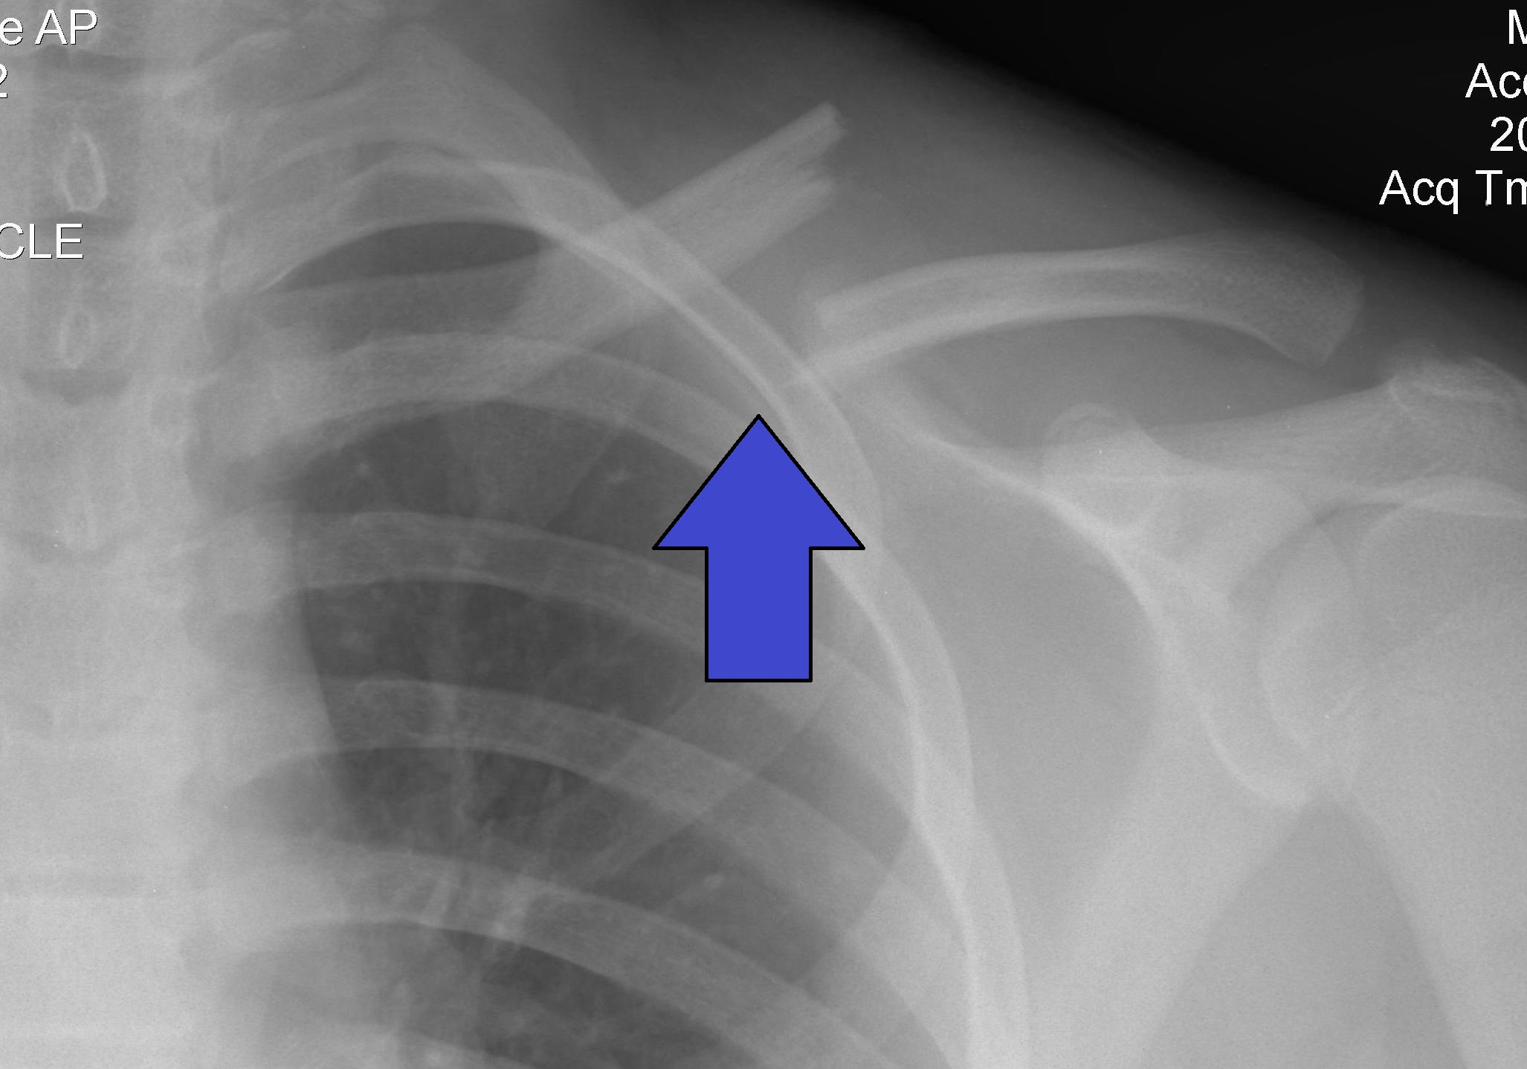
clavicular fracture
mostly affects the middle part
Can be treated conservatively in most cases by:
Figure of 8 dressing
Clavicle strap or sling

Slide 45
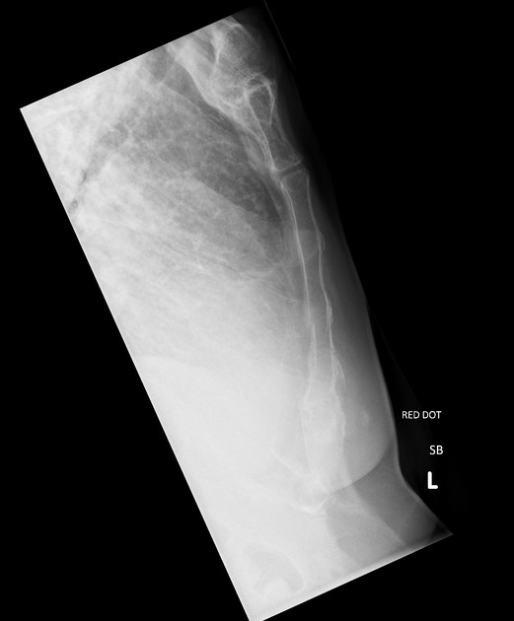
Sternal fracture
Usually seen in RTA
Mostly transverse and affecting the middle and upper part of sternal body
Up to 2/3 of patients have also associated thoracic and head injuries

Slide 46
scapular fracture
Indicates sever force of impact
Carries very high risk of associated injuries

Slide 47
THANK YOU FOR BEING EFFECTIVLY ATTENTIVE!

