Slide 2
Pharmacology lecture 5 (UG)
Third Year

Slide 9
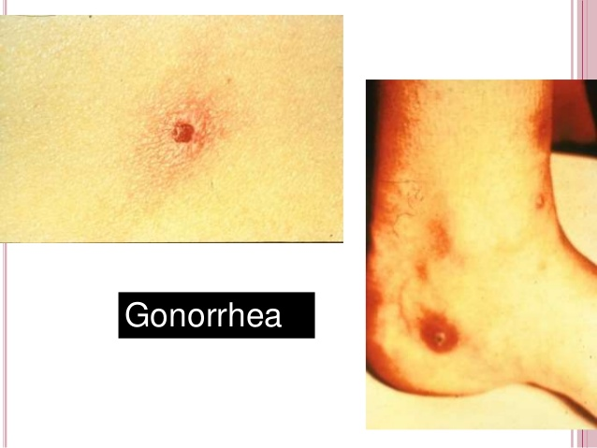

Slide 16
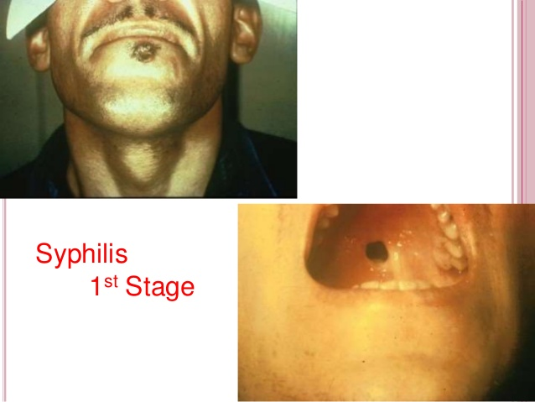

Slide 38
Thank You
Dr. Gehane

