Slide 1
Endocrin module
Prof. Dr./ Sherif Wagih Mansour
Prof. of Physiology dpt.

Slide 2
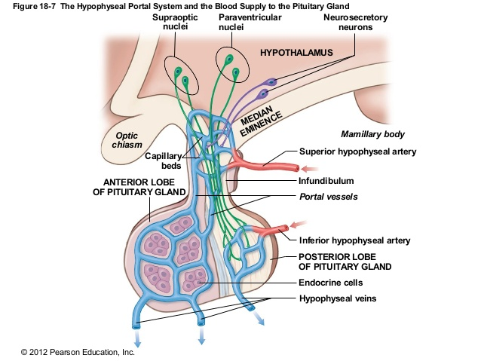
THE PITUITARY GLAND (Hypophysis) The hypophysis is a small gland , 1 cm in diameter, lies in the Sella Turcica at the base of the brain connected to the hypothalamus by the hypophyseal stalk . It is a compound gland derived partly from a downgrowth of nervous tissue and partly from an upgrowth of the mouth .

Slide 3
The arteries which supply the median eminence (lower most portion of the hypothalamus) are divided in its substance to form like primary capillary plexus and then coalescing to form the hypothalamic- hypophyseal portal vessels which pass downward along the hypophyseal stalk to supply the anterior pituitary sinuses .
Secretion of Hypothalamic neurosecretory substances in the median Eminence :
The neurons originating in various parts of the hypo­thalamus send fibres into the median eminence and tuber cinereum which secretes a small polypeptide hormones (hypothalamic hormones or neurosecretory substances) that are absorbed into the hypothalamic-hypophyseal portal capillaries to be carried to the adenohypophysis . They control the release of adeno-hypophyseal hormones .
-They are called releasing or inhibitory factors according to their function :
- Thyrotropin Releasing Factor (TRF) . - Corticotropin Releasing Factor (CRF) .
- Somatotropin Releasing Factor (SBF) . - Somatostatin (Growth hormone inhibiting factor) .
- Gonadotropin Releasing Factor (GRF) . - Luteotropin (Prolactin) Inhibitory Factor (LIF) .
-Melanostatin (Melanocyte Stimulating hormone release Inhibitory Factor).

Slide 4
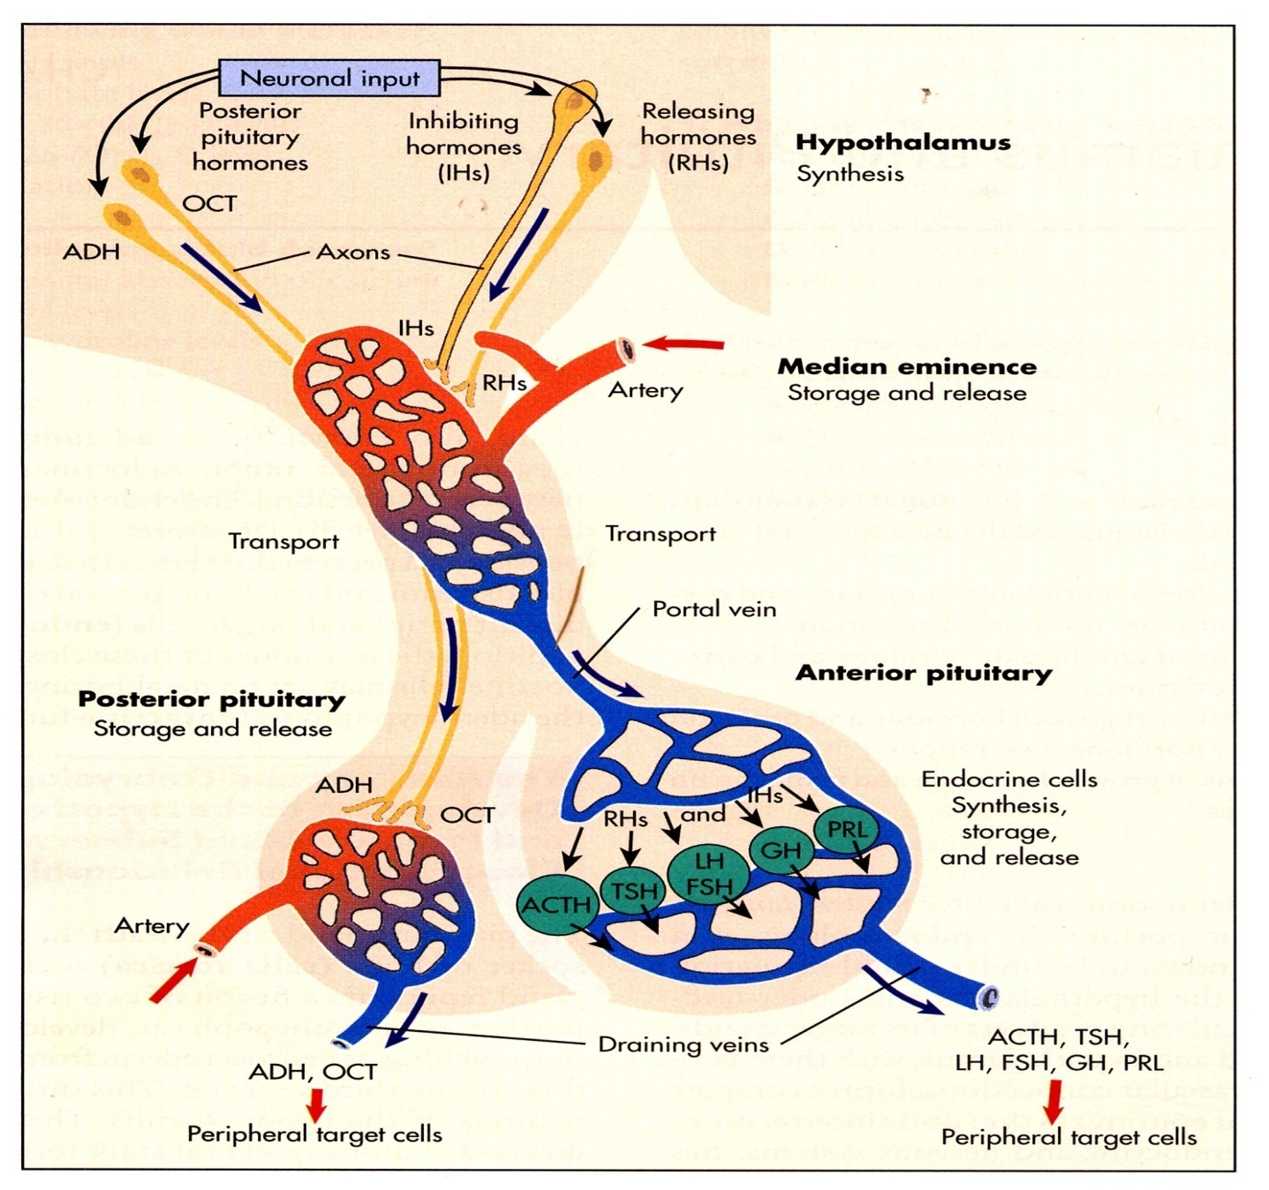
Somatostatin hormone
- It is a Growth hormone release inhibiting factor.
It has been located in tissues other than the hypothalamus e.g. the pancreatic islets.
When given parenterally it blocks the effect of TRH (thyrotropin releasing hormone) and suppresses the release of Growth hormone , prolactin , insulin and glucagon hormones .
The physiological role of this extraordinary substance is uncertain.

Slide 5
Adenohypophysis (Anterior pituitary )
-It is composed of three types of cells :
1-Chromophobes: (50% of all cells)
It is the precursor cells of either alpha or beta cells.
2- Acidophils (alpha cells): (40% of all cells)
It produces :- Growth hormone.(GH) -Prolactin or Luteotropic hormone(LTH)
3-Basophils (Beta cells): (10% of all cells)
It produces : - Thyrotropin (TSH)
- Corticotropin (ACTH)
- Luteinizing H.(LH)
- Follicle stim­ulating H. (FSH)

Slide 6
Functions and Regulation of Adeno-hypophyseal Hormones
1-Thyroid stimulating hormone (TSH):
Functions: 1-It stimulates the development of the thyroid structure and function.
2 -It also stimulates the process of thyroxin formation (iodide trap, iodination of tyrosine, release of T3,4).
Control:
a- Negative Feedback Mechanism: between T3-T4 and TSH pituitary secretion and thyrotropin releasing factor from the hypothalamus.
b-Thyrotropin releasing factor is stimulated mainly by neural reflexes.
2.Adrenocorticotrophic hormone (ACTH) -Corticotropin :
Functions: 1- It stimulates the development of the adrenal cortex structure and function except Zona glomerulosa..
2- It stimulates the formation and secretion of all the adrenal cortex hormones except aldosterone hormone .
3- It has a fat mobilizing effect and a melanocyte-stimulating effect.
Control:
a- Feedback mechanism : increase in adrenocortical hormones level in blood → inhibits ACTH secretion directly on the anterior pituitary and reflexly through inhibition of the hypothalamus.
b- Neural Stresses : emotional excitement, pain and fear stimulate the hypothalamus to secrete corticotropin - releasing factor to stimulate ACTH secretion . Circulatory stresses as haemorrhage and surgical trauma stimulate the anterior pituitary directly .

Slide 7
c- ADH (vasopressin) stimulates corticotrophin release from the adenohypophysis ,which it reaches via the hypothalamo- hypophyseal portal system .
3. Gonadotrophins:
Two hormones are secreted from the anterior pituitary to regulate the ovarian and testicular activity :
Functions:
A- Follicle-stimulating hormone:
In Females : It stimulates the growth and maturation of Graafian follicle and secretion of oestrogen from it .
In Males : It stimulates spermatogenesis.

Slide 8
B-Luteinizing hormone (LH) or interstitial cell stimulating hormone:
In Female : It stimulates maturation and ovulation and formation of corpus luteum and secretion of progesterone.
In Male : It stimulates the interstitial cells of Leydig and secretion of testosterone hormone .
Control :
a- Feedback mechanism :
-Small and moderate doses of oestrogen stimulate FSH secretion while large dose of oestrogen inhibits FSH secretion. .
- Moderate dose of oestrogen stimulates LH secretion.
- Increase in progesterone level in blood inhibits LH secretion and vice versa (as in normal ovulatory cycle).
b- Hypothalamus : It secretes Gonadotropin-releasing factor (LH-FSH-Releasing factor) . Fear of pregnancy in girls and emotional upsets inhibit the releasing factors → inhibit FSH and LH secretion → stoppage of menstrual cycle .

Slide 9
4. Lipotrophin:
- It is a large polypeptide in alpha and beta form released from the ACTH secreting cells of the anterior pituitary .
The Lipotrophin contains within it melanocyte stimulating hormone (MSH) and Endorphins.
Functions of Lipotrophin and the endorphins are unknown but endorphins are so called because of their endogenous morphine like action on the brain .

Slide 10
5. Growth hormone (GH) Somatotropin H.
It is a polypeptide hormone formed of 191 amino acids with a molecular weight of 22,000. The growth hormone is metabolized rapidly in the liver which is responsible for its duration of action (20 minutes) .
Functions: This hormone stimulates growth of all tissues of the body . It increases the size and number of the cells by :
Increase in the rate of protein synthesis :
Adequate Insulin activity as well as adequate availability of carbohydrates necessary for growth hormone to be effective.
It enhance amino acids transport through the cell membrane.
It increases amino acids concentration for protein building and it decreases amino acid blood level .
It also causes enhancement of RNA translation to promote protein synthesis by the ribosomes.
Moreover , it increases nuclear transcription DNA to form RNA This inturn promotes more protein synthesis.

Slide 11
2- Lipolytic and Ketogenic effect :
It increases mobilization of fatty acids and increases the use of fatty acids for supplying energy to the body. So, excess hormone → ketosis
3- Decreases the utilization of carbohydrate for energy :
It decreases the use of glucose for energy production as a result of increased utilization of fatty acids for energy. The fatty acids for a large quantities of acetyl-CoA that initiate -ve feedback effects to block the breakdown of glucose.
It depresses the uptake of glucose by the cells , so it increases the blood glucose level up to 100% above normal (diabetogenic effect - pituitary diabetes) .
It increases insulin output (over stimulation) that causes burn out of the beta cells of the pancreas.
It increases hepatic glucose output.
It inhibits the hexokinase enzyme (effect opposite to insulin effect) and so, it inhibits glucose uptake by the muscles.

Slide 12
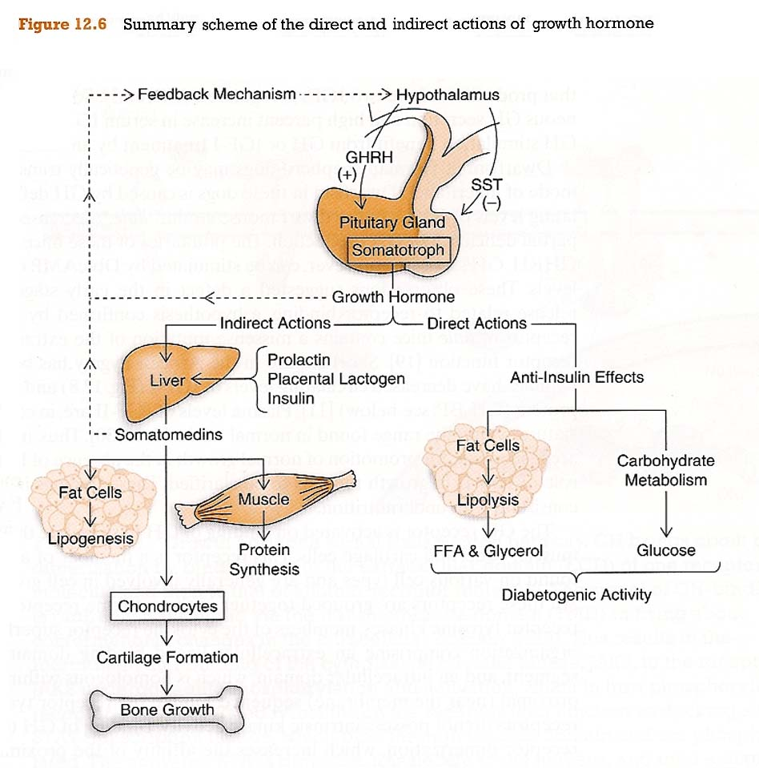
4- It increases calcium absorption from the G.I.T.
5- It causes reabsorption of Na+ , K+, Ca++, P04--, and C1- from the kidney and so , helping bone matrix formation.
6-Chondrogenesis and Bone Growth :
- In young subjects in which the epiphysis have not yet fused to the long bones , growth hormone stimulates chondrogenesis (proliferation of epiphyseal cartilage), and as the cartilaginous epiphyseal plates widen, they lay down more matrix at the end of long bones with stimulation of osteoblastic activity (bone forming cells) → increased length of long bones.
- In adult subjects in which the epiphysis are closed the linear growth is impossible.

Slide 13
Control:
1-Feedback Mechanism: Hypoglycaemia and increased amino acid concentration in blood, especially Arginine , stimulate the release of G.H. . It is also released by muscular exercise, stress stimuli and glucagon hormone.
Growth hormone feeds back to inhibit its own secretion and it is also inhibited by cortisol , free fatty acids and medroxy-progesterone .
2-Hypothalamus: It secretes a Somatotropin- releasing factor which stimulates the release of G.H.. Cellular depletion of proteins is the major factor that enhances SRF secretion (to correct the protein deficiency) beside stressful stimuli.
- The hypothalamus also release an inhibitory factor.
Mode of Action of Growth Hormone :
The mode of action of G.H. is by acting on the liver to produce Somatomedins (or sulfation factor, as it stimulates the incorporation of sulfate into the cartilage), These are relatively simple peptides (Growth H. is a 191 amino acid polypeptlde) which induce growth promoting activities in many tissues and cartilage with a prolonged duration of action (20 hours).

Slide 14
Thank You

