Slide 1
The Adrenal Glands
A paired endocrine organs; the cortex & medulla

Slide 2
Adrenal Cortex
Synthesizes three different types of steroids:
Glucocorticoids (cortisol), zona fasciculata, zona reticularis (small contribution)
Mineralocorticoids (aldosterone) zona glomerulosa
Sex steroids (estrogens and androgens), zona reticularis

Slide 3
ADRENOCORTICAL HYPERFUNCTION
Three distinctive hyper adrenal clinical syndromes:
Cushing syndrome: an excess of cortisol.
Hyperaldosteronism: an excess of mineralocorticoid.
Adrenogenital or virilizing syndromes: an excess of androgens.

Slide 4
Cushing Syndrome
1
Definition: Hypercortisolism; ↑↑↑glucocorticoid levels.
Causes:
Exogenous (The vast majority of cases): administration of glucocorticoids (iatrogenic).
Endogenous, the three most common disorders are:
Primary hypothalamic-pituitary diseases, ass with hypersecretion of ACTH
Secretion of ectopic ACTH by nonpituitary neoplasms
Primary adrenocortical neoplasms (adenoma or carcinoma) &, rarely, primary cortical hyperplasia.

Slide 5
Cushing Syndrome
1
1.Primary hypothalamic-pituitary disease ass/w hypersecretion of ACTH (Cushing disease)
70% of spontaneous, endogenous Cushing syndrome.
Women are affected four times higher than men.
Young adults 20s & 30s are most frequently affected.
ACTH-producing microadenoma is the cause in the vast majority

Slide 6
Cushing Syndrome
1
1.Primary hypothalamic-pituitary disease ass/w hypersecretion of ACTH (Cushing disease)
Mostly there is a microadenoma & rarely, the anterior pituitary contains areas of corticotroph cell hyperplasia without a discrete adenoma.
Hyperplasia may be primary or, much less commonly, secondary to hypothalamic corticotrophin-releasing hormone (CRH)–producing tumor.
Secondary to the elevated levels of ACTH (“ACTHdependent”Cushing syndrome). → Adrenal cortical hyperplasia → hypercortisolism.

Slide 7
Cushing Syndrome
1
2. Secretion of ectopic ACTH by nonpituitary tumors (Paraneoplastic syndrome)
10% of cases of Cushing syndrome.
Mostly the tumor is a small-cell carcinoma of the lung.
Other neoplasms; carcinoids, medullary carcinomas of the thyroid, & others.
Occasional neuroendocrine neoplasms produce ectopic CRH → causes ACTH secretion → hypercortisolism.

Slide 8
Cushing Syndrome
1
3. Primary adrenal neoplasms
Adrenal adenoma, carcinoma, and rarely, primary cortical hyperplasia responsible for 15-20% of endogenous Cushing syndromes.
Designated ACTH-independent Cushing syndrome, because the adrenals function autonomously.
Adrenal Cushing syndrome: ↑↑ cortisol levels & ↓↓serum levels of ACTH.
Caused by a unilateral adrenocortical neoplasm.

Slide 9
Cushing Syndrome Morphology
1
Morphologic changes in the adrenal glands also depend on the cause of the hypercortisolism and include:
(1) Cortical atrophy,
(2) Diffuse hyperplasia,
(3) Macronodular or micronodular hyperplasia,
(4) An adenoma or carcinoma.

Slide 10
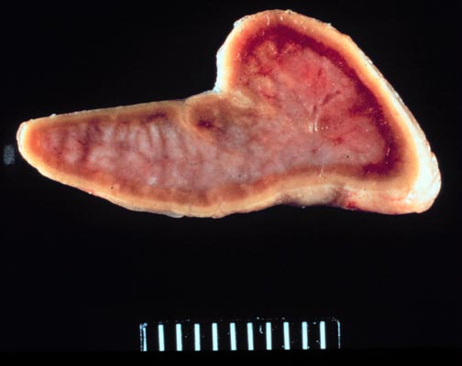
Morphology - Cortical atrophy
Cushing Syndrome
1
Syndrome results from exogenous glucocorticoids → suppression of endogenous ACTH → bilateral cortical atrophy, due to a lack of stimulation of zona fasciculata and zona reticularis by ACTH

Slide 11
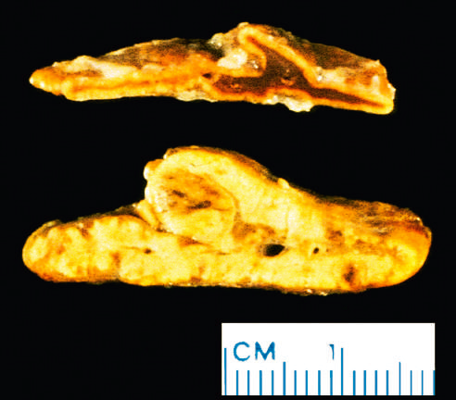
Morphology - Diffuse hyperplasia
Cushing Syndrome
1
ACTHdependent Cushing syndrome.
Both glands are enlarged, each weighing up to 30 g.
Cortex is diffusely thickened w subtle nodularity.
Yellowish in color→ presence of lipid-rich cells→ appear vacuolated under the microscope.

Slide 12
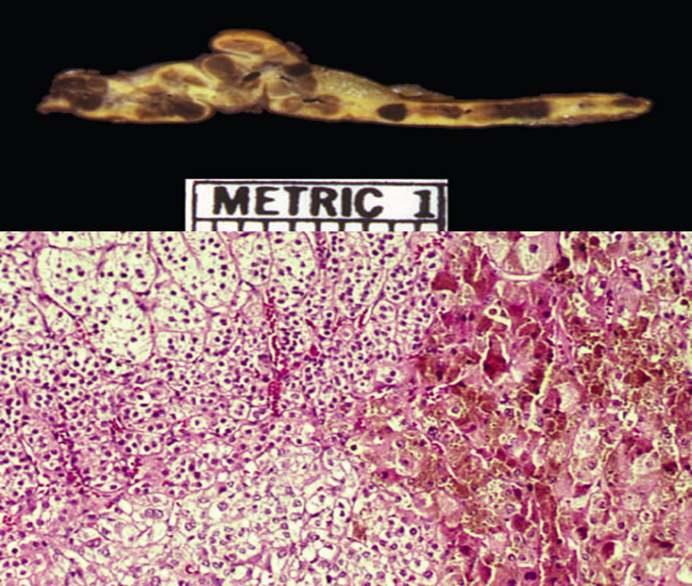
Morphology - Nodular hyperplasia
Cushing Syndrome
1
In primary cortical hyperplasia, the cortex is replaced almost entirely by macronodules or 1- to 3-mm darkly pigmented micronodules
The pigment is believed to be lipofuscin, a wear-and-tear pigment

Slide 13
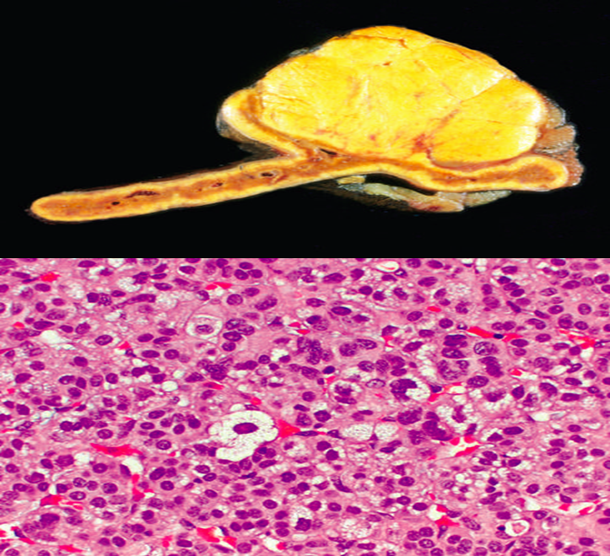
Morphology - Adenoma or carcinoma
Cushing Syndrome
1
Both are more common in women in their 30s -50s.
Only definitive criteria for malignancy are distant metastasis or local Invasion.
Functioning tumors, both benign & malignant, causes adjacent adrenal cortex & contralateral adrenal gland are atrophic.

Slide 14
Clinical Features
Cushing Syndrome
1
Represent an exaggeration of glucocorticoids known actions.
Develops gradually & may be quite subtle in early stages.
A major exception is Cushing syndrome ass/w lung small cell Carcinoma.

Slide 15
Clinical Features - Hypertension
Cushing Syndrome
1
Selective atrophy of fast-twitch (type II) myofibers→ ↓↓ muscle mass→ proximal limb weakness.
Induce gluconeogenesis + inhibit glucose uptake by cells → secondary diabetes.(hyperglycemia, glucosuria,& polydipsia)

Slide 16
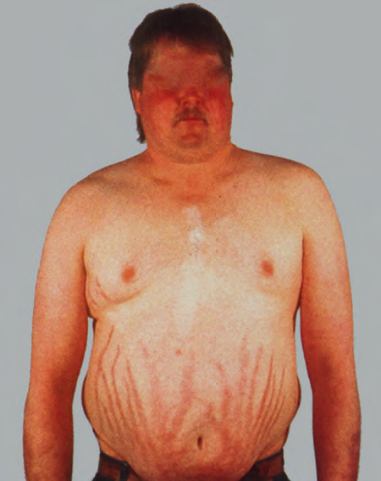
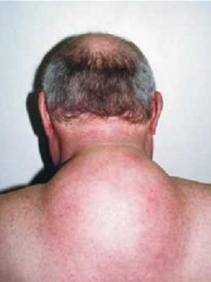
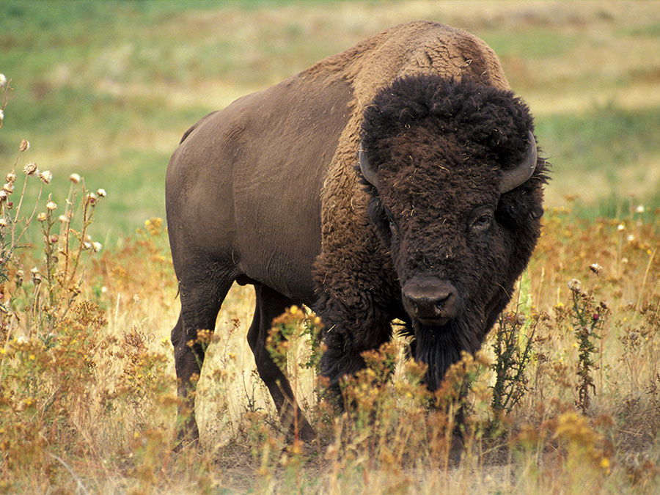
Clinical Features - weight gain
Cushing Syndrome
1
characteristic centripetal redistribution of adipose tissue becomes apparent with time → truncal obesity, “moon facies” & accumulation of fat in the posterior neck and back “buffalo hump”.

Slide 17
Clinical Features - other
Cushing Syndrome
1
Catabolic effects of insulin resistance on proteins→ loss of collagen→ skin is thin, fragile, & easily bruised cutaneous striae (common in abdominal area)
Cortisol → resorption of bone → development of Osteoporosis → ↑↑ susceptibility to fractures.
Glucocorticoids suppress immune response→ ↑↑ risk for a variety of infections
hirsutism
menstrual abnormalities.
psychiatric symptoms
Cushing syndrome caused by pituitary or ectopic ACTH secretion ass/ with skin pigmentation 2ndary to melanocyte-stimulating activity in the ACTH precursor molecule.

Slide 18
Hyperaldosteronism
2
Definition: A group of conditions characterized by chronic ↑↑↑ aldosterone secretion.
Hyperaldosteronism may be primary, or secondary to an extra-adrenal cause:
Primary: Autonomous overproduction of aldosterone with resultant suppression of the renin-angiotensin system & decreased plasma renin activity.
Secondary: Aldosterone release occurs in response to activation of the renin-angiotensin system.

Slide 19
Bilateral idiopathic hyperaldosteronism
Primary hyperaldosteronism
2
Bilateral nodular hyperplasia of the adrenal glands.
The most common underlying cause of primary hyperaldosteronism, 60% of cases.
The pathogenesis is unclear (idiopathic),a subset harbors germline mutations in the KCNJ5 gene → encodes a potassium channel protein that is expressed in the adrenal gland.

Slide 20
Adrenocortical neoplasm
Primary hyperaldosteronism
2
An aldosterone-producing adenoma (most common cause) or, rarely, an adrenocortical carcinoma.
35% of primary hyperaldosteronism is caused by a solitary aldosterone-secreting adenoma (Conn syndrome)
Somatic mutations of KCNJ5 are also present in a subset of aldosteron sesecreting adenomas.

Slide 21
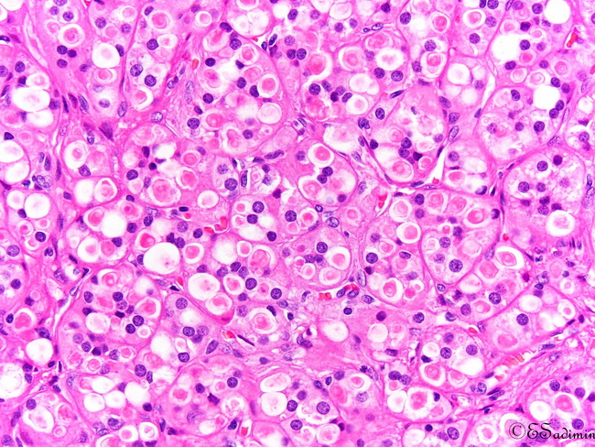
Adrenocortical neoplasm -Adenoma
Primary hyperaldosteronism
2
Solitary,small (<2 cm)
Composed of lipid-laden cells more resembling fasciculata cells than glomerulosa cells.
Aldosterone-producing adenomas has eosinophilic, cytoplasmic inclusions (spironolactone bodies) → treatment with spironolactone(drug of choice in primary hyperaldosteronism)

Slide 22
Familial hyperaldosteronism
Primary hyperaldosteronism
2
Rare, genetic defect that leads to overactivity of the aldosterone synthase gene.

Slide 23
Secondary hyperaldosteronism
2
Activation of renin-angiotensin system → aldosterone release.
Characterized by ↑↑ levels of plasma renin, encountered in ass with:
Decreased renal perfusion (arteriolar nephrosclerosis,renal artery stenosis)
Arterial hypovolemia & edema (congestive heart failure, cirrhosis, nephrotic syndrome)
Pregnancy (caused by estrogen-induced increases in plasma renin substrate)

Slide 24
Clinical Features
Hyperaldosteronism
2
The most important clinical consequence of hyperaldosteronism is hypertension.
Primary hyperaldosteronism may be the most common cause of 2ndary hypertension.
Hypertension & its long-term effects; left ventricular hypertrophy, & an increase in the prevalence of adverse events (stroke & myocardial infarction
Hypokalemia due to renal K+ wasting. Can cause neuro-muscular Manifestations; weakness, paresthesia, visual disturbances, & occasionally frank tetany.

Slide 25
Adrenogenital Syndromes
3
Definition: A group of disorders caused by androgen excess
May stem from: (Origin)
(1) Primary gonadal disorders
(2) Primary adrenal disorders.
Unlike gonadal androgens, adrenal androgen is regulated by ACTH → excessive secretion can present as an isolated syndrome or in combination with Cushing disease features.
The adrenal causes of androgen excess:
(1) Adrenocortical neoplasms (mentioned earlier)
(2) Congenital adrenal hyperplasia (CAH), uncommon group

Slide 26
Congenital adrenal hyperplasia (CAH).
3
AR disorders, each characterized by a hereditary defect in an enzyme involved in adrenal steroid biosynthesis (cortisol).
↓↓↓cortisol→ compensatory ↑↑↑ ACTH due to absence of feedback inhibition→ adrenal hyperplasia →↑↑↑ production of cortisol precursor steroids → channeled into synthesis of androgens → virilizing activity
Certain enzyme defects also may impair aldosterone secretion, adding salt loss to the virilizing syndrome.
The most common enzymatic defect is 21-hydroxylase deficiency ( > 90% of cases)

Slide 27
Congenital adrenal hyperplasia (CAH).
3
21-hydroxylase deficiency
Deficiency may range from a total lack to a mild loss, depending on the nature of the mutation.
In the adrenal glands cortisol, aldosterone & sex steroids are synthesized from cholesterol through various intermediates.
21-hydroxylase is required for synthesis of cortisol & aldosterone but not sex steroids.
So, a deficiency of it will (1) reduces cortisol & aldosterone synthesis & (2)shunts the common precursors into the sex steroid pathway.

Slide 28
CAH - Clinical Features
3
Depending on the nature & severity of the defect clinical symptoms:
occur in perinatal period, later childhood, or (less commonly) adulthood.
with or without aldosterone & glucocorticoid def.

Slide 29
CAH - Clinical Features
3
In 21-hydroxylase deficiency, ↑↑↑ androgenic activity causes:
Masculinization in females: clitoral hypertrophy & pseudohermaphroditism in infants.Oligomenorrhea, hirsutism, & acne in postpubertal girls.
In males, androgen excess is ass/w enlargement of the external genitalia & precocious puberty in young patients. Most men with CAH are fertile but some have oligospermia.
one-third has Aldosterone deficiency,
CAH should be suspected in any neonate with ambiguous genitalia

Slide 30
ADRENOCORTICAL INSUFFICIENCY
Caused by either primary adrenal disease (primary hypoadrenalism) or decreased stimulation resulting from ACTH deficiency (secondary hypoadrenalism).
Primary adrenocortical insufficiency may be:
Acute (Adrenal crisis)
chronic (Addison disease)

Slide 31
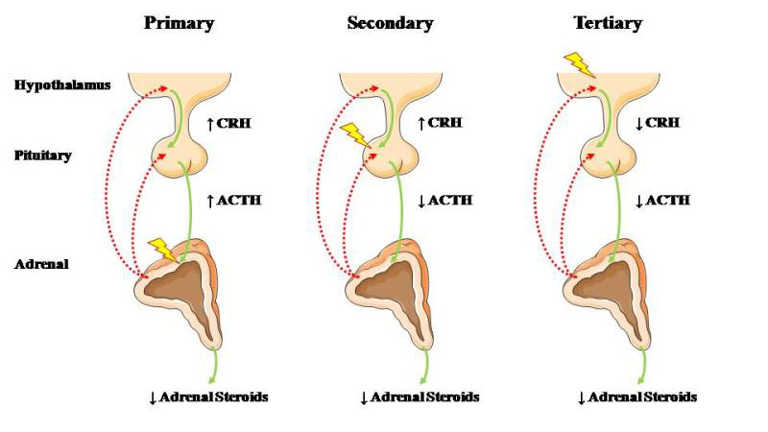
ADRENOCORTICAL INSUFFICIENCY

Slide 32
Adrenal Crisis
1
Definition: Acute adrenocortical Insufficiency
Three clinical settings:
Individuals with chronic adrenocortical insufficiency may develop an acute crisis after stress that taxes their limited physiologic reserves.
Patients maintained on exogenous corticosteroids after rapid withdrawal of steroids → inability of the atrophic adrenals to produce glucocorticoids.

Slide 33
Adrenal Crisis
1
Massive adrenal hemorrhage may destroy enough of the adrenal cortex to cause acute adrenocortical insufficiency, causes:
Patients maintained on anti-coagulant therapy.
Postoperative patients who develop disseminated intravascular coagulation DIC.
Patients with overwhelming sepsis (Waterhouse-Friderichsen syndrome): more common in children, endotoxin effect ?

Slide 34
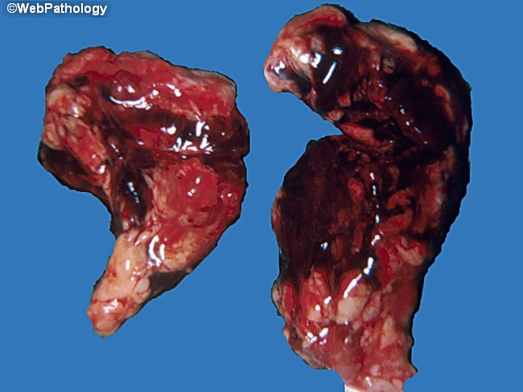
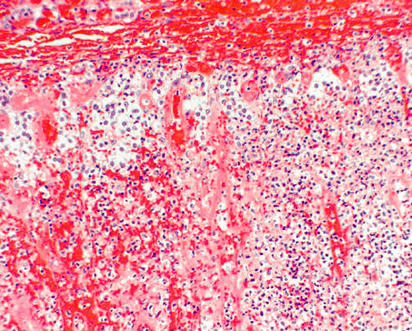
Waterhouse Friderichsen syndrome
Adrenal Crisis
1

Slide 35
Addison Disease
2
Definition: Chronic Adrenocortical Insufficiency
An uncommon disorder resulting from progressive destruction of the adrenal cortex.
90% of cases are caused by four disorders:
Autoimmune adrenalitis.
Tuberculosis.
The acquired immune deficiency syndrome (AIDS).
Metastatic cancer

Slide 36
Addison Disease
2
Autoimmune adrenalitis
60% to 70% of cases.
The most common cause of primary adrenal insufficiency in developed countries.
Autoimmune destruction of steroid-producing cells, & autoantibodies to several key steroidogenic enzymes.
Tuberculosis
Tuberculous adrenalitis used to cause 90% of Addison disease, now less common with improved anti-tuberculosis therapy

Slide 37
Addison Disease
2
Acquired immune deficiency syndrome
AIDS patient are at risk to develop adrenal insufficiency from several other infectious (cytomegalovirus, Mycobacterium avium-intracellulare) & noninfectious (Kaposi sarcoma) complications of their disease.
Metastatic cancer
Can destroy sufficient adrenal cortex to produce a degree of adrenal insufficiency.
Most commonly carcinomas of lung & breast

Slide 38
Addison Disease
2
Clinical Manifestation do not appear until at least 90% of the adrenal cortex has been compromised
Initially Nonspecific
Progressive weakness & easy fatigability
GI disturbances
Anorexia, nausea, vomiting,& diarrhea.
Decreased aldosterone
Hyperkalemia, hyponatremia, volume depletion, & hypotension
In Primary only → ACTH doesn't affect aldosterone

Slide 39
Addison Disease
2
Clinical Manifestation do not appear until at least 90% of the adrenal cortex has been compromised
Hypoglycemia
A result of glucocorticoid deficiency & impaired gluconeogenesis.
More common in infants and children than adults
Hyperpigmentation
In primary adrenal Insuff., due to increased levels of ACTH precursor hormone.
Face, axillae, nipples, areolae, & perineum

Slide 40
Adrenal Medulla
Distinct from the cortex. It is cells derived from the neural crest
Populated by chromaffin cells & their supporting sustentacular cells.
Synthesize & secrete
catecholamines in
response to signals from
sympathetic nervous system

Slide 41
Pheochromocytoma
Neoplasms composed of chromaffin cells & synthesize & release catecholamines.
Give rise to a surgically correctable form of hypertension.
Pheochromocytomas usually subscribe to “rule of 10s”:
10% of pheochromocytomas are extraadrenal sites (organ of Zuckerkandl & carotid body) → called paragangliomas,
10% of adrenal pheochromocytomas are bilateral; may rise to 50% in cases ass/w familial syndromes.
10% of adrenal pheochromocytomas are malignant.
10% are familial (changed .. Now 25% are familial)

Slide 42
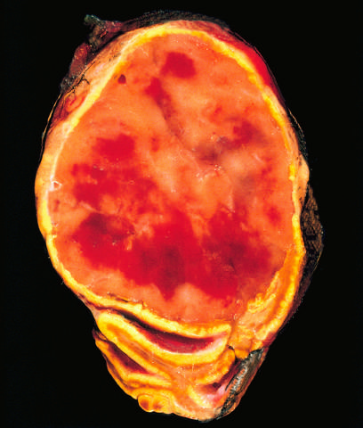
Pheochromocytoma
Grossly:
Can be small, circumscribed
lesions or large, hemorrhagic masses weighing several kilograms.
On cut surface, smaller lesions are yellow-tan. Larger lesions tend to be hemorrhagic, necrotic.

Slide 43
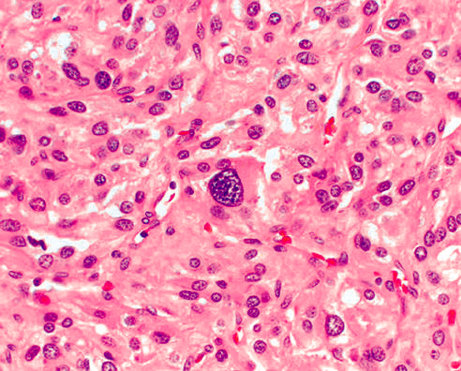
Pheochromocytoma
Microscopically:
Pheochromocytomas are composed of polygonal to spindle chromaffin cells & supporting cells compartmentalized into small nests, by a rich vascular network.
Cytoplasm has a finely granular appearance → presence of catecholamines granules
Nuclei are often pleomorphic.

Slide 44
Pheochromocytoma - Clinical features
The dominant clinical manifestation of pheochromocytoma is hypertension, in 90% of patients.
The cardiac complications and sudden cardiac death due to → catecholamine cardiomyopathy, or catecholamine induced myocardial instability and ventricular arrhythmias.
Isolated benign pheochromocytomas are treated with surgical excision.
Multifocal lesions → long-term medical treatment for hypertension may be required.

