Slide 1
Pediatric Malignancies
Presented by: Saja Zuaiter
Hammam Al Tarawneh
Supervised by : Dr Ahmad Odeh

Slide 2
Neuroblastoma

Slide 3
Neuroblastoma
The median age is 22 month ^^ 5 or younger ^^
Its an embryonal malignancy
is a malignant neuroendocrine tumor of the sympathetic nervous system that originates from neural crest cells potentially secretes catecholamines, and is usually found in the adrenal glands or sympathetic ganglia..
most common childhood malignancy
leukemias
brain and other CNS tumors
lymphomas
neuroblastoma
kidney tumors
malignant bone tumors
# fourth most common childhood malignancy.
Is the most common extracranial solid tumor of childhood (8-10%).
The most common malignancy in infancy.

Slide 4
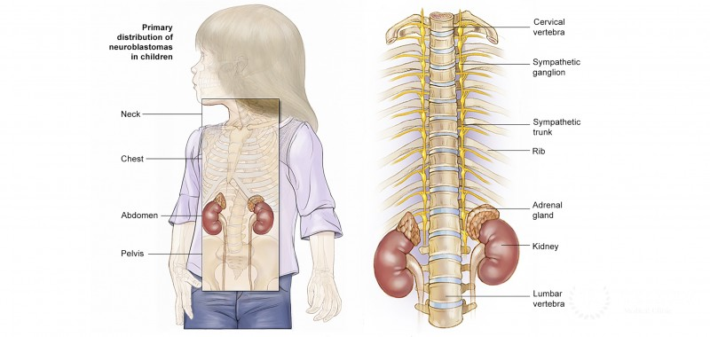
Given its origin, neuroblastoma can occur in any aggregation of sympathetic nervous tissue, including the adrenal glands, the sympathetic chain, and the paraganglia (e.g., the carotid body).
but the classical presentation is an abdominal suprarenal mass.
- Adrenal glands (45%)
Retroperitoneal sympathetic ganglia (25%)
Paravertebral ganglia of chest (15%)
Neck (5%)
- Pelvic sympathetic (5%)

Slide 5
Clinical features The clinical presentation is mainly determined by the site of the primary tumor, if it secretes catecholamines, and whether it has metastasized.
General symptoms
Failure to thrive or weight loss
Fever
Nausea, vomiting, loss of appetite
Hypertension
Localized symptoms
Location of primary tumors | Associated signs and symptoms
Abdomen | Palpable, firm, irregular abdominal mass that may cross the midline (in contrast to nephroblastoma, which is smooth and usually does not cross the midline) Abdominal distension and pain Hepatomegaly Constipation
Chest : particularly paravertebral ganglia | Spinal cord compression → back pain, weakness, numbness, ataxia, loss of bowel or bladder control Dyspnea, cough Inspiratory stridor
Neck | Horner syndrome *if the stellate ganglion is involved Symptoms due to spinal cord compressions

Slide 6
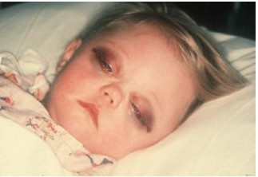
Location of metastases | Associated signs and symptoms
Orbit of the eye | Periorbital ecchymoses (“raccoon eyes”) Proptosis
Bones | Bone pain Anemia (bone marrow suppression)
Skin | Subcutaneous nodules
Paraneoplastic effects:
vasoactive intestinal peptide secreting tumors and opsoclonus myoclonus syndrome.

Slide 7
Laboratory/Imaging Studies
CBC
X-ray: Calcification within abdominal
urinary catecholamines: About 90% of neuroblastomas produce catecholamines (Vanillylmandelic acid; Homovanillic acid)
A computed tomography (CT) scan of the chest, abdomen, and pelvis;
Metaiodobenzylguanidine “MIBG” scan;
Bilateral bone marrow aspiration and biopsies;
Definitive diagnosis of neuroblastoma requires tissue biopsy

Slide 8
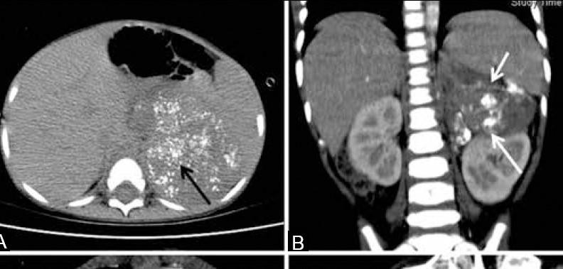
The mass often contains calcification and hemorrhage that can be appreciated on plain radiography or CT.
a left supra-renal mass with typical stippled calcifications (arrow in A) and a mass with calcifications (arrow in B) displacing the left kidney inferiorly.
Treatment is determined mainly by patient age at the time of diagnosis, clinical stage,
.
Spontaneous remission may occur even in cases of metastatic disease.

Slide 9
International Neuroblastoma Staging System (INSS) ^{[13]}
Stage | Definition
1 | Localized tumor Complete gross excision with or without microscopic residuals Negative ipsilateral lymph nodes
2A | Localized tumor Incomplete gross excision Negative ipsilateral lymph nodes
2B | Localized tumor Complete or incomplete gross excision Positive ipsilateral lymph nodes
3 | Unresectable unilateral tumor that crosses the midline with or without lymph node involvement Any tumor with positive contralateral lymph nodes Midline tumor with bilateral tumor or lymph node involvement
4 | Any tumor with dissemination to distant lymph nodes or other organs (e.g., bone, liver, skin), with the exception of Stage 4S disease
4S | Localized primary tumor with dissemination to skin, liver, or bone marrow, occurring in infants < 12 months

Slide 10
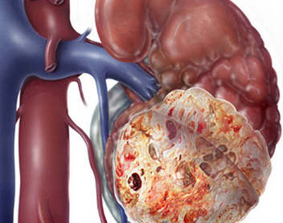
Wilms Tumor

Slide 11
Wilms tumor also known as nephroblastoma, is the second most common malignant abdominal tumor in children after neuroblastoma.
The mean age of diagnosis is 3 to 3.5 years of age.
Histology determines the prognosis and treatment

Slide 12
Etiology
The exact etiology of nephroblastoma remains unknown, but it is associated with several genetic mutations and syndromes.
Genetic Predisposition
Associated with loss of function mutations of tumor suppressor genes on chromosome 11: WT1 (wilms tumor 1) & WT2 gene
Leads to abnormal proliferation of the metanephric blastemal cells (primitive embryologic cells of the kidney).

Slide 13
2. Associated Syndromes
A- WAGR syndrome: due to deletion of WT1 on chromosome 11
- Nephroblastoma
-Aniridia
-Genitourinary anomalies (pseudohermaphroditism, undescended testis)
- intellectual disability

Slide 14
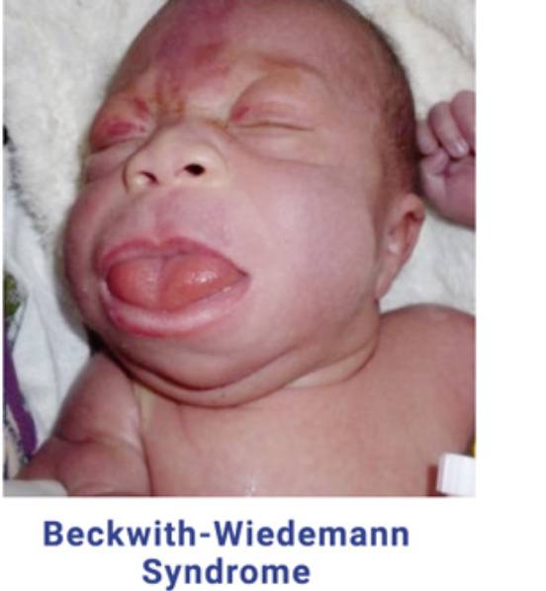
B- Denys-Drash Syndrome
C- Beckwith-Wiedmann (Fetal overgrowth syndrome )
mutation of WT2 gene mutations in short arm of chromosome11, that leads to overactivity of the IGF-2 gene
Presented with hyperinsulism, neonatal hypoglycemia, macrosomia, macroglossia, omphalocele, visceromegaly, hemihyperplasia, embryonal tumors
1- diffuse mesangial sclerosis
2- Wilms tumor
3- pseudohermaphroditism (gonadal dysgenesis)

Slide 15
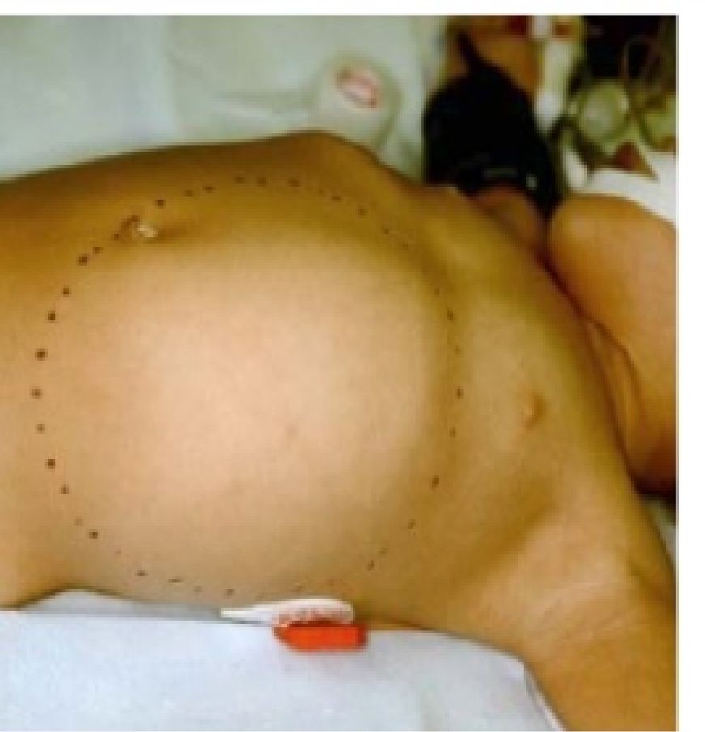
Clinical Features
Large flank, palpable abdominal mass (often found incidentally) and rarely invasive
Non-tender
Unilateral, not crossing midline
Smooth and firm
Other signs and symptoms
Hematuria
Hypertension
Symptoms caused by metastic spread (most common pulmonary symptoms)

Slide 16
Diagnosis Imaging
Ultrasound (best initial test)
Shows vascular infiltrations and hydronephrosis
Differentiates between cystic and solid masses
With doppler: evaluates the collecting system and demonstrate intravascular spread and tumor thrombi in the renal veins and IVC
Abdominal CT (claw sign)
To assess location and extent of involvement
Surgical planning
CT thorax/CXR
To detect lung metastasis

Slide 17
National Wilms Tumor Study (NWTS) system
Stage | Tumor location | Tumor spread | Surgery
I | Unilateral | Limited to the kidney No renal sinus vessel involvement | Complete resection with no tumor beyond the excision margins
II | Unilateral | Extends beyond kidney Renal capsule Soft tissue of the renal sinus Blood vessels beyond the renal parenchyma
III | Unilateral | Confined to the abdomen Dissemination in abdomen (e.g., regional lymph nodes, peritoneal involvement) | Incomplete resection with residual tumor remaining postoperatively (e.g., not resectable due to infiltration into vital structures)
IV | Unilateral | Hematogenous metastasis (e.g., lung, liver, bone, brain) Distant lymph nodes involvement (outside of abdomen)
V | Bilateral | Both kidneys are affected

Slide 18
Management
Treatment of nephroblastoma according to stage
Treatment |  | Stages I and II | Stages III and IV | Stage V (bilateral)
Surgery | Renal parenchymal-sparing resection | No |  | Yes
 | Nephrectomy | Yes |  | No
Chemotherapy | Preoperative chemotherapy | No |  | Yes
 | Doxorubicin | No | Yes
 | Dactinomycin and vincristine | Yes
Radiation |  | No | Possible | Yes

Slide 19
Summary

Slide 20
Ventral Wall Defects

Slide 21
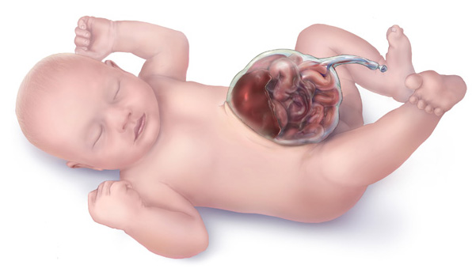
Omphalocele

Slide 22
Ventral wall defect that results in congenital herniation of abdominal viscera through the abdominal wall at the umbilicus.
Persistent herniation of the midgut derivatives due to impaired closure of the lateral umbilical folds
The hernia sac is covered by the amniotic membrane and the peritoneum.
Prognosis is dependent on the size of the defect and birth weight

Slide 23
Clinical Features
Most commonly affects premature infants
Umbilical hernia sac (may contain intestine, liver, and gallbladder)
Etiology
Frequently observed in trisomy (21,13,18) and Beckwith-wiedmann
Often associated with additional malformations (cardiac, gastrointestinal, genitourinary, and neural tube defects)

Slide 24
Diagnosis
Clinical diagnosis at birth
Can be detected prenatally
US: polyhydramnios in utero
↑ Maternal serum alpha fetoprotein
Management
Surgery (within the first 24 hours of life)
Usually primary abdominal wall closure
Larger defects require secondary closure:
- Staged silastic (silo) repair with serial reduction of size

Slide 25
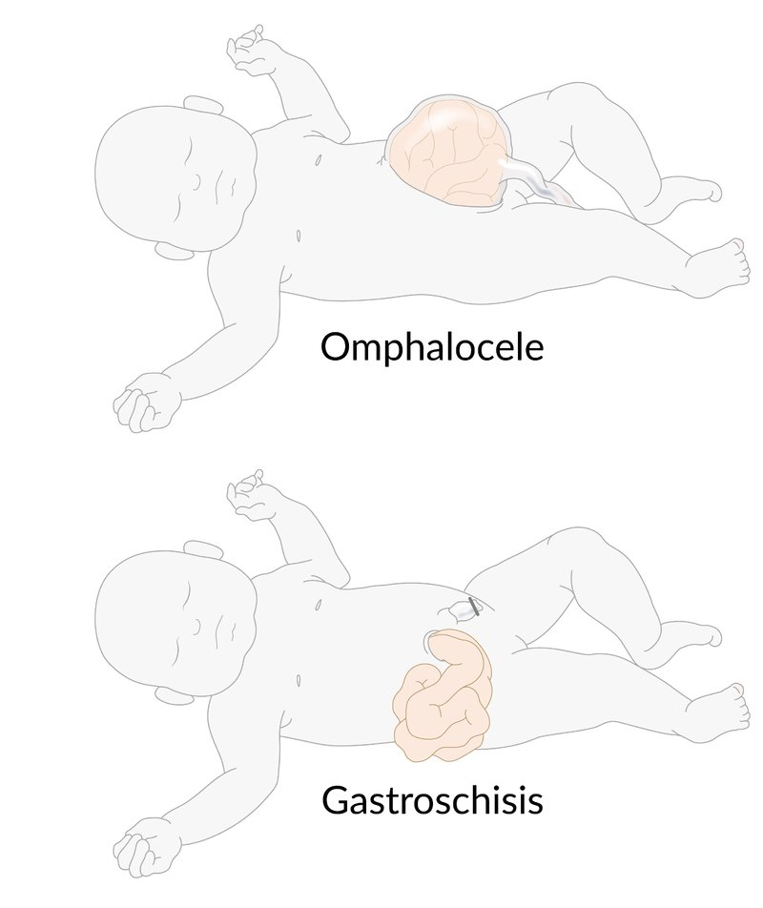
Gastroschisis

Slide 26
A ventral wall defect that results in paraumbilical herniation of the intestine through the abdominal wall without formation of a hernia sac
Failed formation of a sufficiently large peritoneal cavity → growing bowel leads to rupture of the anterior abdominal wall at its weakest point → herniation of bowel sections
Because the malformation occurs relatively late in development, additional anomalies are rarely present (in contrast to omphalocele)

Slide 27
Clinical features
-Protrusion of intestinal content usually on the right side of the umbilicus -The intestine is not contained in a hernia sac and appears edematous, erythematous, and dull. -Shortened bowel -Malabsorption caused by mucosal damage -Peritonitis -Seen especially in premature infants and associated with cryptorchidism and gastrointestinal stenoses or atresia Diagnosis Can be detected prenatally
Elevated AFP and acetylcholinesterase

Slide 28
Treatment
Emergency surgery (to avoid bowel damage)
Preoperatively: cover with bowel bag to prevent fluid and heat loss
Primary abdominal wall closure
Alternative: staged silo repair

Slide 29
Overview of abdominal wall defects
 | Omphalocele | Gastroschisis | Umbilical hernia
Description | A ventral wall defect that results in congenital herniation of abdominal viscera through the abdominal wall at the umbilicus | A ventral wall defect that results in paraumbilical herniation of the intestine through the abdominal wall, without formation of a hernia sac | A ventral wall defect with a protruding sac (possibly containing intestines) at the umbilicus
Pathophysiology | Persistent herniation of the midgut derivatives due to impaired closure of the lateral umbilical folds | Failed formation of a sufficiently large peritoneal cavity → growing bowel → rupture of the anterior abdominal wall at its weakest point → herniation of bowel sections | Failed spontaneous closure of the umbilical ring following physiological herniation of the midgut → patent umbilical orifice
Anatomy | Viscera (may also contain liver and gall bladder) herniate into the umbilical cord. The hernia sac is covered by amniotic membrane and peritoneum. | Protrusion of intestinal content usually on the right side of the umbilicus The intestine is not contained in a hernia sac. | The mass protrudes through the umbilicus. The hernia is covered by skin.
Associated conditions | Frequently observed in individuals with trisomies (trisomy 21, trisomy 18, and trisomy 13) and Beckwith-Wiedemann syndrome Often associated with additional malformations (e.g., cardiac, GI, genitourinary, and neural tube defects) | Additional anomalies are rarely present. | Incidence is more common in children with other congenital anomalies (e.g., trisomy 21, trisomy 18, congenital hypothyroidism).
Diagnostics | Clinical diagnosis
 | Can be detected prenatally Ultrasonography: polyhydramnios in utero ↑ MSAFP |  | Usually no further diagnostics necessary
Management | Wrapping of the hernia sac/free intestines with sterile saline dressings covered with plastic wrap Nasogastric suction IV fluids |  | Conservative: closes spontaneously by the age of 5 years
Surgery | Within the first 24 hours of life | Emergency surgery | Rarely necessary

Slide 30
Congenital Diaphragmatic Hernia
A congenital diaphragmatic hernia is a complex anomaly with a significant risk of death, principally due to lung hypoplasia.
The aim of postnatal ventilation strategies is to ameliorate this – whereas prenatal intervention seeks to reverse this in utero.

Slide 31
Embryology
Precursors of the diaphragm begin to form during the fourth week of gestation.
• The diaphragm develop from the fusion of four embryonic components:
- Anteriorly by the septum transversum
- Dorsolaterally by the pleuroperitoneal folds (PPFs)
- Dorsomedially by the crura from the esophageal mesentery
- Posteriorly by the body wall mesoderm
• The pleuroperitoneal membranes close and separate the pleural and abdominal cavities by the eighth week of gestation.
• The right side closes before the left

Slide 32
Inadequate closure of the pleuroperitoneal canal allows the abdominal viscera to enter the thoracic cavity when they return from the extraembryonic coelom to herniate into the chest.
As a result, pulmonary hypoplasia develops (decrease in bronchial divisions, bronchioles, and alveoli)
Affects the contralateral lung as well
The pulmonary arteries exhibit a decrease in density as well as an increase in muscularization (CDHASSOCIATED PULMONARY HYPERTENSION)

Slide 33
Prevalence of CDH: 2.3–2.4 per 10,000 live births
Male infants more common
90% are posterolateral or “Bochdalek”
- Left sided (80%)
- Right sided (19%)
- Bilateral (1%)
10% are located anteriorly, termed “Morgagni” hernias
60% of CDH cases are isolated, 40% associated with anomalies of the cardiovascular
(27.5%), urogenital (17.7%), musculoskeletal (15.7%), and central nervous (9.8%) (CNS) systems, GI system (atresia).

Slide 34
Diagnosis
PRENATAL DIAGNOSIS:
Approximately 50–70% of infants
Fetal US features include:
Polyhydramnios, intrathoracic fluid-filled bowel loops, mediastinal shift, and/or an intrathoracic stomach, spleen, or liver
The lung-to-head ratio (LHR) is a prenatal US assessment ratio, utilizing the contralateral lung area to the head circumference, which predicts CDH severity.
If the LHR is 1 or less, the prognosis is poor

Slide 35
Postnatal diagnosis
Chest radiograph:
- Intestinal loops within the hemithorax,
- Cephalad displacement of the stomach/orogastric tube
- Mediastinal shift toward the contralateral hemithorax
80% will be diagnosed within the first 24 hours of life
20% may present outside the neonatal period (These patients present with mild respiratory symptoms, chronic pulmonary infections, pleural effusions, pneumonias, feeding intolerance)

Slide 36
CLINICAL PRESENTATION
Respiratory distress:
tachypnea, chest wall retractions, grunting, cyanosis.
On physical examination:
- Scaphoid abdomen
- Increase in thoracic diameter
- The point of maximal cardiac impulse is often displaced
- Bowel sounds may be auscultated within the thoracic cavity
- Decrease in breath sounds bilaterally

Slide 37
Treatment
RESUSCITATION AND STABILIZATION:
- Prompt endotracheal intubation (without bag mask ventilation)
Initiation of conventional mechanical ventilatory support A nasogastric tube should be inserted to avoid gastric and intestinal distention .
Operative Repair
CDH is no longer considered an emergency procedure.
surgery is performed after cardiopulmonary stability(Low ventilator support with evidence of resolving pulmonary hypertension by echocardiogram)

Slide 38
Poor prognosis
-Large defect size
- Major congenital heart disease
- prematurity
- liver herniation
- LHR less than 1
- Right more than left

