Slide 1
Arterial Blood Gas
Interpretation
Associate Professor
Dr. Samah Shehata

Slide 2
OBJECTIVES
➢ ABG
Sampling
➢ Interpretation of ABG
▪ Oxygenation status
▪ Acid Base status
➢ Case
Scenarios

Slide 3
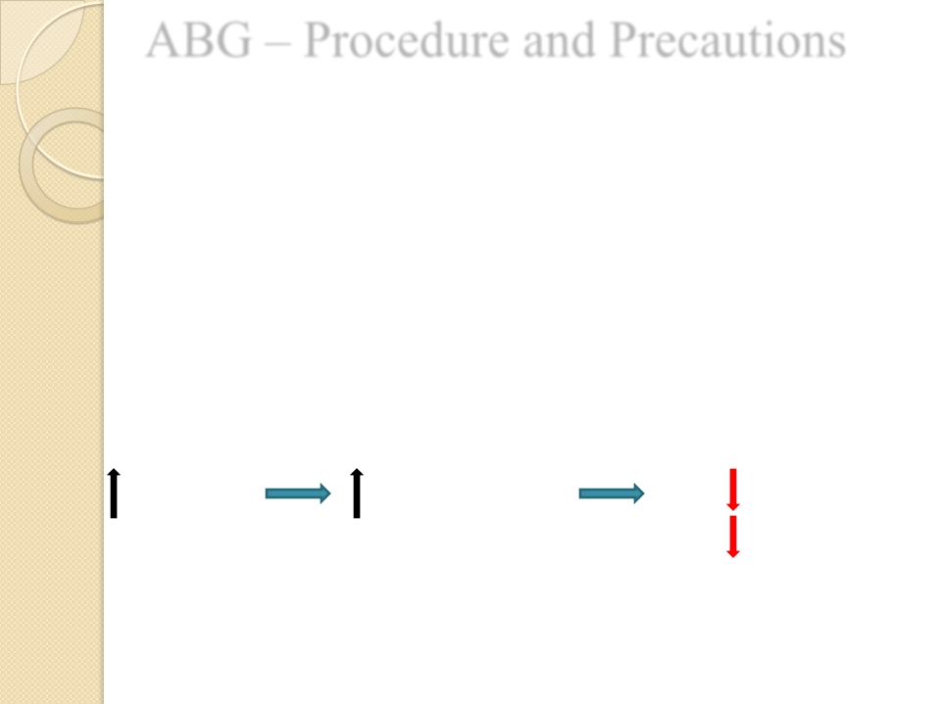
ABG – Procedure and Precautions
➢ Ideally - Pre-heparinised ABG syringes
- Syringe should be FLUSHED with 0.5ml
of 1:1000 Heparin solution and emptied.
DO NOT LEAVE EXCESSIVE HEPARIN IN THE
SYRINGE
HEPARIN DILUTIONAL HCO 3
EFFECT PCO 2
✓ Only small 0.5ml Heparin for flushing and discard it
✓ Syringes must have > 50% blood. Use only 2ml or less syringe
.

Slide 4
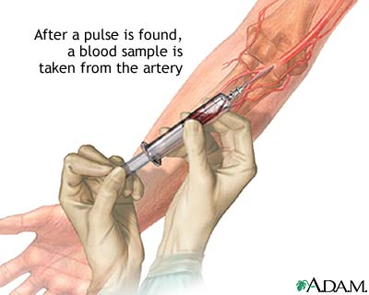
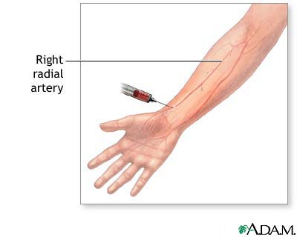
Sites for obtaining ABG
Radial artery ( most common )
Brachial artery
Femoral artery
Radial is the most preferable site used because:
It is easy to access
It is not a deep artery which facilitate palpation, stabilization and puncturing
The artery has a collateral blood circulation

Slide 5
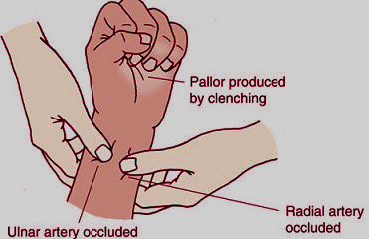
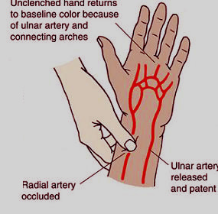
Allen’s test
It is a test done to determine that collateral circulation is present from the ulnar artery

Slide 6
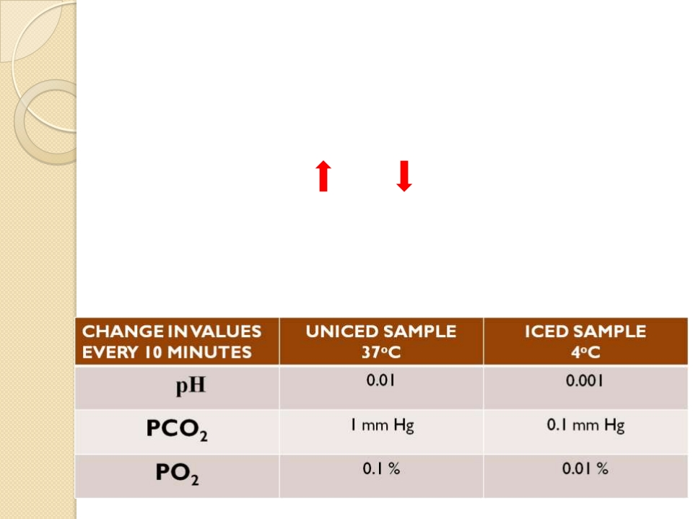
➢ Ensure No Air Bubbles. Syringe must be sealed immediately
after withdrawing sample.
◦ Contact with AIR BUBBLES
Air bubble = PO 2 150 mm Hg , PCO 2 0 mm Hg
Air Bubble + Blood = PO 2 PCO 2
➢ ABG Syringe must be transported at the earliest to the
laboratory for EARLY analysis via COLD CHAIN

Slide 7
Interpretation of ABG
❑ OXYGENATION
❑ ACID
BASE

Slide 8
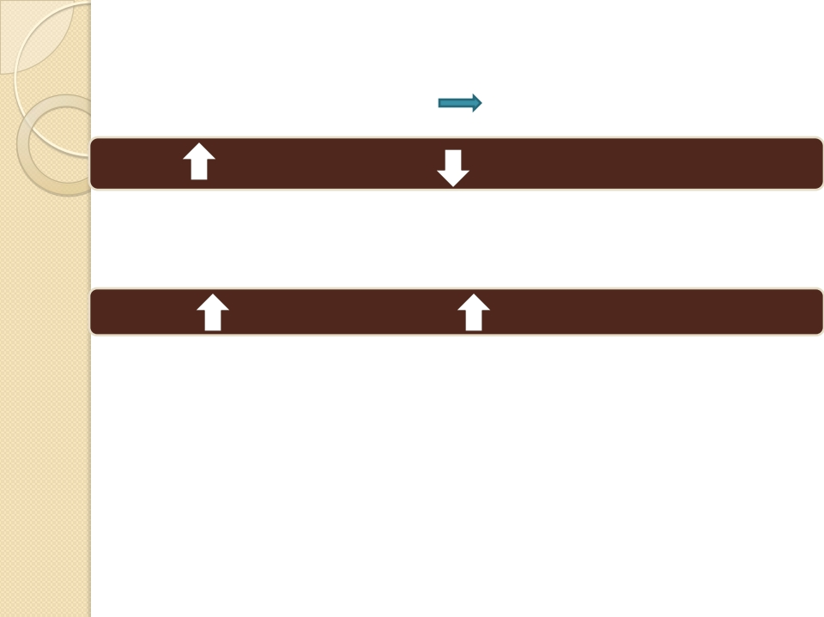
O
➢ Determination of PaO 2
PaO 2 is dependant upon
As Age the expected PaO 2
X
Age, FiO 2 , P atm
Y
G
E
• PaO 2 = 109 - 0.4 (Age)
N
As FiO 2
the expected PaO 2
A
• Alveolar Gas Equation:
T
• P A O 2= (P B -P h2o ) x FiO 2 - pCO 2/R
I
P A O 2 = partial pressure of oxygen in alveolar gas, P B = barometric pressure
(760mmHg), P h2o = water vapor pressure (47 mm Hg), FiO 2 = fraction of
inspired oxygen, PCO 2 = partial pressure of CO 2 in the ABG, R = respiratory
quotient (0.8)
O
N

Slide 9
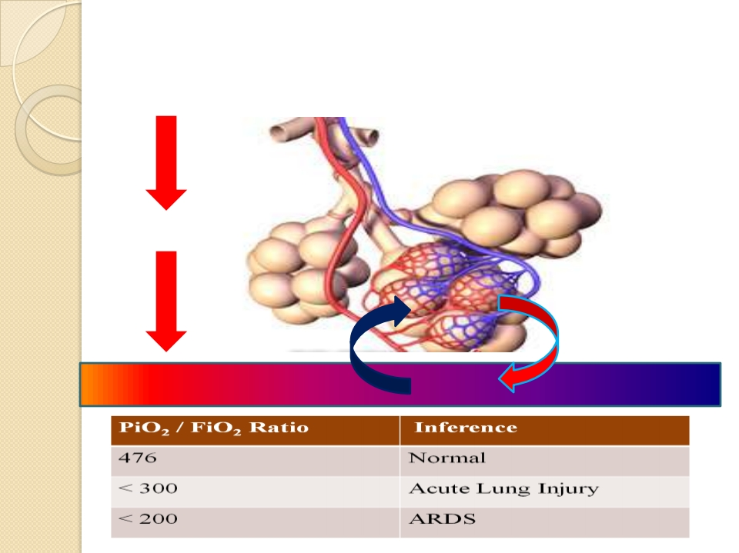
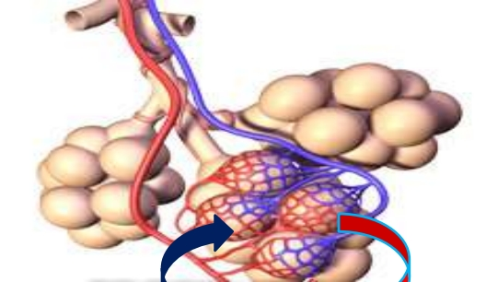
➢ Determination
Inspired Air FiO 2 = 21%
of the PaO2 / FiO2 ratio
PiO 2 = 150 mmHg
P alv O 2 = 100 mmHg
CO 2
O 2
PaO 2 = 95 mmHg

Slide 10
PO 2/ FiO 2 ratio ( P:F Ratio )
➢ Gives understanding that the patients
OXYGENATION with respect to OXYGEN delivered
is more important than simply the PO 2 value.
Example,
 | Patient 1 On Room Air | Patient 2 On MV
PO2 | 68 | 90
FiO2 | 21% (0.21) | 50% (0.50)
P:F Ratio | 324 | 180

Slide 13
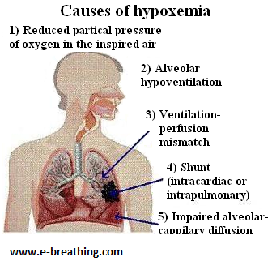

Slide 14
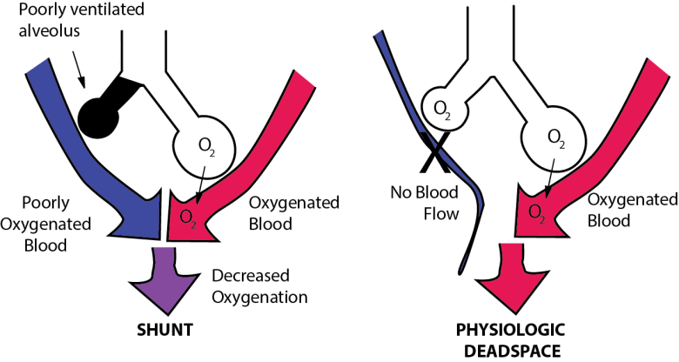
Shunt is perfusion of poorly ventilated alveoli. Physiologic dead space is ventilation of poor perfused alveoli.

Slide 16
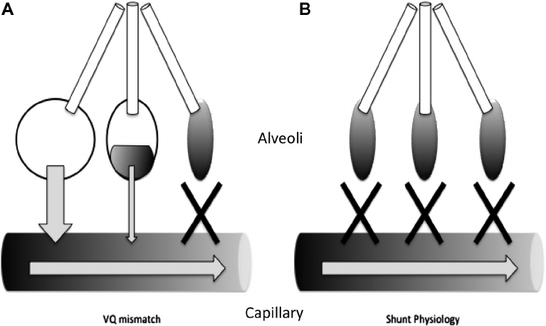

Slide 17
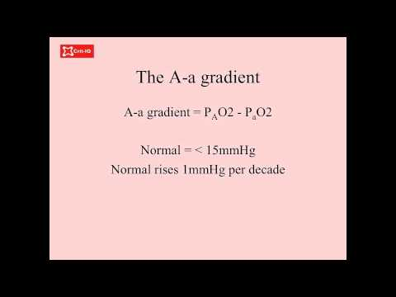

Slide 18
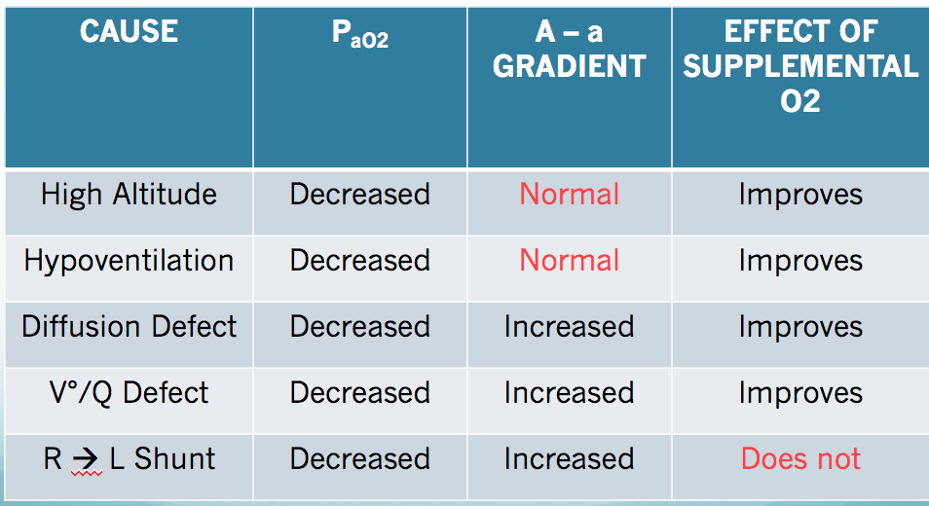

Slide 19
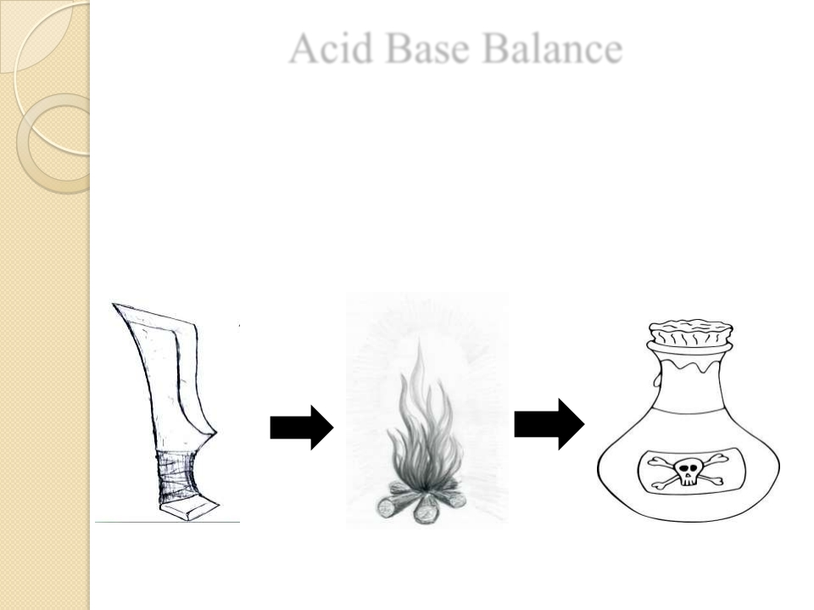
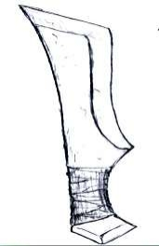
Acid Base Balance
A
+
➢ H ion concentration in the body is
precisely regulated
C
I
+
➢ The body understands the importance of H
and hence devised DEFENCES against any
change in its concentration-
D
B
A
S
E
BICARBONATE
RESPIRATORY
RENAL
BUFFER SYSTEM
REGULATION
REGULATION
Acts in hours to days
Acts in few seconds
Acts in few minutes

Slide 24
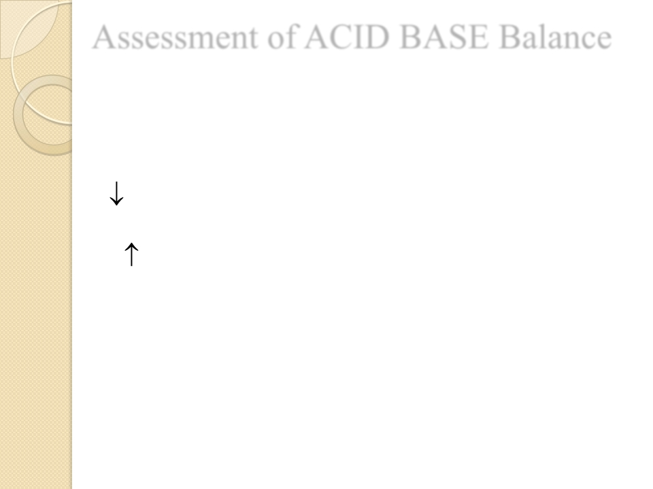
Assessment of ACID BASE Balance

Definitions and Terminology
❑ ACIDOSIS – presence of a process which tends to
+ -
pH by virtue of gain of H or loss of HCO 3
❑ ALKALOSIS – presence of a process which tends
+ -
to pH by virtue of loss of H or gain of HCO 3
If these changes, change pH, suffix ‘ emia ’ is added
● ACIDEMIA – reduction in arterial pH (pH<7.35)
● ALKALEMIA
– increase in arterial pH (pH>7.45)

Slide 26
secretion

Slide 27
If PCO2 & [HCO3] move in opposite directions

Slide 28
Mixed disturbance

Slide 30
STEP WISE APPROACH
to
Interpretation Of
ABG reports

Slide 31
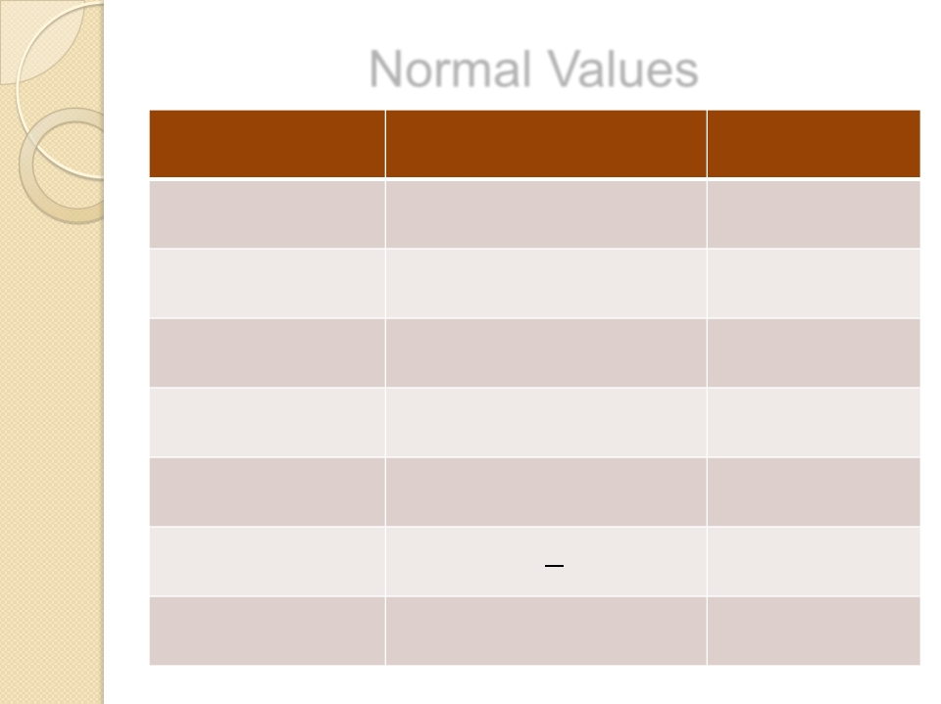
Normal Values
ANALYTE | Normal Value | Units
pH | 7.35 - 7.45
PCO2 | 35 - 45 | mm Hg
PO2 | 80 – 100 | mm Hg`
[HCO3] | 22 – 26 | meq/L
SaO2 | 95-100 | %
Anion Gap | 5-11 | meq/L
∆HCO3 | +2 to -2 | meq/L

Slide 32
• ACIDEMIA or ALKALEMIA?
STEP 1
• RESPIRATORY or METABOLIC?
STEP 2
• If Respiratory – Compensated or Not?
• If METABOLIC – ANION GAP?
STEP 3
STEP 4

Slide 33
STEP 1
ACIDEMIA OR ALKALEMIA?
➢ Look at pH
<7.35 - acidemia
>7.45 – alkalemia

Slide 34
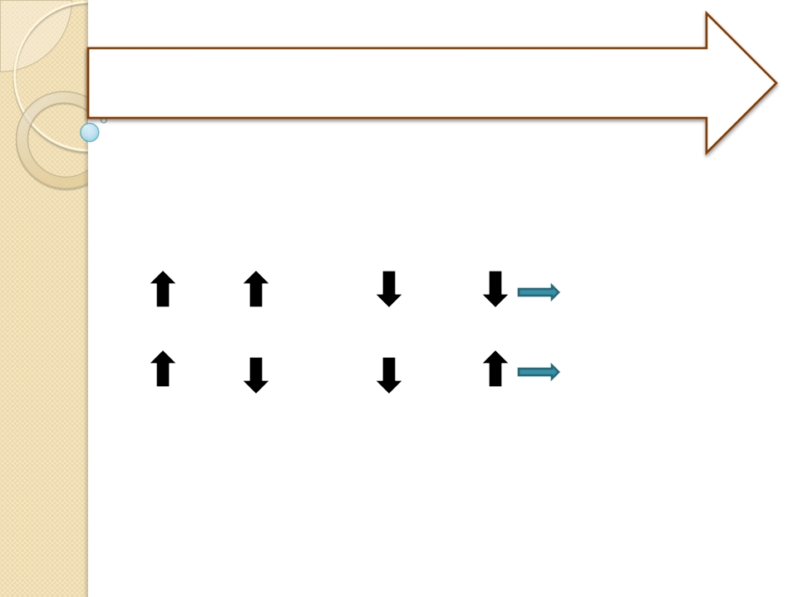
STEP 2
RESPIRATORY or METABOLIC?
IS PRIMARY DISTURBANCE RESPIRATORY OR
METABOLIC?
➢ pH
PCO 2 or
pH
PCO 2
METABOLIC
➢ pH
PCO 2 or pH
PCO 2
RESPIRATORY

Slide 35
RESPIRATORY -
STEP 3
Compensated/decompensated?

Slide 36
a. Respiratory acidosis
Phase | PH | PaCO2 | HCO3
UNCOMPENSATED | ↓ | ↑ | ------
Because there is no response from the kidneys yet to acidosis the HCO3 will remain normal
Phase | PH | PaCO2 | HCO3
PARTIAL COMPENSATED | ↓ | ↑ | ↑
The kidneys start to respond to the acidosis by increasing the amount of circulating HCO3
Phase | PH | PaCO2 | HCO3
FULL COMPENSATED | N | ↑ | ↑
PH return to normal PaCO2 & HCO3 levels are still high to correct acidosis

Slide 37
B. Respiratory alkalosis
Phase | PH | PaCO2 | HCO3
UNCOMPENSATED | ↑ | ↓ | ------
Because there is no response from the kidneys yet to acidosis the HCO3 will remain normal
Phase | PH | PaCO2 | HCO3
PARTIAL COMPENSATED | ↑ | ↓ | ↓
The kidneys start to respond to the alkalosis by decreasing the amount of circulating HCO3
Phase | PH | PaCO2 | HCO3
FULL COMPENSATED | N | ↓ | ↓
PH return to normal PaCO2 & HCO3 levels are still low to correct alkalosis

Slide 38
STEP 4
• If METABOLIC – ANION GAP?

Slide 39
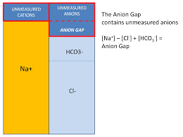

Slide 40
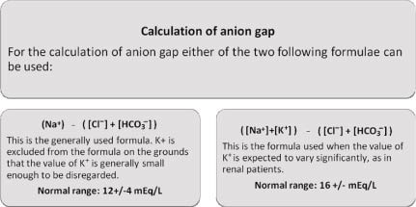

Slide 41
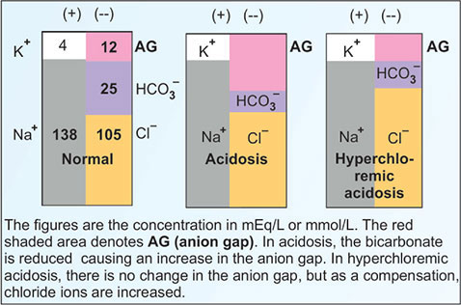

Slide 42
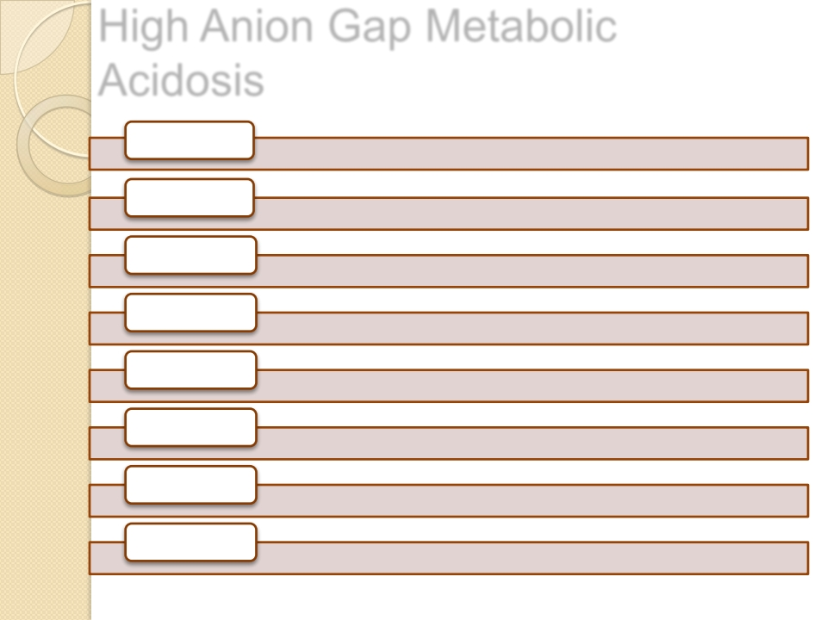
High Anion Gap Metabolic
Acidosis
M
METHANOL
U
UREMIA -
ARF/CRF
D
DIABETIC KETOACIDOSIS & other KETOSIS
P
PARALDEHYDE, PROPYLENE GLYCOL
I
ISONIAZIDE, IRON
L
LACTIC ACIDOSIS
E
ETHANOL, ETHYLENE GLYCOL
S
SALICYLATE

Slide 44
Clinical
CASE
SCENARIOS

Slide 45
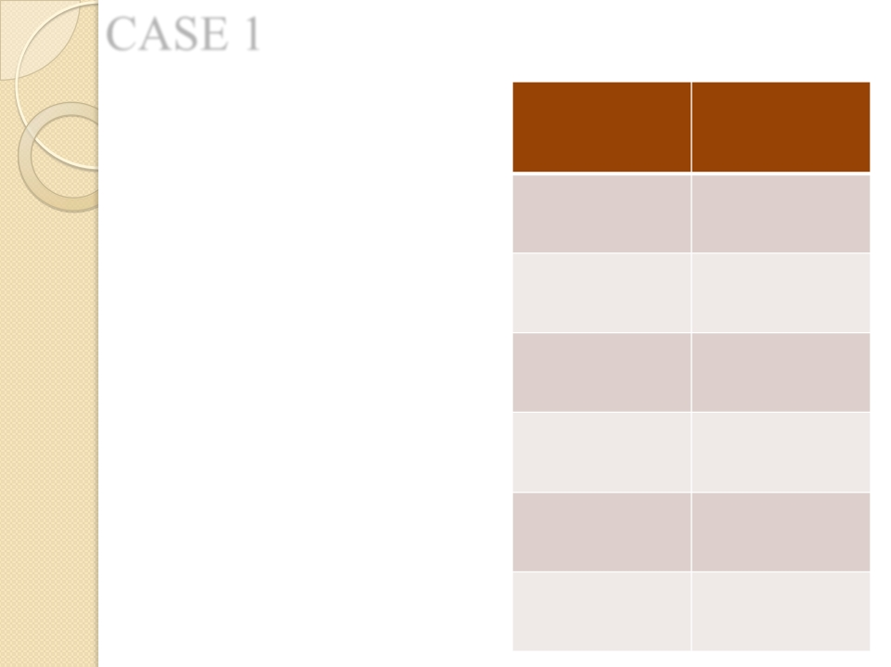
CASE 1
22/7/2011 | 7:30 am
pH | 7.20
PCO2 | 92 mmHg
PO2 | 76 mmHg
Actual HCO3 | 28.00 mmol/l
SO2 | 89
FiO2 | 37%
62 years old Male patient
➢ COPD
➢ Breathlessness,
progressively increased
, aggravated
on exertion, 2 days
➢ Chronic smoker
➢
expiratory
rhonchi

Slide 46
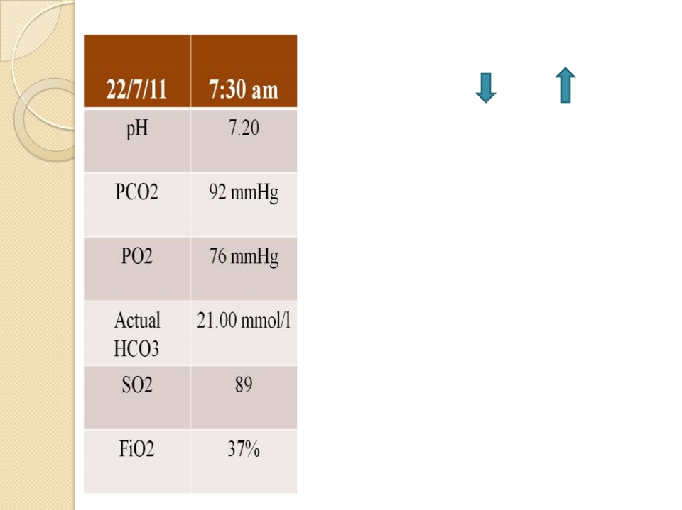
➢ STEP 1 – ACIDEMIA
➢ STEP 2 – pH PCO 2
Respiratory
➢
STEP 3
Primary Respiratory Acidosis,
partially compensated
STEP 4
Mild hypoxemia

Slide 47
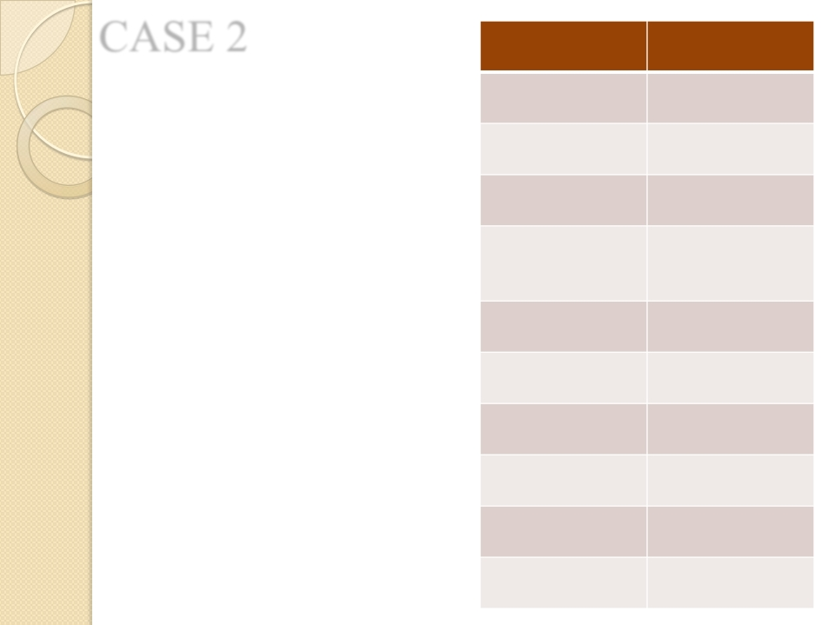
CASE 2
31/7/2011 | 11:30pm
pH | 7.18
PCO2 | 21.00
PO2 | 82
Actual HCO3 | 7.80
Base Excess | -18.80
SO2 | 95
Na | 140.6
Chloride | 102
K | 4
Albumin | 2.4
63 years old ,Male patient
➢ CRF
➢ Breathlessness
➢ Decreased Urine Otpt. 2days
➢ Vomiting 10-15

Slide 48
➢ STEP 1 – ACIDEMIA
➢ STEP 2 – pH PCO2
METABOLIC
➢ STEP4 – ANION GAP
= (Na + K) – (HCO3 +Cl)
= (140.6 + 4)-(7.80+102)
= 34.8
HIGH AG Met. Acidosis
K | 4

Slide 52
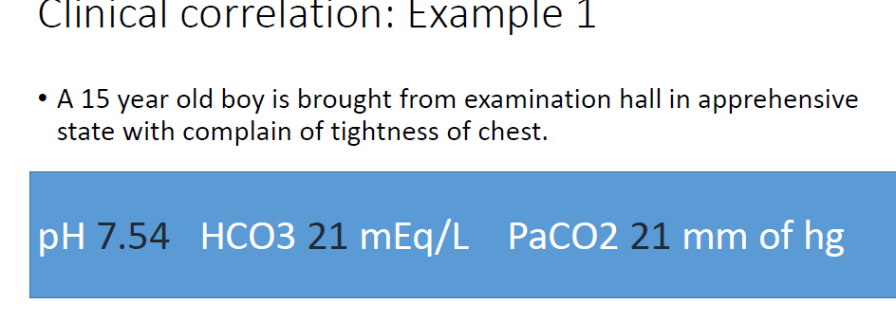

Slide 54
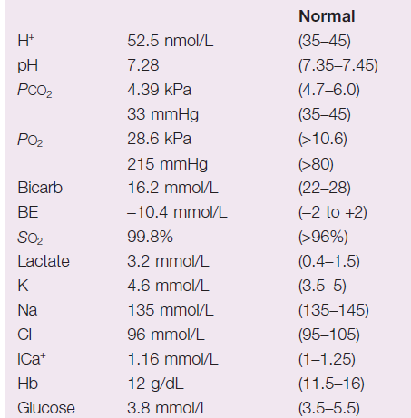
On 10 liters o2 simple face mask

