Slide 2
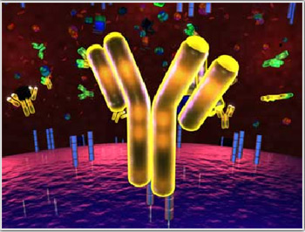
4
GENERAL Virology
Diagnosis and Management
of
viral infection
By:
Prof. Dr. Ghada Fahmy Helaly

Slide 3
Laboratory viral diagnosis
Detection of virus.
Virus Isolation.
Detection of viral antigen.
Detection of anti-viral antibody.
Detection of virus nucleic acid.
Gene sequencing.

Slide 4
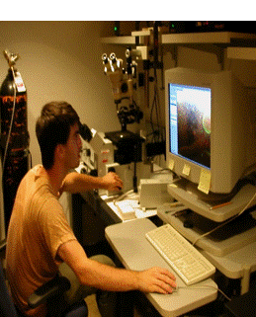
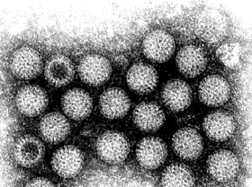
Detection of virus:
Electron Microscopy detects
virus particles, which can be characterized by their size and morphology (e.g. Rota virus, Ebola virus)

Slide 5
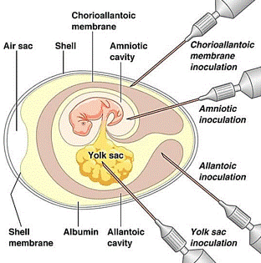
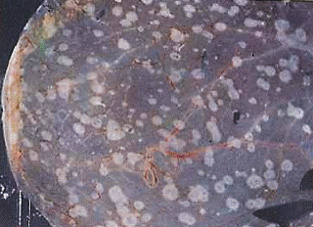
Virus Isolation:
Embryonated egg:
In yolk sac, amniotic cavity, allantoic cavity, chorioallantoic membrane.
Test the presence of Pocks on chorioallantoic membrane used as quantitative assay.

Slide 6
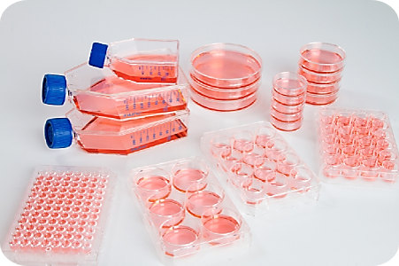
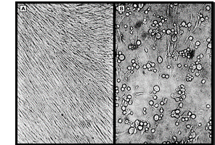
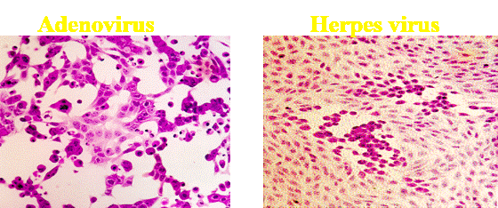
Tissue culture:
When growing virus in a cell culture, the cells affected with virus will evolve morphologic changes, called Cytopathic effect (CPE), often specific for the type of virus involved.
CPEs of infected cells can be observed with inverted light microscopes, such as the ballooning of cells or syncytia formation,……
Cytopathic Effect (CPE)

Slide 7
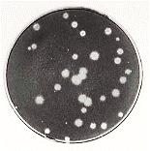
if not producing CPE , the presence of the virus could be detected by :
Haemadsorption (mumps, Influenza, and parainfluenza)as cells acquire the ability to stick to mammalian red blood cells.
Interference.
Characteristic inclusion bodies, immuno-histochemical staining of viral antigens.
Confirmation of the identity of the virus may be carried out using neutralization, haemagglutination -inhibition or immunofluorescence tests.
Tissue culture in plates showing CPE in the form of plaque formation used in quantitative assay of viruses.

Slide 8
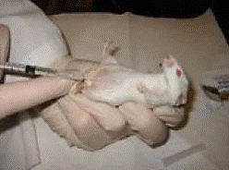
3 types of cell cultures:
Primary cells - Primary Monkey Kidney.
Semi-continuous cells - Human embryonic kidney and skin fibroblasts- human diploid fibroblasts.
Continuous cells - HeLa, Vero, and HEp2 ….
Animal inoculation:
Mice are infected and observe the development of clinical symptoms or death.

Slide 9
Serologic tests:
To determine viral antigens or antibodies.
Virus antigen detection:
Immuno-suppresed patients do not produce antibodies.
Antibodies take time to be produced (window period).

Slide 10
virus Antibody detection:
IgM detection to diagnose recent infection.
IgG antibodies:
Indicate past infection or persistent infection
Paired blood samples: at the onset and during the recovery, at least a fourfold increase in titer (IgG) to indicate a current infection.
Absence of IgG antibodies can determine susceptibility to infection e.g. Rubella in pregnant women.

Slide 11
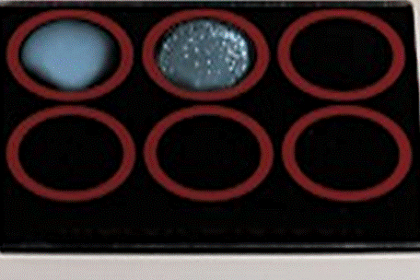
Types of diagnostic serological tests:
1. Agglutination:
Antigen-Antibody reaction causes visible aggregation
e.g. Rota virus detected in stool by mixing sample with specific antibody coated particles.

Slide 12
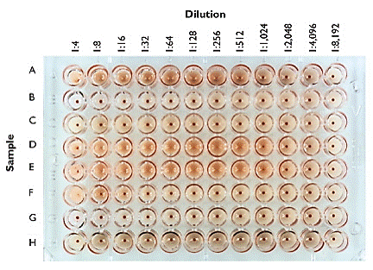
2. Haemagglutination Inhibition:
Some viruses cause RBC agglutination → preventing them from settling.
Addition of serum sample that contain the type specific antibody will inhibit this haemagglutinantion (e.g. Influenza & Parainfluenza).
Notes:
12

Slide 13
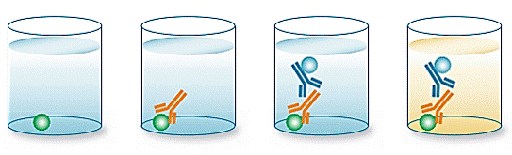
3. ELISA Procedures:
Indirect ELISA
Sandwich ELISA

Slide 14
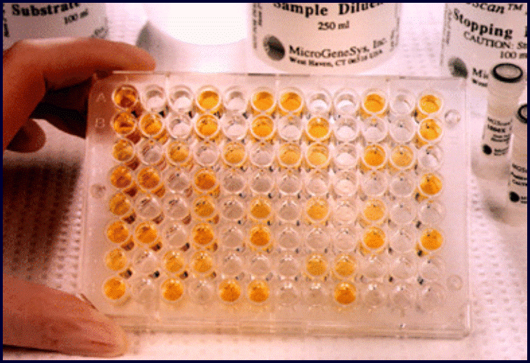

Slide 15
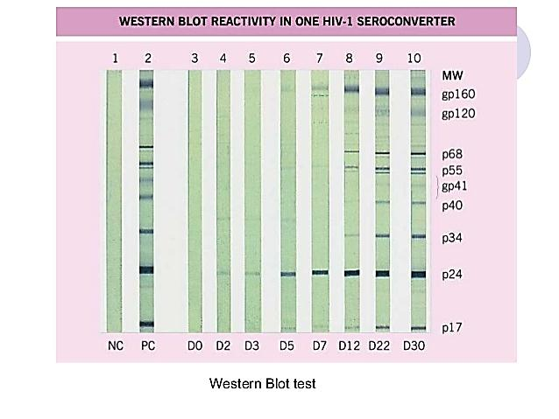
4. Western Blot:
Viral proteins are blotted on membrane → serum samples are added.
If serum samples have the specific antibodies → interaction → detected by labelled antihuman antibodies.

Slide 16
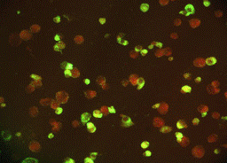
5. Fluorescent antibody tests: (UV)
Direct fluorescent antibody test :
Antigen + fluorescent labeled specific antibody
Indirect fluorescent antibody test :
Antigen+ unlabelled antibody → wash → add fluorescent labeled anti-species globulin.

Slide 17
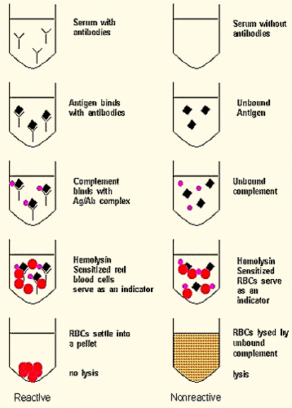
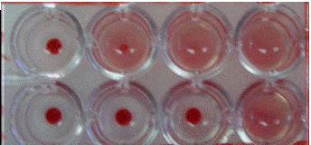
6. Complement Fixation Test:

Slide 18
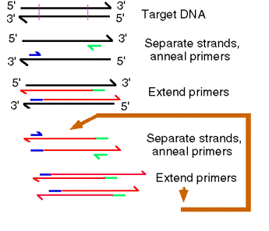
Nucleic acid detection:
Target amplification methods:
Polymerase chain reaction (PCR).
Real time PCR
Signal Amplification Techniques:
bDNA, Hybrid Capture.
polymerase chain reaction
Molecular techniques are usually used to confirm positive serological results due to their higher sensitivity and specificity

Slide 19
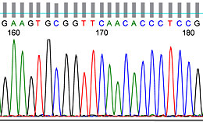
Gene sequencing:
Certain genotypes → virulence and treatment.
Testing specific mutations → to determine antiviral therapy.

Slide 20
Treatment and Prevention of Virus Infections:
Antiviral agents:
Selectively inhibit viral replication (selective toxicity)
Targeting one of the steps in the viral life cycle.
Only a few viral infections have antiviral agents
There are no broad-spectrum antivirals.
Generation of resistant variants.
At present, no antiviral can eradicate latency.
Notes:
Antivirals
Vaccines and immunisation

Slide 21
Antiviral Targets:
Attachment/fusion/un-coating:
Raltegravir → CCR5 co-receptor (HIV)
Amantadine bind to the M2 protein (un-coating) of influenza A virus
Enfuvirtide → HIV viral fusion protein gp41.
mRNA inhibitors: Fomivirsen is an antisense compound → CMV retinitis.
Inhibitors of nucleic acid synthesis: acyclovir, gancyclovir , AZT, lamivudine, ribavirin (nucleoside analogues). Raltegravir inhibits HIV integrase.
Notes:
Attachment/Entry
Picornaviruses
Nucleic acid replication
Human immunoideficiency virus (AZT)
Herpes simplex virus (Acyclovir)
Virus protein processing
HIV (Protease inhbitors)
Virus maturation
Influenza A virus (Neuraminidase blockers)
Problems of antivruals
Dificuly in finding a virus specific site against which to direct the antivrial
As with the use of antiiotics – resistant mutant scan be readily generated that are resistant to antiirals – this is particuarly a problem with those against HIV where the drug has to be used for prolonged periods of time.

Slide 22
Inhibition of cleavage of precursor polypeptide :
HIV protease inhibitor : indinavir, ritonavir,…used for HIV.
HCV protease inhibitor: Simeprevir, grazoprevir.
Inhibition of viral protein synthesis: Interferon induces expression of translation inhibitory protein (TIP) that binds to ribosome, inhibits host expression of viral proteins.
Inhibition of viral release: Oseltamivir (Tamiflu) and Zanamivir (Relenza) → for prophylaxis & treatment.

Slide 23
Vaccines and immunisation
Active immunity: Live attenuated [e.g. measles, mumps, rubella ( MMR), poliovirus (Sabin vaccine)] and killed vaccines [e.g. poliovirus (Salk vaccine), rabies, influenza].
Passive immunity: Preformed antibodies in preparations called immunoglobulins.
Passive-active immunity: Giving both immunoglobulins → immediate protection and a vaccine → long term protection.

Slide 24
