Slide 1
Neck injury
Prepared by : Mohammed Hashim
Mohammad Al-Zoubi
Mohannad Al-Zaben

Slide 2
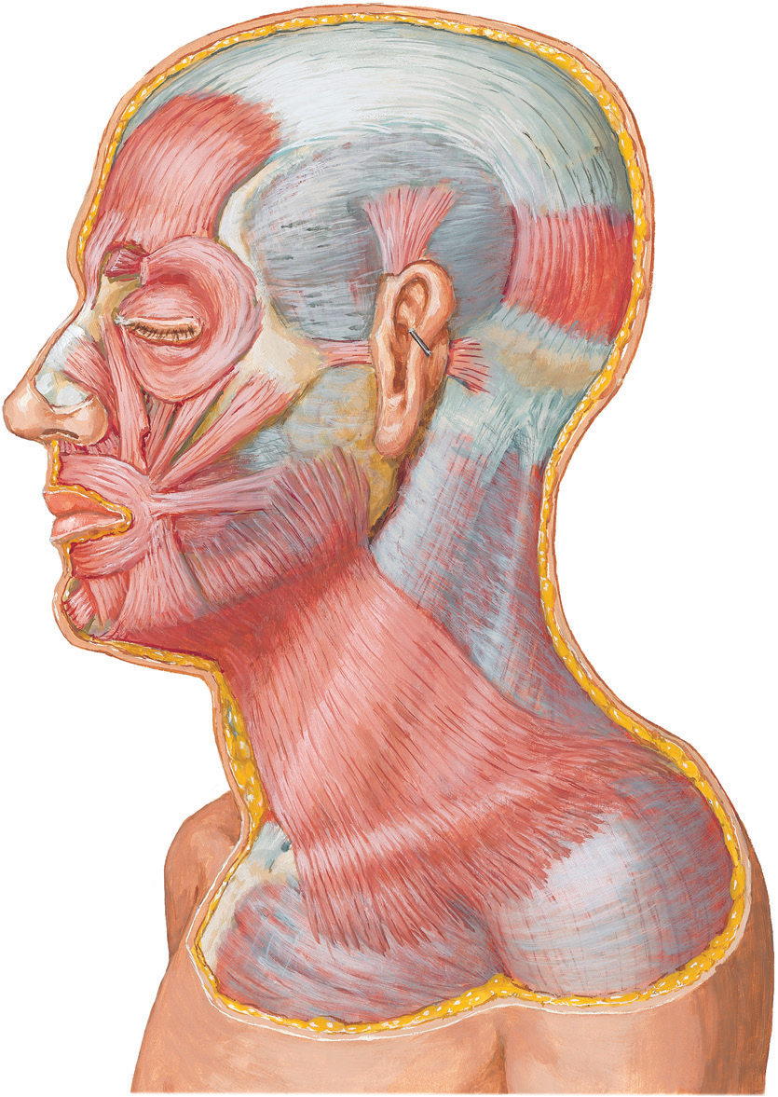
Anatomy of the neck
skin and subcutanious fat
platysma

Slide 3
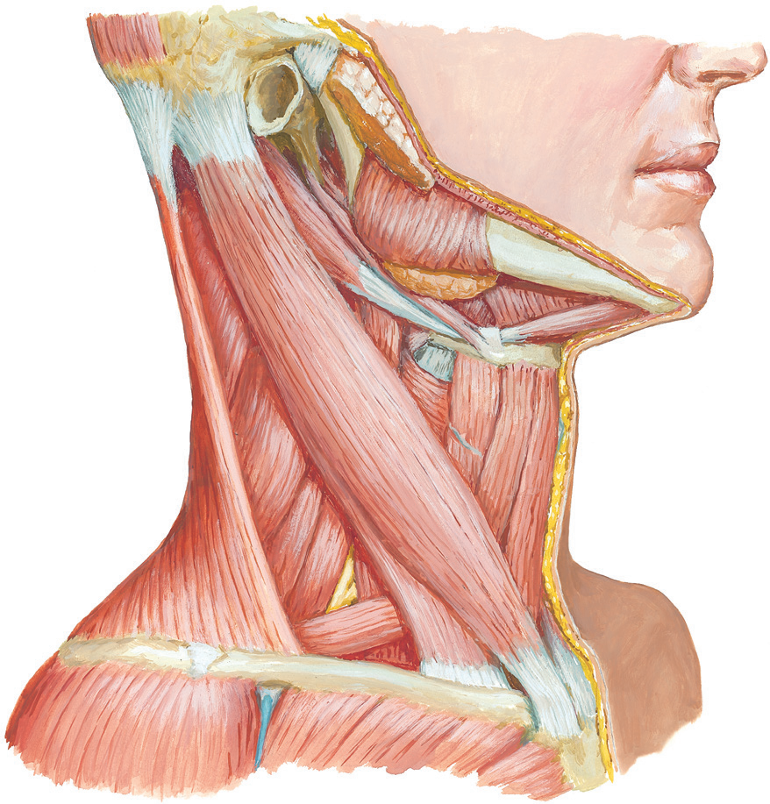
Anatomy of the neck
Anteriour triangle (green)
Sternocleidomastoid
Posteriour triangle (blue)
Trapezius
Notes:
1. the neck is devided into 2 triangels anterior and posteriour by the SCM muscle

Slide 4
Anatomy of the neck
Anteriour triangle
Submental
Submandibular
Carotid
Muscular
Posteriour triangle
Occipital
Subclavian
Notes:
1. the neck is devided into 2 triangels anterior and posteriour by the SCM muscle

Slide 5
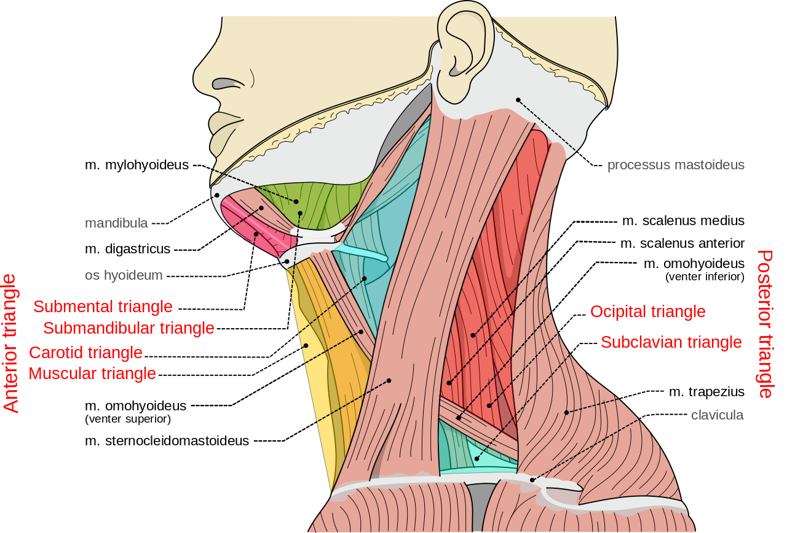
Anatomy of the neck

Slide 6
Anatomy of the neck
Airway
Thyroid
Carotid
sheath
Notes:
The three structures located in the carotid sheath
include the common carotid artery, internal jugular
vein, and vagus nerve

Slide 7
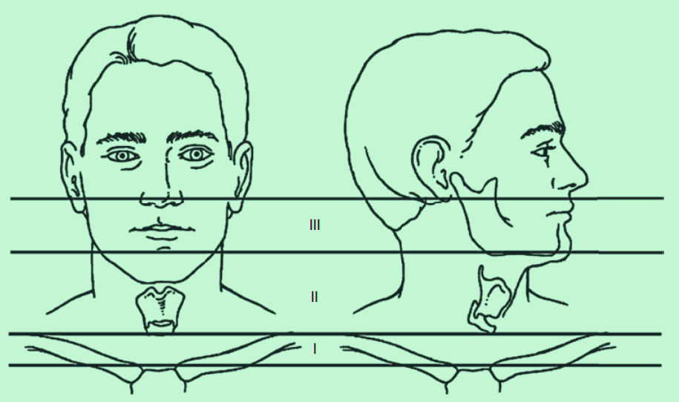
Neck Zones
In the setting of penetrating trauma, the neck is divided into three anatomic zones in order to summarize structures that are at risk for potential injury.
Remember that the neck zones are numbered in the direction of carotid blood flow.

Slide 9
Zone I
Borders
Clavicles and sternal notch Cricoid cartilage
aortic arch
subclavian
the brachiocephalic
Vascular
Respiratory
trachea, apex of the lung
brachial plexus
left recurrent laryngeal sympathetic trunks
Nural
Other
Thoracic duct on the left
Thyroid gland
Notes:
Im only mentioning the anteriour triangle here

Slide 10
Zone II
Borders
Cricoid cartilage
Angle of the mandible
Mid-carotid and vertebral arteries, jugular veins
Vascular
Respiratory
larynx, and trachea
vagus
recurrent laryngeal
phrenic nerve
Nural
Notes:
Im only mentioning the anteriour triangle here

Slide 11
Zone III
Borders
Angle of mandible Base of skull
Proximal internal and external carotids vertebral arteries
uppermost segments of jugular vein
Vascular
Respiratory
pharynx, mainly the oropharynx
cranial nerves 9–12
Nural
Notes:
Im only mentioning the anteriour triangle here

Slide 12
Signs/Symptoms/Hard signs
01
Vascular
They include active arterial bleeding, pulsatile or expanding hematoma, or the presence of shock, a palpable thrill, audible bruit, and neurological deficits that indicate a possible stroke. The presence of one of these findings (particularly the first three) is an indication for immediate surgical exploration.
Horner’s syndrome
02
(ptosis, miosis, and anhydrosis) may indicate injury to the vessels in the neck on the basis of anatomical proximity, because sympathetic fiberse are located along the course of the common carotid and internal carotid arteries.
Thrill/bruit
03
Damage to the subclavian or carotid artery and adjacent vein can create an arteriovenous fistula; turbulent blood flow causes the vein to vibrate, leading to a palpable rumble or a whooshing sound on auscultation
Notes:
hard signs means immidiate intervention

Slide 13
Signs/Symptoms/Hard signs
Stridor
04
upper airway obstruction caused by compression of the trachea from a large hematoma, soft tissue swelling, direct laryngeal injury, or bilateral recurrent laryngeal nerve injury; it warrants immediate attention to the airway, usually in the form of endotracheal intubation
Odynophagia
05
suggestive of an injury to the oropharynx or esophagus
Crepitus
06
subcutaneous emphysema (air trapped under the skin) secondary to injury of the aerodigestive tract (trachea, bronchus, or esophagus) or lungs
Notes:
even if there was no hard signs, injury to critical structures needs to be ruled out. While evaluating the wound is essen_x0002_tial, it is critical not to probe the injury as this could dislodge
a clot.

Slide 14
Pathophysiology
What Is the Significance of Whether or Not the Injury Has Penetrated the Platysma (Superficial Neck Muscle)?
Injuries that do not penetrate the platysma are non-penetrating neck injuries. As these injuries do not place the vital structures of the neck in harm’s way, they do not require any further diagnostic workup or surgical exploration.
However, it is often difficult to be confident that the platysma is not violated based on physical exam alone.

Slide 15
What Is a Pseudoaneurysm? How Does It Differ From a Hematoma?
A pseudoaneurysm develops when an artery sustains a focal full thickness
injury (all three layers) that is temporarily tamponaded by the surrounding soft tissue. This differs from a hematoma, in which there is no active or ongoing hemorrhage from an injured vessel. Blood continues to be pumped into the pseudoaneurysm cavity, creating a pulsatile quality that may be felt on exam as a pulsatile mass on palpation of the overlying skin.

Slide 16
What Nerve Would Be Injured if This Patient Presented with Vocal Cord Paralysis?
The recurrent laryngeal nerves, which supply the vocal cords, are branches of the vagus nerve. They innervate the intrinsic muscles of the larynx except the cricothyroid (innervated by the external branch of the superior laryngeal nerve). Injury to the vagus nerve in the neck (which is prior to the takeoff of the recurrent laryngeal nerve) or damage to the recurrent laryngeal nerve itself leads to ipsilateral vocal cord paralysis. Normally the vocal cords are contracted to keep the airway open; paralysis of one vocal cord causes it to become fixed in a paramedian position and results in a hoarse voice. Bilateral paralysis of the vocal cords may result in complete upper airway obstruction.

Slide 17
INVESTIGATION
Chest X-ray
Essential in all patients with neck injuries.
Do not sit patient up; if there is an open wound, it may cause a fatal air
embolism or complicate a cervical spine injury.
Cervical spine X-ray
Look for the presence of fractures, foreign bodies, or air in soft tissues.

Slide 18
Workup
Injuries to the vessels, aerodigestive tract, and cervical spine need to be ruled out. A CT scan of the neck and chest with oral contrast and IV contrast is indicated (to look for c spine injury as well as oral contrast extravasation from pharynx/esophagus).
This CT does not adequately assess for arterial injury. As such, a CT angiogram (CTA) of the neck and chest is also indicated and should be performed first.
Advantages/disadvantages of the CTA compared to other arterial imaging modalities are discussed below. If an aerodigestive tract injury is suspected on CT, triple endoscopy (laryngoscopy,esophagoscopy, and bronchoscopy) is performed to better assess for laryngeal, esophageal, and bronchial trauma
What Studies Are Recommended
for Patients with Penetrating Neck Trauma?

Slide 19
Imaging study | Advantages | Disadvantages
CT angiography | Relatively fast, accurate, and readily available in most emergency departments; this is the preferred first-line imaging study | Nontherapeutic; requires injection of iodinated contrast medium
Duplex ultrasonography | Noninvasive, no need for contrast | Operator dependent, Zones 1 and 3 not well visualized,
Femoral catheter angiography | Diagnostic and can be therapeutic | Invasive; requires interventional radiologist or endovascular surgery support; risk of stroke, femoral artery injury,contrast-induced nephropathy

Slide 20
Management
The initial evaluation of all trauma patients
begins with the primary survey.
Airway, breathing, and circulation with hemorrhage control assume the highest priority in the initial assessment and management of the trauma patient as derangements in any one of the ABCs may result in significant morbidity and potentially death.
The neck includes anatomic structures vital to the ABCs (the upper airway, the lungs, and the major blood vessels of the neck, respectively).
What Are the First Steps in the Management
of a Penetrating Neck Wound?

Slide 21
A patient who speaks has a patent airway. In a penetrating neck injury, the airway can quickly become compromised by an expanding hematoma, bloody secretions, or deterioration in mental status, all of which may be indications for endotracheal intubation and urgent operative exploration.
A patient’s respiratory rate and effort, oxygen saturation, and breath sounds are key factors in assessing breathing. Circulation can be assessed by blood pressure measurements and evaluation for ongoing significant bleeding.
The ABCDE of the primary survey is completed by determination of the patient’s Glasgow Coma Scale or disability and complete exposure to rule out other injuries.

Slide 22
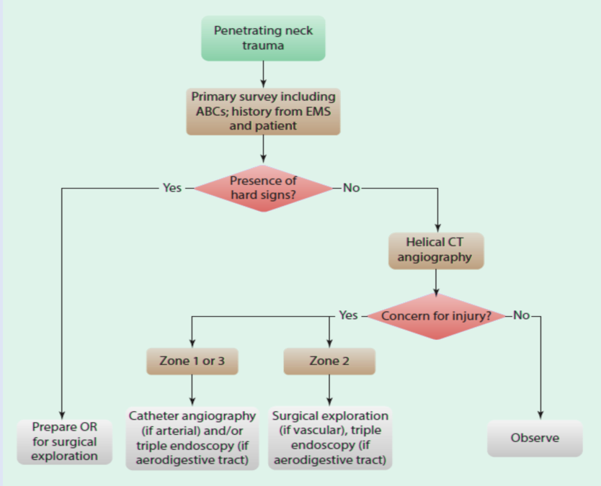

Slide 23
Blunt neck trauma
motor vehicle accidents and sports result in laryngeal, vascular, and digestive injury easily underdiagnosed because their onset can be delayed

Slide 24
Common to all traumatic mechanisms is the direct transfer of severe forces to the larynx. These forces have the potential to produce many devastating injuries, including mucosal tears, dislocations, and fractures.
Edema, hematoma, cartilage necrosis, voice alteration, cord paralysis, aspiration, and airway loss may accompany these injuries.
Common signs of laryngeal injury include stridor, subcutaneous emphysema, hemoptysis, hematoma, ecchymosis, laryngeal tenderness, vocal cord immobility, loss of anatomical landmarks, and bony crepitus

Slide 25
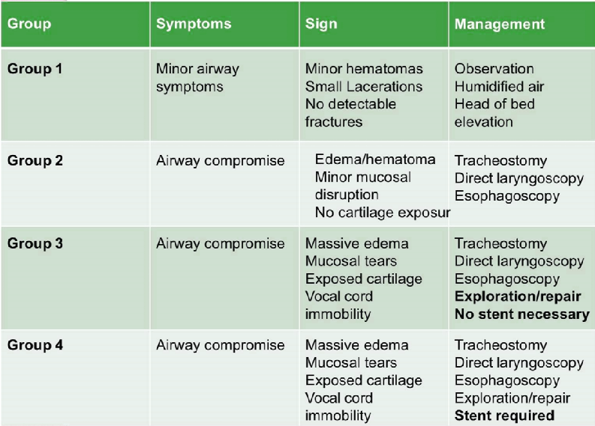
Classification and treatment of laryngotracheal trauma

Slide 26
Thanks
Please keep this slide for attribution.

