Slide 2
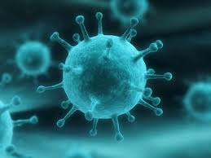
Viral RTI: Corona, Rhino and Paramyxoviruses
BY
Prof. Dr. Ghada Fahmy Helaly
RSM

Slide 3
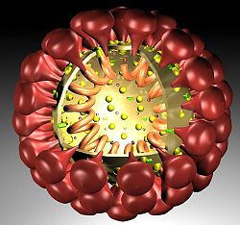
Coronaviruses
Coronaviruses are named for the crown-like spikes on their surface.
Coronaviridae
Coronavirinae
Torovirinae
Alpha coronavirus
Beta coronavirus
Gamma coronavirus
Delta
coronavirus
HCoV-229E,..
HCoV-OC43,..
SARS-HCoV
MERS-CoV
SARS-CoV-2
whales and birds
pigs and birds
Zoonotic diseases?

Slide 4
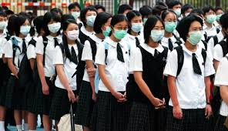
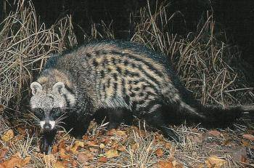
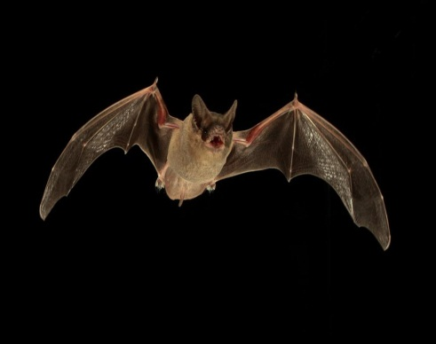
Diseases:
Common cold.
Severe acute respiratory syndrome (SARS): originated in China in 2002. Fatality 9%. Transmitted from civet cats to humans.
Middle East respiratory syndrome (MERS): First reported in Saudi Arabia in 2012. The largest outbreak: South Korea in 2015. Transmitted from camels to humans.
Coronavirus disease 2019 (COVID-19): (China Wuhan City in Hubei Province December 2019). On January 2020, a novel coronavirus (2019-nCoV) by WHO, later renamed as SARS-CoV-2.

Slide 5
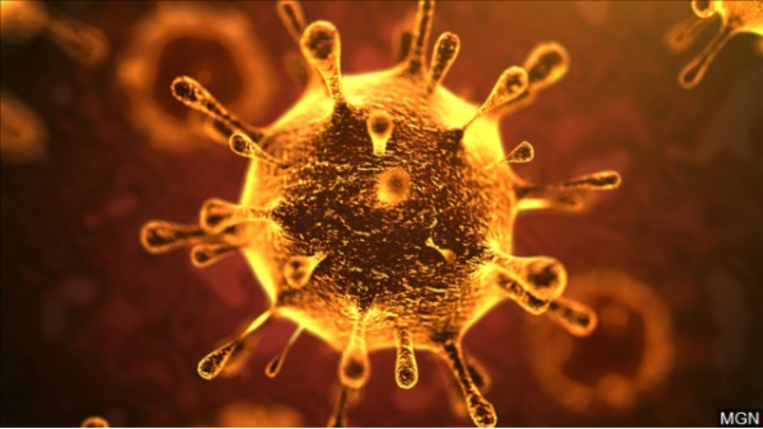
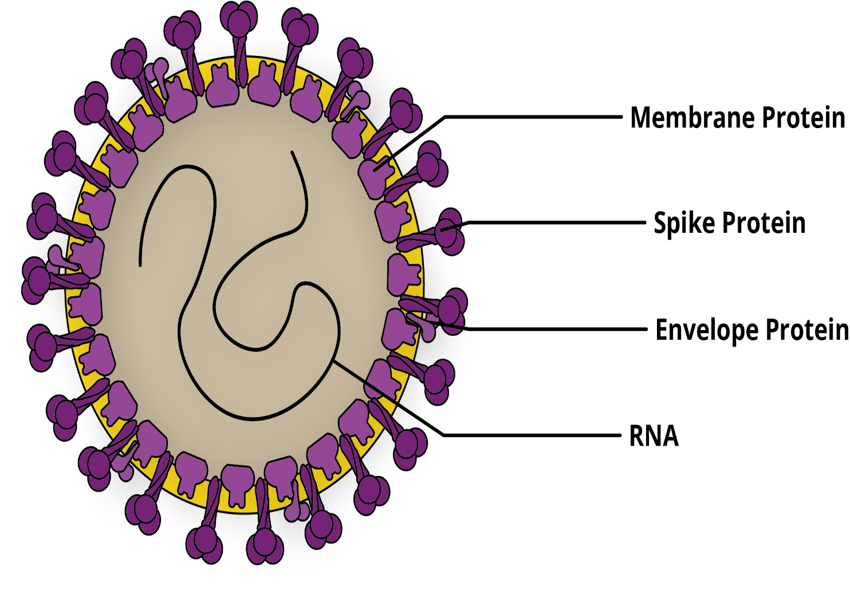
SARS-CoV-2:
Prof. Dr. Ghada Fahmy Helaly
Important Properties:
Large roughly spherical particles with unique surface projections.
Non-segmented, single-stranded, positive-polarity RNA genome. Its RNA sequence is approximately 30,000 bases in length.
Enveloped - Helical nucleocapsid.

Slide 6
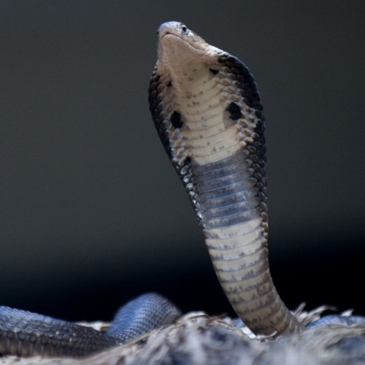
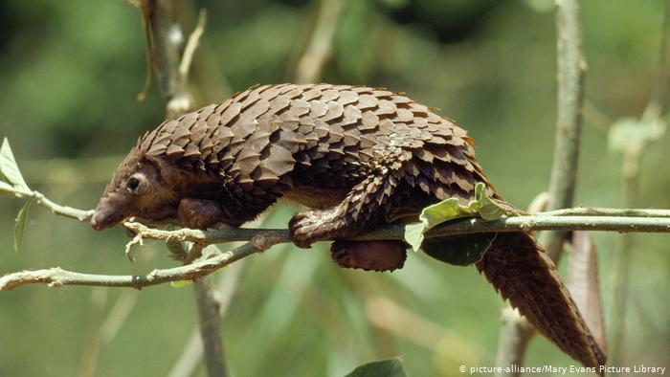
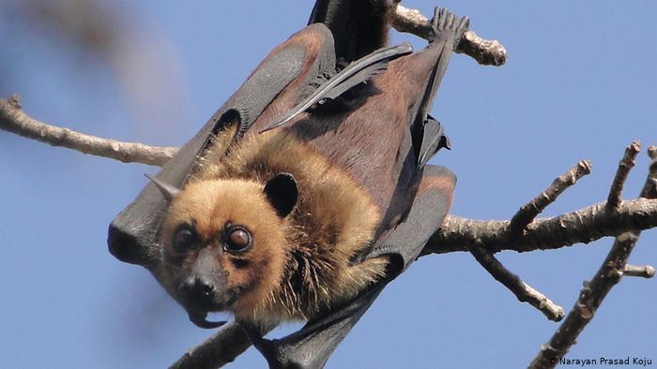
Source of the virus:
Initial speculation pointed to seafood, snakes….
Pangolins.
Bats might be the original host of this virus.
Koalas, Chinese giant salamanders and rats .
Human-to-human transmission: Clusters of infected family members and medical workers.

Slide 7
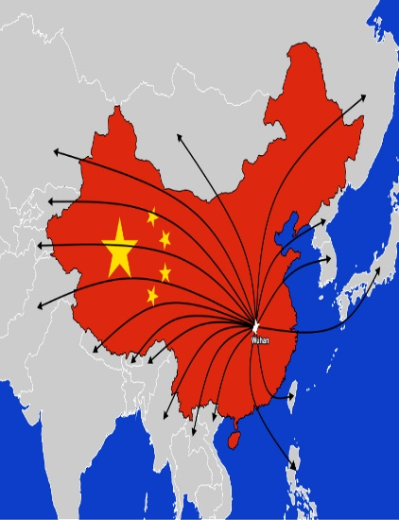
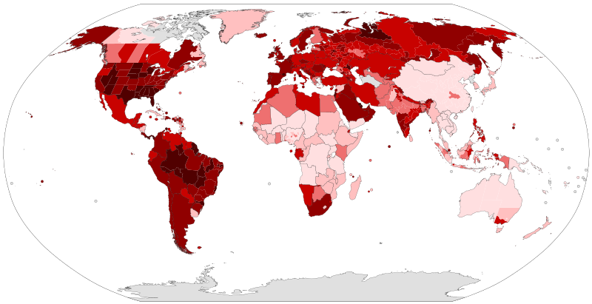
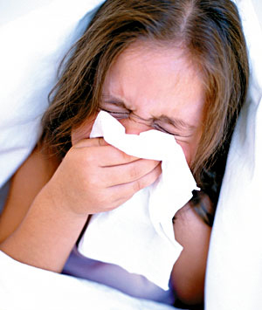
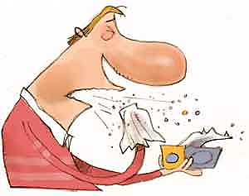
Epidemiology and Modes of transmission:
Globally, there have been more than 43.1 million cases have been confirmed, with more than 1.15 million deaths attributed to COVID-19.
Respiratory droplets (when an infected person coughs or sneezes).
Direct or indirect contact with infected secretions(Fomites).
Asymptomatic transmission ??
No evidence of vertical transmission.

Slide 8
Clinical Picture:
IP. as long as 19 or 24 days.
Symptoms ranging from mild to severe illness, may appear 2-14 days after exposure to the virus.
Super spreaders??
Fever or chills Cough Shortness of breath or difficulty breathing Fatigue Muscle or body aches Headache New loss of taste or smell Sore throat Congestion or runny nose Nausea or vomiting Diarrhea
Emergency warning signs: Trouble breathing Persistent pain or pressure in the chest confusion Inability to stay awake Bluish lips or face
Severe cases: pneumonia, severe acute respiratory syndrome, arrythmia, shock, acute cardiac injury, Kidney failure and even death.

Slide 9
Risk factors
Age between 34 and 59 years------ Sever ≥60 years of age.
Chronic comorbidities such as cardiovascular and cerebrovascular diseases and diabetes
Coinfections of bacteria and fungi.
Children might be less likely to be infected or, if infected, mild manifestations

Slide 10
Pathogenesis and immune response:
Enter the cells through angiotensin-converting enzyme 2 (ACE2)
Encodes viral antagonists modulate induction of IFN and cytokines.
Excessive immune responses [ increased levels of pro-inflammatory cytokines (cytokine storm)] and lytic effects of the virus → disease severity .

Slide 11
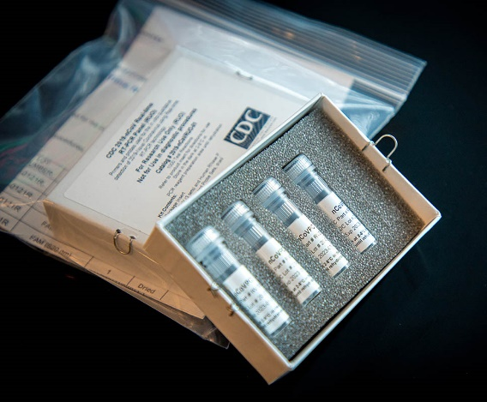
Diagnosis:
Samples required
URT(nasopharyngeal and oropharyngeal swab) and, if possible, LRT(sputum, tracheal aspirate, or bronchoalveolar lavage)
Laboratory findings:
Lymphopenia Prolonged PT Elevated AST Cytokines ??
Ag , RT-PCR and Ab-based tests
Radiology findings:
Chest CT-scan findings : ground-glass and consolidative pulmonary opacities

Slide 12
Treatments:
No specific antiviral treatment for COVID-19.
Isolation and supportive care: O2 therapy, fluid management, and antibiotics treatment.
Corticosteroid treatment ??
Intravenous IGs might help for severely ill patients.
Remdesivir ??
Lopinavir-ritonavir ??
Currently, no vaccination is available.

Slide 13
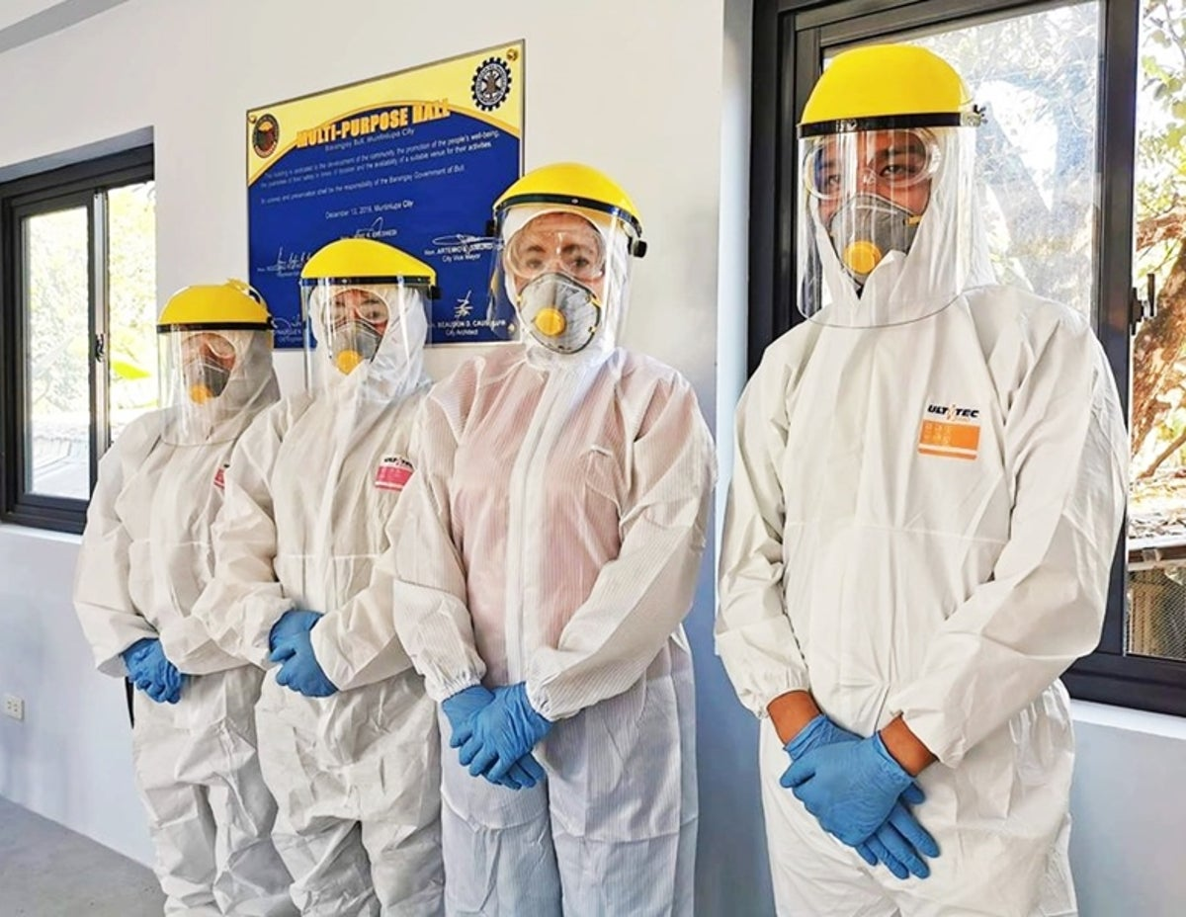
Control and prevention :
Infection control measures: isolating the cases and contact tracing. A confirmed COVID-19 case require hospitalization. Medical personnel should wear personal protective equipment (PPE)
Symptomatic individual ??
Avoid close contact with people who are sick.

Slide 14
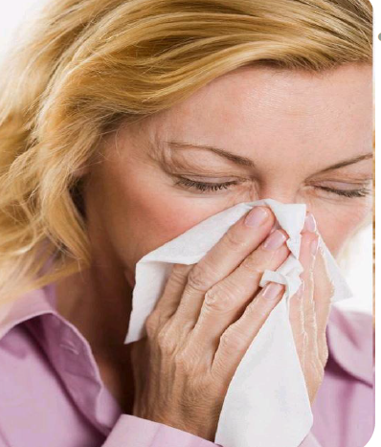
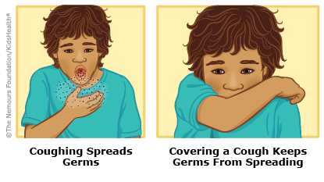
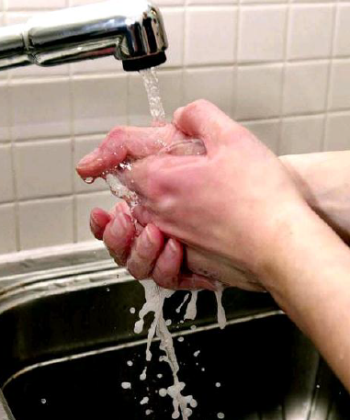
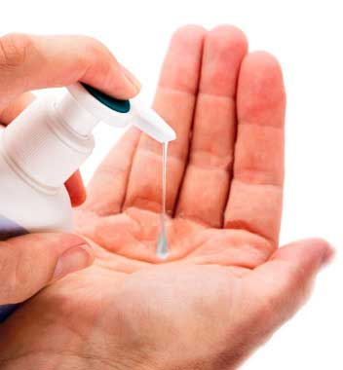
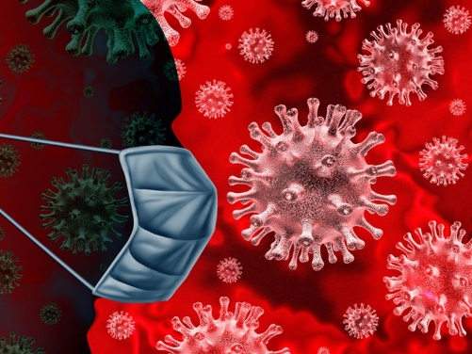
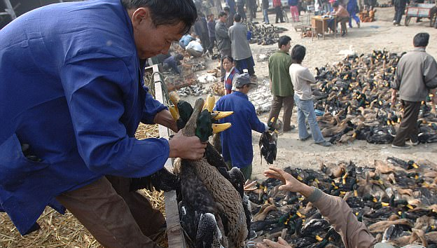
Stay home when you are sick, recognize unusual symptoms .
Cover your cough or sneeze with a tissue, then throw the tissue in the trash.
Clean and disinfect frequently touched objects and surfaces.
Avoid touching your eyes, nose, and mouth with unwashed hands.
Personal hand hygiene, and wearing facemask should also be enforced
Moderating social gatherings.
Consumption of wild caught animal meet should be avoided
Locking down??
Air travel ??

Slide 15
Rhinoviruses:
The most commonly isolated in mild upper respiratory illness.
Picornavirus family
at least 100 serotypes
Common cold
Characteristics:
Naked neucleocapsid
Single-stranded, positive-polarity RNA.
No virion polymerase.
Destroyed by stomach acid.

Slide 16
Transmission:
Aerosol droplets and hand- to- nose contact.
Pathogenesis:
Infection is limited to the mucosa of the upper respiratory tract and conjunctiva. The virus replicates best at low temperatures (33 °C) and less well at 37°C.
Entering a Cell:
The cell surface receptor for rhinoviruses is ICAM-1 , an adhesion protein .
Rhinovirus bonded to a ICAM-1 receptor

Slide 17
Clinical Findings:
Incubation 2-4 days.
Last for 7 days.
Sneezing, Nasal Obstruction, Sore throat.
Secondary infection with Bacteria.
Laboratory diagnosis:
Rarely used clinically.
Viral growth in cell culture.
Serologic tests are not useful.
Prevention:
No vaccine.
Immunity – Rhinoviruses:
Recurrent infections with antigenic variants, may be 2-3 attacks a year.

Slide 18
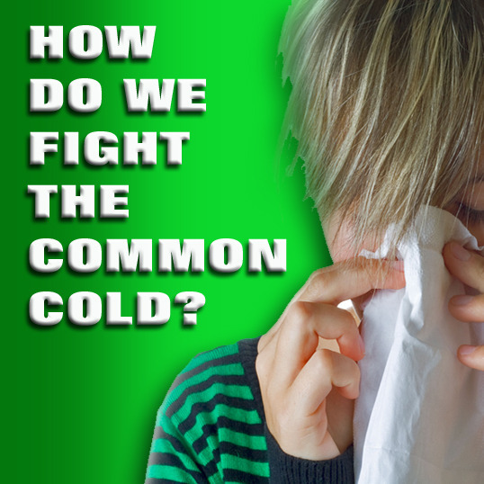
Stop Spreading the Virus
Use Tissue Paper
Sneeze or cough into a facial tissue, and promptly throw it away.
Hand washing
The simplest and most effective way to keep from getting rhinovirus colds.

Slide 19
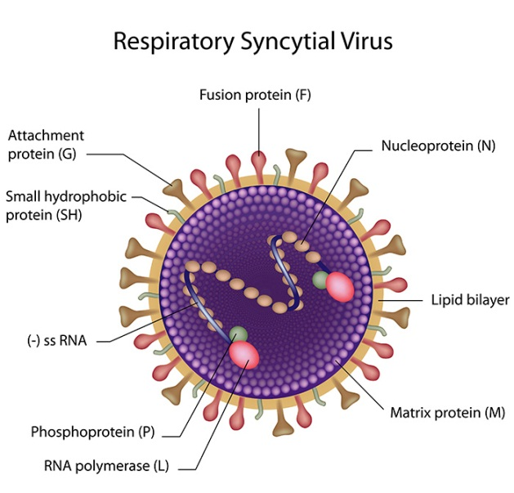
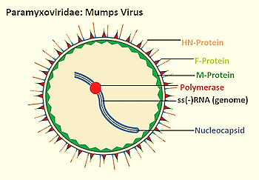
Paramyxoviruses
The Virus | Parainfluenza Virus | Respiratory Syncytial Virus | Mumps Virus
Important Properties
 | Enveloped. Helical nucleocapsid One piece of single stranded, negative polarity RNA. Fusion and haemagglutinin-neuraminidase glycoprotein "spikes" on their surface (antigenicity is stable). There are four serotypes types of HPIV (1 through 4) and two subtypes (4a and 4b). | Enveloped Helical nucleocapsid One piece of single stranded, negative polarity RNA. RNA polymerase in the virion. Only a fusion protein. Single serotype ??, two serotypes A and B. | Two types of envelope spikes: one with both H and N activities and the other with cell-fusing activity. Single serotype.

Slide 20
The Virus | Parainfluenza Virus | Respiratory Syncytial Virus | Mumps Virus
Transmission | Respiratory droplets, winter | Respiratory droplets. Contaminated objects. Outbreaks of RI in hospitalized infants. | Respiratory droplets. Worldwide, winter. 30% subclinical → immunity.
Clinical Manifestations | Croup (laryngo-tracheobroncitis) - children under 5 ys. - parainfluenza virus 1 & 2 infection. Common cold, pharyngitis, laryngitis, otitis media, bronchitis, bronchiolitis and pneumonia. | Bronchiolitis and pneumonia in infants: URTIs (colds) LRTIs (pneumonia and bronchiolitis, Bronchopneumonia) Croup (10% of cases). Otitis media in children. Pneumonia in the elderly and in patients with chronic cardiopulmonary diseases. Infants at Risk of Severe Infection: Congenital heart disease. Underlying pulmonary disease. Immuno-compromised. | IP: 18 to 21 days, → fever, .. → tender swelling of the parotid glands(unilateral or bilateral). Two complications are of significance: Orchitis, if bilateral→ sterility. Meningitis.

Slide 21
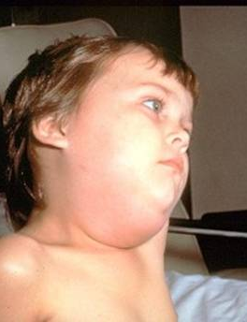
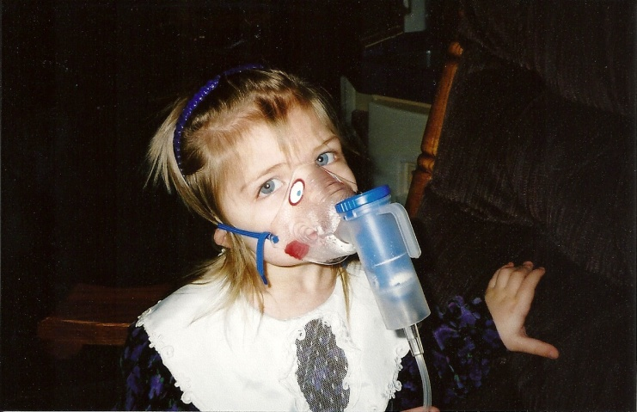
Prof. Dr. Ghada Fahmy Helaly
The Virus | Parainfluenza Virus | Respiratory Syncytial Virus | Mumps Virus
Pathogenesis | Infection of respiratory epithelium without systemic spread Multinucleated giant cells are a hallmark. | Lower respiratory tract in infants without systemic spread. Immune response → pathogenesis. Immune complexes may be involved. | Upper respiratory tract → blood →parotid glands, testis, ovaries, pancreas, meninges ??. Buccal mucosa → parotid gland. Life-long immunity.
Laboratory diagnosis | Nasopharyngeal Swabs, Nasal washings. Isolation of the virus in cell culture. A 4-fold or greater rise in antibody titer. PCR. | Rapid antigen test in respiratory secretions. Virus Isolation - CPE → syncytia formation Rise in antibody titer of at least 4-fold. RT-PCR test. | Clinically. Cell culture. PCR assay. Serological: (S,V Ags and Abs).
Management | No specific antiviral treatment available. Severe cases of croup →hospital (oxygen tents). Trials of live attenuated vaccines. | Aerosolized ribavirin → severe infection. bronchodilators, antipyretics. No vaccine. RSV immunoglobulin. Recovery 1-2 wks. Nosocomial outbreaks ?? | No antiviral therapy Live attenuated vaccine.

Slide 22
Thank You

