Slide 1
Nephrotic Syndrome
Dr. Reham Almardini
5th year 23-24
By: Mona Alzoubi

Slide 2
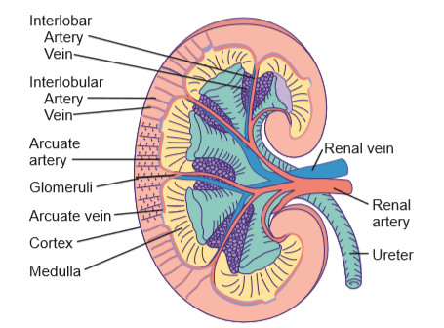
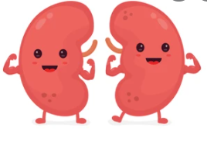
Introduction
Retroperitoneal space
Above the level of the umbilicus
6 cm, 24 g in term newborn - ≥12 cm, 150 g in an adult
Each kidney contains around 1 million nephrons (outcomes of kidney diseases is directly proportional to the number of healthy nephrons)
Number of nephrons completes at 36-40 wk
Functional maturation; continues during the 1st decade of life
قبل ال 34-36 استكمال للعدد وبعد هذا العمر بوقف العدد عن الزيادة, يعني لو طفل انولد قبل ال34 رح يجي بعدد ناقص ويكمل حياته بالعدد اللي اجى فيه وبكون عرضة اكثر في المستقبل لل
Maturation without nephronogenesisبعد ال36 استكمال الوظيفة فقط...
ckd

Slide 3
Nephrons Number
New nephrons cannot be formed after birth
Diseases results in loss of nephrons lead to renal insufficiency
Low birthweight & Prematurity
Risk for: HTN, CKD
Low nephron number: hyperfiltration and sclerosis of “overworked” nephron units
Low nephron number→ over activity of the preserved nephrons to compensate the loss → hyperfiltration→ nephron injury→ apoptosis→ increase CKD risk

Slide 4
Your mission as a physician is to keep the nephron number and protect them from Loss

Slide 5
Functions of the kidneys
Filtration and excretion of fluid & nitrogenous waste products
Bp. control
Acid base balance
Production of Erythropoietin and renin
Activation of vitamin D
Others

Slide 6
Proteinuria (nephrotic related) **nephrotic syndrome is a disease of podocytes
**Proteinuria→ nephrotic related (nephrotic may have some degree of microscopic hematuria)
**Hematuria→ nephritic related (nephrotic may have some degree of proteinuria)
**Diseases of mixed picture of Nephrotic+ nephritic→ kidney biopsy is indicated here
**Mixed picture causes→ post strep, membrano-proliferative nephritis

Slide 7
In Children
normal Protein in urine < 4 mg/m²/ hr
<150 mg/24 hr
Spot urine P/C < 0.2 mg %

Slide 8
How to measure Proteinuria
1. Quantitative method:
Protein in 24 hour urine collection /surface area
Spot Urine: Early morning (to eliminate the effect of orthostatic proteinuria) Protein / Creatinine ratio
2. Semi-quantitative method:
Dipstick testing: Nill
ننتبه انه زراعة البول بنعملها باي وقت

Slide 9
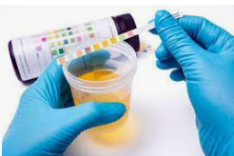
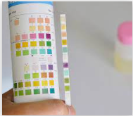
Dipstick testing
ممكن يعملوه الأهل بالبيت
Protein indicator

Slide 10
Glomerular Filtration Barrier size and charge selective
Normal
Nephrotic
Anatomical
barrier:
Podocytes: finger- like projections// slit diaphragm found between these projections contain large amount of proteins (nephrin, podocin,…)
Factors prevent loss of protein through the filtration barrier: interaction between podocytes,
intact BM, negatively charged endothelial cells repel the protein which is negatively charged (physiological barrier)→ net result: protein impermeable barrier
Main pathology of nephrotic syndrome→ injury of GFB (effacement of podocytes)→ protein leak.
Diseases of GBM which end with protein leak: Alport, Good pasture syndrome, membrano-proliferative and membranous diseases
Notes:
he charge and size selective properties of the glomerular capillary wall prevent significant amounts of albumin, globulin, and other large plasma proteins from entering the urinary space (see Chapter 508). Smaller proteins (low-molecular-weight proteins) do cross the capillary wall but are reabsorbed by the proximal tubule. A very small amount of protein that normally appears in the urine is the result of normal tubular secretion.

Slide 11
False Positive Dipstick
Very Alkaline Urine- some UTI
Hematuria
Very concentrated urine( SG> 1.030)
Chlorohexidine
Contamination

Slide 12
Causes of proteinuria
**Persistent proteinuria→ +ve protein for more than 2 weeks,
**Transnet proteinuria→ less than 2 weeks
**Hematuria preferable more than proteinuria
Non Pathological causes (+2>)
Orthostatic: Hematuria, hypertension, hypoalbuminemia, edema, and renal dysfunction are absent
Febrile
Exercise induced
dehydration, cold exposure, heart failure, seizures, or stress
Pathological Causes
Tubular (Allergic interstitial nephritis, ATN)
Glomerular ( NS, GN)
الأخطر
To say its orthostatic proteinuria these points are must:
*Variations of Protein levels during the day: +ve at night, -ve at morning,
*Normal KFT, *Normal BP, *-ve Hematuria, *No systemic disease.
-Orthostatic proteinuria is an accidental finding, no need for treatment, Dx: morning+ evening protein testing

Slide 13
Nephrotic Syndrome

Slide 14
Diagnosis
1. Nephrotic range proteinuria
+3, +4 on dipstick
PCR > 2 mg %
24 hr collection > 40mg/m²/hr, 50 mg/kg/day
2. Hypoalbuminemia < 2.5 gm/dl
3. Cholesterol > 200 mg /dl
4. Edema (decreased oncotic pressure)
Between 4-40, +1 +2, PCR .2-2 → non nephrotic proteinuria
20% of nephrotic pt. have minimal microscopic hematuria// borderline HTN which relieved with treatment→ no need for biopsy (as it can be mistaken with mixed picture of nephrotic+ nephritic)

Slide 15
Clinical presentation
Edema: morning periorbital, evening Lower limb (gravity effect), (ascites, plural effusion, pre-sacral edema, external genital edema morning→ 3rd space loss)
Decreased Urine output - frothy or foamy
Abdominal pain (due to intravascular depletion, ascites, secondary infection)
Complications can be part of presentations as
Headache with neurological signs or irritability: cerebral venous sinus thrombosis
Hematuria (Gross in < 5%, microscopic in 20%)
Mild Hypertension (5%)
Deep vein thrombosis
Abdominal pain - Peritonitis
بتحسنوا بدون اشي ما في داعي للخزعة

Slide 16
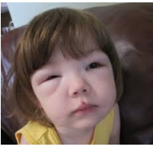
Epidemiology
Age: 2 to 10yrs of age (2>: inherited causes// 10<: FSGS, Membranous, Membrano-proliferative)
Male predominance, male- Female (2:1)
Nephrotic Syndrome affects 1-3/100 000 children
صورة مكررة بالميني اوسكي

Slide 17
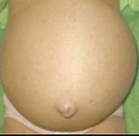
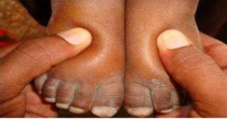
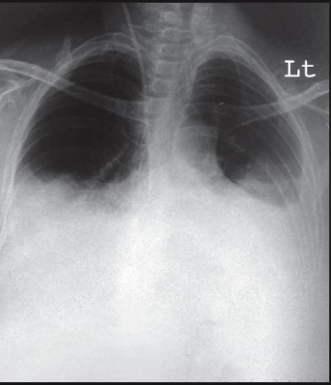
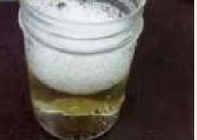
ascites
Peri- orbital edema
مكرر للميني اوسكي
**Pulmonary edema: nephritic
Frothy urine
Plural effusion

Slide 18
Etiology of Edema in NS
2 theories explain the edema in pt. with nephrotic:
Overfill (high Na+, high intravascular volume, high BP.. Don’t give albumin to avoid HF)
Underfill:
**Activation of the compensatory mechanism→ Na+/ water reabsorption into BV lumen which has low oncotic pressure → so they will back to the interstitium → salt and water retention
… compensatory mechanism is a cause for edema.
**To stop this cycle of underfill theory give colloid infusion upon 4h(albumin) → increase oncotic pressure→ Na+/ water reabsorption into the blood→ stop EDEMA.
**After albumin give diuretics (furosemide) to excrete the extra water had reabsorbed into the blood
Compensatory mechanism to improve renal perfusion, but it fails at the end ☺
BP
**Clinical picture:
Edema+ intravascular volume depletion..
**Signs of volume depletion:
Decreased BP
Decreased urine output
Tachycardia
Cold extremities
Delayed capillary refill time

Slide 19
Differential Diagnosis of Nephrotic Syndrome ( hypoalbuminemia), edema
Protein- loosing enteropathy (malabsorption, celiac)
Hepatic failure
Protein energy malnutrition
Acute and chronic GN
Heart failure
Urticaria & Angioedema (just edema with no hypoalbuminemia)

Slide 20
Glucocorticoid therapy is standard therapy for nephrotic syndrome (first line treatment)
We start by 1-2 mg/kg/day or 60mg/m²/day for 4 weeks and then start tapering over 3- 4 months
بنكمل ال4 اسابيع كاملين حتى لو المريض استجاب خلال اول اسبوع

Slide 21
Relevant definitions
Remission: Trace or negative on dipstick or proteinuria <4 mg/m²/h or urinary P/C ratio <200 mg/g (20 mg/mmol) for 3 consecutive days
Relapse: Urine albumin 3+ or 4+ or proteinuria >40 mg/m²/ h or urinary P/C ratio >200 mg/g (20 mg/mmol) for 3 consecutive days + edema+ hyperlipidemia
Frequently relapsing: ≥2 relapses within 6 months of initial response or ≥4 in any 12 month period
Steroid-dependent: 2 consecutive relapses occurring while weaning to alternate day steroids or within 2 weeks of steroid discontinuation
Steroid-resistant: Persistent proteinuria despite 60 mg/m² or 2 mg/kg for 8 weeks, after ensuring no infection or non-adherence to medication (no response to full dose steroid in absence of infection// infection cause relapse)

Slide 22
primary
The Most common one in children
Pt. with NS; test for these infections
Secondary causes;
Treat the underlying cause
+ Tacrolimus + cyclosporine
Lymphoma and NS both have a good response when giving steroids, but 6 months after stopping steroids lymphoma is worsen because you didn’t treat the original cause (misdiagnosis). Always Keep in mind secondary diseases

Slide 23
Pathology
MCD
FSGS
Diagnosed by EM
Second most common in children, diagnosed by LM.
When you take a biopsy to diagnose FSGS be sure to take a large sample..
On LM: It’s a FOCAL, SEGMENTAL disease which mean that the other segments are normal, so you will misdiagnose it with MCD because you take the normal segment not the affected one

Slide 24
Pathology
Most children do not get a kidney biopsy
MCD or FSGS
Minimal change, Normal glomeruli under LM, with podocyte effacement by EM
Characteristic histology in FSGS is segmental sclerosis of affected glomeruli, with the segment often adherent to Bowman’s capsule by synechiae

Slide 25
Investigations
CBC (high Hgb if there is volume depletion, high WBCs with infections)
KFT (should be normal)
Urine Analysis
S. Albumin (low) & LFT
Cholesterol & Triglycerid (high)

Slide 26
Second line investigations in NS
*MCD, FSGS, Membranous→ normal complement level
*Membrano- proliferative→ low complement مهم
Complement C3, C4 (normal in MCD)
Antinuclear antibody (ANA) (to rule out SLE as a secondary cause)
Anti-double- stranded DNA (anti-dsDNA) and ANCA
Hepatitis B and C (HBsAg, anti HCV)
Anti HIV antibodies
Genetic mutation analysis (in pt. less than 2 years, in case of +ve famiy Hx)
Renal biopsy

Slide 27
Indications for Renal biopsy At Onset
Age : more10yrs , less than 1 year
Gross hematuria, persistent microscopic hematuria لأنه الطبيعي ما يكون في دم بالبول
Low C3, Low C3 & C4
Sustained hypertension
Renal failure not attributable to hypovolemia
Suspected secondary causes
Proteinuria despite 4 weeks of full daily steroids (steroid resistance)
Before initiating treatment with tacrolimus (CNI)
CNI (Tacrolimus+ cyclosperin) is a second line treatment and it’s a nephrotoxic medication, so biopsy is indicated before to be sure that the kidney is healthy.

Slide 28
Complications of Nephrotic Syndrome
Infection
Venous thromboembolism +arterial thrombosis
Acute kidney injury (AKI) (due to untreated intravascular depletion/ giving NSAIDs or ACEI to a nephrotic pt./ original disease end up with AKI)
Dyslipidemias
Subclinical Hypothyroidism, iron and Vit. D deficiency (due to loss of there carrying proteins in urine// firstly protein loss is selective to albumen then it becomes non selective)
Growth failure (due to food restriction+ long term use of steroids)

Slide 29
Infections
The Most common infection: peritonitis
The most common micro-organism: gram –ve + strep. Pneumonia.
Don’t miss pneumococcal vaccine in nephrotic pt.
Major complication in NS
It triggers Relapses
Causes
Loss of Ig in the urine and impaired synthesis
Impaired T lymphocytes function
Loss of Compliment
Edema
Corticosteroids and Immunosuppressive agents
Malnutritionurinary
Loss of Compliment factors B and D, lead to impaired opsonization of microorganisms
Common infections: URTI, peritonitis, Cellulitis, bacteremia, others
Encapsulated ( Pneumococci, H. Influenza), Gram Neg, viral ( Chicken pox)

Slide 30
Thrombosis Nephrotic Syndrome is a hypercoagulability state
Cerebral sinus venous thrombosis (convulsions), pulmonary embolism (tachypnea), and renal vein thrombosis (ARF), deep vein thrombosis (redness and pain in the calf), intra- cardiac thrombosis
VTE occurs in 3% of cases of NS during childhood
platelet aggregation
increased synthesis of prothrombotic factors (factors V and VIII)
urinary loss of antithrombin III, protein C and S
altered fibrinolysis
intra vascular fluid depletion
Treatment with low-molecular-weight heparin
There is insufficient evidence to warrant universal thrombosis prophylaxis in childhood NS
Once we establish remission state the risk of all complications disappear,
so your aim is the remission state not to protect against complications

Slide 31
Acute Kidney Injury in Nephrotic Syndrome
3rd most important complication in NS
Diuretics in hemoconcentration
Intravascular volume depletion
Renal vein thrombosis
ATN in the setting of hypovolemia and sepsis
Interstitial nephritis induced by non-steroidal anti-inflammatory drugs or antibiotics
Intrarenal edema (compartment syndrome)
Transformation of underlying glomerular disease (e.g., crescentic nephritis superimposed on membranous nephropathy)

Slide 32
Management Edema in nephrotic syndrome
Salt and fluid restriction with addition of a loop diuretic for severe or symptomatic edema
Albumin infusion, in combination with a loop diuretic: not in all patients only in cases of intravascular depletion
Albumin infusion is contraindicated in patients with hypertension and it can induce pulmonary edema

Slide 33
Steroid Sparing agents
2^{nd+} 3rd line of treatment المطلوب:
S.E// Indications for each one
**الأعراض الجانبية لكل دوا مكتوب مطلوبة, شوفوهم بالسلايد الجاي
Levamisole (used to treat parasitic worm infections, have an immune modulatory effect, hepatotoxic, short course for 6 months, (يوم بعد يوم: Steroid dependent,
Cyclophosphamide (good 2nd line/ S.E: hemorrhagic cystitis, BM suppression, malignancy with long term use, infertility in boys.. To avoid these SE use it for a short term for 8 weeks with dose of 2-3 mg/kg): Steroid dependent and frequent relapsers// ***not given in steroid resistant cases***
Calcineurin inhibitor (S.E: nephrotoxic, so do biopsy first) : Cyclosporine and Tacrolimus, Steroid resistant (2nd line in case of resistant, 3rd line in case of dependent)
Mycophenolate mofitel (could be 2nd or 3rd line, less S.E than cyclophosphamide) : Steroid dependent
Rituximab (monoclonal Ab, Anti CD19,20/ 3rd , 4th line in steroid dependent) : Steroid dependent and less resistant.
*10 year old nephrotic boy (age of puberty), steroid dependent→ don’t give him cyclophsphamide to avoid infertility

Slide 34
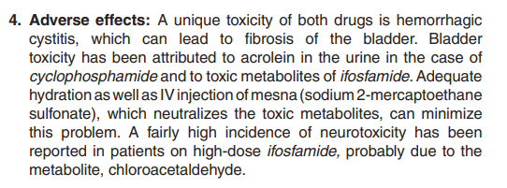
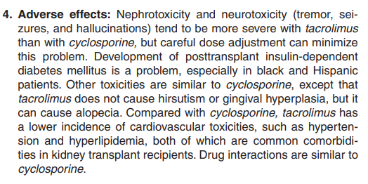
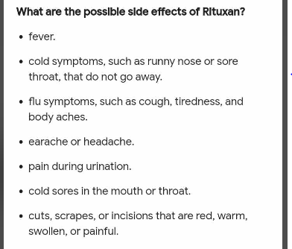
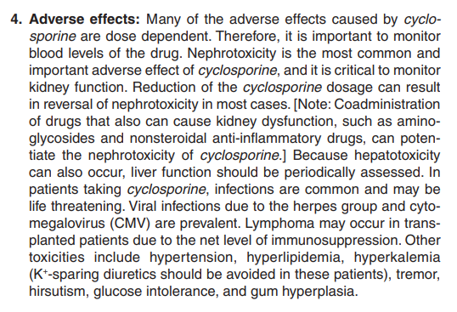
Mycophenolate
Cyclophosphamide
Tacrolimus
Rituximab
Cyclosporine
Levamisole ….

Slide 35
Immunization in Nephrotic syndrome
Live vaccines are contraindicated if the child is receiving steroids or immunosuppressive agents
OPV should not be given to siblings of children with active nephrotic syndrome
Killed/adjuvant vaccines when in remission or on alternate day steroids of 0.5 mg/kg
Annual influenza vaccine (INJECTIBLE)
Varicella 2 doses at 3 months interval ( should not be receiving Steroid or other immunosuppressant
Pneumococcal conjugate vaccine
Live vaccines: MMR, OPV, Rota virus, BCG, Varicella (chickenpox), Yellow, oral Typhoid, intranasal influenza.
Give them after one month of stopping steroids.
بالعادة الاطفال بتشخصوا على عمر ال6 سنوات اللي هو عمر المدرسة وبوخذوا بهذا الوقت مطعوم ال , بننبه الاهل انهم ما يعطوه اياه عشان ما ينصاب الطفل بالعدوى نفسها بسبب المطعوم ومناعته الضعيفة
MMR

