Slide 1
SIRS, Sepsis and septic shock
Hadeel salameen
Aseel Sadaqa
Lubna Sameer

Slide 2
Contents :
Definitions
SIRS criteria
Sepsis definition , signs & symptoms
Multi Organ Dysfunction (MODS)
Treatment for sever sepsis

Slide 3
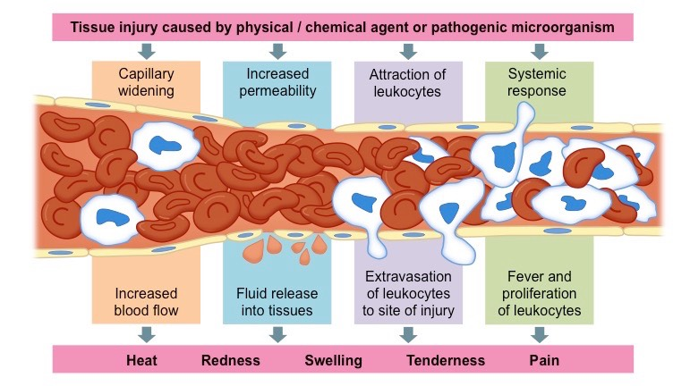
DEFINITIONS:
Infection : microbial phenomenon characterized by an inflammatory respnse to the presence of microorganisms or the invasion of normally sterile host tissues by the organism.
Inflammation : is the term used to describe how blood vessels & immune cells react to injury , allows inflammatory cells , plasma proteins , and fluid to exit blood vessels and enter the interstitial space .

Slide 4
cont...
1. Acute: immediate response with limited specificity , arises in response to
2 tyes of stimuli :
*Infection “ particularly bacterial” -> to eliminate the pathogen.
* necrosis -> th eliminate debris .
2. Chronic: antibodies & T-cells to specific antigen .
3. Bacteremia : presence of viable bacteria in blood stream.

Slide 5
Systemic inflammatory response syndrome (SIRS)
Is an exaggerated defense response of the body to a stressor
(infection, trauma, surgery, acute inflammation, ischemia or reperfusion, or malignancy) to localize and then eliminate the endogenous or exogenous source of the insult.

Slide 6
Criteria of SIRS :
Fever
Heart Rate
01
02
Respiratory Rate
Abnormal WBCs Count
03
04
At least 2 of the following
More than 38
or less than 36 ℃
More than 90 beats per
minute
℃
More than20 breaths per minute or arterial CO2 tension ( PaCO2) less than 32 mmHg.
More than 12,000 or, less than 4,000 or,
> 10% immature band B cell

Slide 7
Sepsis causes a drop of systolic pressure to less than 90 mmHg or a reduction more than 40 mmHg frem baseline in the absence of other causes of hypotension & despite adequate fluid resuscitation .
this is called” Septic Shock”
Causes could be : Pneumonia , Urinary tract infection , Peritonitis ...

Slide 8
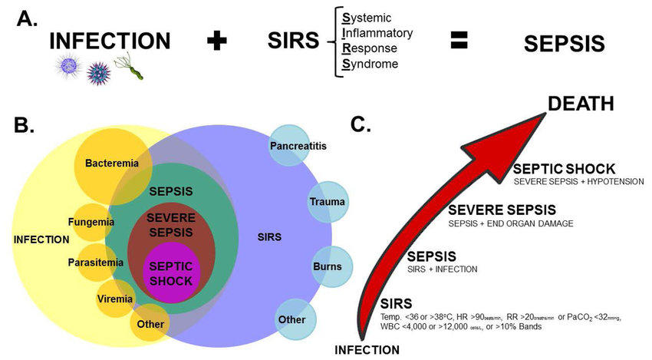

Slide 9
To be continued
Aseel Sadaqa

Slide 10
Sepsis
Sepsis:life threatning condition when body’s excessive response to an infection causes damage to its own tissue
it is the systemic response to infection and is defined as the presence of SIRS in addition to a documented or presumed infection.
Most commenly due to bacterial cause.

Slide 11
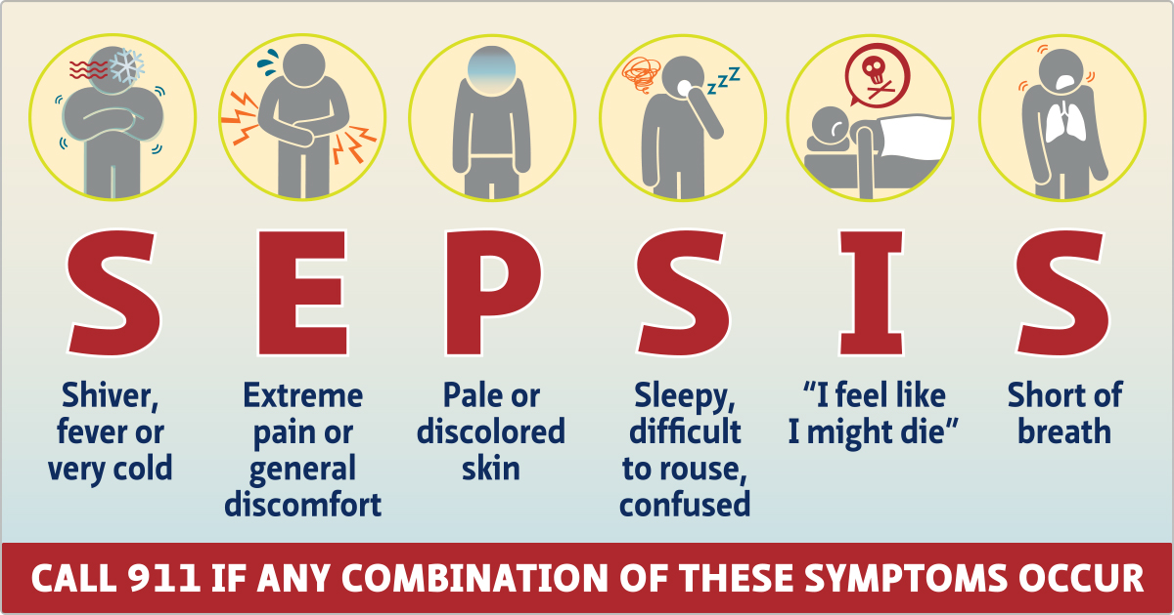
Sign and Symptom of Sepsis
Fever , chills , diaphoresis.
Tachycardia
Tachypnea
Sweating
Fatigue
+CONFIRMATION of ongoing infection

Slide 12
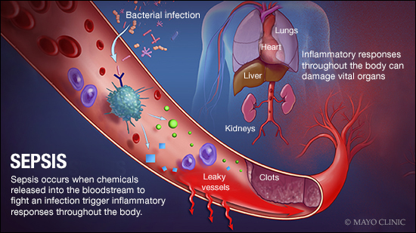
Complications of Sepsis
Multiple organ failuer
RS Failuer
Renal failuer
DIC

Slide 13
Septic Shock
Sepsis if Left untreated may progress to septick shock a body-wide defeciency of blood supply thar leads to oxygen deprevation , build up of waste produts and eventully organ failuer
toxins produced by bacteria can damage the small blood vessels, causing them to leak fluid into the surrounding tissues. cytokine relaese leads to widespraed VD which leads to fluid leakage from capillaries . it also activates coagulation factors that leads to mictothrobi formation which in turn decrease blodd flow to organs , and depleting coagulation factors on the other hand
this poor capillary blood flow , decreased oxygen supply , impairs removal of co2 and waste products which leads to organ failuer

Slide 14
Signs and Symptom of Septic Shock
Signs and Symptom of sepsis and signs and symptom of shock :
Sepsis : Fever (usually >101°F [38°C]), chills, or rigors
Confusion
Anxiety
Difficulty breathing
Fatigue, malaise
Nausea and vomiting
SHOCK:
-Hypotension
-Tachycardia
-skin intially warm and flushed becomes cold and swaety motteled or bluish.
- Confusion/disorientation

Slide 15
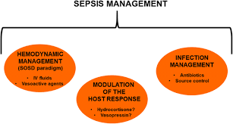
Treatment of septick Shock
-Treating sepsis: IV broad spectrum antibiotics cefotaxime). -Treating shock: aggressive IV fluids and pressors(norepinephrine)

Slide 16
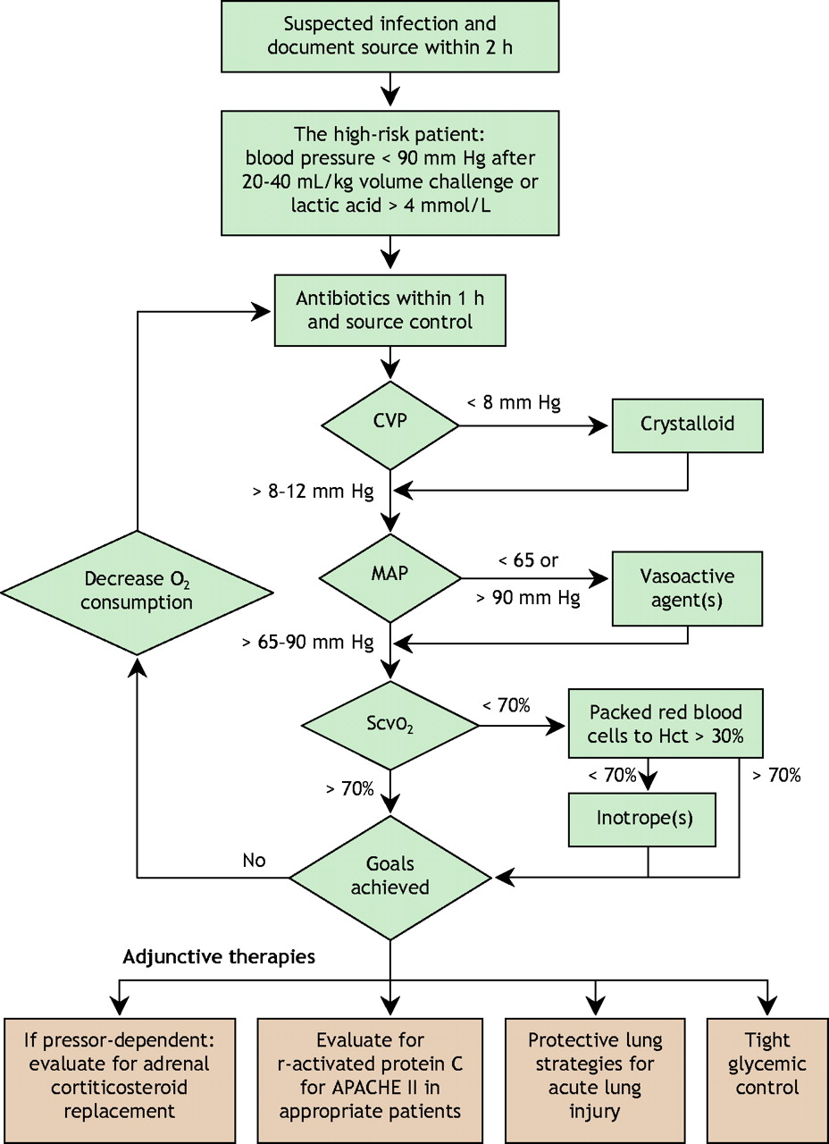

Slide 17
To be continued :Lubna Sameer
MULTIPLE ORGANS DYSFUNCTION (MODS)
Diagnosis
Management

Slide 18
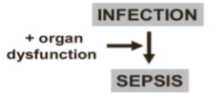
MULTIPLE ORGANS DYSFUNCTION (MODS)
Progressive and potentially reversible failure in the physiologic function of several organs and/or systems …The more organs that are affected, the greater the mortality risk
It is at the severe end of the severity of illness spectrum of both infectious (sepsis, septic shock) and noninfectious conditions (eg, SIRS from pancreatitis).
The presence of altered organ function in an acutely ill patient so that homeostasis cannot be maintained without intervention and it is of two types:
o 1-Primary MODS: a well-defined insult, occurs early and can be directly associated to the insult itself
(e.g., renal failure due to rhabdomyolysis ).
o 2-Secondary MODS: not in direct response to the insult itself, but as a consequence of a host response (SIRS)
Notes:
Sepsis: a severe, life-threatening condition that results from a dysregulation of the patient's response to an infection, causing tissue and organ damage and subsequent organ dysfunction

Slide 19
There are no universally accepted criteria for individual organ dysfunction in MODS.
However, progressive abnormalities of the following organ-specific parameters are commonly used to diagnose MODS and are also used in scoring systems
(eg, SOFA or LODS) to predict ICU mortality
●Respiratory – Partial pressure of arterial oxygen (PaO₂)/fraction of inspired oxygen (FiO₂) ratio
●Hematology – Platelet count
●Liver – Serum bilirubin
●Renal – Serum creatinine (or urine output)
●Brain – Glasgow coma score
●Cardiovascular – Hypotension and vasopressor requirement
In general, the greater the number of organ failures, the higher the mortality, with the greatest risk being associated with respiratory failure requiring mechanical ventilation.

Slide 20
Sequential organ failure assessment score (SOFA score)
Used in critical care settings as a tool to identify organ failure and predict mortality
The score should be calculated after 24 hours of ICU admission and then every 48 hours.
Should not be used to diagnose sepsis

Slide 21
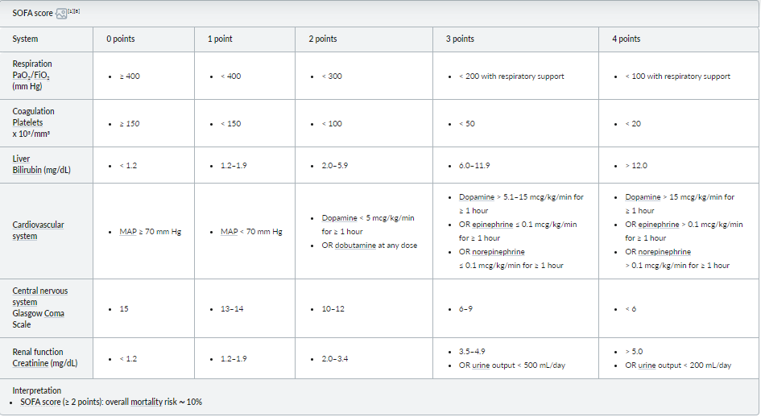

Slide 22
Diagnosis :
The main goals of the diagnostic workup in a patient with suspected sepsis are to determine the presence and severity of organ dysfunction and to identify the source of infection
Laboratory studies
identifying the source of infection
Imaging

Slide 23
Laboratory studies
In addition to serum lactate and blood cultures (at least two sets), the following laboratory studies should be obtained to support the diagnosis and evaluate for organ dysfunction.
CBC:
variable findings, Leukocytosis or leukopenia, Thrombocytosis or thrombocytopenia
CRP, procalcitonin: typically elevated
BMP and electrolytes
Renal function: ↑ BUN and ↑ creatinine
Glucose: hyperglycemia, hypoglycemia
Electrolyte derangements
Liver chemistry and synthetic function tests:
hyperbilirubinemia, ↑ INR, ↑ ALT, ↑ AST
Coagulation panel
D dimer: ↑ prothrombin time, ↑ activated partial thromboplastin time, ↓ antithrombin III, ↑ D dimer may be present
Consider amylase, lipase(if pancreatitis is suspected)
Blood gas to identify possible acid-base disturbances and assess oxygenation
Notes:
Laboratory signs — Similarly, laboratory features are nonspecific and may be associated with abnormalities due to the underlying cause of sepsis or to tissue hypoperfusion or organ dysfunction from sepsis.
Leukocytosis (white blood cell [WBC] count >12,000 microL–1) or leukopenia (WBC count <4000 microL–1) (table 2).
●Hyperglycemia (plasma glucose >140 mg/dL or 7.7 mmol/L) in the absence of diabetes.
●Plasma C-reactive protein more than two standard deviations above the normal value.
●Arterial hypoxemia (arterial oxygen tension [PaO2]/fraction of inspired oxygen [FiO2] <300).
●Acute oliguria (urine output <0.5 mL/kg/hour for at least two hours despite adequate fluid resuscitation).
●Creatinine increase >0.5 mg/dL or 44.2 micromol/L.
●Coagulation abnormalities (international normalized ratio [INR] >1.5 or activated partial thromboplastin time [aPTT] >60 seconds).
●Thrombocytopenia (platelet count <100,000 microL–1).
●Hyperbilirubinemia (plasma total bilirubin >4 mg/dL or 70 micromol/L).
●Adrenal insufficiency (eg, hyponatremia, hyperkalemia), and the euthyroid sick syndrome can also be found in sepsis.

Slide 24
Hyperlactatemia (higher than the laboratory upper limit of normal)
An elevated serum lactate (eg, >2 mmol/L) can be a manifestation of organ hypoperfusion in the presence or absence of hypotension and is an important component of the initial evaluation, since elevated lactate is associated with poor prognosis
serum lactate level ≥4 mmol/L is consistent with, but not diagnostic of, septic shock
Plasma procalcitonin more than two standard deviations above the normal value ,Elevated serum procalcitonin levels are associated with bacterial infection and sepsis
Procalcitonin:
A hormone that is synthesized by the parafollicular C cells of thyroid:
➢ normal level <0.05ng/ml
➢ <0.5 rules out infection
➢ 0.5-2 suspected sepsis
➢ >2- 100 sepsis severity
Notes:
Procalcitonin:
A hormone that is synthesized by the parafollicular C cells of thyroid:
➢ normal level <0.05ng/ml
➢ <0.5 rules out infection
➢ 0.5-2 suspected sepsis
➢ >2- 100 sepsis severity
The rise in concentration start after 6 hrs. and the t1/2 is 24 hrs.
• C-reactive protein (CRP): acute phase reactant used to assess the severity of sepsis
normal value <6mg/l

Slide 25
identifying the source of infection
Microbiology
In addition to blood cultures, consider additional cultures guided by clinical judgment
Urinalysis and urine culture
Sputum culture
Consider also: CSF , wound secretion, tissue/fluid
Diagnostic procedures as indicated to obtain samples for cultures (e.g., lumbar puncture, thoracentesis, paracentesis, arthrocentesis)
Imaging
Direct decisions based on clinical suspicion.
There are no radiologic signs that are specific to the identification of sepsis other than those associated with infection in a specific site (eg, pneumonia on chest radiography, fluid collection on computed tomography of the abdomen)
Notes:
Examples of commonly performed imaging include:
Chest x-ray: if pneumonia is suspected and/or to determine if ARDS is present as a complication
Abdominal x-ray: if a perforation or obstruction is suspected (pneumoperitoneum, air-fluid levels)
Abdominal ultrasound: initial abdomen assessment in most cases
Soft tissue: initial assessment of cellulitis and, in most cases, soft tissue abscess
CT scan: for a more detailed assessment of thoracic and abdominal/pelvic pathology
Echocardiography: to identify valve vegetations

Slide 26
Management:
Diagnostic and treatment measures should be conducted simultaneously in a patient suspected of having sepsis. Success depends on early detection, early and effective resuscitation, and early antibiotic therapy.
Approach:
Sepsis surveillance
Initial clinical evaluation (should follow ABCDE approach)
Initial resuscitation and ongoing clinical reassessment
Supportive care
Notes:
• The early goal directed therapy
• Lung protective ventilation
• administration of adequate antibiotic therapy
• Steroids
• Activated protein C
• goal directed hemodynamic resuscitation
• Maintenance of normal glucose level (4-6 mmol/L)
The goals during the first 6 hours of resuscitation should be:
1. CVP 8-12mm Hg (12-15 on ventilated patients)
2. Mean arterial pressure > 65 mm Hg
3. Urine output > 0.5 mL/kg/hr

Slide 27
Approach:
Sepsis surveillance: Identify patients with potential sepsis.
Quick SOFA criteria :
Consider positive if ≥ 2 of the following are present:
Alteration in mental status
Systolic blood pressure ≤ 100 mm Hg
Respiratory rate ≥ 22/min
Initial clinical evaluation (should follow ABCDE approach)
IV access, vital signs, monitor
Initial labs:
Serum lactate: Elevated lactate reflects hypoperfusion and is associated with worse outcomes.
2 sets of blood cultures (aerobic and anaerobic) before administering antibiotics
(if possible)

Slide 28
Initial resuscitation and ongoing clinical reassessment
Provide hemodynamic support.
Fluid resuscitation: Many patients may benefit from around 30 mL/kg of crystalloid fluids
A fluid administration is continued as long as the hemodynamic improvement continues (e.g., arterial pressure, heart rate, urine output)
If there is persistent hypotension during or after fluid resuscitation, start vasopressors and titrate to maintain a MAP ≥ 65 mm Hg.
Start empiric broad-spectrum antibiotics
Continuous reassessment of the clinical response to resuscitation to guide the decision to escalate fluids or pressors
Supportive care
Notes:
Monitor hemodynamic parameters ^{[7][24]}
Vital signs: e.g., mean arterial pressure (MAP), heart rate
Other clinical parameters: e.g.,urine output, capillary refill, signs of poor peripheral perfusion
Consider invasive vascular monitoring (if vasopressors are used).
Biomarkers: e.g., serum lactate , base excess
Cardiac function monitoring: e.g., devices that measure cardiac index, echocardiography
Consider protocolized resuscitation targets
Lactate guided fluid resuscitation strategy
Early goal-directed therapy
Supportive care
Fluids, nutrition, and electrolytes ^{[7][26]}
Maintenance fluids: Consider after initial fluid therapy for stable patients at risk of hypovolemia.
Bowel rest or enteral feeds: indication depends on the source of infection and level of consciousness
Electrolyte repletion
Normoglycemia: insulin as needed for target glucose of 140–180 mg/dL (see “Inpatient management of hyperglycemia”)
Transfusions: to consider as needed ^{[7][26]}
Other supportive measures ^{[7][26]}
VTE prophylaxis
Renal replacement therapy: e.g., for patients with concomitant severe acute kidney injury
Stress ulcer prophylaxis: on a case-by-case basi

Slide 29
CASE :

Slide 30
Notes:
CT of the chest with contrast may be used for the diagnosis of pulmonary embolism (PE). Given her hospitalization and recent operation, this patient is at an increased risk for developing PE and has some symptoms that are consistent with this condition, like dyspnea, tachypnea, and cough. However, this diagnosis is unlikely because the patient does not mention any chest pain and – unlike the acute onset of symptoms typically seen in PE – this patient's condition was insidious in onset. The presence of malaise, fever, and chills, together with leukocytosis, suggest an infectious etiology.
ravenous cefepime and oral metronidazole
Intravenous cefepime combined with oral metronidazole is used for the treatment of postoperative abdominal infections. Although this patient has had abdominal surgery, there is no evidence of a surgical site infection; she has a well-healing surgical scar and her abdominal examination does not show any abnormalities
An abdominal x-ray may be useful for the diagnosis of pathological processes involving the abdomen such as bowel obstruction or a perforated ulcer. While postsurgical patients are at increased risk of developing a bowel obstruction, the abdominal examination was unremarkable in this patient. Her symptoms suggest an infectious condition originating in the lungs
ntravenous ceftriaxone and azithromycin
22%
Intravenous ceftriaxone and azithromycin may be used for the inpatient treatment of community-acquired pneumonia. This patient has features suggesting pneumonia, but she meets the criteria for hospital-acquired pneumonia (HAP) rather than community-acquired pneumonia. HAP is most commonly caused by gram-negative bacilli (e.g., Pseudomonas) and Staphylococcus aureus, which are not sufficiently covered by ceftriaxone and azithromycin. In addition, she has signs and symptoms suggestive of sepsis, which further warrants the use of broad-spectrum antibiotics that also cover MRSA and Pseudomonas aeruginosa.

Slide 31
Answer :

Slide 32
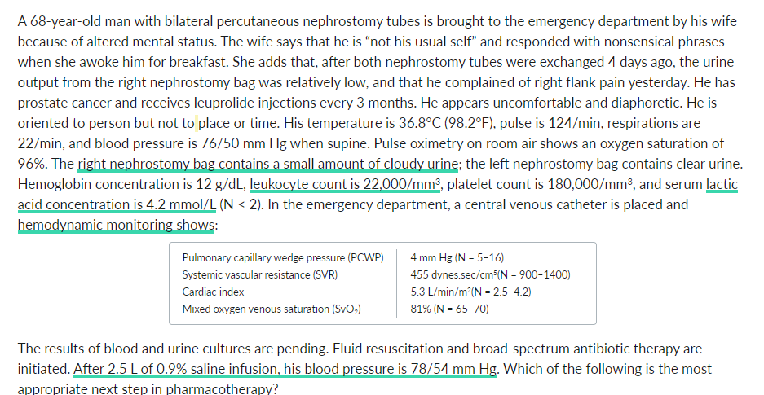

Slide 33
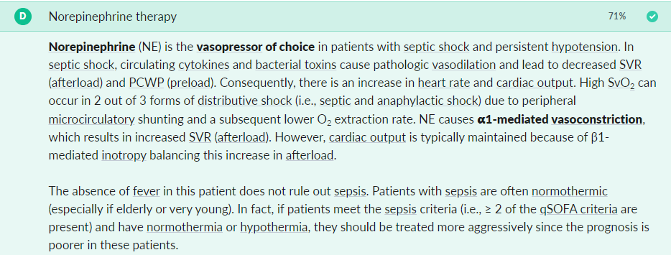
Answer :

Slide 34
Thank you

