Slide 1
Abdominal trauma
Done by: supervised by: dr saad azzawi
Miqdad Alsarayreh
Rayyan Alrawashdeh
Hasan abbadi

Slide 2
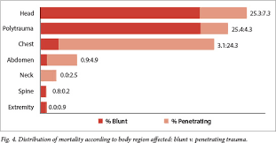
Introduction
1.Road traffic accidents is the main cause of abdominal trauma in the civilian population
2. Abdominal injuries rank third as a cause of traumatic death after head and chest injuries
3. The primary cause of death in abdominal trauma is hemorrhage and sepsis after 48 hours

Slide 3
Types:-:-
There are two types of abdominal trauma:-
1- Blunt abdominal trauma which is the most common cause usually due to RTA, direct blow to the abdomen or falling down.
2- penetrating abdominal trauma may be due to missile injuries or stab wounds.

Slide 4
Blunt abdominal trauma:-
Mechanism of injury:-
1- sudden deceleration can lead to differential movement among adjacent structures especially at fixed points of attachment such as (ligament of Treitz, ileocecal valve, phrenocolic ligament and ligamentum teres)
2- Compression with crush:- intraabdominal contents are crushed between anterior abdominal wall and the vertebral column.
3- compression with rupture:- it affects hollow viscus organs due to sudden rise in intraabdominal pressure.

Slide 5
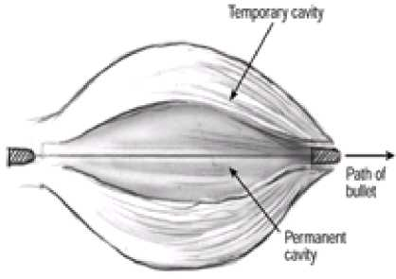
Mechanism of injury in penetrating abdominal trauma:-
The mechanism of penetrating injuries is mechanical disruption of the tissues along the pathway of the bullet or the stab.
Cavitation injuries occurs when velocities exceed 500-600 m/s which is a temporary space torn in tissues at right angles to the direction of travel. It depends on the tissue involved and its elasticity. Usually it occur in a hollow viscus organ as if it occurs in solid organs it will cause shattering of the organ.( cavitation injury require high speed and more elastic tissue)
Combined Penetrating & Blunt traumas can occur in explosive devices due to penetrating fragments wounds in addition to the patient being thrown or struck.

Slide 6
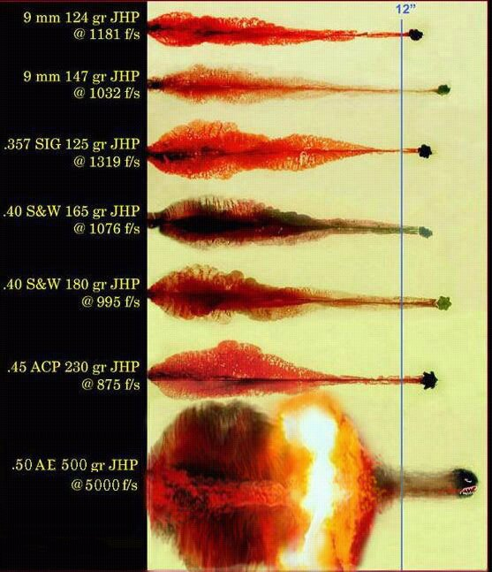

Slide 7
Approach to Patient
Resuscitation of all injuries to the abdomen should follow traditional Advanced Trauma Life Support (ATLS) principles:
Primary Survey (ABCDE)
Resuscitation
Secondary Survey:
History (AMPLE) & head to toe physical examination
Continuous monitoring and re-evaluation
Definitive care and transfer

Slide 8
Approach to Patient
After initial resuscitation:
Abdominal trauma patients can generally be classified into the following categories based on their physiological condition into:
Haemodynamically ‘stable’: Assessment & investigation is more limited aiming at establishing whether the patient can be managed non-operatively, whether angioembolisation can be used, or whether surgery is required.
Haemodynamically ‘unstable’: investigations need to be suspended as immediate surgical correction of the bleeding is required.

Slide 10
Assessment of blunt abdominal trauma:-
History:-
In RTA:-
1- The type of collision.
2- The extent of vehicle damage.
3- The patient position in the vehicle.
4- The extraction time.
5- The status of other passengers.
In Falling Down patients the most important question is to ask about the height of FD and in direct blow patients you have to ask about the site of blow.
We have to ask about the BP of the patient to know if there is intraabdominal injury even if the patient arrives at hospital normotensive.
Examination:-
There are some signs that indicate an intra abdominal injury such as abdominal distention, seat belt mark, abrasions and ecchymosis.
The most reliable signs and symptoms in alert patients are pain, tenderness, gastrointestinal hemorrhage, hypovolemia, and evidence of peritoneal irritation.

Slide 11
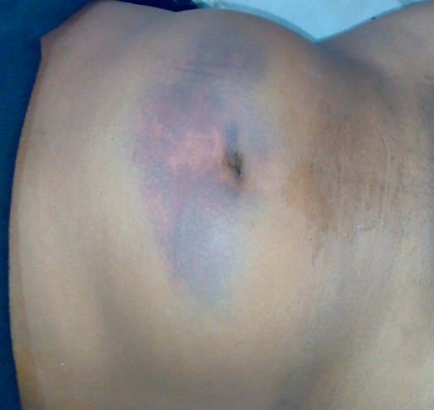
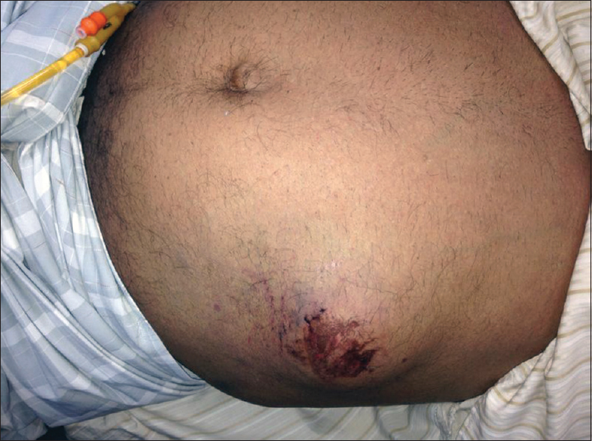
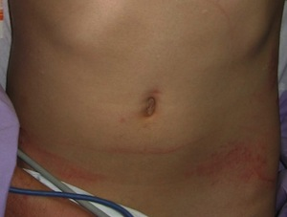

Slide 12
Assessment of penetrating injuries:-
History:- generally we have to ask about the time between injury and reaching hospital and the type of weapon and the site of injury.
If it is knife we have to ask about how many times and its length.
If it is gunshot we have to ask about the type and how many bullets.
Examination:-
Assessment should be done when the patient is stable.

Slide 13
cont
Site:-
Any wound in the boundaries of the abdomen is a potential abdominal injury.
If the wound in the retroperitoneum we consider it in the ascending or descending colon.

Slide 14
Physical Examination: Inspection
The patient must be fully undressed.
The anterior and posterior abdomen, as well as the lower chest and perineum, should be inspected for:
Abrasions, contusions from restraint devices, lacerations, Penetrating wounds.
Abdominal distension
Impaled foreign bodies.
Log roll the patient for complete examination.

Slide 15
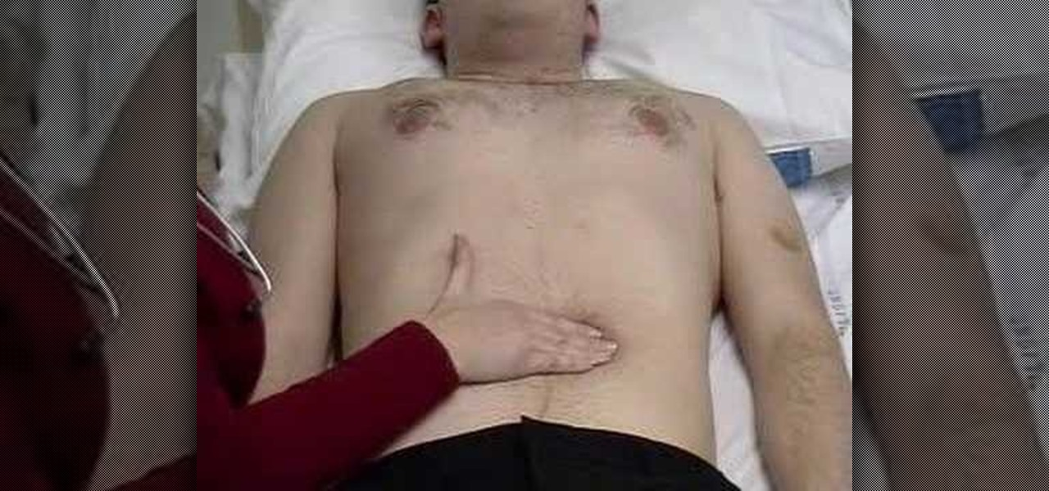
Physical Examination: Palpation
Distinguish superficial (abdominal wall) and deep tenderness.
Signs of peritoneal irritation: gaurdining, rigidity and rebound tenderness.
Crepitus at lower thoracic cage.
The presence of a pregnant uterus.

Slide 16
Physical Examination: Auscultation
Used to confirm the presence or absence of bowel sounds.

Slide 17
Urethral, Perineal and Rectal examination
Look for evidence of urethral injury:
Blood at the urethral meatus
Scrotal ecchymosis or hematoma
Rectal examination, look for:
Assess sphincter tone and rectal mucosal integrity.
Determine the position of the prostate.
Identify any fractures of the pelvic bones.
Gross blood from bowel perforation.

Slide 18
Physical examination
Lastly, Vaginal examination is done if severe perineal injuries, pelvic fracture or trans-pelvic gunshot are present.
Gluteal examination: Penetrating injuries to this area are associated with up to a 50% incidence of significant intra-abdominal injuries.
At the conclusion of the rapid physical exam, the patient should be covered with warmed blankets to help prevent hypothermia.
Repeated Physical examinations are encouraged to detect signs of bleeding or peritonitis developing over time.

Slide 19
Diagnosis
1- Local wound exploration:-it is done for penetrating injuries if it is stab wound we dilate the wound and we put a probe to explore the wound when the probe stops it indicates the depth of the wound. If the probe passes the peritoneum then we have to do laparotomy.
If the cause is gunshot then radiological studies are used to determine the depth of injury.
2- Focused abdominal sonar for trauma:- it is used to indicate the presence of blood in the abdominal cavity mainly (morison (hepatorenal recess) pouch, paracolic gutter, splenorenal recess and pouch of douglas). If it is present it is an indication of laparotomy. It can be done in unstable patients.
Accurate in detecting more than 100 ml of fluid in the abdomen.
Should be repeated in 30 minutes for detection of progressive hemoperitoneum.

Slide 20
cont
3- CT scan:- it is used in stable patients to identify injured organs(solid and retroperitoneal)
We can determine bowel perforation, diaphragmatic rupture, retroperitoneal blood and pelvic and spinal fractures.
4- DPL:- it is used to asses the presence of blood in the abdomen.
Indications of DPL:-
1- ambiguous clinical examination.
2- difficulty in assessing the patient.
3- persistence of hypotension despite resuscitation.
4- presence of multiple injuries.

Slide 21
Positive results of DPL:-
Before putting RL:-
- more than 10 ml of blood is aspirated from the abdomen at first.
After putting RL
- the presence of more than 100,000 red cells/µL or more than 500white cells/µL.
Amylase > 175 units.
The presence of enteric contents or bile.

Slide 22
Comparison

Slide 23
splenic injury
The spleen is located posterolaterally in the left upper quadrant of the abdomen (figure 1) beneath the left hemidiaphragm and lateral to the greater curvature of the stomach. The spleen is surrounded by a fibrous capsule composed of collagen, elastin, and smooth muscle. The spleen is important for opsonization of encapsulated organisms.
The spleen is predominantly perfused by the splenic artery, which is a branch of the celiac trunk. Collateral splenic blood flow is also derived from the short gastric arteries, which can have contributions from the left gastric and left gastroepiploic artery. The splenic artery, which can be quite tortuous, traverses along the superior margin of the pancreas, supplying branches to it, before continuing to the spleen

Slide 24
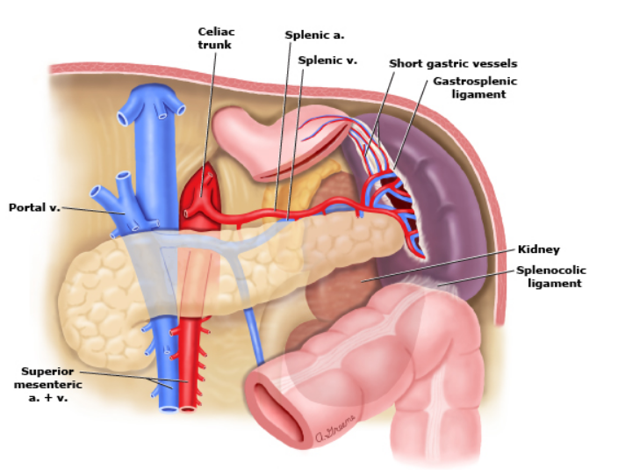

Slide 25
MECHANISM OF INJURY
Splenic injury most commonly occurs following blunt trauma due to motor vehicle collisions (driver, passenger, or pedestrian). However, blunt splenic injury can also result from falls, sports-related activities, or assaults . Penetrating splenic trauma is less common compared with blunt injury and is typically due to assault, but inadvertent impalement may also occur. Assault with a knife compared with gunshot or shotgun wounds is less likely to result in penetrating injury due to the spleen's protected location.
The spleen and liver are the most commonly injured intra-abdominal organs following blunt trauma. In up to 60 percent of patients, the spleen is the only organ injured . Specific elements of the history, physical examination, and diagnostic evaluation pertaining to splenic injury are presented below.

Slide 26
History and physical examination
A history of trauma to the left upper quadrant, left rib cage, or left flank should increase the suspicion for splenic injury. However, a negative history does not reliably exclude splenic injury. A penetrating object can injure the spleen even if the entrance wound is not in proximity to the spleen.
The patient may complain of left upper abdominal, left chest wall, or left shoulder pain (ie, Kehr's sign). Kehr's sign is pain referred to the left shoulder that worsens with inspiration and is due to irritation of the phrenic nerve from blood adjacent to the left hemidiaphragm.
Abdominal tenderness and peritoneal signs are the most common findings indicative of intra-abdominal injury; however, these are not sensitive or specific for splenic injury. Physical findings associated with splenic injury include left upper quadrant or generalized abdominal tenderness, abdominal wall contusion or hematoma (eg, seat belt sign), as well as left lower chest wall tenderness, contusion, or instability due to rib fractures. However, an unremarkable physical examination does not exclude splenic injury

Slide 27
Diagnostic evaluation
Evaluation of the abdominal trauma patient commonly uses focused assessment with sonography in trauma (FAST exam) and computed tomography (CT). The FAST exam is more useful in hemodynamically unstable patients; however, a negative FAST examination is not adequate to exclude splenic injury, particularly intraparenchymal injury. The use of diagnostic peritoneal aspiration/lavage (DPA/DPL) is less common, having been largely replaced by the FAST examination in most major trauma centers. FAST findings — Signs of splenic injury observed with FAST examination include a finding of hypoechoic (ie, black) rim around the spleen, which may represent subcapsular fluid or intraperitoneal perisplenic fluid, or fluid in Morison's pouch (hepatorenal space).
CT scan is typically performed intravenous (IV) contrast to establish and grade splenic injury. Other imaging — Plain films, organ-based ultrasound imaging, and magnetic resonance imaging (MRI) are of limited value in the acute diagnosis of splenic injury.

Slide 28
The AAST imaging criteria for splenic injury are as follows :
the AAST imaging criteria for splenic injury are as follows
●Grade I – Subcapsular hematoma <10 percent surface area. Parenchymal laceration <1 cm in depth (.
●Grade II – Subcapsular hematoma 10 to 50 percent surface area; intraparenchymal hematoma <5 cm. Parenchymal laceration 1 to 3 cm in depth.
●Grade III – Subcapsular hematoma >50 percent of surface area; ruptured subcapsular or intraparenchymal hematoma ≥5 cm. Parenchymal laceration >3 cm in depth.
●Grade IV – Any injury in the presence of a splenic vascular injury or active bleeding confined within splenic capsule. Parenchymal laceration involving segmental or hilar vessels producing >25 percent of devascularization
●Grade V – Any injury in the presence of splenic vascular injury with active bleeding extending beyond the spleen into the peritoneum. Shattered spleen.

Slide 29
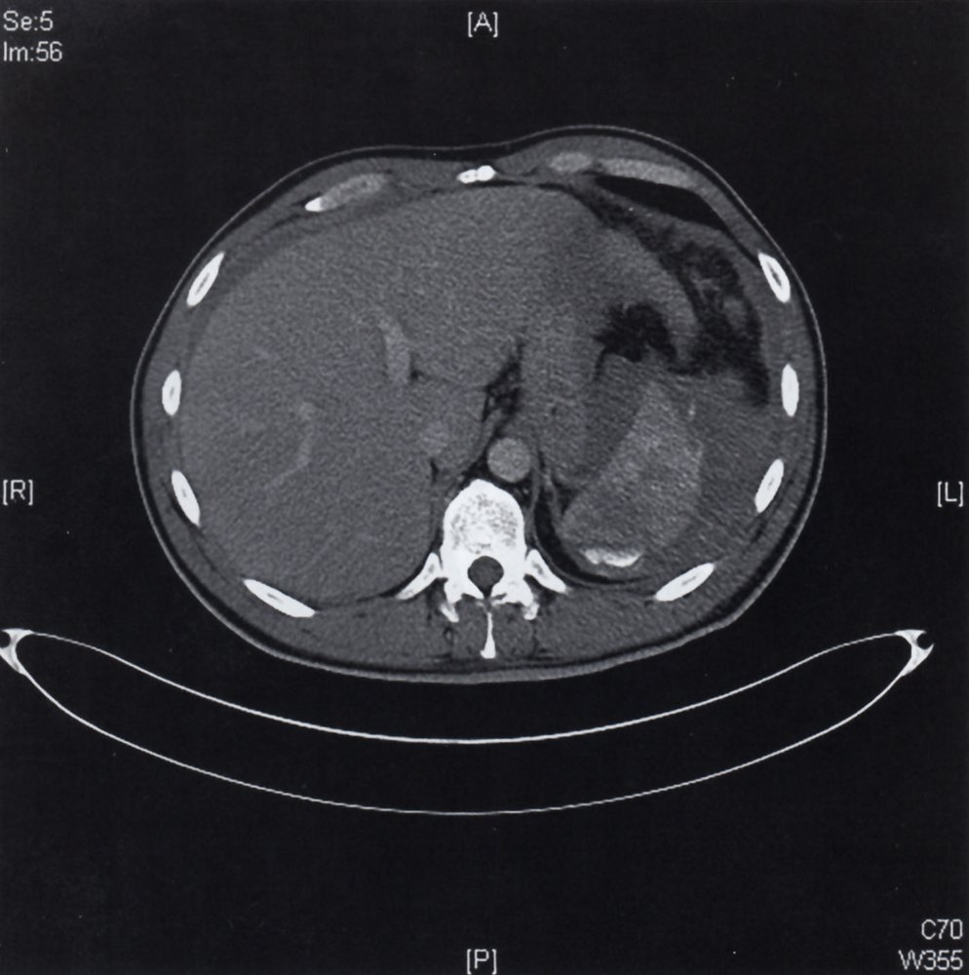

Slide 31
MANAGEMENT APPROACH
Splenic injury can be initially managed with observation, angiographic embolization, or surgery depending upon the hemodynamic status of the patient, grade of splenic injury, and presence of other injuries and medical comorbidities
Hemodynamically unstable – Based upon Advanced Trauma Life Support (ATLS) principles, the hemodynamically unstable trauma patient with a positive focused assessment with sonography in trauma (FAST) scan or diagnostic peritoneal aspiration/lavage (DPA/DPL) requires emergency abdominal exploration to determine the source of intraperitoneal hemorrhage
Hemodynamically stable patients with low-grade (I to III) blunt or penetrating splenic injuries without any evidence for other intra-abdominal injuries, active contrast extravasation, or a blush on computed tomography (CT) may be initially observed safely
Contraindications to nonoperative management — Nonoperative management is not appropriate in patients with hemodynamic instability, generalized peritonitis, or for patients with other intra-abdominal injuries requiring surgical exploration

Slide 32
IMMUNOCOMPETENCE AFTER SPLENIC INJURY
Immunization is recommended for asplenic patients since splenectomy impairs opsonization of encapsulated organisms
Ideally, vaccines are administered either 14 days prior to or 14 days following splenectomy for maximal immunologic benefit

Slide 33
Atraumatic rupture
Splenic rupture in the absence of trauma is uncommon but may be life threatening
A systematic review of 845 cases from the literature identified the following causes ●Neoplasm (eg, leukemia, lymphoma) – 30 percent
●Infection (eg, infectious mononucleosis, cytomegalovirus [CMV], HIV, endocarditis, malaria) – 27 percent
●Inflammatory disease/non-infectious disorders (eg, acute and chronic pancreatitis) – ●Drug and treatment related (eg, anticoagulation, granulocyte colony-stimulating factor [G-CSF], thrombolytic therapy, dialysis) – ●Mechanical causes (eg, pregnancy related, congestive splenomegaly) ●Idiopathic (normal spleen)

Slide 34
Splenosis
splenosis refers to implants of splenic tissue resulting from spillage of cells following abdominal trauma or surgery.
There are often multiple implants, and they can be located anywhere in the peritoneal cavity. Common sites include the left upper quadrant of the abdomen

Slide 36
Colorectal trauma

Slide 37
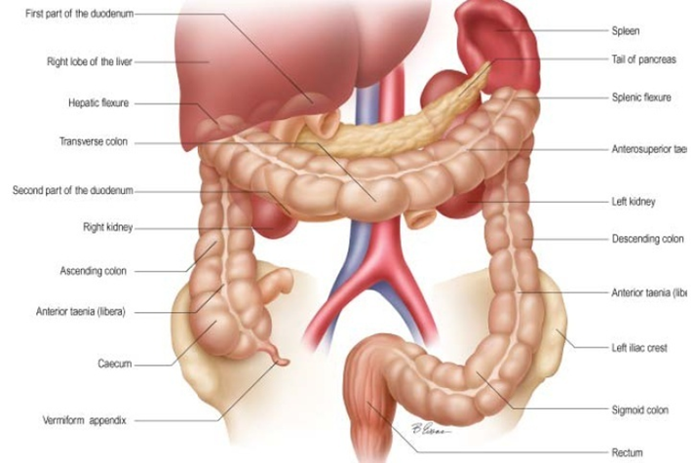
Anatomy

Slide 38
Connects the cecum proximally and the rectum distally
Ascending colon
Retroperitoneal
Ascends along the right posterolateral abdominal wall from the cecum up to the right subcostal region, where it makes a 90° turn to the left (hepatic flexure)
Transverse colon
Intraperitoneal
Extends from the hepatic flexure to the splenic hilum, where it makes a 90° turn caudally (splenic flexure)
Descending colon
Retroperitoneal
Descends along the left posterolateral abdominal wall from the splenic flexure to the left iliac fossa
Sigmoid colon
Intraperitoneal
The S-shaped terminal portion of the descending colon located in the left iliac fossa
Extends up to the S3 vertebra

Slide 39
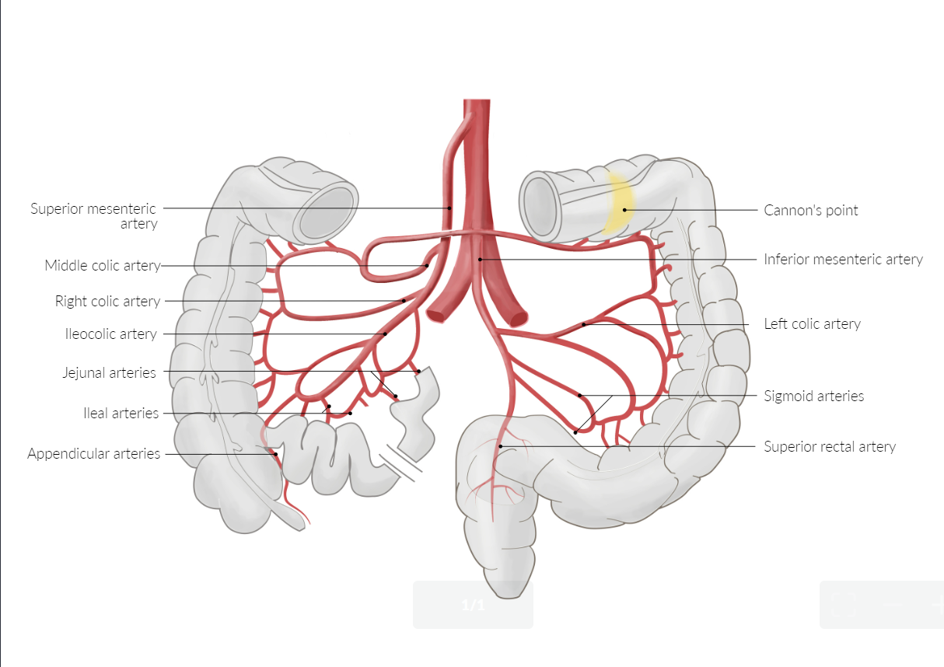
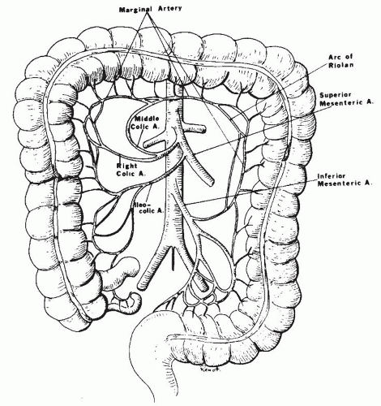

Slide 40
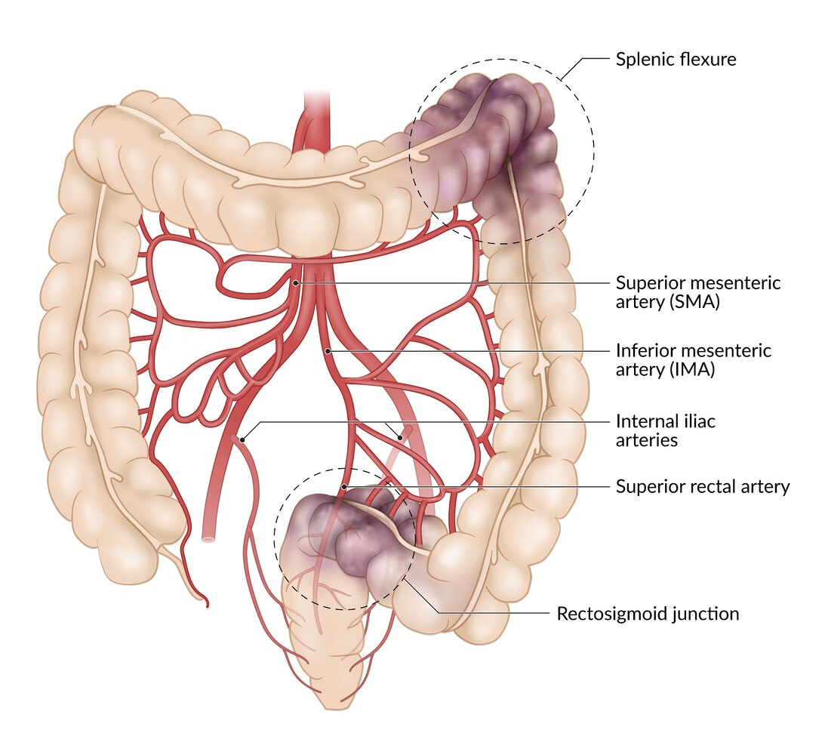
Watershed areas in colon ischemia

Slide 42
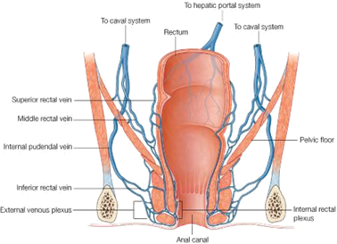
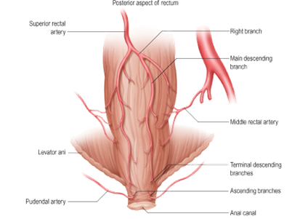

Slide 44
Incidence:
Penetrating 16%
Relatively infrequent after blunt trauma (2-5%)
Morbidity – 20-35%
Mortality – 3-15%
Etiology
Penetrating trauma
Blunt trauma
epidemiology

Slide 45
Colorectal Injury
Penetrating trauma
This is the most common type of trauma seen, and is usually due to:
High velocity missiles.
Rectal impalement injuries result when a patient falls on a penetrating object.
Iatrogenic injuries due to uterine perforation during curettage of the uterus, use of endoscopies or with rectal instrumentations.
During surgical operations for urologic or gynecologic operations.

Slide 46
Colorectal Injury
Blunt trauma
This is rare due to the protected situation of the anus and rectum and it is usually associated with fracture pelvis. The commonest cause is motor vehicle accidents followed by falls and crush injuries.

Slide 47
Intra-abdominal injuries are diagnosed as any abdominal trauma by the presence of manifestations of peritoneal irritation, free intraperitoneal fluid or air, and/or by assuring the presence of penetration into the peritoneal cavity.
How to suspect large bowel injuries

Slide 48
Rectal, anal canal and perineal trauma are diagnosed by proper inspection and per rectal examination of the patient.
The presence of bleeding per rectum is a very important sign.
The presence of different types of uretheral injuries as well as different types of fracture pelvis should stimulate the surgeon to properly examine and even sigmoidoscope the rectum and the pelvic colon.
How to suspect large bowel injuries

Slide 49
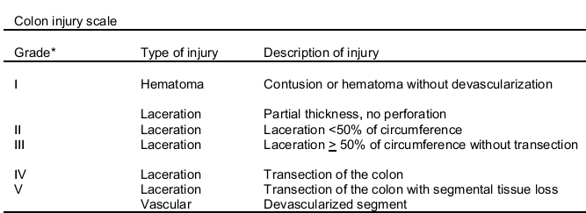
Colon Injury Grading

Slide 50
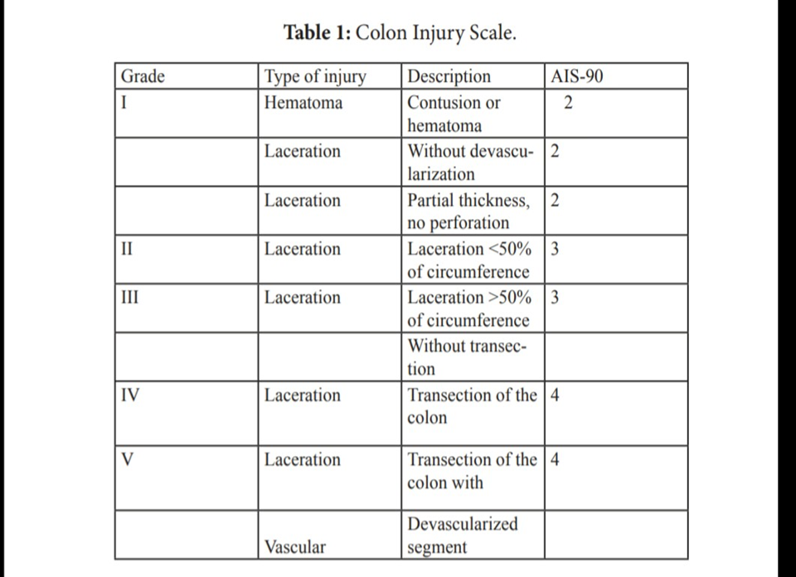

Slide 51
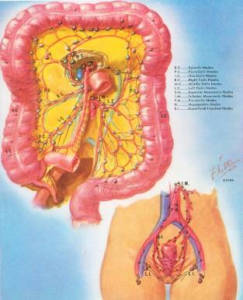
Treatment
There are three different methods for treating colonic injuries:
Primary repair
Colostomy
Exteriorized repair

Slide 52
Primary Repair
Include lateral suture of perforations and resection of the damaged colon with reconstruction by ileocolostomy or colocolostomy.
Advantage of primary repairs is that definitive treatment is carried out at the initial operation.
Disadvantage is that suture lines are created in suboptimal conditions, and leakage may occur.

Slide 53
Primary Repair
Necessitates the presence of the following conditions
Small tear less than 2 cm
Little contamination and minimal fecal spillage
Interference in a time less than 8 hours from wound inflection
No other large bowel injuries
No other organ injuries
No hemodynamic shock

Slide 54
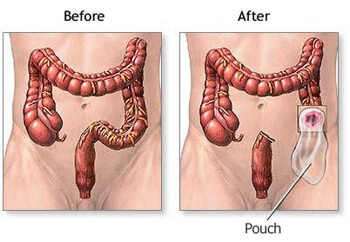
Colostomy
Several different styles of colostomies are used to manage colonic injuries.
Advantage of colostomy is that it avoids an unprotected suture line in the abdomen.
Disadvantage is that a second operation is required to close the colostomy.

Slide 55
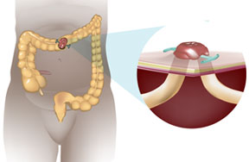
Types of colostomies
Ther three possibilities: (1) If the wound involves part of the circumference of the gut, you can make a loop colostomy without dividing the gut, as in E. Loop colostomies are easier in the transverse or sigmoid colon.
But if you mobilise the colon properly you can use them anywhere at or beyond the hepatic flexure. The loop must lie easily on the abdominal wall without tension. If it is tight, it will gradually retract and cause great problems with abdominal wall abscesses

Slide 56
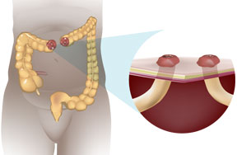
Double-barrel Colostomy
If you have to resect a short (5cm) length of gut you can bring the cut ends out through same incision (F).

Slide 57
If you have to resect a longer length of gut (more than about 5 cm), you cannot bring the two cut ends out of the same incision. So you will have to bring them out through separate incisions as faecal and mucous colostomies (G)

Slide 58
If the lower end of the gut is too short to bring out to the surface, you will have to use Hartmann’s procedure (H).

Slide 59
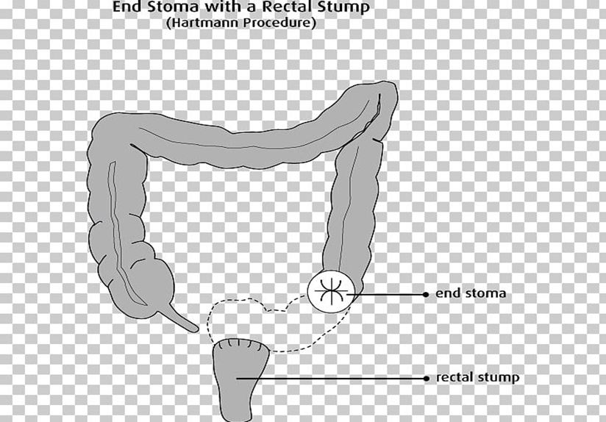

Slide 60
Exteriorized repairs
Exteriorized repairs are created by the suspending of a repaired perforation or anastomosis on the abdominal wall with an appliance after the fashion of a loop colostomy.
If after 10 days the suture line does not leak, it can be returned to the abdominal cavity under local anesthesia without subsequent risk of leakage.
If the repair breaks down before 10 days, it is treated as a loop colostomy. Healing is successful in 50 to 60 percent of cases.

Slide 61
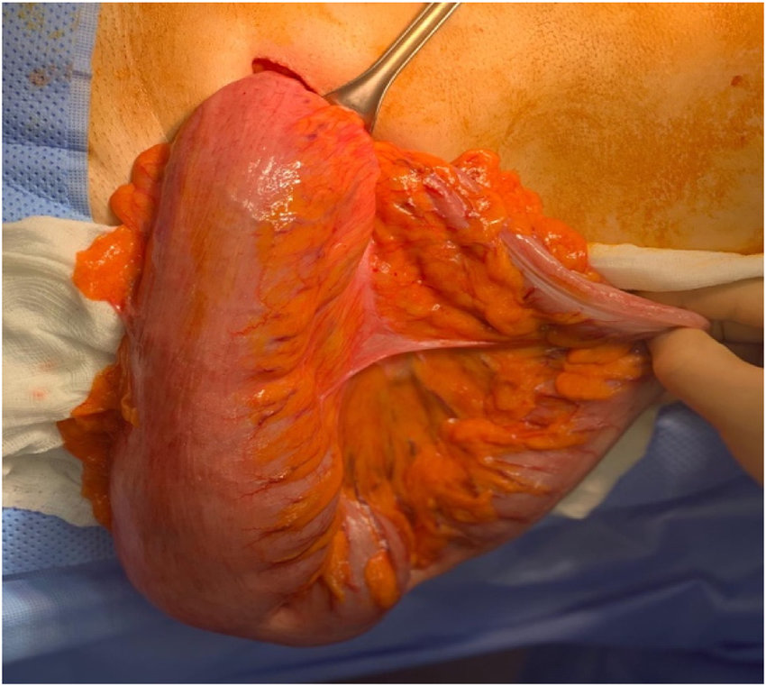
exteriorization of the sigmoid colon showing the mini-incision in left iliac fossa

Slide 62
Exteriorized repairs
advantage is avoidance of an intraperitoneal suture line when it is at risk of leakage.
disadvantage is that 40-50% of patients require colostomy closure.

Slide 63
Complications
Complications related to the colonic injury and its treatment may include :
Intraabdominal abscess
Fecal fistula
Wound infection
Stomal complications

Slide 64
