Slide 1
Hip Fracture
Presentsed by :
Malak Waleed Al-Fanatseh
Rawan Mohammad Al-Bawwab
Supervised by :
Dr- Bilal Al-zoubi

Slide 3
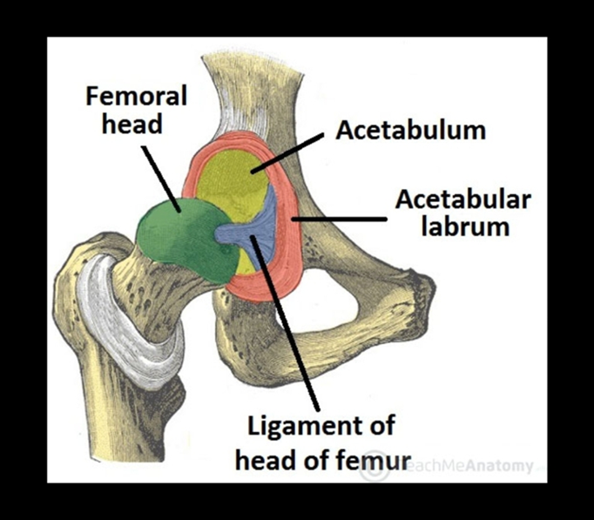
Hip Dislocation
Hip joint inherently stable due to :
bony anatomy
soft tissue constraints including
labrum
capsule
ligamentum teres
Mechanism:
​High energy trauma.
Either anterior or posterior but posteriorly more common.

Slide 4
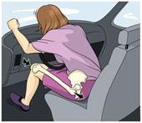
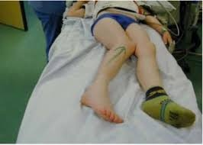
Posterior Hip Dislocation (90%)
Etiology:
Occurs in a road accident when someone seated in a truck or car is thrown forwards, striking the knee against the dashboard.
Presentation :
Hip pain which radiates to the
knee.
Hip and leg in slight flexion,
adduction, and internal rotation.

Slide 5
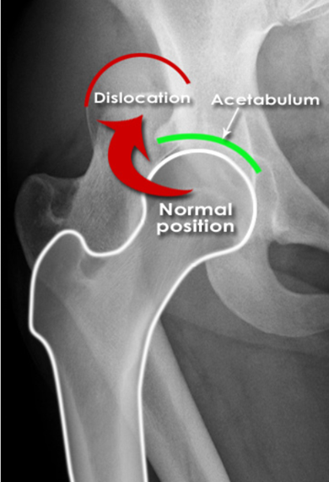
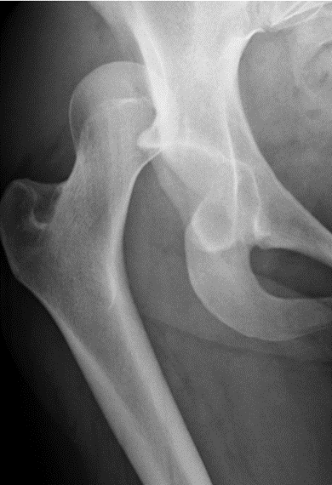
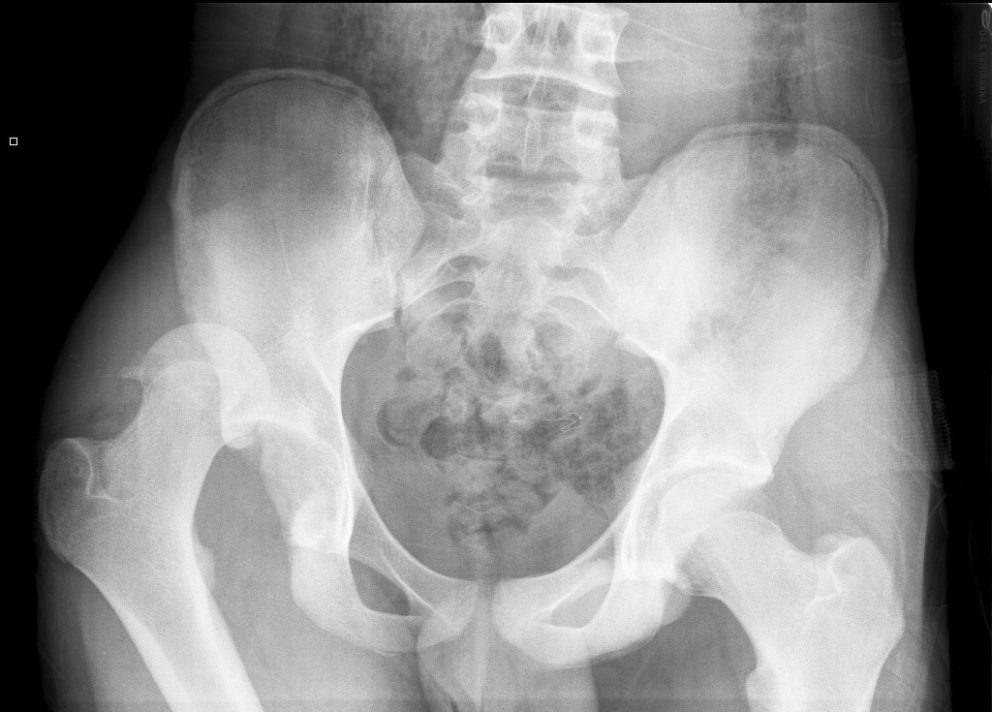
Posterior Hip Dislocation
Diagnosis:
x-ray, CT scan which includes the pelvis, the entire femur and the knee in every case of severe injury
X-ray: femoral head is seen out of its socket and above the acetabulum

Slide 7
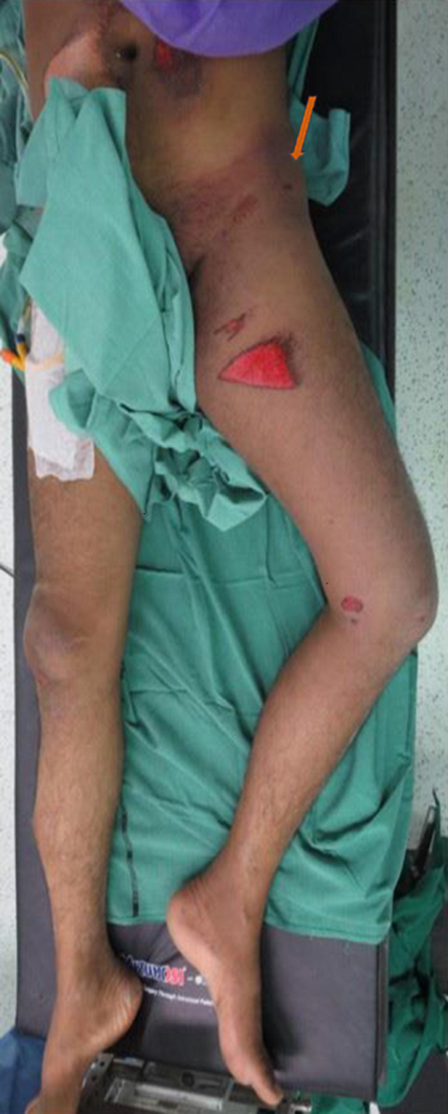
Anterior dislocation (10%)
Presentation:
Hip pain which radiates to the
knee.
Hip and leg in extension, abduction, and external rotation.
Seen from the side, the anterior bulge of the dislocated head is unmistakable.

Slide 8
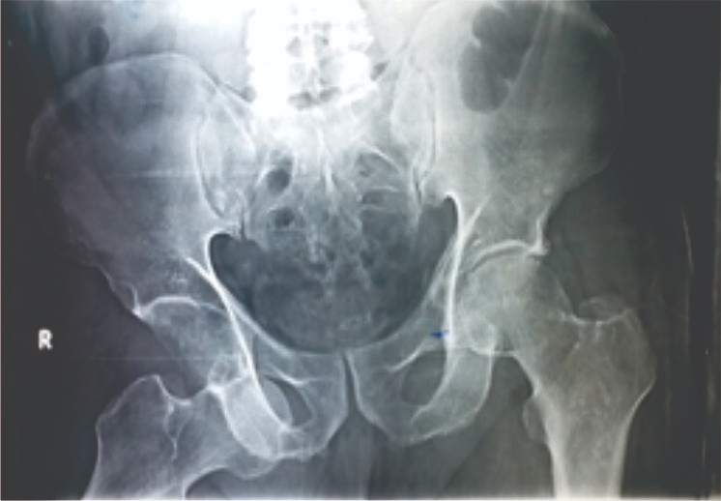
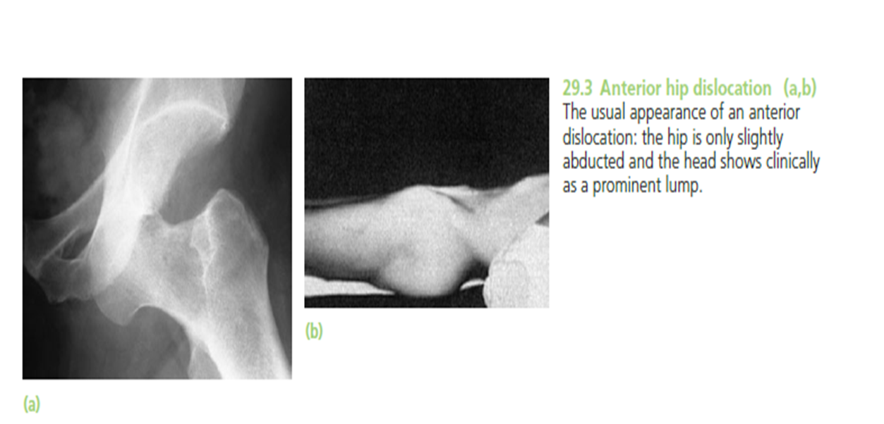
Anterior dislocation
X-rays:
The head is almost directly in front of its normal position; any doubt is resolved by a lateral film

Slide 9
Hip Dislocation
Treatment :
Closed reduction within 6 Hours .
Open reduction if :
failed closed reduction , the joint is unstable , or if bony fragments/tissue sit within the joint space.
Complications :
Post-traumatic arthritis
Femoral head osteonecrosis
Sciatic nerve injury or peroneal nerve injury.
Recurrent dislocations

Slide 10
Hip fracrutes
Epidemiology: Peak incidence: > 70 years Sex: female > male
Mechanism of injury: (most commonly due to) Older adults: Fall onto greater trochanter/lateral hip Children and young adults: high-speed trauma Pathological fracture
Risk factors: Osteoporosis (Osteoporosis related fracture) Low body weight Poor nutrition (vit D deficiency or calcium deficiency)

Slide 11
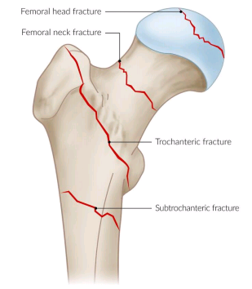
Hip fracrutes
Types of hip fractures :
Hip fractures are divided into:
Intracapsular : Femoral head Femoral neck
Extracapsular: Trochanteric Intertrochanteric Subtrochanteric

Slide 12
Femoral head fracture
Femoral head fractures are rare traumatic injuries that are usually associated with hip dislocations . The location and size of the fracture fragment and degree of comminution depend on the position of the hip at the time of dislocation.
5-15% of Posterior hip dislocations are associated with a femoral head fracture because of contact between femoral head and posterior rim of acetabulum.
Anterior hip dislocations are associated with impaction/indentation fractures of the femoral head

Slide 13
Femoral head fracture
History:
frontal impact MVA with knee striking dashboard
fall from height
Symptoms : localized hip pain , unable to bear weight
Physical exam:
Inspection: -shortened lower limb with large acetabular wall fractures, little to no rotational asymmetry is seen
-posterior dislocation: limb is flexed, adducted, internally rotated
-anterior dislocation: limb is flexed, abducted, externally rotated
Ipsilateral knee
Ligamentous stability
Neurovascular may have signs of sciatic nerve injury
Imaging
X-RAY
CT

Slide 15
Femoral head fracture
Management :
1.ORIF surgery:
Indications
-Pipkin II with > 1 mm step off
-if performing removal of loose bodies in the joint
-associated neck or acetabular fx (Pipkin type III and IV)
-polytrauma
-irreducible fracture-dislocation
-Pipkin IV
2.Arthroplasty:
Indications
-Pipkin I, II (displaced), III, and IV in older patients
-fractures that are significantly displaced, osteoporotic or comminuted

Slide 16
Femoral head fracture
Complications: 1. AVN (incidence is 0-23%)
risk is greater with delayed reduction of dislocated hip
2. Sciatic nerve neuropraxia (incidence is 10-23%)
usually peroneal division of sciatic nerve
spontaneous recovery of function in 60-70%
3. DJD (incidence 8-75%)
due to joint incongruity or initial cartilage damage
Decreased internal rotation
may not be clinically problematic or cause disability

Slide 17
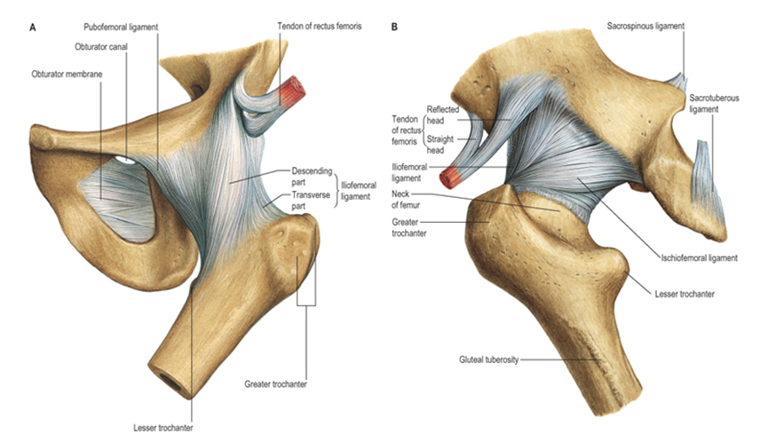
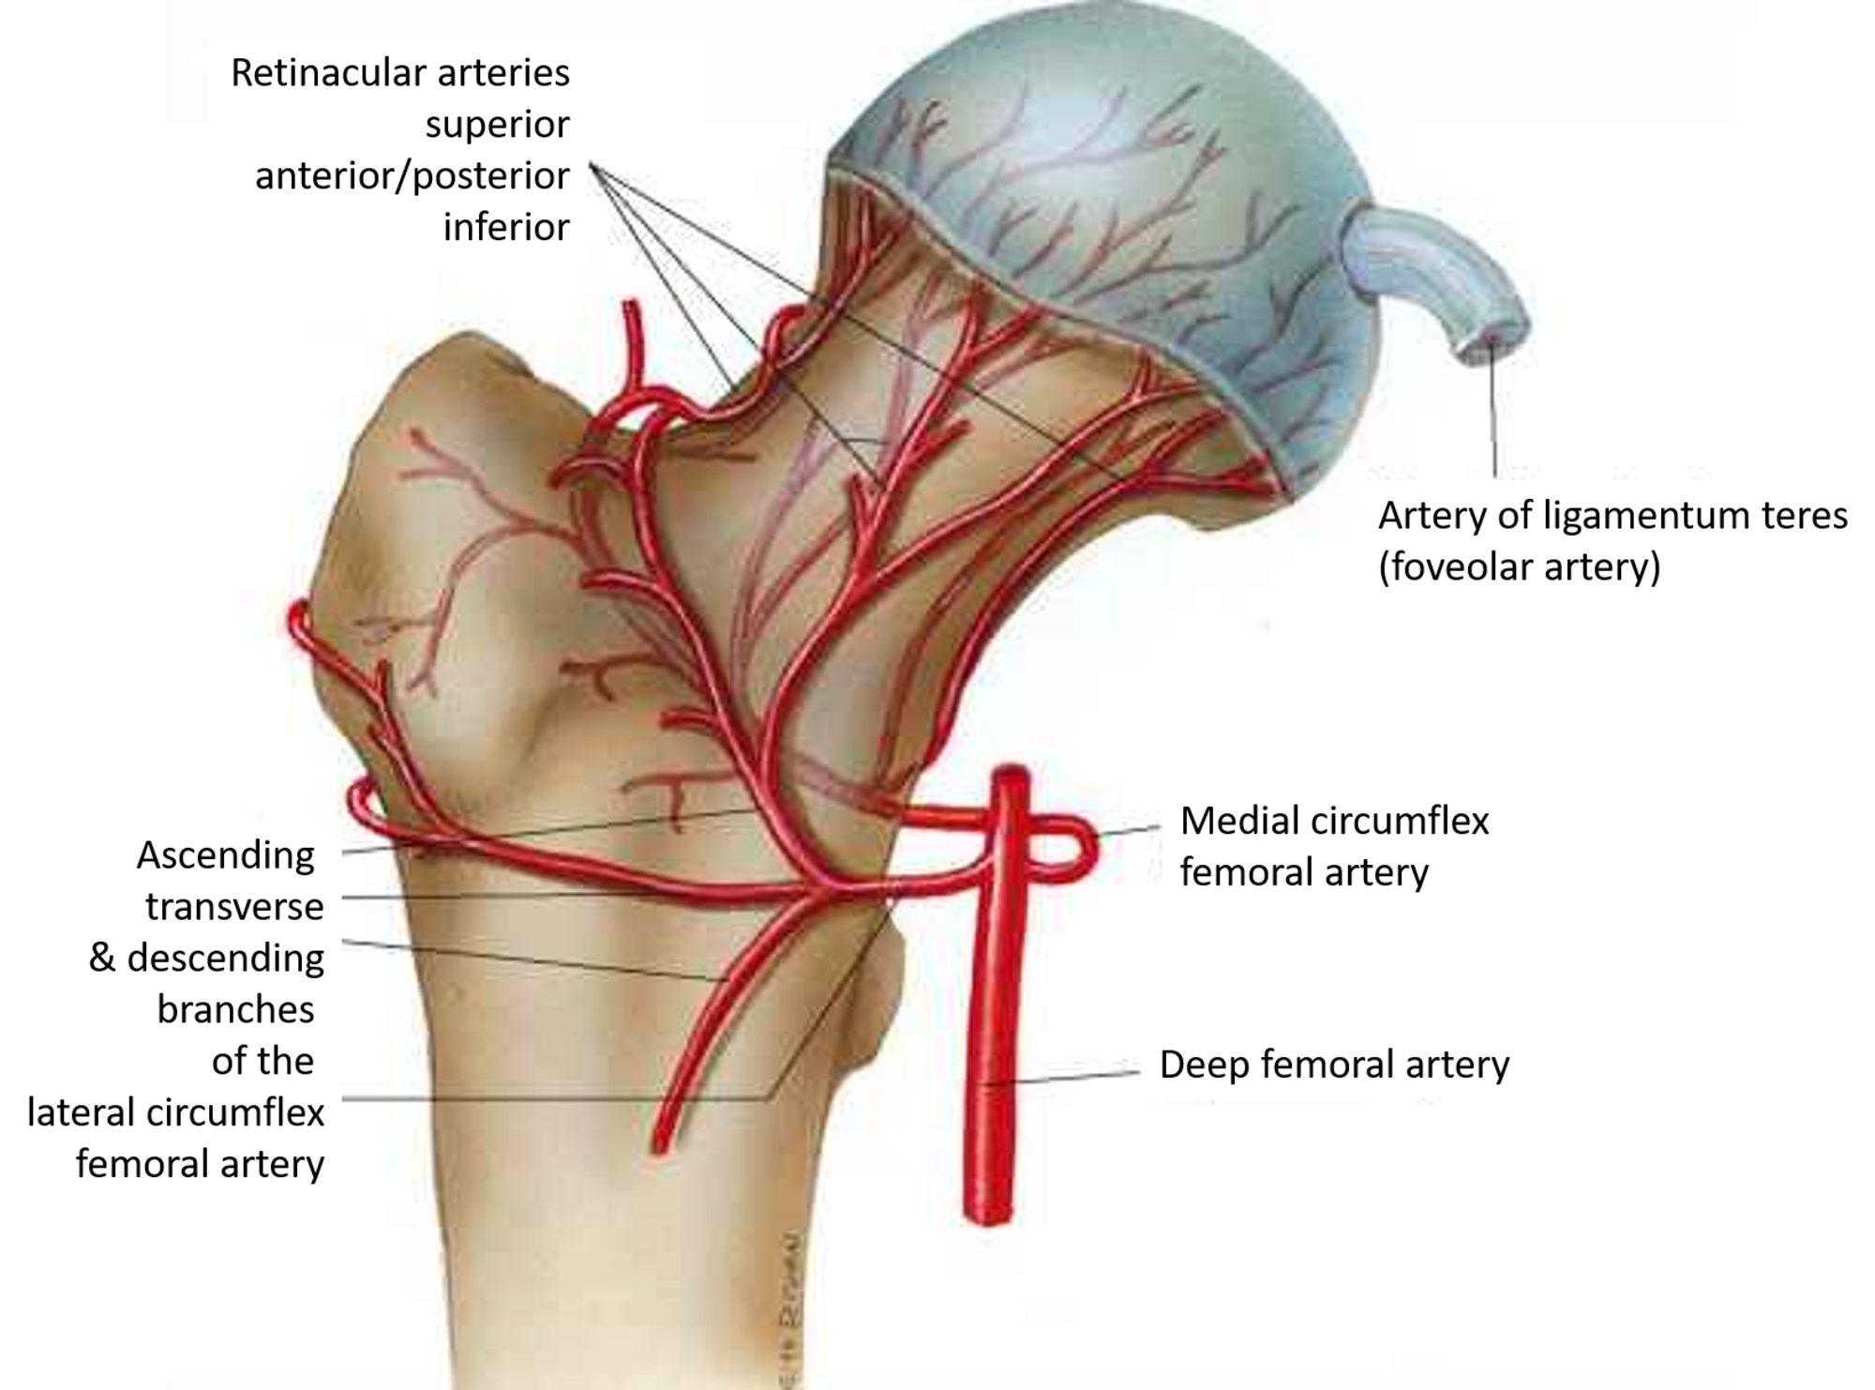
Femur Neck fracture
Blood supply
The femoral head gets its blood supply from three sources:
(1) Intramedullary vessels in the femoral neck
(2) Ascending cervical branches of the medial and lateral circumflex anastomoses
(3) The vessels of the ligamentum teres.

Slide 18
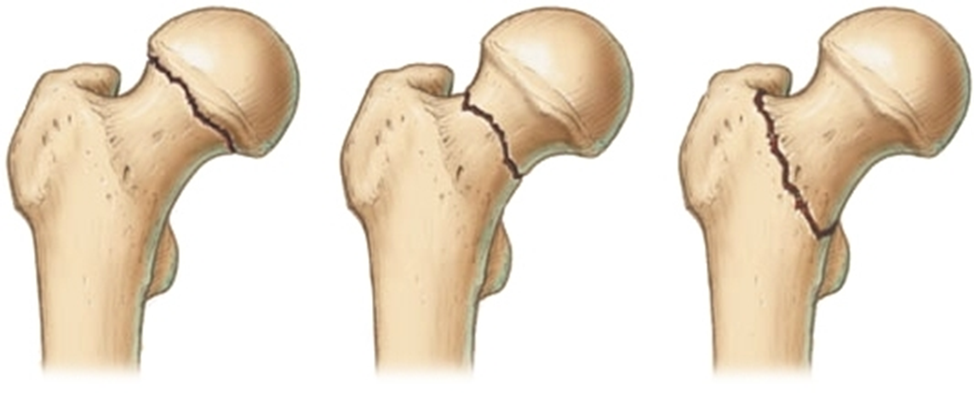
Femur Neck fracture
Mechanism
High energy in young patients
Low energy falls in older patients.
Pathophysiology
healing potential
Femoral neck is intracapsular, bathed in synovial fluid
Lacks periosteal layer
Callus formation limited, which affects healing

Slide 20
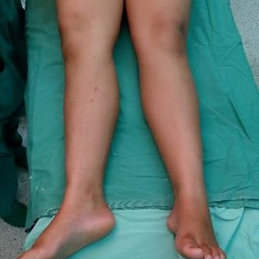
Femur Neck fracture
Presentation
Symptoms
Impacted and stress fractures
slight pain in the groin or pain referred along the medial side of the thigh and knee
Displaced fractures
pain in the entire hip region
Physical exam
Impacted and stress fractures
no obvious clinical deformity
minor discomfort with active or passive hip range of motion, muscle spasms at extremes of motion
pain with percussion over greater trochanter
Displaced fractures
leg in external rotation and abduction, with shortening

Slide 21
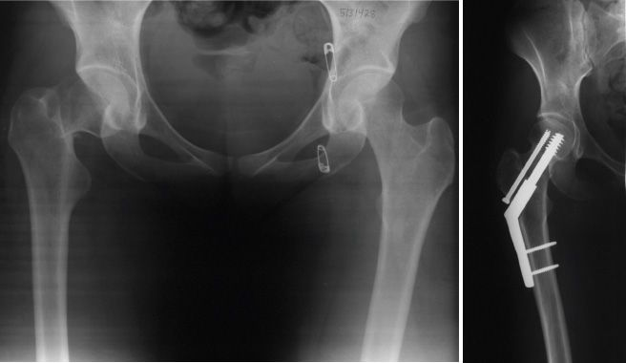
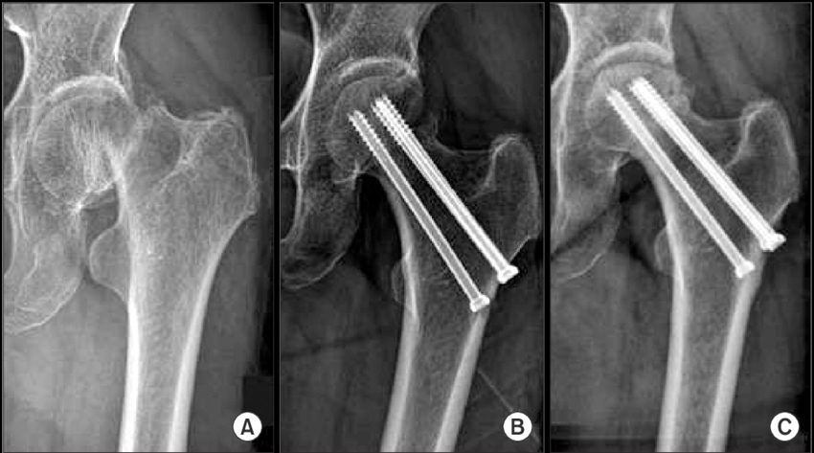
Femur Neck fracture Treatment
Operative
ORIF
displaced fractures in young or physiologically young patients
(ORIF indicated for most pts <65 years of age)

Slide 22
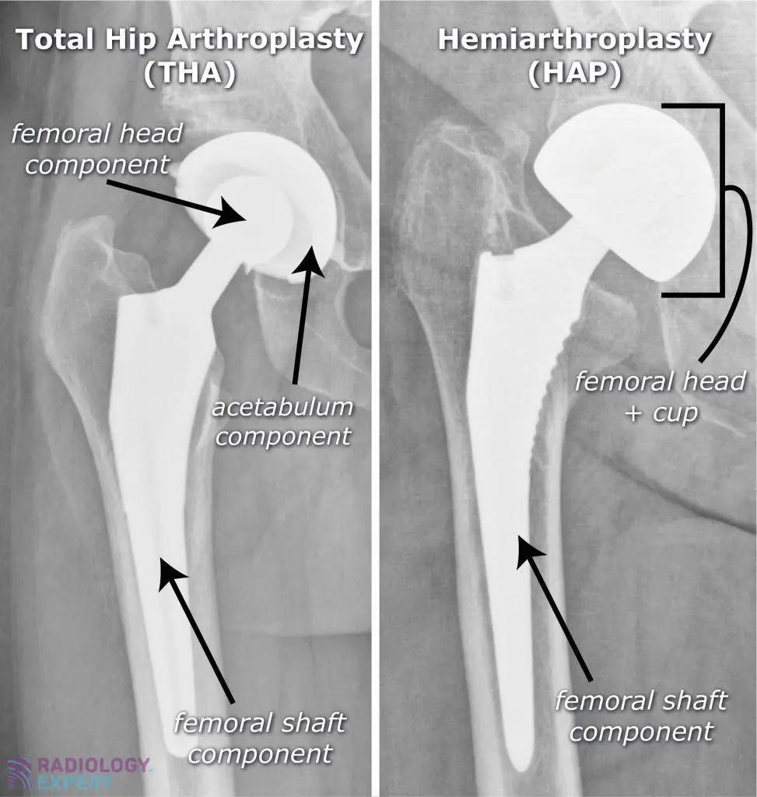
Femur Neck fracture
Hemiarthroplasty/ Total hip arthroplasty

Slide 23
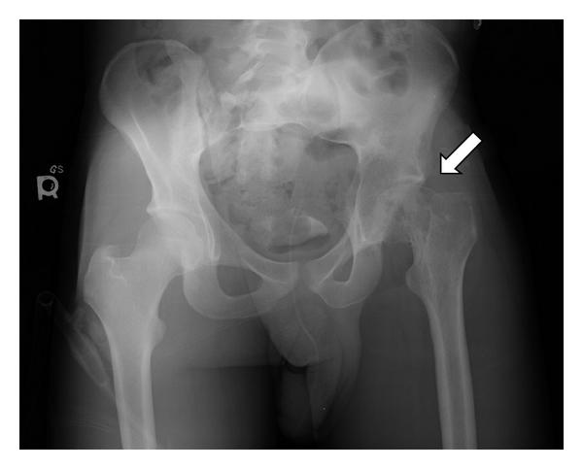
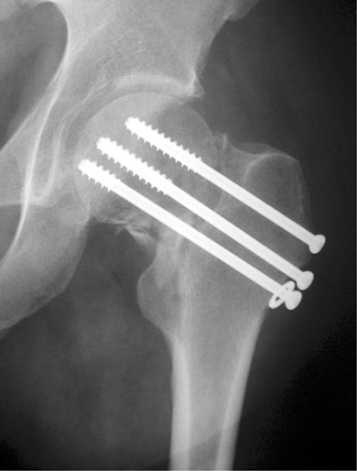
Complications
Osteonecrosis
Incidence of 10-45%
Increased risk with increase initial displacement
AVN can still develop in nondisplaced injuries and nonanatomical reduction
Nonunion
Incidence of 5 to 30%
Increased incidence in displaced fractures

Slide 24
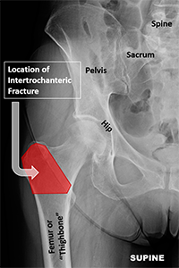
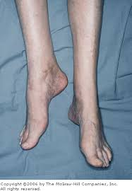
Intertrochanteric fracture
Intertrochanteric area exists between greater and lesser trochanters
Mechanism
Elderly
low energy falls in osteoporotic patients
Young
high energy trauma
Physical Exam
painful, shortened, externally rotated lower extremity

Slide 25
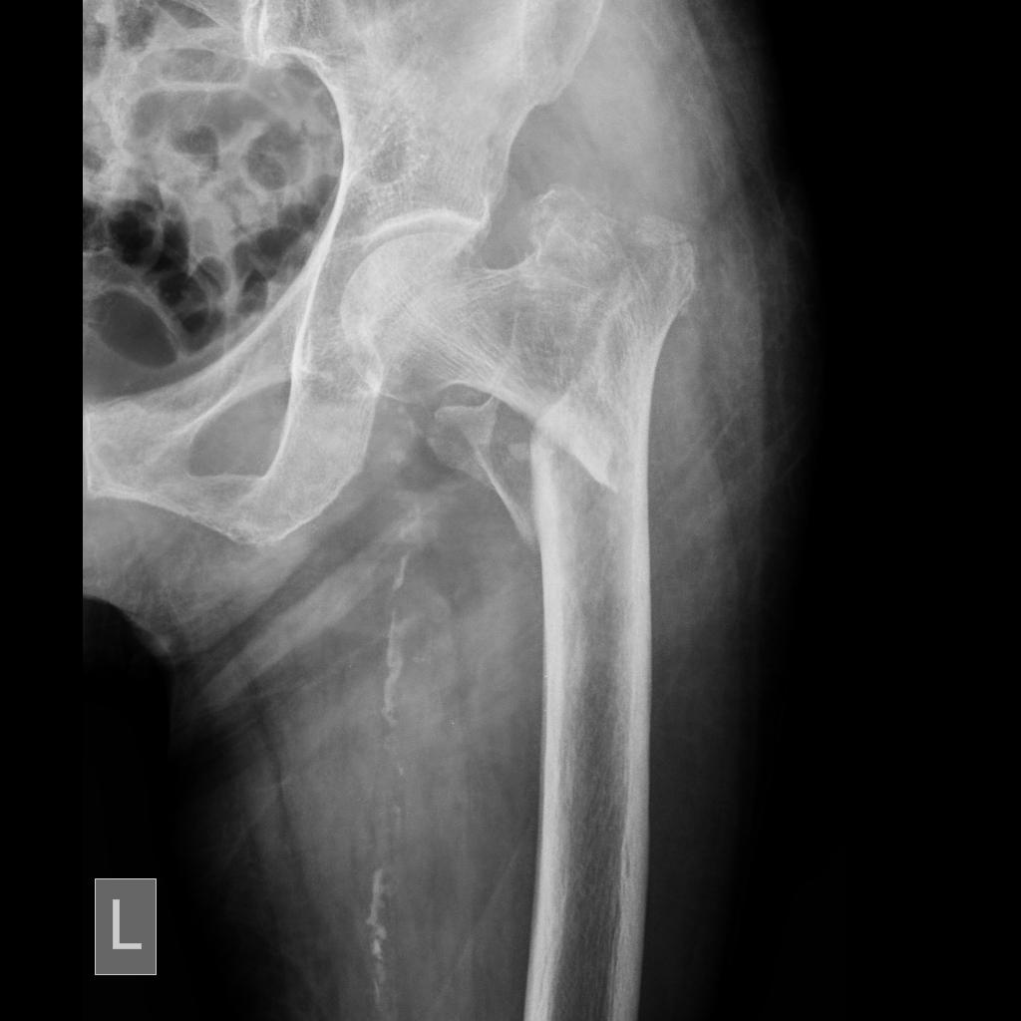
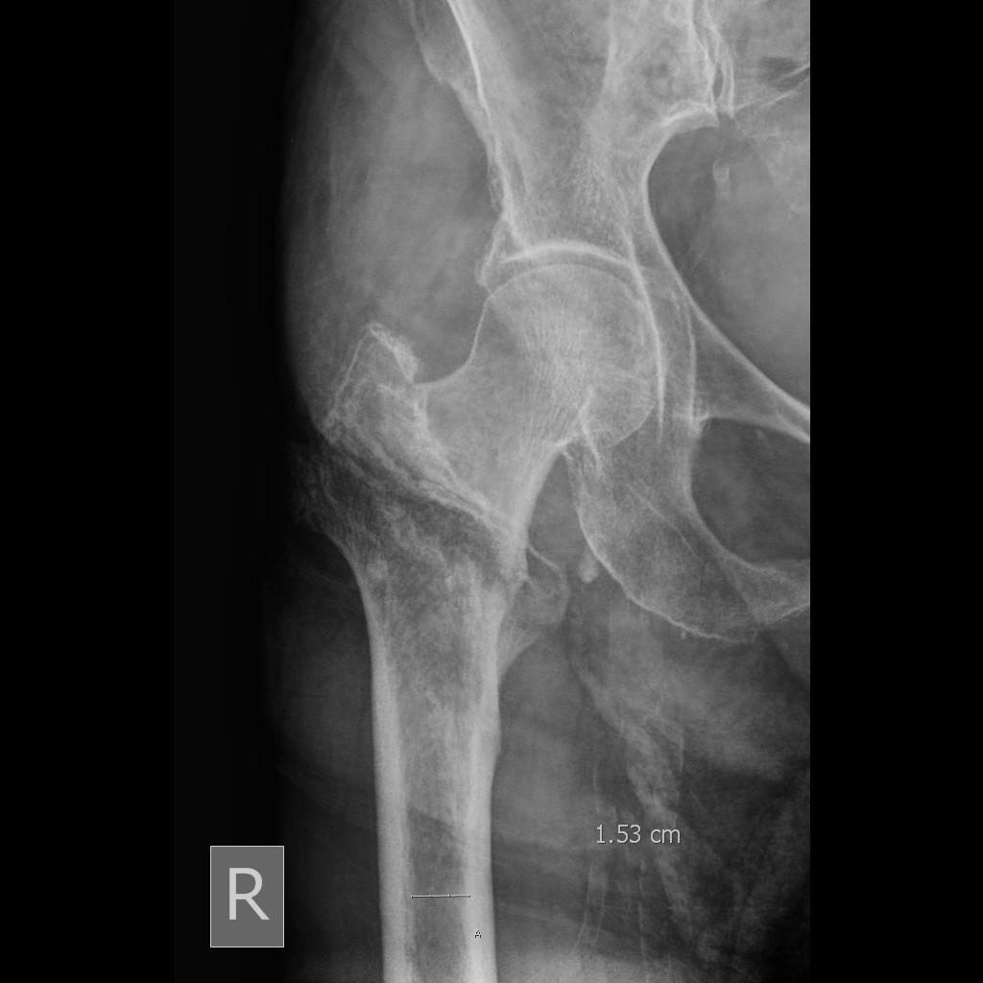
Intertrochanteric fracture

Slide 26
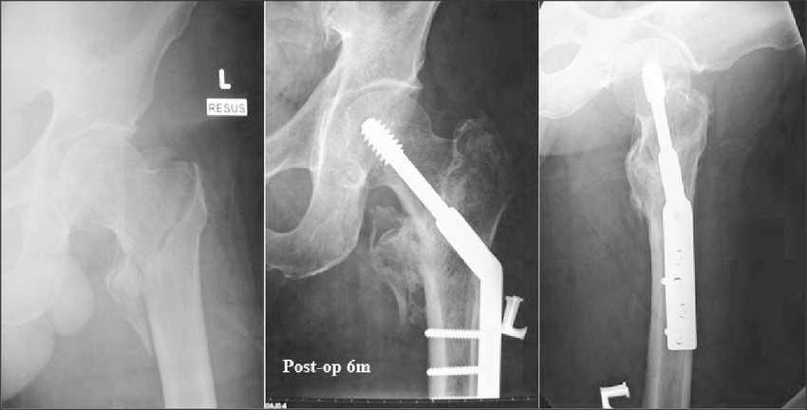
Intertrochanteric fracture- Treatment
Operative
Sliding hip compression screw

Slide 27
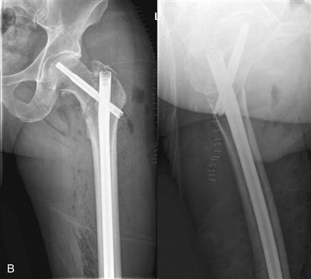
Intertrochanteric fracture
Intramedullary hip screw (cephalomedullary nail)

Slide 28
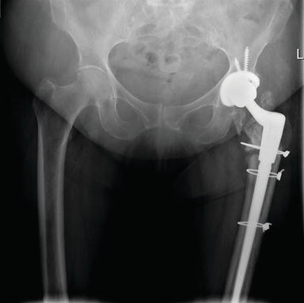
Intertrochanteric fracture
Arthroplasty
severely comminuted fractures
preexisting symptomatic degenerative arthritis
osteoporotic bone that is unlikely to hold internal fixation
salvage for failed internal fixation

Slide 29
Subtrochantaric Fracture
The subtrochanteric fracture is a fractures of the proximal femur that occur within 5 cm of the lesser trochanter.
It’s the worst type of fracture
Less vascularity less healing potential and ability
This area is made of hard cortical bone that doesn't heal well
Area of high compression forces
There is a lot of deforming force on the proximal fragment(flexed by iliopsoas abduct by gluteus medius and minimus and externally rotated by the short rotator muscles)

Slide 30
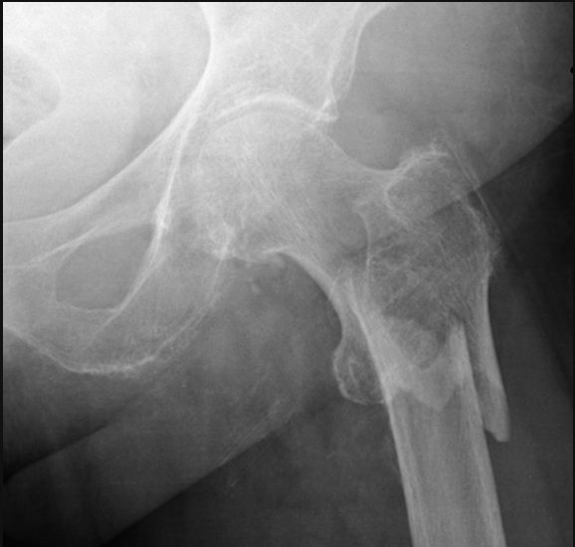
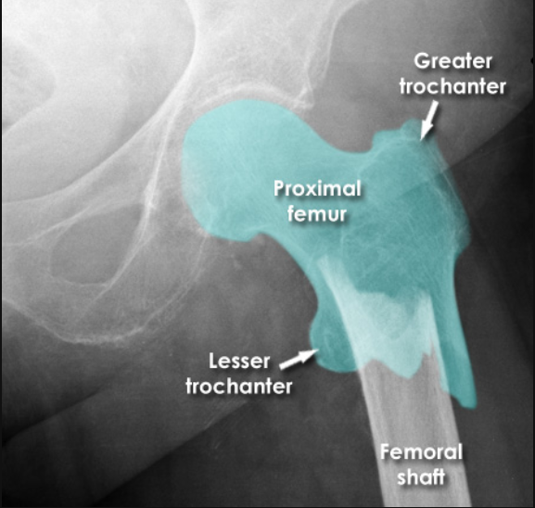
Subtrochanteric Fractures
Subtrochanteric fractures may occur at any age if the injury is severe enough; but most occur with relatively trivial injury, in elderly patients with osteoporosis, osteomalacia, Paget’s disease or a secondary deposit.
Blood loss is greater than with femoral neck or trochanteric fractures.
The leg lies externally rotated and short, and the thigh is markedly swollen. Movement is excruciatingly painful.
X-ray examination shows that the fracture is through or below the lesser trochanter and is frequently comminuted.

Slide 31
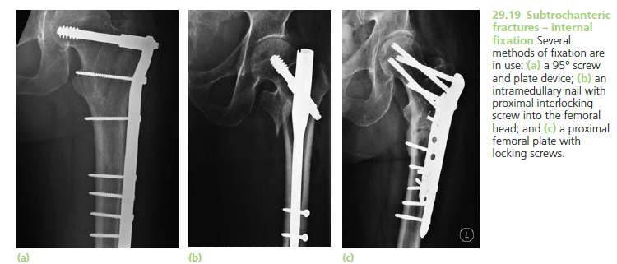
Subtrochanteric Fractures
Treatment
Open reduction and internal fixation is the treatment of choice. Intramedullary nails with locking screws into the femoral head or else a compression (dynamic) hip screw and long plate will provide satisfactory fixation.
Postoperatively the patient is allowed partial weightbearing (with crutches) until union is secure.
Complications
Malunion is fairly common and, if marked, may need operative correction.

Slide 32
Thank You

