Slide 1
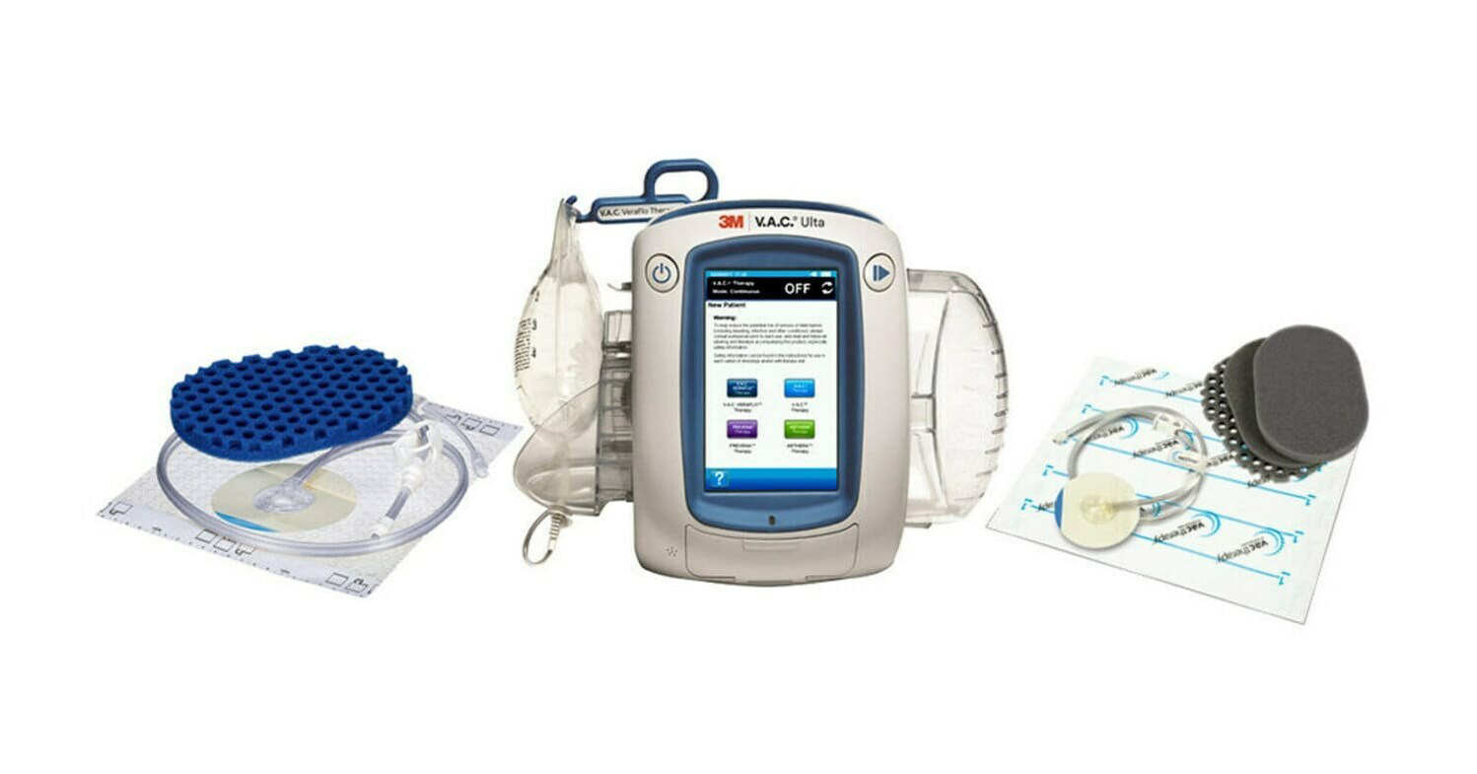
Negative pressure wound therapy
Supervised by: Dr. Mohammad Asim Aideh
Done by : Rumayssa Ibrahim , Shaimaa Almukahal

Slide 2
DEFINTIONS
HOW IT IS WORK
TABLE OF CONTENTS:
WHO NEED TO USE IT WITH
CONTRA-INDICATION
COMPLICATION

Slide 3
A wound is a rapid onset of injury that involves lacerated or punctured skin (an open wound), or a contusion (a closed wound) from blunt force trauma or compression. In pathology, a wound is an acute injury that damages the epidermis of the skin. To heal a wound, the body undertakes a series of actions collectively known as the wound healing process.
What's the wound?

Slide 4
So…
What's the negative pressure wound therapy?
it is a non invasive therapeutic technique using a pump , tube , dressing to remove excess exudate and promote healing in acute or chronic wound & second , third degree burns.
The therapy involve controlled application of sub-atmospheric pressure to the local wound environment using a sealed wound dressing connected to a vacuum pump.
Its also called [Vacuum Assisted Wound Closure], VAC dressing.

Slide 5
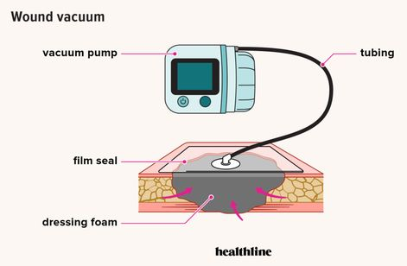
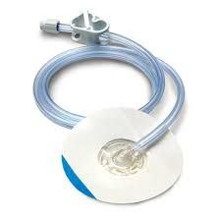
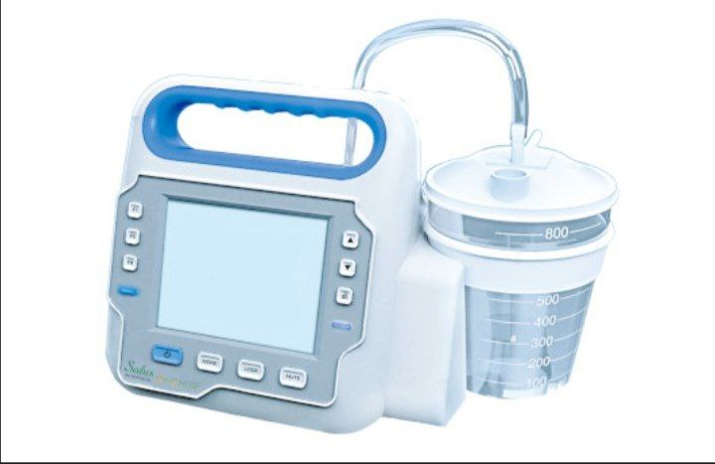
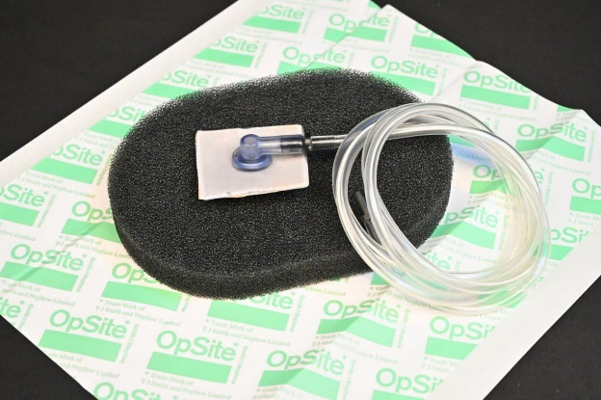
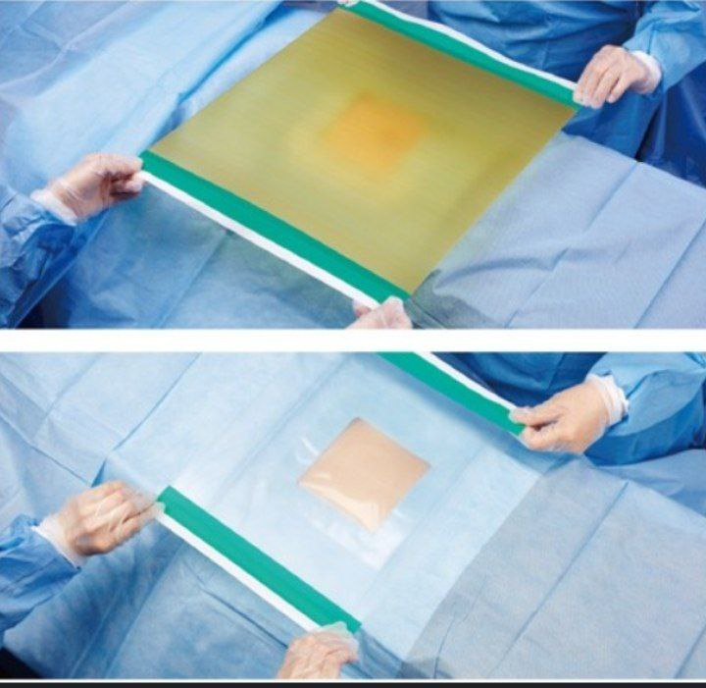
TUBE: lead from under the adhesive film and connects to a portable vacuum pump
VACCUM PUMP:
Removes air pressure over the wound.
CANISTER: collection chamber
With connecting tube
Content of NPWT dressing pack:
DRESSING FOAM: is putting directly on the wound
ADHESIVE FILM: covers and
seals the dressing and
wound

Slide 6
Npwt benefits:
Decreasing swelling and inflammation
Decrease risk of bacterial infection
Increase blood flow to the wound
Gentle pulling together of the wounds edges
Decrease overall discomfort
Less changing of wound dressing compared with other treatments

Slide 7
How npwt works?
Provides a closed and moist wound healing environment
Decreases wound volume
Removes excess fluids that can inhibit wound healing
Helps remove interstitial fluid
Promotes granulation

Slide 8
Who need to use npwt?

Slide 9
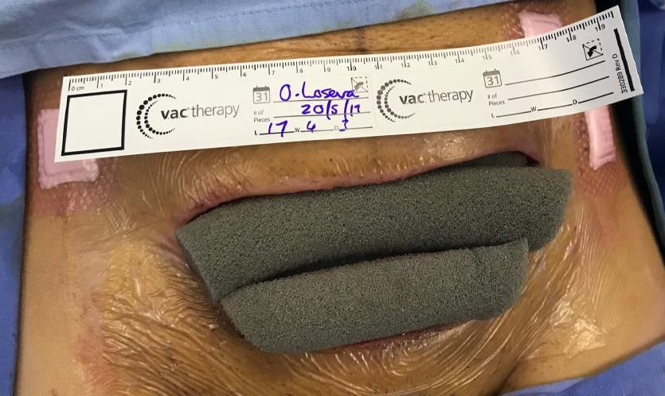
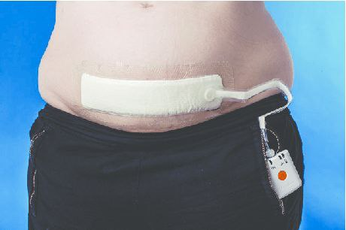
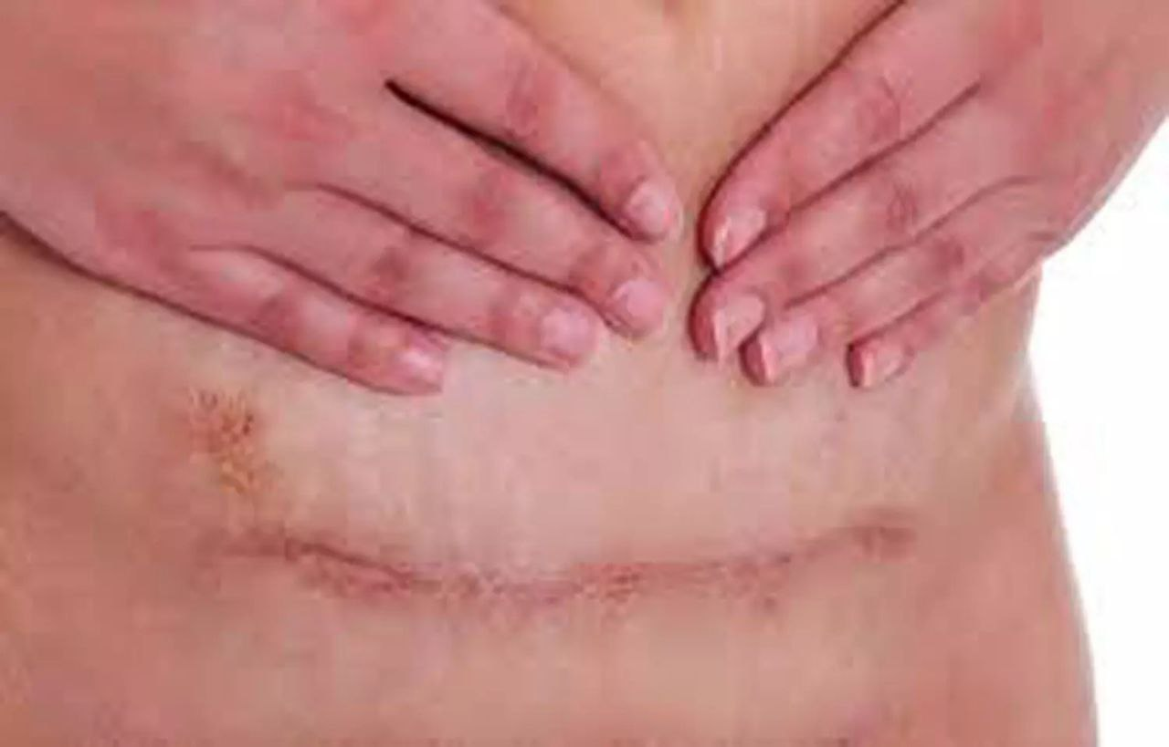
1
Cesarean delivery ( C-section)
Studies on the effectiveness of NPWT at Cesarean delivery are heterogeneous but suggest reduction in surgical site infection and overall wound complications.
Larger definitive trials are needed to clarify the clinical utility of NPWT after Cesarean delivery

Slide 10
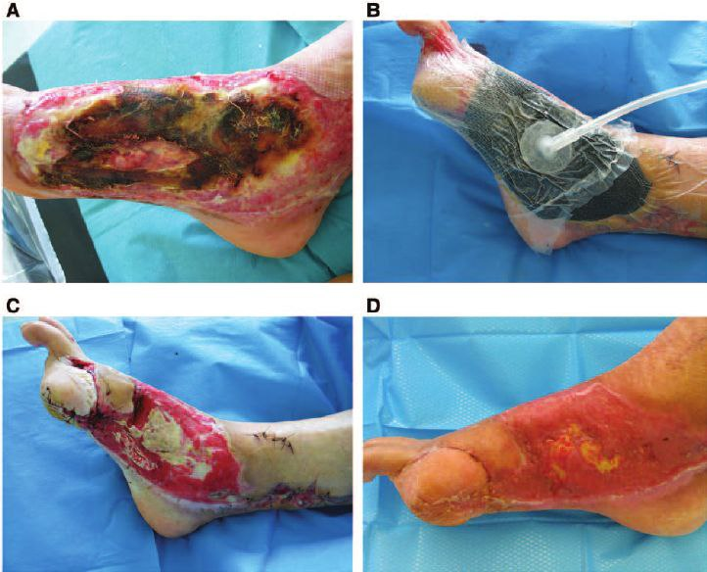
Burns : burn wounds may benefit from NPWT by reducing edema formation and increasing perfusion thus NPWT prevent the progression of partial thickness burn injuries
2

Slide 11
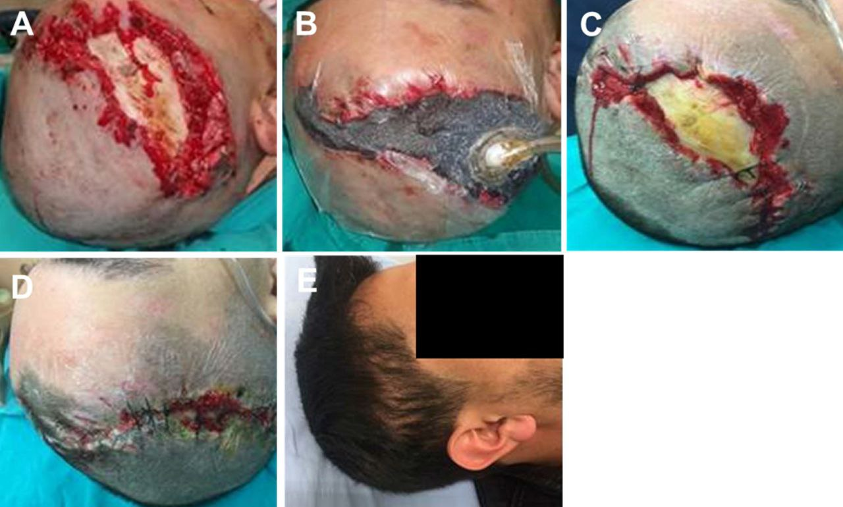
Traumatic and surgical wounds :
NPWT might be usful in the healing of traumatic and postoperative wounds
One review concluded that NPWT has potential to reduce infections after Surgary
3

Slide 12
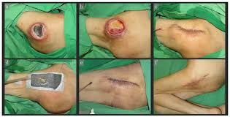
pressure ulcer :
Pressure ulcer are sore skin spots caused by continuous pressure.
NPWT may be suitable treatment option in. Some cases
One study trusted source looked at the use of this therapy to heal patients ulcer. Using NPWT healed the ulcer in 6 weeks at half the cost of reconstructive surgary
4

Slide 13
Types of wound not suitable for npwt
NPWT is suitable for wide range of wound some types of wounds aren't suitable for NPWT these include :

Slide 14
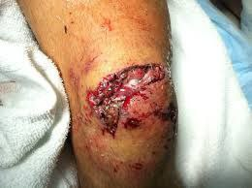
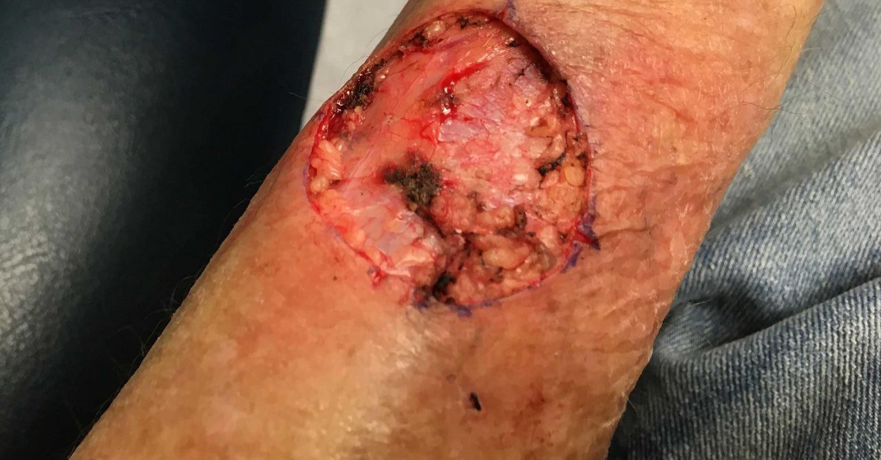
1
Wound near joints that may be reopen with limb movment
2
Cancer tissue present in the wound

Slide 15
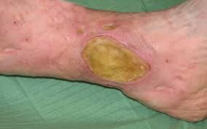
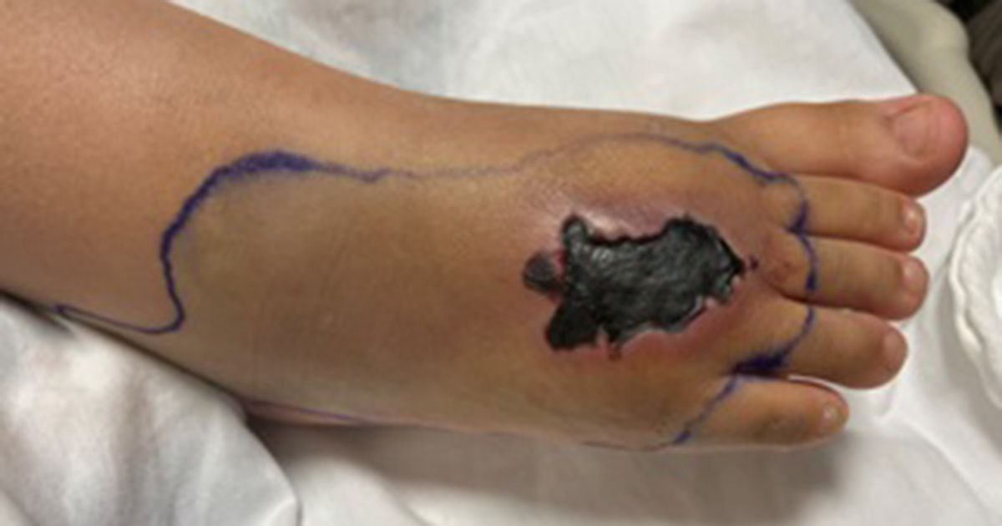
Exposed organs or blood vessels
3
Infected wounds
4
5
Necrotic tissue with eschar encompassing more than 20 percent of the wound bed

Slide 16
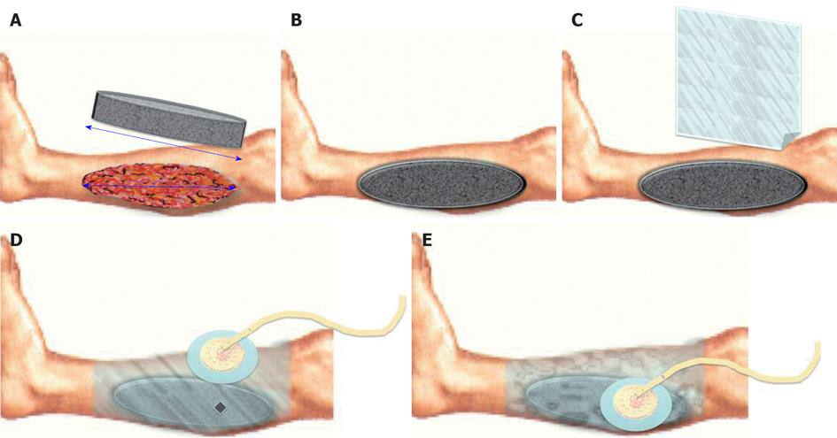
How to apply npwt?

Slide 17
1
Cut wound interface to fit shape wound.
- The foam have a different shape and type examples :
a. Reteculated black foam
b.silver reteculated foam
c.green foam
d.white foam
*** PPI (pores per linear inch )
The most common type of foam in the NPWT is a reteculated black foam

Slide 18
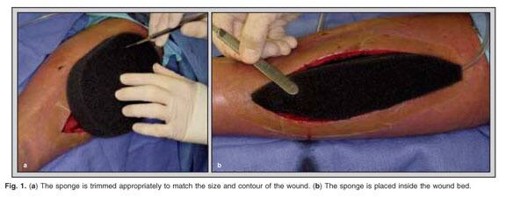

Slide 19
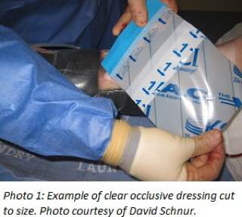
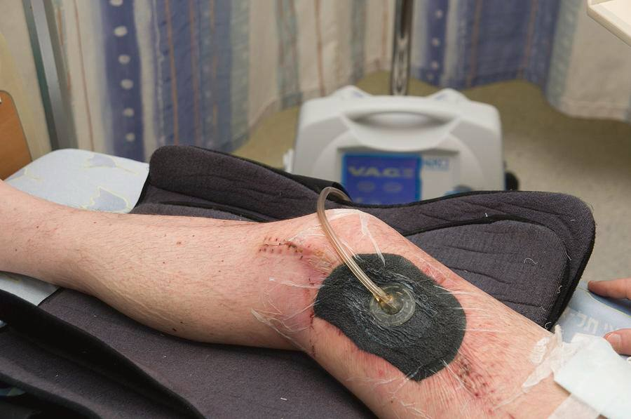
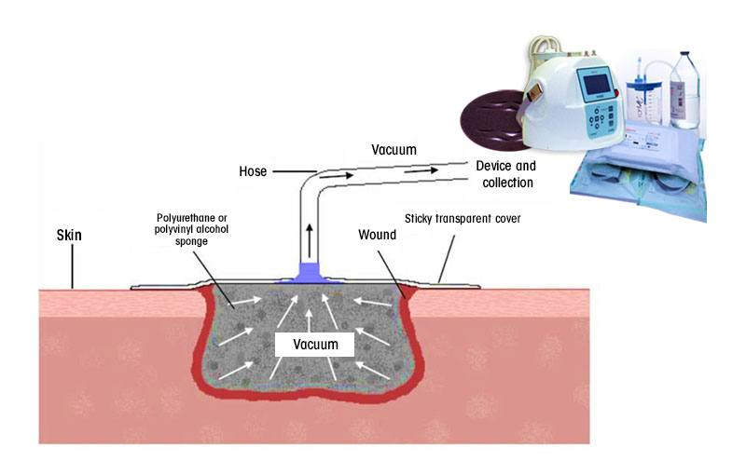
2
The foam dressing covered by occlusive adhesive transparent dressing
3
Place vented end of flexible vacuum tubing flush with wound interface
4
Connect the tube to canister of vacuum pump

Slide 20
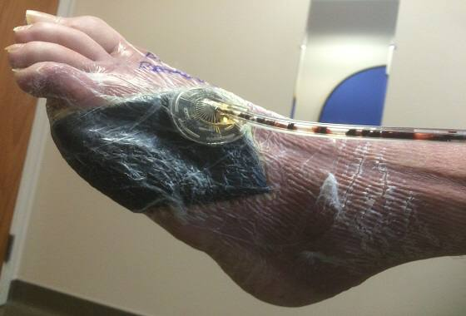
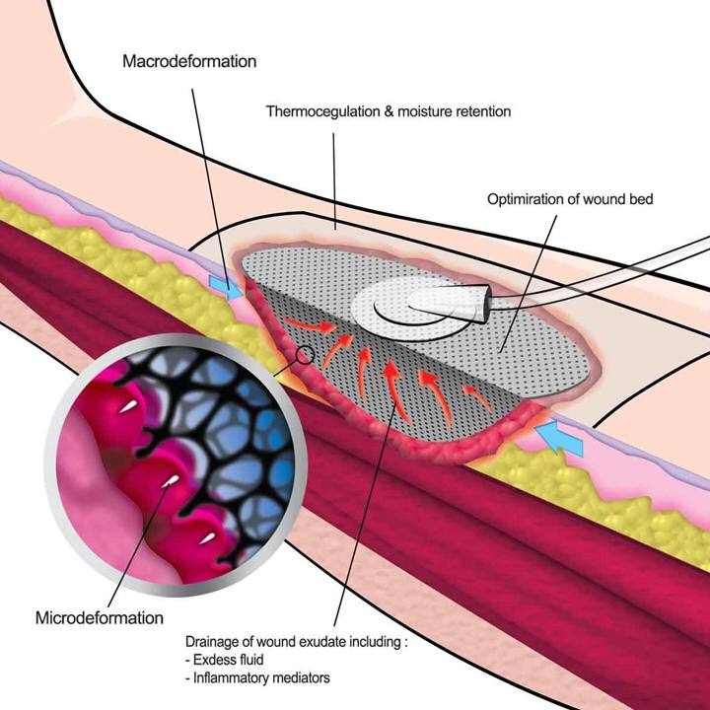
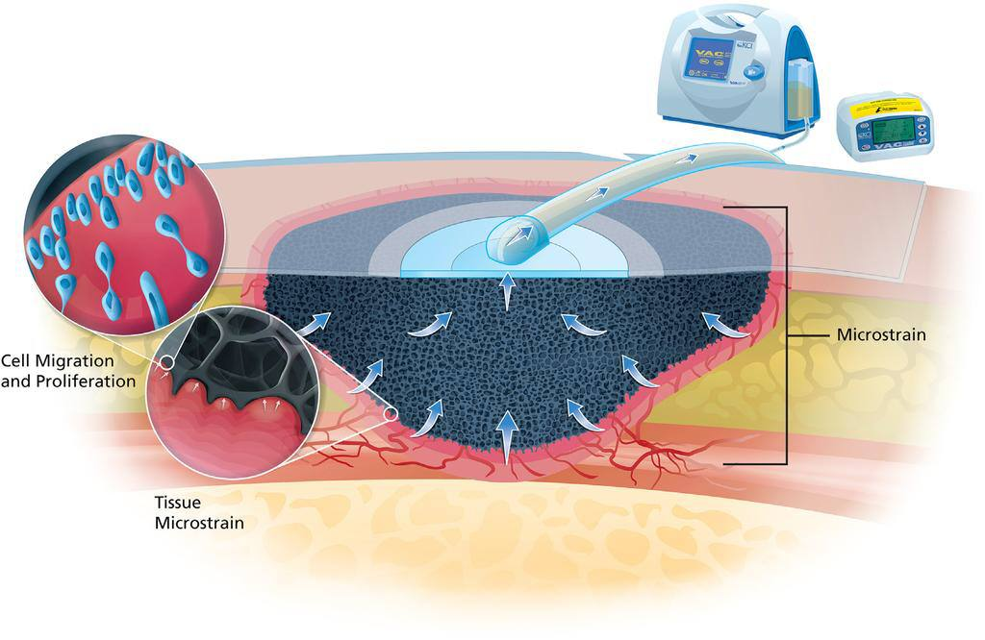
After suction applied:
1. The size of foam reducing under pressure and the wound contraction (macro deformation)
2. absorption of the fluid from the wound
3. under pressure increase blood flow to tissue
4. GRANULATION of tissue (microdeformation )

Slide 21
Complications
- Despite it’s excellent properties in promoting wound healing , there are sporadic but increasing reports on the complications. These complications included :
1- Wound infection caused by anaerobes OR due to retained foam.
2- Loss of blood & fluids.
3- Overgrowth of granulation tissue into foam.
4- Pain (usually dissipates after 20 minutes).
5- Enteric fistula if foam placed over compromised intestine.
6- Maceration and pressure damage to adjacent skin areas.
7- Reduction in perfusion caused by pressure on small vessels.

Slide 22
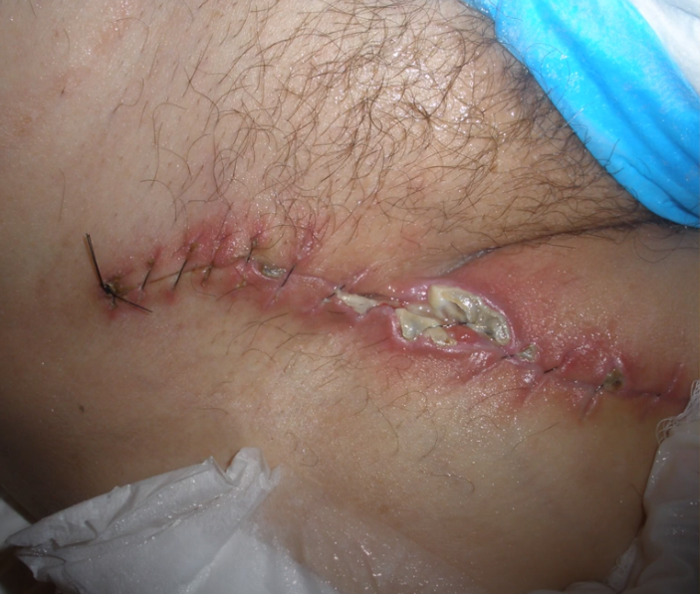
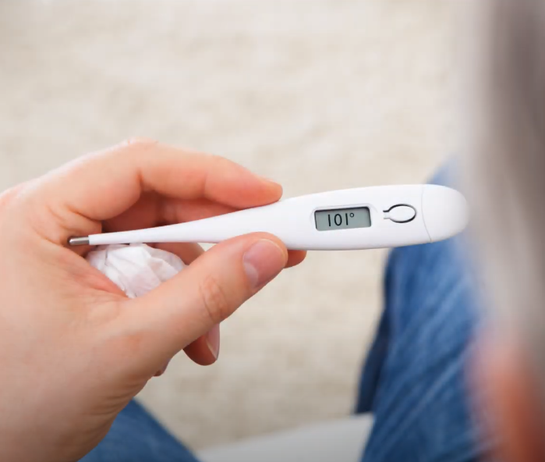
When to stop using npwt
Oral temperature greater than 101 F (38.3 C).
Bleeding around the wound
Rash around your wound
Dizziness or nausea or vomiting
Confusion or sore throat
Headache or diarrhea

Slide 23
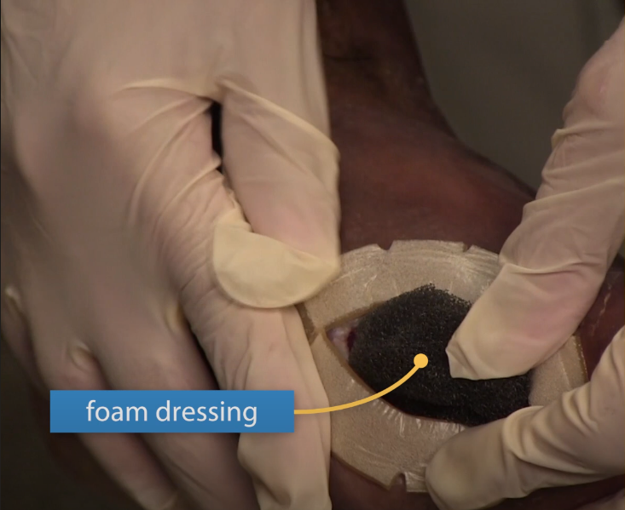
Notes:
The length of time the procedure takes vary widely depending on the size & location of your wound.
The dressings should be changed two to three times a week. If your wound gets infected , the dressings may need changing more often.
Usually , a healthcare provider will change your bandages. In some cases, a family member or a caregiver can be trained to change your dressings.

Slide 24
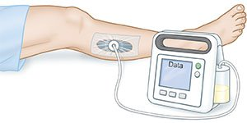
summary:
NPWT is only an adjunct to management of chronic, acute and difficult wounds and it’s not the ultimate solution
NPWT prepares wound bed for greater chance of successful closure
NPWT does not replace surgical procedures

Slide 25
Thank you

