Slide 1
HYDROCARBON TOXICITY

Slide 2
Chemistry
Organic compound made up primarily of carbon and hydrogen atoms (1-60 C).
Classified into 2 main classes; Aliphatic (open chain as petroleum distillates) and Aromatic (benzene ring) as benzene, toluene.
The physical properties of hydrocarbons vary by the number of carbon atoms and molecular structure.
Most commercial hydrocarbon like gasoline and kerosene products are variable mixtures of individual hydrocarbon compounds.

Slide 3
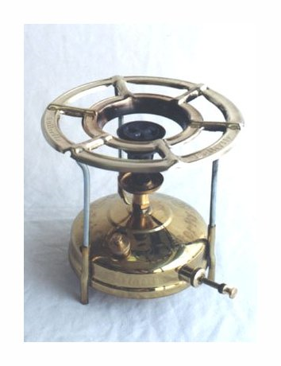
Household Products Containing Hydrocarbons
Adhesives (glues).
Baby oil.
Cod liver oil
Paint removers
Furniture polishes.
Gasoline.
Kerosene.
Solvents
Stain removers

Slide 4
KEROSENE POISONING
Kerosene is a domestic volatile hydrocarbon.
These compounds are derived from plants (e.g. Pine oil) or from fractional distillation of crude petroleum.
Uses:
degreaser, cleaner
fuel oil in Kerosene “Paraffin” lamps & stoves
solvent for many insecticides e.g. Parathion

Slide 5
Mode of poisoning:
Suicidal
Accidental
3 populations
children
workers
young females &low education standard

Slide 6
Mechanism of action:
Dual action
local
systemic
GIT 5%
RESPIRATORY (50%)
CNS 3%
Heart

Slide 7
Pathophysiology:
The main site of action is the lung
Reach the lung through aspiration
Because of kerosene is of low volatile, low viscosity, low surface tension so few concentrations entering the respiratory passage will spread throughout lungs.
Inhibits the surfactant alveolar collapse
Chemical inflammation of lung tissues: pneumonitis, alveolitis & haemorrhagic bronchitis.
Hyperaemia, mucosal irritation & inflammation of oropharynx.

Slide 8
Clinical picture
GIT : nausea and vomiting (SMELL OF KEROSENE).
diarrhea, hematemesis.
Lung: Gagging, coughing, choking, leading to aspiration with bronchospasm, rales, tachypnea, hypoxia; later hemorrhagic pulmonary edema, with cyanosis.
CNS: drowsiness, stupor and then coma. Seizures may occurs.
Heart: ventricular premature beats, tachycardia, fibrillation due to sensitization of myocardium to epinephrine may occur.

Slide 9
Clinical picture:

Slide 10
Investigations:
GIT
RESPIRATORY
HEART
CNS
ECG
X-RAY
BLOOD GASES

Slide 11
Treatment
Within 6 hours
No symptoms
Normal x ray
Symptoms
Abnormal chest x ray
No ttt
hospitalization

Slide 12
Treatment
1-Emergency measures: Oxygen inhalation if the patient is conscious.
2-General measures:
Skin : wash with soap and water.
GIT decontamination: (emesis – gastric lavage) contraindicated
Aspiration mild system toxicity
Why???????????

Slide 13
Treatment
what are Indications and precautions of gastric lavage in Kerosene poisoning:
cuffed endotracheal tube
concomitant ingestion

Slide 14
Treatment
3-Symptomatic treatment: antibiotic for bronchopneumonia & corticosteroids for chemical pneumonitis

