Slide 1
Heme degradation
Investigation or how to diagnose the case based on?
1.Clinical examination
2.Lab investigation
3.Radiological studies XR,CT scan,MRI

Slide 2
Fate of RBCs
Life span in blood stream is 90-120 days,
RBCs are phagocytosed and/or lysed
Normally, lysis occurs extravascularly
in the ER of reticuloendothelial system
(liver, spleen and bone marrow).
subsequent to RBC phagocytosis
Lysis can also occur intravascularly
(in blood stream).
In the human body approx. 100 – 200
million RBCs are broken down every hour.
Fe²⁺ → transported with transferrin and
used in the next heme biosynthesis
Not only Hb but other hemoproteins also
contain heme groups which are degraded
by the same pathway.
Protoprphyrin →convert ino bilirubin and excreted in stool or urine.
Phagocytosis
& Lysis
Hemoglobin
Fe²⁺
Globin
Heme
Person with aminoaciduria cant reutalized acidic AA (glutamate , aspartate)>>so excreted in urine >> PH OF urine will be more acidic > formation of stone and will be formed in alkaline.
.
Gout→ accumulation of uric acid> that can be precipitated in a kidney in acidic PH
So it can be treated by alkalization of urine. (urosoline) to reduce precipitate uric acid in urine
Iron pool
Amino acids
Bilirubin
Low m.w
Amino acid pool
Excretion
go to liver to be reutilized
لو ما صار اله هيك ممكن يحدث عند المريض aminoaciduria.

Slide 3
Handling of free (intravascular) hemoglobin
Purposes: 1- Scavenge iron
2- Prevent major iron losses
3- Complex free heme (very toxic)
When Hb release it should bound to haptoglobin.
1- Haptoglobin: hemoglobin-haptoglobin complex is readily
metabolized in the liver and spleen forming an iron-globin
complex and bilirubin. Prevents loss of iron in urine. Prevent dangerous effect of different compound
2- Hemopexin: binds free heme. The heme-hemopexin
complex is taken up by the liver and the iron is stored bound
to ferritin. Prevents loss of iron and Prevent dangerous effect of different compound
3- Methemalbumin: complex of oxidized heme and albumin Prevents loss of iron.
Bilirubin metabolism
- Bilirubin formation - Transport of bilirubin in plasma
- Hepatic bilirubin transport
A- Hepatic uptake B- Conjugation C- Biliary excretion
Enterohepatic circulation
Hb has LOW M.W so it can pass through the glomerular filtration membrane →precipitation in renal tubule →renal failure
So haptaglobin prevent renal failure and iron loss and toxic effect of heme
In hemolytic jaundice the haptoglobin is decease and may be never found because it consume.

Slide 4
Bilirubin formation
120 days
Iron
hemoglobin
Globin
RBCs
Senecent RBCs
Chiefly
70+%
Bilirubin Biliverdin heme
Bilirubin
Hepatic Hemoproteins
20%
Prtoporphyin
Iron
1-5%
Premature destruction of newly formed RBCs
UB :uncojugated bilirubin need carriers (albumin)
Albumin genralized carriers.
Transport of bilirubin in plasma
Albumin + UB UB ~ Albumin Complex
H affinity binding sites
Bilirubin
2:1
Molar Ratio Plasma protein Albumin
L affinity binding sites
> 2:1 Bilirubin
can be replaced by Other organic anions and low pH or H →
↑UCB

Slide 5
If the person come with DM may be suffer from jaundice because acetoacetic acid and b hydroxy butyrate found in the blood in ionized state-→تاركين الهيدروجين →H con is increase and it replace the UB .

Slide 6
Hepatic Bilirubin Transport
1. Hepatic uptake of bilirubin
UCB ~ Albumin complex separated
(be) taken up
Bilirubin Plasma membrane of the liver
2.Conjugation of bilirubin
bound to Z protein (ligandin in liver cell )
UCB carrier protein ER
(Lipid soluble) Conjugation
(catalyzed by
UDPGT)
(Water soluble) CB CBGA
3.Biliary excretion of bilirubin
Transfer across
CB Bile canaliculus
Microvillar membrane

Slide 7
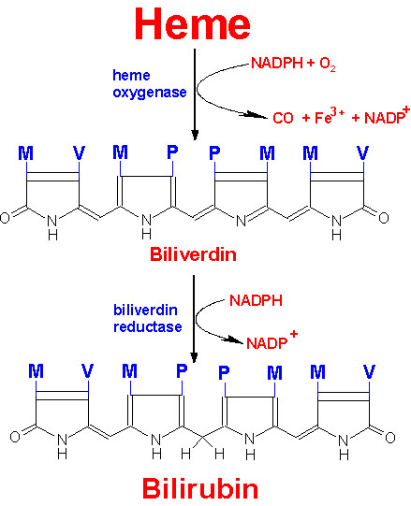
Degradation of heme to bilirubin
It the only reaction in the body produce CO
75% is derived from
RBCs
In normal adults this
results in a daily load of
250-300 mg of bilirubin
Normal plasma
concentrations are less
then 1 mg/dL
Hydrophobic –
transported by albumin to
the liver for further
metabolism prior to its
excretion
Saturation of bond between ring 3 and 4
P₄₅₀ cytochrome
*Heme oxygenase system بفك cyclized heme to linear heme
And make cleavage between ring 1and ring 2 (Proionate) is midle molecule.
*F+3 : ferric to bind transfrin to be carried to storage sit (liver ,spleen ,BM) .
In contusion RBC release to extravascular tissue →give ride color →with catabolisum heme convert itno biliverdin (deep green but we see it blue)→then convert nto bilirubin (yellowish brown)

Slide 8
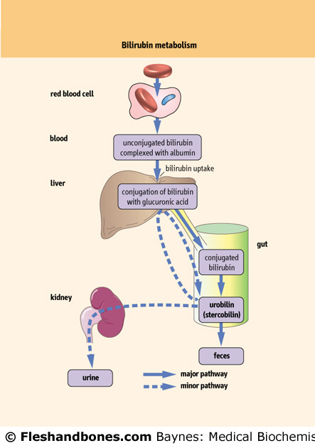
Uptake of bilirubin by the liver is mediated by
a carrier protein (receptor)
Uptake may be competitively inhibited by
other organic anions
On the smooth ER, bilirubin is conjugated
with glucuronic acid, xylose, or ribose
Glucuronic acid is the major conjugate –
catalyzed by UDP glucuronyl transferase
“Conjugated” bilirubin is water soluble and is
secreted by the hepatocytes into the biliary
canaliculi
Converted to stercobilinogen (urobilinogen)
(colorless) by bacteria in the gut
- Oxidized to stercobilin which is colored
- Excreted in feces
Some stercobilin may be re-adsorbed through
enterohepatic circulation by the gut and re-
excreted by either the liver or kidney
Normal bilirubin metabolism

Slide 10
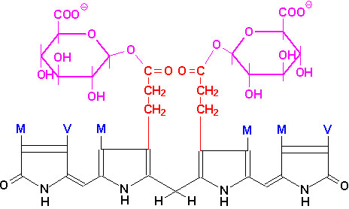
bilirubin-diglucuronide = conjugated bilirubin is soluble in water → „direct bilirubin“
Conjugation of bilirubin in ER of hepatocyte by enzyme(UDPGT ) IN two step with two molecules of glucuronic acid → 1. convert it to bilirubin monoglucronid→repeat the same reaction again →2. bilirubin diglucuronide (conjuogated bilirubin or direct bilirobin or water soluble bilirubin)

Slide 11
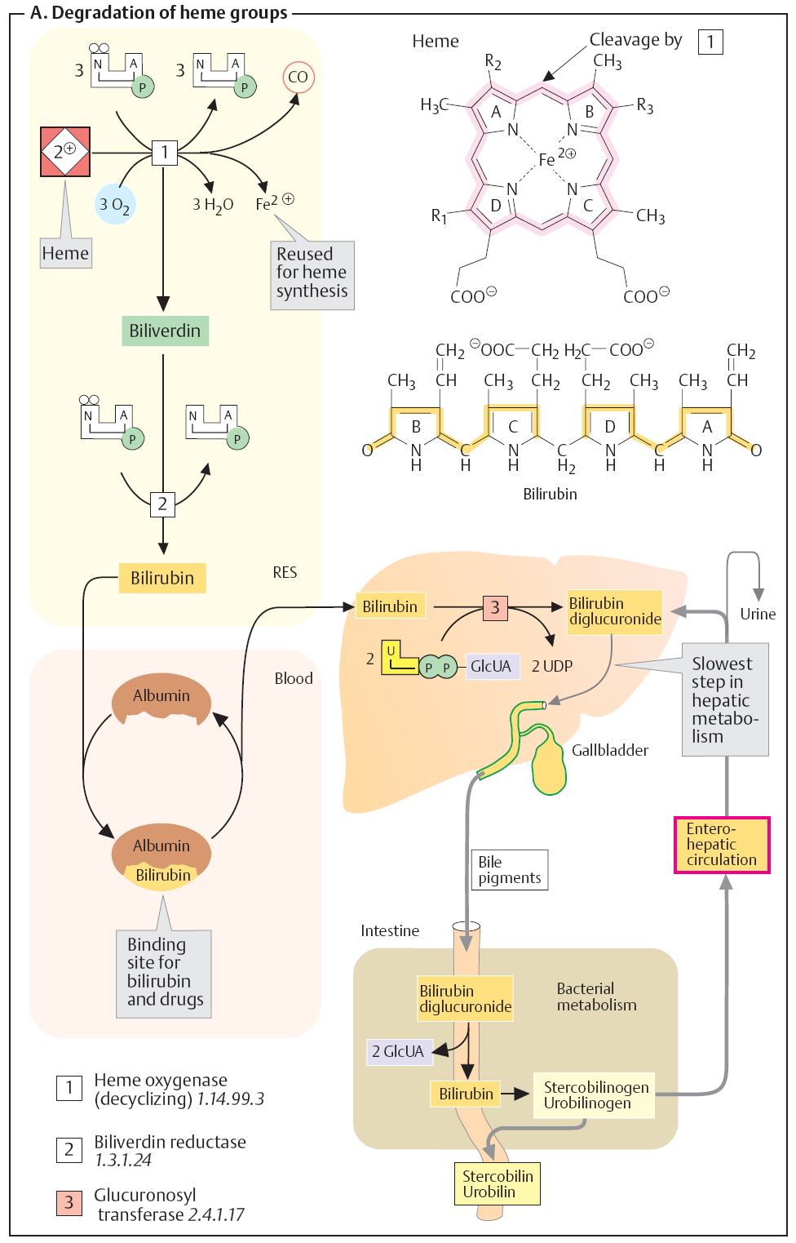
Bile pigments:
- Bilirubin - urobilin - stercobilin

Slide 12
Clinical correlations Determination of bilirubin (Bil) in serum
Blood tests
Bil reacts directly when reagents(diacyl sulfonic acid) are added to the blood
sample → conjugated bilirubin(in liver) = direct Bil (up to 3.4 µmol/L react directly and give violet color))
free Bil does not react to the reagents)the same reagent but don’t react until you add methanol befor it ) until alcohol
(methanol) or caffeine is added to the solution. Therefore, the
measurement of this type of bilirubin is indirect →
unconjugated bilirubin(in blood) = indirect Bil (up to 13.6 µmol/L) deep violet
Total bilirubin measures both unconjugated and conjugated
Bil (normal value up to 17 µmol/L→ equivalent to 1mg/dl which is normal level of total bilirubin in healthy people.

Slide 13
Bilirubin physiology
Ligandins responsible for transport from plasma membrane to
endoplasmic reticulum. They are necessary for intracellular transport of
bilirubin, are also low at birth and reach adult levels by 3-5 days.
Bilirubin conjugated in presence of UDPGT (uridine diphosphate
glucuronyl transferase) to mono and diglucoronides, which are then
excreted into bile canaliculi.
Enterohepatic Circulation
Conjugated bilirubin is unstable and easily hydrolyzed to unconjugated
bilirubin.
This process occurs nonenzymatically in the duodenum and jejunum
and also occurs in the presence of β glucuronidase, an enteric mucosal
enzyme, which is found in high concentration in newborn infants and in
human milk.

Slide 14
Entero - hepatic circulation
Be degraded
CB Urobilinogens (colorless)
Bacterial enzymes
Feces (feceal urobilinogens) → 50-200 mg/d
re-excreted
Mostly liver bile feces
20% 90%
Reabsorbed plasma
trace
circulation kidneys
4 mg/day urine urobilinogen
- The serum of normal adults contains ≤1 mg of bilirubin per 100 ml.
- In healthy adults → The direct fraction is usually <0.2 mg/100 ml
The indirect fraction is usually <0.8 mg/100 ml

Slide 15
Jaundice
Kenicterus :mental retardation caused by increase level of UCB lipid soluble that can cross BBB and enter brain →yellowis coloration →stop metabolic reaction in the brain
Keni cterus
دماغ اصفر

Slide 16
Definition of Jaundice
- Also called icterus
A yellowish straining of the skin, conjunctiva, base of tongue
palms and soles with bile pigments which are increased in plasma
Can be seen on examination at serum bilirubin levels 27-35
μmol/l (1.5 – 2 mg/dl) Pathophysiologic classification of Jaundice
- Hemolytic Jaundice
- Hepatic Jaundice
- Obstructive Jaundice (cholestasis)
- Genetic based jaundice
Jaundice classification (according to type of bilirubin)
- Unconjugated hyperbilirubinemia: when direct bilirubin level
is less than 15% of total serum bilirubin.
- Conjugated hyperbilirubinemia: when direct bilirubin level is
greater than 15%

Slide 17
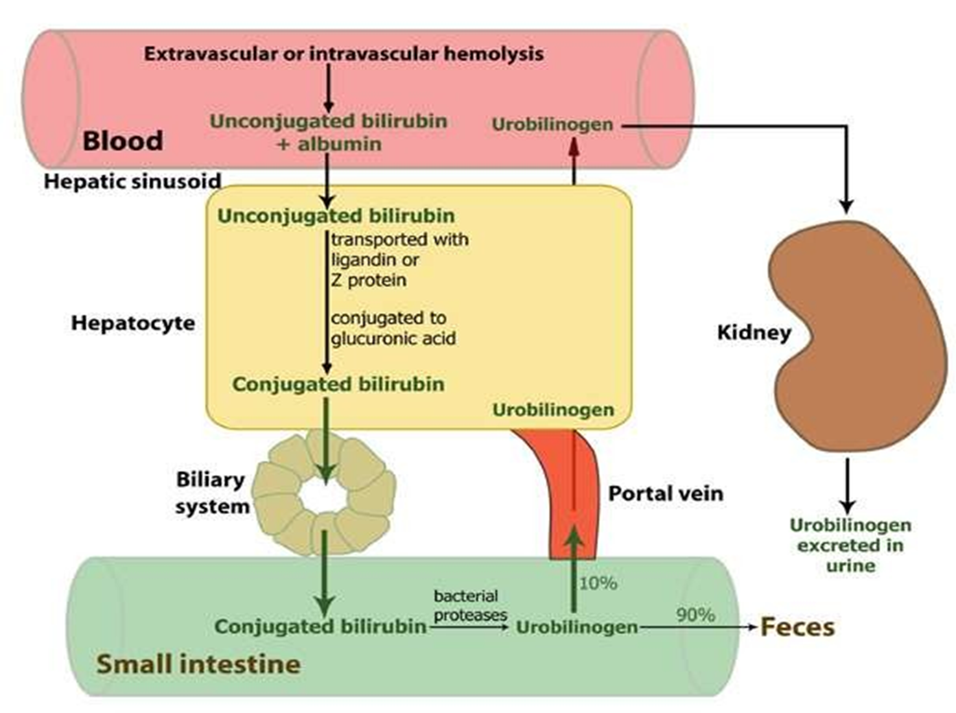

Slide 18
Hemolytic jaundice
Intrahepatic jaundice
Obstructive/ Surgical jaundice

Slide 19
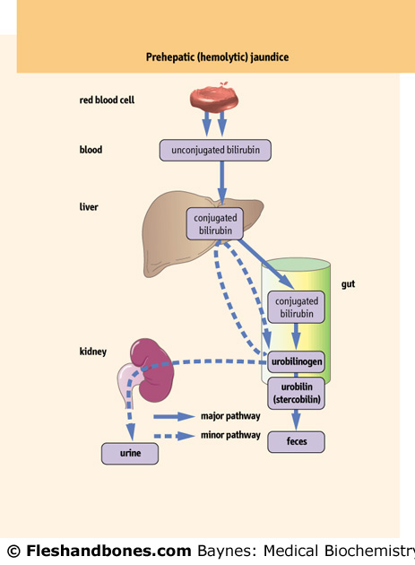
Prehepatic (hemolytic, unconjugated) jaundice
- Results from excess production
of bilirubin (beyond the ability of
liver to conjugate) following
hemolysis liver cell can uptaking and
conjugation of the amount 300 mg of UCB
Causes
- Increased production of bilirubin due
to extravascular hemolysis,
extravasation of blood into tissues,
intravascular hemolysis and errors in
production of red blood cells(sickle cell)
- Pyruvate kinase and glucose
6-phosphate dehydrogenase
deficiency decrease NADPH
- Impaired hepatic bilirubin uptake
as in CHF→ compression on liver cell so liver unable to uptake the normal amount of UCB
- Ineffective erythropoiesis

Slide 20
- Impaired bilirubin conjugation
Gilbert’s and Crigler-Najarr syndromes
Hyperthyroidism
Liver diseases as in chronic hepatitis, cirrhosis, Wilson’s disease(genetic disorder→increase copper accumulation )
Laboratory findings
- UB↑ without bilirubinuria(water insoluble UCB so absent in urine) (50-150 μmole/l)
- Hemolytic anemia
- Hemoglobinuria caused by depletion of haptoglobin (in acute intravascular hemolysis)
- Reticulocyte counts↑ (10-30 %; normal range <1 %)
- Urinary changes:
- Bilirubin: absent(normal uptake of normal amount of bilirubin)
- Urobilinogen: increased or normal
- Faecal changes: stercobilinogen: normal

Slide 21
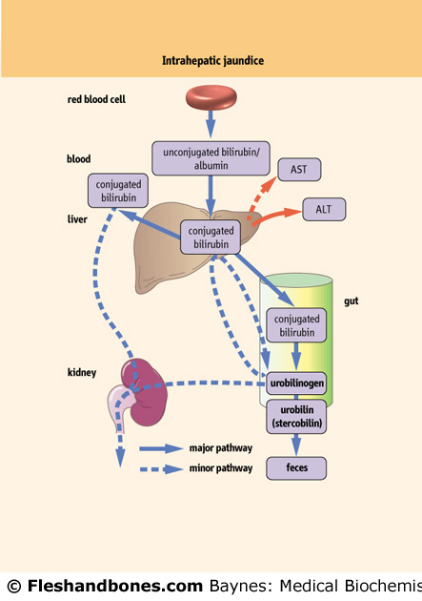
Intrahepatic (conjugated) jaundice
Due to a disease affecting hepatic
tissues either congenital or acquired
diffuse hepatocellular injury
Impaired uptake, conjugation, or
secretion of bilirubin
Reflects a generalized liver
(hepatocyte) dysfunction and increase
In the level of liver enzyme(5 enzyme)
بنعمل منهم واحد فقط
ALT
- In this case, hyperbilirubinemia
is usually accompanied by other
abnormalities in biochemical
markers of liver function
*AST /*ALT /*ALP /GGT /5-nucleotidase
اول ثلاث انزيمات هما اللي غالبا بنعملوا

Slide 22
Causes
- Impaired or absent hepatic conjugation of bilirubin
- Gilbert‘s and Grigler–Najjar(type I /type II)
- Acquired disorders
- Hepatocellular necrosis
- Hepatitis, Cirrhosis, Drug-related
- Sepsis
- Infiltrative: TB, amyloid, lymphoma
- Toxins
- Hepatic crisis in sickle cell disease
Laboratory findings
- liver function tests are abnormal
- Both CB and UCB↑
- Bilirubinuria (↑ 50-250 μmole/l)
- Urobilinogen: normal or reduced
- Stercobilinogen: normal or reduced
SELF MEDICATIN
يعالج نفسه بنفسه مثلا يتوقع ان تظهر عليه اعراض الصداع بعد ساعات معينه وياخذ بنادول وبالليل يتوقع انه ممكن تظهر عليه اعراض IDA
فياخذ حديد
the first organ affect in this state is the liver

Slide 23
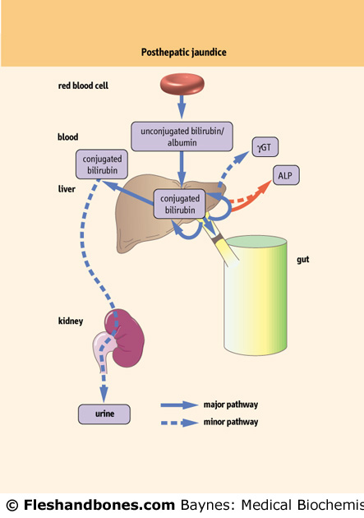
Posthepatic (Obstructive) jaundice
Partial :affect color of urine and stool partially
Cpomlete: sever change in color of stool and urine.
Caused by intra- and extra hepatic
obstruction of bile ducts
Plasma bilirubin is conjugated,
and other biliary metabolites,
such as bile acids accumulate in
the plasma
Characterized by pale colored
stools (absence of fecal bilirubin
or urobilin), and dark urine
(increased conjugated bilirubin)
In a complete obstruction,
urobilin is absent from the urine

Slide 24
Causes
Intrahepatic
- Blockage of Bile Canaliculi
- Dubin-Johnson syndrome
- Hepatitis-viral, chemical(carbon tertachloride →toxic to the liver )
- Infiltrative tumors
Extrahepatic
- Obstructive of bile ducts by tumors, CBD or CHD stone and Stenosis
- Acute and chronic pancreatitis
Parasitic infections as Ascaris lumbricoides and liver flukes(shistosoma)
Laboratory Findings
- Serum Bilirubin↑ (100-500 μmole/l) 30 time more than normal level . so the level of direct bilirubin 30 mg/dl but not cross BBB so its not dangerous and can be easily excreted in urine →deep green color of urine
- Fecal urobilinogen ↓ (incomplete obstruction) or absent in (complete
obstruction)
- Urobilinogenuria is absent in complete obstructive jaundice
- Bilirubinuria ↑ - Cholesterol ↑
- Urinary changes:green because of excretion of CB.
1- Bilirubin: increased 2- Urobilinogen: reduced or absent
Faecal changes: stercobilinogen: reduced or absent
Patient with jaundice due to obstructive bile suffer from sever itching
(increase cholesterol and bile solt →deposited subcutanous
لانه صار ارتجاع لل (bile) باتجاه الكبد ثم للدم ومن الدم الى الانسجه ويترسب تحت الجلد
Cancer in bile duct /pacreas

Slide 25
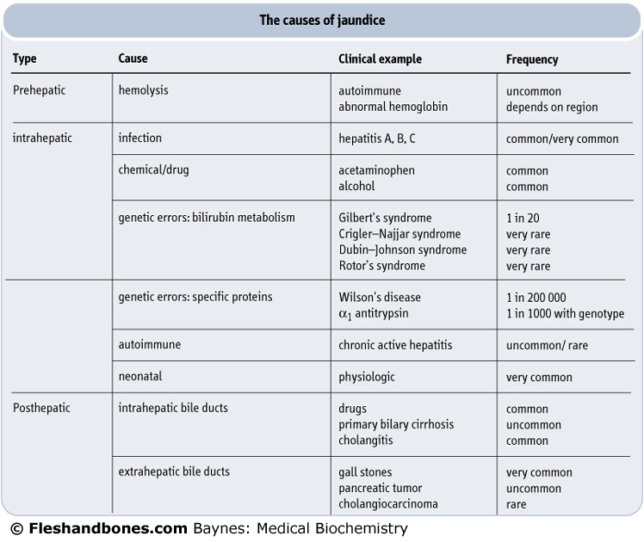

Slide 26
Early change in 3 type of jaundice
 | Pre-hepatic | Hepatic | Post-hepatic
Urine | No Bilirubin Urobilinogen ↑ | There is bilirubin Normal urobilinogen | There is bilirubin Urobilinogen is absent
Faeces | Dark | Pale clay stool مثل لون الطين | Pale clay stool مثل لون الطين
Blood | ↑Reticulocyte count الوحيد Related to hemolysis ↑ Unconjugated bilirubin (up to 100μmol/L) الاخطر Normal ALP and γ GT Normal AST and ALT PT Normal | Normal reticulocyte count ↑ Bilirubin – mixed conjugated & unconjugated ↑ ALP and γ GT ↑ AST and ALT ↑ PT – not correctable with Vit K because liver cant storage vit K and decrease production of coagulation factors | Normal reticulocyte count ↑ Bilirubin (up to 1000μmol/L) – conjugated ↑ ALP and γ GT نصهم bad /normal Normal AST and ALT ↑ PT – correctable with Vit K

Slide 27
Neonatal Jaundice
- Common, particularly in premature infants
Transient (resolves in the first 10 days), due to immaturity of the enzymes involved in
bilirubin conjugation
High levels of unconjugated bilirubin are toxic to the newborn – due to its
hydrophobicity it can cross the blood-brain barrier and cause a type of mental
retardation known as kernicterus
If bilirubin levels are judged to be too high, then phototherapy with UV light is used to
convert it to a water soluble, non-toxic form
If necessary, exchange blood transfusion is used to remove excess bilirubin
Phenobarbital is oftentimes administered to Mom prior to an induced labor of a
premature infant – crosses the placenta and induces the synthesis of UDP glucuronyl
transferase
Jaundice within the first 24 hrs of life or which takes longer then 10 days to resolve is
usually pathological and needs to be further investigated

Slide 28
Gilbert’s syndrome
Benign liver disorder considered the most common hereditary cause of
increased bilirubin.
A major characteristic is jaundice, caused by elevated levels of
unconjugated bilirubin in the bloodstream.
-The cause of this hyperbilirubinemia is the reduced activity of the
glucuronyl transferase, which conjugates bilirubin and some other
lipophilic molecules.
It is caused by a 70%-80% reduction in the glucuronidation activity of
the enzyme UDP-glucuronosyltransferase 1A1.
- ½ of the affected individuals inherited it
- Males more frequently affected than females
- Onset of symptoms in teens, early 20’s or 30’s
Can be treated with small doses of phenobarbital to stimulate UDP
glucuronyl transferase activity

Slide 29
Crigler - Najjar syndrome, type I
A very rare disease (estimated at 0.6 - 1.0 per million live births), and
consanguinity increases its risk.
Inheritance is autosomal recessive.
Type 1 is characterized by a serum bilirubin usually above 345 µmol/L
(310 - 755)
No UGT1A1 (UDP glucuronosyltransferase 1 family, polypeptide A1)
expression can be detected in the hepatic tissue.
These children died of kernicterus (=bilirubin encephalopathy), or
survived until early adulthood with clear neurological impairment.
Today, therapy includes:
- exchange transfusions in the immediate neonatal period,
- 12 hours/day phototherapy
- heme oxygenase inhibitors to reduce effect of hyperbilirubinemia
oral calcium phosphate and -carbonate to form complexes with
bilirubin in the gut,
- liver transplantation prior to the onset of brain damage.

Slide 30
Crigler - Najjar syndrome, type I
A very rare disease (estimated at 0.6 - 1.0 per million live births), and
consanguinity increases its risk.
Inheritance is autosomal recessive.
Type 1 is characterized by a serum bilirubin usually above 345 µmol/L
(310 - 755)
No UGT1A1 (UDP glucuronosyltransferase 1 family, polypeptide A1)
expression can be detected in the hepatic tissue.
These children died of kernicterus (=bilirubin encephalopathy), or
survived until early adulthood with clear neurological impairment.
Today, therapy includes:
- exchange transfusions in the immediate neonatal period,
- 12 hours/day phototherapy
- heme oxygenase inhibitors to reduce effect of hyperbilirubinemia
oral calcium phosphate and -carbonate to form complexes with
bilirubin in the gut,
- liver transplantation prior to the onset of brain damage.

Slide 31
Crigler-Najjar syndrome, type II
Differs from type I in several aspects:
1- bilirubin levels are generally below 345 µmol/L.
2- Some cases are only detected later in life because of lower serum
bilirubin, kernicterus is rare in type II.
3- bile is pigmented, instead of pale in type I or dark as normal.
4- UGT1A1 is present at reduced but detectable levels
(typically <10% of normal), because of single base pair mutations
5- therefore, treatment with phenobarbital is effective, generally with a
decrease of at least 25% in serum bilirubin.
The inheritance pattern of Crigler – Najjar syndrome type II has been
difficult to determine, but is generally considered to be autosomal
recessive.
Dubin-Johnson and Rotor’s syndromes
- Characterized by impaired biliary secretion of conjugated bilirubin
Present with a conjugated hyperbilirubinemia that is usually mild

