Slide 2
Definition
Delusions are fixed, false beliefs that remain despite evidence to the contrary and cannot be accounted for by the cultural background of the individual
They can be categorized as either bizarre or nonbizarre.
A nonbizarre delusion is a false belief that is plausible but is not true. Example: “The neighbors are spying on me by reading my mail.” A bizarre delusion is a false belief that is impossible. Example: “A Martian fathered my baby and inserted a micro- chip in my brain.”

Slide 4
Delusional types
Patients are further categorised based on the type of delusions they experience:
o Erotomanic type: Delusion that another person is in love with the individual.
o Grandiose type: Delusion of having great talent.
o Somatic type: Physical delusion.
o Persecutory type: Delusion of being persecuted.
o delusion of guilt
o Mixed type: More than one of the above.
o Unspecified type: Not a specific type as described above.

Slide 5
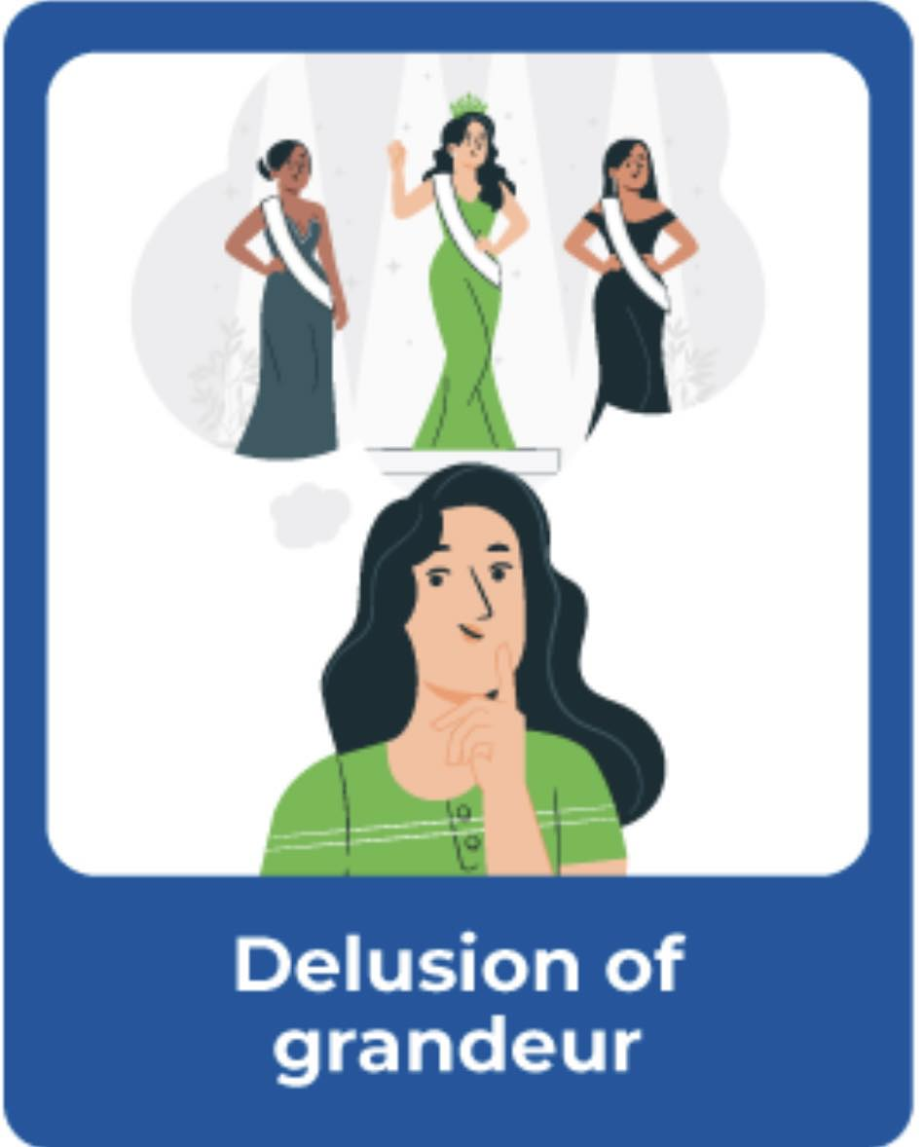
Delusion of grandeur
Belief that one has special powers beyond those of a normal person.

Slide 6
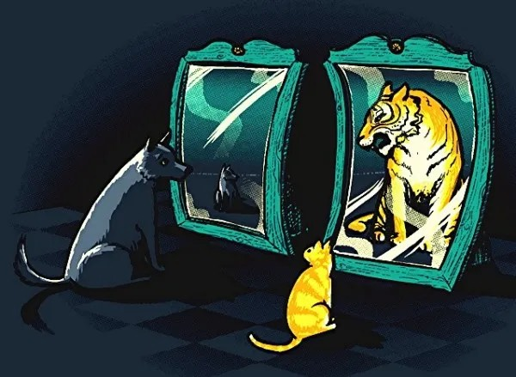
Delusion of negation/nihilistic delusions
This is a false belief that one doesn’t exist or has become decreased.
Reverse of grandiose delusions

Slide 7
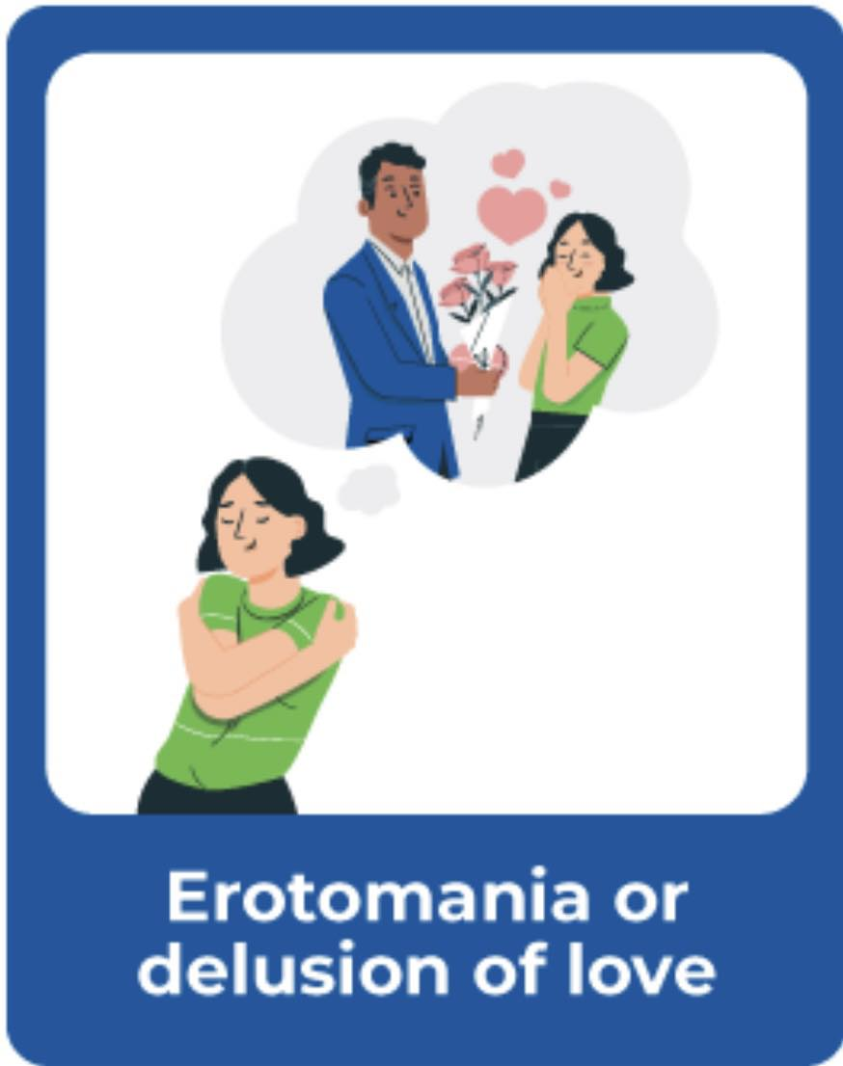
Eromomaniac delusions
A type pf Delusion that another person is in love with the individual. Usually this person is famous, not of the patient’s social circle and not attainable. They may attempt to contact the person of the delusion

Slide 8
Delusion of persecution/paranoid delusion
Irrational belief that one is being persecuted. Example: “The CIA is after me and tapped my phone.”

Slide 9
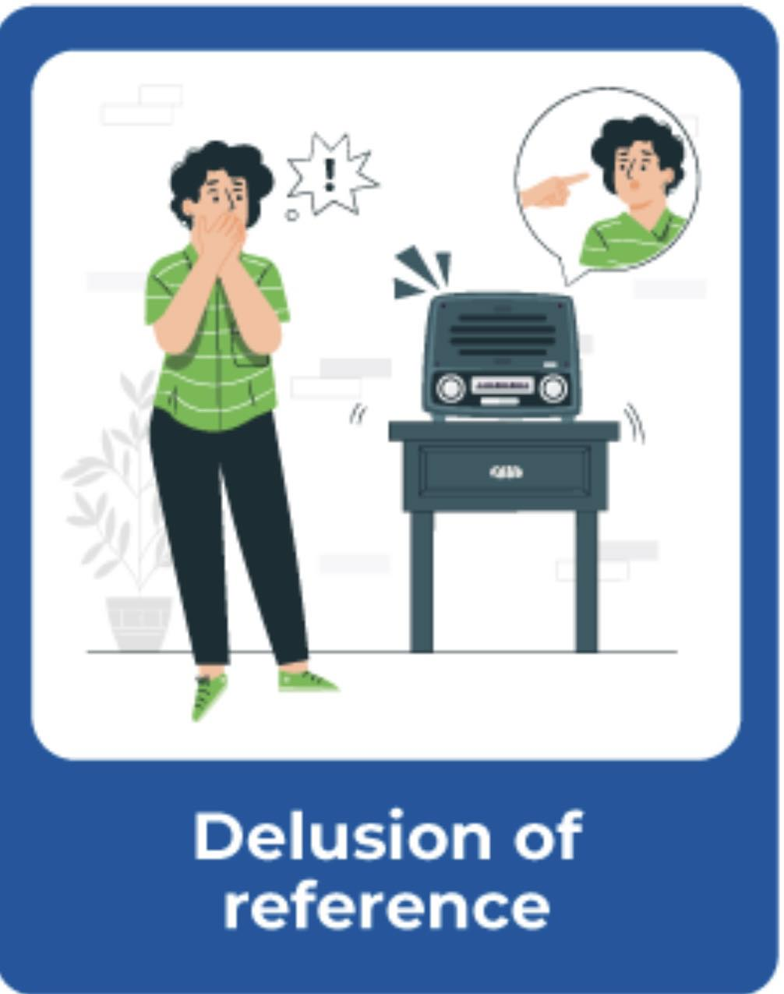
Ideas of reference
Belief that cues in the external environment are uniquely related to the individual. Example: “The TV characters are speaking directly to me.”

Slide 10
Delusions of guilt
Belief that one is guilty or responsible for something. Example: “I am responsible for all the world’s wars.”

Slide 11
Somatic delusions
Belief that one is infected with a disease or has a certain illness.

Slide 12
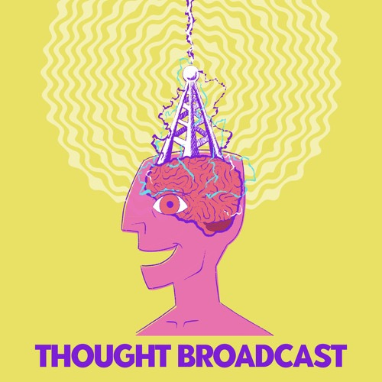
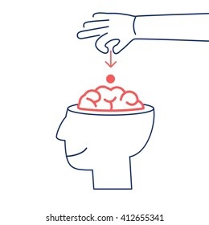
Delusion of control
Includes thought broadcasting (belief that one’s thoughts can be heard by others)
thought insertion (belief that others’ thoughts are being placed in one’s head).

Slide 13
Clinical features
A. The presence of a non-bizarre delusion is the cardinal feature of this disorder
B.Other symptoms that might appear include:
• 1-An irritable, angry, or low mood
• 2-Hallucinations
• 3-Mood, Feelings, and Affect.
• 4-Insight.

Slide 14
Diagnosis
Although there is no set of labs required for a delusional disorder like most other psychiatric disorders
.Imaging or laboratory tests should be considered to rule out any organic causes. Substance-induced conditions should be ruled out by getting a urine drug screen
.After an organic cause is ruled out a clinical exam should be completed.
A clinician would do an assessment and ask further questions about their delusions. During the assessment, a complete mental status exam should be done. Interviewing family members and friends should be considered because they can provide further details about the delusions and more importantly a timeline of the presenting symptoms.

Slide 15
Diagnosis

Slide 17
Deferential diagnosis
• Obsessive-compulsive disorder: A person who remains convinced that his/her obsessions and compulsions are true convictions, should be given the diagnosis of obsessive-compulsive disorder with absent insight.
• Schizophreniform and schizophrenia: This can be differentiated from delusional disorder by the presence of other symptoms of the active phase of schizophrenia.
• Delirium/major neurocognitive disorder: Can mimic delusional disorder but distinguished based on the chronology of symptoms.
• Depression or bipolar disorder: Delusions occur with mood episodes. A delusional disorder is diagnosed only when the span of delusions exceeds the total duration of mood symptoms.

Slide 18
Prognosis
• The prognosis of delusional disorder is better with treatment and medication compliance.
→ Almost 50% of patients have a good response to medications.
→ more than 20% of patients report a decrease in symptoms .
→ less than 20% of patients report minimal to no change in symptoms.
→ A good prognosis is also related to:
i. higher social and occupational functioning.
ii. early-onset before age 30 years.
iii. female.iv. sudden onset of symptoms.
v. short duration.
Delusional disorder is typically a chronic (ongoing) condition, but when properly treated, many people with this disordercan find relief from their symptoms.

Slide 20
Management &Treatment
1-PSYCHOTHERAPY:
A good doctor-patient relationship is a key to treatment success.
2-HOSPITALIZATION
may be needed if the doctor believes that patients are dangerous.
3-ELECTROCONVULSIVE THERAPY
4-COGNITIVE THERAPY: helps the person learn to recognize and change thought patterns and behaviors that lead to troublesome feelings.
5-PHARMACOLOGICAL TREATMENT:Antipsychotic drugs are not generally used but are sometimes effective in reducing symptoms
A long-term treatment goal is to shift the person’s focus away from the delusion to a more constructive and gratifying area, although this goal is frequently difficult to achieve.

Slide 21
Thank you

