Slide 1
Bronchial Asthma Dr.Samah M.Shehata Associate Prof. of Chest Diseases

Slide 3
Chief complaints
Difficulty in breathing for … years
Cough for … months
Wheeze and tightness in the chest … months.

Slide 7
Our Goals
Definition of bronchial asthma
Etiologic factors
Immunology
Pathophysiology
Diagnosis
Differential diagnosis
Treatment guidelines

Slide 8
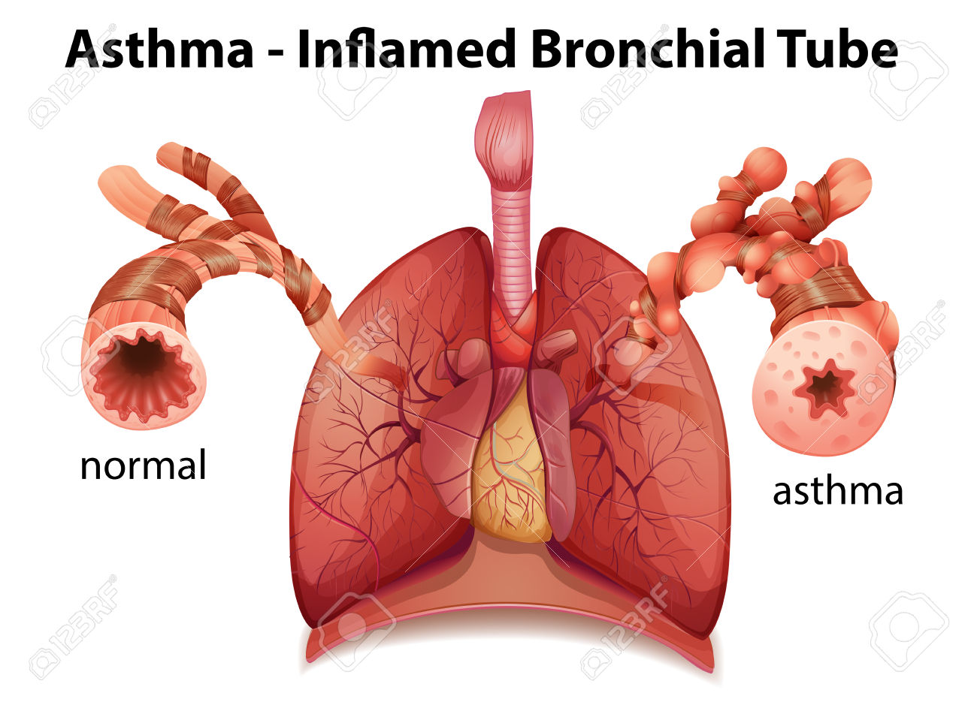
What is asthma?

Slide 9
Asthma is a heterogeneous disease, usually characterized by chronic airway inflammation. It is defined by the history of respiratory symptoms such as wheeze, shortness of breath, chest tightness and cough that vary overtime and in intensity, together with variable expiratory airflow limitation.

Slide 10
Asthma Pathophysiology
Individual
Inflammation
Impact
Genetic predisposition
Environmental triggers
Inflammation underlies
disease processes
Clinical symptoms also vary by individual and over time

Slide 11
chronic inflammatory disorder of the airways in which many cells and cellular elements play a role, in particular,
-mast cells,
-eosinophils,
-T lymphocytes,
-macrophages,
-neutrophils, and epithelial cells

Slide 12
Airflow obstruction is often variable, reversible either spontaneously or with treatment and associated with recurrent episodes of wheezing, breathlessness, chest tightness, and coughing, particularly at night or in the early morning.

Slide 13
Bronchial hyperreactivity
exaggerated response of bronchial smooth muscle to trigger stimuli to physical, chemical, immunologic, and pharmacologic stimuli

Slide 14
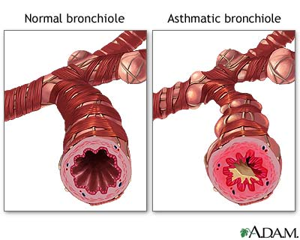

Slide 15
Asthma Etiology

Slide 16
Asthma is a complex trait
Heritable and environmental factors contribute to its pathogenesis

Slide 17
What are the Triggering Factors?

Slide 19
Types of asthma

Slide 20
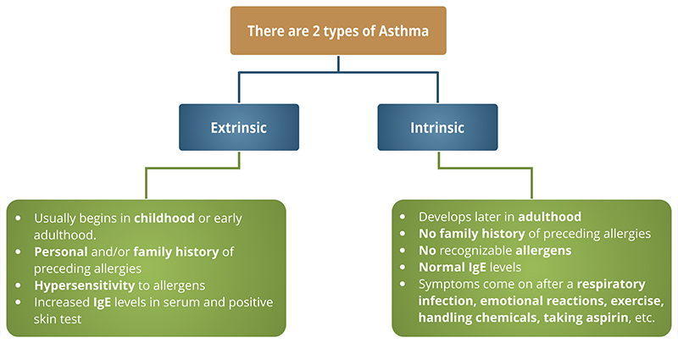

Slide 21
Diagnosing Asthma

Slide 22
History
Based on intermittent symptoms of wheezing, chest tightness, shortness of breath, and coughing
May worsen seasonally-spring, fall
May worsen with exercise
Note any triggers
cats, perfume, tobacco
Family history

Slide 23
Symptoms
Intermittent episodes of expiratory wheezing, coughing and dyspnea
Severity of disease
occasional, mild bouts of breathlessness
daily wheeze in spite of multiple medications
may be triggered by environmental factors (e.g. seasonal allergens)

Slide 24
Acute severe asthma
Tachycardia ≥ 110 beat/min
Tachypnea ≥ 25 breath/min
Use of accessory muscles of respiration
Anxiety, can not complete one sentence.
PEF ≤ 50%
Bilateral generalised inspiratory and expiratory rhonchi
Pulsus paradoxus

Slide 25
Life-threatening asthma
Confusion
Silent chest,cyanosis
Bradycardia,hypotension
Pao2<60 ,Paco2 ≥ 50
PEF < 33%

Slide 26
Pulmonary function tests

Slide 27
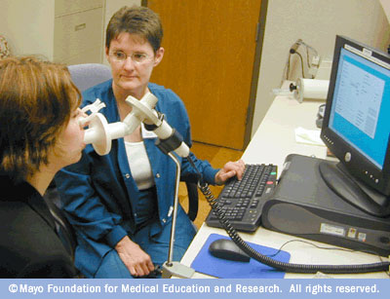

Slide 28
Lung Volumes
Notes:
Image source: http://en.wikipedia.org/wiki/Main_Page

Slide 29
Pulmonary Function Tests-Spirometry
FEV1
is that volume of air exhaled in 1 second
FVC
Forced vital capacity - volume of air exhaled with maximal forced effort

Slide 30
FEV1:FVC ratio
Most reproducible of the PFTs
Healthy individuals can exhale 75-80% of VC in 1 second and almost all in 3 seconds
Normal ratio is 70%

Slide 31
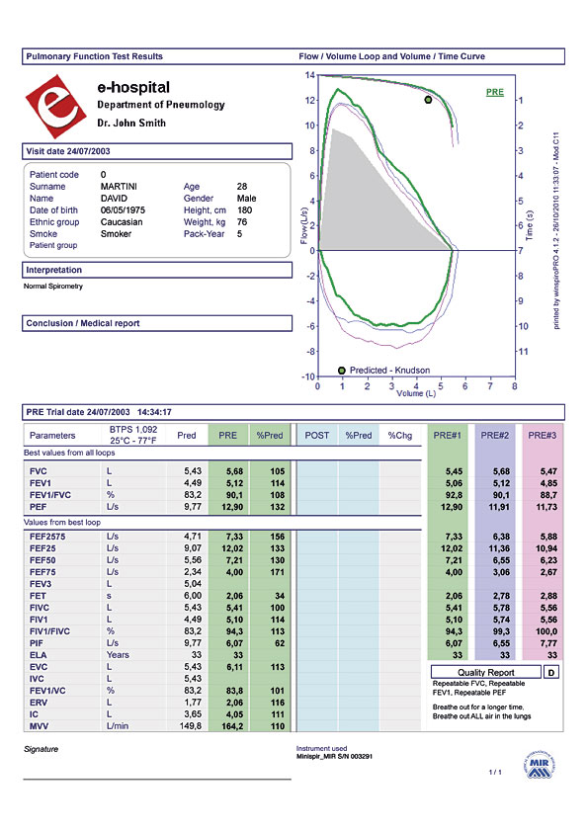

Slide 32
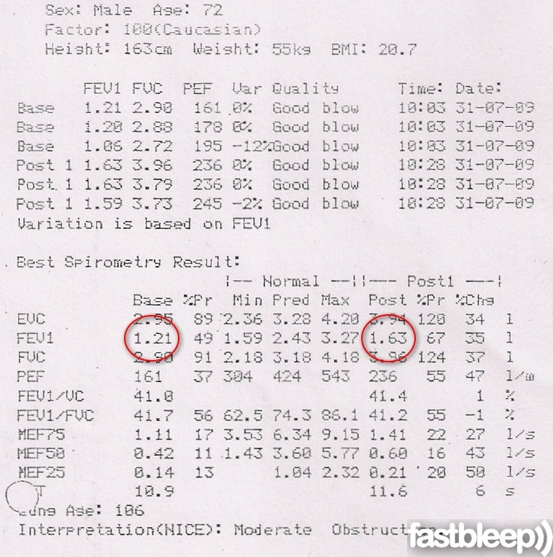

Slide 33
Peak Expiratory Flow (PEF)
Maximal rate of flow that can be produced during forced expiration
Useful in ED, at home, at clinic
Changes in PF usually correlate with change in FEV1
However, PEF is less reproducible than FEV1
Healthy young adult has PEF - 60L/min

Slide 34
Peak Expiratory Flow (PEF) Meters
Allows patient to assess status of his/her asthma
Persons who use peak flow meters should do so frequently
Many physicians require for all severe patients
Notes:
Managing Asthma: Peak Expiratory Flow (PEF) Meters

Slide 35
Reversible Airway Obstruction
FEV1 is gold standard for determining reversibility of airway disease and bronchodilator efficacy
Significant Clinical Reversibility More than or equal to12% improvement in FEV1 after inhaled bronchodilator

Slide 36
CXR
Most patients with asthma have normal x-rays.
Signs of acute severe asthma:
Hyperinflation(Diaphragm is down to the 8th rib anteriorly,MCL-ribbon-shaped heart…)
Complications:
Pneumonia
Pneumothorax

Slide 37
Blood Gas Measurments
Best indicators of overall lung function are arterial blood gases
PaO2, PaCO2, pH)
Oxygen saturation (O2 sat)
Quantity of O2 bound to Hb/
Normal O2 sat 97.5%

Slide 38
Conditions Mimicking Asthma
Obstruction of small airways
COPD
Aspiration
Bronchiolitis
Cystic Fibrosis
Obstruction of large airways
Foreign body
Congenital malformations
Cardiac disease
Endobronchial tumors
Extrabronchial obstruction
Psychogenic

Slide 39
Key Components of Asthma Therapy
Assessment and monitoring
Pharmacologic therapy
“Trigger” control
Patient education

Slide 40
Management of Acute exacerbation of Bronchial Asthma

Slide 41
Oxygen Therapy:
By nasal cannula or mask to achieve saturation > 90%,Controlled O2 therapy in patients with elevated CO2
Bronchdilators:
Nebulized B2 agonists Combined with nebulised ipratropium bromide
given continuously for one hour, then every 60 min, after that regularly every 4-6 hours, Reduced according to response.

Slide 42
Corticosteroids:
hydrocortisone 100 mg every 6-8 hours to be reduced to dexamethasone or oral preparation later ,then inhaled preparations started.
Antibiotics : when signs of bacterial infection
Intravenous magnesium
Aminophylline:
intravenous infusion every 8 hours to be transformed into oral long acting preparation after improvement of acute attack.

Slide 43
Overview of Asthma Medications
Daily: Long-term Control (anti-inflamatory)
Corticosteroids (inhaled and systemic)
LABAs
Methylxanthines (theophylline) SR
Leukotriene modifiers
-Immunomodulators: 1.Omalizumab
2.Allergen-specific immunotherapy
As-needed: Quick Relief (bronchodilators)
SABAs
Anticholinergics
Systemic corticosteroids
Notes:
43

Slide 44
DRUGS USED IN ASTHMA
(Mechanism of action and side effects)
Notes:
44

Slide 48
TOXICITY
-For the inhaled therapy:
oropharyngeal candidiasis
Dysphonia
-For oral therapy
Gastritis
DM
Hypertension
Osteoporosis
Adrenal suppression

Slide 49
LEUKOTRIENE ANTAGONISTS
Interfere with the synthesis or action of leukotrienes
Not as effective as corticosteroids in severe asthma
Low toxicity

Slide 50
Zafirlukast and montelukast
Orally active
Effective in preventing exercise-, antigen-and aspirin-induced bronchospasm.

Slide 51
BETA-2 AGONISTS
Most important sympathomimetic used to reverse bronchoconstriction
Almost given exclusively by inhalation
Decreases the systemic dose and adverse effects
Occasionally by nebulizer

Slide 52
BETA-2 AGONISTS
Salbutamol, terbutaline, Short-acting
Drug of choice for acute asthma
Salmeterol and formoterol
Long-acting
12 h or more
Used for prophylaxis

Slide 54
BETA-2 AGONISTS
TOXICITY
Skeletal muscle tremor
Significant β₁ effects (tachycardia) at high clinical dosage
Arrhythmias may occur when used excessively
Hypokalaemia.

Slide 55
METHYLXANTHINES
Bronchodilation is the most important therapeutic effect
CNS stimulation, cardiac stimulation, vasodilation and slight increase in BP (due to release of NE from adrenergic nerves

Slide 56
Slow-release theophylline
For control of nocturnal asthma
Most important in clinical use
TOXICITY
Common adverse effects
GI distress
Tremor
Insomnia
Overdosage
Severe nausea and vomiting
Hypotension
Cardiac arrhythmias
Convulsion

Slide 57
MUSCARINIC ANTAGONISTS
Competitively blocks muscarinic receptors in the airways
Prevents bronchoconstriction mediated by vagal discharge

Slide 58
MUSCARINIC ANTAGONISTS
Ipatropium
Delivered to the airways by pressurized aerosol
Have little systemic action
Tiotropium
Newer longer-acting analog

Slide 59
TOXICITY
Delivered directly to the airway, minimally absorbed
Systemic effects are small
In excessive dosage, minor atropine- like toxic effects may occur
Does not cause tremor or arrhythmias

Slide 60
CROMOLYN AND NEDOCROMIL
No bronchodilator action but can prevent bronchoconstriction caused by a challenge with antigen to which the patient is allergic
Food allergy
Given orally
Asthma in children
Most important use
Hay fever
Nasal and eyedrop formulations

Slide 61
TOXICITY
Cough and irritation of the airway when given by aerosol
Drug allergy is rare

Slide 62
Anti-IgE antibody
Omalizumab
Humanized murine monoclonal antibody to human IgE
Prophylactic management of asthma
Given parenterally

