Slide 1
Disseminated intravascular coagulation
Majed Dwairi
Mohannad Yamin
Dr. Mohammad Alanii

Slide 2
Introduction
Definition: systemic activation of blood coagulation, which results in generation and deposition of fibrin, leading to microvascular thrombi in various organs and contributing to multiple organ dysfunction syndrome (MODS).
Consumption and subsequent exhaustion of coagulation proteins and platelets (from ongoing activation of coagulation) may induce severe bleeding, though micro clot formation may occur in the absence of severe clotting factor depletion and bleeding.

Slide 3
DIC is not a kind of independent disease, but a middle process or complication of some diseases.
It is essentially an imbalance between the coagulation process and anticoagulation process. It is a syndrome characterized by massive activation and consumption of coagulation proteins, fibrinolytic proteins and platelets.
Coagulation is usually confined to a localized area by the combination of blood flow and circulating inhibitors of coagulation, especially antithrombin II. If the stimulus to coagulation is too great, these control mechanisms can be overwhelmed, leading to the syndrome of DIC.

Slide 4
Epidemiology
DIC may occur in 30-50% of patients with sepsis, and it develops in an estimated 1% of all hospitalized patients.
DIC occurs at all ages and in all races, and no particular sex predisposition has been noted.

Slide 5
What are the conditions predisposing to DIC?
Complications of obstetrics (abruptio placentae, saline-induced therapeutic abortion, retained dead fetus or products of conception, amniotic fluid embolism): Placental tissue with tissue factor activity enters or is exposed to the maternal circulation.
Infection, particularly with gram-negative organisms: Gram-negative endotoxin causes generation or exposure of tissue factor activity in phagocytic, endothelial, and tissue cells.
Cancer, particularly mucin-secreting adenocarcinomas of the pancreas, adenocarcinomas of the prostate, and acute promyelocytic leukemia: Tumor cells express and expose (or release) tissue factor.
Shock due to any condition that causes ischemic tissue injury and exposure or release of tissue factor.

Slide 6
Normal Hemostasis
To understand DIC, it is best to first review the normal physiology of clot formation.
Its start with transient vasoconstriction (local myogenic spasm) to limit the blood flow to the injured area.
it is a localized process that results in a primary platelet plug through platelet adhesion and aggregation followed by a secondary fibrin clot through the activation of the coagulation cascade, which occurs in a series of enzymatic steps that lead to the formation of thrombin. Thrombin then converts soluble fibrinogen to an insoluble clot of fibrin polymers, which forms a mesh that incorporates the previously formed platelet plug as well as RBCs, if present. this secondary hemostasis coagulation cascade thought to be initiated either through tissue factor (TF) release into the bloodstream, which activates factor VII and then the extrinsic system, or through disruption of the endothelium exposing collagen and the subendothelium directly to blood. This results in platelet aggregation, which in thought to activate factor XII in vivo and subsequently the rest of the intrinsic (contact) cascade.

Slide 7
Once a fibrin clot is produced, it is stabilized by covalent cross-linking through the actions of factor XIII. The last step of the healing process is for blood clots to be reorganized and resorbed by fibrinolysis so that unimpeded blood flow through the originally damaged vessel can be reestablished..
The body initiate pathway to breakdown the clot →fibrinolytic pathway is activated in DIC ,Stimulation of endothelial cells by cytokines causes the release of tissue plasminogen activator from endothelial cells. Both tissue plasminogen activator and plasminogen attach to fibrin polymers, and plasmin (generated by tPA cleavage of plasminogen) cleaves fibrin into D-dimers and other fibrin degradation products. DIC can, therefore, cause both thrombosis and bleeding (if the consumption of platelets and/or coagulation factors is excessive).

Slide 8
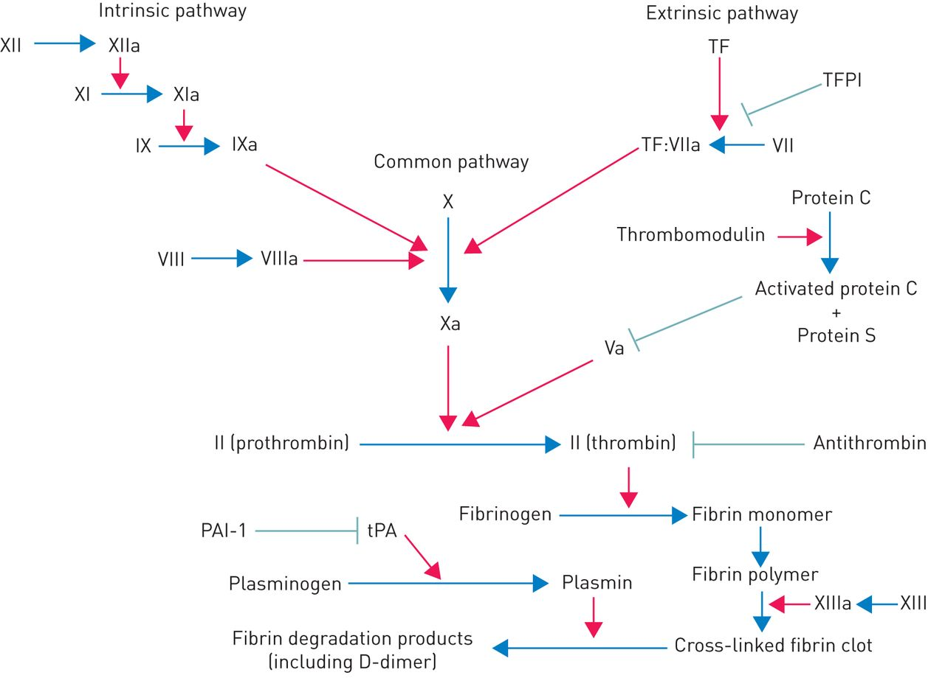

Slide 9
pathogenesis
Some medical condition release procoagulants that tips the scale in favor of clot formation.
Release of procoagulants, (tissue factors, bacterial components, enzymes/major endothelial injury) → excessive activation of coagulation cascade → thrombosis of small/medium blood vessels → activation of fibrinolysis to resolve clots → fibrin degradation products released into circulation → interfere with platelet aggregation, clot formation
Depletion of platelets, fibrin, coagulation factors → consumption coagulopathy
Acquired, paradoxical process of thrombosis, bleeding

Slide 10
Acute DIC is a consumption coagulopathy state where excess thrombin is generated to such a high degree that it overcomes the large amounts of natural anticoagulants normally present in the plasma, In acute DIC, an explosive generation of thrombin depletes clotting factors and platelets and activates the fibrinolytic system→ Bleeding into the subcutaneous tissues, skin, and mucous membranes occurs, along with occlusion of blood vessels caused by fibrin in the microcirculation.
In chronic DIC, the process is the same, but it is less explosive. Usually there is time for compensatory responses to take place, which diminish the likelihood of bleeding but give rise to a hypercoagulable state. These changes in the blood can be detected by testing the coagulation system.

Slide 11
Slowly evolving DIC primarily causes venous thromboembolic manifestations ( deep venous thrombosis, pulmonary embolism), although occasionally cardiac valve vegetations occur; abnormal bleeding is uncommon.
Severe, rapidly evolving DIC, in contrast, causes thrombocytopenia, depletion of plasma coagulation factors and fibrinogen, and bleeding. Bleeding into organs, along with microvascular thromboses, may cause dysfunction and failure in multiple organs. Delayed dissolution of fibrin polymers by fibrinolysis may result in the mechanical disruption of RBCs, producing schistocytes and mild intravascular hemolysis

Slide 12
Signs & symptoms
1- Circulatory signs
Signs of diffuse or localized thrombosis
Signs of spontaneous and life-threatening hemorrhage
2- Cardiovascular signs
Hypotension
Tachycardia

Slide 13
3- Gastrointestinal signs
Hematemesis (vomiting blood)
Hematochezia (fresh blood per-rectum)
4- Genitourinary signs
Hematuria
Menorrhagia (heavy menstrual bleeding)
Uterine hemorrhage
5- Dermatologic signs
-Ecchymosis ( bruises)
-Purpura (red or purple discolored spots on the skin that do not blanch on applying pressure)
- Bleeding from mucosal sites -Petechiae

Slide 14
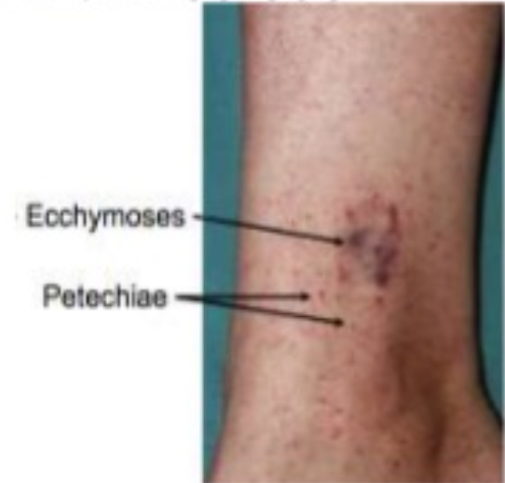

Slide 15
Complication

Slide 16
DIC can cause complications, especially when it isn’t treated properly. Complications can occur from both the excessive clotting that happens in the early stages of the condition and the absence of clotting factors in the later stages. Complications include:
blood clots that cause a lack of oxygen to limbs and organs thus causing necrosis.
Stroke.
excessive bleeding that may lead to death.
Acute kidney injury.
Change in mental status due to if either thrombi or hemorrhage to areas of the brain arise.

Slide 17
7. Respiratory dysfunction leading to dyspnea and hemoptysis.
8. Hepatic dysfunction.
9. Cardiac tamponade.
10. Hemothorax.
11. Intracerebral hematoma.

Slide 18
History

Slide 19
a recent history of severe infections or trauma as well as hepatic failure, obstetric
complications, and malignancy.
A remote history of deep vein or arterial thromboses may also be suggestive of DIC.
experience bleeding from multiple sites including gingiva, areas of trauma or surgery, the vagina, the rectum, or through devices such as urinary catheters.
Symptoms of hematuria, oliguria, and anuria may be seen if concomitant renal failure from DIC results.
dyspnea and hemoptysis if pulmonary hemorrhage or pulmonary embolism is occurring.
A patient could also experience chest pain if arterial occlusion of a coronary artery develops

Slide 20
Physical Examination

Slide 21
obvious bleeding, or frank hemorrhage in various areas of the body may be noted by inspection.
Skin lesions including ecchymosis, hematomas.
jaundice from liver failure.
necrosis, and gangrene may also arise.
Excessive coagulation may lead to widespread purpura, petechiae, and cyanosis.

Slide 22
BLEEDING

Slide 23
ECCYHMOSIS

Slide 24
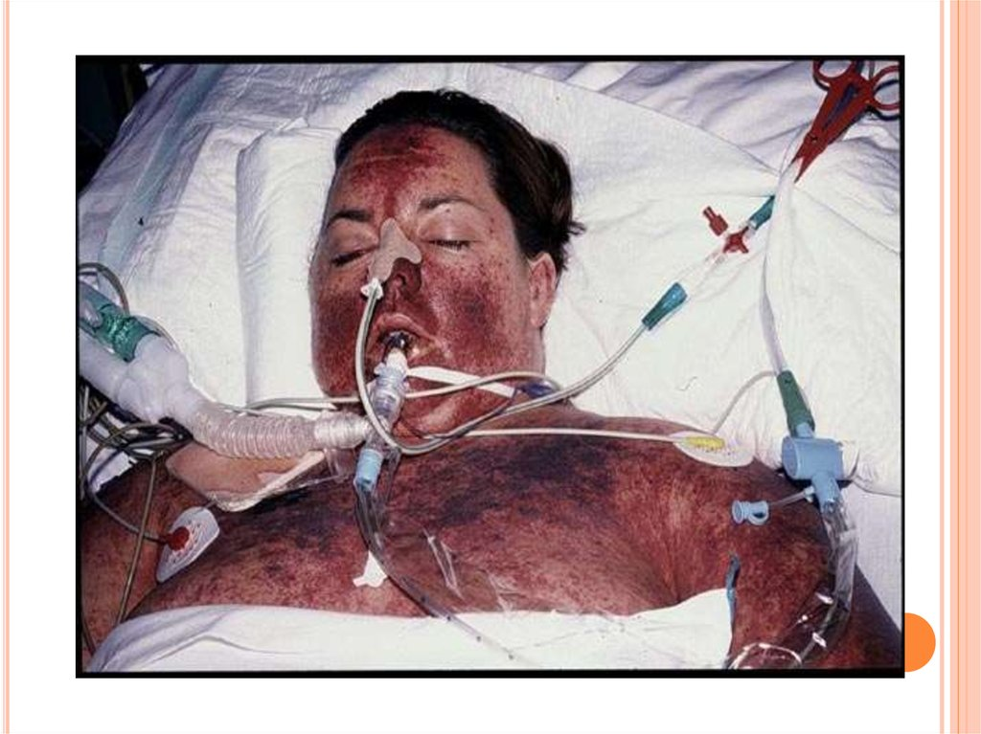
PURPURA AND PETECHIAE

Slide 25
NECROSIS AND GANGRENE

Slide 26
Investigation

Slide 27
No single history, physical exam, or laboratory component can lead to a diagnosis of or rule out DIC; therefore, a combination of both subjective, objective, and laboratory findings should be utilized to make a diagnosis of DIC.
A specific scoring system to assess for the presence of DIC was established in 2007. This score includes platelet count, fibrin markers such as D-dimer, prolonged PT, and fibrinogen level with a score over five indicating a high likelihood for overt DIC.

Slide 28
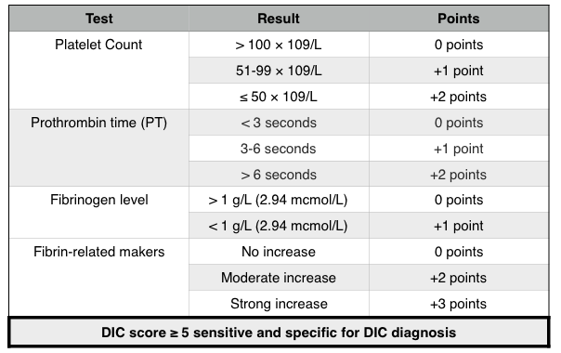

Slide 29
Treatment

Slide 30
The treatment for DIC centers on addressing the underlying disorder, which ultimately led to this condition, such as:-
antibiotics and human activated protein C for severe sepsis.
possible delivery for placental abruption.
possible exploratory surgical intervention for trauma.
Platelet and plasma transfusions should only be considered in patients with active bleeding or a high risk of bleeding or those patients requiring an invasive procedure

Slide 31
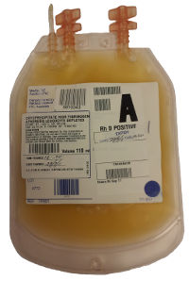
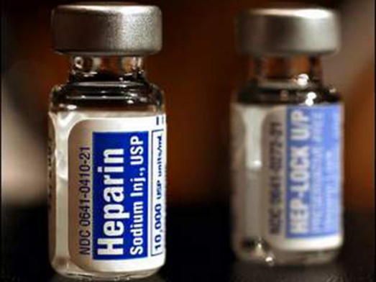
Likewise, fresh frozen plasma, typically at a dose of 15 mL/kg to 30 mL/kg, and cryoprecipitate can be transfused to replenish coagulation factors.
Patients with DIC who are not actively bleeding should receive prophylactic
anticoagulation with heparin or low molecular weight heparin (LMWH).

Slide 33
THE END

