Slide 1
Respiratory Bacterial Infections
Respiratory system
Dr Amin Aqel
Professor of Medical microbiology

Slide 2
Pseudomonas and related organisms
Aerobic gram-negative non fermentative rods
Pseudomonas aeruginosa: extremely opportunistic infections of multiple sites
Moraxella catarrhalis: opportunistic RT infections

Slide 3
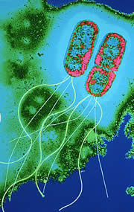
Pseudomonas
Structure and Physiology
Gram-negative rods.
Motile with polar flagella.
Obligate aerobe.
Oxidase-positive.
Encapsulated.
Do not ferment carbohydrates.
Resistant to multiple drugs.

Slide 4
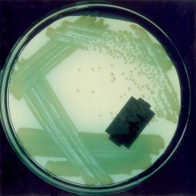
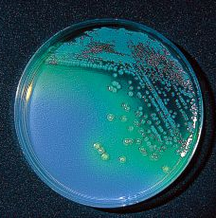
P. aeruginosa
Forms round colonies with a fluorescent greenish color, fruity odor, and β-hemolysis.
Pyocyanin- nonfluorescent bluish pigment;
pyoverdin- fluorescent greenish pigment;
pyorubin, and pyomelanin
Identification of P. aeruginosa is usually based on oxidase test and its colonial morphology: β-hemolysis, the presence of characteristic pigments, sweet odor, and growth at 42 ºC.

Slide 5
P. aeruginosa: Pathogenesis and Immunity
This organism is widely distributed in nature and is commonly present in moist environments in hospitals. It is pathogenic only when introduced into areas devoid of normal defenses, e.g.,
1. Disruption of mucous membrane and skin.
2. Usage of intravenous or urinary catheters.
3. Neutropenia (as in cancer therapy).
P. aeruginosa can infect almost any external site or organ.
P. aeruginosa is invasive and toxigenic. It attaches to and colonizes the mucous membrane or skin, invade locally, and produces systemic diseases and septicemia.
P. aeruginosa is resistant to many antibiotics. It becomes dominant when more susceptible bacteria of the normal flora are suppressed.

Slide 6
P. aeruginosa
Virulence Factors
Antigenic structure, enzymes, and toxins
Pili and nonpilus adhesions.
Capsule seen in cultures from patients with cystic fibrosis.
LPS- endotoxin, multiple immunotypes.
Pyocyanin: catalyzes production of toxic forms of oxygen that cause tissue damage. It also induces IL-8 production. Pyoverdin: a siderophore.
Proteases
protease cause tissue damage and help bacteria spread.
Phospholipase C: a hemolysin
Exotoxin A: causes tissue necrosis and is lethal for animals (disrupts protein synthesis); immunosuppressive.
Exoenzyme S and T: cytotoxic to host cells.

Slide 7
P. aeruginosa
Clinical Diseases
Infection of wounds and burns (blue-green pus). Patients with severe burns may develop into bacteremia.
Skin and nail infections
Meningitis (when introduced by lumbar puncture).
Pulmonary infection
Tracheobronchitis
Necrotizing pneumonia in CF patients: diffuse, bilateral bronchopneumonia with microabscess and necrosis.
Eye infections
Ear infections
Otitis externa: mild in swimmers; malignant (invasive) in diabetic patients.
Chronic otitis media
Osteochondritis of the foot.
Urinary tract infection
Gastrointestinal infection
Sepsis

Slide 8
P. aeruginosa
Laboratory Diagnosis
Specimen: skin lesions, pus, urine, blood, spinal fluid, sputum.
Culture: blood agar plate and differential media.
Treatment
Combined antibiotic therapy is generally required to avoid resistance that develops rapidly when single drugs are employed. Aminoglycoside, antipseudomonal B-lactam or a quinolone

Slide 9
P. aeruginosa
Prevention and Control
Spread is mainly via contaminated sterile equipments and cross-contamination of patients by medical personnel.
Control:
1. Patients at high risk should not be admitted to a ward where cases of pseudomonas infection are present.
2. Patients infected with P. aeruginosa should be isolated.
3. Sterilize all instruments, apparatus, and dressing

Slide 10
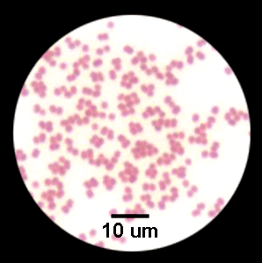
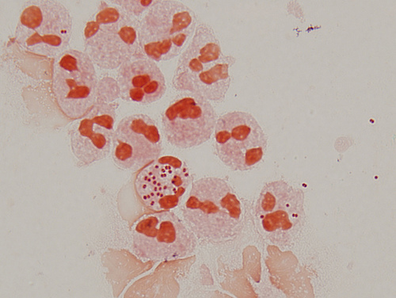
Moraxella catarrhalis

Slide 11
Moraxella catarrhalis
General characteristics
Aerobic, gram-negative cocci or cocobacilli
Diplococci or diplococcibacilli
Non motile
Oxidase positive
They don't ferment carbohydrates
Normal commensal of the respiratory tract (humans only)
Has become an important opportunistic pathogen

Slide 12
Clinical infections
Clinical infections
Pneumonia
Sinusitis
Otitis media (3rd most common cause)
Eye, CNS, Joints infection
Predisposing factors
Advanced age
Immunodeficiency
Neutropenia
Other debilitating diseases

Slide 13
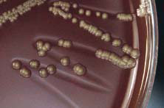
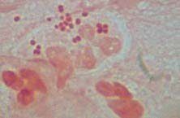
Laboratory diagnosis
Colonies appear smooth with a grayish- white color
When colonies pushed with loop, they “scoot” across media
Moraxella catarrhalis growing on chocolate agar after 48 hours of incubation
Direct smear from an otitis media sample showing intracellular gram-negative diplococci

Slide 14
Laboratory Diagnosis and treatment:
Oxidase positive
Catalase positive
All sugar fermentation negative
Produce beta- lactamase
DNase positive
Treatment: fluoroquinolones, most second and third generation cephalosporins, erythromycin, and amoxicillin-clavulanate.

Slide 15
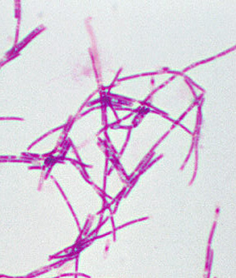
Bacillus
B. anthracis: anthrax of the animals and humans.
Morphology and Physiology
Aerobic or facultative anaerobic.
Large gram-positive rods, have square ends, arranged in long chains.
Spore is located in the center of the cell.
Most are saprophytic (soil, water, air, and on vegetation.)

Slide 16
B. anthracis
Physiology and Structure
B. anthracis is encapsulated and non-motile.
The capsule consists of polypeptide (poly-D-glutamic acid) and is an important virulence factor.
The spores can withstand dry heat and certain disinfectants for moderate periods, and persist for years in dry earth.

Slide 17
B. anthracis
Pathogenesis and Immunity
Primarily a disease of herbivores (sheep, cattle, horses); humans are rarely affected.
In animals, portal of entry is mouth and GI tract. In humans, scratches in the skin (95% of infection), ingestion or inhalation lead to infection.
The spores germinate in the tissue at the site of entry, and growth of the vegetative forms results in gelatinous edema and congestion. Bacillus spread via lymphatics to the blood and other tissues.

Slide 18
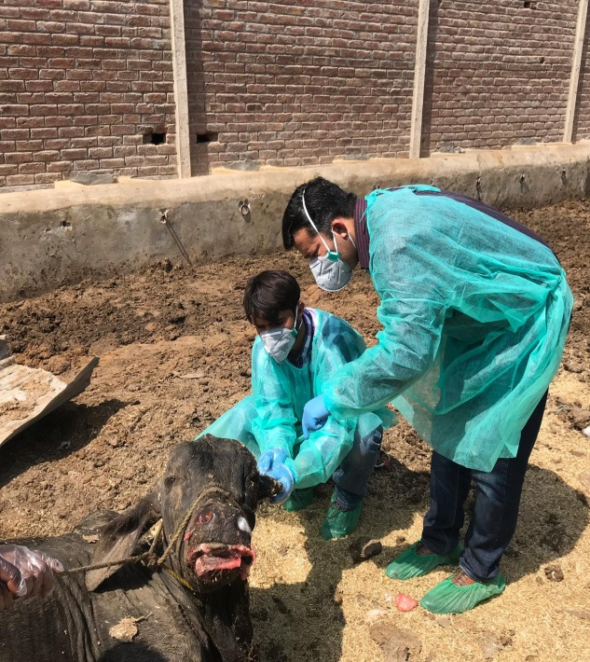
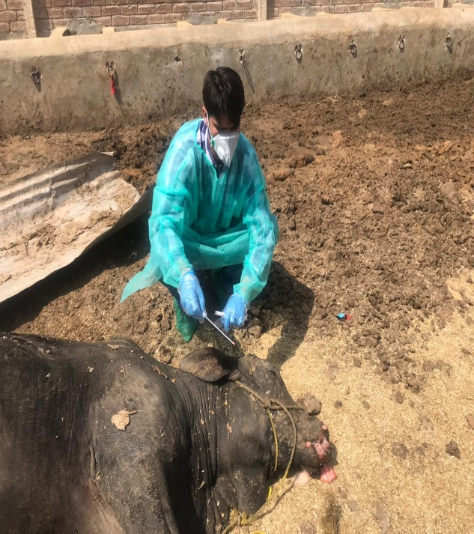
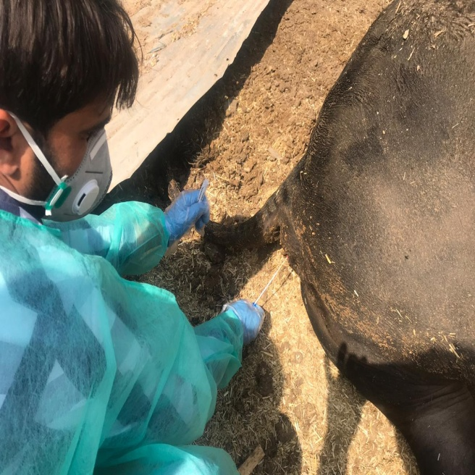
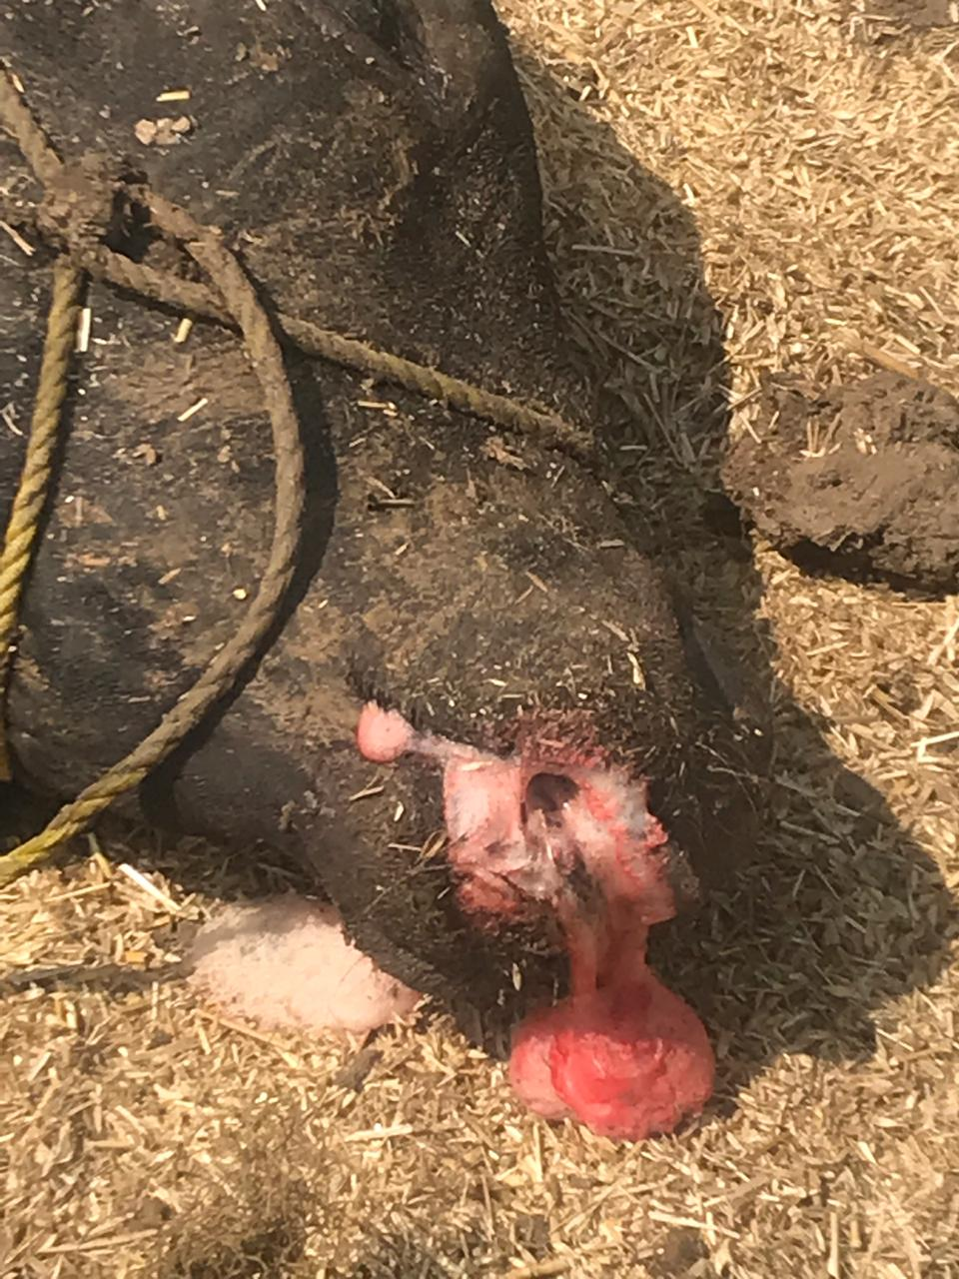
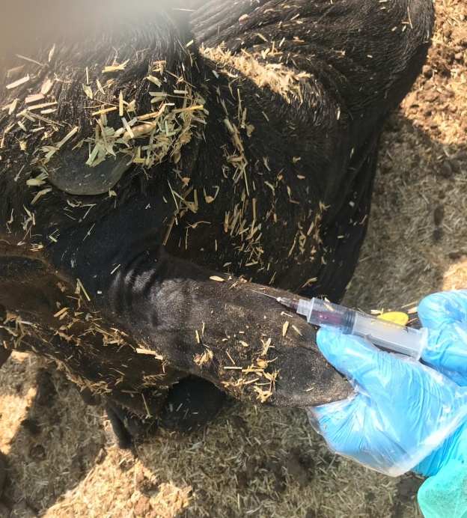
Anthrax Suspected Carcass Sampling

Slide 19
B. anthracis
Pathogenesis and Immunity
Virulence factors
Capsule (encoded from a plasmid)
Exotoxins (A-B toxins encoded from another plasmid)
Edema toxin is composed of protective antigen (B-subunit) and edema factor (EF; an adenylate cyclase). This toxin complex increases vascular permeability which leads to shock.
Lethal toxin is composed of protective antigen and lethal factor (LF; a metalloprotease). This toxin causes cell death and stimulates macrophages to release proinflammatory cytokines.

Slide 20
B. anthracis
Clinical Diseases
Inhalation anthrax (wool-sorters’ disease): long incubation time (2 months or more).
Progressive hemorrhagic lymphadenitis /Mediastinitis (enlargement of mediastinal lymph nodes), sepsis, and meningitis (50% patients).
Pulmonary disease rarely develops. Fatal if untreated 100%
Cutaneous anthrax
Gastrointestinal anthrax (very rare)

Slide 21
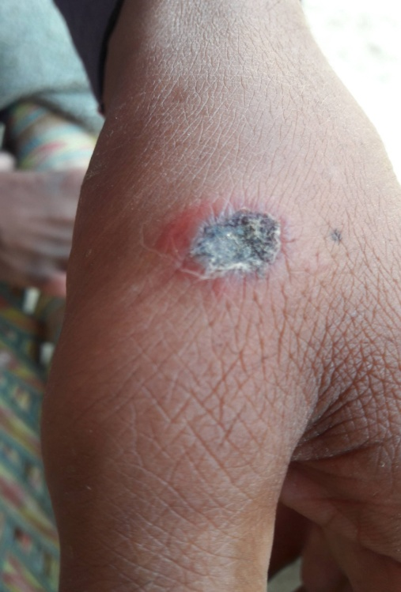
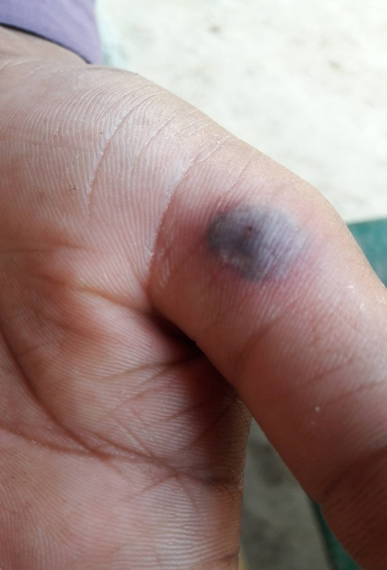
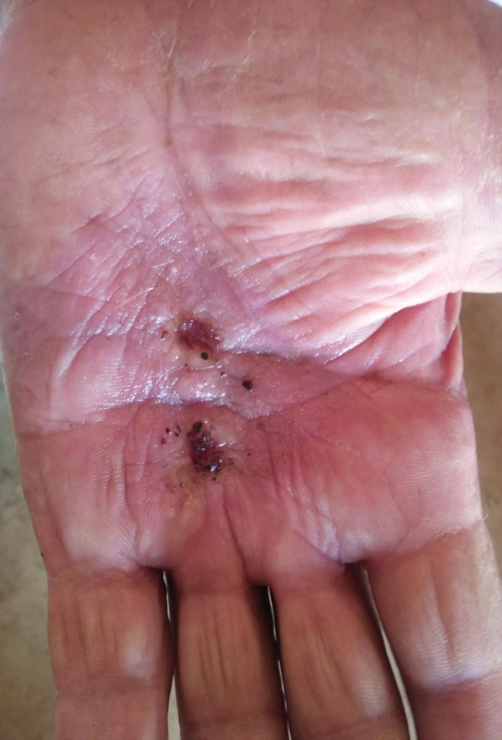
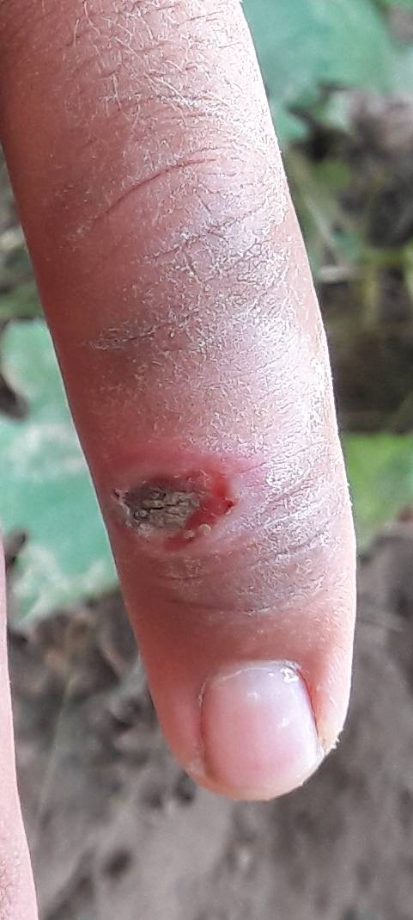
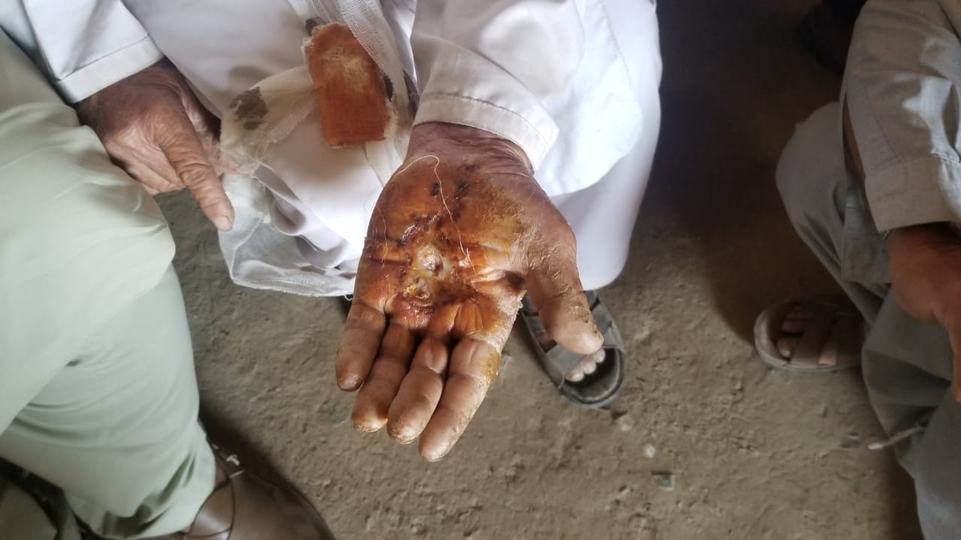
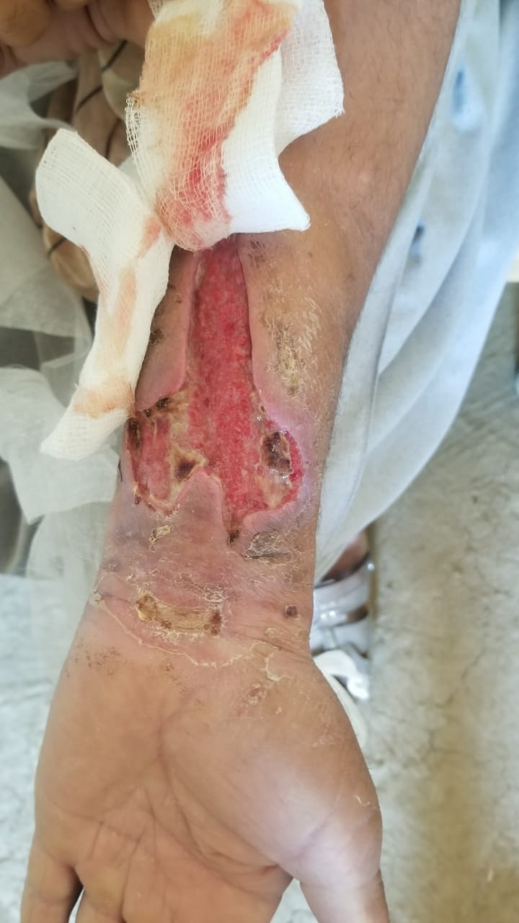
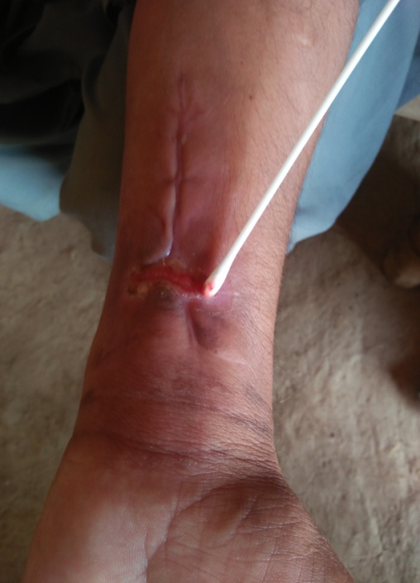
Human Cutaneous Anthrax Sampling (Suspected)

Slide 22
B. anthracis
Laboratory Diagnosis
Specimens: fluid or pus from local lesion, blood, or sputum.
Smears: long chains (a characteristic of B. anthracis) of large gram-positive rods without spores can be seen. Immuno-fluorescence stain can be used for dried smears.
Culture: nonhemolytic gray colonies with dry surface on blood agar plates.
Identification: made in a reference lab by direct fluorescent Ab test against capsular polypeptide or PCR test.
Serological tests: detection of antibodies to lethal toxin and edema toxin.

Slide 23
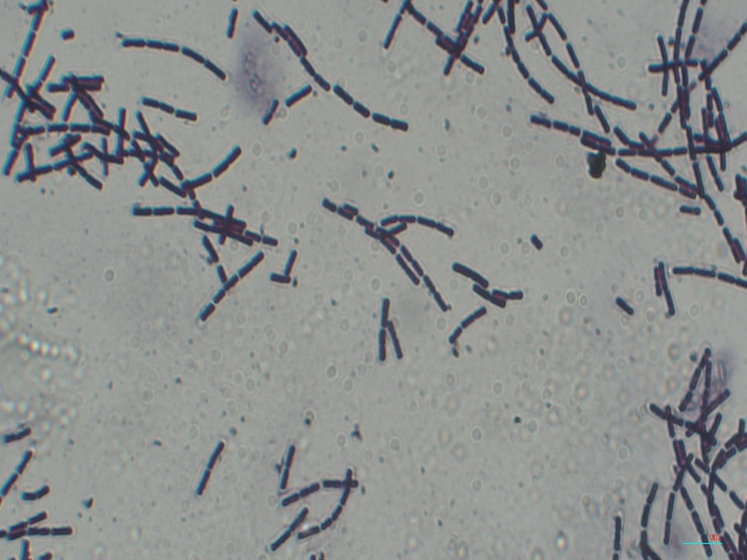
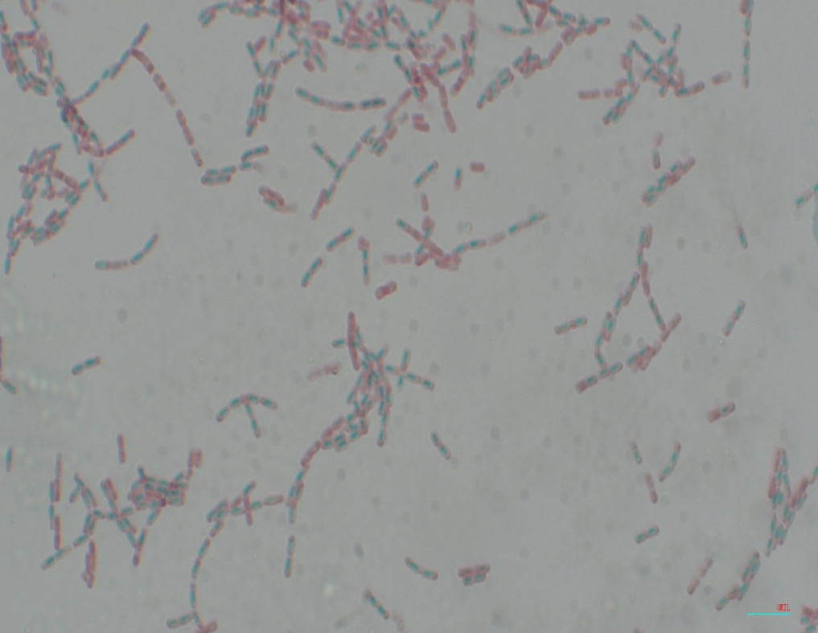
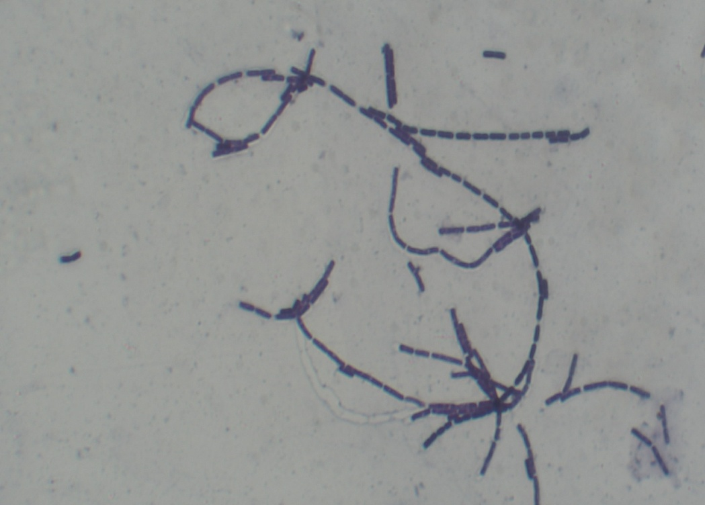
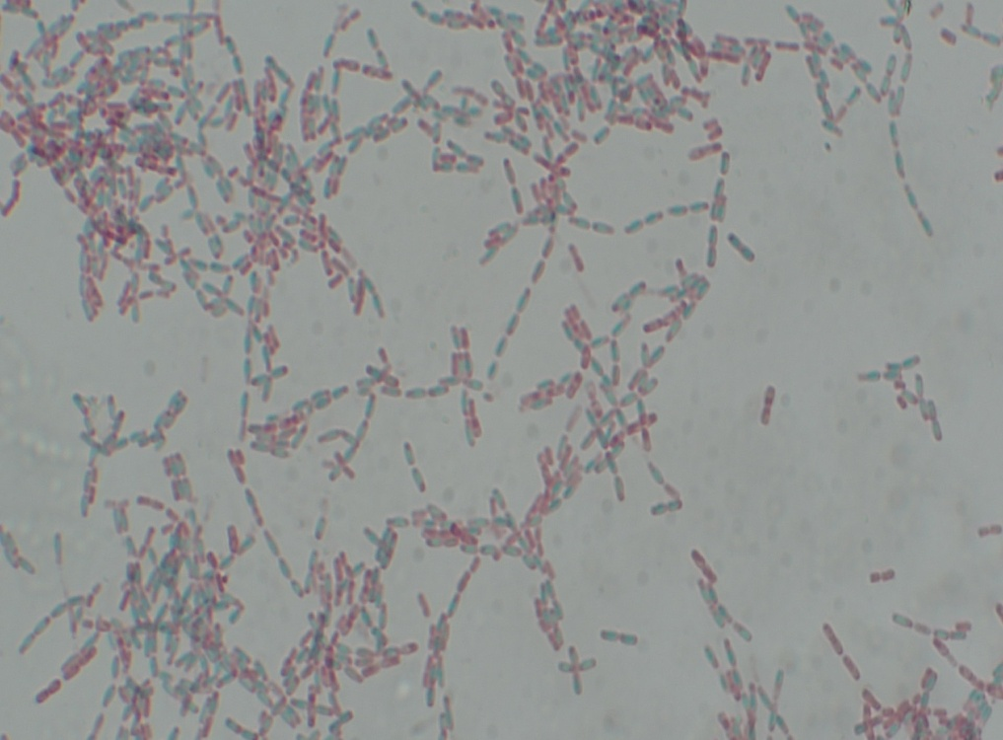
Results
Gram +ve Rods
Vegetative cells + Endospores

Slide 24
B. anthracis
Treatment
Multi drug therapy, Ciprofloxacin, rifampin and vancomycin
Control
Proper disposal of animal carcasses (burning or deep burial in lime pit).
Autoclaving of animal products.
Protective clothing and gloves for handling infected animals.
Vaccination of domestic animals.
Immunization of persons at high risk with a cell-free vaccine based on the protective antigen is under investigation.

Slide 25
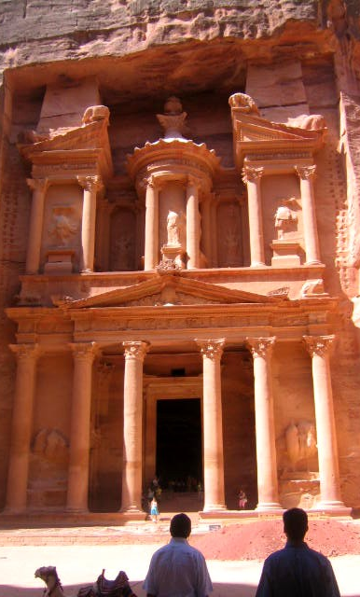
Victoria,
British Columbia , Canada
01 – 05 September 2013
MOLECULAR EPIDEMIOLOGY
OF ANTHRAX IN JORDAN
Amin A. Aqel^{1,} Ekhlas Hailat², Luigina Serrecchia³, Suad Aqel² , Lorenzo Pace³, Giuliano Garofolo⁴, Antonio Fasanella³
¹ Faculty of Medicine, Mu'tah University, Al-Karak, Jordan,
² Ministry of Agriculture, Jordan
³Istituto Zooprofilattico Sperimentale of Puglia and Basilicata, Foggia, Italy
⁴ Istituto Zooprofilattico Sperimentale dell’Abruzzo e del Molise “G. Caporale”, Teramo, Italy

